Slide 1

The Affordable Care Act and Employers
Key Concerns on Compliance
Tuesday October 8, 2013
1:00 p.m. Eastern / 10:00 a.m. Pacific

Slide 2

Please send your questions during or after today’s event to:
erice@namm.org

Slide 3

Jim Goldberg
Goldberg and Associates, PLLC
Principal

Slide 4

Neil Trautwein
National Retail Federation
Vice President
Employee Benefits Policy Counsel
Government Relations

Slide 5
Health Care Reform –
What You Need to Know
Key Concerns on
Affordable Care Act Compliance
October 8, 2013

Slide 6
Key concerns
Introduction
Urgency of Implementation
Timeline

Slide 7

The time to implement is (still) now!
US Supreme Court upheld the constitutionality of the ACA in 2012.
Divided Congress makes repeal impossible. But, key changes are gaining momentum.
Re-election of President Obama means implementation of the ACA will move forward.
But, the Obama Administration has announced a one-year delay of employer mandate and reporting requirements.

Slide 8
Key effective dates for employers
  Reporting value of health care benefits on Form W-2 (first due by January 31, 2013)
  Patient-Centered Research Outcome Institute (PCORI) fee (first due July 31 of calendar year following plan year ending on or after October 1, 2012)
  State-based health insurance exchanges
  Individual mandate
  Premium tax credits
  Employer mandate
  Medicaid expansion
  Additional insurance market reforms
  Health insurers’ fee
  Employer reporting to the IRS and employees (first due by 1/31/2015)
  Reinsurance fee
  Immediate health insurance individual market reforms
  Medicare Part D “donut hole” relief begins
  40% excise tax on high-cost health plans
  2014
  2010
  2011
  2012
  2013
Coverage expansions take effect
  2017
  2018
  2020
  Branded prescription drug fee
  Limitation on over-the-counter drugs for FSAs, HSAs and HRAs
  Increased tax on non-medical withdrawals from HSAs
  Increase Medicare payroll tax by 0.9% on earned income
  3.8% tax on unearned income
  Eliminate deduction for retiree drug costs covered by Medicare Part D subsidy
  Excise tax on medical device manufacturers
  Fair Labor Standards Act notices to employees (pending issuance of Department of Labor regulations)
  $500,000 compensation deduction limitation for health insurance issuers
  States may open Exchanges to large group market
  Medicare Part D donut hole closed

Slide 9
October 1 FLSA Requirement
Employers must inform employees of (1) existence of exchange coverage and (2) potential availability of exchange subsidies, (3) subject to availability of employer-provided coverage.
No Fair Labor Standards Act penalties attached!
Why important nevertheless.

Slide 10
What is still coming?
  State-based health insurance exchanges
  Individual mandate
  Premium tax credits
  Employer mandate
  Medicaid expansion
  Additional insurance market reforms
  Health insurance tax / other industry taxes / pass-through
  Employer reporting to the IRS and employees (first due by 1/31/2015)
  Reinsurance fee / PCORI fee
  REMEMBER: it is only a one year delay!!

Slide 11
Compliance Advice
2013-2015
Small Employers
Larger Employers

Slide 12
Smaller employers should:
Identify by size whether tax penalties may apply in 2015
  50 employee threshold for applicable “large employer”
  Part-time hours are considered if full-time employees (30 hours+) are below 50.
Consider whether multiple locations (tax code control group rules) may make you an applicable employer. Expansion plans should consider potential future ACA issues.
Consult with benefit advisors on plan structure and ACA requirements applicable to employers of all sizes – e.g. job status and wage information reporting.

Slide 13
For truly large employers, an integrated implementation approach is essential
  The ACA creates a business issue, not just a benefits issue, requiring coordination between HR, Tax, Finance, and IT
  Direct and indirect costs must be quantified to budget and plan for gradual changes
  Systems and processes need to be established to prepare for significant IRS reporting requirements
  Shareholders, boards, and audit committees want to understand the costs and tax liabilities, and the plan for minimizing the exposure
  Employee education on health plan options is extremely important
  Timely responses to Exchange notifications can preserve appeal rights
  How much time and money has been expended toward ACA compliance. Can this be paused? Or, will companies proceed ahead?

Slide 14
Employer Penalties under IRC § 4980H
Size and full-time determination
The “look-back”
Critical elements to consider
Calculation of penalty
Practical example: 500 full-time employees
Other considerations supporting offer of coverage
Options

Slide 15
How Many Full-Time Employees are Required to Make Me Subject to Penalties?
If < 50
If > 50
Part-Time Hours/120 = FTE (full-time equivalent)
If FT + FTE > 50
If FT + FTE < 50
Business is not subject to ACA penalties
Business is subject to ACA penalties
Business is subject to ACA penalties

Slide 16
Who Must I Offer Coverage To?
Full-Time Employees
Not Part-Time
Not Seasonal
Not
Temporary
Dependents

Slide 17
Who Must I Pay For?
Full-Time Employees
Not Dependents
Not Part-Time
Not Temporary or Seasonal

Slide 18
Who is Full-Time?
30 hours per week per month on average
If hired as full-time, waiting period can be no longer than 90 days
Can “look-back” as much as one year in exchange for an equal period of coverage

Slide 19
Calculation of coverage excise tax
  Tax for no coverage
  IRC §4980H(a)
  Tax for unaffordable coverage IRC IRC §4980H(b)
  A large employer that does not offer coverage to its full-time employees and their dependents may face a tax of:
    $2,000 x the total number of full-time employees minus the first 30 FT employees if at least one FTE is receiving a premium assistance tax credit
  A large employer that offers coverage to their full-time employees and their dependents, but the coverage is unaffordable to certain full-time employees or does not provide minimum value may face a tax of:
    The lesser of $3,000 x the number of FTEs receiving a premium assistance tax credit or $2,000 x the total number of FTEs, minus the first 30 FT employees

Slide 20
Possible Compliance Strategies
All in: satisfy (a) and (b) penalties.
  Cost, complexity, low wage employees?
Part-way in: satisfy (a) but not (b) penalties
  Lesser cost, employee confusion?
All out: pay (a) penalties
  Less competitive for employees? Public relations.
More time now to plan and test strategy

Slide 21
Exchanges, Communication & IRS
Exchanges
States and Medicaid Eligibility
Communication
Employer reporting and data collection

Slide 22
Health Insurance Exchanges
The Affordable Care Act (ACA) depends on states to establish Health Insurance "Exchanges" (now called “Markets”), which are virtual marketplaces intended to make it easier for individuals and small employers to shop for, compare, and enroll in health insurance coverage.
Individuals and certain businesses (100 or fewer FT employees) can purchase health insurance coverage through Exchanges or Health Insurance Markets beginning in 2014.
OR
OR
States will establish both an individual exchange (Exchange) and a small business exchange (SHOP Exchange)
The federal government will establish a default exchange or hybrid federal-state exchange
Private exchanges and the outside market may also be available for employers of all sizes.
Insurance premiums and out-of-pocket responsibility are varied along a “metal” scale: Platinum, Gold, Silver, and Bronze. For example, platinum coverage will have the most expensive insurance premium but the least amount of out-of-pocket financial responsibility. Bronze coverage has the lowest premium but greatest out-of-pocket responsibility.

Slide 23
Exchange issues for Employers
Employee applications to exchanges
Will employers be the “bad guy” if an offer for qualifying coverage in 2015 makes an employee ineligible for exchange subsidies?
The reporting obligations – delayed until 2015 – are substantial. Use 2014 to build and test systems!

Slide 24
Summary of annual employer reporting requirements to the Treasury and IRS
Provision | IRC §6051 | IRC §6055 | IRC §6056
Applies to: | Employers that offer coverage under a group health plan | Health insurance issuers, government agencies, employers that sponsor self-insured plans, and other persons that provide minimum essential coverage to an individual | Large employers who are subject to employer responsibility coverage excise tax under 4980H
Due by: | January 31, 2013, annually thereafter | January 31, 2015, annually thereafter | January 31, 2015, annually thereafter
Data elements include: | Aggregate cost of employer-provided coverage includes both the portion paid by the employee and employer; cost of coverage may be calculated using the COBRA premium, the premium charged for an insured plan, or other methods permitted by IRS | Detailed information, including: Name, address, TIN of insured and all others covered under the policy Dates of coverage Whether coverage is a qualified health plan (QHP) offered through an Exchange For QHPs offered through an Exchange, the amount of cost-sharing subsidies or PTCs received For employer-sponsored coverage: Name, address and employer ID number of the employer maintaining the plan The portion of the premium paid by the employer Statements to individuals | Detailed information, including: Length of any waiting period Months during the year for which coverage was available Monthly premium for the lowest-cost option Employer’s share of total allowed cost of benefits The name, address and TIN of each full-time employee during the calendar year and the month (if any) during which such employee (and any dependents) were covered Similar information reported to each employee

Slide 25
Additional taxes
PCORI fee
Transitional reinsurance fund fee
High dollar plan excise tax
Increase in Medicare taxes, unearned income

Slide 26
Additional employer taxes and fees
Employers are subject to the following additional taxes and fees:
Excise tax equal to $100 per day per individual to whom the failure to comply with ACA and HIPAA requirements relates.
Beginning in 2013, additional 0.9% hospital insurance tax imposed on wages and self-employment income in excess of $250,000 on joint returns, $125,000 for married taxpayers filing a separate return, $200,000 in all other cases.
  3.8% Medicare tax on unearned income.
Per capita PCORI fee ($1 in fiscal 2013; $2 thereafter through 2019) that funds the Patient-Centered Outcomes Research Institute (PCORI)
Beginning January 2014, per capita fee of $63 that funds a transitional reinsurance fund.
Beginning in 2018, 40% excise tax on the value of health plan coverage that exceeds certain dollar thresholds under IRC §49801.

Slide 27
Additional Concerns
Age Rating Band Constriction
Insurance Market Reform

Slide 28
Health Insurance Market Reform
The Affordable Care Act (ACA) will fundamentally reshape how people buy health insurance coverage, particularly those who obtain coverage from a small employer or buy coverage on their own. States will continue to regulate insurance companies, but now to new stringent federal standards. Access to coverage will improve for those unable to obtain coverage before, but coverage costs likely will increase for others.
Effective in 2010
Lifetime dollar limits on benefits for any participant or beneficiary prohibited
Annual dollar limits on benefits for any participant or beneficiary phase out by 2014.
All group plans must cover dependents up to age 26.
All group plans must comply with nondiscrimination rules [IRS 105(h)] that prohibit better benefits for highly compensated individuals.
Preexisting condition exclusions for children 19 or under prohibited.
Preventative services must be covered without cost-sharing.
Emergency services must be covered on an in-network basis regardless of network status of medical provider.

Slide 29
Effective in 2012
All group plans must provide the new Summary of Benefits and Coverage² document that combines a “plain language” explanation of benefits and specific examples of benefits available under the plan. Effective after September 2012.
Effective in 2014
Coverage must be offered on a guaranteed issue³ basis in all markets and also be guaranteed renewable⁴. The individual mandate seeks to counter risk selection issues created by guaranteed issue requirements.
Exclusions based on preexisting conditions would be prohibited in all markets.
Annual and lifetime limits fully prohibited.
Maximum allowable waiting period is 90 days.
All coverage subject to strict modified community rating standards, increasing costs for younger, healthier populations. - Premium variations only allowed for age (3:1 ratio), tobacco use (1.5:1), family composition and geography.
Wellness incentives may vary insurance premiums by 30% - HHS allowed to increase variance to 50%.
Catastrophic-only coverage allowed for age 30 and younger.

Slide 30
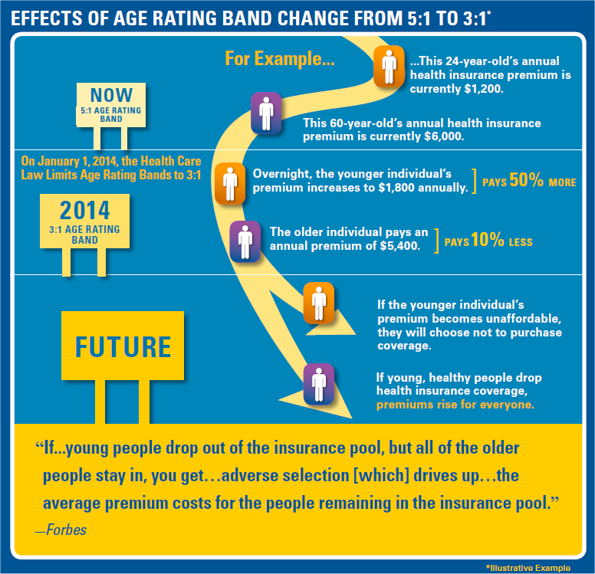
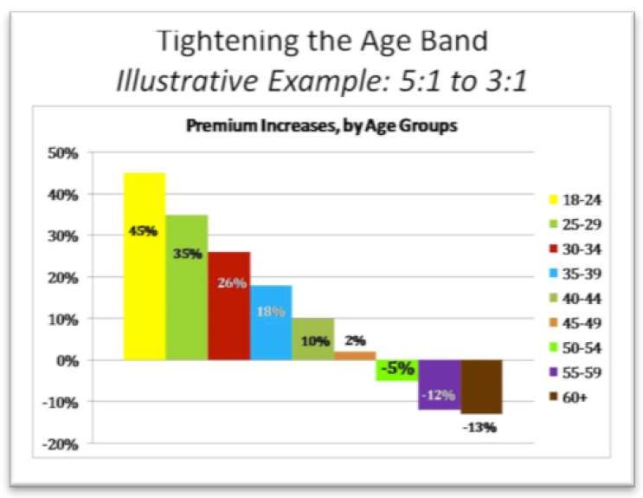
Perils of Age Rating Band Compression

Slide 31
Contact info:
Neil Trautwein
Vice President, Employee Benefits Policy Counsel
TrautweinN@nrf.com
Materials are also available at www.retailmeansjobs.com/healthcare

Slide 32
Thanks for Joining Our Webcast
Stay Tuned for Updates and Information at
“Public Affairs” on NAMM.ORG

