Slide 1
Notes:
Static Title Screen with Logo
How to pronouce b2BIG
What it stands for
Web url

Slide 2
Welcome to the b2BIG Meeting
Short presentation by your moderators:
Robin Walenta — West Music
Paul Ward — Roland US
Dan Kessler — NAMM
Q&A Session with Ad-hoc Tech Committee
Networking Session
Exchange contact info
Ask each other questions

Slide 3
Today’s Goals
Extend the reach and expand user base
Provide a path to enable Members to use XML to communicate business tranactions
Foster a 'community' based approach to the evolution of the NAMM B2B XML standard
Provide a forum to get useful feedback for improving the standard.

Slide 4
Topics
We are going to cover:
Why should we use standards
What the Standard does
What is b2BIG
About the Ad-hoc Tech Committee
Who is using the NAMM Standard

Slide 5
Why should we use standards?
Efficiency
Accuracy
Easy to add more partners
Less better work

Slide 6
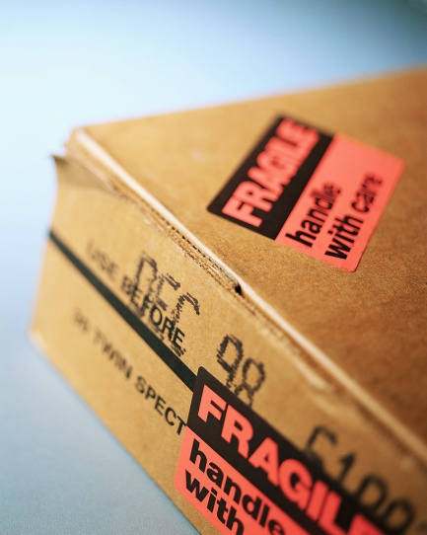
Standards Improve Accuracy
Retail Survey – frequently heard complaints:
Filling orders correctly
Shipping on time
Giving accurate delivery forecasts
Addressing problems in a timely manner
“We waste too much time and effort every week trying to get shipping and order-entry mistakes corrected. It is a complete drag.”

Slide 7
Defects and Rework in the Inventory Management Process
“On average, PO’s with errors had an additional two days labor allocated to them, but some had as many as 77 additional days.”
“8% of the PO’s received failed to comply with retailer specifications.”
- ERI Journal August 2006

Slide 8
Defects & Rework in the Inventory Management Process

Slide 9
What is b2BIG
Pronounced ”bee- too- BIG”
Those interested in the NAMM Standard and other technology issues affecting the MI industry
Activities on www.namm.org/initiatives/b2b
Ad-hoc Tech Committee working documents and conversations on web.

Slide 10
Looking Back
NAMM has supported standards for many years including bar-codes
The board committee worked with GS1 to develop ”multi-ship PO” to solved complex problems but complexity was overly burdensome.
In 2006 the Ad-hoc Tech met to create a more practical XML specification
2007.1 first published version
2009.1 extended document set
Draft 2010 version will be released this week.

Slide 11
What’s in the NAMM Standard?
Published documents
Party
Item
Purchase Orders
Invoices
Advance shipment notification
other supporting documents.

Slide 12
The NAMM Standard in Action
Supplier
Buyer
Item
Advanced Shipment Notification
Party
Invoice
Party
Purchase Order

Slide 13
Who is using the NAMM Standard
Providers, Manufacturers, Retailers, Distributors
Guitar Center
Roland
Korg
Sweetwater
West
Tritech customers
D’Addario
Kaman
Hal Leonard
Alfred
Yamaha
RetailUp!
Many Others too!
Your Company Here
*Also Involved: Pro-Active

Slide 14
The Ad-hoc Technology Commitee
Members vary, and have included manufacturors, retailers, distributors and software providers.
Current Members and guests
Paul Ward – Roland US [Chair]
Robin Walenta – West Music
Bill McGloine – Korg USA
Gordon O’Hara - RetailUp
Greg Bryniak – D’Addario
Jerry Grochowski – Hal Leonard
Eric Cranley – Willis Music
Amy Pearson – Sweetwater
MaryAnne DelMundo – Guitar Center
Pat Murphy – Tri Tech
Bill Walzak – Pro-Active Software
Gary Duvall – Yamaha

Slide 15
Q & A
Let’s take some time to answer questions and discuss concerns

Slide 16
I’m interested! Now what?
Join b2BIG by visiting http://www.namm.org/initiatives/b2b
Talk to your IT department or provider
Download the Implementation Guide to get started

Slide 17
Networking with b2BIG
Let’s talk…
Exchange contact info
Ask questions

Slide 18
So long and thanks for all the fish
☺

