Slide 1

“The Dirty Dozen:
This Year’s Best Ideas”
Panel Discussion
Moderated by Danny Rocks
The Company Rocks

Slide 2
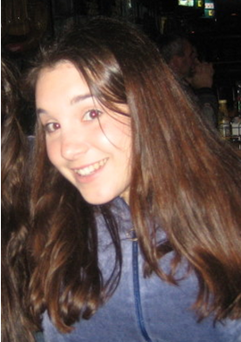

Jessica Duarte

Slide 3
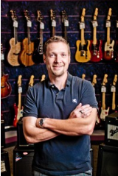

Mitch Brashers

Slide 4
Gathering Ideas
Adapting Ideas
Implementing Ideas
Improving Ideas

Slide 5
Gathering Ideas
Sharing Groups
Professional Associations
Trade Shows
Trade Magazines
Online

Slide 6
Adapting Ideas
To fit your store
To a different season
To a different scope

Slide 7
Implementing Ideas
Planning
Budgeting
Communicating
Running

Slide 8
Improving Ideas
End-of- Project “Autopsy”
  How did we do?
  What worked well – and how can we improve it?
  What did not work so well – and how can we prevent it in future?

Slide 9
Seasonal Promotions
Easy to Adapt & Implement

Slide 10
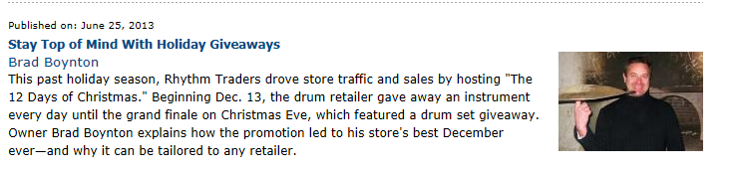
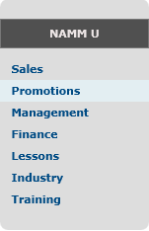

Slide 11
“12 Days of Christmas Promo” – Key Points
Ticket to win with every item purchased over $10.00
Products donated by suppliers
In-store displays & signage
Promoted via Facebook
http://www.namm.org/nammu/promotions/stay-top-mind-holiday-giveaways

Slide 12
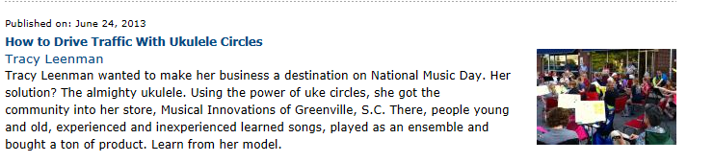

Slide 13
“Drive Traffic with Uke Circles Promo – Key Points
Tied-in w National Music Day
  500 Cities in 100 Countries
Uke Promotional Power w/ E-mails & Press Releases
Vendors “chip in” with products & promo allowances
Keep it simple
Create Sense of Urgency
http://www.namm.org/nammu/promotions/how-drive-traffic-ukulele-circles

Slide 14

Adapting Promotions for Your Market
http://www.bertrandsmusic.com/information.php?pID=50

Slide 15
Adapting Promotions for Your Market
Raffled a 2-year old Martin Guitar
Made it a contest!

Slide 16
Year-round Promotions
Commemorate Significant Milestones in Your Company’s History

Slide 17
30 Years in Business – Year-round Promotions

Slide 18
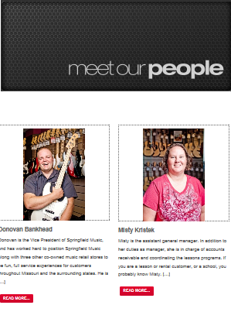
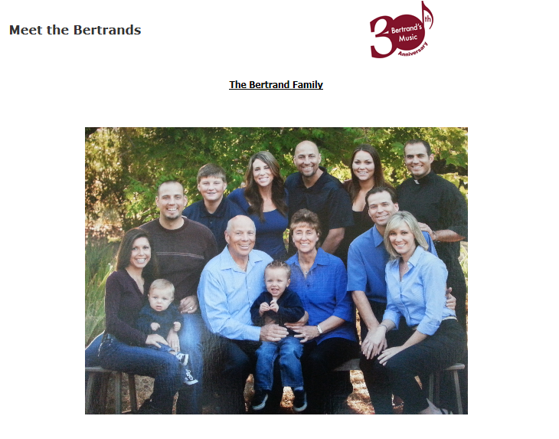

Slide 19
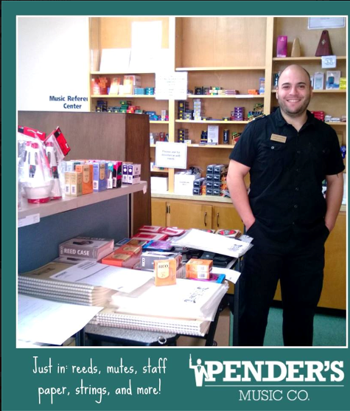
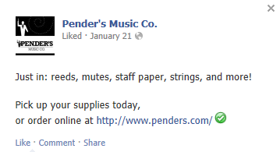

Slide 20
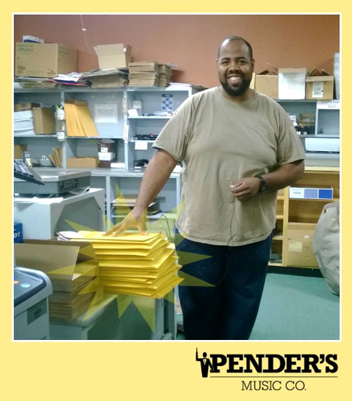
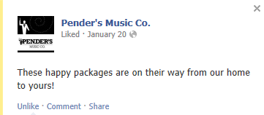

Slide 21
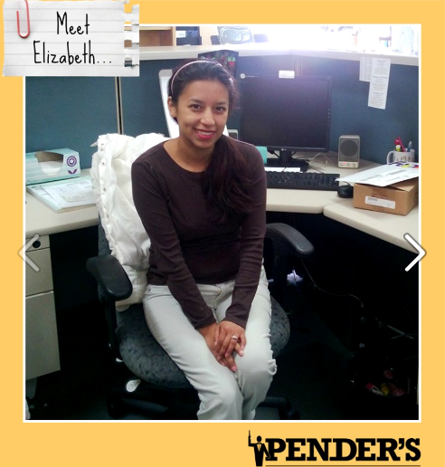
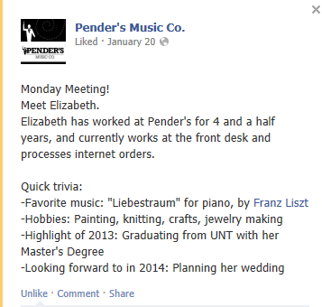

Slide 22
Communicating with Staff
Best Ideas from your peers

Slide 23
Final Thoughts

Slide 24
Questions?

Slide 25
Thank You!

