Slide 1

Course Title
Navigating the Social Media Maze
Grant Billings

Slide 2





Navigating the Social Media Maze
Notes:
Good afternoon and thank you for coming.
I hope you’re all having a great show and appreciate your spending the next 30 minutes with me to talk about social media
Social Media landscape changes quickly
Today, I’ll be focusing on efficient use of the 4 most effective platforms
Who are the players? (click)

Slide 3

The Players
Notes:
1/7th of the world’s population
1 billion people
More than 167 million in the US at last count
18m in Canada
That’s 73% of the online population.
For most American’s, it has become ubiquitous
They rule.

Slide 4


The Players
Notes:
About 142 million US users and 10m Canada
They tend to be younger
Tend to follow celebrities/causes – not businesses

Slide 5

The Players
Notes:
Please raise your hand if you are on Google+
Please raise your hand if you have a Gmail account
Everybody with a Gmail account is on Google+
Even with their dominance, they are trailing FB
When that changes, it’s important that you’ve already had a presence

Slide 6

The Players
Notes:
Raise your hand if you’re on LinkedIn
Many overlook LinkedIn as a way to connect with your best retail customers
Much more likely to connect with you here than friend you on FB
Allows you to be an individual, but only showing your professional side
We’ve seen the players – how do we help them through the maze? (click)

Slide 7

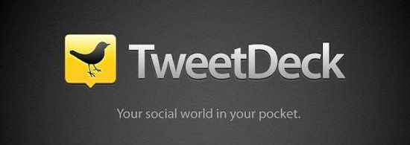
Get a Bird’s Eye View
Notes:
Any MAZE is easier to navigate if you’ve seen it from above first.

Slide 8
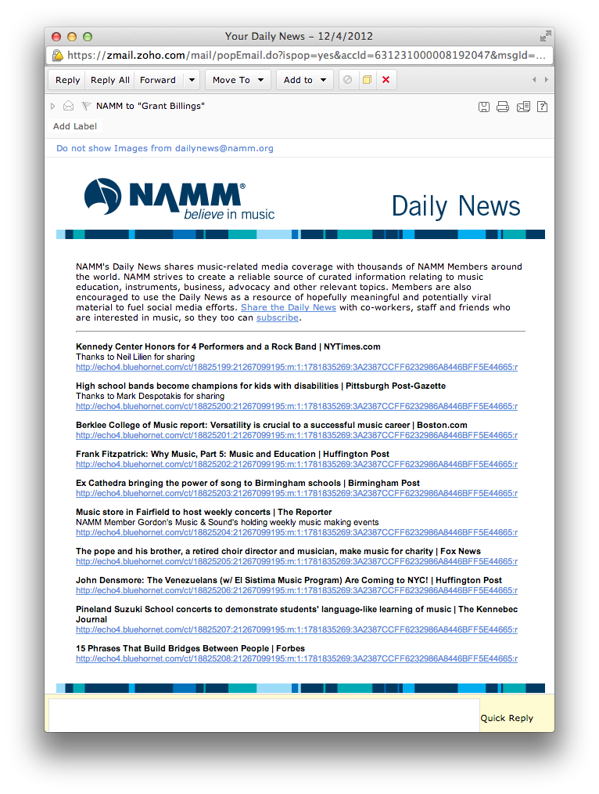
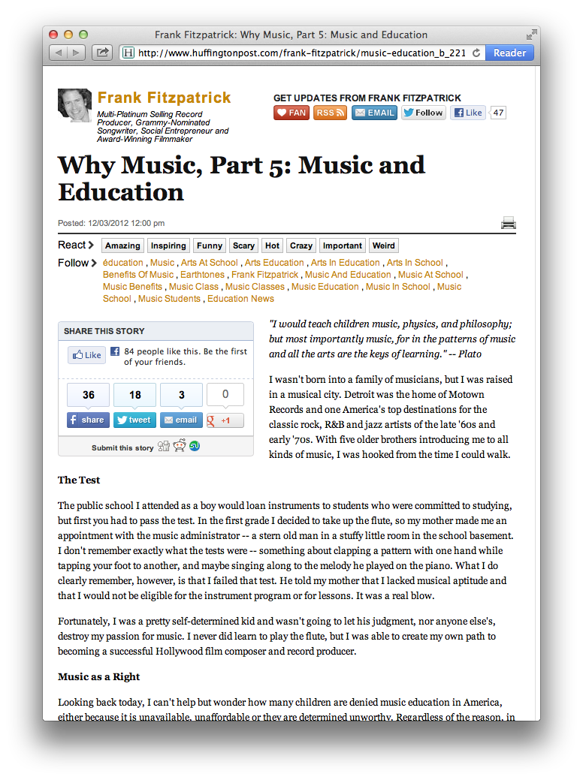
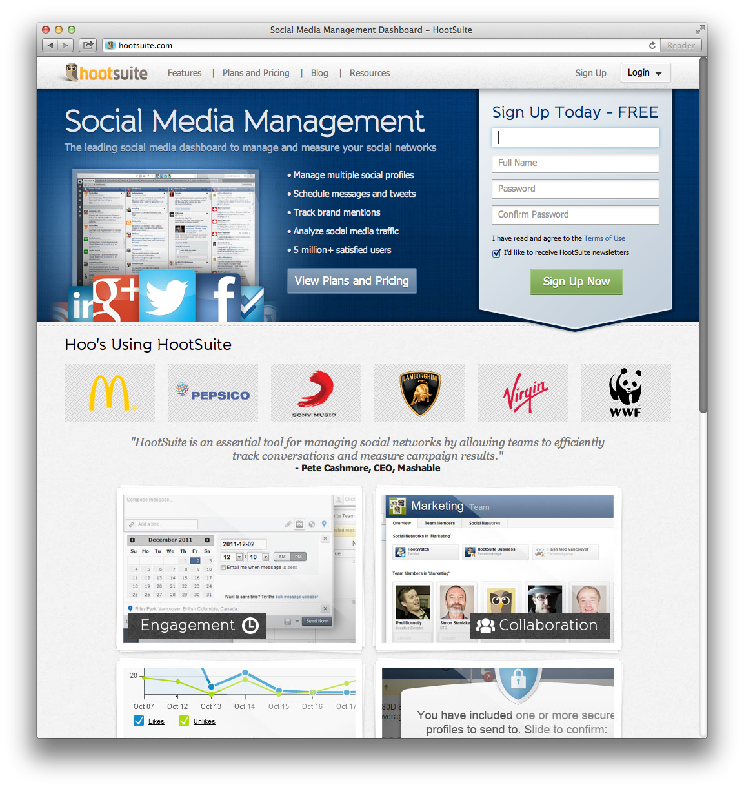
Knowing Where to Turn

Slide 9
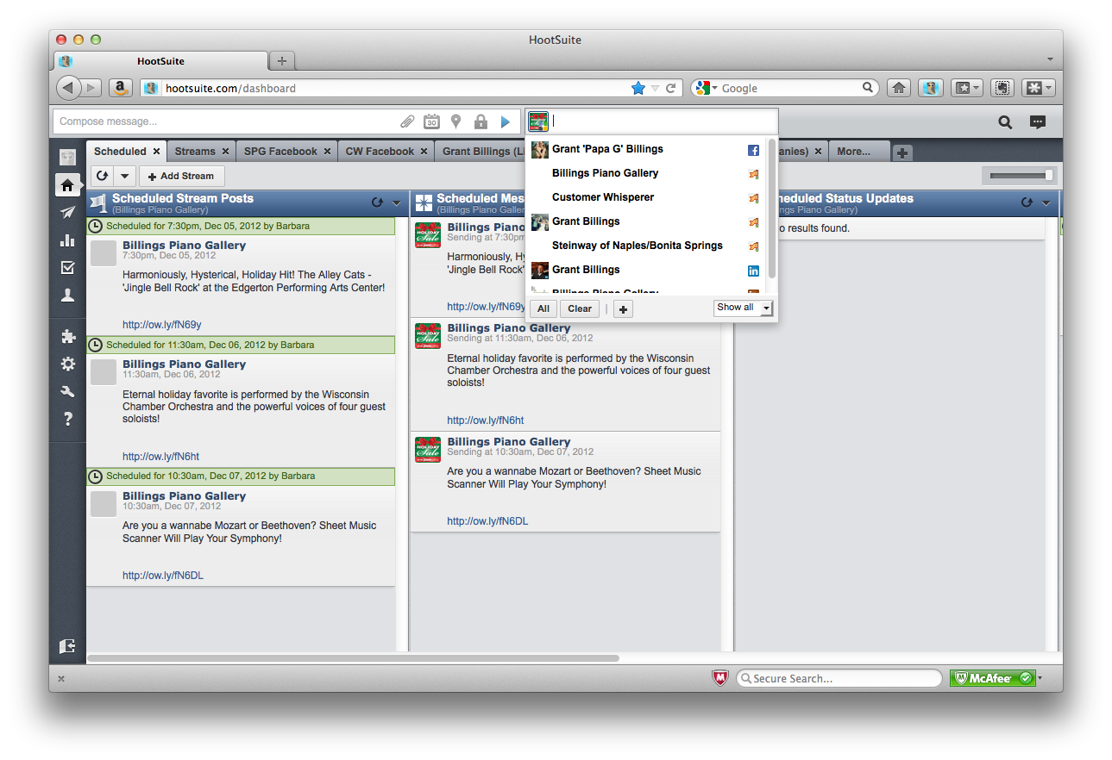
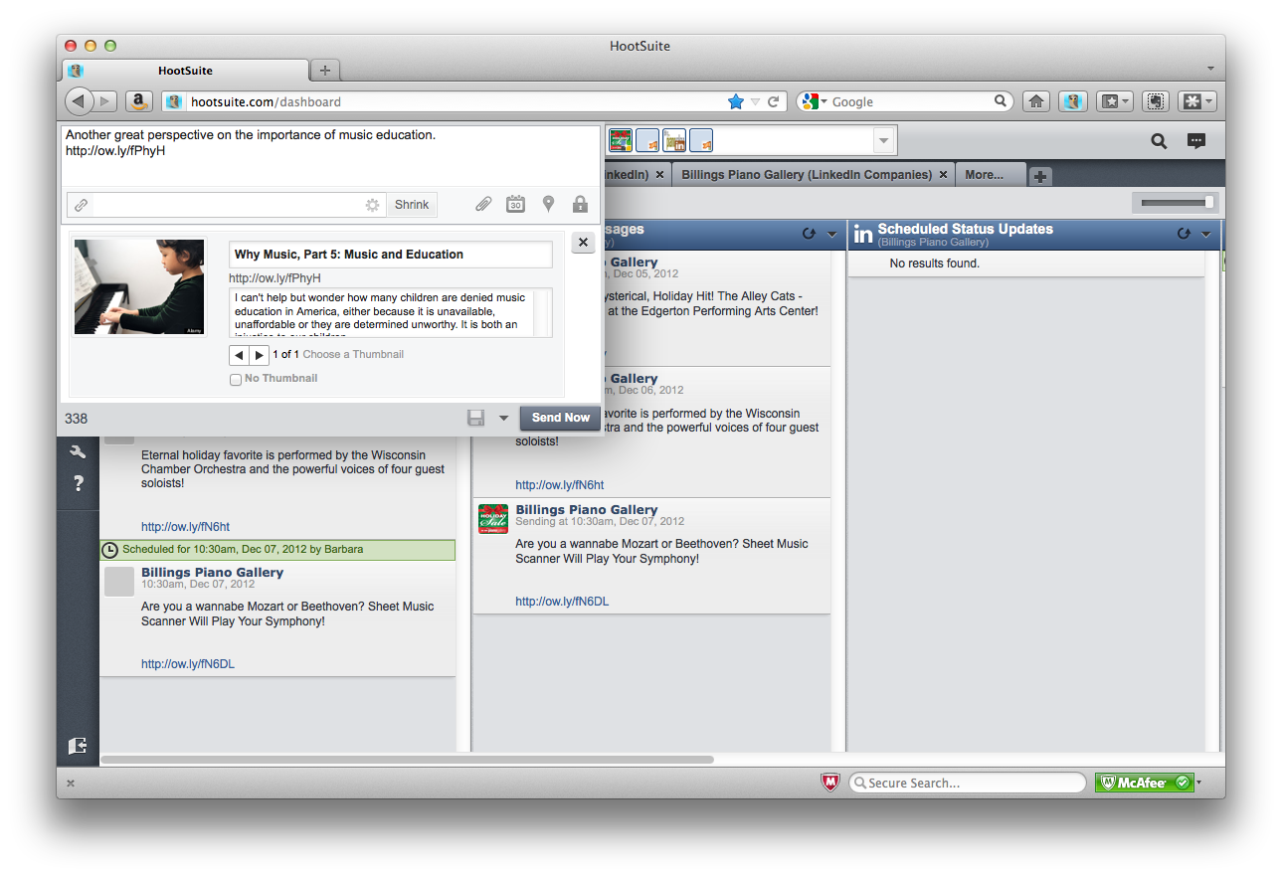
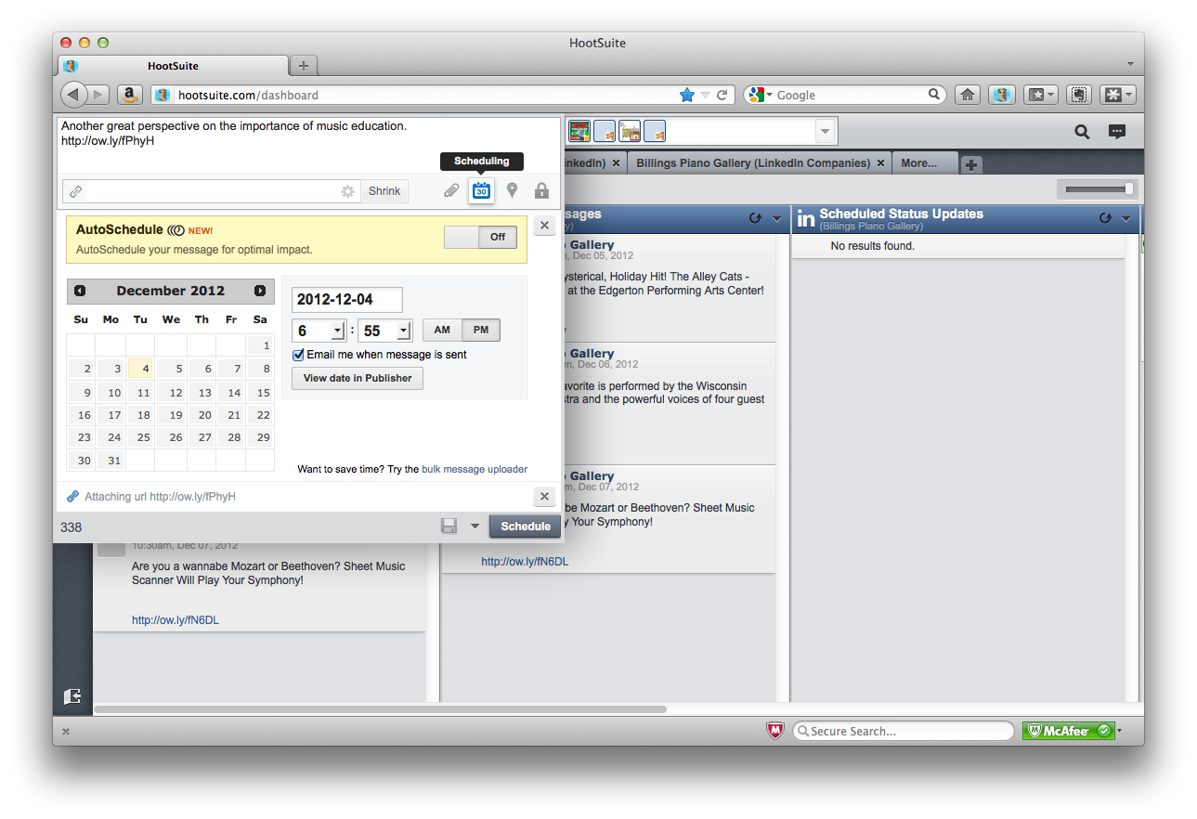
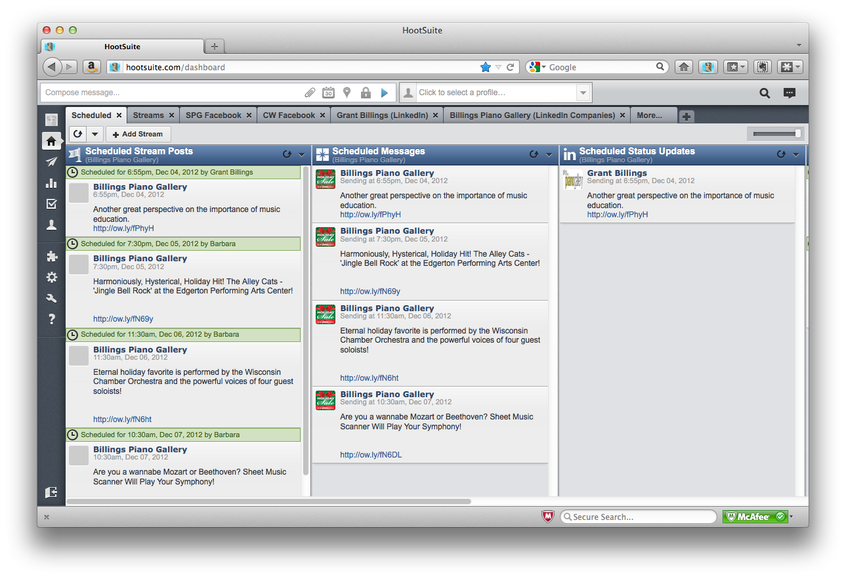
Knowing When to Turn

Slide 10
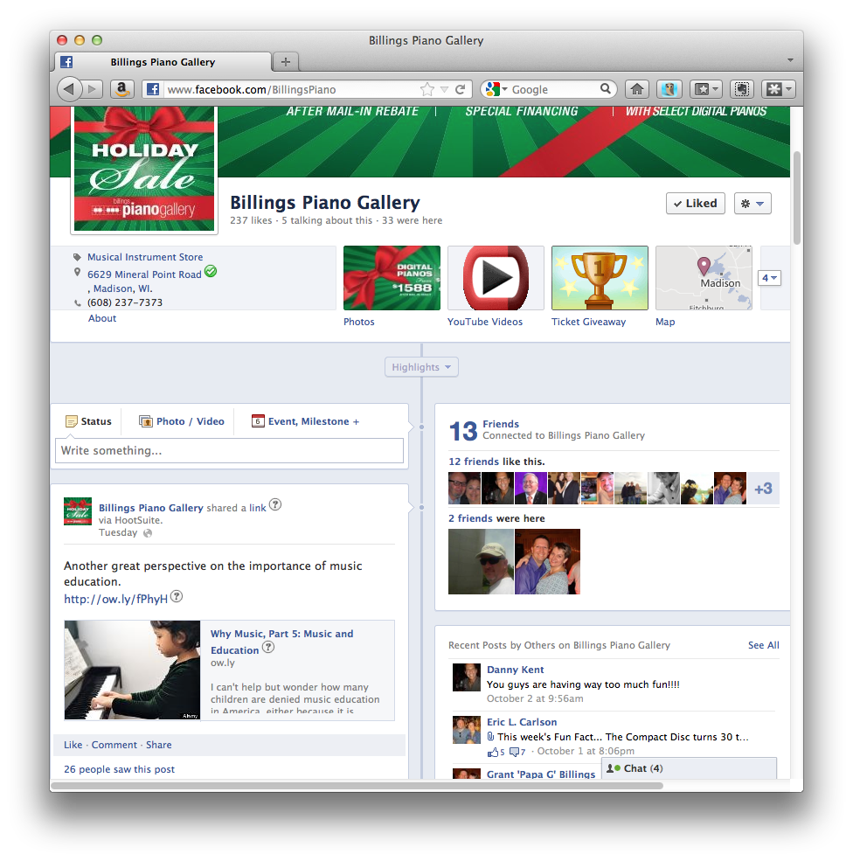
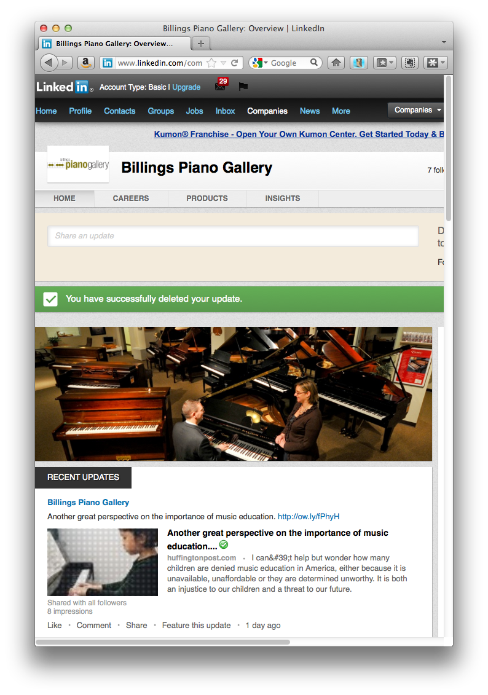
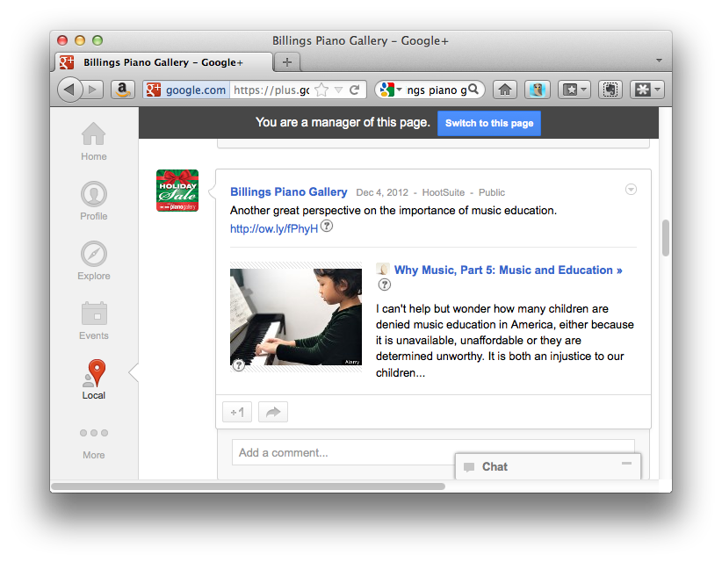
The End is in Sight!

Slide 11
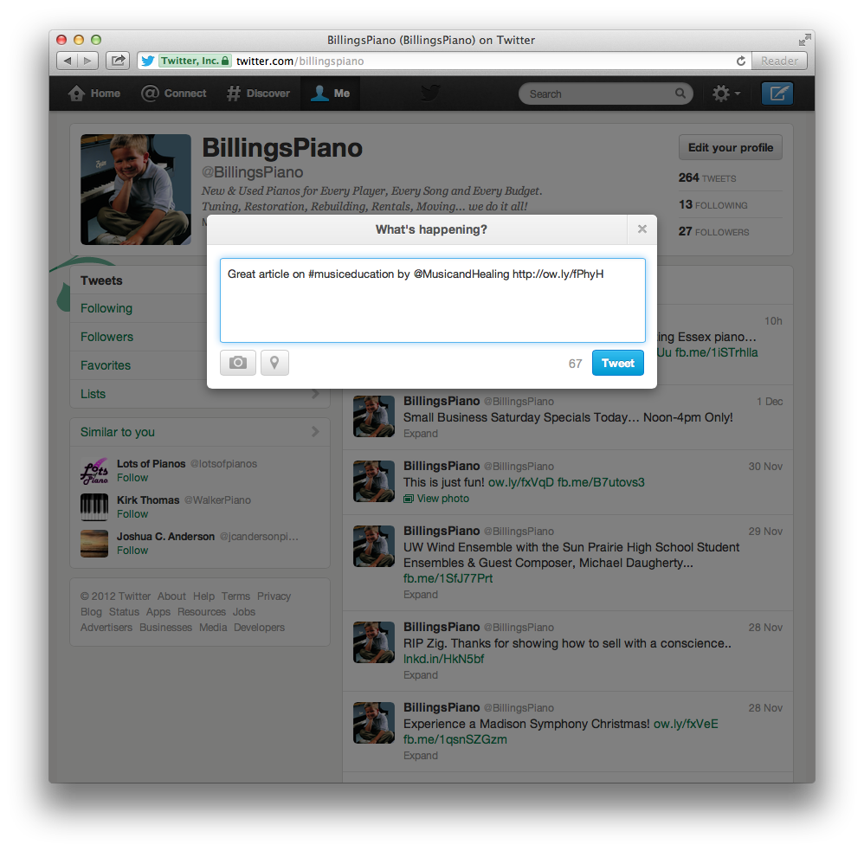
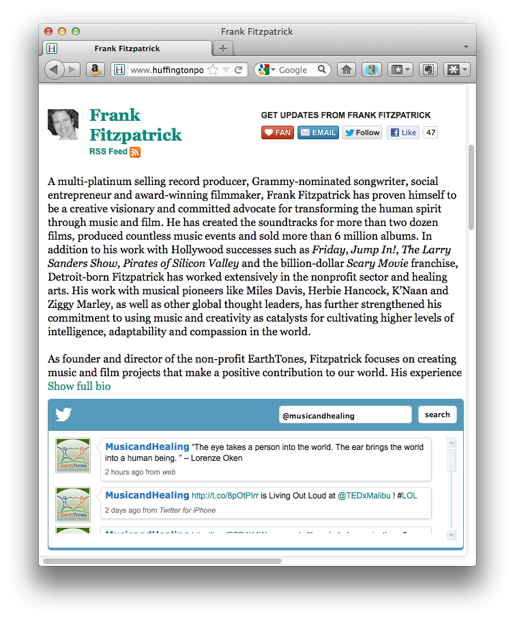
Twitter-speak
Great article on
#musiceducation
by
@MusicandHealing
http://ow.ly/fPhyH

Slide 12

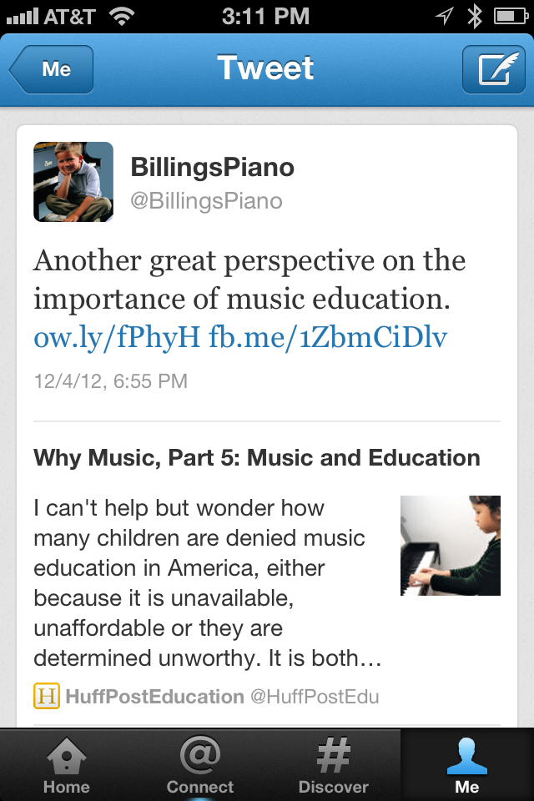
All bases… covered!

Slide 13

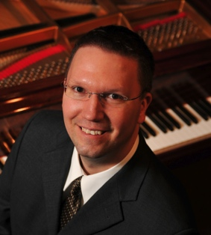
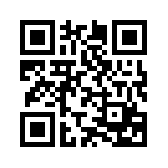
Covering Your Social Media Bases
Grant Billings
grant@billingspiano.com
/grantbillings88
@customerwhisper
/grantbillings
/grantbillings?
Notes:
So I know what you’re thinking… am I on social media?

