Slide 1


Slide 2
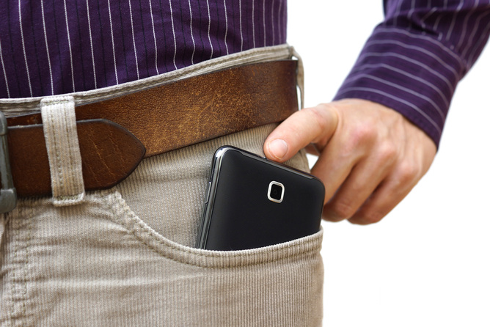
The
Mobile
Web
Get Into Your Customers’ Pockets
Grant Billings

Slide 3
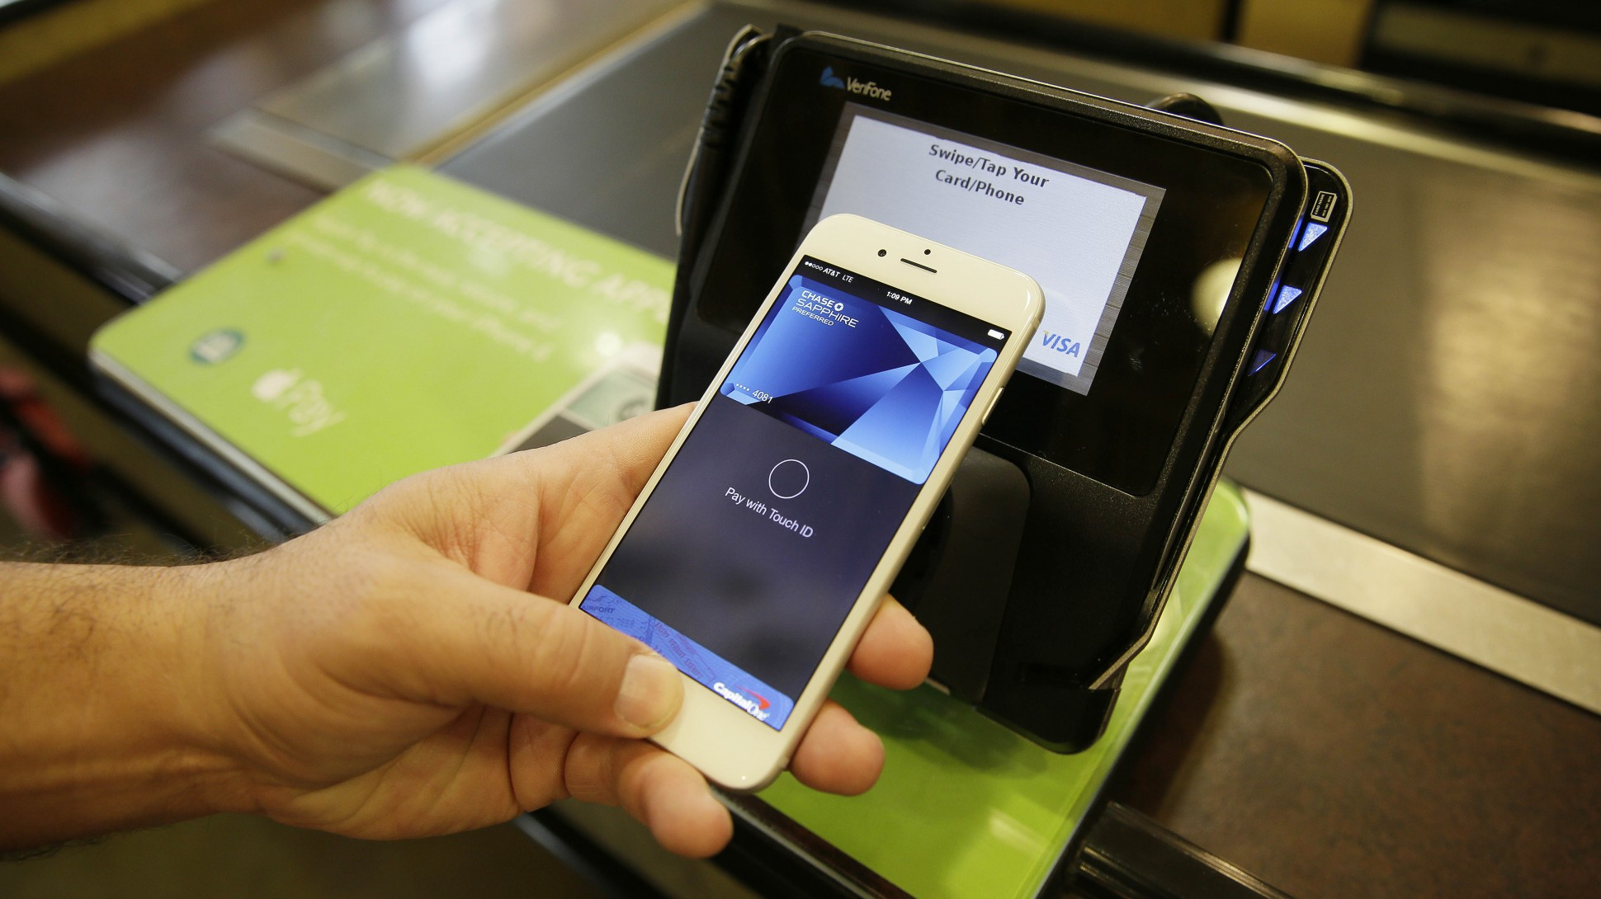
Notes:
More and more, your customers are reaching for their cell phones before they reach for their wallets
Spontaneous
Impulse Purchases
Your first mobile impression is critical

Slide 4
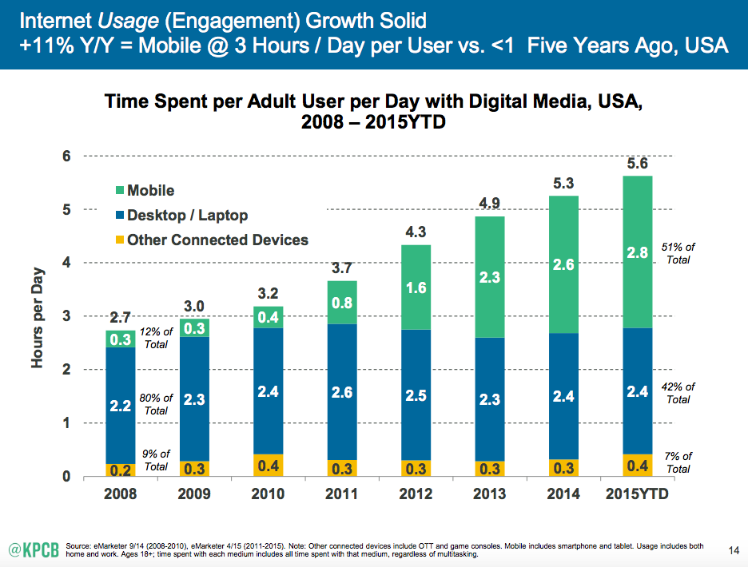
Notes:
Net new users -desktops -flat for the past 7 years
Mobile - continued growth - now 51% of all internet usage
Most important, it’s where customers go when they’re ready to make a purchase.

Slide 5

“If you're not able to reach your audience
through mobile search or display,
or you're not providing a
satisfactory mobile experience
you will miss out.”
- Dave Chaffey
Source: http://www.smartinsights.com
Notes:
The implications are clear…
… compared to competitors who are
If you are a brick and mortar retailer, this is critical
Mobile directions bring people to right into you parking lot–You barely need to have a sign!

Slide 6



300,000,000
350,000,000
1,100,000,000
Source: http://www.ebizmba.com/articles/search-engines
Source: http://www.levyonline.com/seo-bing-yahoo-2015/
Notes:
How can we get you in front of more of these customers TODAY
Think about the FREE first impression first.
These are unique monthly searches
Keep in mind, Yahoo is mostly powered by Bing (source)
You need to be here to be in their pockets

Slide 7

“Google Search will be expanding its use of mobile-friendliness as a ranking signal.”
Source: https://support.google.com/adsense/answer/6196932?hl=en
Notes:
First- you want to know if your site is mobile friendly now.
This means, if customers are searching from a mobile device and you site isn’t mobile friendly, you’re not going to rank. NO CHANCE!

Slide 8
https://www.google.com/
webmasters/
tools/
mobile-friendly/
Notes:
Important to know - Simple tool to see if this affects you
Feel free to try it now
If you fail the test, this resource also tells you how you can fix it
I’ll also put this on my linkedin and facebook pages later today

Slide 9

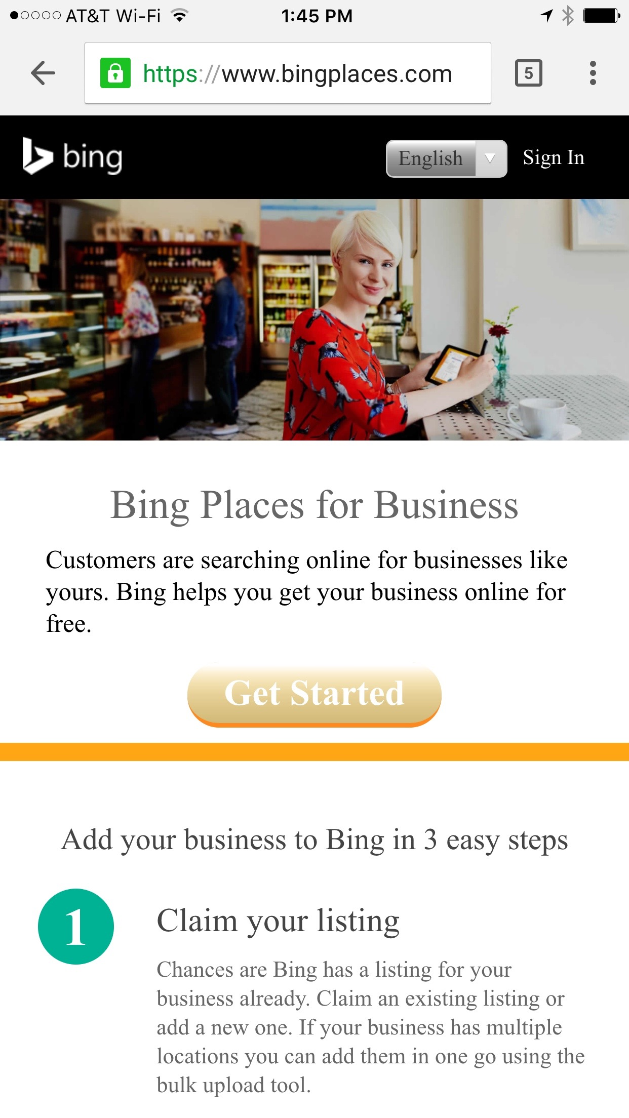
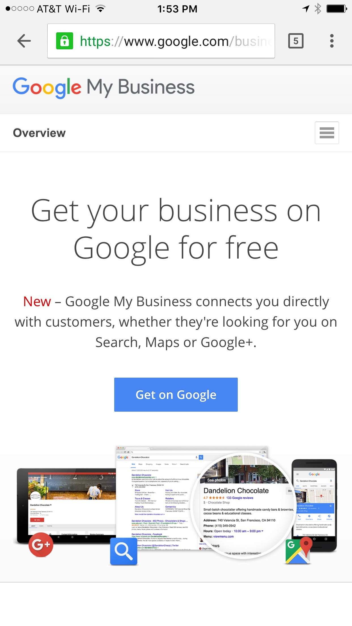
Claim your
Google My Business and Bing Places for Business Pages
bingplaces.com
google.com/business
Notes:
Here, you’ll verify your location, phone number, hours and landing page
Everything important to your customers
(Click) and it’s FREE!

Slide 10
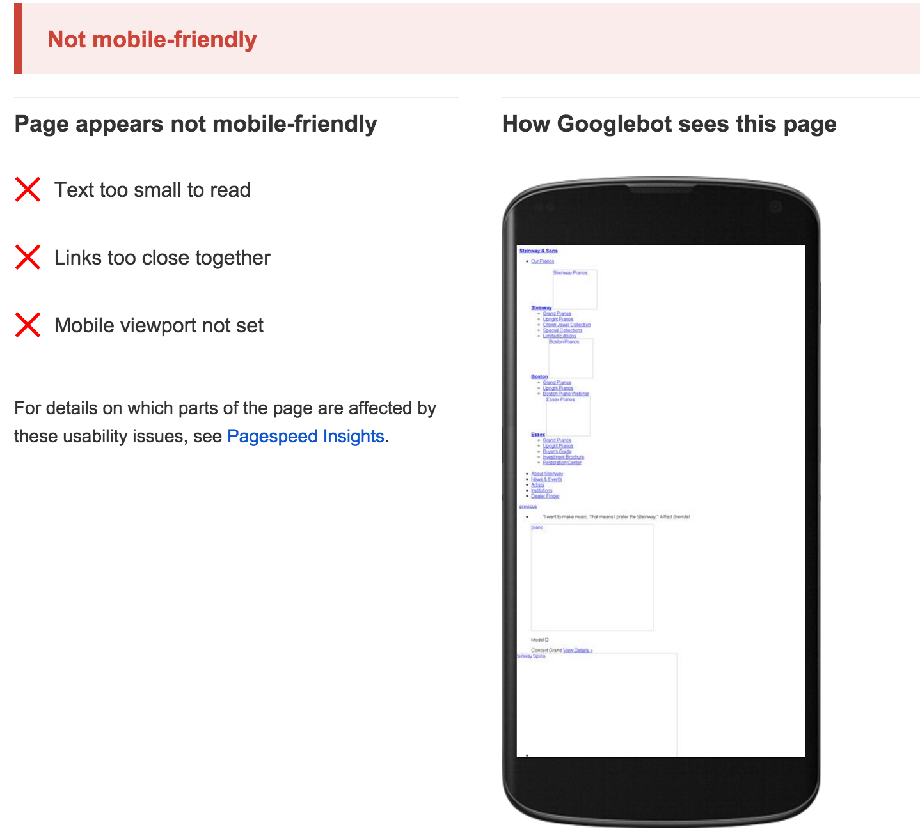


Notes:
If you passed, that’s great!
If your web page fails this test,
link your Bing and Google pages to your Facebook business page – which links to your site and includes location, phone, and hours

Slide 11

Notes:
Make sure our home page includes
Products
Brands
Physical Address
Phone Number

Slide 12
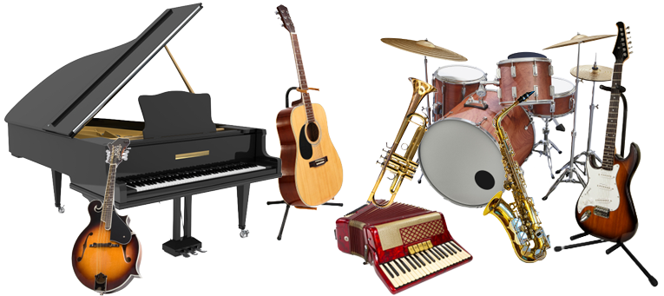
Notes:
Products
Think like a consumer– how would they search?
Woodwinds? No, clarinets
Strings? No, violins
Percussion? No, drums

Slide 13

We have the best selection of quality used pianos from Fort Myers to Bonita Springs to Naples to Marco Island! You'll also find fantastic new pianos at the lowest
piano prices from industry leaders like Steinway & Sons, Steinway designed Boston pianos and Essex pianos, Roland digital hybrid pianos, and easy to use
player systems like the QRS Pianomation II Cloud
Player Piano.
Notes:
Brands - Think like a consumer.
Everything in bold here is a keyword that my clients search for.
Yes, it’s a lot of copy, but Google likes that!
It doesn’t matter if the page visitor reads it.

Slide 14
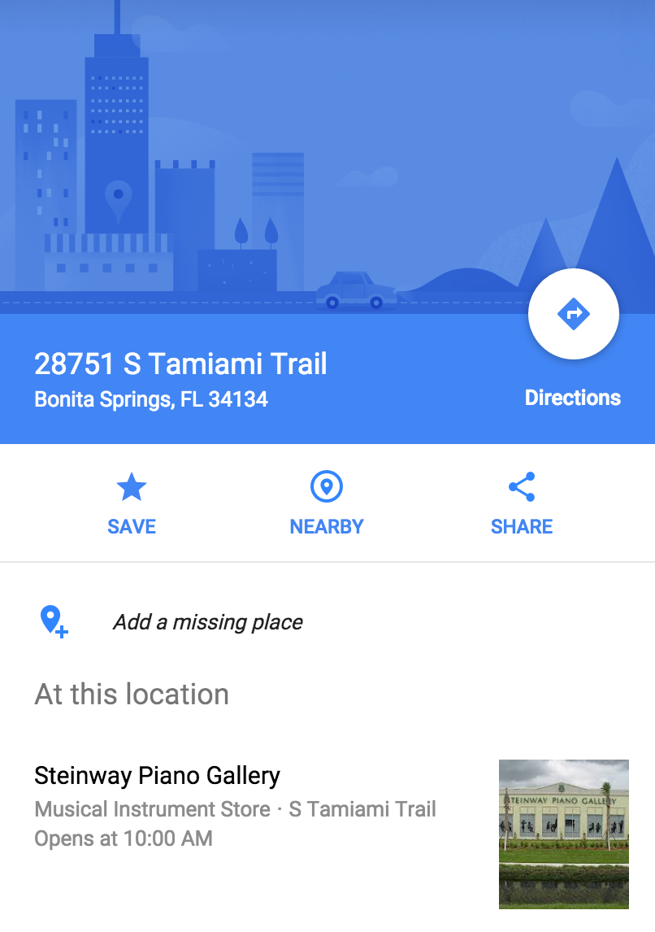
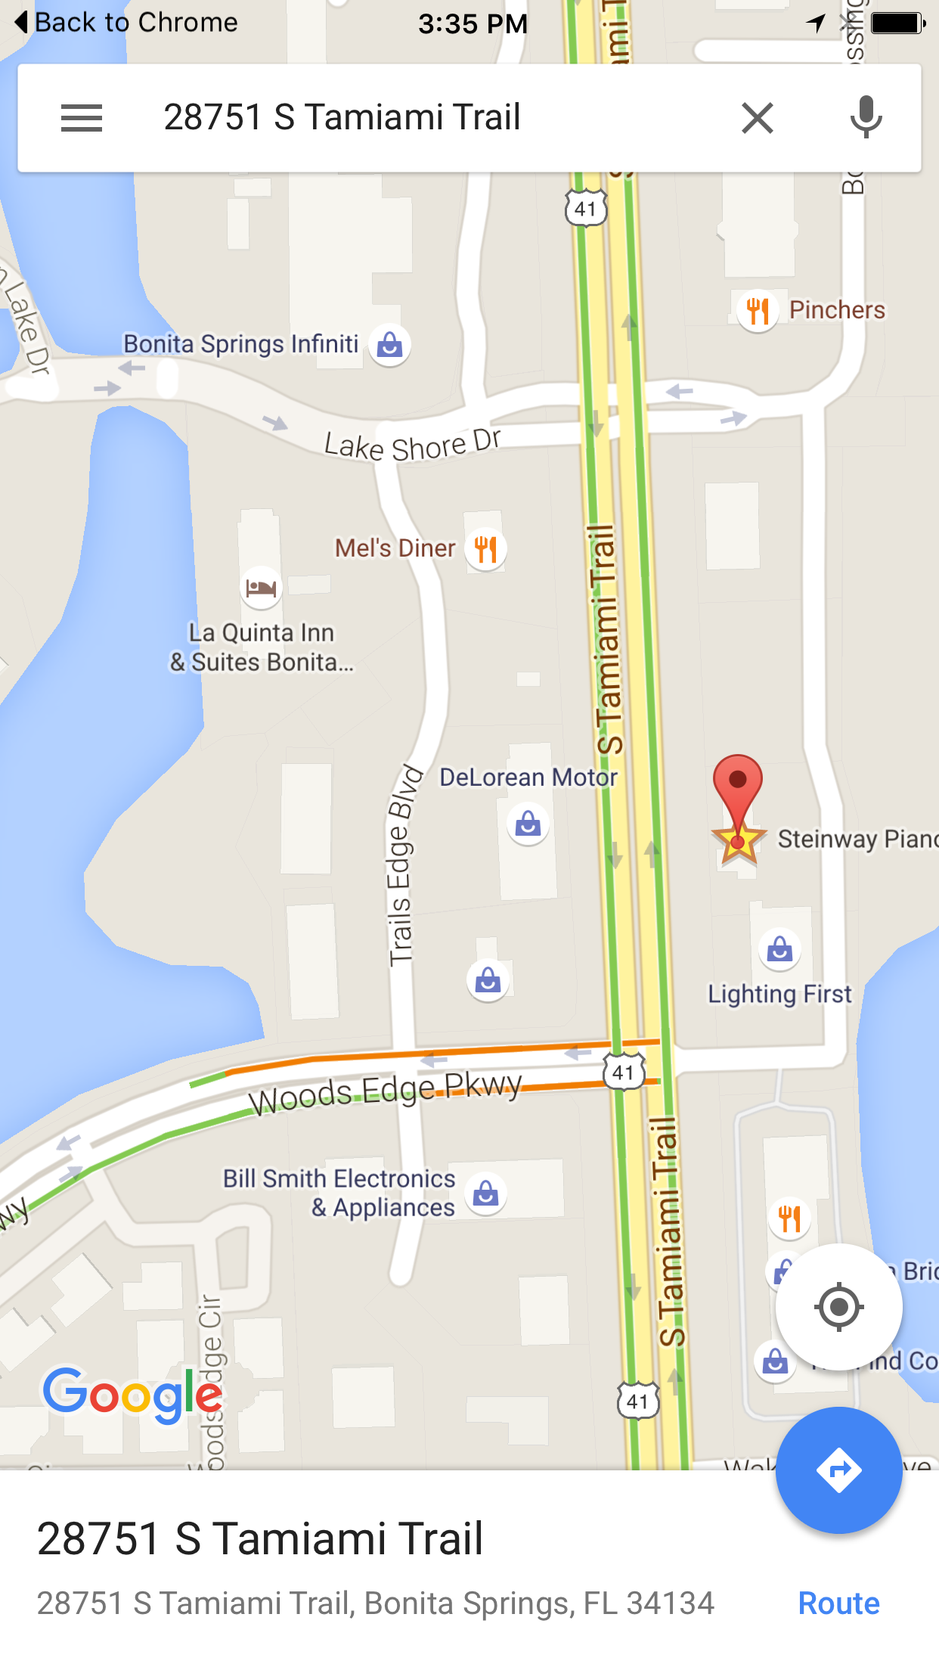
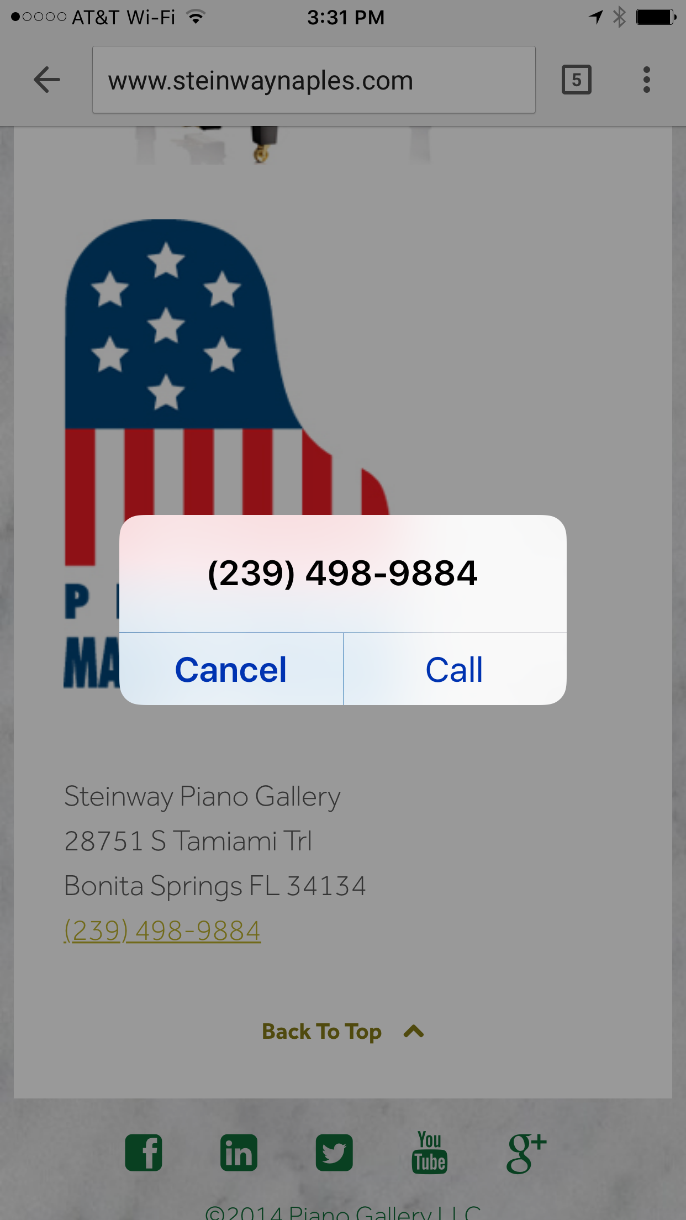
Include your physical address
Link to a Google Map
Include your phone number
Use the tel: link
Notes:
Address and Phone
Anybody here remember yellow pages ads?
How would you react if the new book came out and they had omitted your phone number and address?

Slide 15

Claim your Business Pages
Link it to a web friendly landing page
Give your customers the information they want
Notes:
This is the low hanging fruit!
Claim your pages CLICK
You can probably get a lot of this done while you at the show
Or pop for the wifi on the plane ride home. It’ll be money well spent

Slide 16
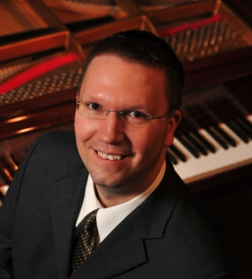



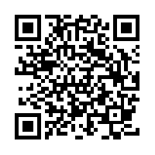


Thank you!
/grantbillings
The
Mobile
Web
Get Into Your Customers’ Pockets
/grantbillings88
“Start Being Social”
Music Inc, June 2013
@customerwhisper
/grantbillings
grant@SteinwayNaples.com

Slide 17
The
Mobile
Web
Get Into Your Customers’ Pockets
Grant Billings

