Slide 1

The 10 Commandments of
Selling on Amazon & eBay

Slide 2
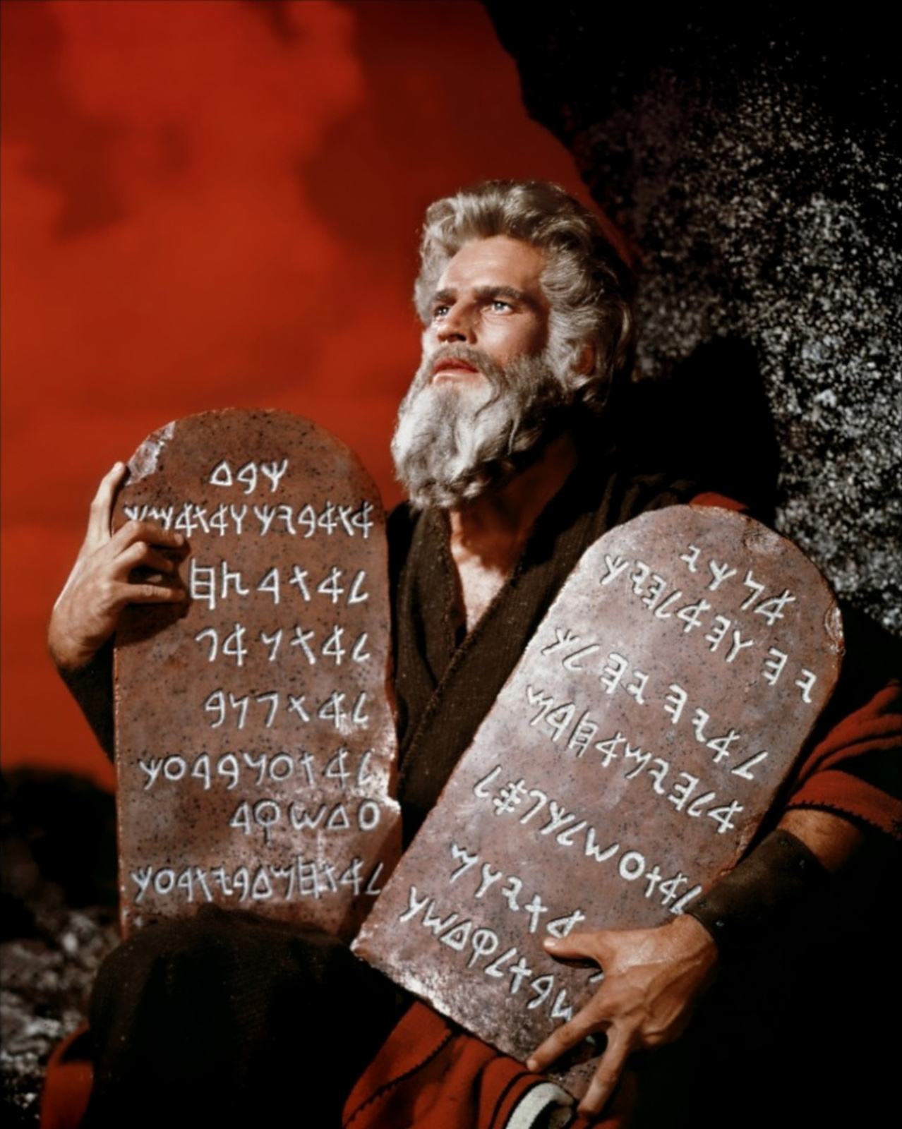
Not from those famous books,
but from
Instrumental Music Center, Tucson
Leslie Faltin, Co-owner

Slide 3
You can make money and turn product on Amazon and eBay.
You don’t have to like them or agree with their business practices to use the platform.
There will ALWAYS be an “Amazon” or “insert threatening retailer here” …

Slide 4


Slide 5


#10
Get Thee a great camera

Slide 6

#10
Get Thee a great camera
It’s not the megapixel ratings … it’s the sensor size that really affects resolution
I chose the Canon Rebel T5i DSLR ~$700
  Bought it locally and got a free class!

Slide 7
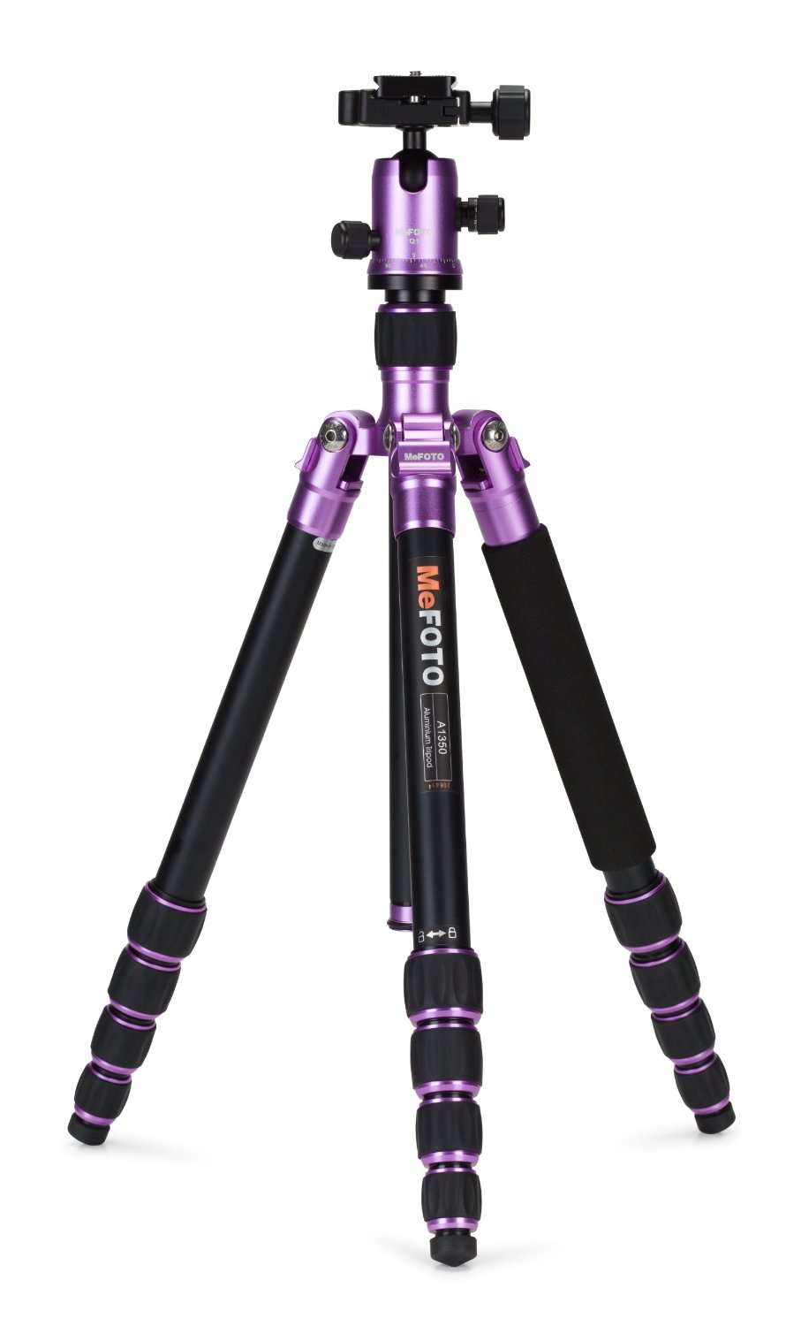
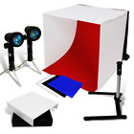
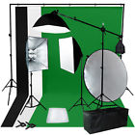
#10
Things to make your life easier
  Tripod
  Better lighting
  Backdrops
  Photo editor
    Xara Photo & Graphic designer
    Corel Photopaint
$45
$148
$175

Slide 8
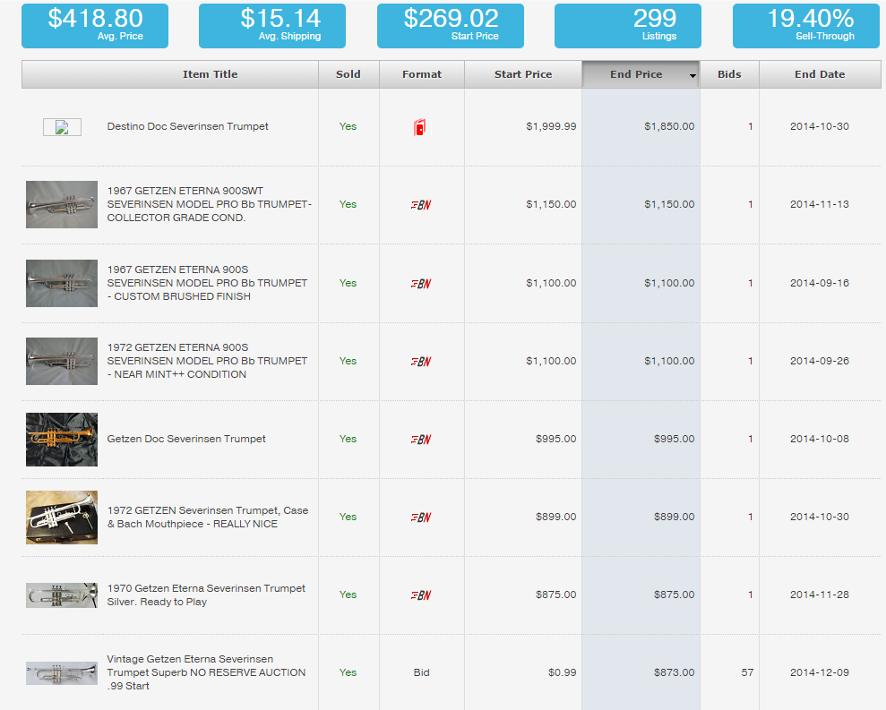
#9
Know Thy Market:
www.Terapeak.com
Search for: Severinsen Trumpet
This tool has fine-tuned our trade-in offers and honed pricing for eBay.

Slide 9
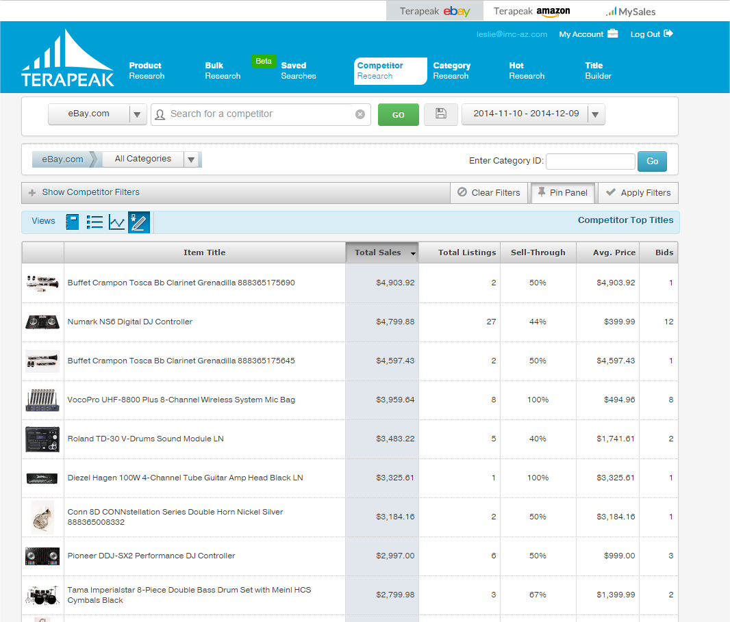
#9
Know Thy Market:
www.Terapeak.com
Research competitors
Find out what is hot
This tool is HUGE

Slide 10
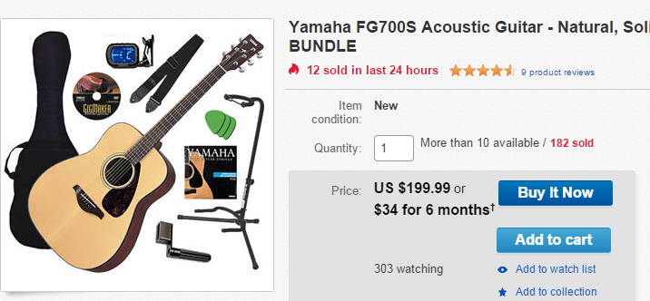
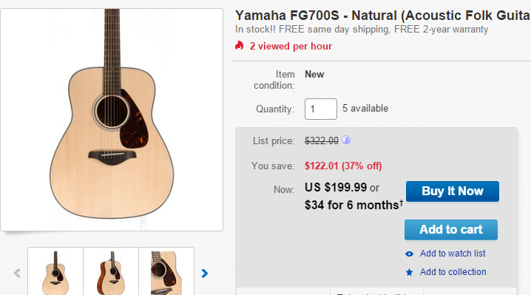
#8
Thou Shalt BUNDLE
Create packages that provide solutions to people
Pricing concerns usually on product, not the free accessories.
  Which would you buy?

Slide 11
#7
Thou Shalt Use eBay Global Shipping
+ You ship to a U.S. eBay shipping center
+ There is no fee to join the Global Shipping Program.
+ If the tracking shows acceptance at the U.S. shipping center of four days or less from the date of buyer payment, you'll get an automatic five-star detailed seller rating for ship time.
+ Offer free domestic shipping to get an automatic five-star detailed seller rating for shipping cost.
- Prices appear higher to overseas customers since the prices include all import fees
+ Removes the option to “Mark the value as $5”
+ Completely out of your hands once it gets to shipping center

Slide 12
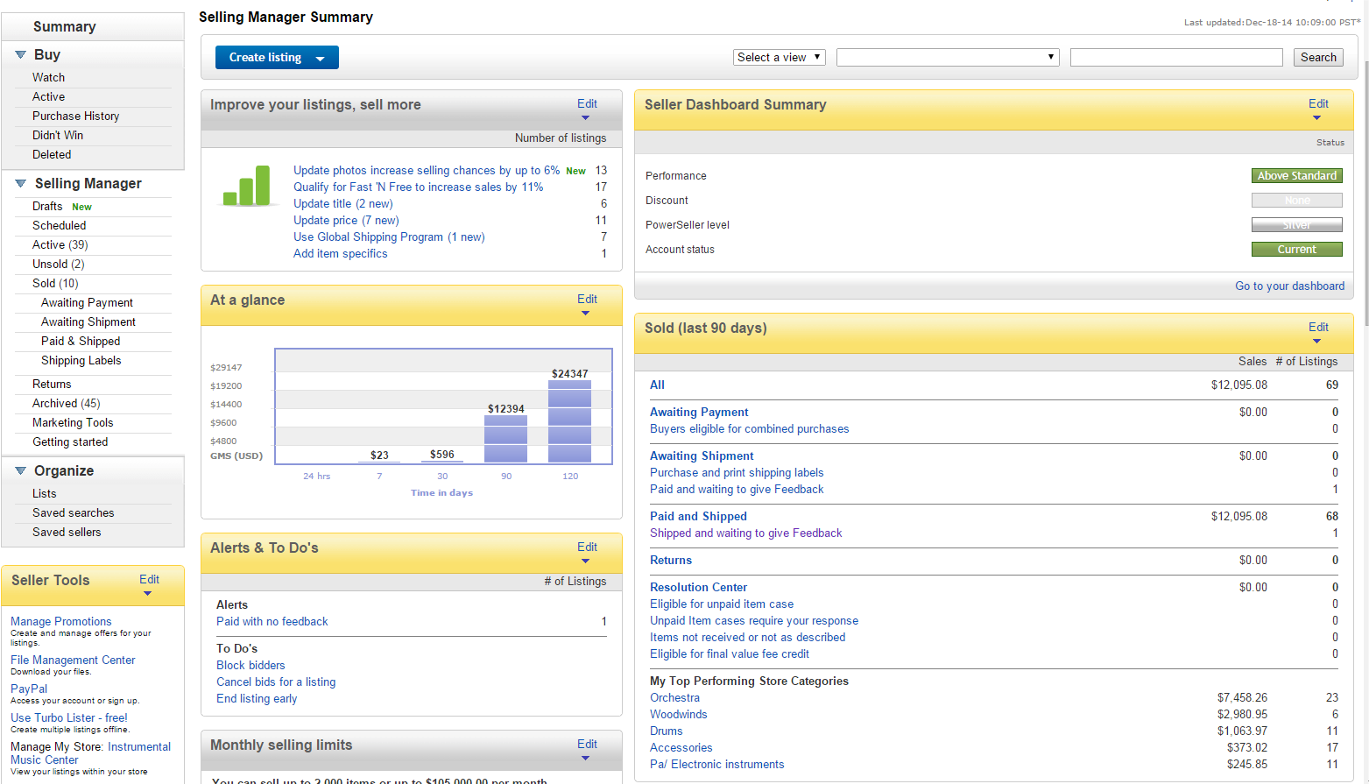
#6
Thou Shalt obtain Selling Manager Pro
Selling Manager Pro is a subscription in addition to your store subscription
$15.99/mo or free with Premium or better eBay store

Slide 13
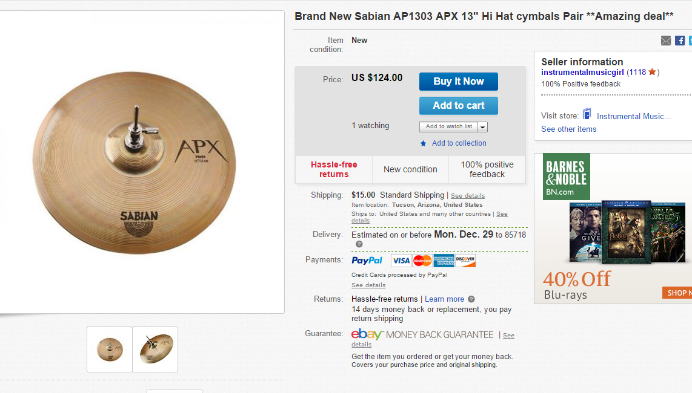
#5
Thou shalt pick a great selling strategy
Buy it Now
  Great for commodity items
  Great for turning “regular” stock

Slide 14
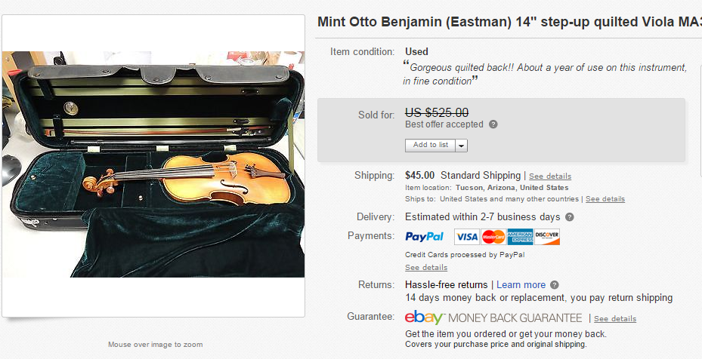
#5
Thou shalt pick a great selling strategy
Buy it Now with Best Offer
  Customers will send in offers and you decide
  Watch the small print … they may sneak in “free shipping” as part of the deal
  Great if something doesn’t have a fixed price or isn’t getting interest on eBay

Slide 15
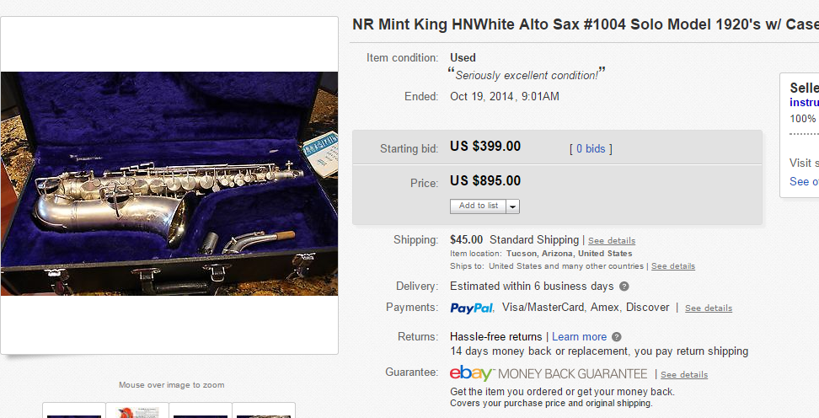
#5
Thou shalt pick a great selling strategy
Auction with reserve / or high start price
  Know what you want for an item? Start it there
  All auctions should end on a weekend

Slide 16
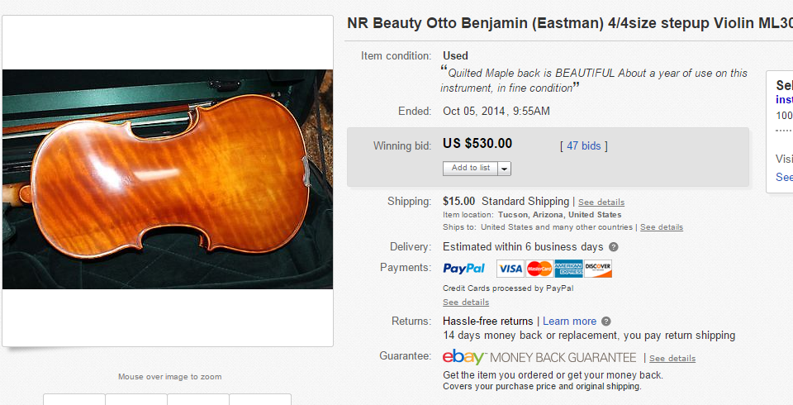
#5
Thou shalt pick a great selling strategy
Straight-up Auction
  Market will dictate what it’s worth
    Pro … sometimes it goes for more than you expect
    Con … sometimes it goes for a song
  All auctions should end on a weekend

Slide 17
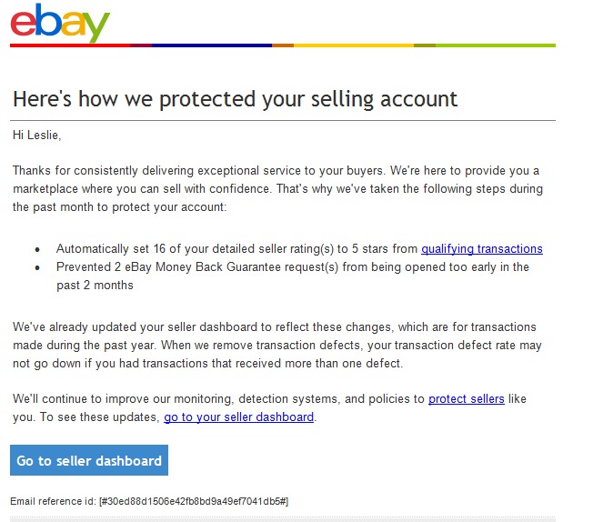
#4
Know that eBay is trying to help you
They don’t sell to your customers
They are attempting to be more seller-friendly
Site is somewhat clunky
  Buying postage from eBay is helpful

Slide 18
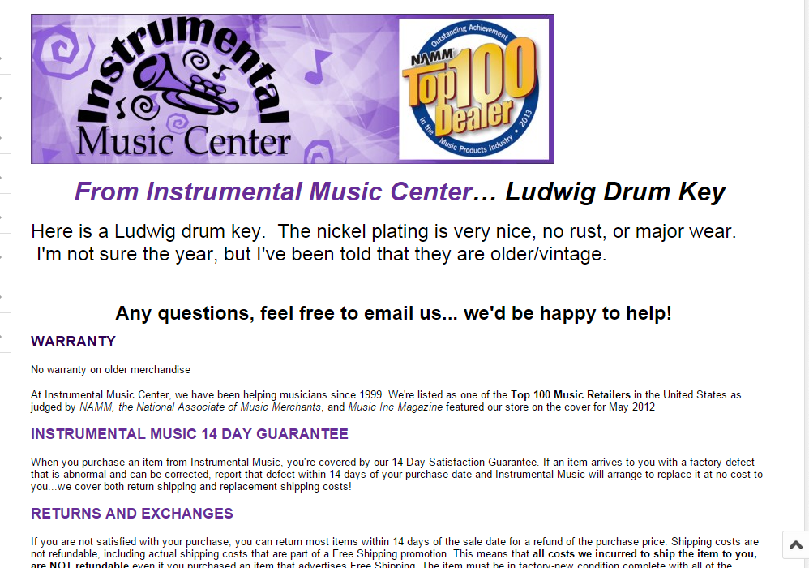
#3
Create Thy identity
Customize your “look” by adding logos
  Host them on Imgur or Photobucket, then paste the graphics link into the html when creating your listing.
  Use this as a template, then edit as needed

Slide 19
#2
Covet Top Rated + Status
The Top Rated Plus seal displayed prominently
A 20% discount on final value fees. (This applies to the final item price only, not to shipping charges)
An additional 5% discount on final value fees (final item price only) on eligible Top Rated Plus listings that offer extended holiday returns for transactions from November 1 through December 31
Improved search standing
USPS Commercial Plus pricing

Slide 20
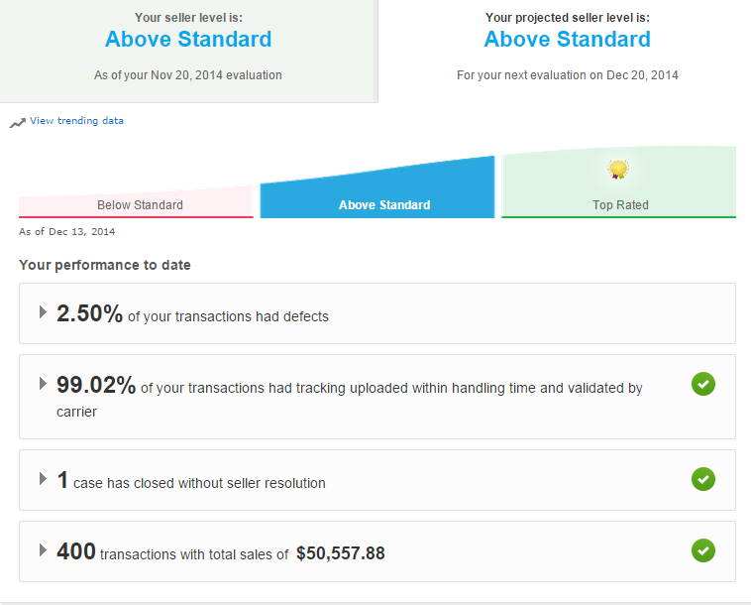
#2
Covet Top Rated + Status
Active for 90 days
100 transactions and $1,000 in last 12 mo
Defects <2%
14-day returns
1-day handling

Slide 21
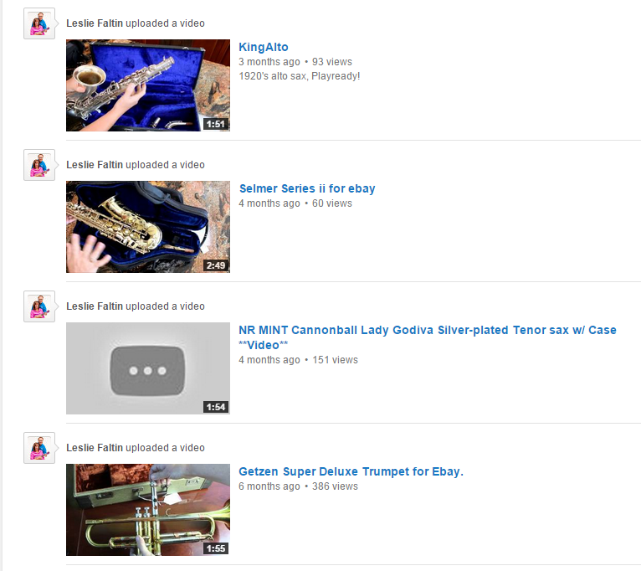
#1
Thou shalt include videos
Detailed videos give customers confidence
Go through the whole horn … show the good and the bad
Then upload that video to youtube.com
  Be sure to tag them!

Slide 22
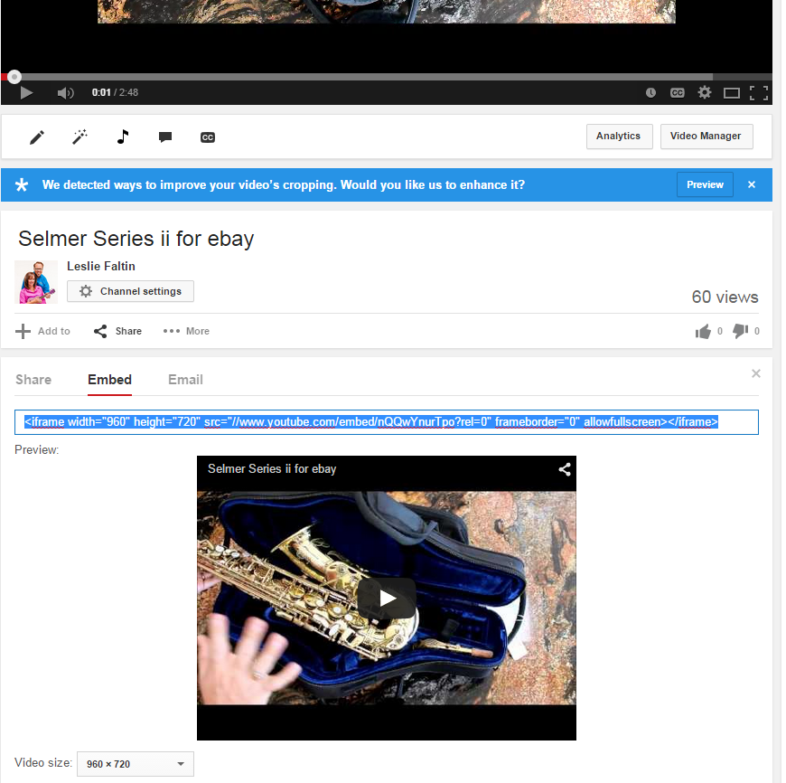
#1
Thou shalt include videos
From the video’s page, click Share
Click Embed
Choose the video size and copy that link

Slide 23
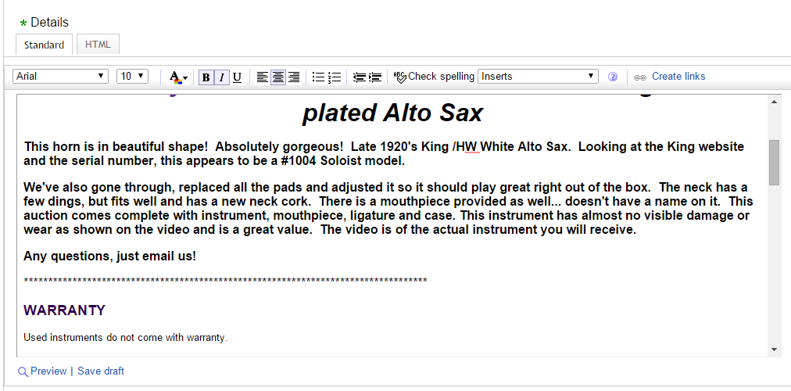
#1
Thou shalt include videos
Head back to eBay…
In the Details Section Include a line of *****
Then click HTML

Slide 24
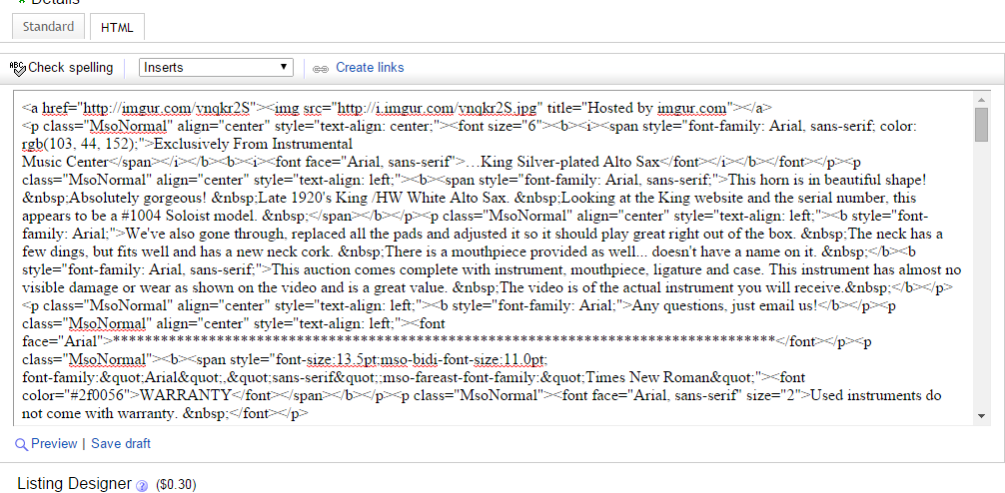
#1
Thou shalt include videos
Paste your embedded link between >< right after your line of **

Slide 25
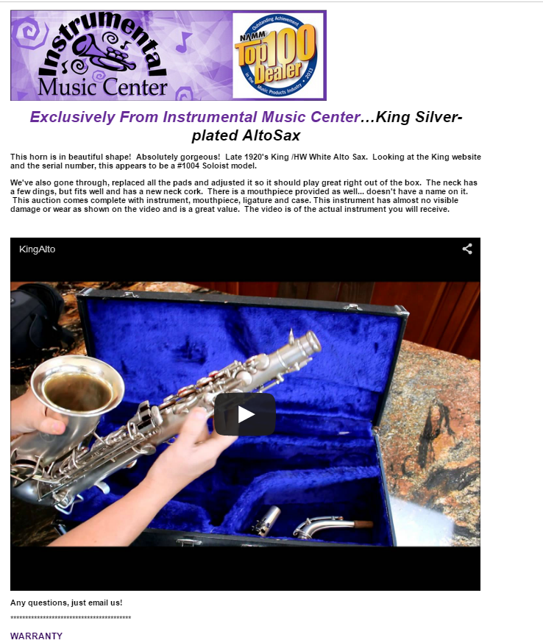

#1
Thou shalt include videos

Slide 26


Slide 27

#10
Thou shalt remember where you stand
  They will own the “buy box”
They encourage consumers to use your store as their showroom
They are your competitor, and they see our stores as such

Slide 28
#9
Thou shalt market yourself
Insert marketing material, coupons, etc. to encourage customers to shop at your store directly
Get a call/email with questions?
  We do what we can to book that sale directly

Slide 29
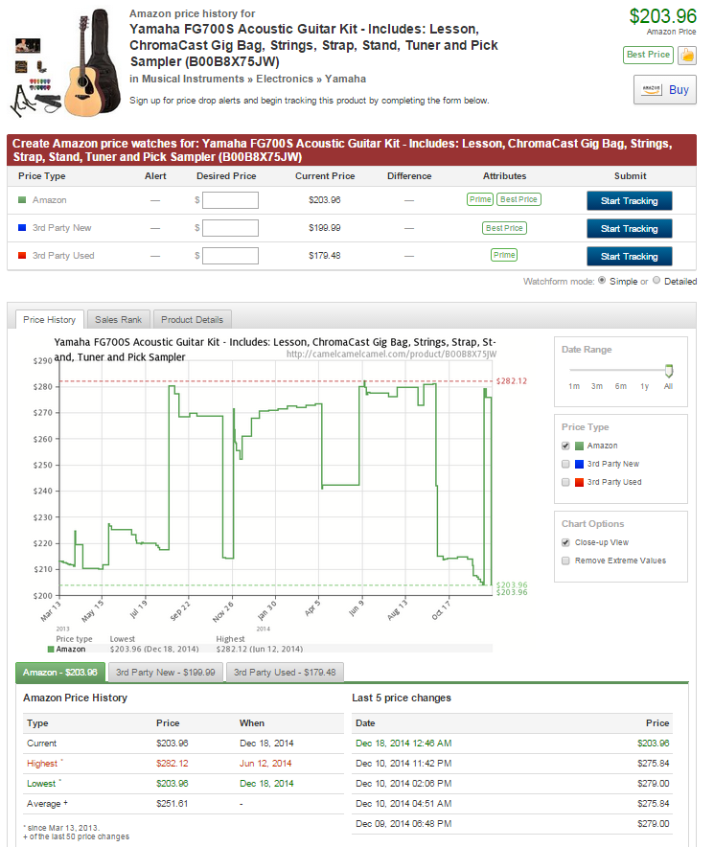
#8
Know thy market
Camel Camel Camel.com
Free Amazon price checker
Shows historical price data
Terapeak
Allows competitor research
  Great way to see what is working for other strong music retailers

Slide 30
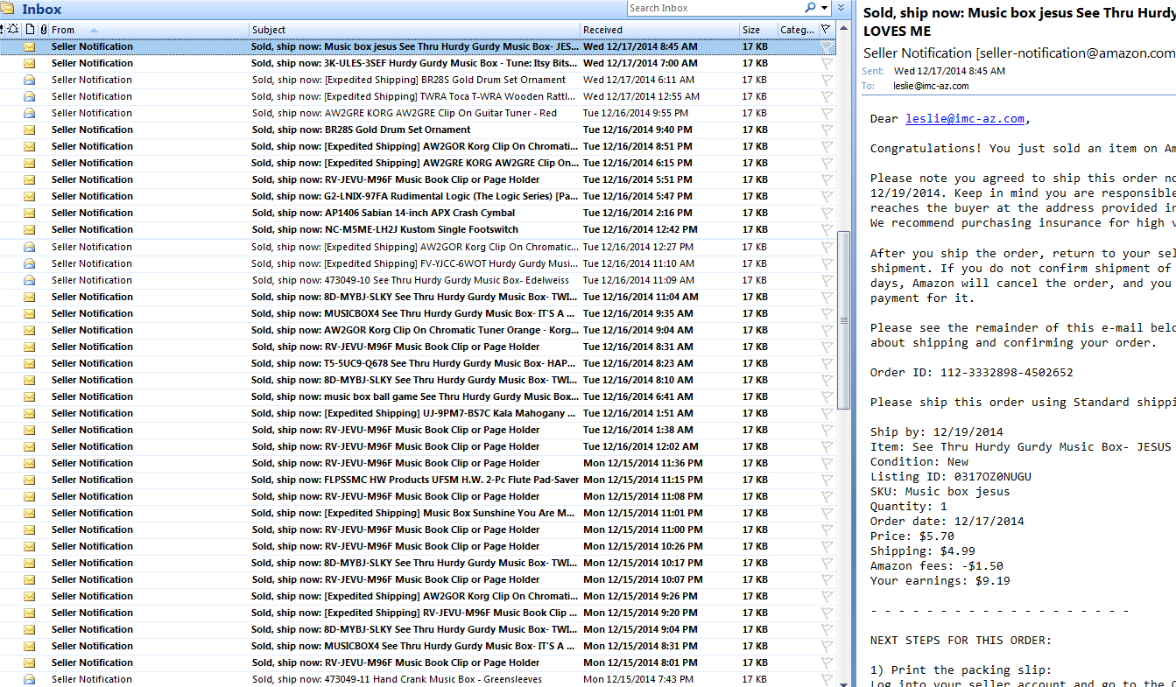
#8
Know thy market
There are tons of customers there if you can find a money-making niche
Customers looking for ease, perceived bargains or lack of interaction
  They check their brain at the home page and assume they are getting the best price possible.
Can be operated by one staffer or a team … get as big as you want.
New products/commodity stuff is best on this platform.
  New issue print music that isn’t going to work in-store

Slide 31
#7
There will be problems
The wrong thing will get sent to the wrong person
People will claim they never got it
Product will be returned damaged, and they said they got it that way
Customers will threaten lawsuits because you ran out of stock
Lack of empathy from customers. Be prepared to deal with the unexpected
In general, there is a lot less fraud in Amazon payments than eBay

Slide 32
#6
Choose thy plan wisely
Individual sellers
  $.99 per sale
  Cannot offer free shipping
  Cannot edit or create listings
Professional sellers
  $39.99/mo
  Can offer free shipping

Slide 33
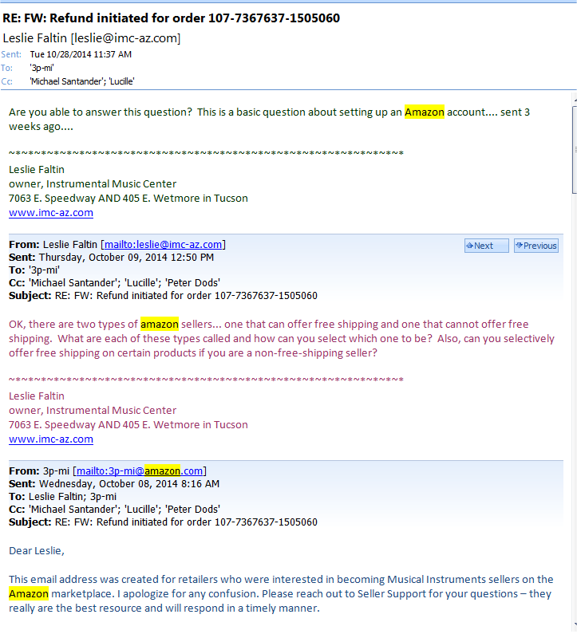
#5
Prepare to be frustrated
Customer service is hit and miss … try calling a few times to get the answer you want
FBA returns take 45 days to resolve
Arbitrary deductions from account for “defects” without your knowledge or approval
  They can be successfully challenged

Slide 34
#4
Covet thy margins
We sell many low-dollar items and make more on shipping than the item itself
In my opinion, if IMC is making less than Amazon, it’s not worth listing on the site
Not all of you store’s products will work on this platform

Slide 35
#3
FBA Blessings and not so much
Good news…
Offers people “Prime” shipping
Often earns that buy box … even if yours is more expensive
Bad news…
Fees for storage, fees for administering
If you don’t choose correctly, your serial number could be sold under another seller’s name
Returns are whack

Slide 36
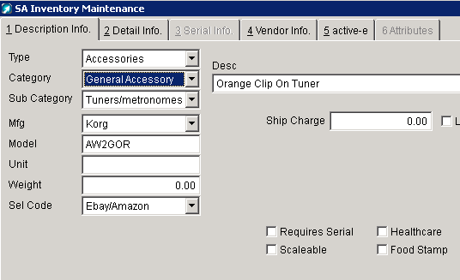
#2
Forsake not your inventory
If your POS is not hooked to Amazon/eBay, you could run out of something in-store and still have it listed online.
Aimsi
  Selection Code and consistently run reports of sold product for items listed online

Slide 37
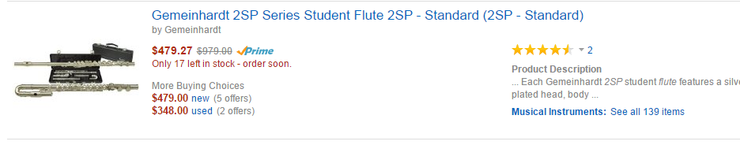
#1
Beware of the crowd-sourced listing
Wrong images are often uploaded by customers or another seller
  Getting them changed/corrected is next to impossible
Many important details in existing listing are incorrect
  Can lead to returns … even if you did everything to communicate

Slide 38
Move your stuff on an easily controlled platform.
TONS of volume, when you find your niche.

