Slide 1
Essential Tips for a Successful YouTube Channel
Chrissy Hansen, Chicago Music Exchange

Slide 2
youtube.com/chicagomusicexchange
2 YEARS
30K subscribers to 125K subscribers
600 videos
32 million views

Slide 3
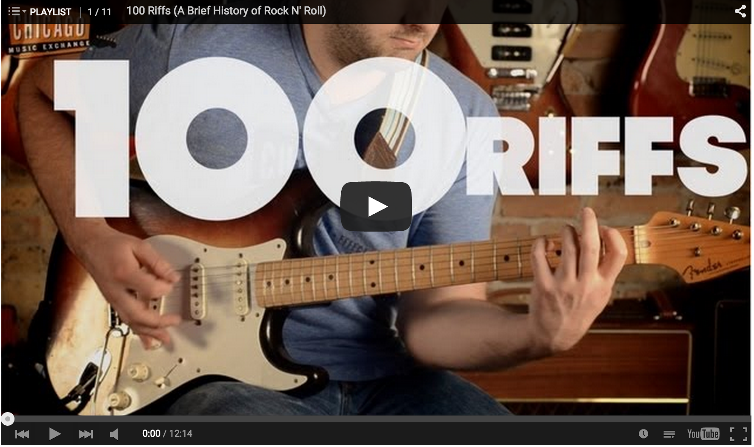
100 Riffs: A Brief History of Rock’N’Roll
14 million views

Slide 4
The elusive viral video…is NOT the answer.
100 Riffs: 14 million views
Total Channel: 32 million views
2012: $3.5M
2014: $20M

Slide 5
HAVE a purpose
Drive sales
Entertain
Build your brand
Educate
Monetize with ads

Slide 6
USE your Assets
Talented players
Access to artists
Good storytellers
Voiceover talent
Experts
Unique space
Humor…are you SURE?

Slide 7
What You’ll need
Camera equipment
Lighting
Set / backdrop
Script
Editing software
Ideally, a videographer
Notes:
Importance of scripting
Editing software – Final Cut or iMovie
Importance of editing

Slide 8
The Power of Collaboration
Supplement your shortcomings
Build relationships
Create brand ambassadors

Slide 9
Know when to say “No”
Realize cost vs. benefit
Defend your resources
Protect integrity of your brand

Slide 10
Be ready for the trolls
Sometimes ignore
Sometimes react
Don’t censor (except in extreme cases)
Reward good behavior
Pay attention to consensus

Slide 11
It starts with one video
Make a video
Keep making videos
Create a video schedule
Promote your videos
Integrate video into every part of your business
Look back in 6 months and realize you have a YouTube Channel

Slide 12
