Slide 1


Slide 2

How to Cover All Your Bases on Google
Donovan Bankhead, Springfield Music, Inc.

Slide 3

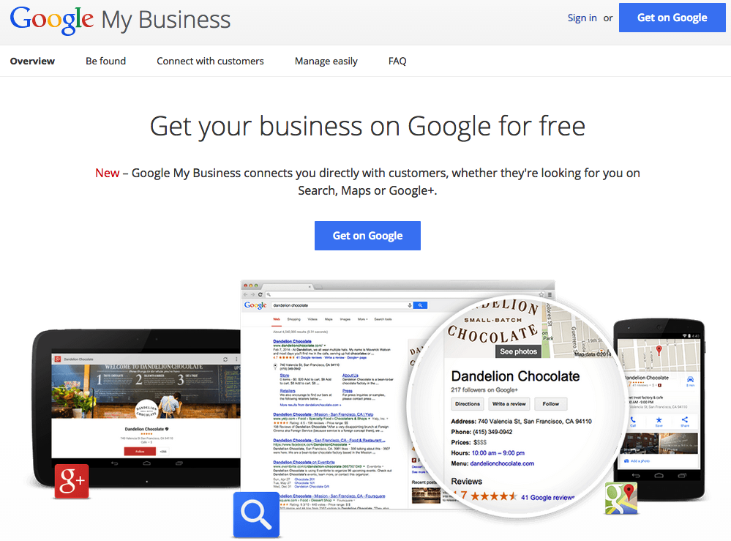
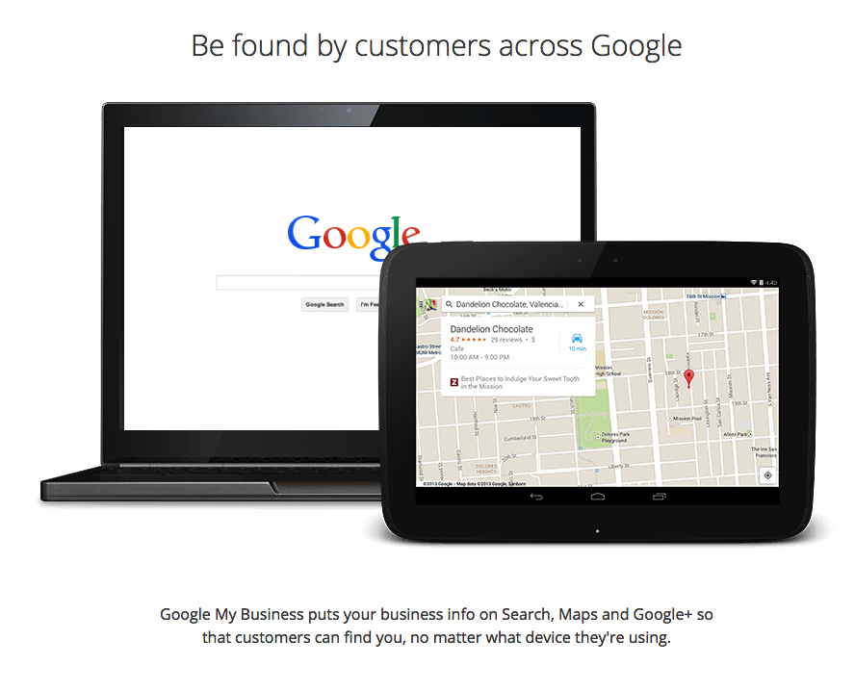
First Things First:
www.google.com/business

Slide 4
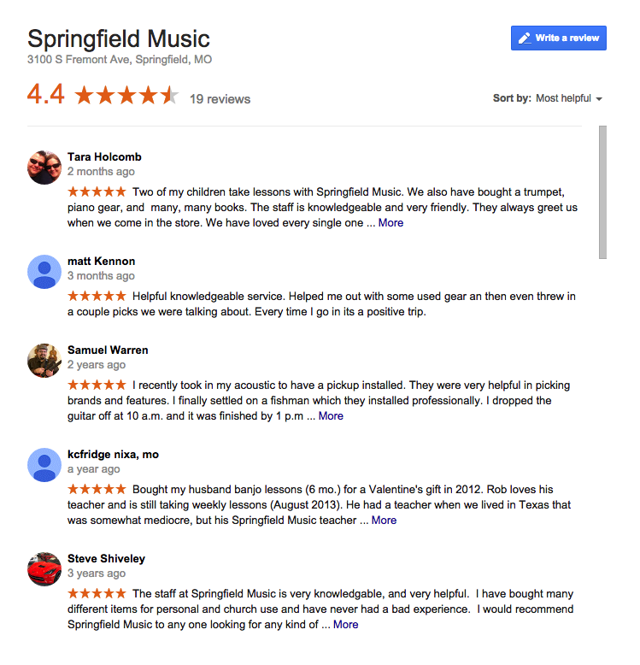
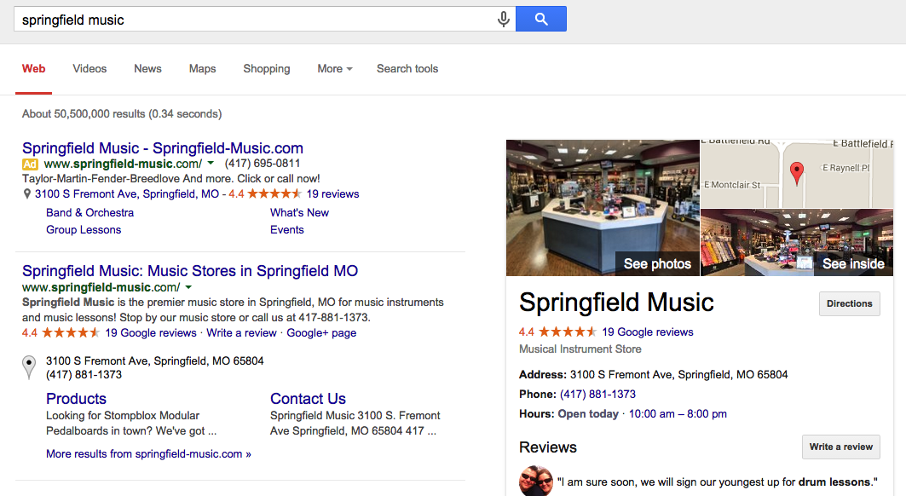
Read Reviews,
Respond Positively (if necessary),
Ask for more!

Slide 5

When Organic Search
Isn’t Enough:
http://www.google.com/adwords/express/

Slide 6


Slide 7
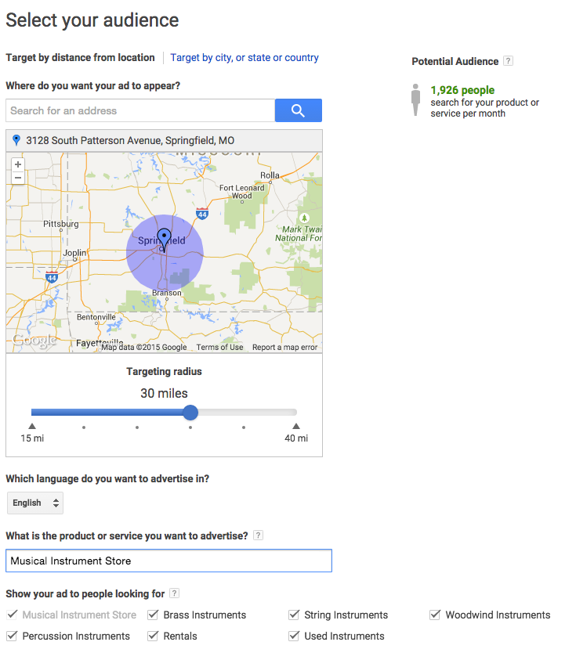

Slide 8
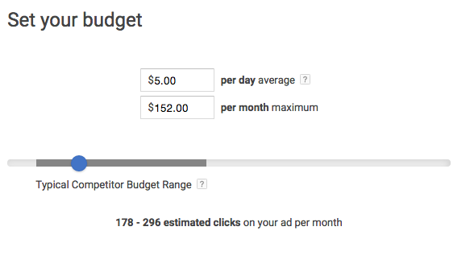

Slide 9
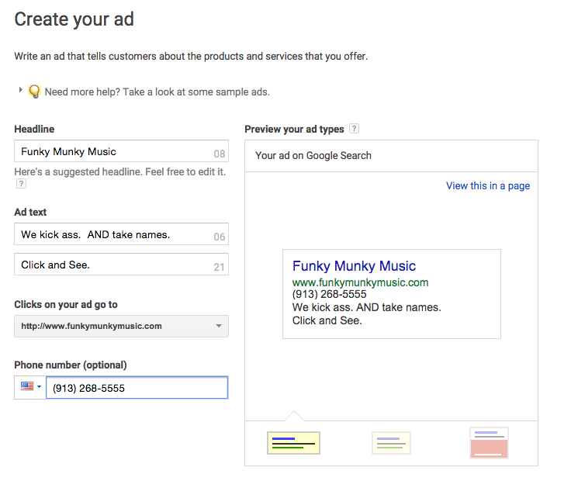

Slide 10
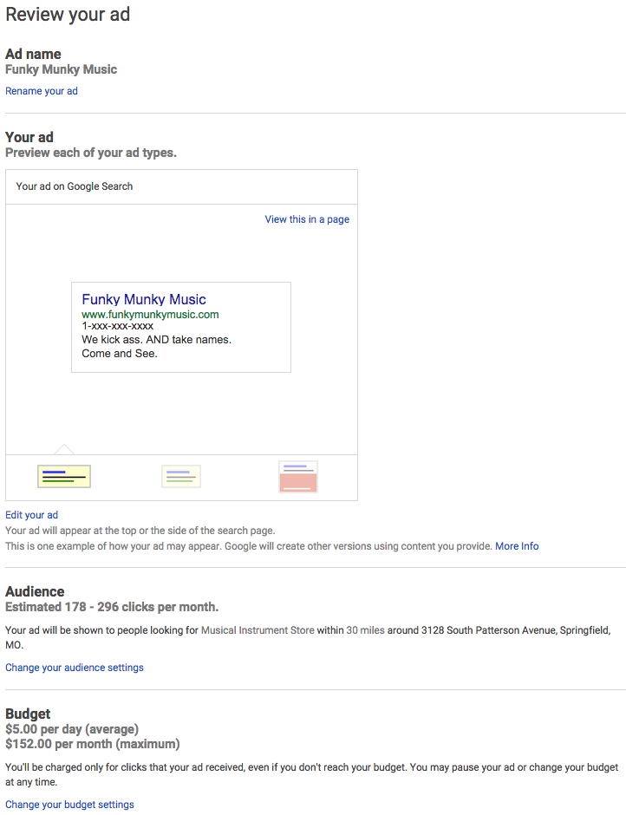

Slide 11

Search Engine Optimization (SEO)
Notes:
This has gotten much harder to do, and the manipulations don’t work as well.

Slide 12

4 Tips for (SEO)
Have great content (don’t suck)

Slide 13

2. Choose your keywords wisely.
The words or phrases that you use in your content must match those that your customers search for...

Slide 14

3. Make sure your site is easy to use
Notes:
Google knows people like visiting easy-to-use pages over hard-to-use pages.

Slide 15

4. Social Media is
the Internet

Slide 16

For More On This:
http://blog.capterra.com/improve-your-seo-rankings-beginners/

Slide 17
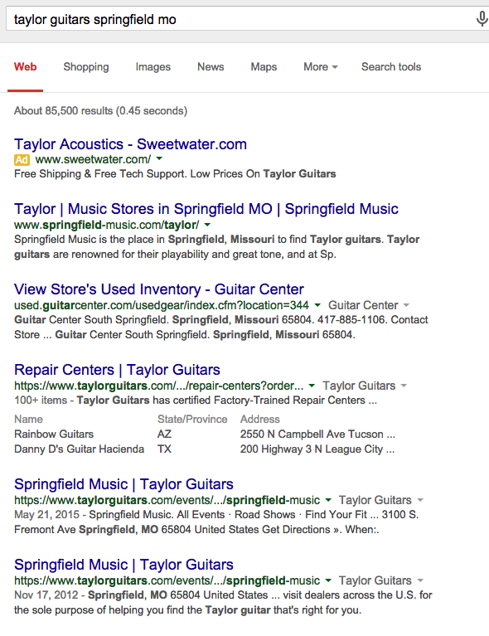
Quick Check:
Select Private Browsing, or Incognito Model on your browser.
Search for your desired keyword to see how you rank...

Slide 18

Not so quick check...
http://www.google.com/analytics
Notes:
It’s likely that whoever developed your site has already set this up - so check with them to be sure.
If you are maintaining your site yourself, then you can likely figure it out.

Slide 19
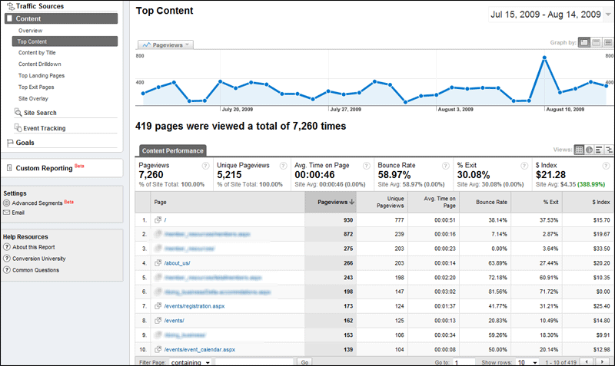

Slide 20

Might be worth hiring a pro to analyze your current site.
Expect to pay $200 - $1,000 for this...

Slide 21


