Slide 1


Course Title
Create Your Own
Woodstock
In Your Store
Pete Gamber

Slide 2


Slide 3
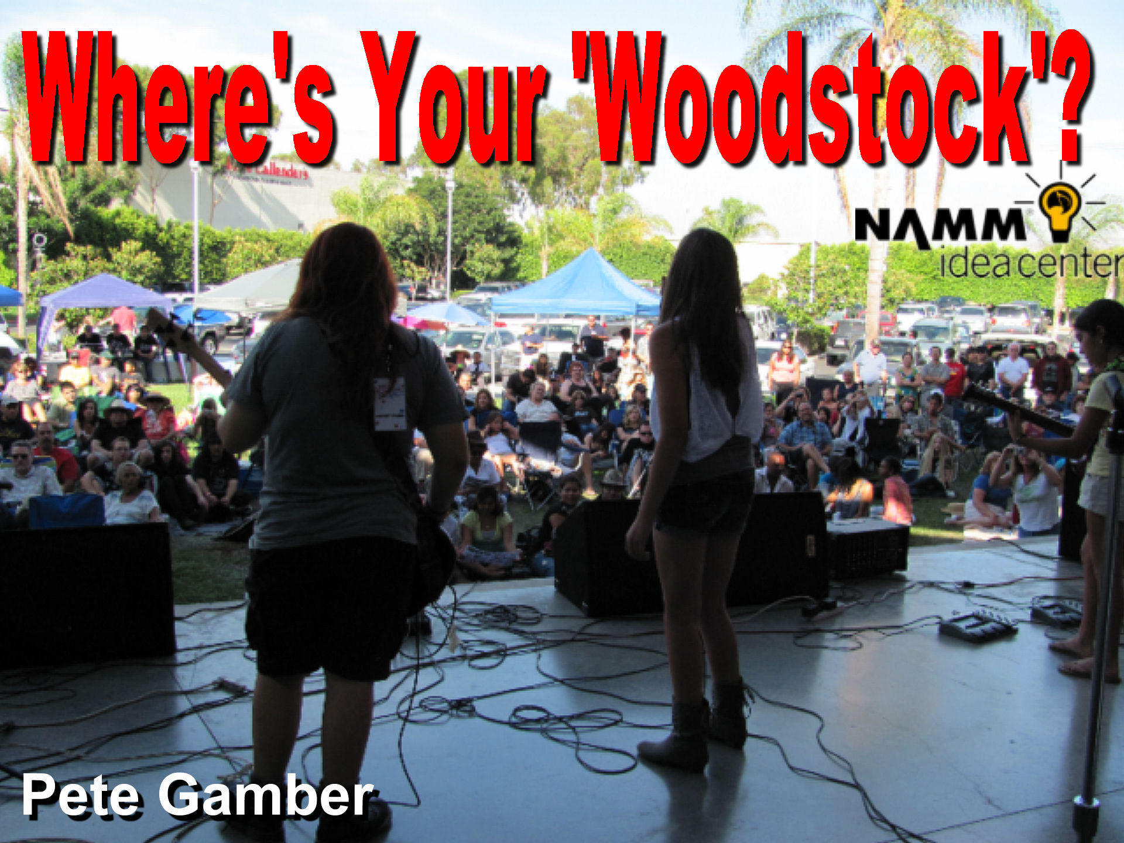

Slide 4


Slide 5
