Slide 1


Wave A Wand and Make My Problems Disappear
Presented By
Alan M. Friedman & Daniel Jobe
Friedman, Kannenberg & Company, P.C.

Slide 2


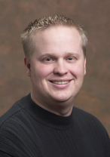
Deep Thoughts
by Sigmund Friedman
Aha Moments
by Daniel Freud

Slide 3

Repression
CASE STUDY 1

Slide 4
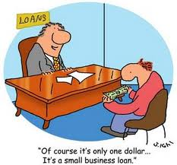
Banking
Be prepared with docs
Advocate
Be Real

Slide 5
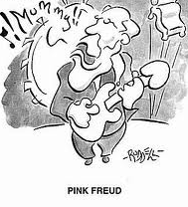
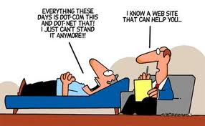
Case Study 2 Psychoanalysis

Slide 6
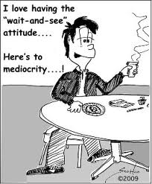
Be Proactive. Not Reactive
Get Automated
Reconcile Bank Accounts Monthly
Have Meetings to Review Performance

Slide 7

Dream Interpretation
Case Study 3

Slide 8

Succession Planning
Have a Plan
Delegate & Teach
Know your business value

Slide 9

Need Help?
Contact Jen outside the Idea Center entrance
after this session to set up a meeting time
www.fkco.com

