Slide 1
Make More Money With Your iPad
Joe Dorsey

Slide 2
POS Super Tool
Hardware
Software
Imagination

Slide 3
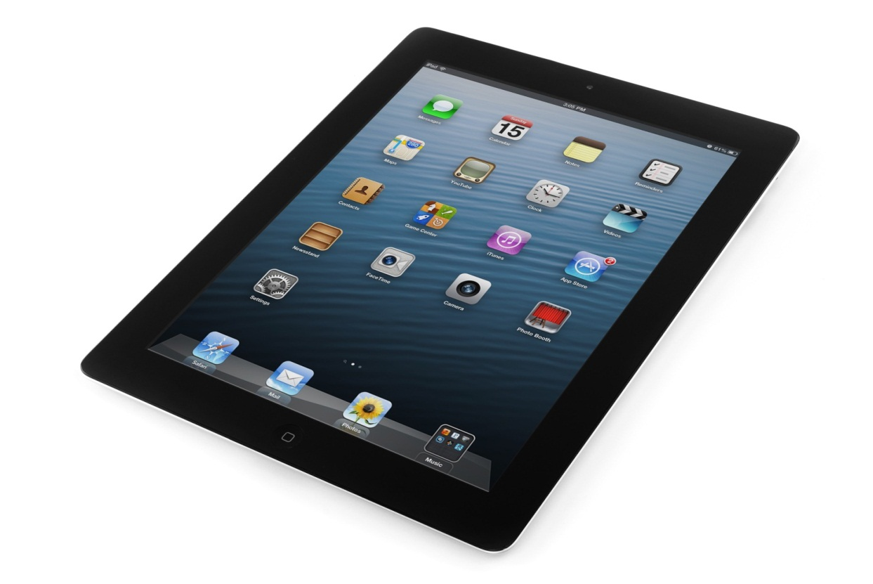
Hardware
iPad

Slide 4
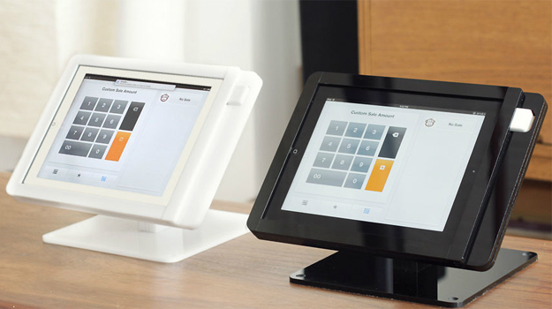
Hardware
iPad
Stand

Slide 5
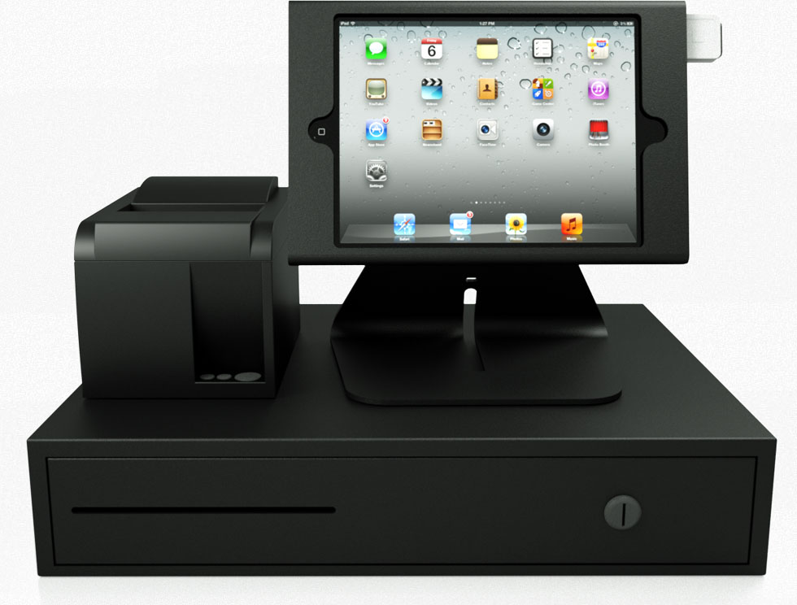
Hardware
iPad
Stand
POS

Slide 6
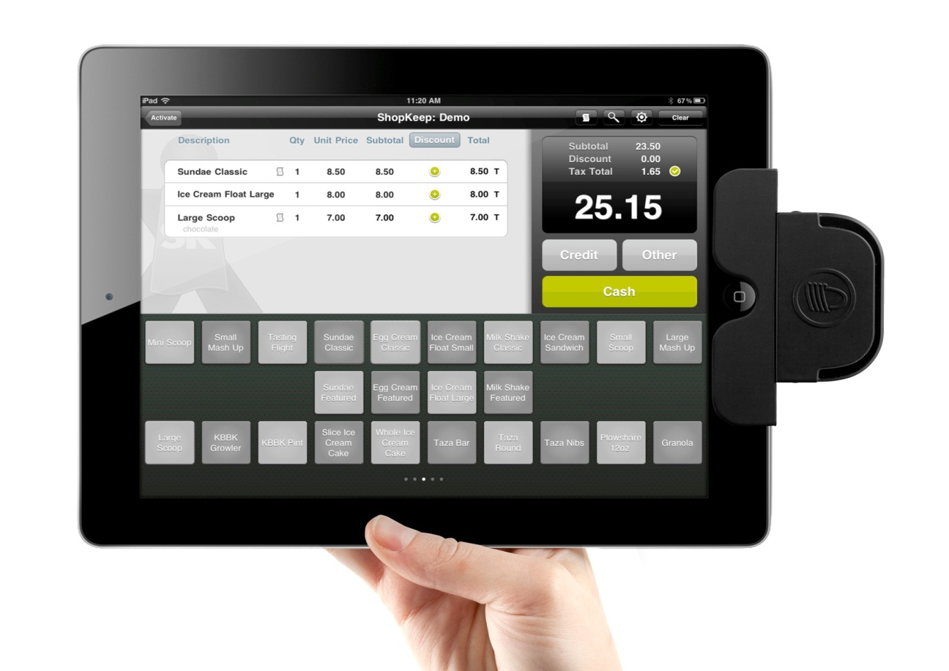
Hardware
iPad
Stand
POS
Reader

Slide 7
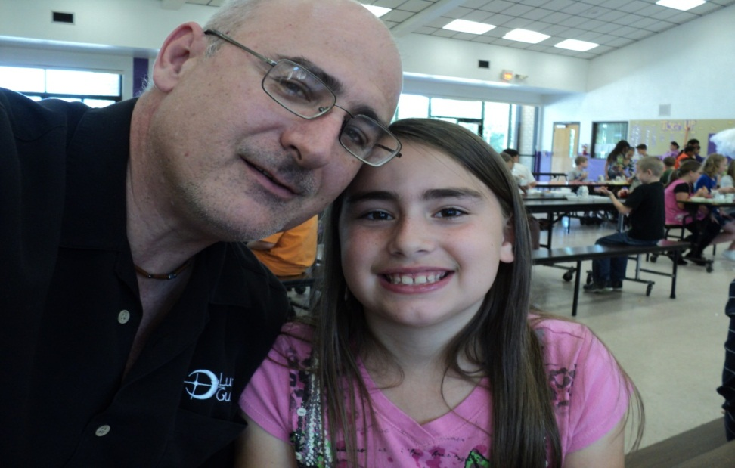
Software
Dad, they have an App for that

Slide 8
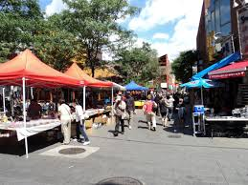
How to increase sales
Go Mobile

Slide 9
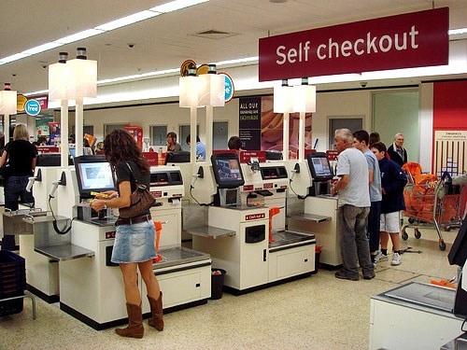
How to increase sales
Self Checkout

Slide 10
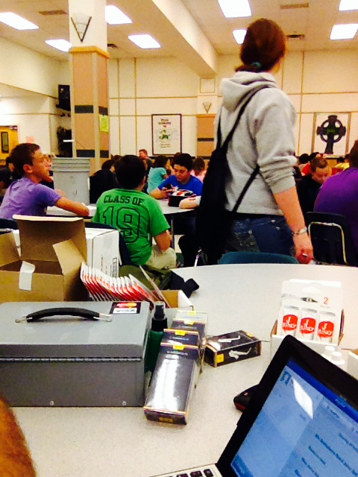
How to increase sales
Band Camp

Slide 11
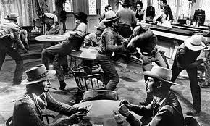
How to increase sales
Rental Night

Slide 12
Things to Remember
The Dog Effect
Speed
Size
Control
W-2

