Slide 1


Slide 2
Make Your Marketing Relevant for 2015
A Simple Set Of Tested Tools For Success In Growing Your Brand Image & Bottom Line

Slide 3

Problem 1: Fragmented Brand Image

Slide 4
Problem 1: Fragmented Brand Image

Slide 5

Problem 1: Fragmented Brand Image

Slide 6

Problem 1: Fragmented Brand Image

Slide 7

Problem 1: Fragmented Brand Image

Slide 8
Problem 2: Inconsistent Brand Messaging Across Sales Platforms

Slide 9
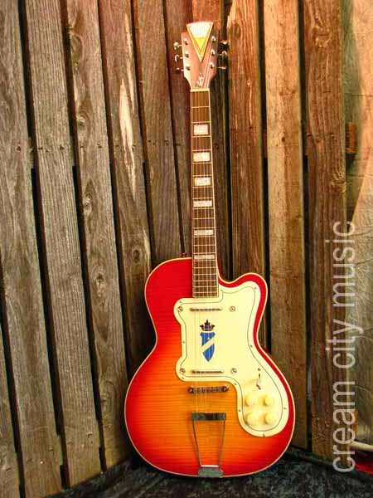
Problem 2: Inconsistent Brand Messaging Across Sales Platforms

Slide 10
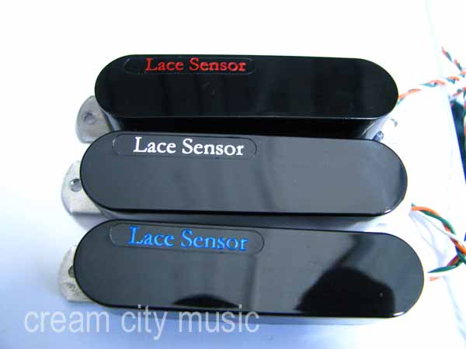
Problem 2: Inconsistent Brand Messaging Across Sales Platforms

Slide 11
Problem 2: Inconsistent Brand Messaging Across Sales Platforms

Slide 12
Problem 2: Inconsistent Brand Messaging Across Sales Platforms

Slide 13
Problem 2: Inconsistent Brand Messaging Across Sales Platforms

Slide 14
Problem 3: A Disjointed Perception Among Our Retail Customers About Who Cream City Music Is As A Business

Slide 15
The Question: How Can We Make Our Marketing Relevant To Address These Issues And Drive Growth & Profitability?

Slide 16
Step 1: Ask who and what my store is to my customers, my staff, and myself.

Slide 17
Step 1: Ask who and what my store is to my customers, my staff, and myself.
Step 2: Hire a professional graphic designer

Slide 18
Step 1: Ask who and what my store is to my customers, my staff, and myself.
Step 2: Hire a professional graphic designer
Step 3: Choose your store’s marketing voice

Slide 19
Step 1: Ask who and what my store is to my customers, my staff, and myself.
Step 2: Hire a professional graphic designer
Step 3: Choose your store’s marketing voice
Step 4: Commit to your chosen marketing channels

Slide 20
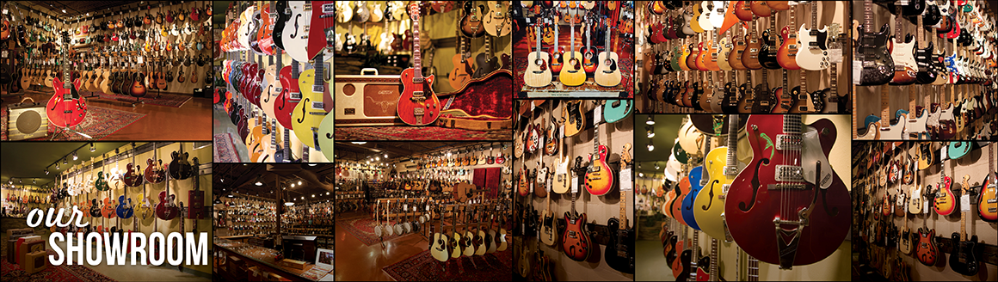
The Results: A Business Defined

Slide 21
The Results: Consistent Brand Identity

Slide 22
The Results: Consistent Brand Identity

Slide 23

The Results: Consistent Brand Identity

Slide 24
The Results: A Consistent ‘Voice’ Through Imagery In Sales Platforms

Slide 25
The Results: A Consistent ‘Voice’ Through Imagery In Sales Platforms

Slide 26
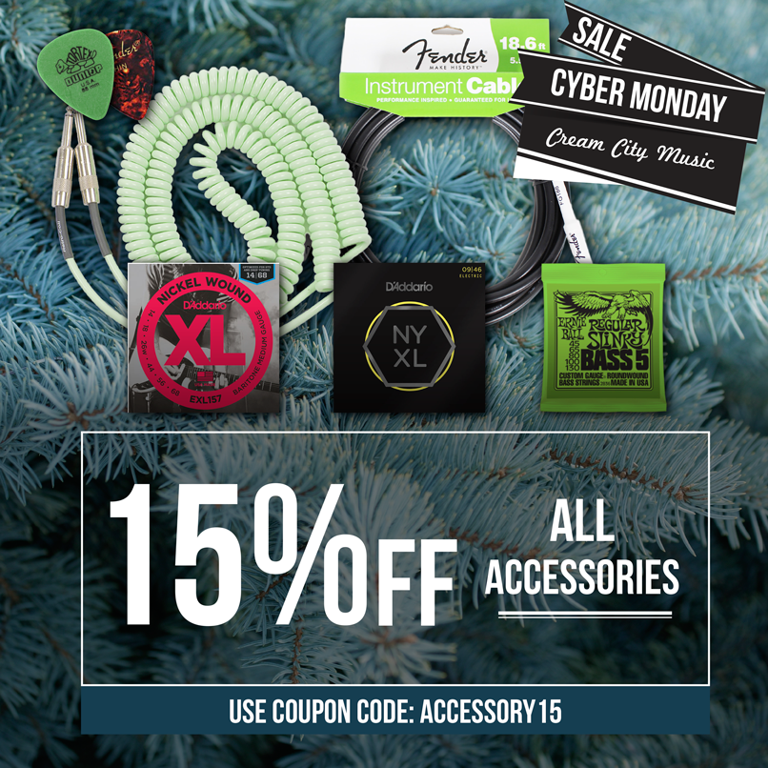
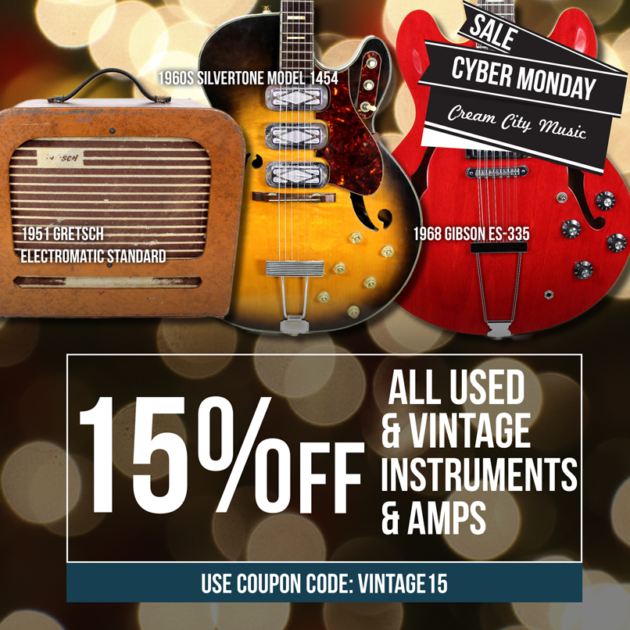
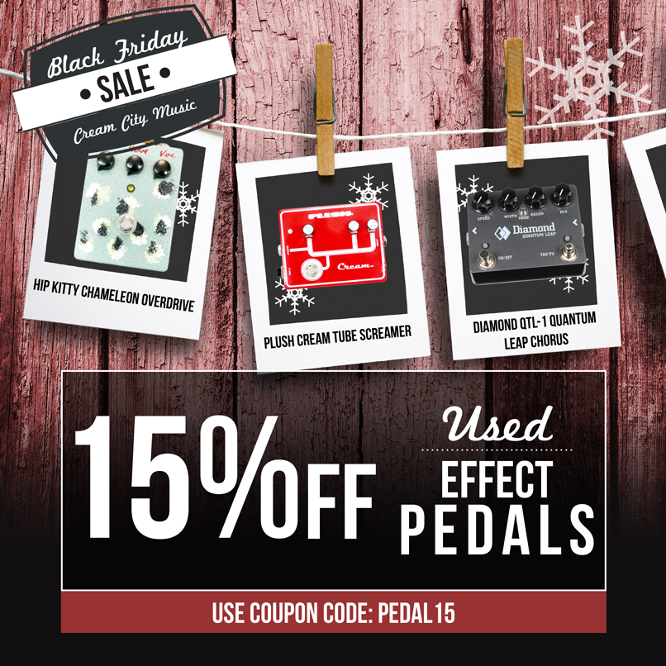
The Results: A Loyal Following Derived From Your Chosen Marketing Channels

Slide 27
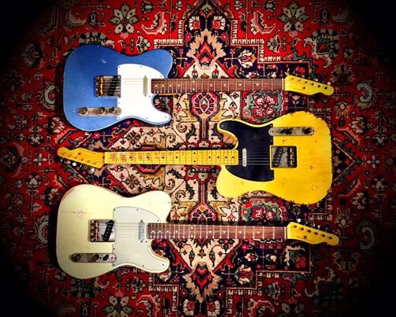
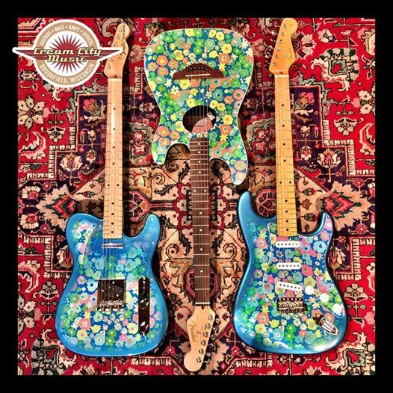

The Results: A Loyal Following Derived From Your Chosen Marketing Channels

Slide 28
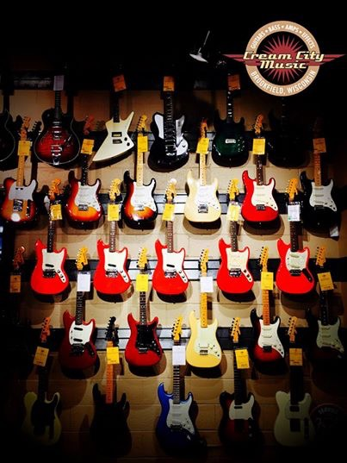
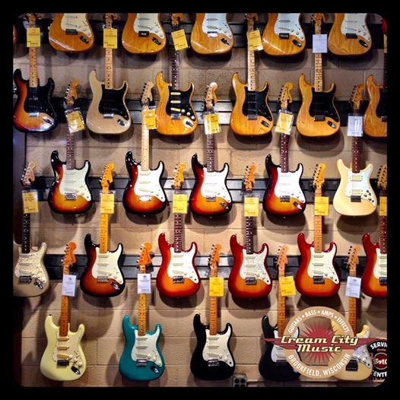
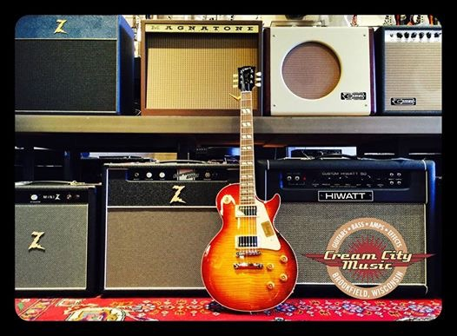
The Results: A Loyal Following Derived From Your Chosen Marketing Channels

Slide 29
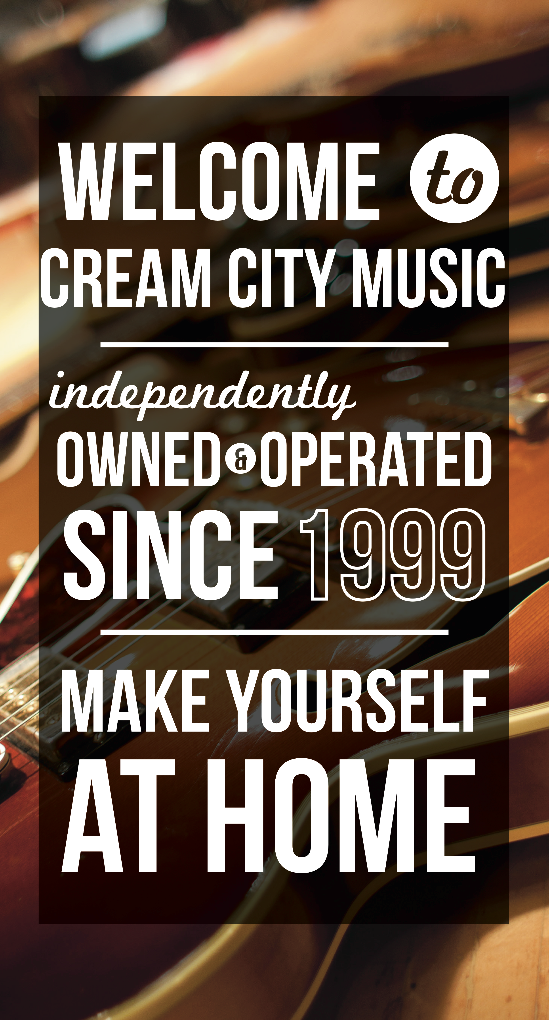

The Results: A Loyal Following Derived From Your Chosen Marketing Channels

Slide 30
The Takeaway: How Well Did It Work?

Slide 31
The Takeaway: How Well Did It Work?
1. Email list increased by over 5,000 subscribers

Slide 32
The Takeaway: How Well Did It Work?
1. Email list increased by over 5,000 subscribers
2. Social media followers increased by over 9,500

Slide 33
The Takeaway: How Well Did It Work?
1. Email list increased by over 5,000 subscribers
2. Social media followers increased by over 9,500
3. Retail sales increased by over 40%

Slide 34
The Takeaway: How Well Did It Work?
1. Email list increased by over 5000 subscribers
2. Social media followers increased by over 9500
3. Retail sales increased by over 40%
4. Website holiday sales up over 75%

Slide 35
The Takeaway: How Well Did It Work?
1. Email list increased by over 5000 subscribers
2. Social media followers increased by over 9500
3. Retail sales increased by over 40%
4. Website holiday sales up over 75%
The Total Cost: $15,000.

