Slide 1


Slide 2
Create a Successful Year-Round Promotions Calendar
Very rarely traffic flow is where we like it to be…sometimes at Back to School time and just before Christmas…we like it to look like this…

Slide 3
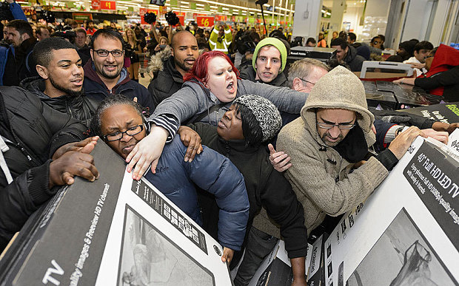

Slide 4
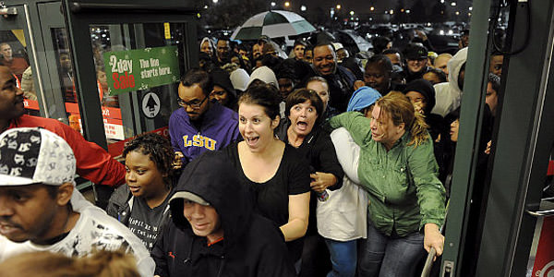

Slide 5
Create a Successful Year-Round Promotions Calendar
Unfortunately, the rest of the year can look and sound like this…..

Slide 6
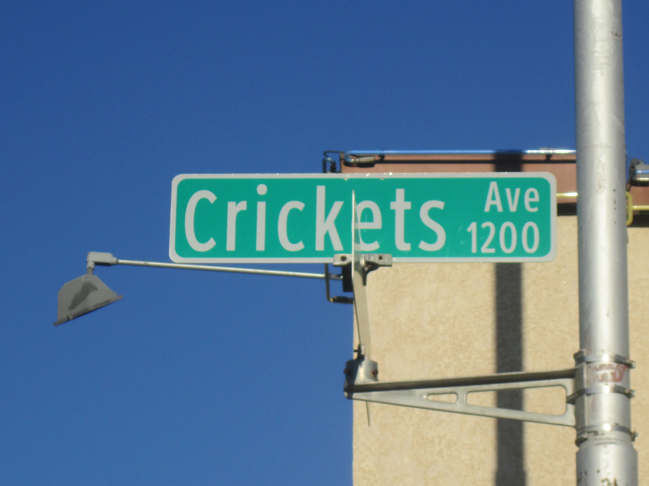


Slide 7
So the goal is simple yet elusive…
KEEP CASH FLOW BALANCED YEAR ROUND!

Slide 8
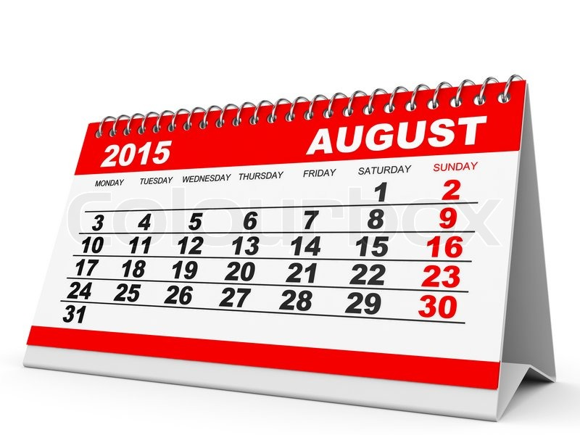

Slide 9
Summer Student Showcase
Closest Sunday to August 15th
Date picked months in advance with signs up all over the store
Late enough in the summer to give students a great reason to continue taking lessons but not so late where it interferes with back to school
Also gives a great reason for kids thinking of signing up for summer lessons to join.

Slide 10
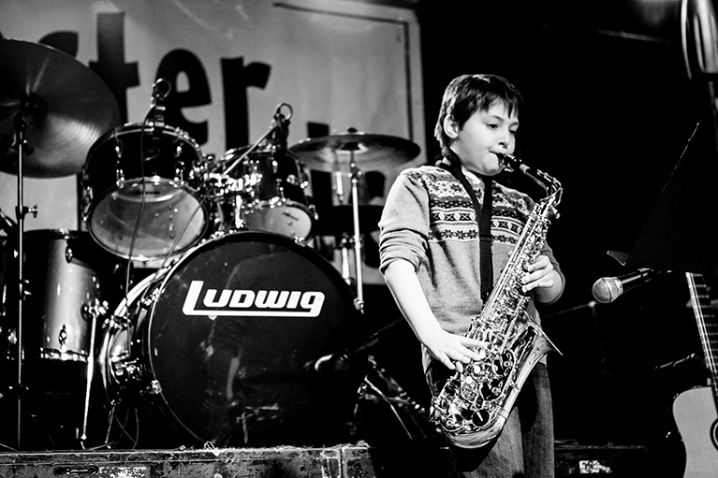
MONSTER SUMMER SHOWCASE

Slide 11
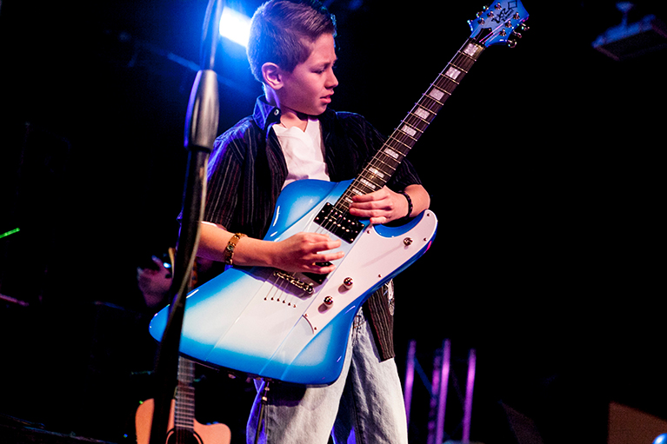
MONSTER SUMMER SHOWCASE

Slide 12
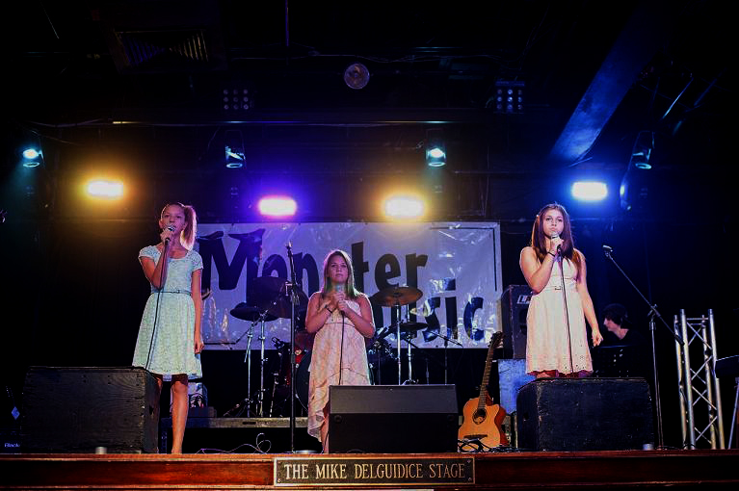
MONSTER SUMMER SHOWCASE

Slide 13
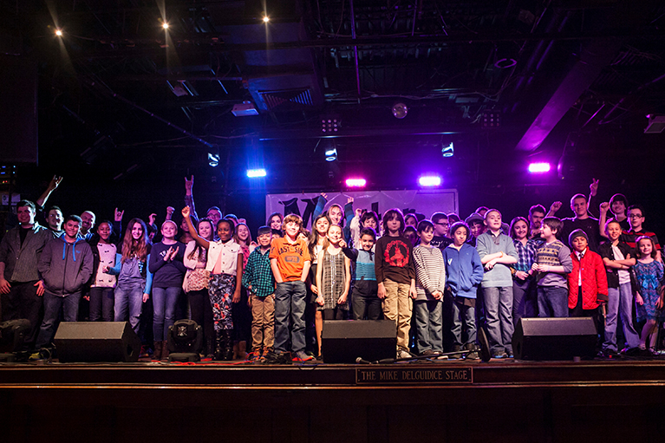
MONSTER SUMMER SHOWCASE

Slide 14
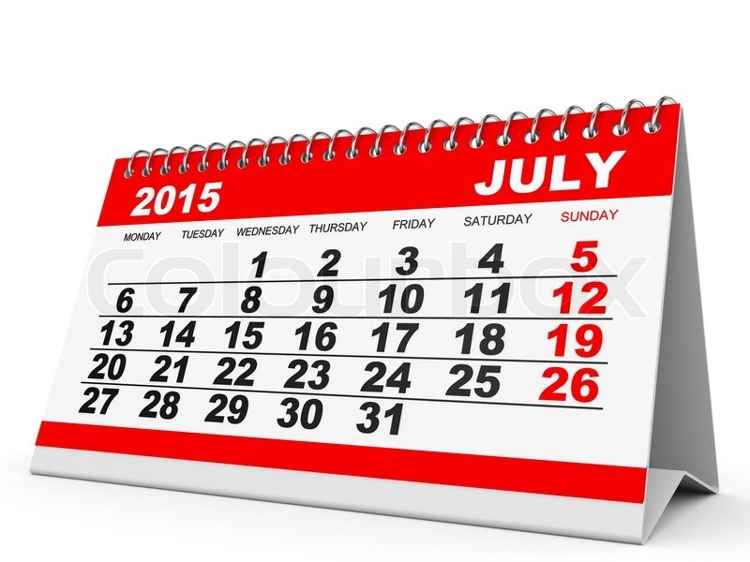

Slide 15


Slide 16


Slide 17
Inexpensive to Put On:
 | Cost
Local pro to do a 30 min set | $100
Mai Tai Bar | $50
Hawaiian Pizza | $50
Teacher to Conduct Group Lesson | $50
Total Cost | $250

Slide 18
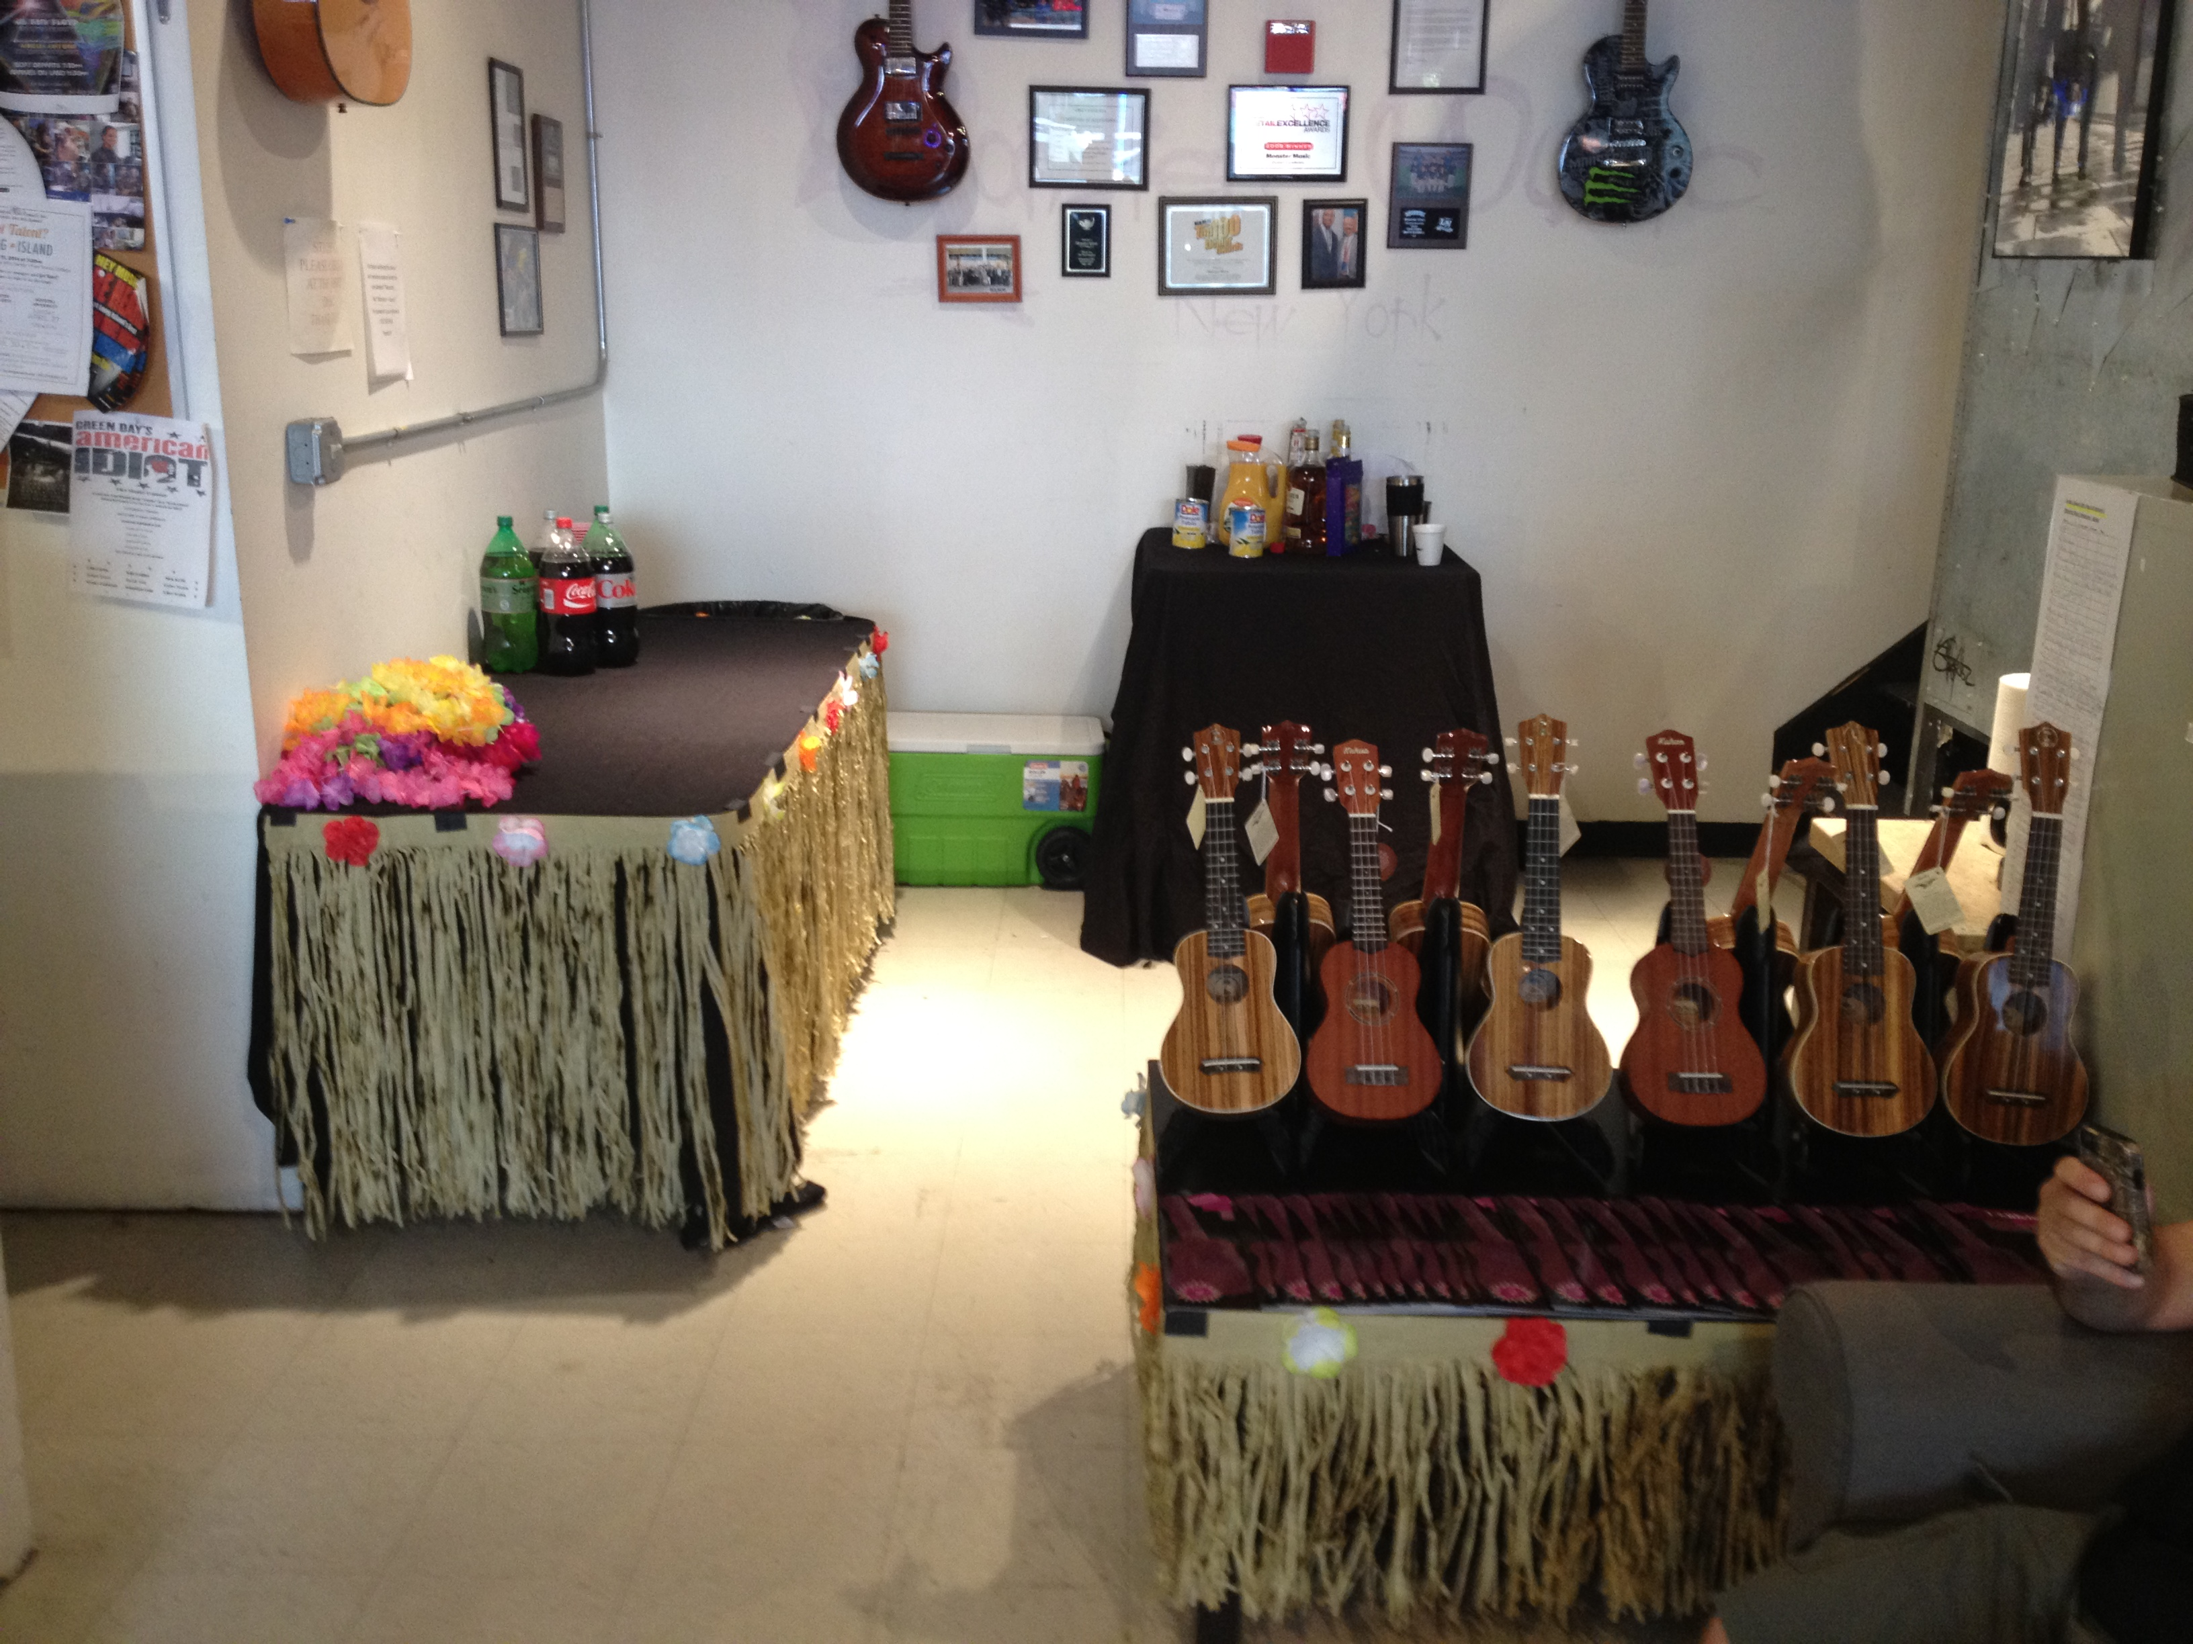
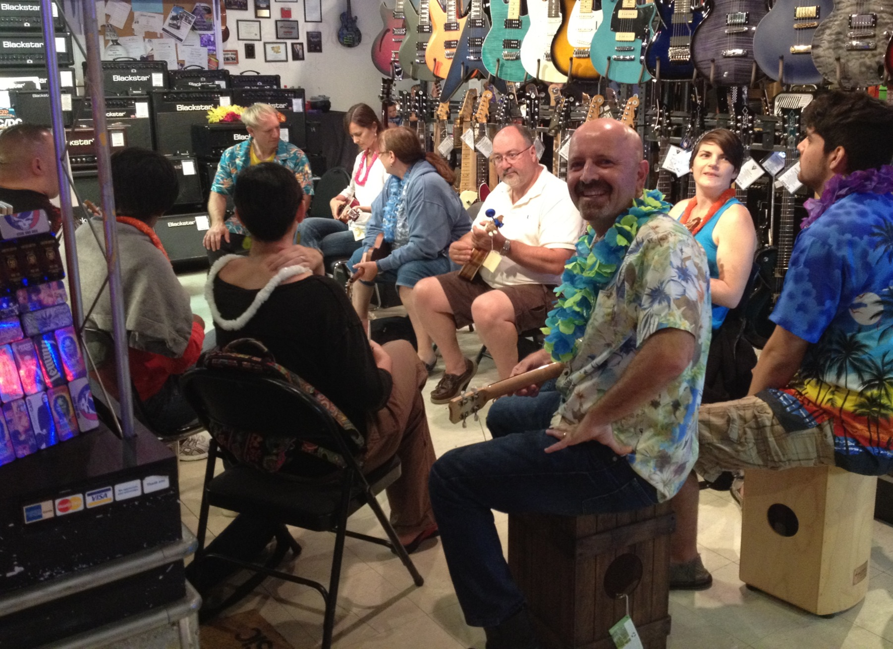
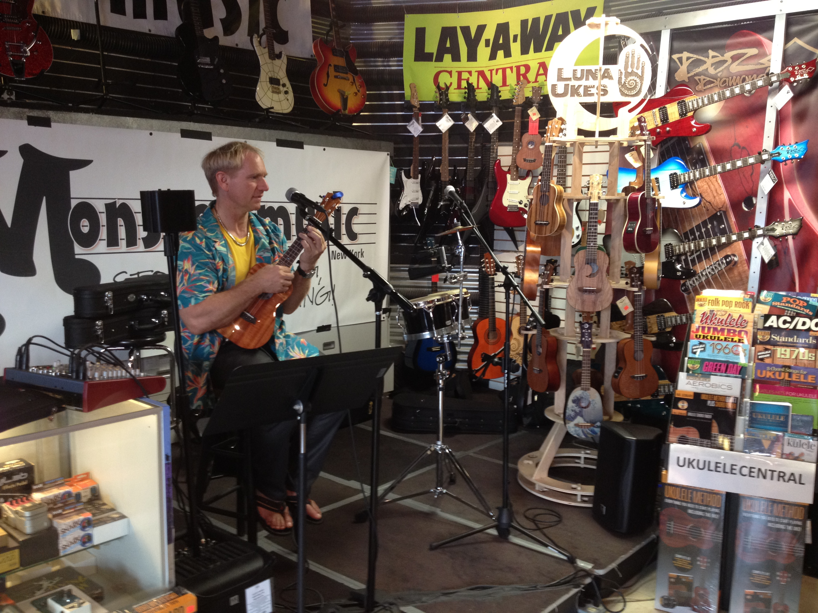
Last Year Uke Luau

Slide 19
Pics from Open Mic Night

Slide 20
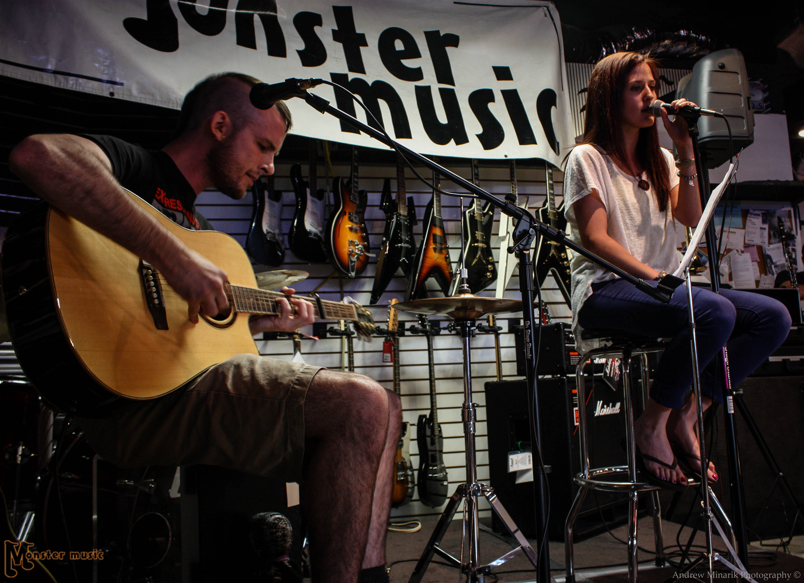

Slide 21
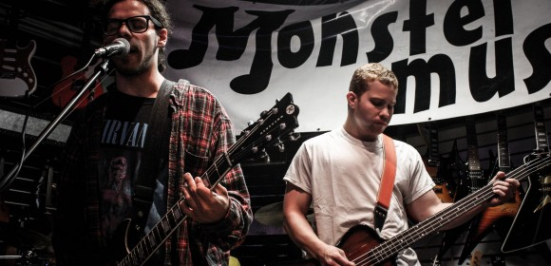

Slide 22
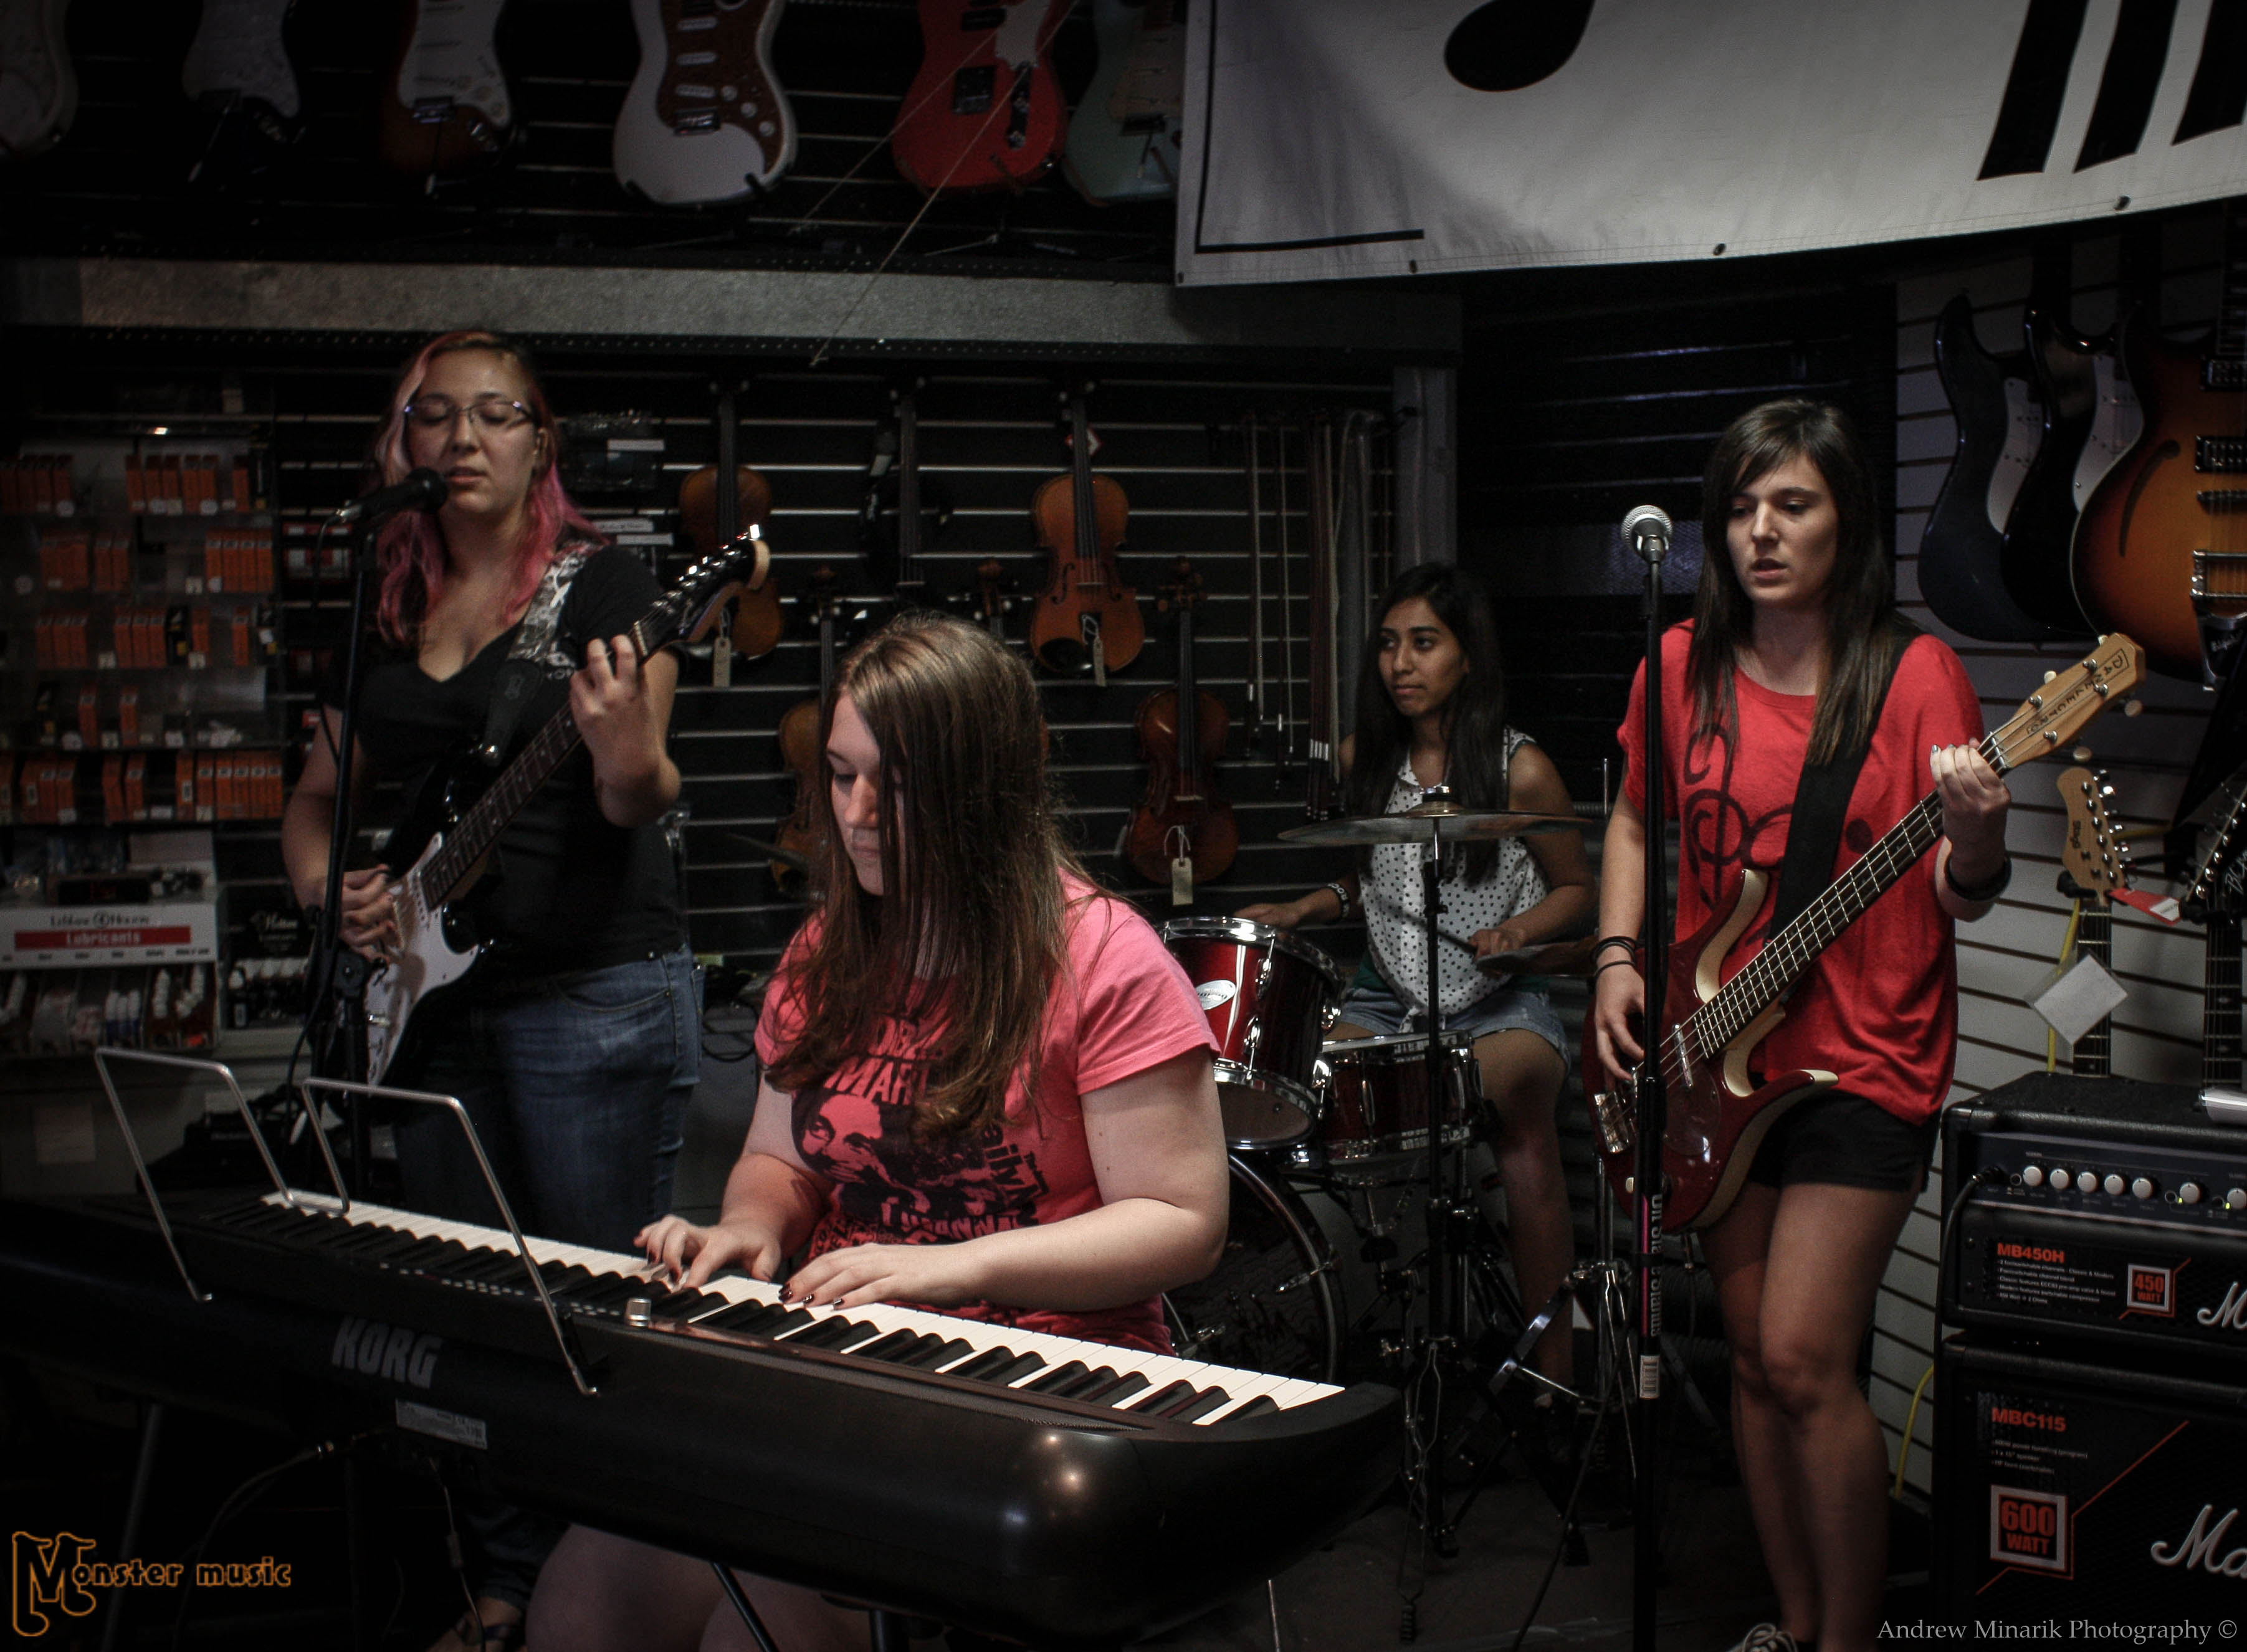

Slide 23
Other Successful July Events We Run:
Open Mic Night
Songwriter’s Workshop
Free Restring Event
Principle: Sometimes, we need to be creating our own excitement

Slide 24
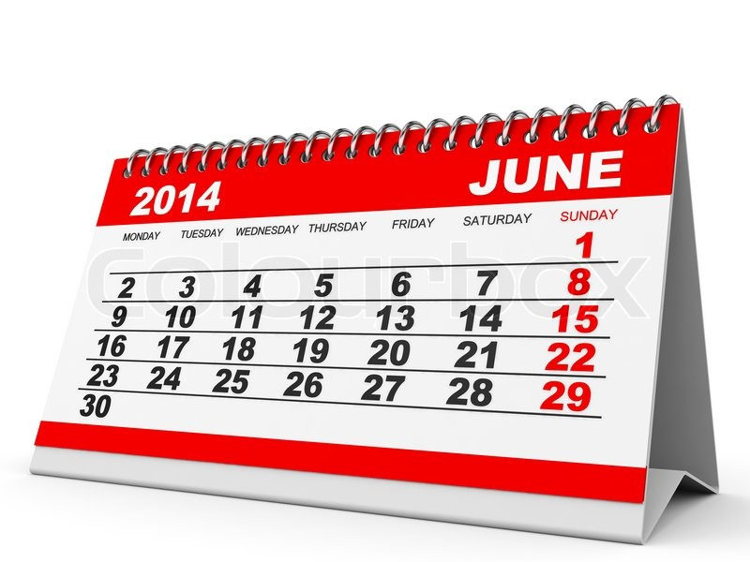

Slide 25
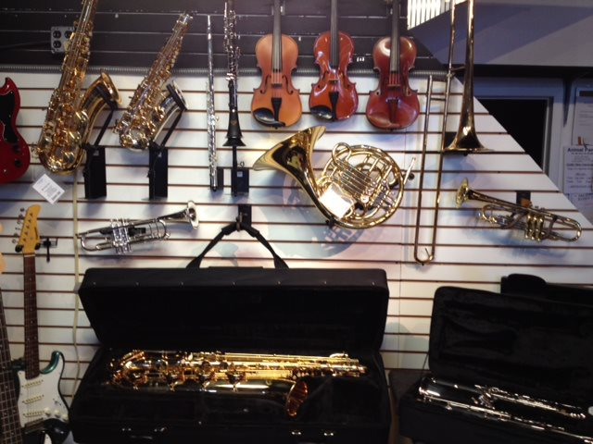
Rentals – give thought to when contracts expire

Slide 26
When we rent band instruments every back to school season in September we set all rental contracts to expire June 30th.
Tremendous opportunity to make calls starting June 15th every contract called “How would you like to renew the annual contract now…you get the summer for free.”
As much as 35 – 40% of the contracts will get renewed this way.
The result is what would historically be one of the slowest cash flow periods turns into one of the most consistent.

Slide 27
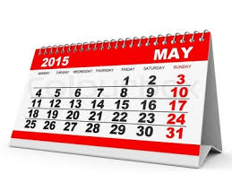

Slide 28


Slide 29
Start aggressively promoting in early May, in anticipation of the number of students who will stop for the Summer on Memorial Day
We need to create new students now to preemptively fill those slots as well as help historically sluggish May cash flow
Sell a SUMMER LONG block of lessons and include a free dreadnaught sourced from a willing manufacturer at relatively low cost

Slide 30
Particulars/Requirements
They must begin taking the lessons by Memorial Day and complete the 20 lessons within the next 20 weeks
Some never actually take the lessons, and they’ve spent premium $ for an inexpensive guitar.
Most take the lessons and often trade up, etc.

Slide 31
Results:
Much higher total number of summertime lessons than would otherwise be—lets teachers continue to eat over the summer
Also—since they must pay in full upfront—adds a nice jolt to May cash flow than would otherwise be there in absence of the promotion.

Slide 32


Slide 33
Another Student Showcase

Slide 34
Early Year Showcase:
I have the date/sign up sheet during the Holidays and it gives the kids a chance to show off the gear they fell in love with that Santa brought them.

Slide 35
It also gives me something significant to talk about after the holidays
For the “New Years Resolution”-type customers, it shows them that we always have something exciting going on…they chose the right place to learn to play their instrument.
For the kid who just got the first guitar from Santa and is looking to learn how to play it: I can point to the showcase flier and say “You probably won’t be ready for this showcase…but don’t worry, we hold another in August”

Slide 36
Misc:
1-Tips for when/how to raise tuition
2- Summertime band instrument loaner
3- Best time for gear clinics

Slide 37
HAVE A GREAT REST OF THE SHOW!

