Slide 1


Slide 2
Shoot an Effective Store Promotion Video—On a Shoestring
Myrna Sislen, Middle C Music

Slide 3

Get out of your store
Attend an industry trade show

Slide 4
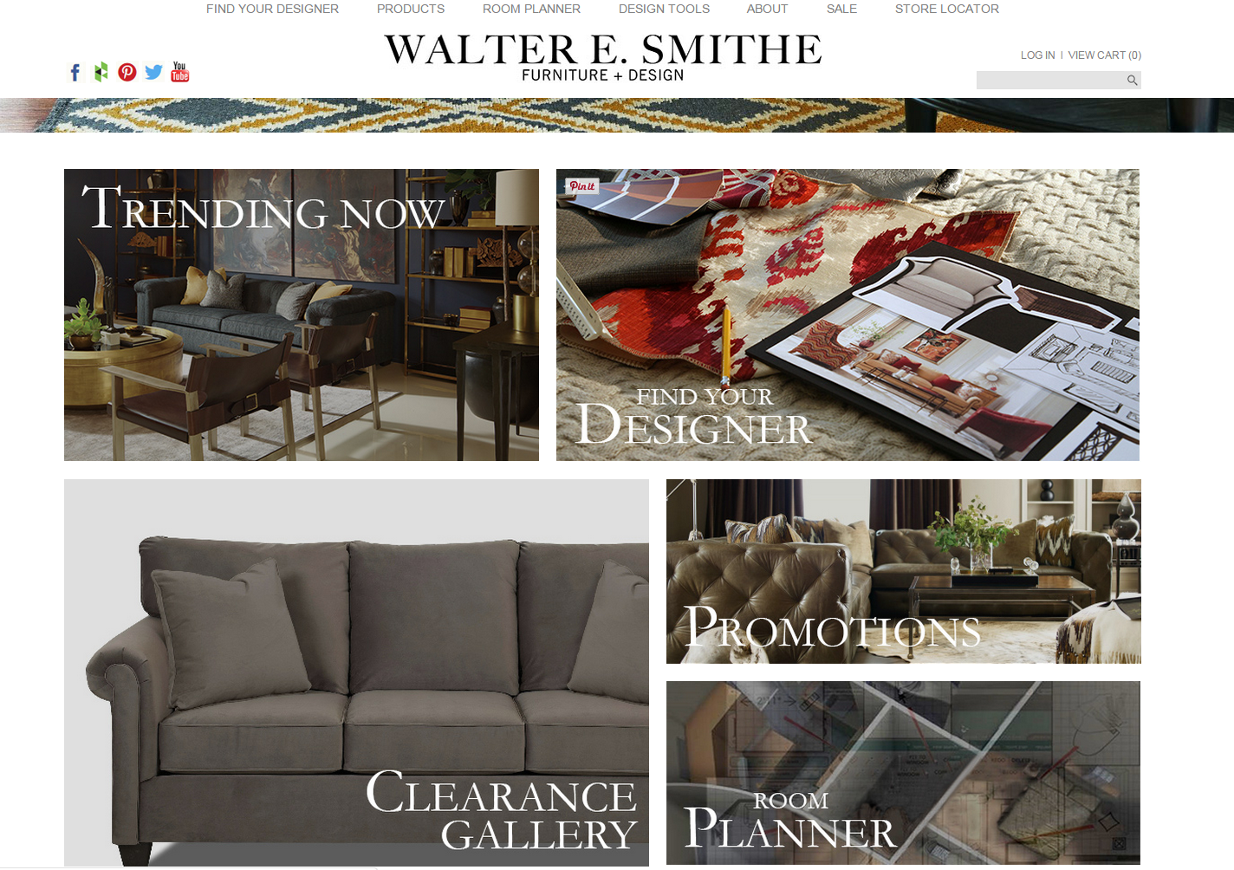
Tim
Smithe

Slide 5
Waaay outside the box:
https://youtu.be/2_gwfygLSa8

Slide 6
Outside the box, inside the store:
Anniversary video

Slide 7
Smithe’s cost: $250,000
My budget: 0

Slide 8
Contest for teachers and staff
Winning idea:
Come Together

Slide 9
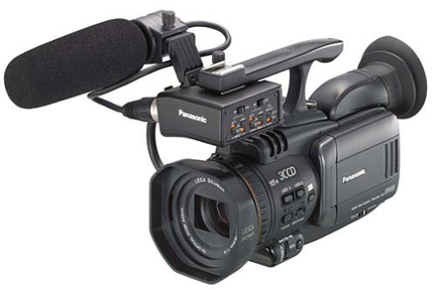
Old tech to the rescue:

Slide 10
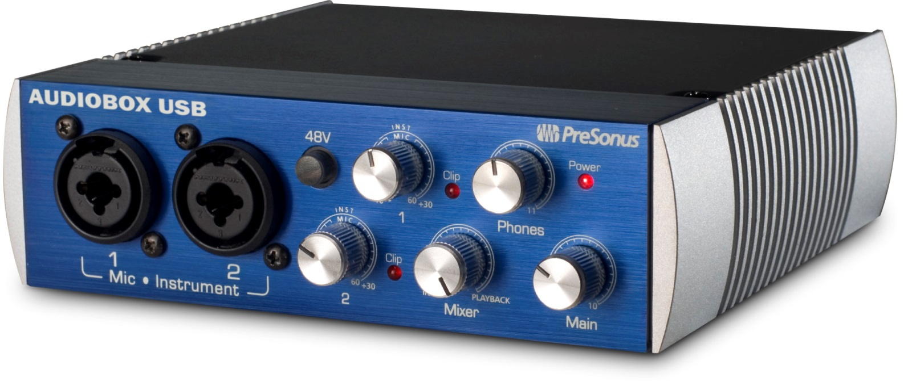
We sell it, we use it:

Slide 11
Everything done in-store
Cost: $0

Slide 12


Slide 13
Market research
“It’s the only station I can watch with my kids.”

Slide 14

RESULTS:
- MORE SALES!
  More engagement
  with the
  community and staff
  Greater
  name and brand recognition

Slide 15
The ads:
No Stressin’
13th Anniversary
Come Together

