Slide 1
Successful
Facebook
Promotions
5
Rick Camino
Social Commerce Expert
Rick.Camino@gmail.com

Slide 2
Background

Slide 3
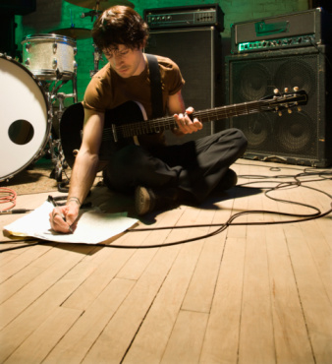
FACEBOOK FACTS
128m active users
76% login daily
66% are 15-34 and have an average of 300 friends
Users average 20 minutes per day
73% have incomes above $75,000 (compared to 17% on Twitter, and 13% on Pinterest)

Slide 4
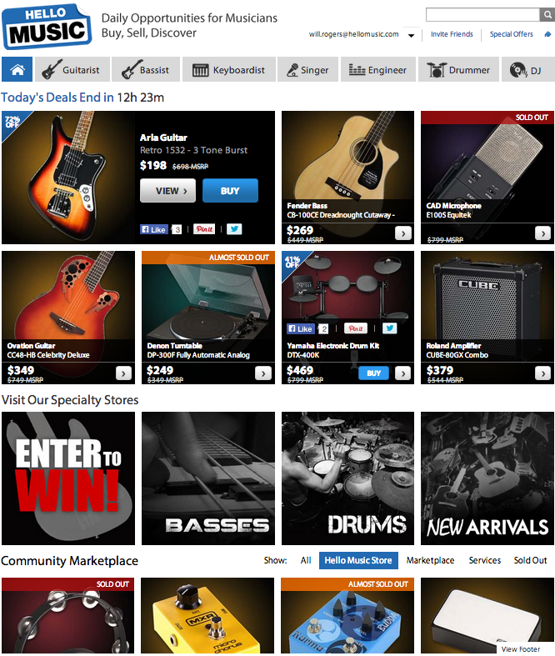

Social Commerce Platform for musicians
Community (Members Only)
Curated Content
Commerce
C2C Marketplace

Slide 5
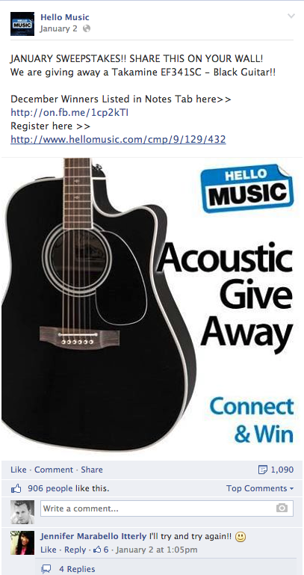
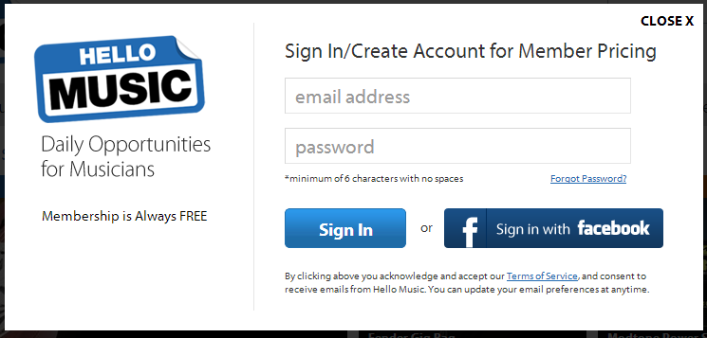
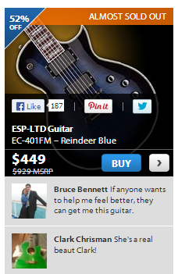
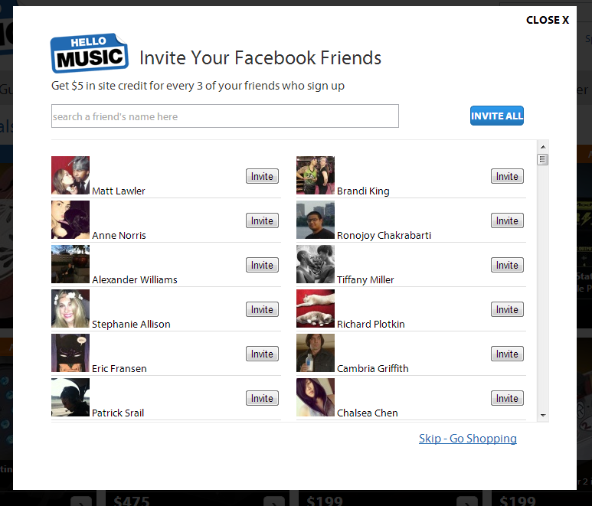
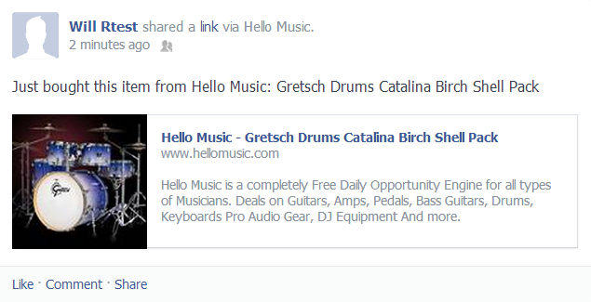
Leveraging Facebook
Acquisition
Sign In
Endorsement
Referrals
Amplification

Slide 6
Strategy

Slide 7
TARGET A SEGMENT OF YOUR CONSUMER’S JOURNEY
Awareness
Familiarity
Consideration
Purchase
Loyalty
  Focus On Specific Actions:
  Likes – Social endorsement and demand gauge
  Shares – Amplification of content to friends
  Comments – Engagement and conversation
  Clicks – Redirect to a landing page
  Message
  Loyalty

Slide 8
AVERAGE ENTRIES PER CAMPAIGN
Source: How to Maximize Earned Media with Social, WildFire Interactive

Slide 9
RATE OF SHARING BY CAMPAIGN TYPE
Source: How to Maximize Earned Media with Social, WildFire Interactive

Slide 10
Tactics

Slide 11


PROMOTIONS THAT WORK
Polls, surveys, and community
Pre-sales – Early access to the hottest products and services
Exclusives – Facebook-only products & services
Sweepstakes – Give-a-way dream products
Coupons & special offers – Early access to limited quantity deals

Slide 12
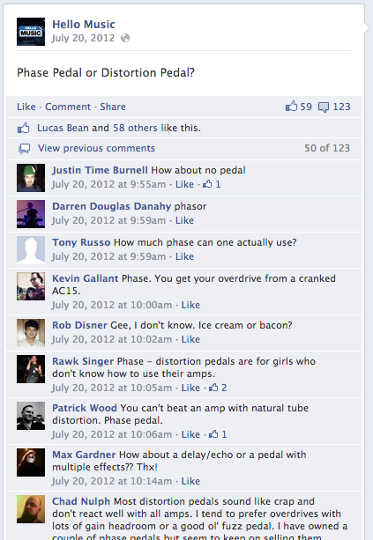
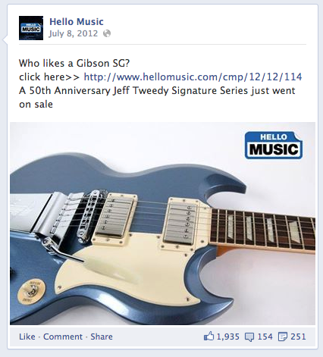
POLLS, SURVEYS, AND COMMUNITY
Sell without selling
Engagement drives clicks
Clicks drives traffic
Traffic drives sales

Slide 13
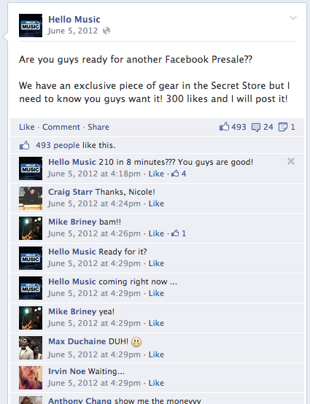
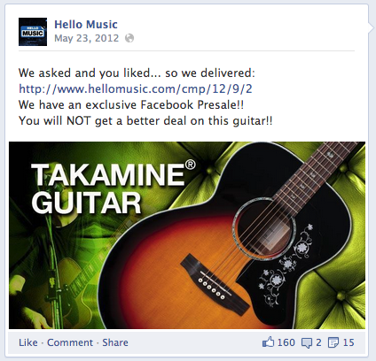
PRE-SALES
Access to pre-sales make customers feel special
Key words create urgency
Channel specific campaigns promote loyalty
Early access drives community status

Slide 14
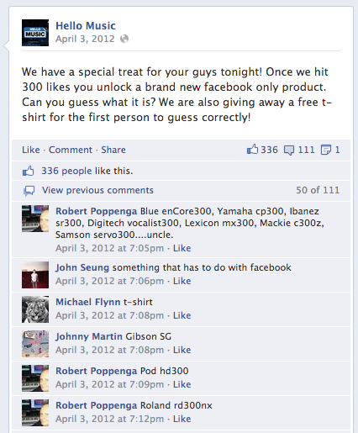
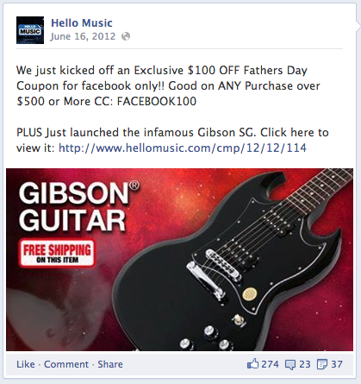
EXCLUSIVES
Create a community game that unlocks value
Need to show immediate and recognizable value
Reward membership
Exclusivity attracts market influencers

Slide 15
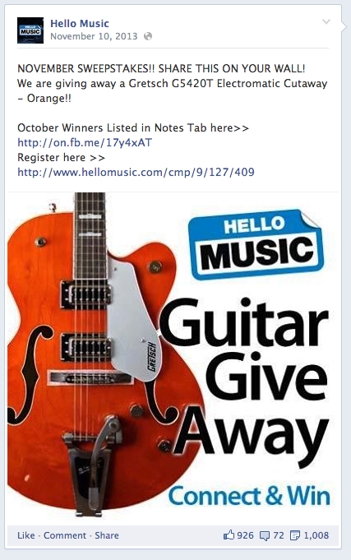
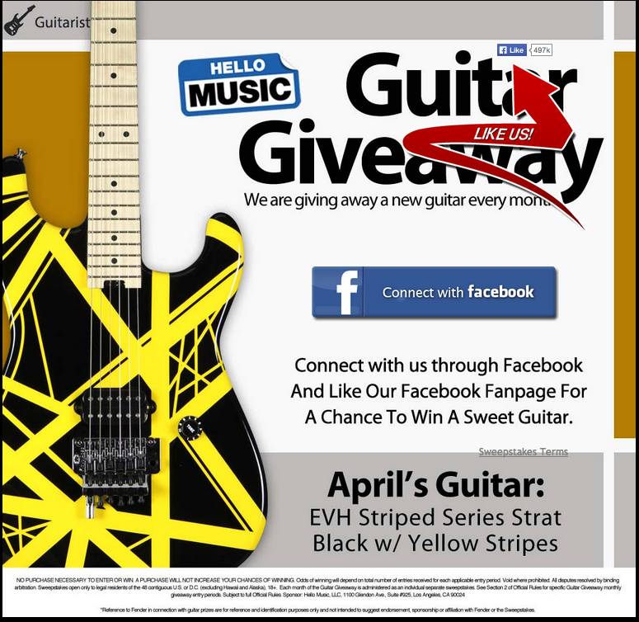
SWEEPSTAKES
“Like Us” as a contingency for entering
Entering via Facebook creates a newsfeed post
What you give away is important, as it amplifies your brand image
Communities love to brag. Ask them to “Share”.

Slide 16
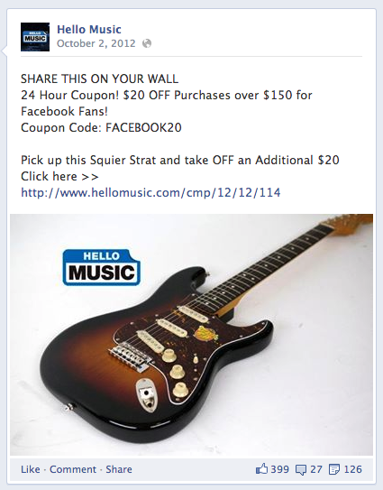
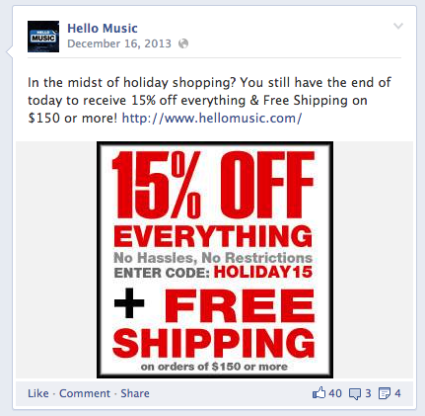
COUPONS AND SPECIAL OFFERS
The deal needs to be compelling to create impulse
Time-windowed offers create urgency
Use descriptive coupon codes
Ask your community to share

Slide 17
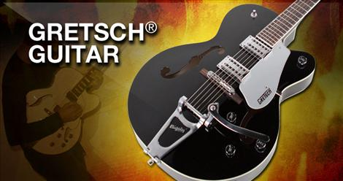
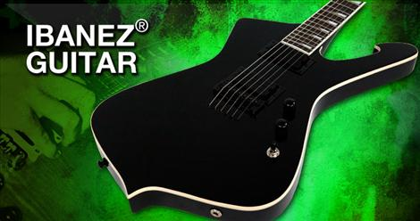
TIPS AND TRICKS:
Use sexy images of your gear to drive engagement
Feature aspirational products that drive social status
Respond to any and all constructive feedback
  Positive or negative
  Great feedback deserves a great response
Notes:
We want to connect with our community no matter where they are. We realize they aren’t going to be on our site all day long so we reach them where they do spend a lot of their time and we all know everyone is on Facebook. Our first touch point with a lot of our members is Facebook.

Slide 18
Results

Slide 19

A highly effective platform
2,000,000 musicians weekly
497,000+ Facebook members
35% of Hello Music traffic
25% of daily sales originate from Facebook

Slide 20
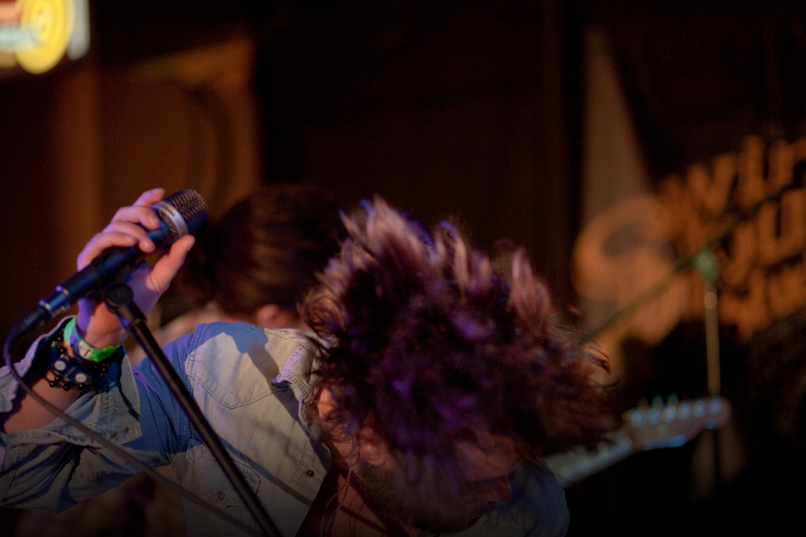
THANKS

