Slide 1


Slide 2
How I Had My Best Month
Ever Using Radio
Brian Reardon, Monster Music

Slide 3
Let’s start by listening to the radio spot!

Slide 4



Slide 5
I always try to get the word out
Print ads, direct couponing, Facebook, Constant Contact, etc.
25 years in biz yet still hear from local folks, “Did you just open?”

Slide 6
Radio is far less expensive than you’d think.
For me, about weekly available ad dollars.
I was paying $500 per week already for direct couponing and seeing diminishing returns.
I was willing to redirect that weekly $500.

Slide 7
I had dabbled in radio in the past…
Underwhelmed
Their message, not mine

Slide 8
BRAND IT!
“What musical instrument do you play?”
“Stop Dreaming, Start Playing!”

Slide 9
Story that kept repeating itself:
“I’m at (big-box store) trying unsuccessfully to buy a guitar. Can you help me?”
For every person who had this experience and found me, there must be 1,000 that don’t know Monster is an alternative!

Slide 10


Slide 11
All stations today have a niche audience, and The Shark is the station in my market that has a heavy male 25–54 audience…guys that buy guitars.
I KNOW that you are out there.

Slide 12
“Sometimes guys just want to come in and talk about guitars”
I didn’t focus on a particular product or price but rather a more subtle EXPERIENCE.
I was speaking to an experience that they still seek out, and THAT was responded to!

Slide 13
AND THEY CAME IN!
March overall sales were up 50%.
Overall guitar sales doubled in March.
Best sales month ever…better than any December or any September ever.
“Welcome home”

Slide 14
You need to be willing to put in the work!
Here is how my negotiations went:
We agreed on a weekly fee for an eight-week run on the Shark.
Radio company had another station in my market…a “Happy Pop” station that the moms of the kids that take lessons listen to.

Slide 15


Slide 16
My Rep: “K-98.3 is doing an Easter Egg Hunt near your store. The title sponsorship is available. Thousands of people and your students can play music live. It is $___. Are you interested.”
Me: “I am interested if the Shark campaign is free and my weekly payment stays at $500.”
SHE LAUGHS…

Slide 17
…then she ran it by the Big Kahuna and — to her surprise — he said “yes” (more on this in a moment)
Now I can access this other demographic:
“Music makes your child smarter”
“Nothing can build confidence and self esteem like a willingness to perform onstage”

Slide 18
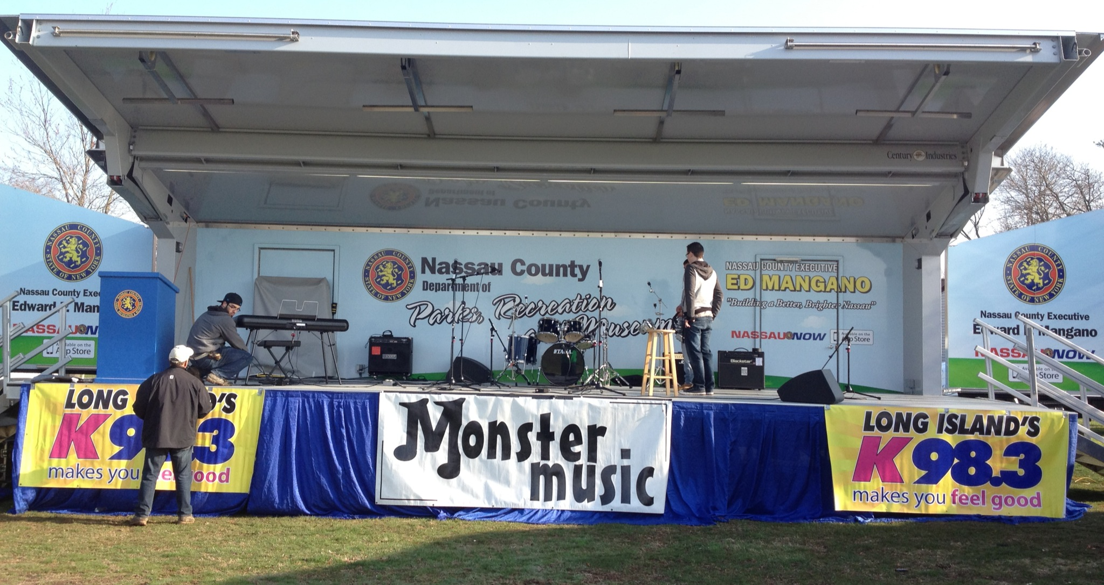

Slide 19
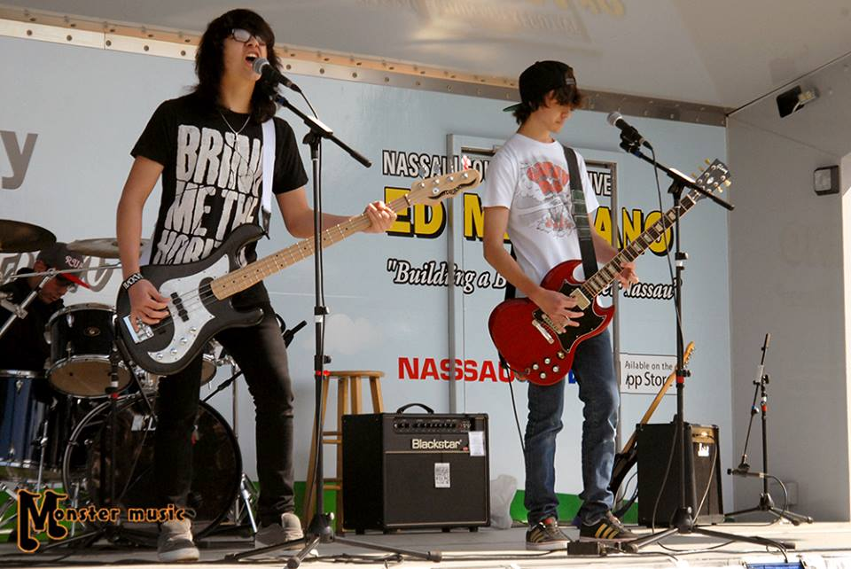

Slide 20
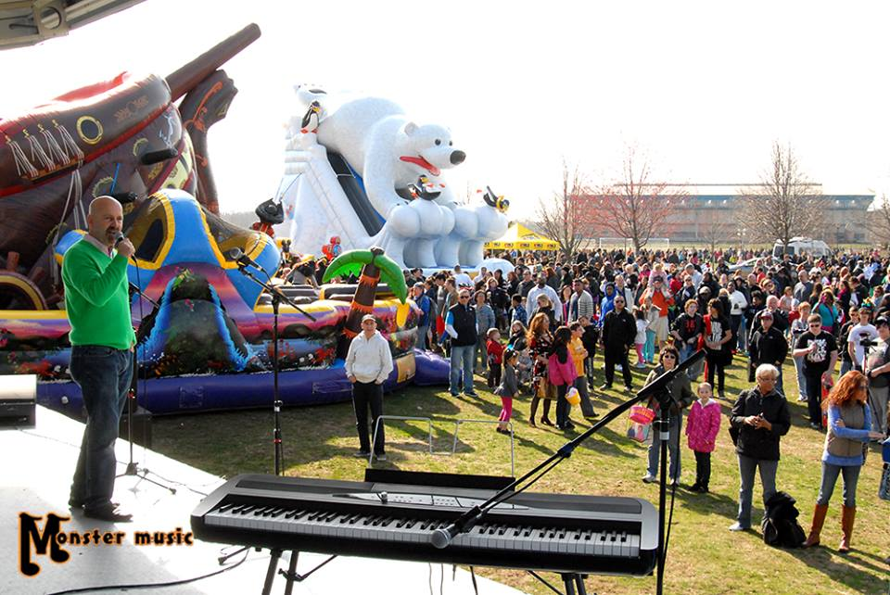

Slide 21
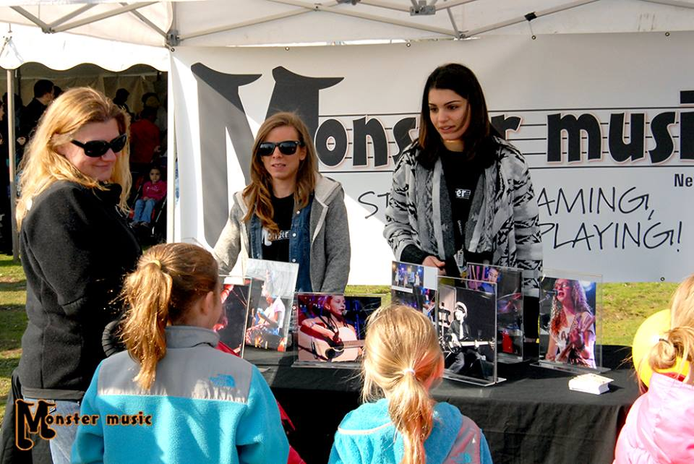

Slide 22
At the egg hunt, I got to bend the ear of the Big Kahuna. I learned some important things:
They VALUE independent businesses!
“When you spend $15K with us over the course of a year, you could have bought yourself a car.”

Slide 23
What now?
Rep wants new Shark Campaign
Maybe…give me something free on K98.3
Rep: Can’t
Me: I’ve got the Big Kahuna’s card.

Slide 24
Again, you need to work it, folks
But you can make it work in your market
Here is what she came up with for me:

Slide 25


Slide 26
The National Anthem
They play it every day at noon
But now they will play a version recorded by a Monster Music student once a week.
“This is Mikey Whoever from Levittown, and he takes lessons at Monster Music”

Slide 27
And the coup de gras:
The Monster Music Minute
Once per week Friday morning prime time between 8-8:30 on the K98.3 Morning show

Slide 29
MAKE IT HAPPEN!

Slide 30
Thank you!
Brian Reardon, Monster Music
Email: monstermusic@optonline.net

