Slide 1

Course Title
“Everything I Learned,
I Learned from
My Fellow Retailers”
- A Panel Discussion

Slide 2
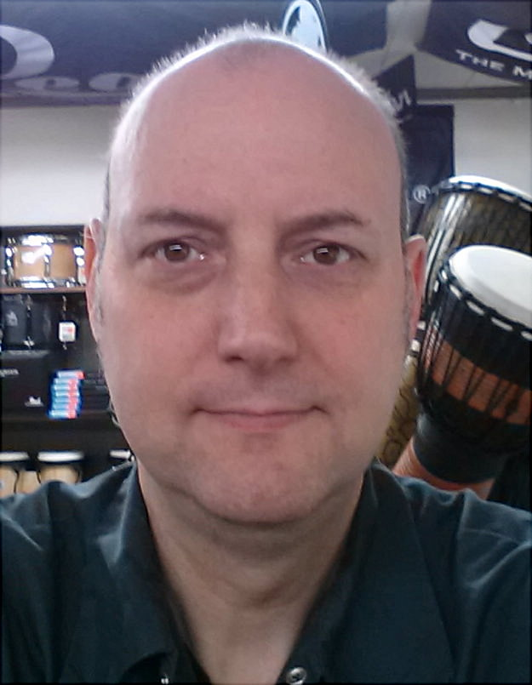

Evan Jones

Slide 3
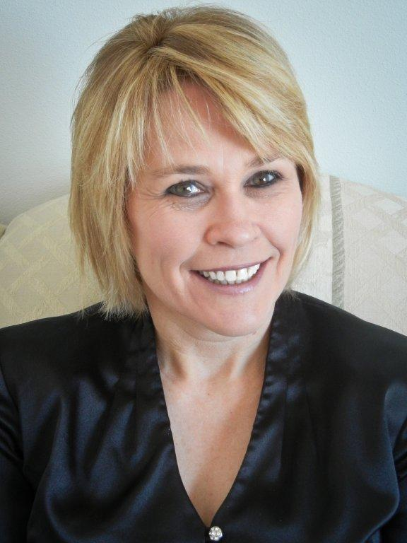

Connie Smith

Slide 4
A few words about …
Your store
Your staff
Yourself

Slide 5
Sources for Ideas
Where do you gather ideas?

Slide 6


Association Meetings
Sources for Ideas

Slide 7


Association Meetings
Sources for Ideas

Slide 8
Ideas from Fellow Retailers
Sources for Ideas
Visit their Store?
Chat on Phone?
Conversations at Shows?

Slide 9
Implementing New Ideas
Challenges faced

Slide 10
Challenges Faced
Implementing Ideas
People?
Logistics?
Timing?

Slide 11
An Idea that Did Not Work
Implementing Ideas
Describe it
Why Didn’t it Work?

Slide 12
An Idea that Did Work
Implementing Ideas
Describe it
Why Did it Work?

Slide 13
Closing Thoughts

Slide 14
Thank You!

