Slide 1

Course Title
Why You Should Reinvent
Your Lesson Program
Liane Rockley,
Rockley Music Center

Slide 2
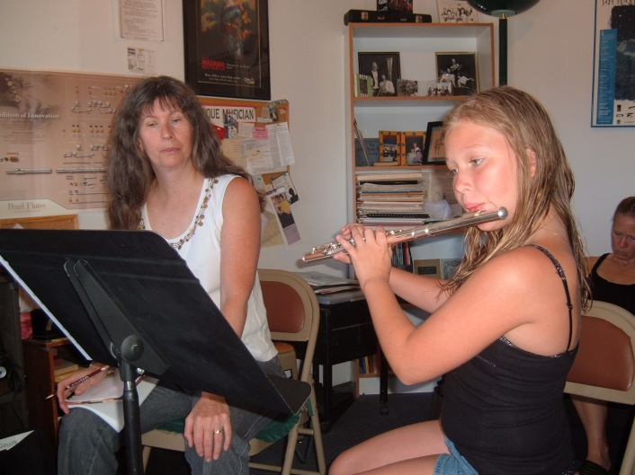
Establishing Your Vision
What do you want to offer?
  Private Lessons
  Group Lessons
  Summer Camps
  Recitals
  Are you willing to build or invest money in construction?

Slide 3
Establishing Your Vision
What Are Your Goals?
Money
Sell More
Promote Music Education
What Format is Best For You?
Landlord- Rent Space
Lessons as an Accessory
Music Education Center or School

Slide 4
Music Education Center
Teachers
Students
Advertising
Software
Policies
Contracts
1099
REGISTRATION FORMS

Slide 5
Setting up the Infrastructure
Management- Who’s going to run your program
Software- How are you going to keep track of your schedule and accounting?

Slide 6
Setting up the Infrastructure
How do you treat your Teachers?
Employee
Tenant
Independent Contractor (1099)

Slide 7
Setting up the Infrastructure
Independent Contractor (1099)
1. Common Law Rules
Behavioral, Financial, Type of Relationship
2. Draw up a contract based on the Common Law Rules
3. Get the contract to your attorney to make sure you are in compliance with Federal/State law

Slide 8
Setting up the Infrastructure
Teachers
1. How do you hire? Resume/Audition/Interview
2. Background Checks
Teacher Registration Form (different from Contract)
What is your fee per 30 minute lesson?
(This is critical to the #1 Goal- Money and #3 Goal Promoting Music Education)
5. Advertise for Teachers

Slide 9
Setting up the Infrastructure
Students
1. Student Contract/Policies
Registration (Critical to #2 Goal- Sell More)
-Part of your registration is rental/sale of instruments/accessories
-Registration Fee (important in marketing)
-Cancellation Policy

Slide 10
Setting up the Infrastructure
Students
Invoicing Students/Collecting Money
-Direct Debit/Credit Card
Advertising/Marketing to Students
-Promo packet for parents
-Newspaper coverage
(Can often get free press in local papers for promoting music education- Goal #3!)

Slide 11
Setting up the Infrastructure
Students
Advertising/Marketing continued
-Direct Mail Postcard
-Email Blasts to your list
-Music Lesson Gift certificates
-Groupon/Google Ad
-Grassroots efforts with churches/schools

Slide 12
Setting up the Infrastructure
Misc Things to Remember
Revisit your general liability policy
Register your trade name (if you’ve used a different name in your program) with your Secretary of State
Train your staff to promote your program

Slide 13
QUESTIONS?
Email Liane at:
LPROCKLEY@AOL.COM
(or see me afterwards)

