Slide 1

Good Debt is a Good Thing
Alan Friedman & Daniel Jobe
Friedman, Kannenberg & Company, PC

Slide 2
OBJECTIVES
Define “debt” and kind of debt found in music retailing today
Discuss the “pros” & “cons” of carrying debt
Illustrate how the “right” debt creates positive cash flow
Q&A

Slide 3
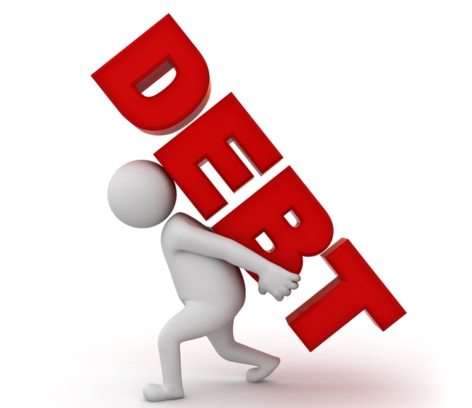
Debt (“det”); noun… Something that is owed or due
Something that is typically money
Something that scares most business owners

Slide 4
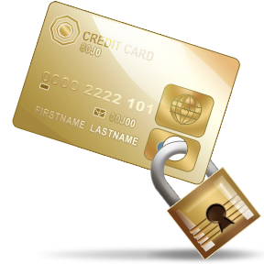
Accounts Payable
Trade, credit card & other debt incurred to purchase goods for resale and services needed to run your business
  Pros: Time to pay bill, early pay discounts, little punishment for late pmt
  Cons: Steady impact on cash flow, may have to pay for product before item is sold, credit hold, lose line for non-payment
Best suited for quick-turning inventory or consumables

Slide 5
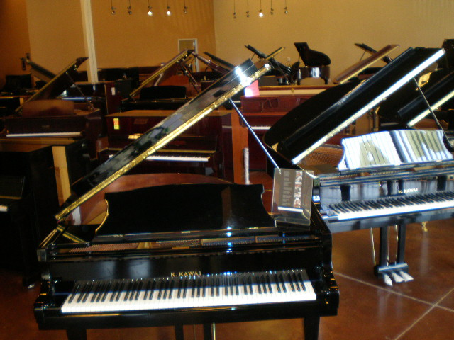
Floor Planning (Asset Based Lending)
A financing arrangement between a retailer, supplier & financing company; used to finance large ticket items
  Pros: Least impact on cash flow
  Cons: Aging inventory will erode profitability with interest charges; easy to spend a flooring company’s money on other items (business or non-business)

Slide 6

Accrued Expenses
Non-invoiced liabilities, such as customer deposits, unpaid taxes, unearned lesson income, etc.
  Pros: Other people’s money
  Cons: Severe impact on cash flow, given the limited time to pay debt without incurring punitive charges for late or non-payment

Slide 7
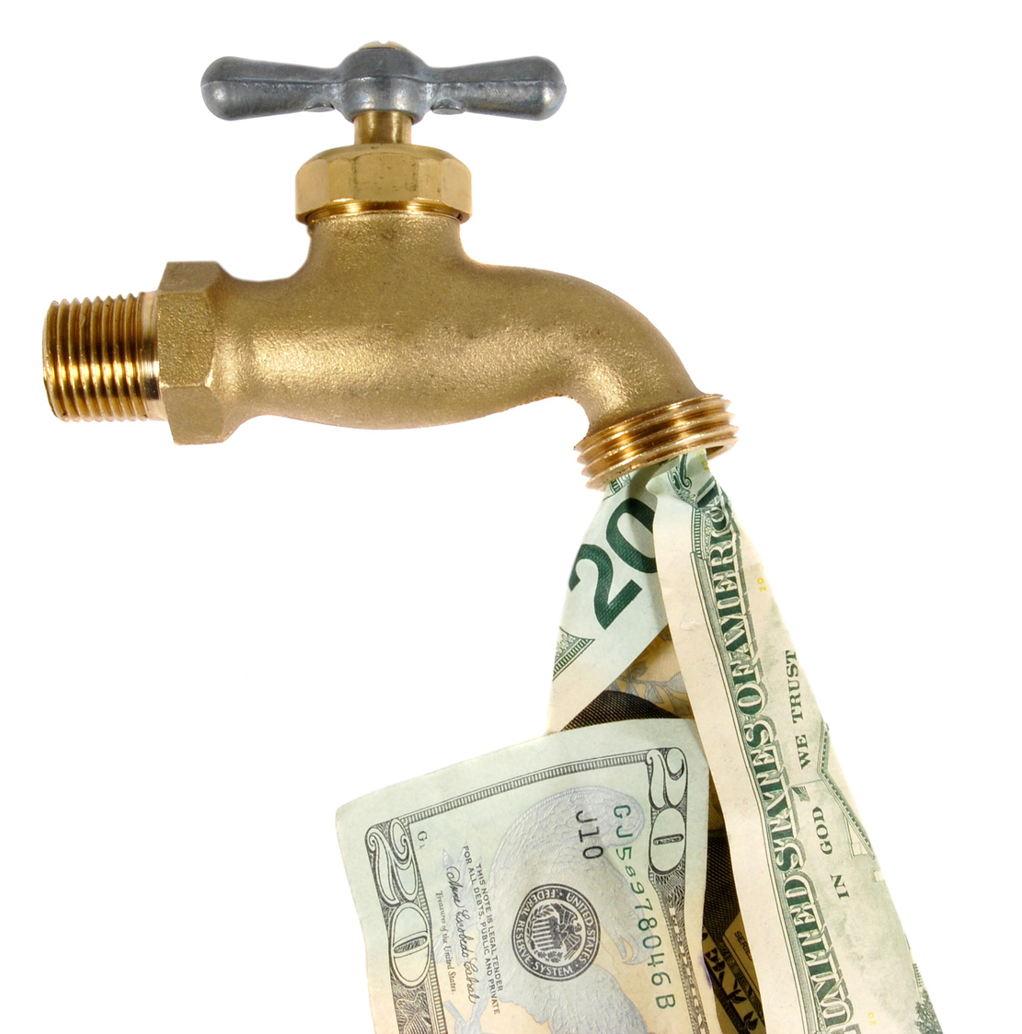
Lines of Credit
A constant availability of bank funds to finance A/R and purchase inventory
  Pros: Little impact on cash flow via “interest-only” cost each month
  Cons: Severe impact on cash flow when due, as LOC’s need to be paid off (in full) for 30 days during the year

Slide 8
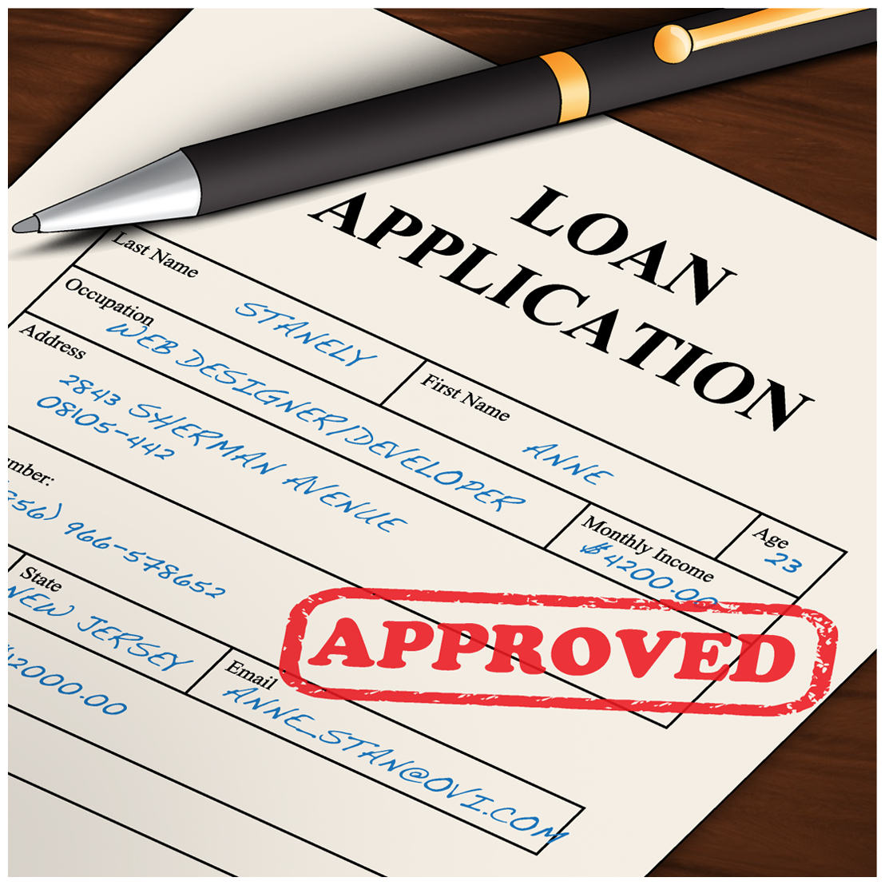
Amortizing Notes
Typically, a bank loan that calls for a set amount (including principal & interest), at a set rate for a set number of months; used to finance fixed and rental assets (long-term)
  Pros: Modest impact on cash flow
  Cons: Paid monthly, can mask profitability problems in your business, usually has a personal guarantee & loan covenants

Slide 9

Debt is good when you…..
Manage your inventory
Monitor profitability
Build retained earnings
Are involved in the business
Successful businesses use other people’s money to grow their business!!

Slide 10
You’re buying 10 grand pianos at $10,000 each (totaling $100k), with a selling price of $15,000 each; you know you can sell all 10 pianos within 6 months.
Your have a $100,000 bank line of credit at 6%
Your supplier offers you free flooring for 180 days; after that it costs 12% interest on unsold goods
How do you pay for the pianos – LOC or flooring?

Slide 11
EXAMPLE: Bank LOC or Flooring?
 | LOC | Flooring
SALES | $ 150,000 | $ 150,000
COST OF GOODS SOLD | 100,000 | 100,000
GROSS PROFIT | 50,000 | 50,000
Less interest cost | (3,000)
Less LOC fee (1%) | (1,000) | -
NET PROFIT | $ 46,000 | $ 50,000

Slide 12

Debt is a great tool to make potential profits (an investment) a reality!

Slide 13
A quick test …
Which one is ultimately most important . . . profitability or cash flow?
“Profitability”

Slide 14

Is poor cash flow a “problem” ?
No ... it’s a “symptom” of a problem.

Slide 15
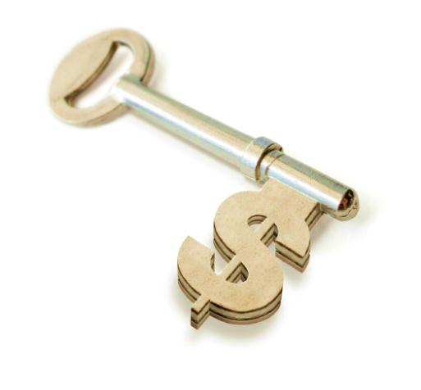
Takeaways…
Match inventory turn with financing term
Manage your inventory, avoid aging
Pay your supplier or your financier according to the terms
Cash-flow
<
Unlock your potential

Slide 16


Slide 17
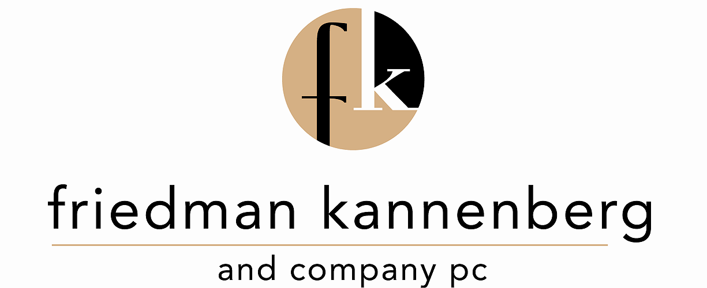
Consulting Meetings
Contact Jen outside the Idea Center entrance
after this session to set up a meeting time

