Slide 1

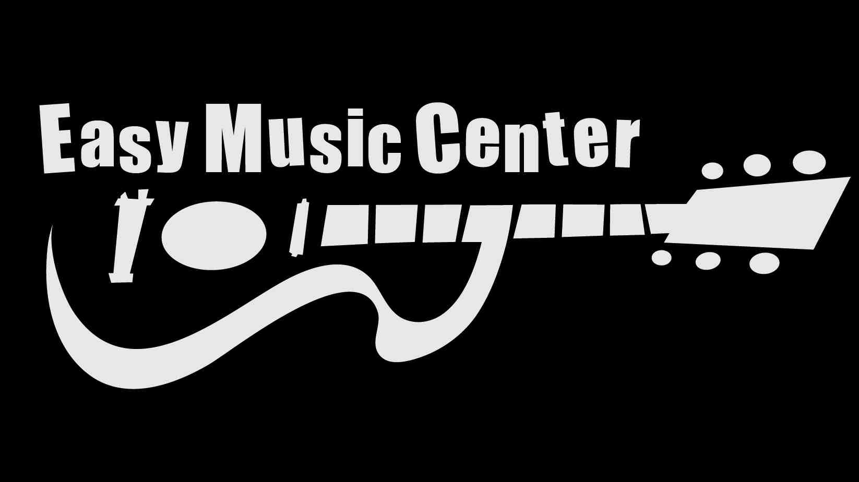

Slide 2
Invest in your infrastructure – continually! It is your future
PPE: Better shelving and fixtures, better transport, lifts, storage facilities…
Improved PPE = Cost savings on wages and increased sales per head
Do more with less
Over 1/3 of net profits for 2009–2012
And we still have a ways to go …
What is your ARX moment?

Slide 3
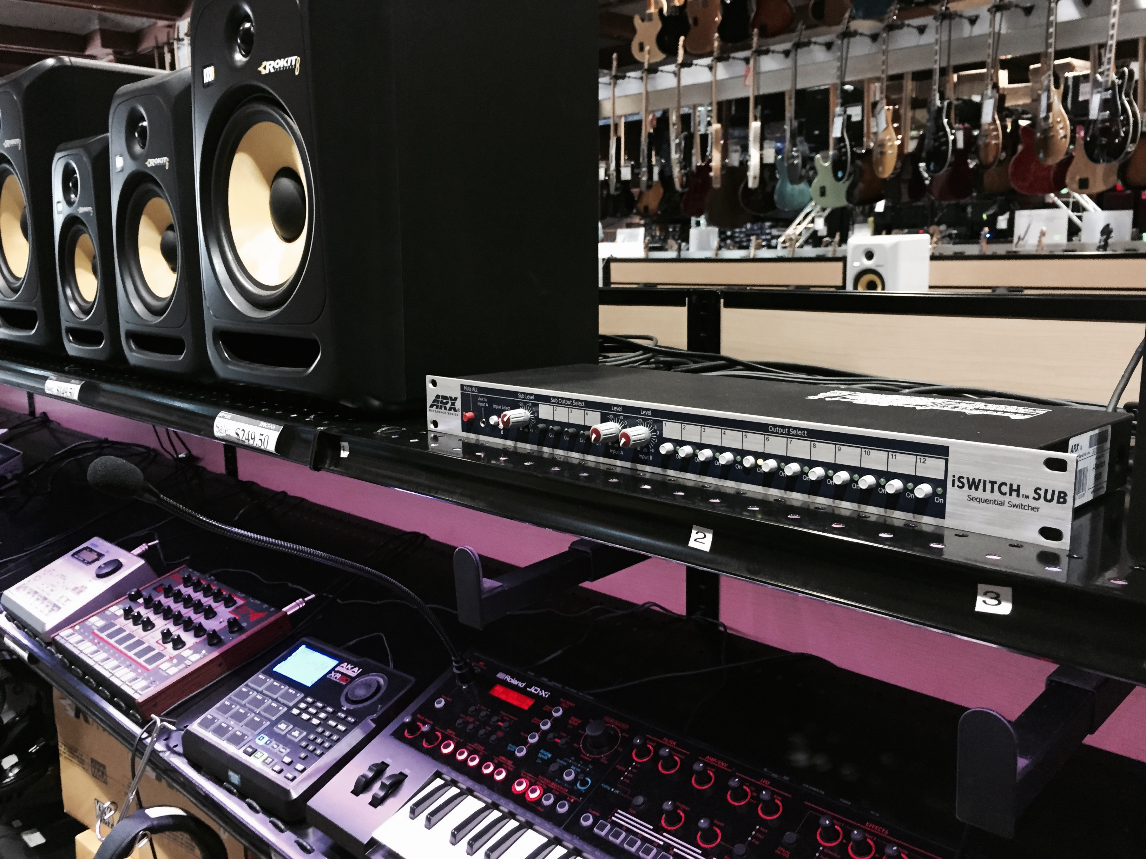
Gibson booth…this is why you go to trade shows
Bought six of them – over 3K investment
Buying Tascam CD racks, as well
Lots of money upfront for something you can’t sell
BUT … think of the time saved for demos
Think of the extra sales you will make and:
Save sanity = Priceless

Slide 4
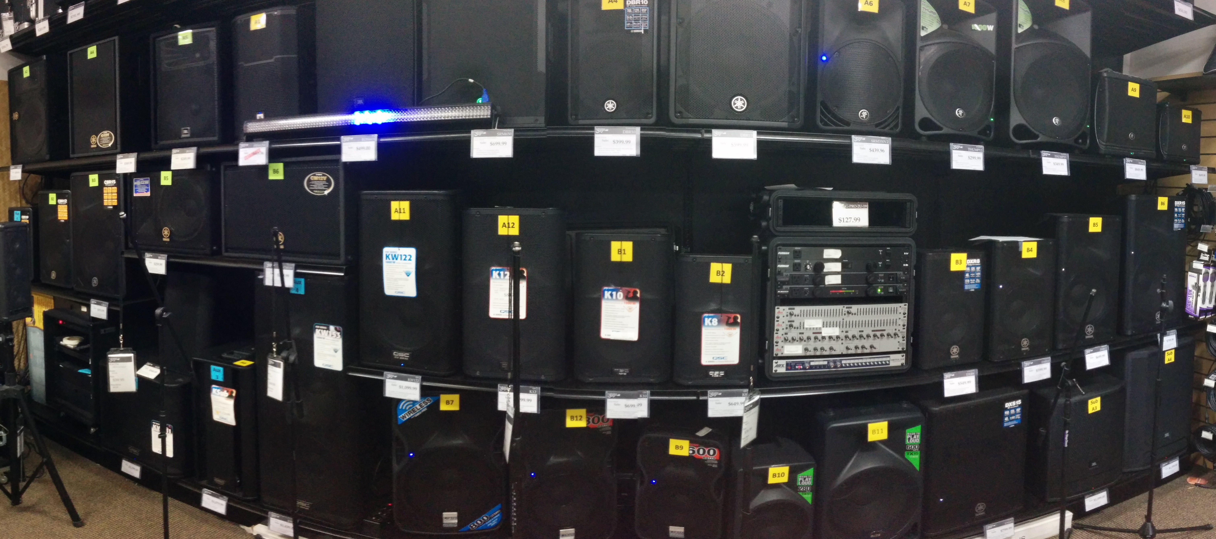

Slide 5
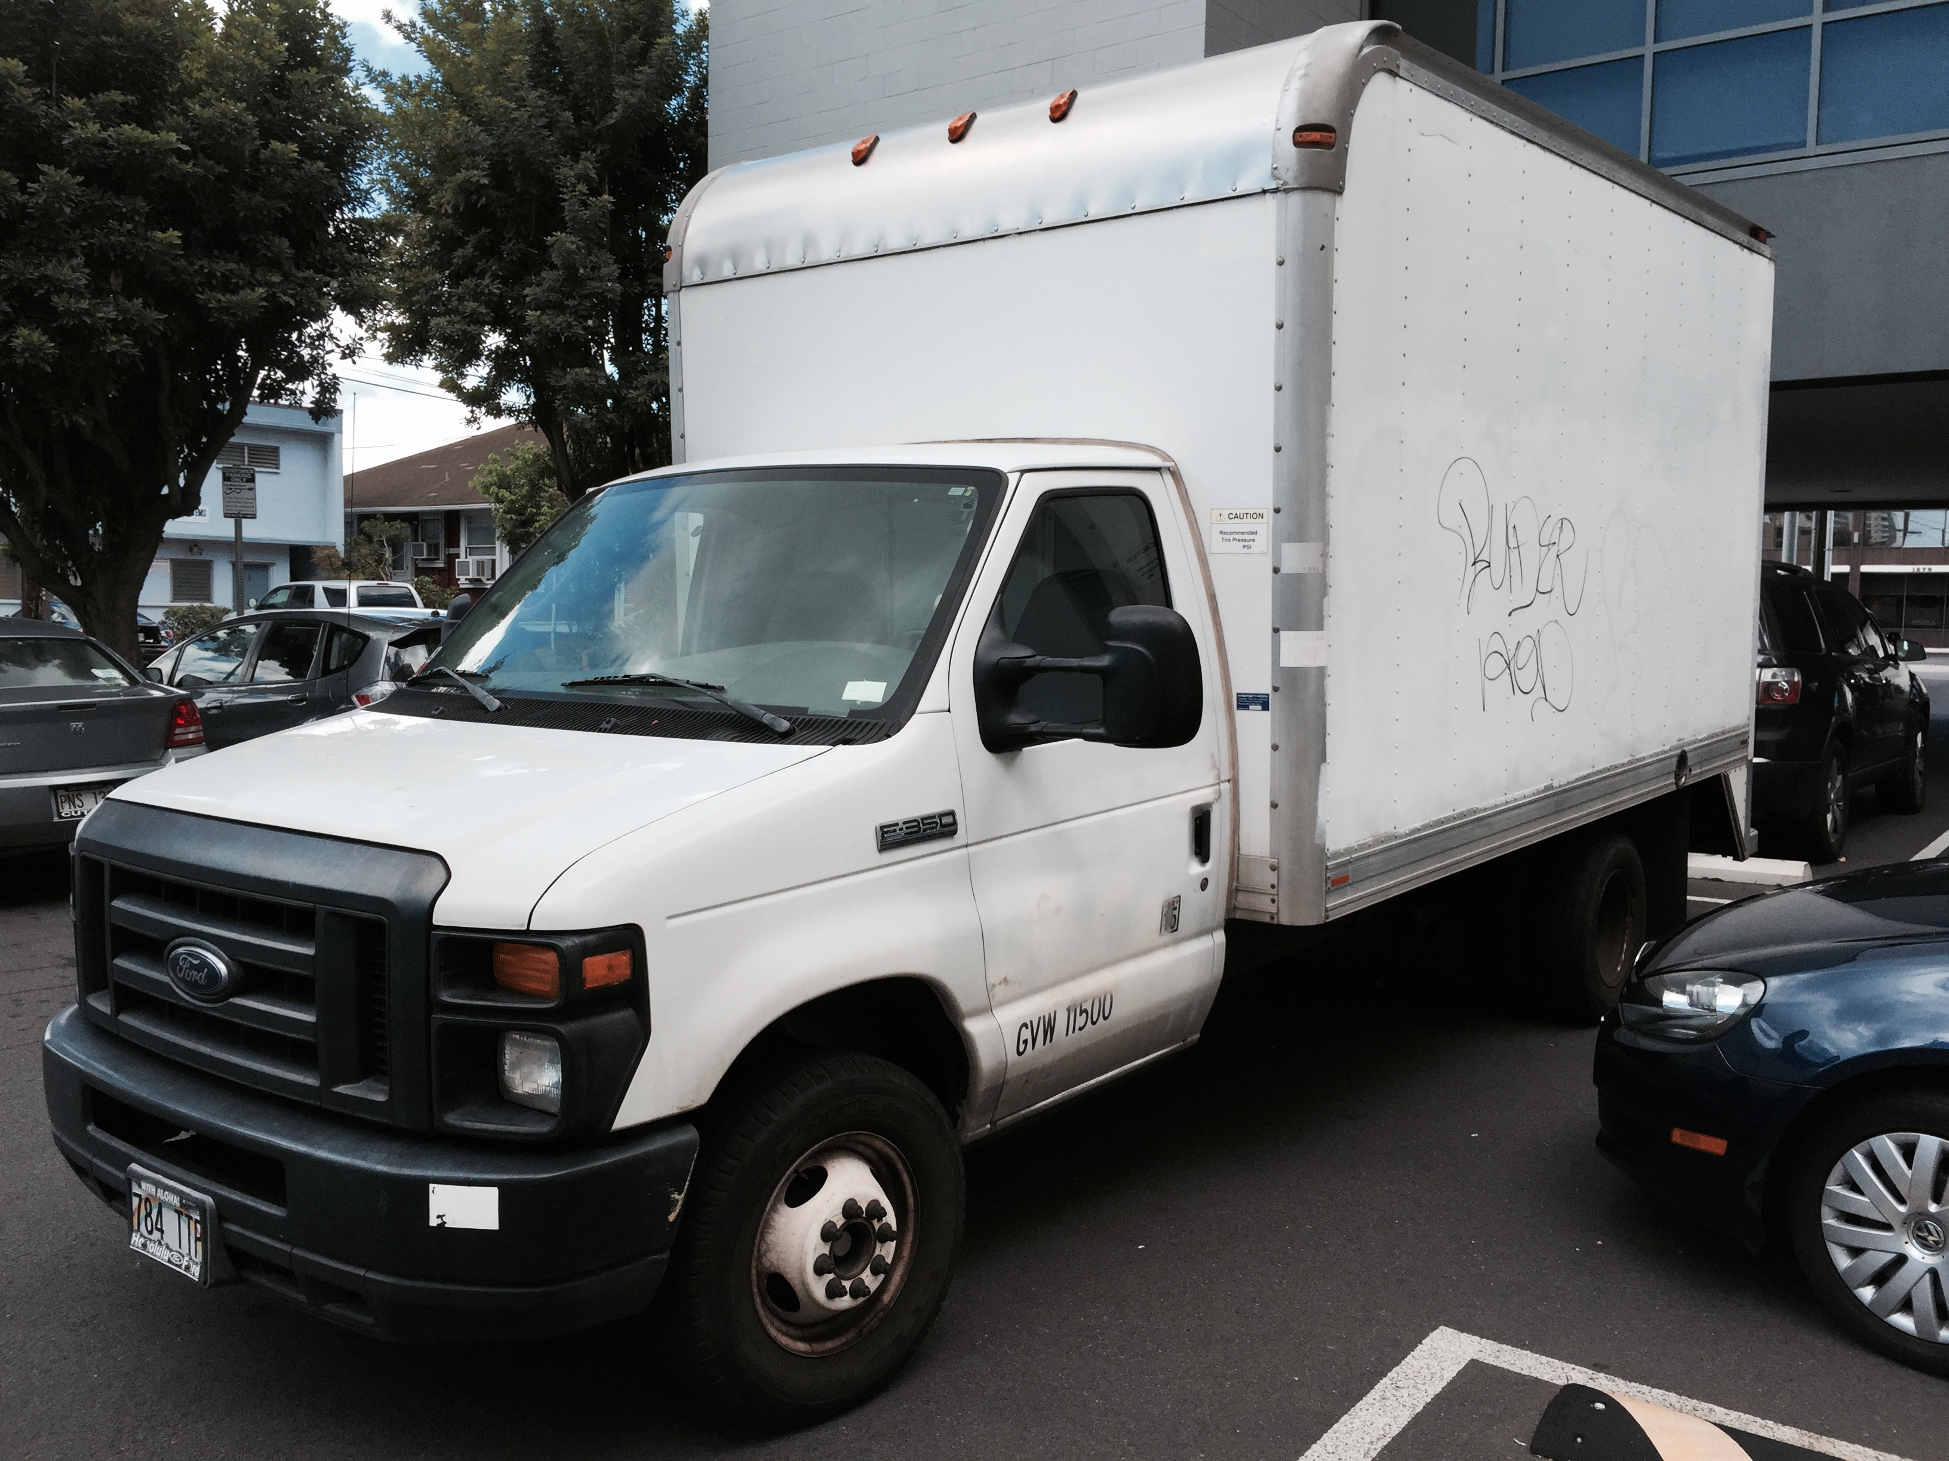
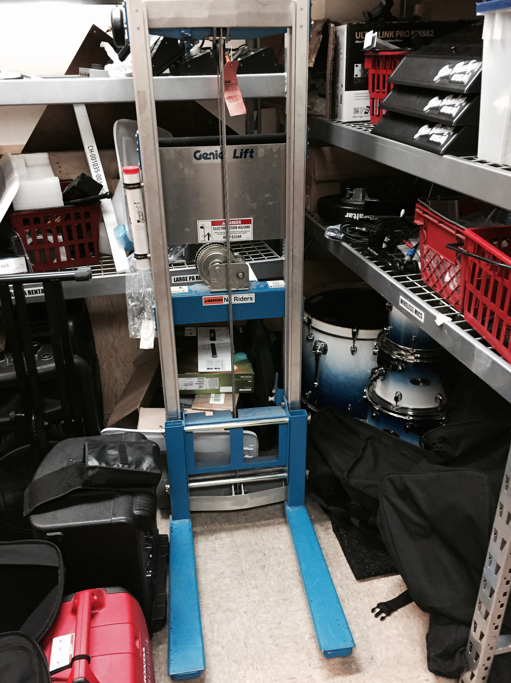

Slide 6

Better PPE = Lower payroll
Switched from fully managed Payroll Outsourcer to ADP and doing it in house
Check your rates – shop around
Savings = Clerical worker to do payroll
Great Success – Able to leverage up – Work on my business

Slide 7
PUT YOUR MONEY WHERE THE PROFIT IS!
Ukulele Quadruple Down – increased SKU, capital allocation and stocking by 4 times!
More custom photos and eBay
Studio – credible threat
PA, DJ and Lighting – huge increases in offerings – can’t seem to go wrong here yet
Acoustics we doubled down…

Slide 8
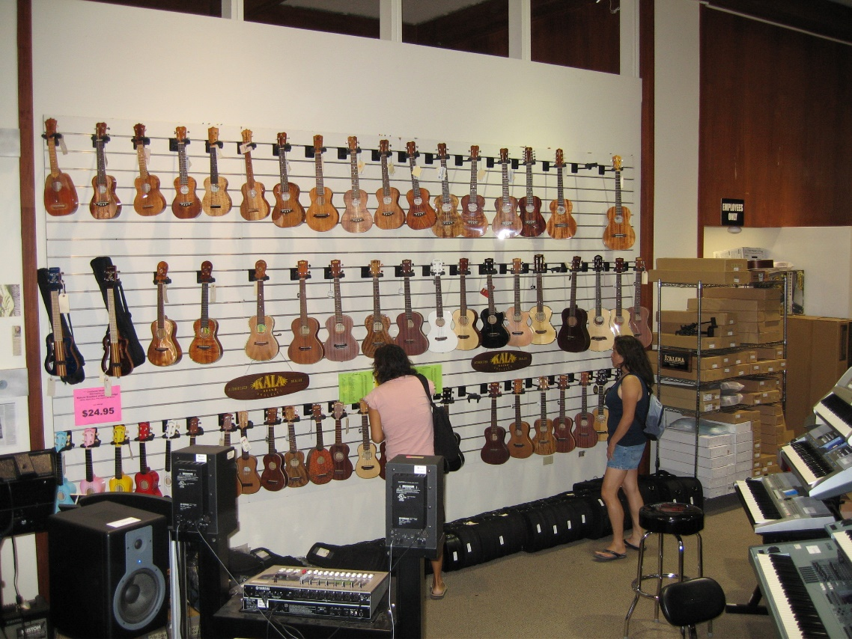

Slide 9
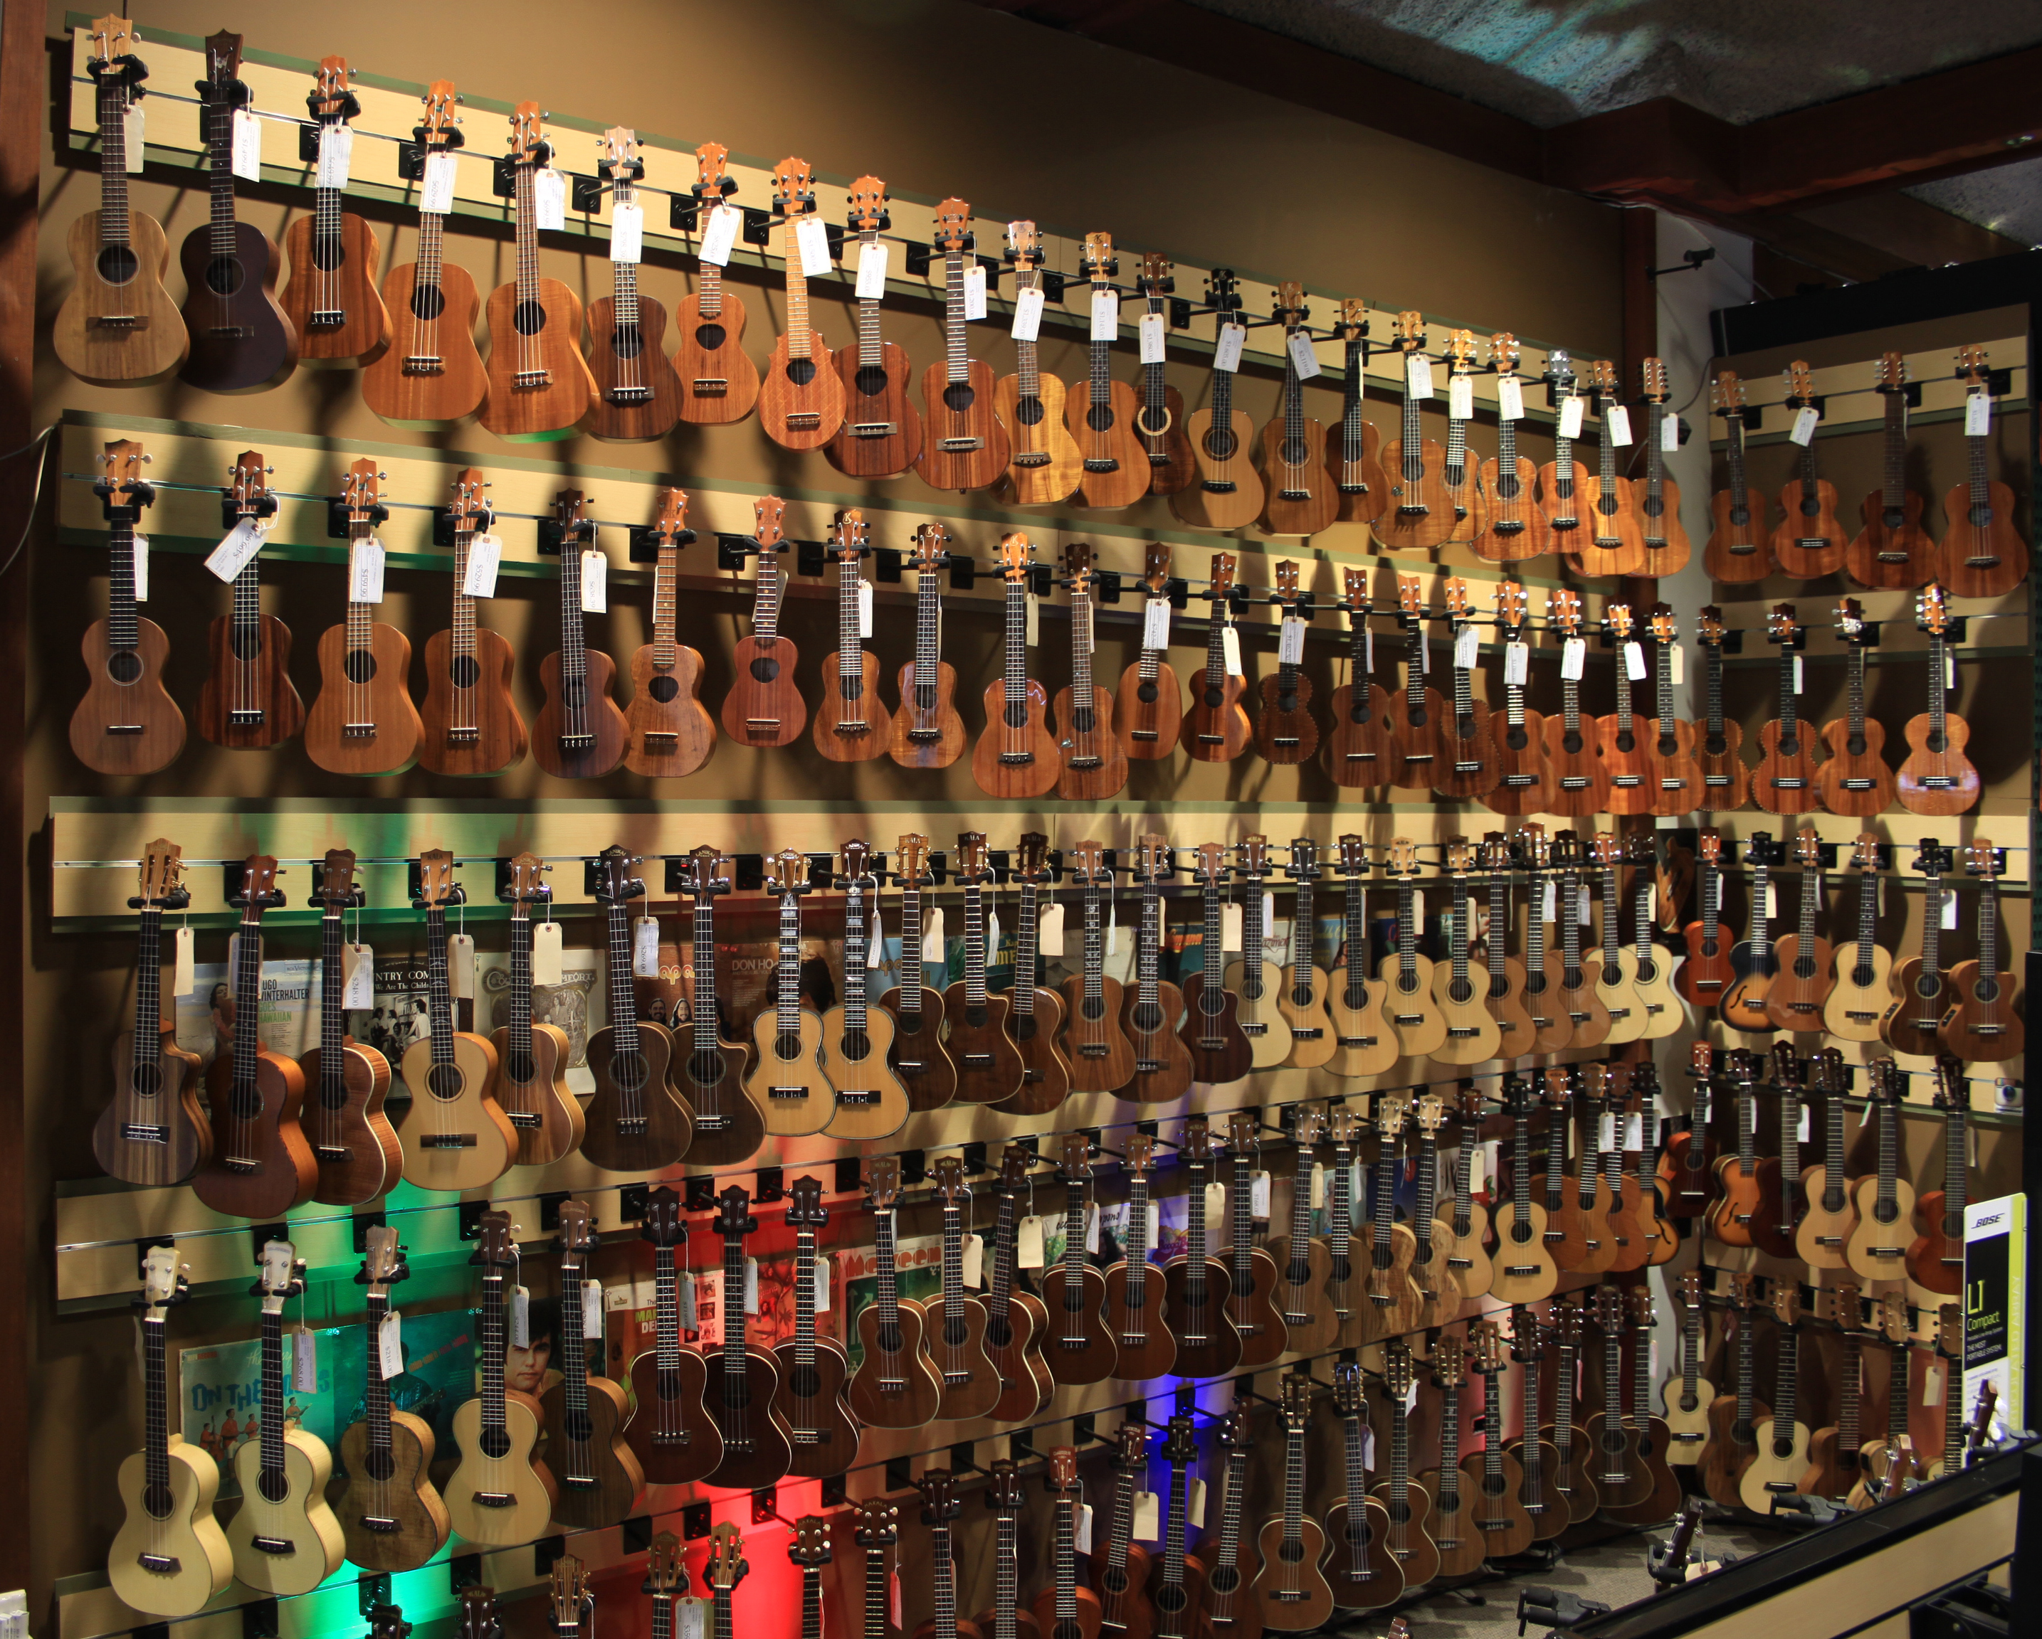

Slide 10
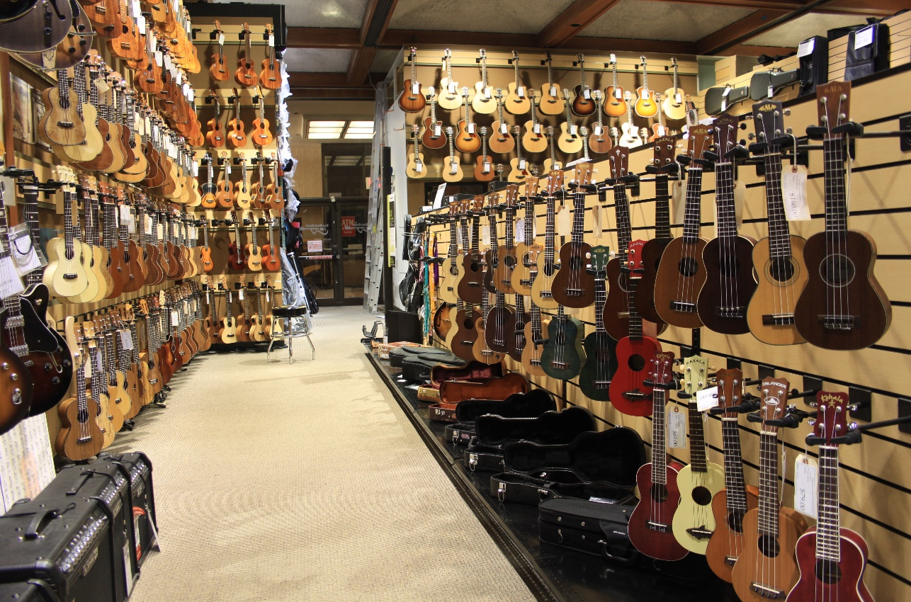

Slide 11
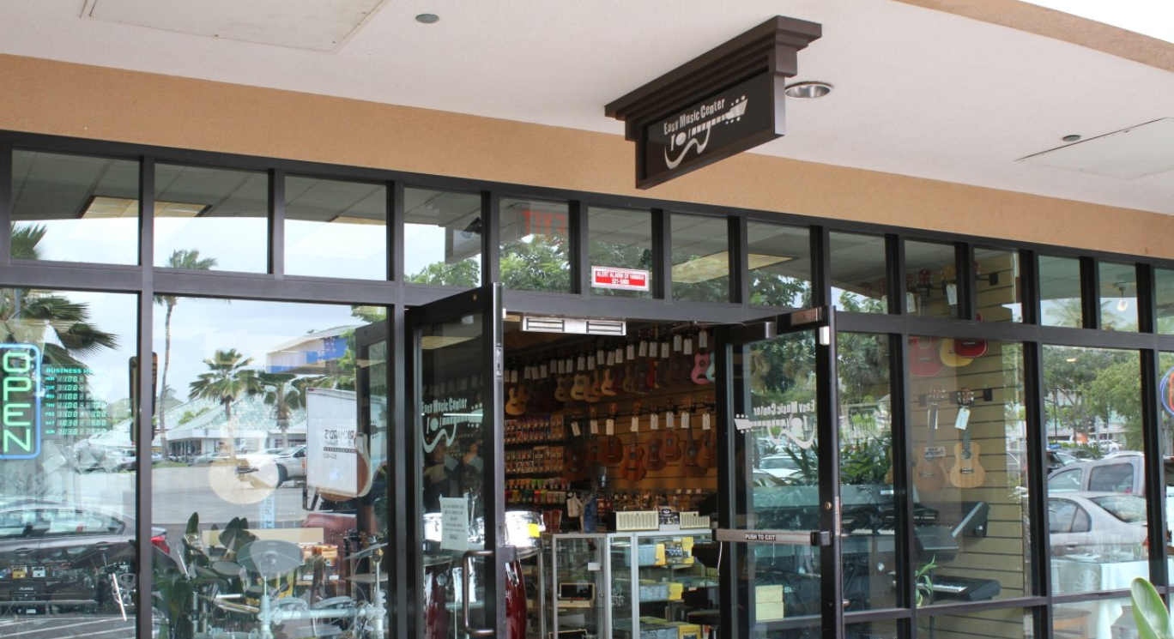
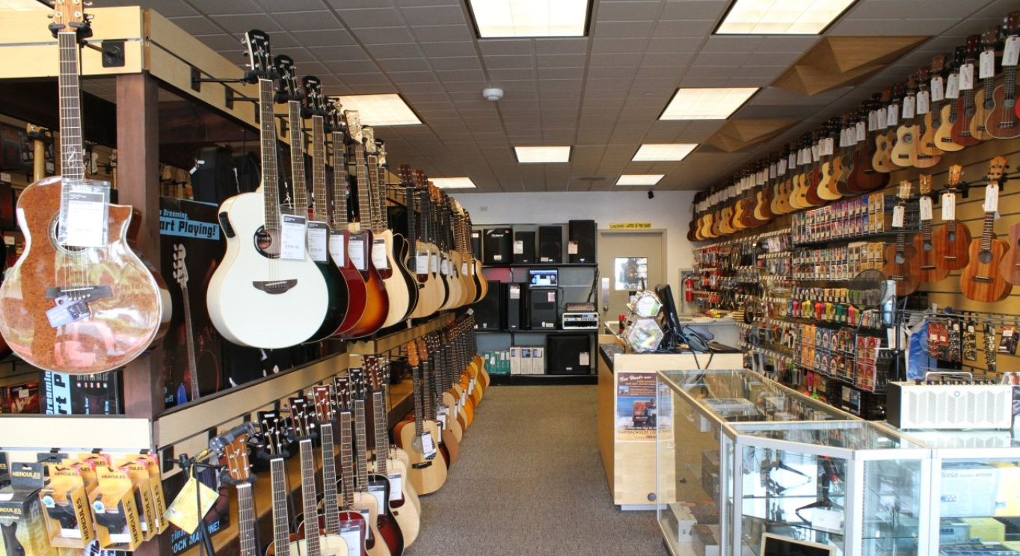
ACCEPT, LEARN AND THEN MOVE ON…
For EMC that was the Kapolei store
Backtracked – was bleeding us from a talent perspective, good only, and cannibalization
HOW NOT TO COMPETE WITH THE INTERNET … this mistake could have buried us if we let it …

Slide 12
LOW GMROI sections and product
Electric Guitar, Bass, and Amplification:
While we didn’t scale back a ton, we didn’t expand here … by proportion, it is a smaller part of our business now
This freed up more resources for growing product categories
Pared it back, GMROI is coming back and our capital is now better allocated

Slide 13
PPE – storage was a huge limitation to growth
Large storage = Containers, better freight and margins, more effective physical inventory, and reduce need for more workers
How do you compete with the internet? In stock all the time …
We converted old offices and old stage to a huge storeroom
New stage we made into things we sell
New “bullpen” helped increase communication and fostered better relationships, creating a better environment for team work
DIY DIY DIY

Slide 14
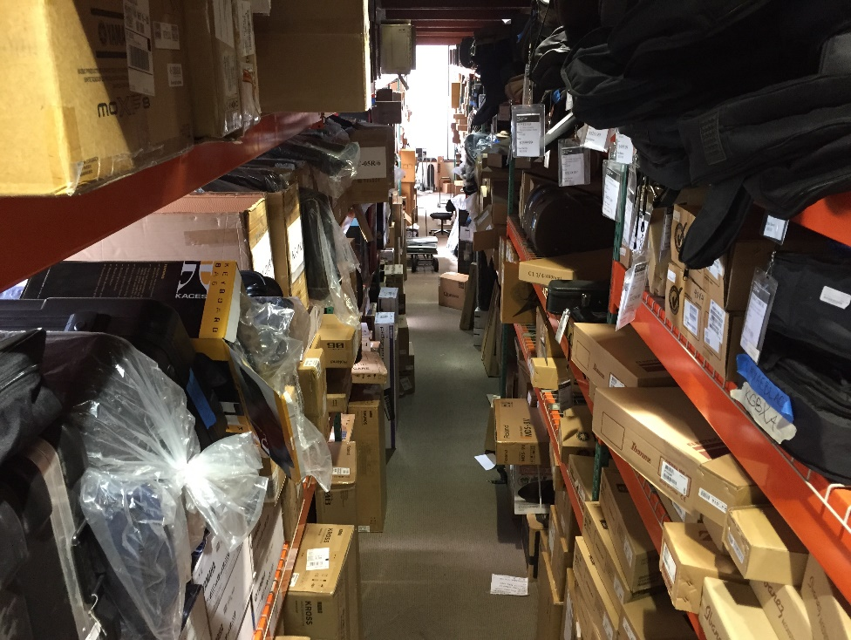

Slide 15
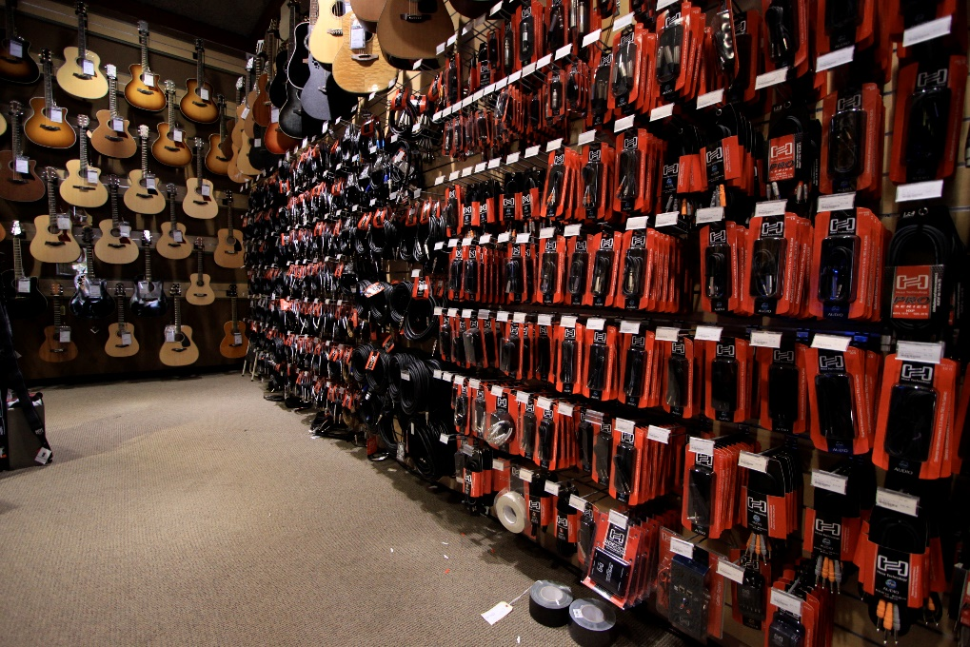

Slide 16
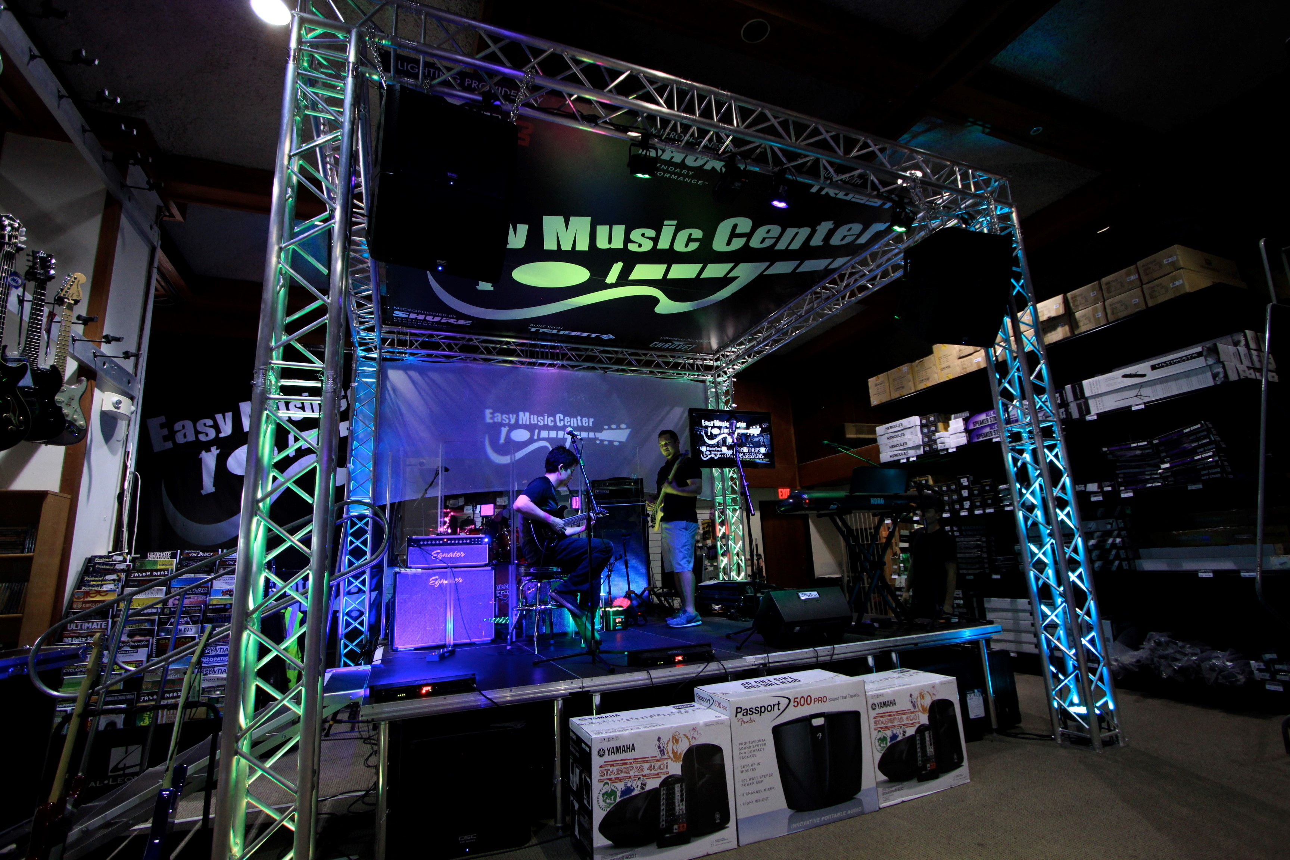

Slide 17
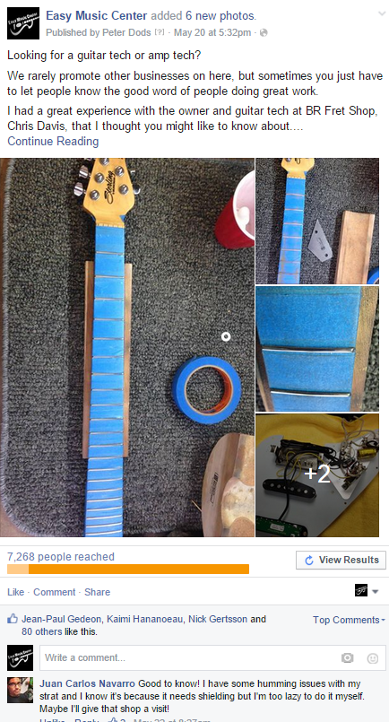
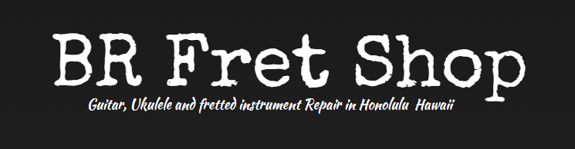
Sought out repair technicians
Vendors were not going to do this for us …
Helped foster new relationships
Promote them! They will promote you!
Facebook? Email blast?
Great for business
Good deeds: word gets around … BR is in our corner!

Slide 18
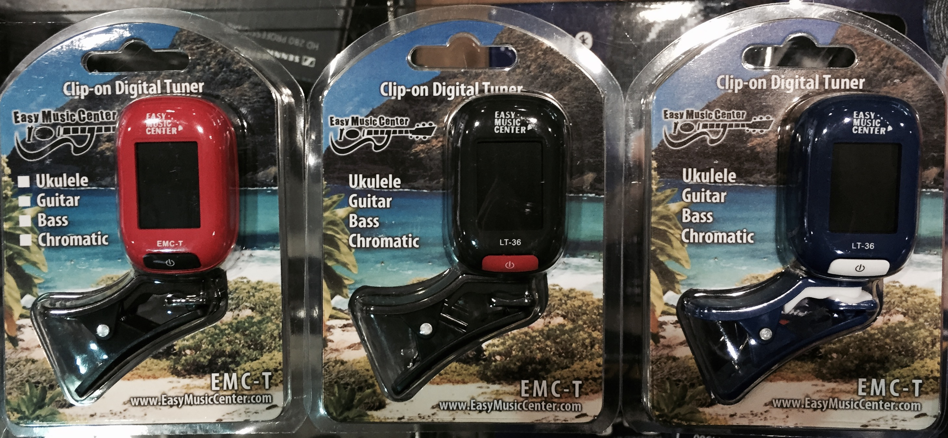
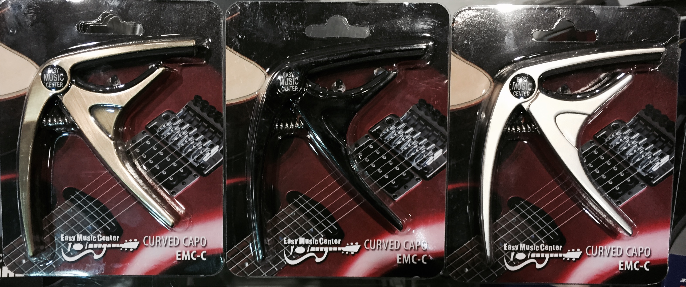
OEM
10-15% of our bottom line
“Beggars Lounge?” Get down there!
Tuners, capos, bags, etc.
Create BRANDED product that only you have
HI Bags … guy walking down the street
GP through the roof!
Great giveaways and BUYOFFS!

Slide 19
2009-2012: Hunkered down … put more and more into it, and seemed to be getting less out of it
2012: Foot traffic started to bounce back
Increase in PPE is noticed
Gross Profit per employee is at a record high
2013: A strong year
2014: A record-breaker
2015: Looking to be the strongest year yet

Slide 20
Find a mentor…
AIMM
Participate in NAMM:
NAMMU and Retail Boot Camp
Bring employees to the show
NYP – NAMM Young Professionals Event: Friday, July 10, 4–6 PM, Music City Center Room 205
More info at http://event.nammyp.com or nammyp.com
The industry is more than your store …

