Slide 1


Slide 2
5 Proven Events to Increase Traffic and Sales
Donovan Bankhead - Springfield Music, Inc
Gordon Wilcher - Owensboro Music
Don Tegeler - Tegeler Music Center
Allen McBroom - Backstage Music
Jim Destafney - Blues Angel Music
Proud Members of
MusicStoreOwners.com!

Slide 3

Musician’s Flea Market & Swap Meet
Gordy Wilcher: Owensboro Music Center - Owensboro, KY
owensboromusic@yahoo.com

Slide 4
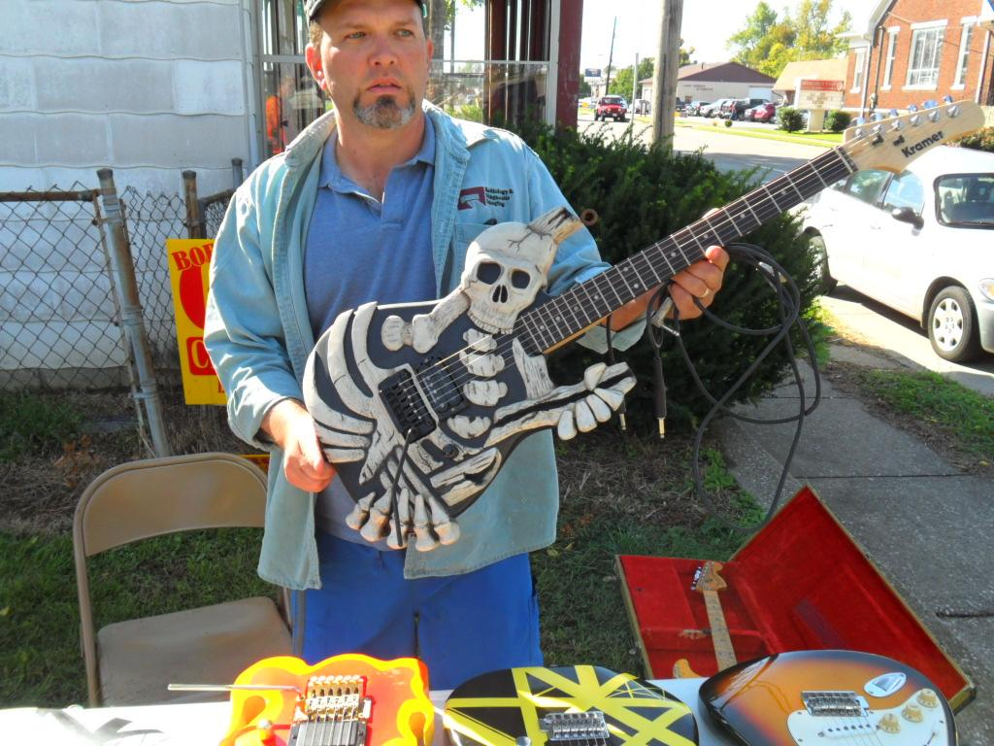
How does a Musician’s Swap Meet benefit my store?

Slide 5
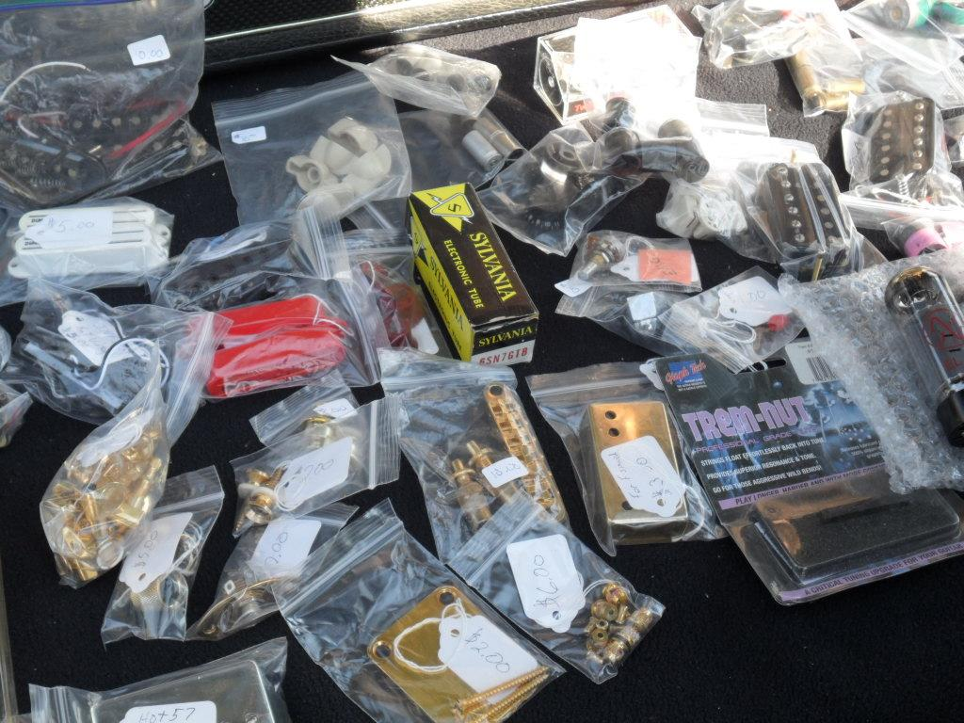
Typical objections...

Slide 6
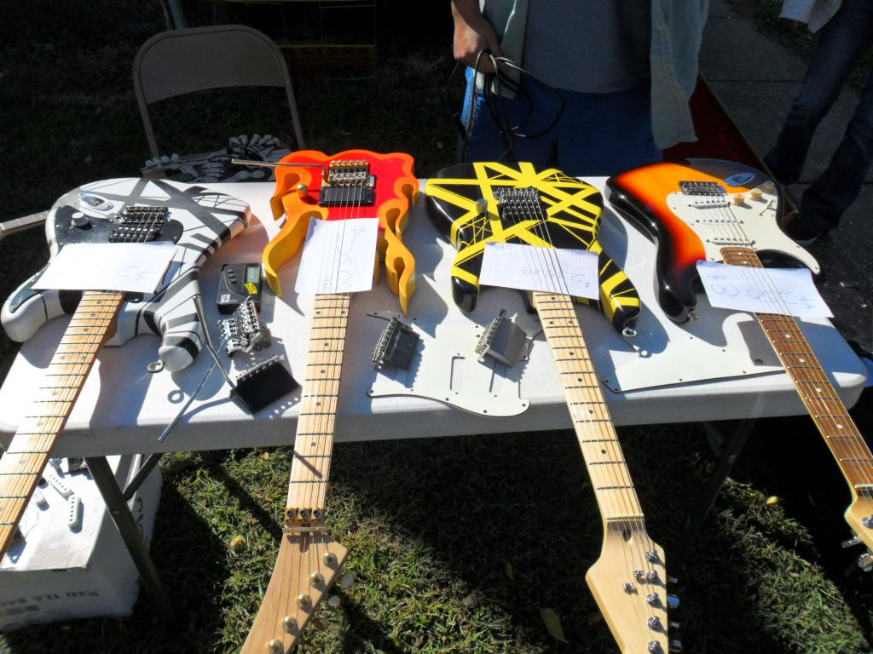
Some tips on selecting a good date and location...

Slide 7
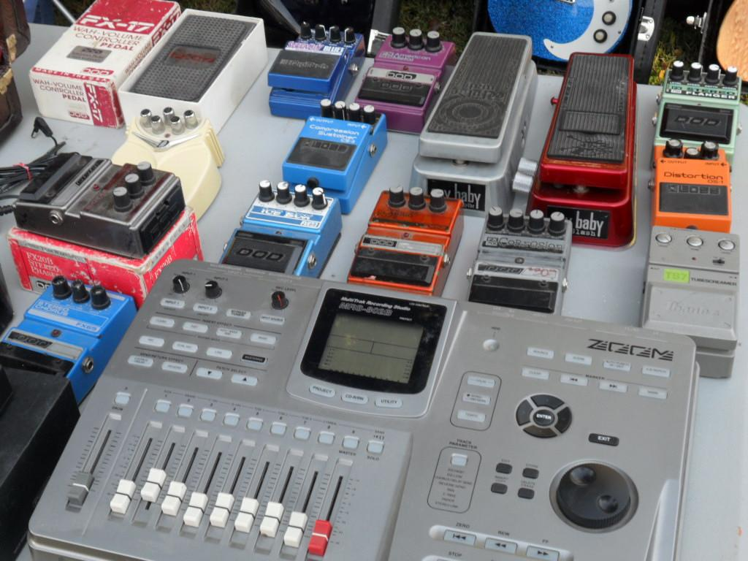
How to prepare for your Musician’s Swap Meet...

Slide 8
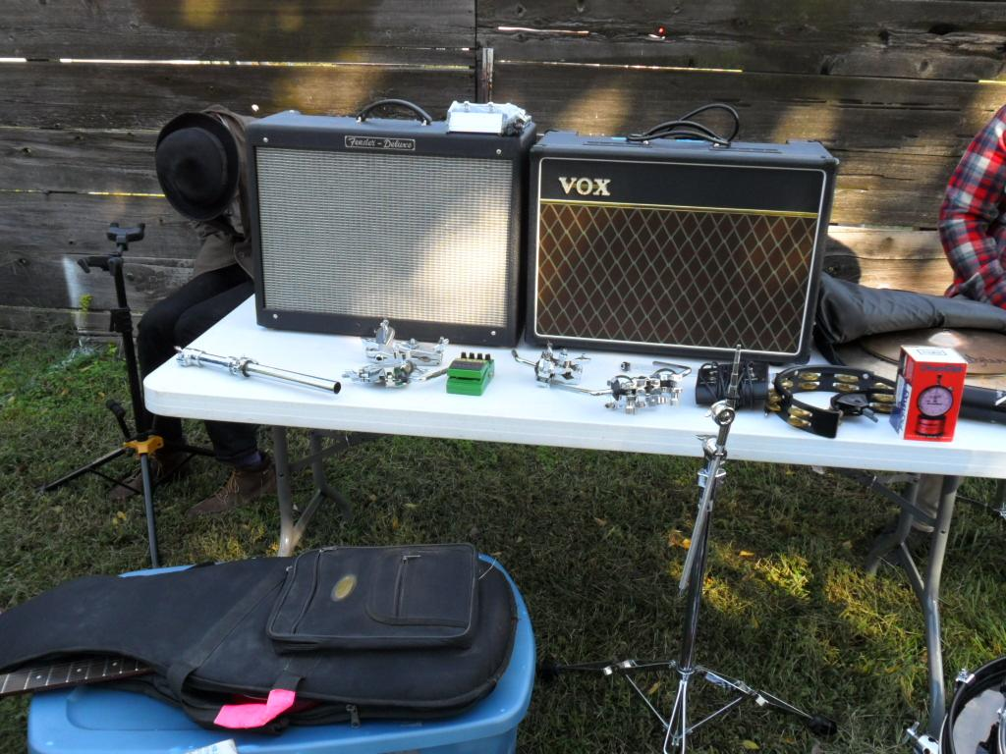
Lessons learned...

Slide 9
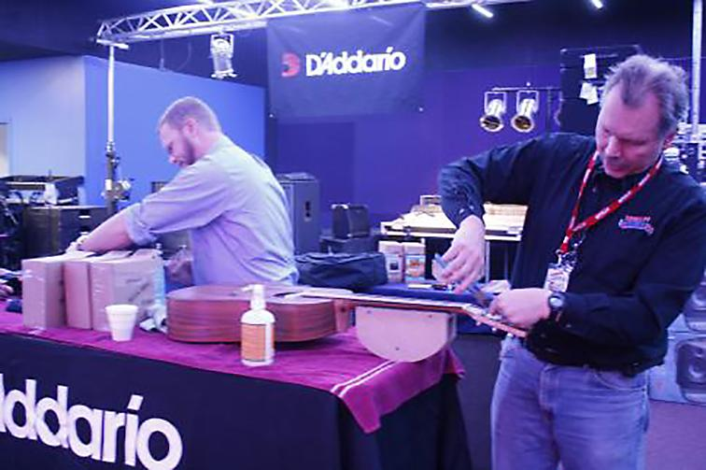

Food for Strings - Now with LIVE Video Streaming
Don Tegeler: Tegeler Music - Clinton, IA
don@tegelermusic.com

Slide 10
6 Things Before Your Event:
Set your date
Contact your string provider and ask them to donate strings
Ask other vendors for giveaway items
Line up your volunteers – restring personnel, check-in, photos and video, jam session host
Decide what guitar items to put on sale that day and stock up - Cases, Tuners, etc.
Start marketing – social media, email list, etc.

Slide 11
10 Things on the Day of the Event:
Setup restring stations and check-in table
Take care of volunteers – maybe donuts and coffee
Set up a scale to weigh the food
Do sequential numbers on the guitars to keep them in order
Hand out tickets for drawings
Be ready to write work orders for additional repairs needed on guitars

Slide 12
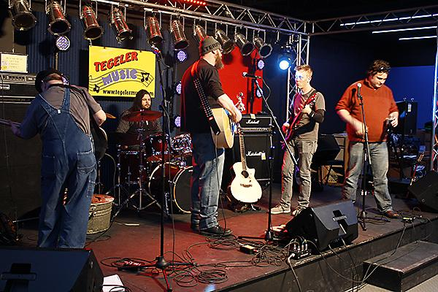
7. Organize and start jam session

Slide 13
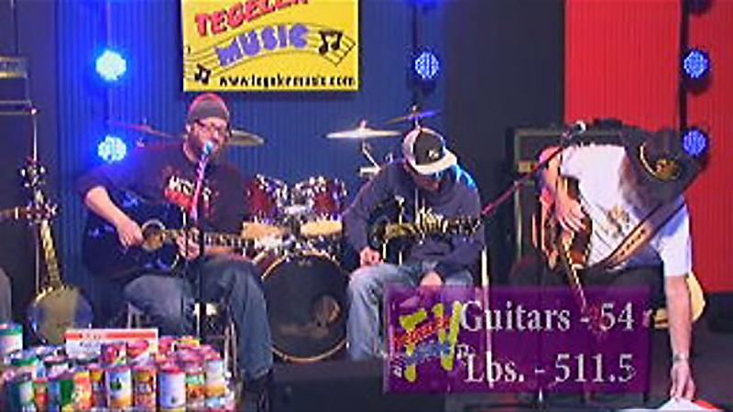
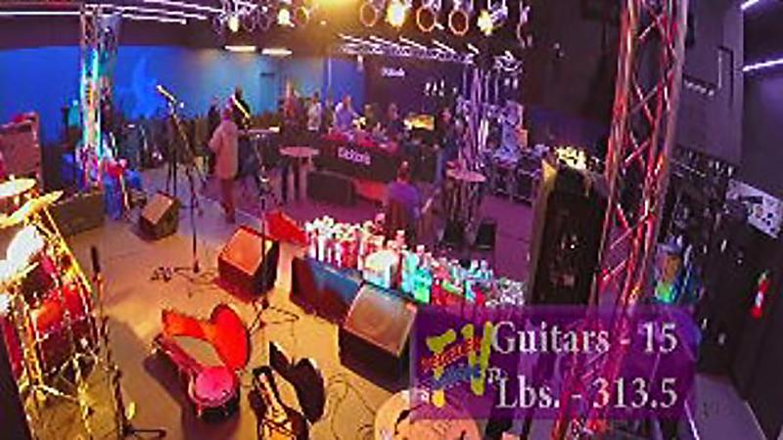
8. Videotape and take photos of the event
9. STREAM the event live - Livestream.com or Google Hangouts

Slide 14
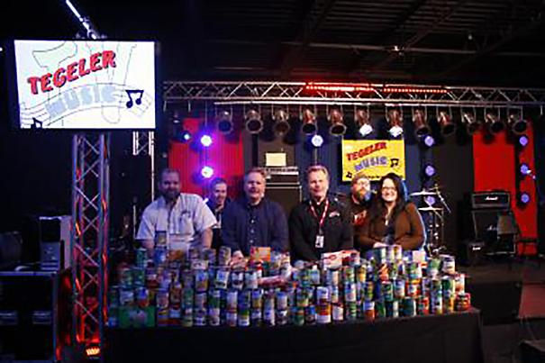
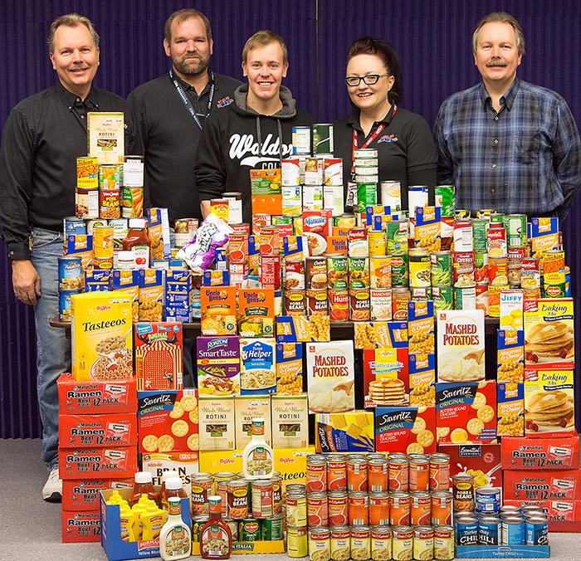
10. When it's over, stack up the food and take a group photo

Slide 15
3 Things After the Event:
Post photos and videos to social media
Write and send a press release to local news outlets
THANK THE VOLUNTEERS

Slide 16
How to Turn a Vendor Rep Visit Into a Store Event
Allen McBroom: Backstage Music Company - Starkville, MS
AllenMcBroom@backstagemusic.com

Slide 17
How to Turn a Vendor Rep Visit Into a Store Event
Arrange with one of your reps to do a four-hour afternoon event showing off new or cool gear.
Ask rep to donate a good giveaway product
Get the word out. Start pushing the event on social media and email two weeks prior to the event

Slide 18
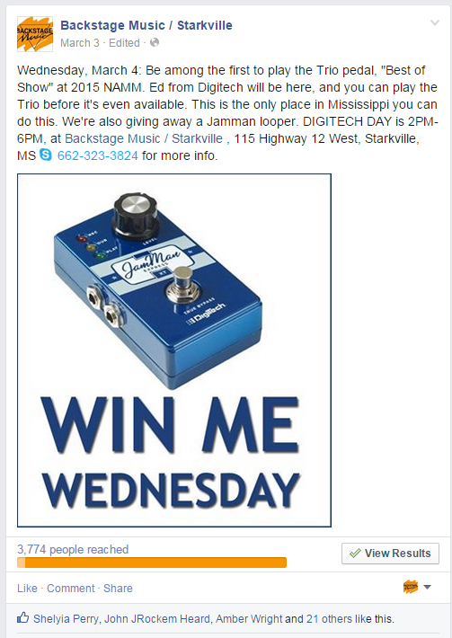
Boost your Facebook promos.
Use photos of the giveaway item.

Slide 19
Get the rep to come early on the event day. Get you and your staff up to speed on what the demos will be, how the products work.
At the event:
  Take lots of clear photos.
  Video the demos.
  Have a drawing.
When it is over, send the rep a thank you letter.

Slide 20
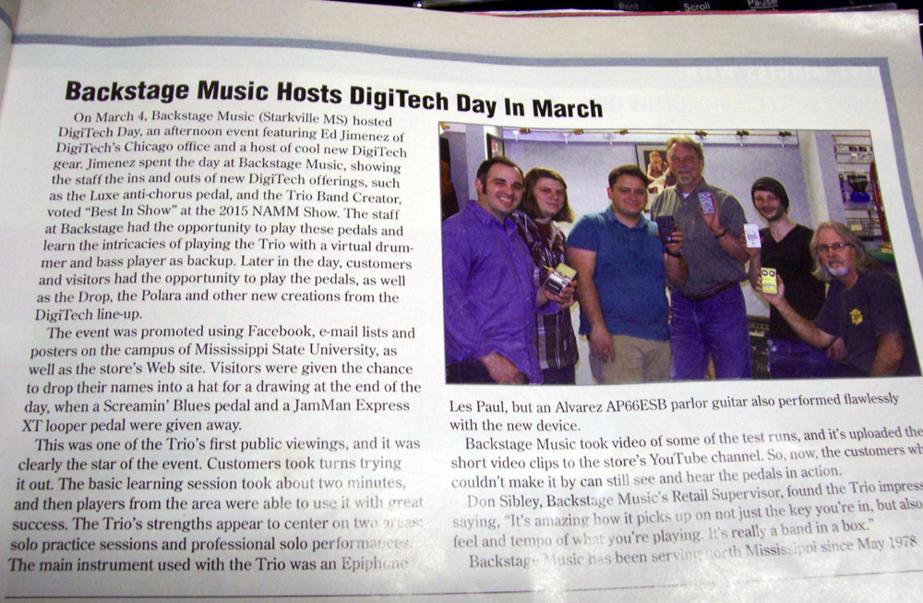
Write an article for the trade journals, and email it, with several photos.
Make sure the rep is in the photos.

Slide 21
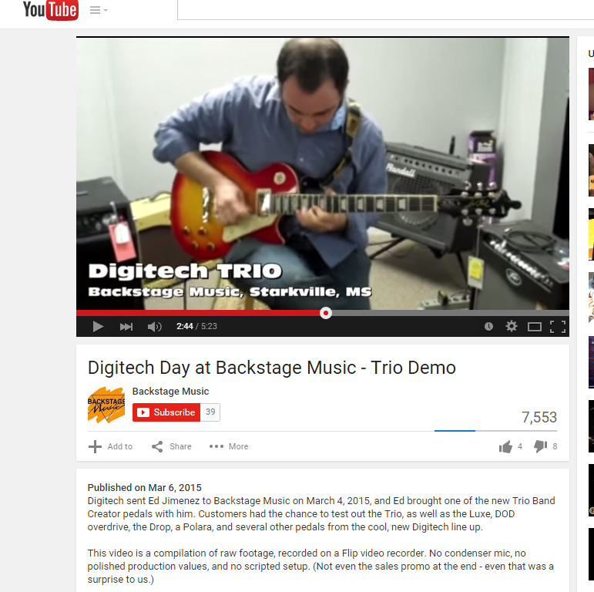
Make brief product demo videos, and post them on YouTube, Facebook, your website, etc.

Slide 22
Total cost of a relatively high-profile event: $128
That’s Facebook boosts, posters, refreshments and the rep’s lunch.

Slide 23

Get OUT of Your Store and Get IN FRONT of Your Customers!
Donovan Bankhead: Springfield Music - Springfield, MO
donovan@springfieldmusic.com

Slide 24
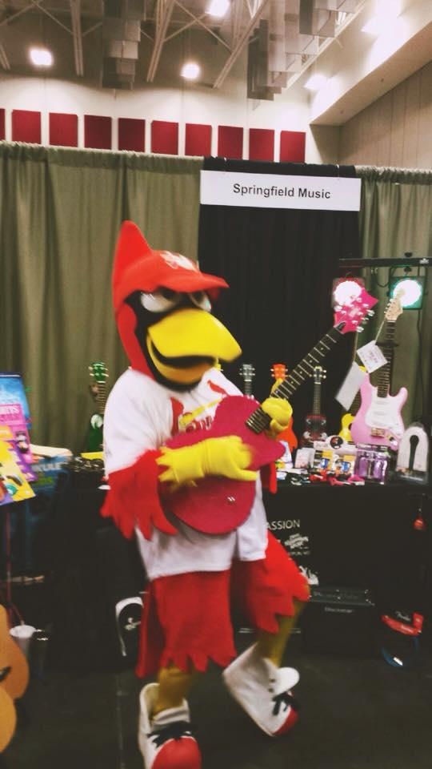
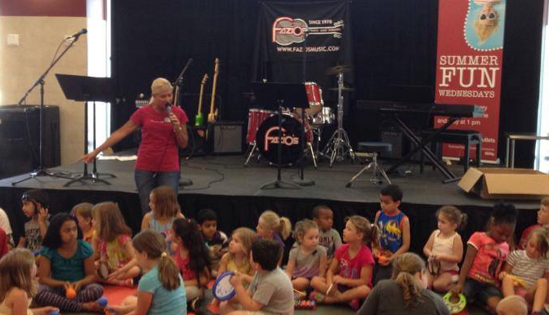
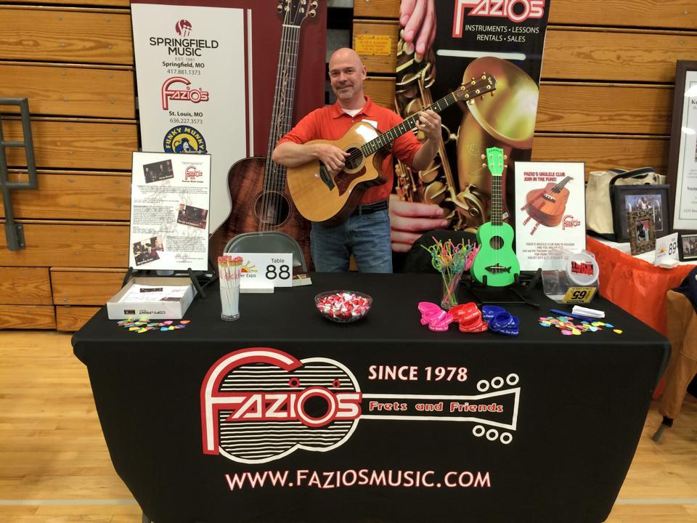
Use the Power of Other People’s Marketing and Draw!

Slide 25
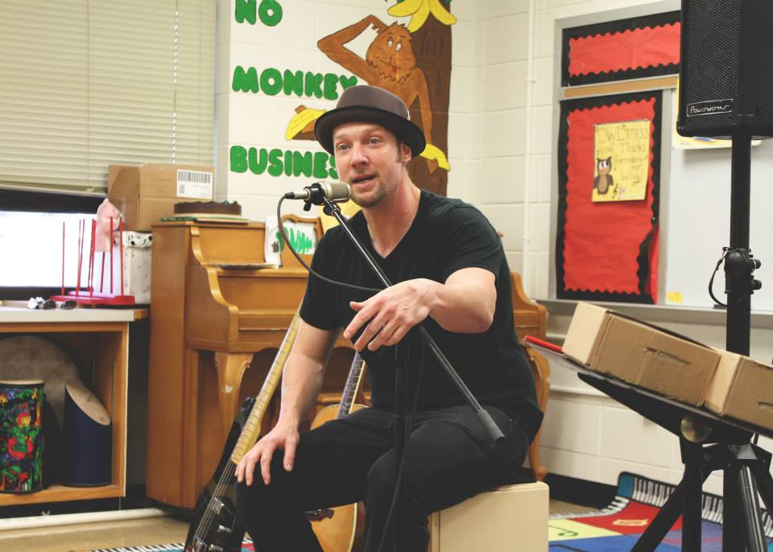
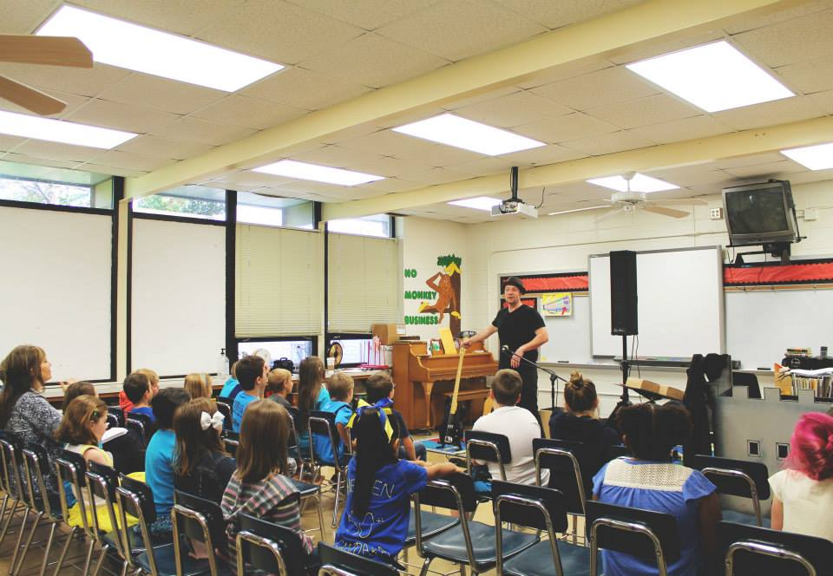
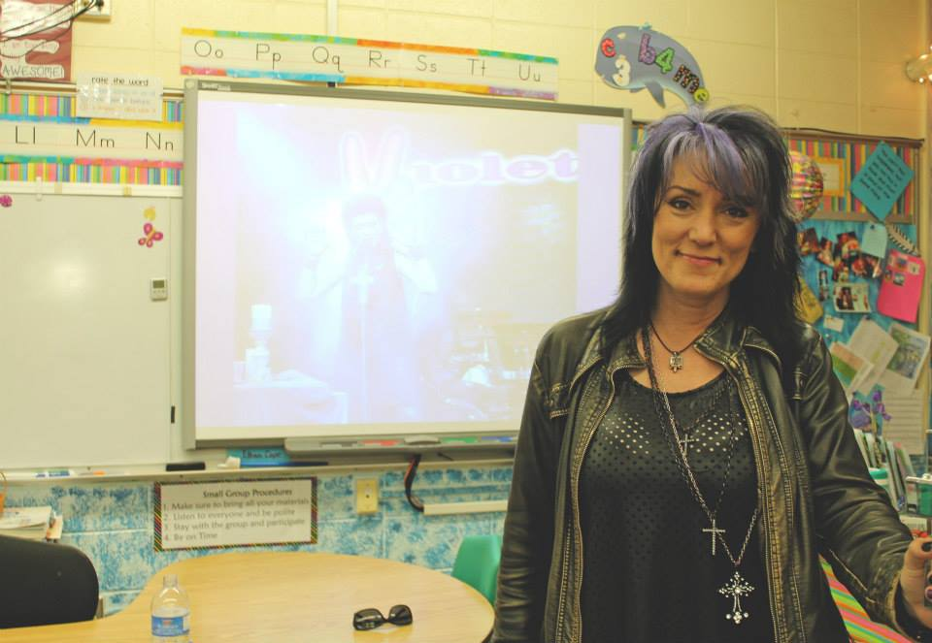
Use Career Day as an Opportunity to Educate & Promote!

Slide 26
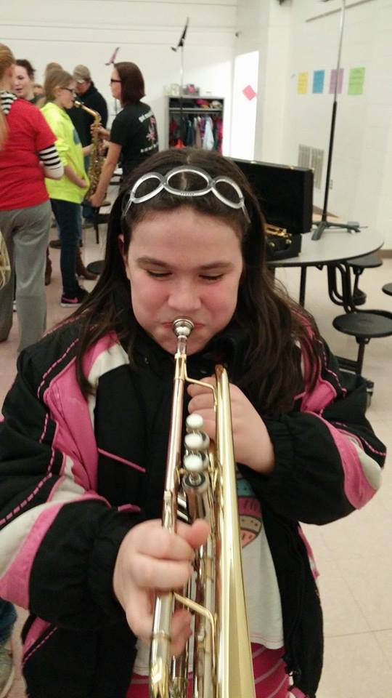
Sponsor an Instrument Petting Zoo

Slide 27
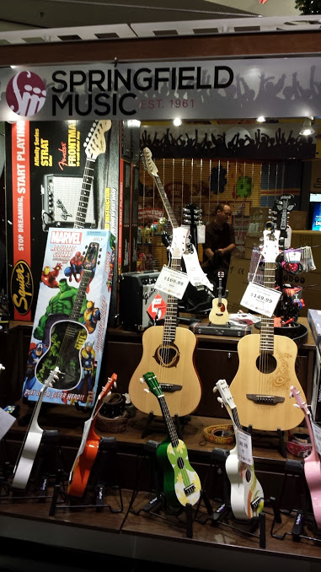
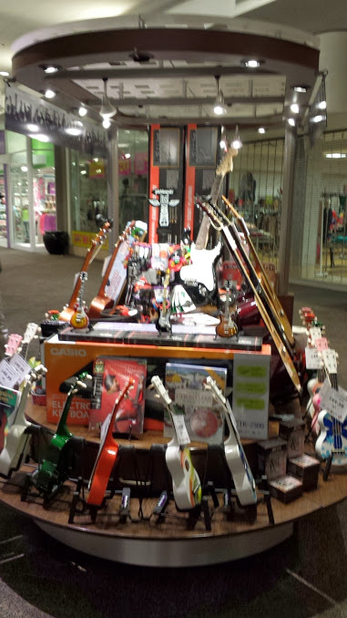
Holiday Mall Cart

Slide 28
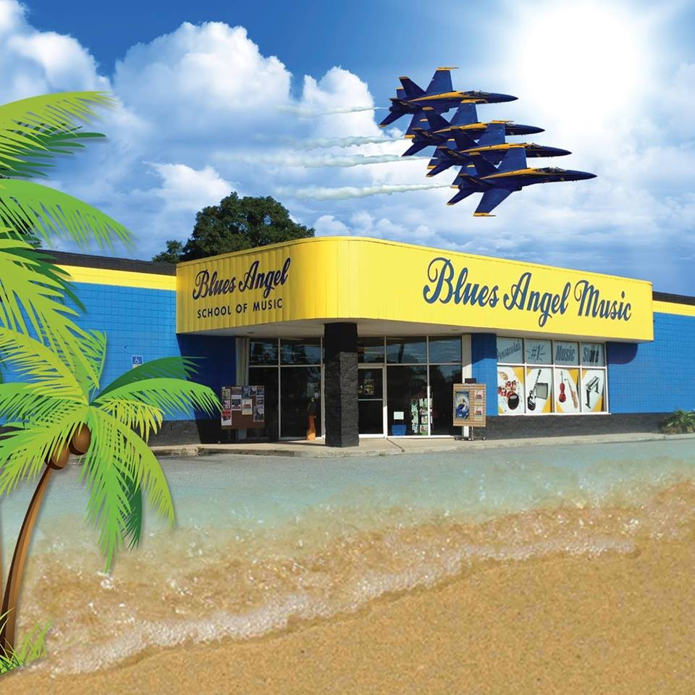
Ukulele Events Program
Jim DeStafney, Owner, Blues Angel Music, Inc.

Slide 29
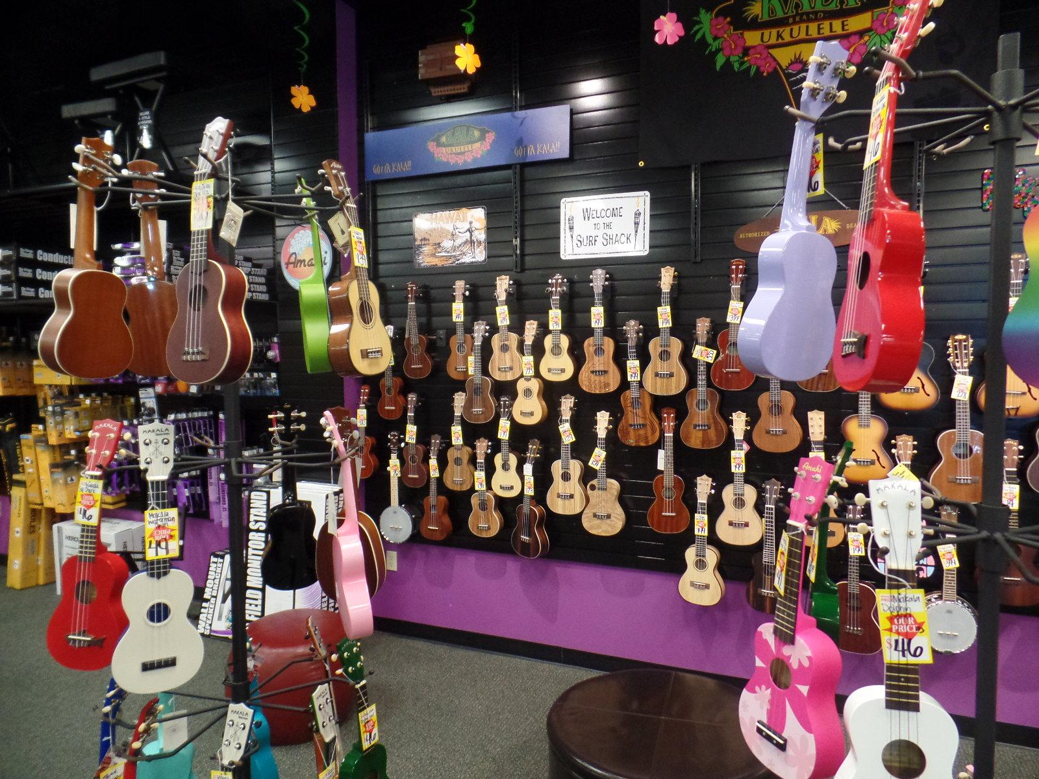
1. Ukulele Product Selection
2. Ukulele Merchandising
3. Ukulele Events

Slide 30
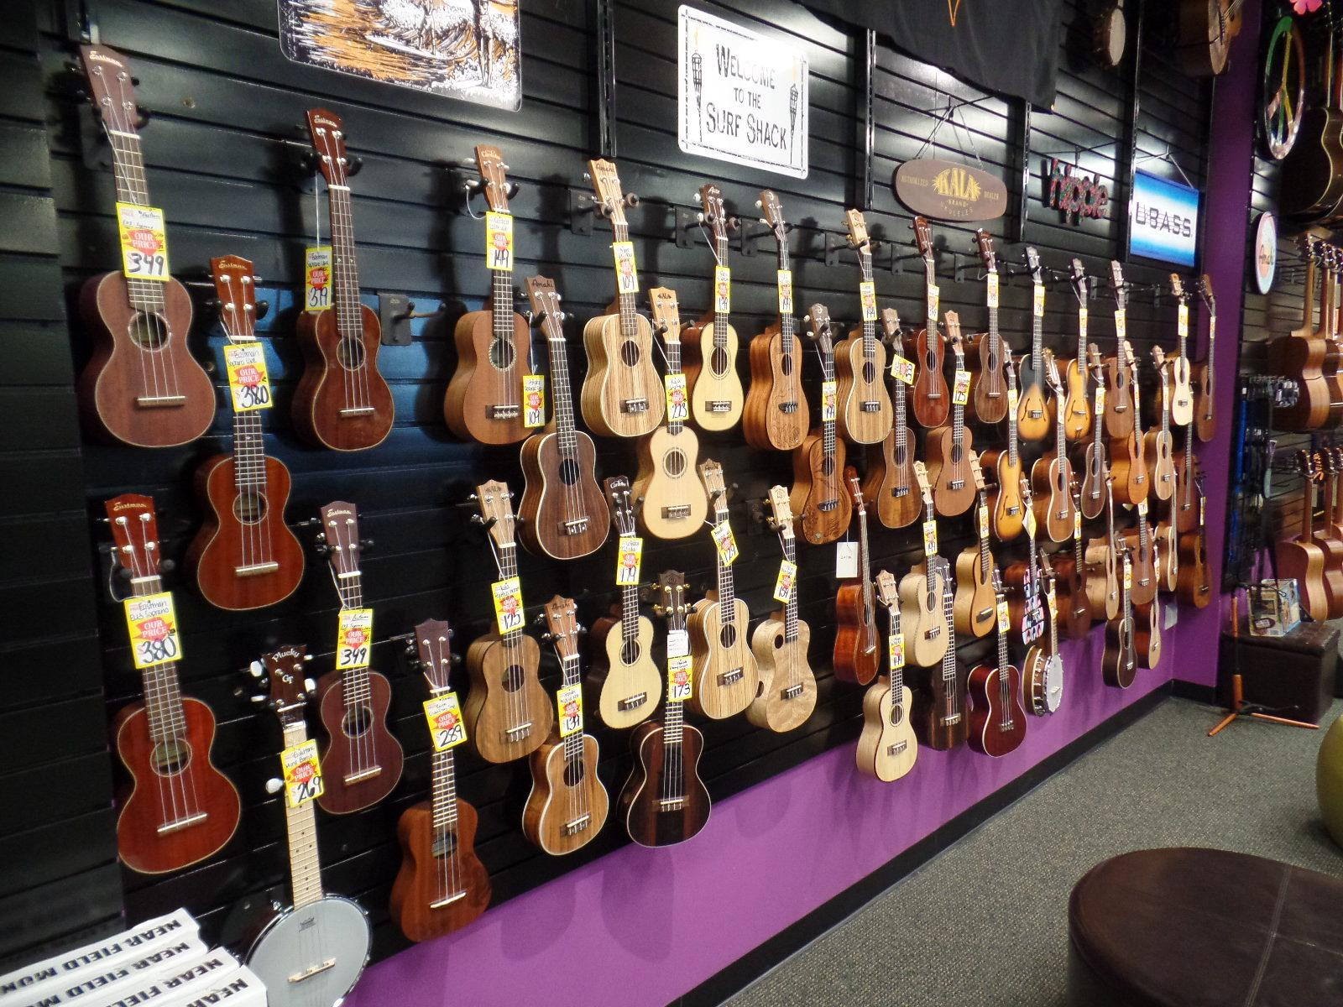
Product Selection
100+ Ukes
Accessories are Important
Many Brand Choices
Hot Button Price …

Slide 31
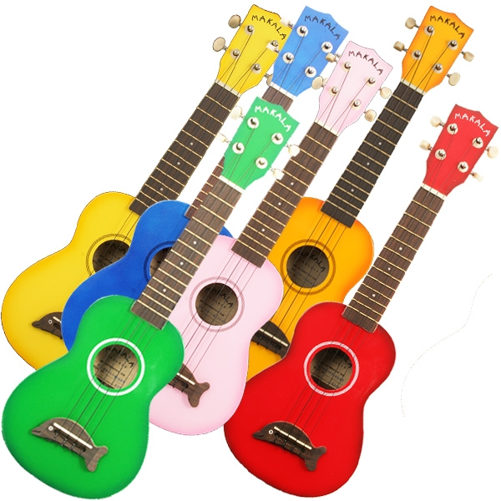
Merchandising
Fun…Fun…Fun!!!
Colorful
Strategic Location

Slide 32
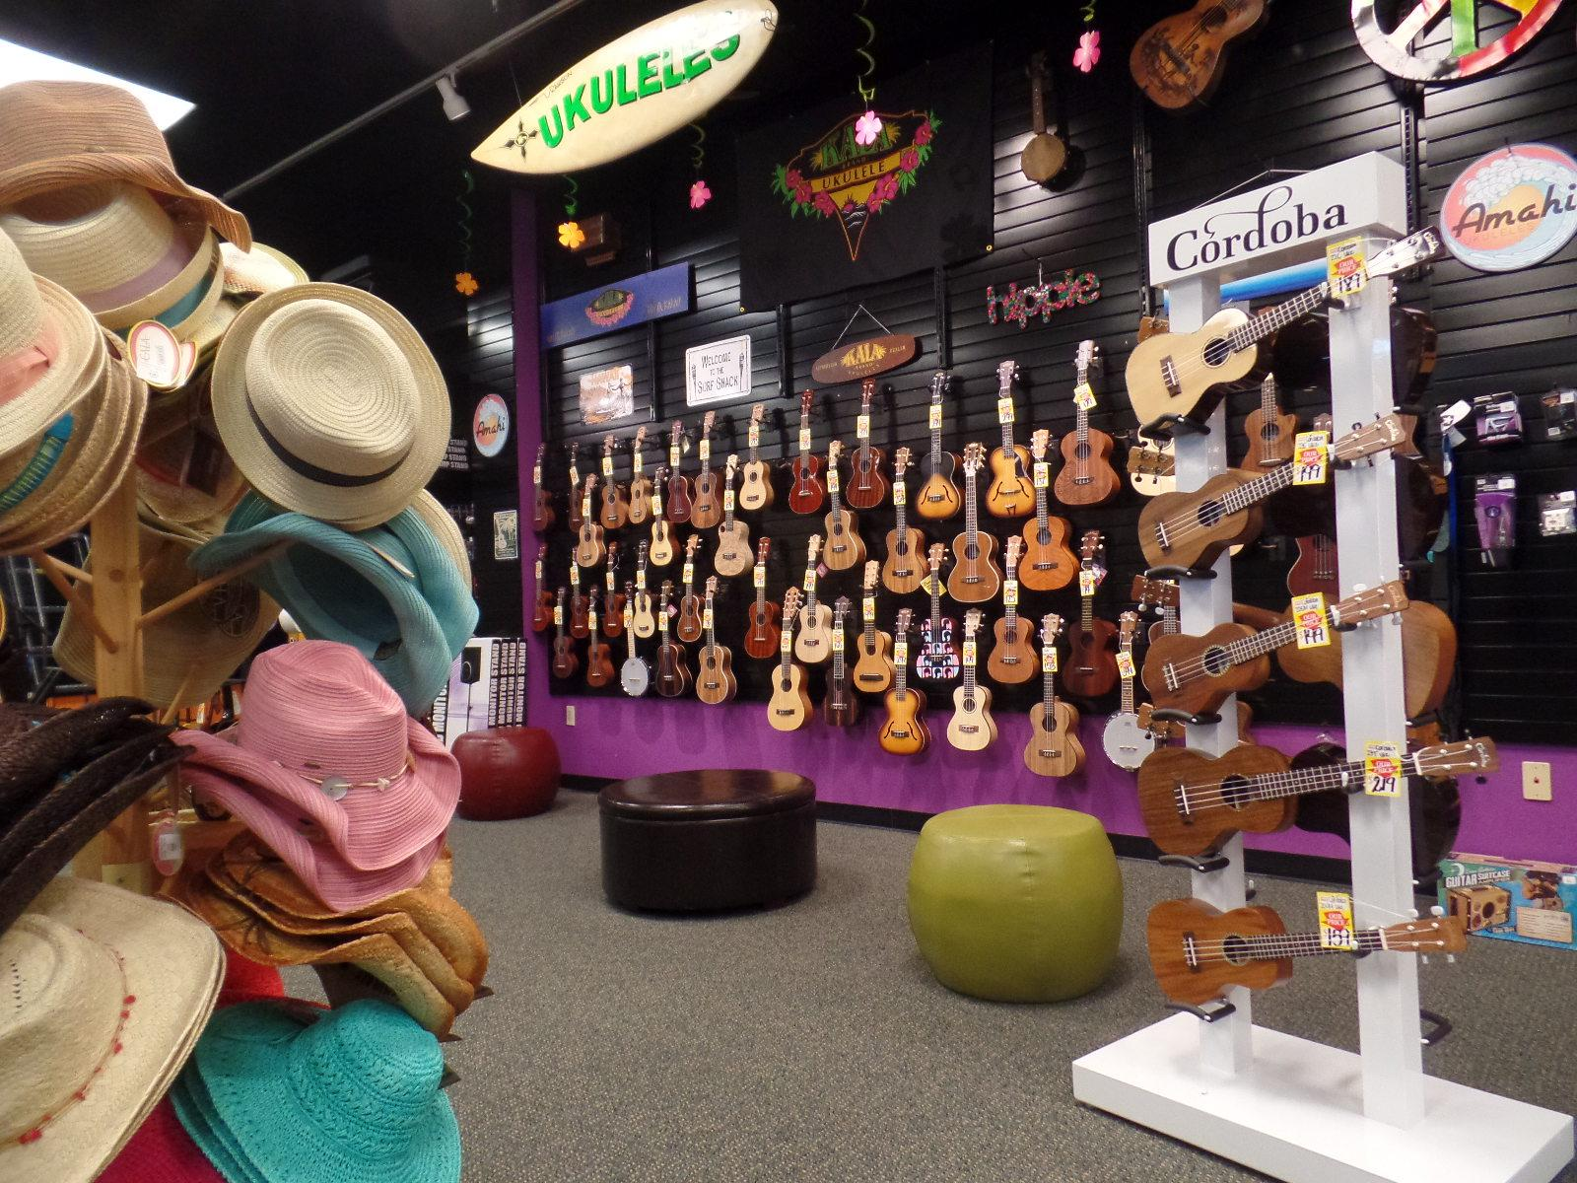

Slide 33
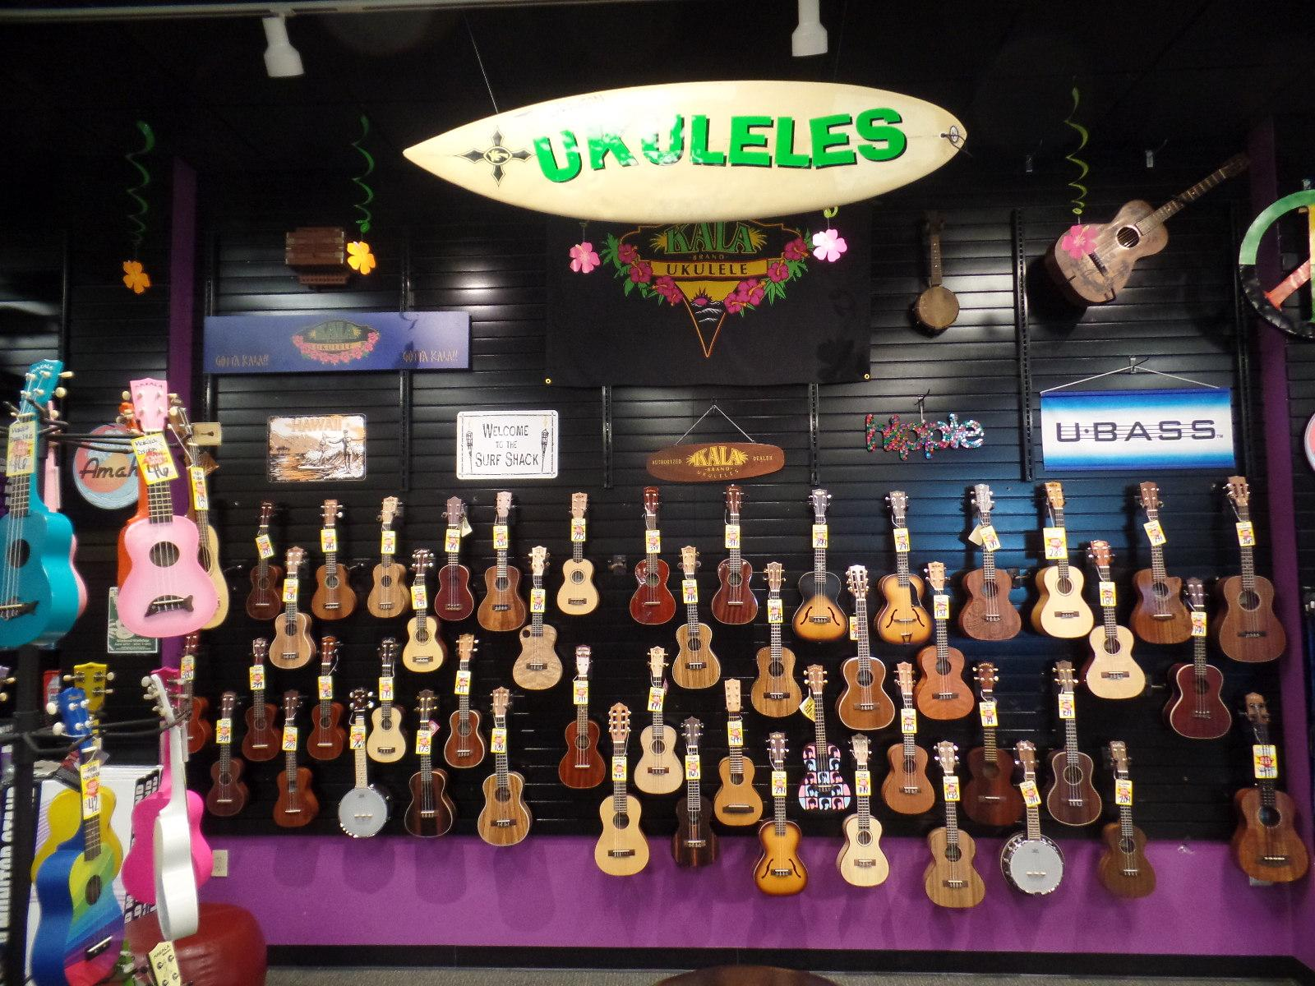

Slide 34
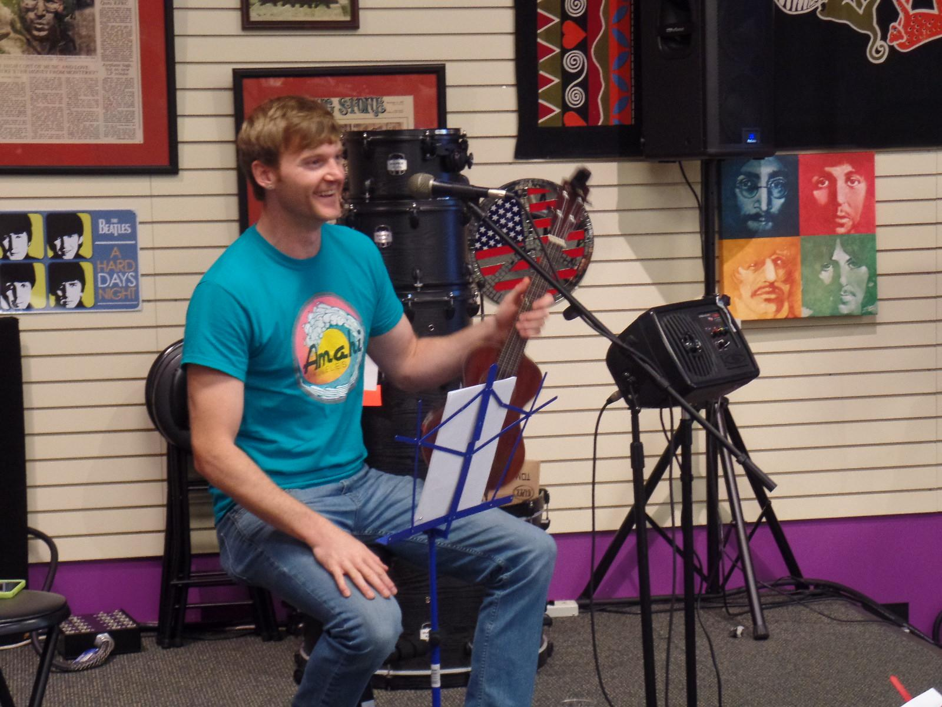
Events
Group Ukulele Lessons
Ukulele Group/Club
  Started as Jam, Became Club/Group
  Take it Seriously
  Social Media
  Community Outreach
  Ukulele Clinic
Build Your Own Ukulele

Slide 35
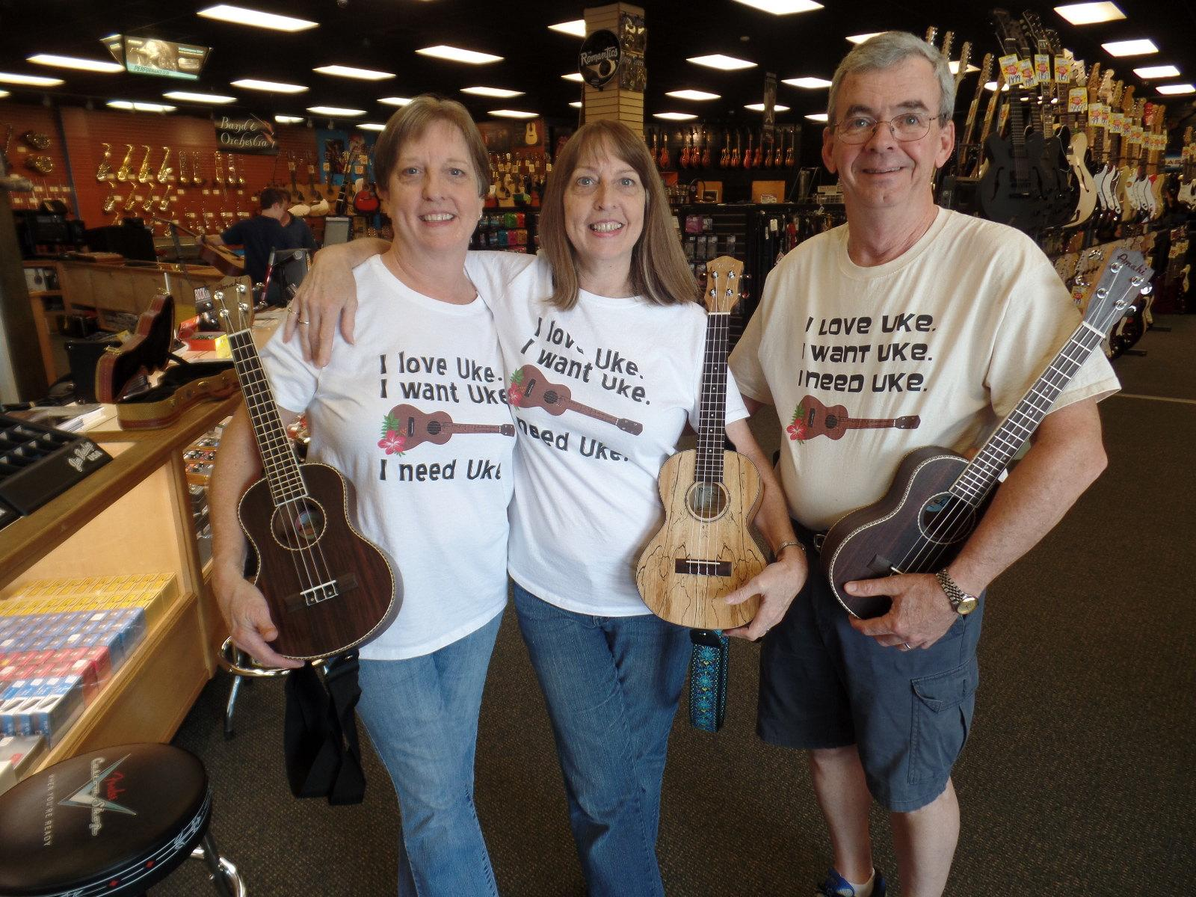

Slide 36
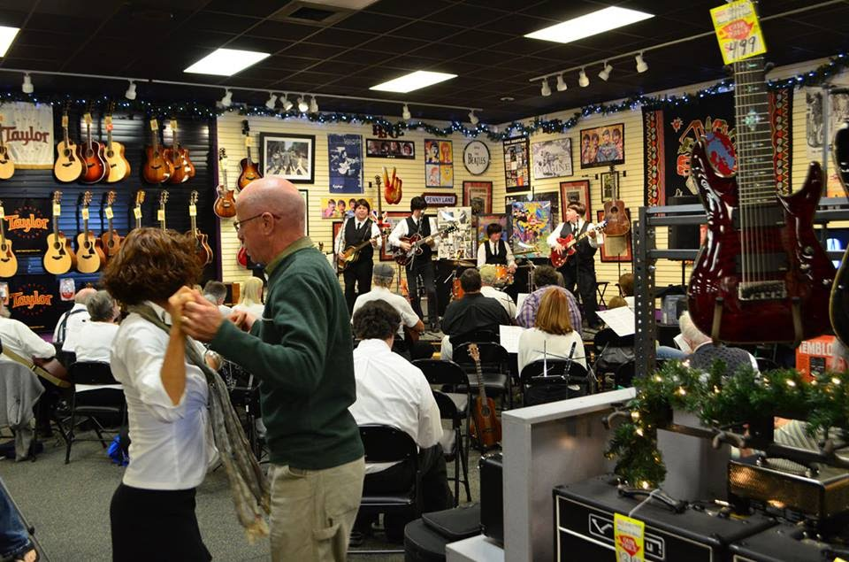

Slide 37
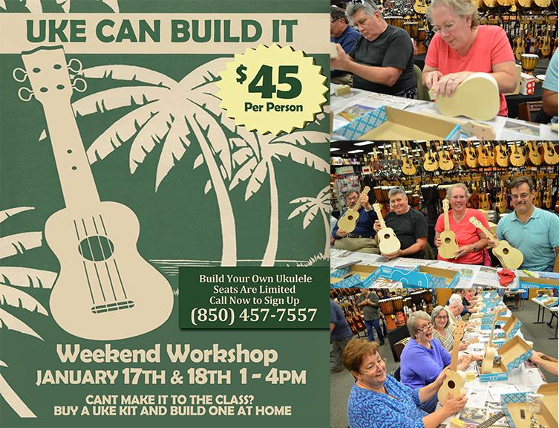

Slide 38
Ukulele Events Program
Jim DeStafney, Owner, Blues Angel Music, Inc.

Slide 39

BONUS TIP: Join the Independent Music Store Owner’s Group!
It’s free, and you can connect with hundreds of other store owners like yourself to share ideas, strategies and stories!
http://musicstoreowners.com/
Download this presentation at
http://musicstoreowners.com/2015.ppt

