Slide 1


Slide 2
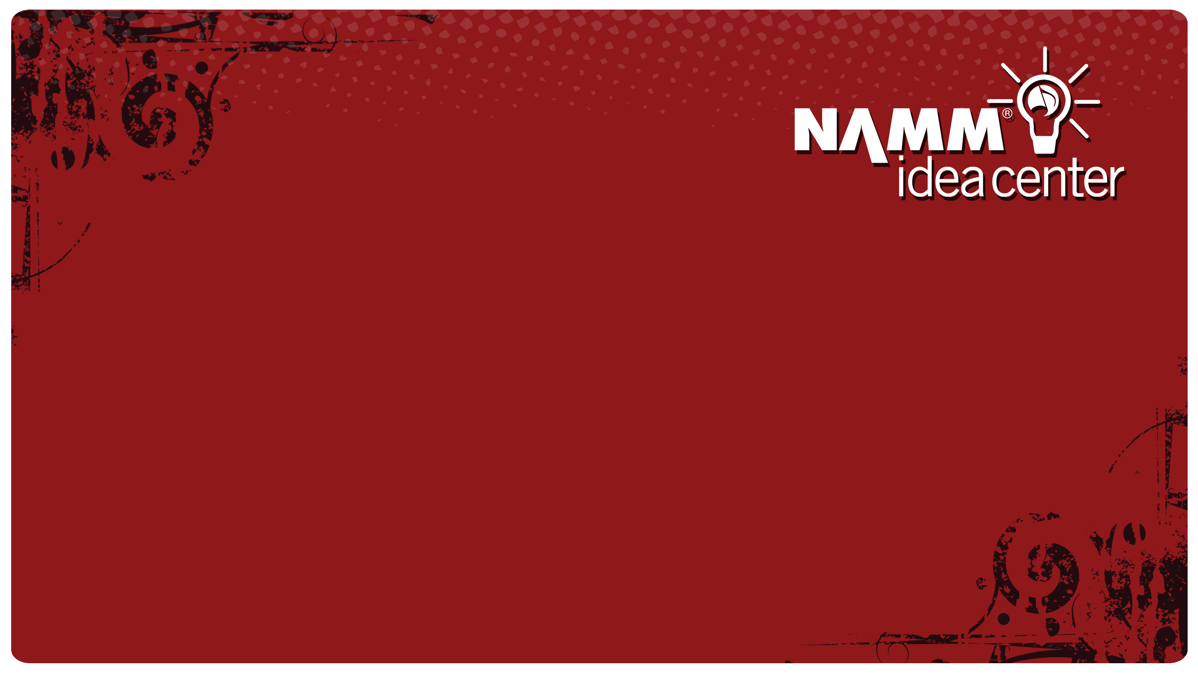
Do Your Customers Trust You Enough To Buy?
Tony Caporale – TwinBear Management
Jen Lowe – Friedman, Kannenberg & Co.

Slide 3
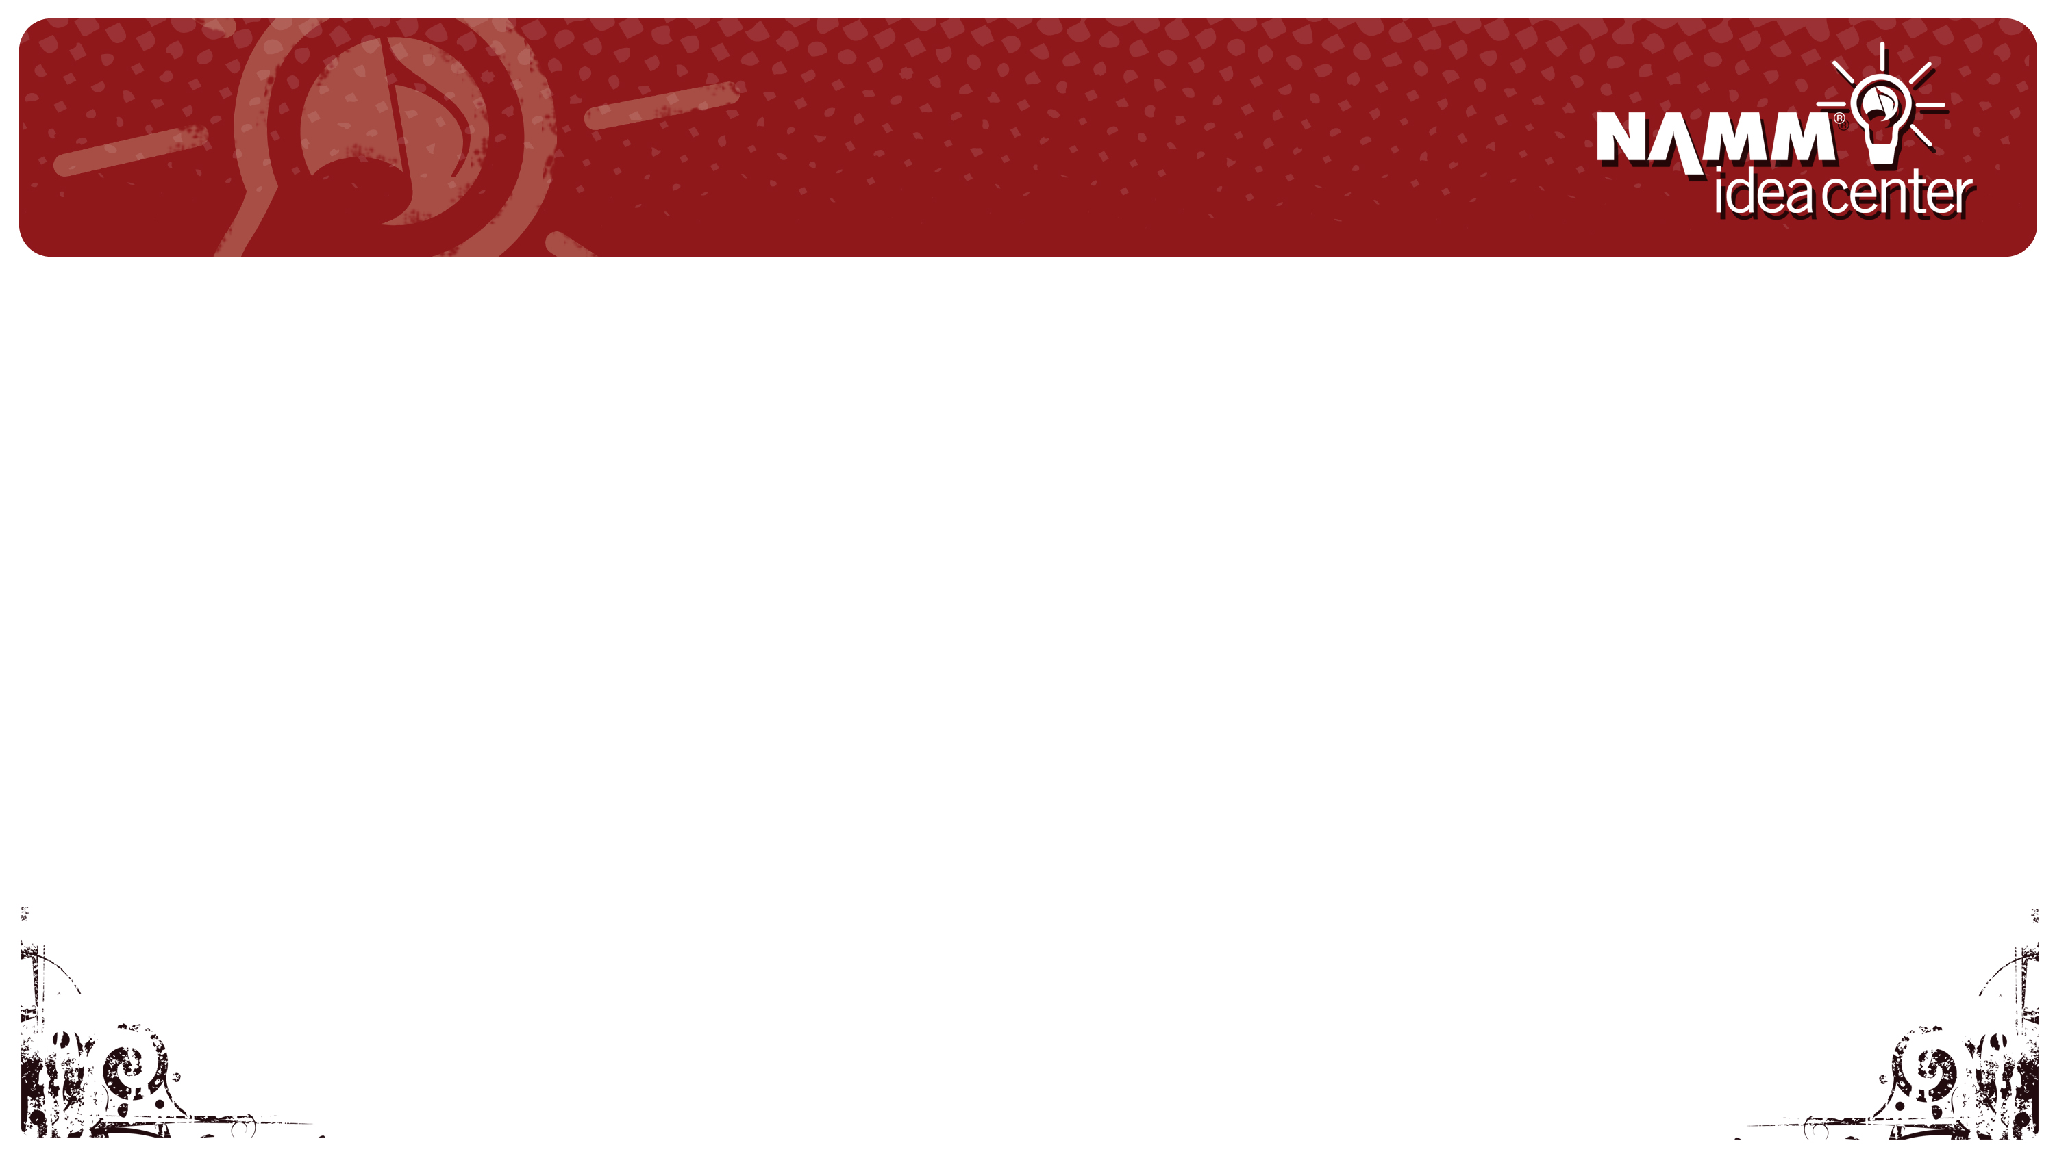

Tools of the Trade
Content at your finger tips
Manufacture’s
Local Artists
Community Events

Slide 4

Repost and share…

Slide 5
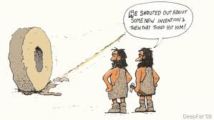
Build Trust With Your Likeness
Study your peers – no need to reinvent the wheel

Slide 6
Use video to introduce products, your staff and yourself to your audience

Slide 7
Build trust by giving your brand a voice

Slide 8
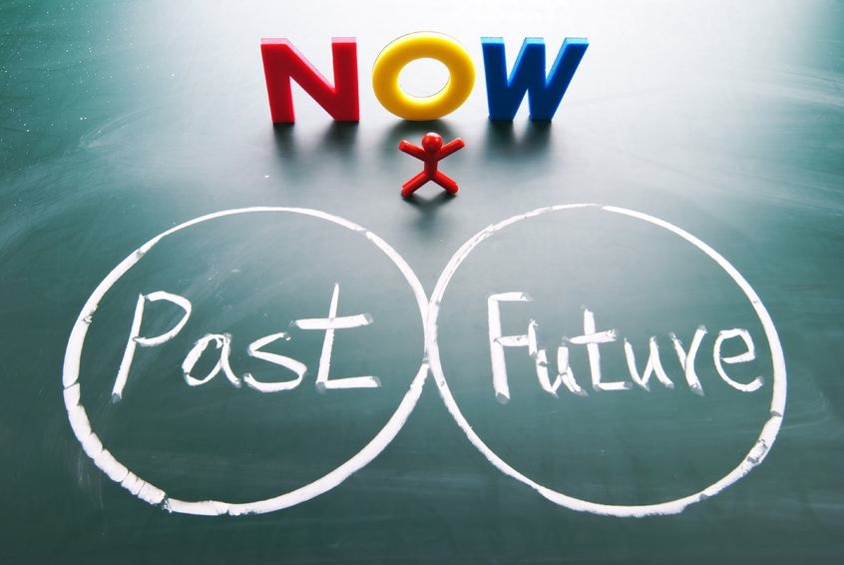

Slide 9

Last Five Years
People Connecting to People

Slide 10
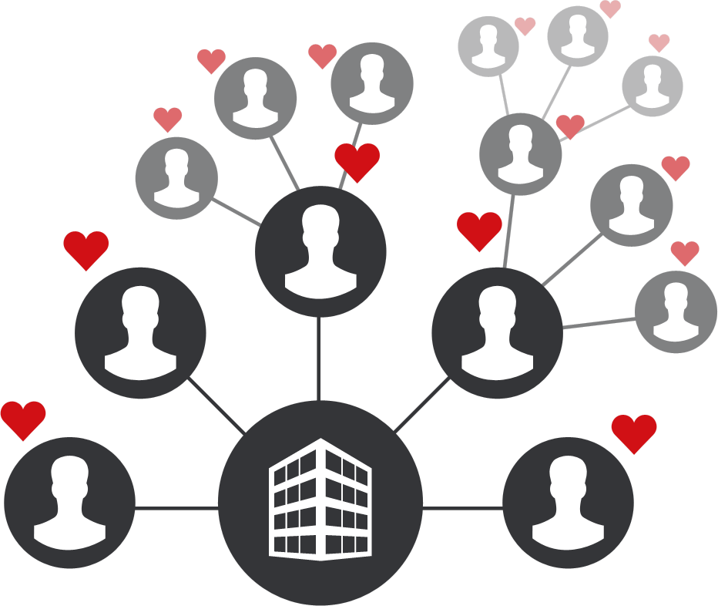
Next Five Years
Businesses Connecting to People

Slide 11


Slide 12

Guest Relationships
{ National Brand }

Slide 13
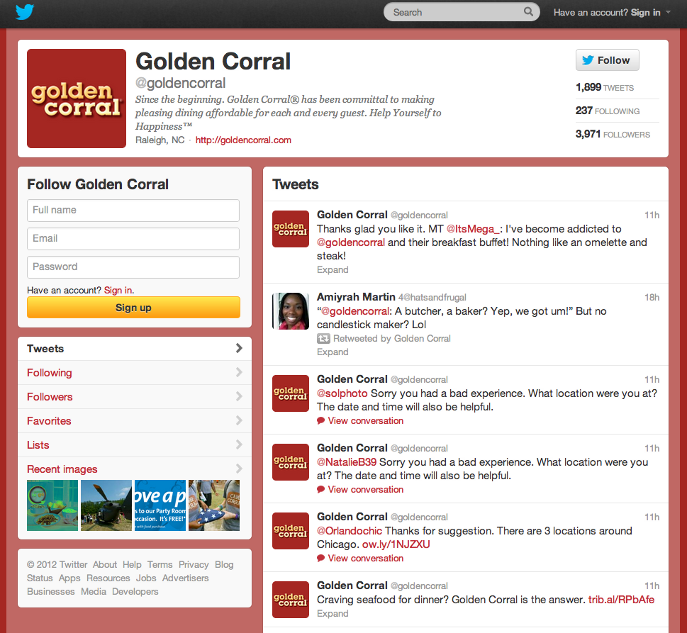
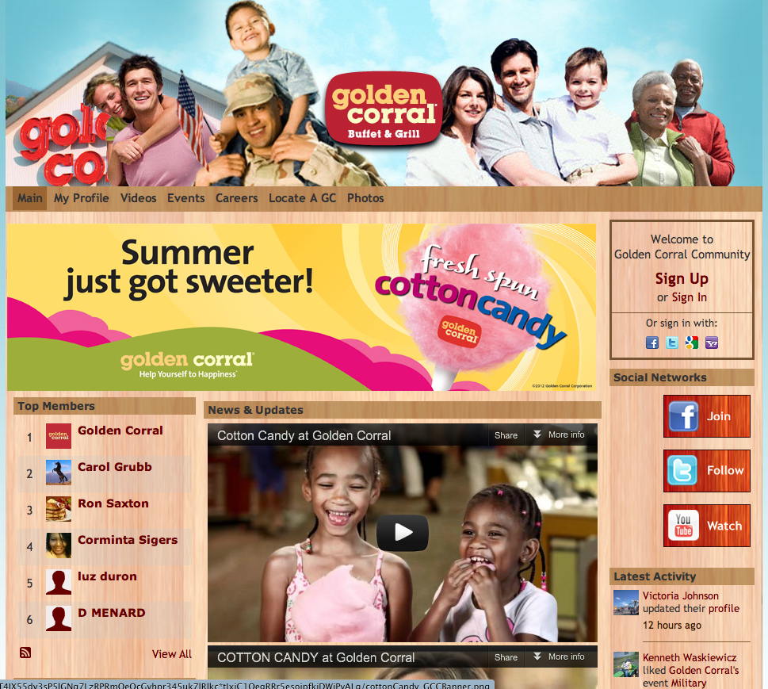
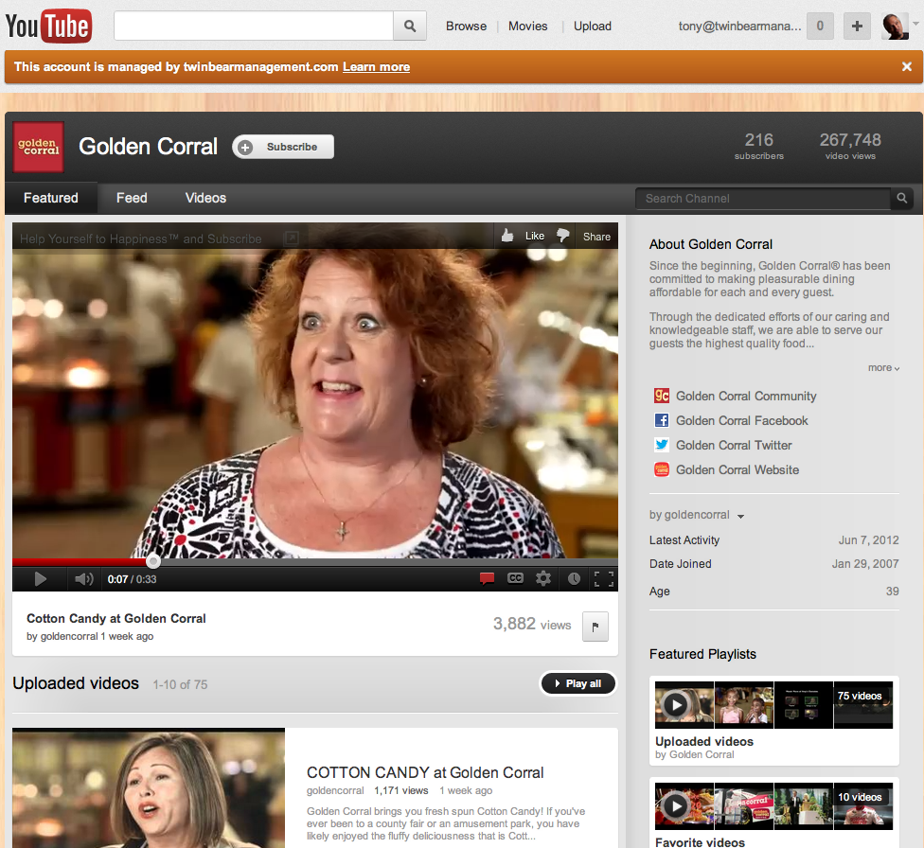
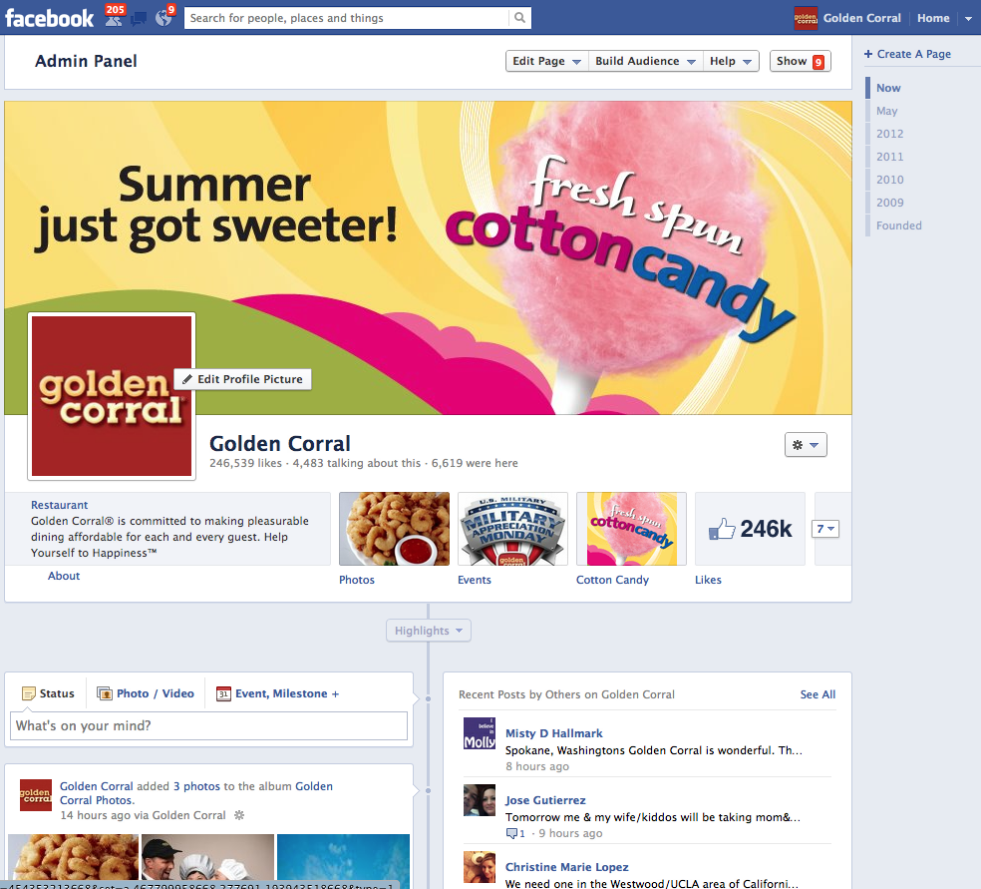

Slide 14
337%
Organic Growth!
Identified Content
Added Technology

Slide 15
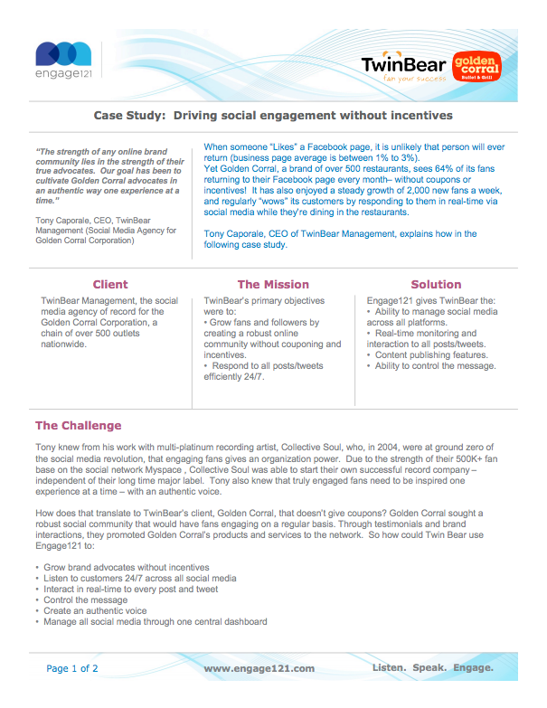
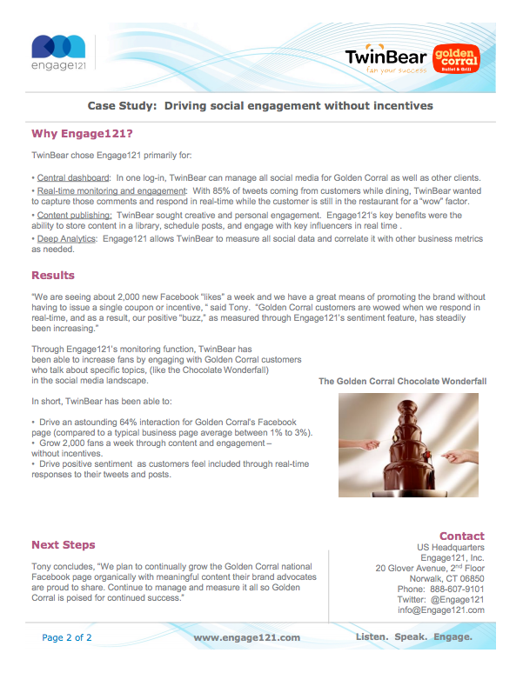

TwinBear drives engagement without giving anything away!
“Golden Corral, a brand of over 500 restaurants, sees 64% of its fans returning to their Facebook page every month– without coupons or incentives!”

Slide 16
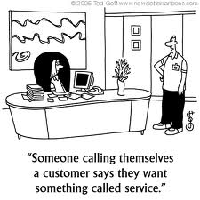
Customer Service
Ask Questions
Respond timely
Engage Often

Slide 19

Create POP
Let your customers know how to socialize with you

Slide 20
Questions?
www.twinbearmanagement.com
www.fkco.com

