Slide 1



Give Credit Where Credit Is Due
(a panel discussion)
A Panel Hosted By
Alan M. Friedman, CPA
Friedman, Kannenberg & Company, P.C.

Slide 2
“Banking & Financial Crisis”

Slide 3
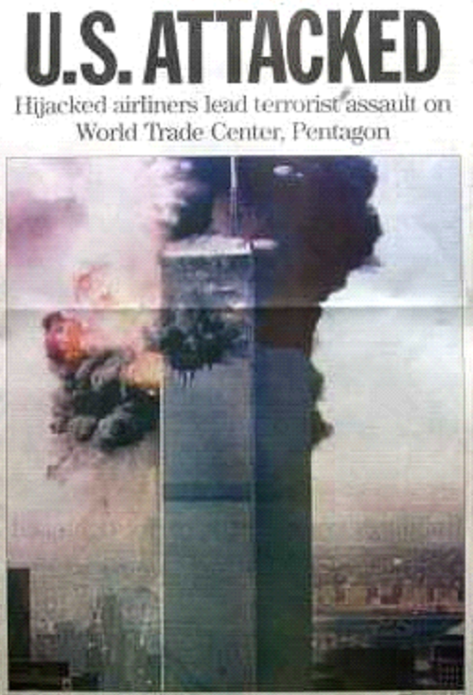
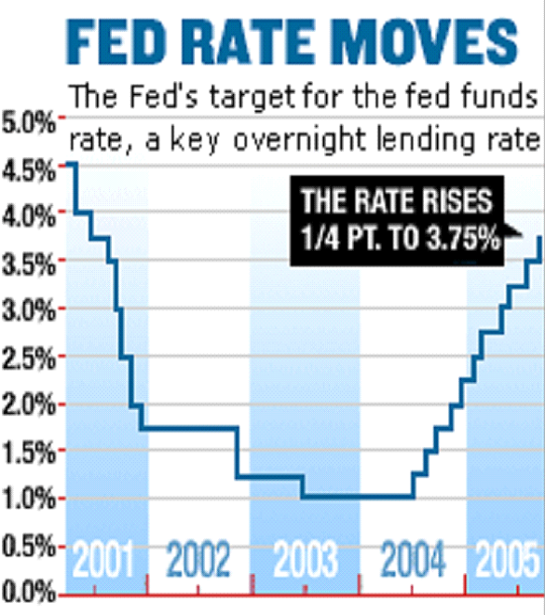
How Did It All Start?

Slide 4
2007
FEB: HSBC (the world’s largest financial group) announces major losses from sub-prime mortgages
JUNE: Bear-Stearns hedge funds (with large holdings of subprime mortgages) report large losses and are forced to dump assets; trouble spreads to Merrill Lynch, JPMorgan Chase, Citigroup and Goldman Sachs who had loaned money to these funds
AUGUST: French bank BNP Paribas freezes withdrawals from three investment funds, starting a global panic
SEPTEMBER: U.K. bank Northern Rock incurs losses and asks Bank of England for help; share prices fall as customers line up to withdraw their money
OCTOBER: Citigroup announces $7 billion in third quarter losses; Merrill Lynch reports $8 billion in losses

Slide 5
2008
JAN: Merrill Lynch reports $12 billion in losses, Swiss bank UBS reports $14 billion in losses, Citigroup reports $18 billion in losses for the 4th quarter of 2007
FEB: U.K. bank Northern Rock is nationalized
MARCH: Carlyle Capital fails; Bear Stearns, 5th largest investment bank, fails; taken over by JPMorgan
APRIL: German Deutsche Bank loses $4 billion for 1st quarter; Wachovia reports huge losses for same qtr
MAY: HSBC writes off $3 billion in sub-prime mortgages
JULY: Washington Mutual reports $3 billion loss for 2nd quarter
SEPTEMBER: Fannie Mae & Freddie Mac seized by the U.S. Treasury, and placed into "conservatorship”

Slide 6
The last 4 months of 2008
SEPTEMBER: Lehman Bros. files for bankruptcy and stock markets plummet; Central banks inject billions into money markets; Bank of America buys Merrill Lynch; U.S. Federal Reserve bails out AIG, the world's biggest insurer; Halifax Bank of Scotland merges with Lloyds in an emergency rescue plan; WaMu, the largest thrift, fails and is sold to JP Morgan
OCTOBER: Congress passes $700 billion bail-out; EU leaders meet in Paris for emergency summit to discuss financial crisis; Bank of America reports a 68% profit drop and sells stock to raise $10 billion; two major Icelandic banks are nationalized while they freeze UK customers' accounts; Wells Fargo takes over Wachovia; Swiss government coughs up $59 billion to bail out UBS

Slide 7
The last 4 months of 2008
NOVEMBER: Bank of England cuts interest rates to 3%, the lowest in more than half a century; Germany says its economy (Europe's largest) is now officially in a recession, followed by Japan with France close behind; U.S. Govt announces a rescue package for Citigroup; Detroit’s “Big 3” auto makers travel to Washington to plead for a government bail-out
DECEMBER: Stock market continues to be erratic; former NASDAQ exec, Bernie Madoff, steals $50 billion from investors; U.S. retailers try to attract holiday shoppers by slashing prices to keep product moving – to no avail; the worst holiday season is over 20 years

Slide 8
2009
The year starts with AIG announcing a $62 billion loss for 4th quarter of ’08 – largest business loss ever posted in U.S. corporate history; Microsoft sales drop for the 1st time in 23 years; U.S. travel business reports business is down by 30%; KPMG sued for 1 billion dollars
California leads 48 states in the midst of a fiscal budget crisis, and can’t timely pay taxpayers their rightful refunds; U.S. Unemployment hits almost 10% (up from 4.9% in 2007)
Bernie Madoff sentenced to 150 years in prison; his accountant is arrested for securities fraud, and JPMorgan sued for the handling of Madoff funds
Chrysler & General Motors file for bankruptcy after receiving 20 million in U.S. Government “soft” loans

Slide 9
2010
June 22, 2010 – Moody’s reports “Bank profits have shrunk to unprecedented levels due to write-offs of $436 Billion in bad loans.”
July 16, 2010 – Businessweek reports “Bank of America, the largest U.S. lender, fell as much as 7 percent in New York trading after the company posted lower profits and revenue amid an economy that’s muddling along.”
October 21, 2010 – Federal Housing Finance Agency says “Government-backed funds may need further aid over bad mortgage losses” and warns U.S. taxpayers that “Fannie Mae and Freddie Mac may need $363 Billion more in bailouts.”
December 31, 2010 – Alan Friedman buys a new 100-watt, all-tube, 3-channel guitar amp to stimulate the economy.

Slide 10
2011 - 2012
Saturday, October 22, 2011 The Wall Street Journal “Spenders Become Savers, Hurting Recovery”
Because of the uncertainty of employment and a recovery, people are paying down mortgages, credit cards, auto loans and other personal debts at unprecedented rates
Total household debt has fallen $1.1 trillion dollars since 2008
This debt reduction, coupled with a renewed household savings, is the primary reason why recovery has been slow

Slide 11
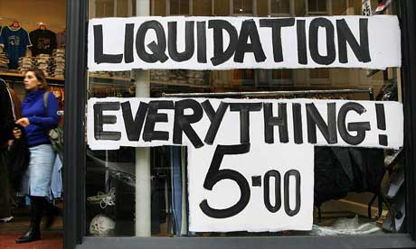
So, what’s next…??

Slide 12
Why are banks nervous?
Consider what banks put at risk to make a return of profit (“the spread”)
Unfortunately, receivables can go bad and inventory obsolete (and often grows “feet”)
Even real estate (usually considered the best collateral) has evaporated in value, often below its corresponding mortgage debt!!

Slide 13
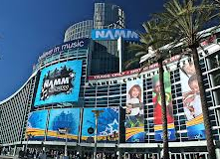
“If not my bank, then where?”
Right here… from your Music Suppliers!!

Slide 14

“How can I get vendor credit?”
Let’s ask an esteemed panel of “credit experts” these questions…

Slide 15
Our Credit Professionals
Chris Rance, Credit Manager, Korg USA
Joanie Barton, Director of CFS, Yamaha Corp
Isabel Cuervo, Credit Manager, Hoshino (Ibanez, Tama)
Glenn Simmons, Corporate Credit Manager, KHS America (Jupiter, Mapex)

Slide 16
QUESTION #1:
“What documents do you need (and how often do you need to get them) from your retail store dealers to give those dealers the best chance of getting credit, extended payment terms or increasing credit facilities?”

Slide 17
QUESTION #2:
“If you had only 5 minutes to look at a music retailer’s financial statement, what are the key items you’d look for to extend them credit?”

Slide 18
QUESTION #3:
“In your opinion, what’s ultimately more important… profitability or cash flow?”

Slide 19

Questions for our panel?

