Slide 1

Converting Social Media…
Into Sales Using Video!

Slide 2


Learn how to create powerful and inexpensive videos that will help you convert your social media efforts into sales!
Take advantage of the simple tools available to today's music retailer and amp up your social media’s effectiveness.

Slide 3
Why Use Social Media?
Because nearly everyone you want to sell your products & services to does!
Over half of the North American population uses Facebook
Consumers search the internet an average of 9 times prior to purchasing online … or in a store
80% of users prefer to connect with brands through Facebook
77% of B2C companies and 43% of B2B companies acquired customers from Facebook in 2012
An average Facebook user has 229 friends

Slide 4
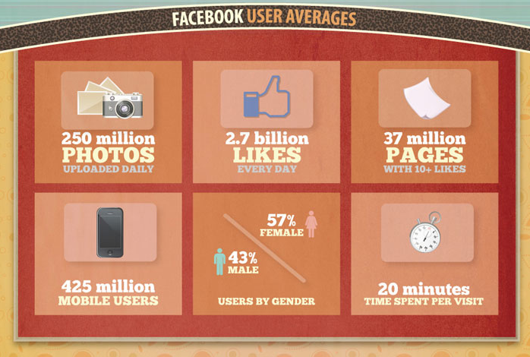
Why Use
Social Media?

Slide 5
Tools Needed to Use Video
In Social Media
Troubleshooting Guide
Video
Editing Tools
Content
Pre-produced
  Vendors
  YouTube
Self-produced
  Hand Held Mini-cam
  iPad
  Smart Phone
No Editing/Raw Footage
iMovie
Packaged Software
PowerPoint
Testimonial
Demonstration
Informational
Introduction
Motivational
Distribution
YouTube
Facebook
Website
Email

Slide 6
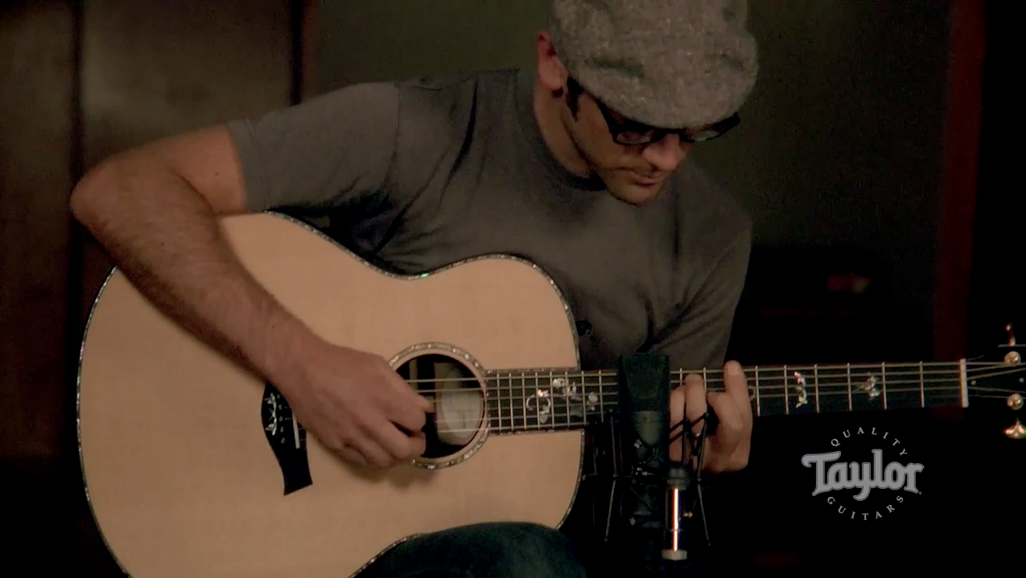
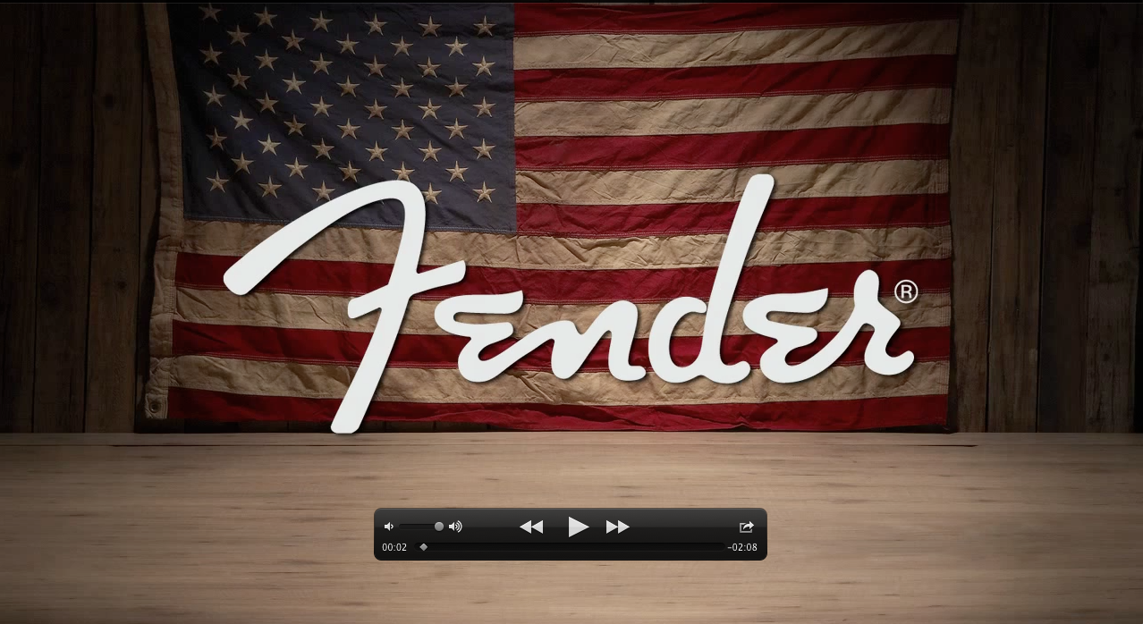
Tools Needed to Use Video
In Social Media
Troubleshooting Guide
Video
Pre-produced
  Vendors
  YouTube
Self-produced
  Hand Held Mini-cam
  iPad
  Smart Phone

Slide 7
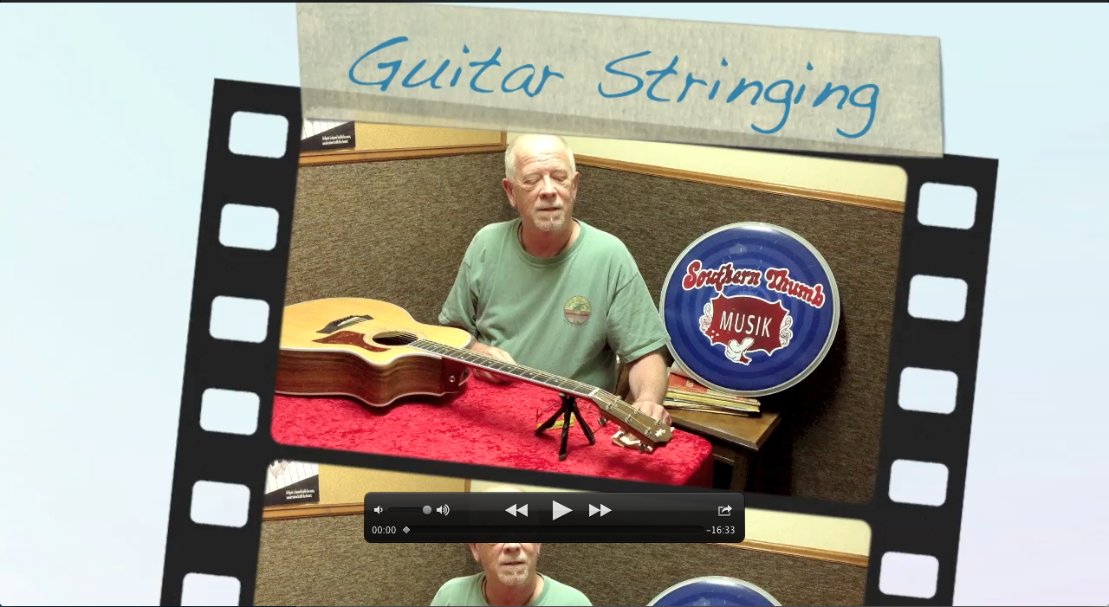
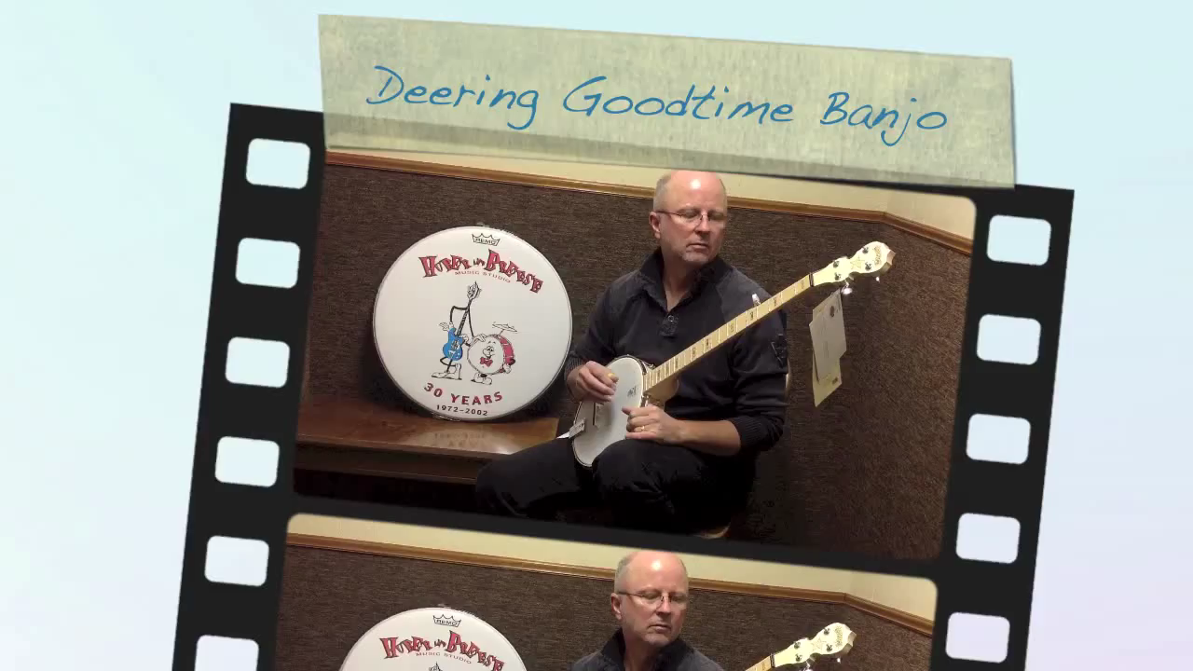
Tools Needed to Use Video
In Social Media
Troubleshooting Guide
Video
Pre-produced
  Vendors
  YouTube
Self-produced
  Hand Held Mini-cam
  iPad
  Smart Phone

Slide 8


Tools Needed to Use Video
In Social Media
Troubleshooting Guide
Editing Tools
No Editing/Raw Footage: YouTube quality is accepted, real and trusted
iMovie: Basic editing tool with small learning curve
Packaged Software: Sky’s the limit, but expect to spend time and money
PowerPoint: Create a slide show, click a button … get a video

Slide 9
Tools Needed to Use Video
In Social Media
Troubleshooting Guide
2nd Largest
Search Engine
Content
Testimonial: No one’s opinion is more important than a customer’s
Demonstration: Concentrate on demonstrating with a small emphasis on selling
Informational: Become the online go-to place
Introduction: Let people know who you and your staff are
Motivational: Who better to pump someone up than someone from the music industry!

Slide 10



Tools Needed to Use Video
In Social Media
Troubleshooting Guide
Distribution
YouTube: Build a channel
Facebook: Create business page not personal
Website: Designate a video page
Email: Must have a service like Constant Contact or Mail Chimp

Slide 11

What’s In It For Retailers?
More Sales!
Less Expenses!
Peace of Mind!

Slide 12
Programs Offered by Collected Concepts
Collected Concepts is a full service consulting agency that offers a variety of programs to assist retailers with:
Social Media
Special Events
Marketing
Training
Shop & Share

Slide 13

Questions? Comments?
We are happy to help you!
Nick Failla
(586) 354-3600
nick@collectedconcepts.com

