Slide 1


“Top 10” Smart Things for 2013
Presented By
Alan M. Friedman, CPA and Daniel Jobe
Friedman, Kannenberg & Company, P.C.

Slide 2
Session Objectives
Provide 10 suggestions & ideas to improve the financial health of your business
Q&A Along the Way

Slide 3

1. Find a Niche and Exploit It

Slide 4

Creating a Niche Means Exploiting a…
Product Niche
Service Niche
Customer/ Industry Niche
Knowledge Niche

Slide 5
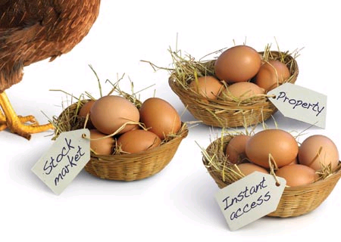
2. Diversify Revenues

Slide 6
Diversify Revenues
Typical / Core Music Store Revenues
  Sales
  B&O Rentals
  Music Education
Potential Music Store Revenues
  Repairs, tunings, delivery
  Piano and Sound Reinforcement Rentals
  Other (i.e. long-term piano storage)

Slide 7

3. Break-up With Your Old Inventory

Slide 8
Inventory
Remember….it’s all about “turns” and lost opportunity costs!!
Track Aging Inventory and Try Something New…
  Re-merchandise
  Spiffs to Sales Staff
  Blow-Out in Store or Online
  Donation

Slide 9
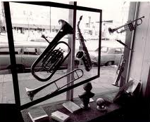
4. Get Real with Rentals

Slide 10
Rentals
Account For Them Properly – book monthly income, depreciate them, and only show a receivable for past due rent
Obtain Adequate Financing – finance them over the same time (or longer) as it takes to recoup your cost on the instrument
Track the Productivity of the Pool
  Collections – watch your bad debt stats!
  Unrented Units – get them ready to go…or change the mix!

Slide 11

5. Pay Down Debt

Slide 12
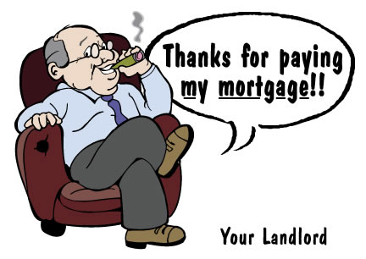

6. Be Your Own Landlord

Slide 13
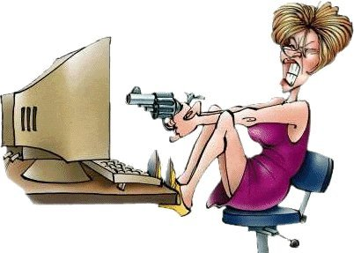
7. Streamline Your Technology

Slide 14
Streamline Your Technology
Data Storage
  Document retention policies
  Electronic computing policies
Accounting Software
  Multiple solutions with no monthly financial data
Technology
  Hardware trends (virtualize)
  Back-up (test often; off-site is best!)

Slide 15

8. Safeguard Assets

Slide 16
Security
Reconcile bank accounts
Reconcile inventory discrepancies
Reconcile payroll records
Segregate incompatible duties
Create systems of checks & balances

Slide 17

9. Save For
The
“Rainy Day”

Slide 18

10. Invest in Education

Slide 19

In summary…
Review Your Business Plan
Involve Others
Dream, but Create Action
Do Something!!

Slide 20

Need more help?
Contact Shaun Conrad after this seminar
to set up a meeting time

