Slide 1


Slide 2
Keep Your Rock Camps Rolling
All Year Round
Billy Cuthrell
Progressive Music Center
Menzie Pittman
Contemporary Music Center

Slide 3

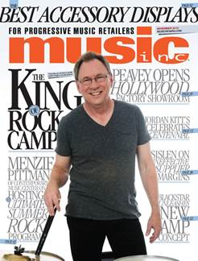


Billy Cuthrell
Menzie Pittman

Slide 4
Session Objective
Rethink “Summer Rock Camps” and offer these programs throughout the year

Slide 5
Why summer rock programs?
Keep current students engaged with new “band camp” experiences
Attract new students to your program
Keep your teachers engaged
And … money to be made during typically slow lesson program time

Slide 6
Typical Successful Summer Rock Camp Format
1or 2 week intensive programs
3 sessions throughout the summer
1 teacher for 2 “bands”
Students grouped together by interest and skill
Engage kids throughout camp with songwriting, song selection, concert organization and more
Recording sessions
End of session “concert”

Slide 7
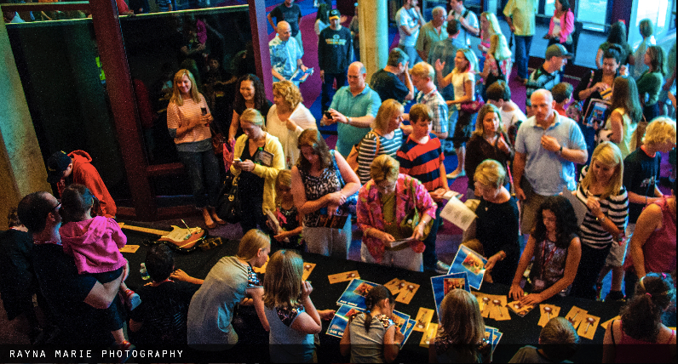
TThe kids (and parents)
LOVE it!
Notes:
Share personal success stories of this format.

Slide 8
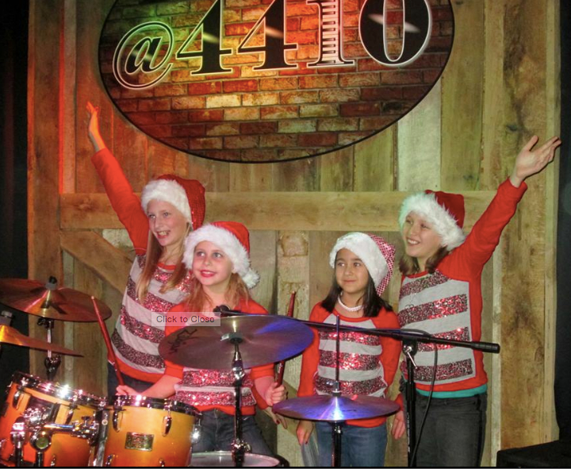
What if you could expand this program to the other 10 months of the year?

Slide 9
Rather than weeklong camps, offer weekly “ensemble” lessons
Group students by interests, skills and availability
10-week sessions
One hour per week
One band coach per band
End of session “concert”
Performance opportunities at school talent shows, nursing homes, town-wide events, etc.

Slide 10
More lessons + new students = new revenue streams
Some students take both private and ensemble lessons; others ensemble lessons only
  Move kids “up to” ensembles when they are ready
Reach new groups of adults looking to play with other musicians

Slide 11

Promote your program
Teachers recommend students to participate in ensemble lessons
Student bands perform at community events
  Students love performing, entices others to join
  Sponsored by: Your School signs
Marketing: brand your ensemble lesson program with store signage, email marketing, social media

Slide 13
Tips and Tricks
Identify an enthusiastic teacher(s)
Pilot the program for one session, then roll out broader
Get commitment from ensemble participants (consider prepayment, “band” contract, etc.)
Attractive ensemble pricing (e.g. 60% of private lessons)
Ensemble room(s) with full band setup
  Offer ensemble lessons at same time as individual lessons with tools like JamHub studios OR have multiple bands in one room
  Recording the full band for fun and review

Slide 14
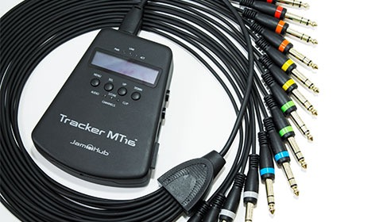
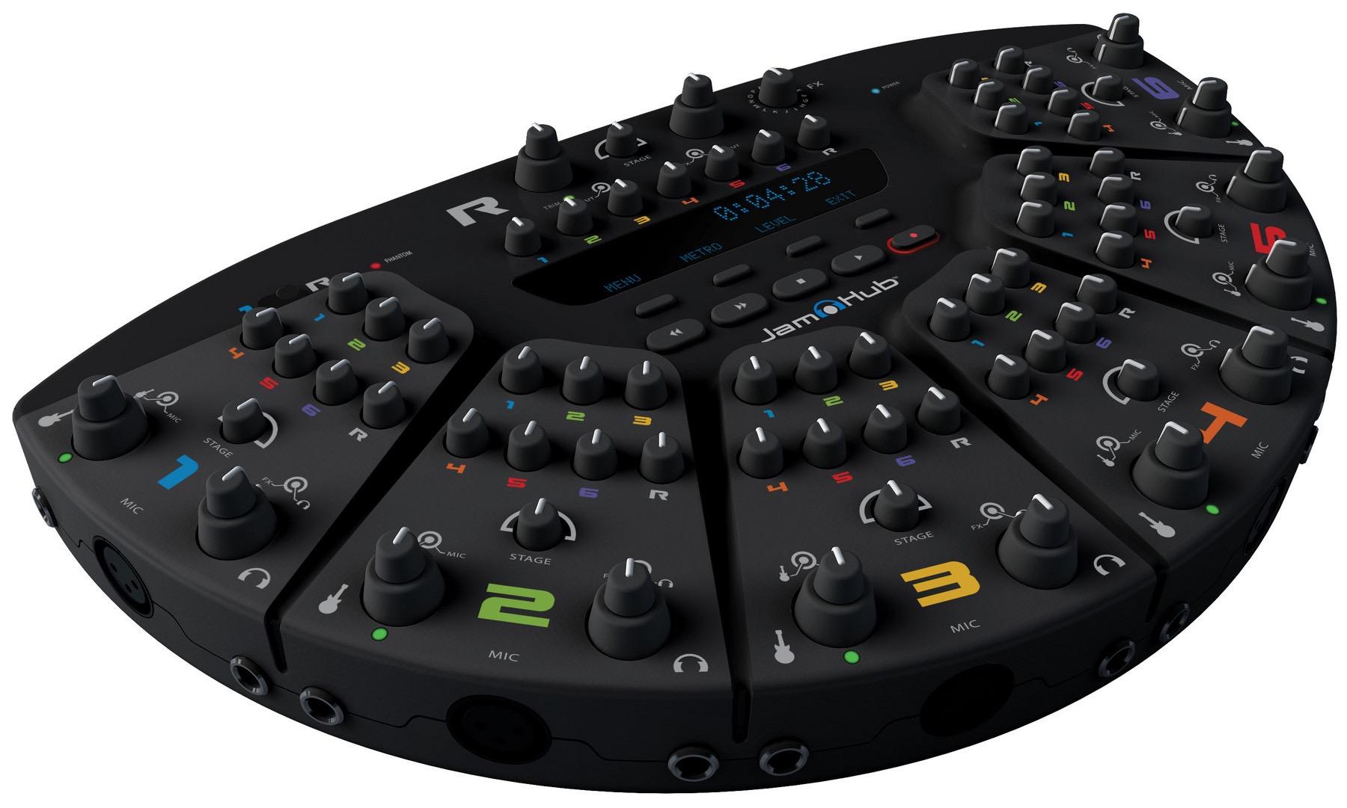


Slide 15
Questions?
Feel free to contact us at:
billy@raleighmusiclessons.com or menzie@contemporarymusiccenter.com

Slide 16
Thank you!

