Slide 1


Slide 2
Take the Stress Out of Your Financial Operations
Lori Supinie
Senseney Music

Slide 3

Agenda
Top 10 Do’s
What is your role as owner or store manager?
Stress-reducing

Slide 4
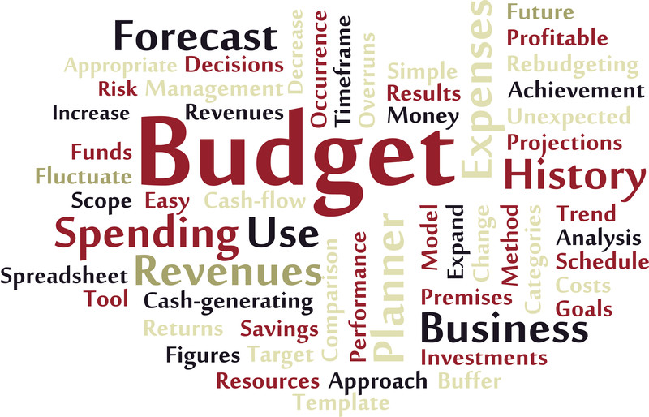
#1 Do Prepare a Budget
Sets expectations
Manager accountability
Hope is not a plan

Slide 5
#2 Do a Monthly, Timely Bank Reconciliation
Good financial controls
Review, looking for out-of-the-ordinary activity
Deter employee theft and embezzlement

Slide 6

#3 Do Prepare Monthly Financial Statements
Know your financial position
Review with your accountant
Compare with prior year and plan

Slide 7
#4 Do Practice Good Internal Control Procedures
Definition: Safeguard assets and ensure an efficient accounting system with reliable financial information
Emphasis on transactions: authorized, executed, recorded and accountable

Slide 8

Internal Control General Principles:
Competent and responsible employees
Separation of duties
Rotation of duties
Rules for control of assets
Well-designed source documents

Slide 9

#5 Do Delegate, but Don’t Abdicate
Eliminate situations of motive and opportunity
Balance between empowering employees and being reasonably vigilant

Slide 10

#6 Do Make Good Cash Flow Everybody’s Responsibility
Not just an accounting problem
Focus on reducing errors, making good buying decisions and having prudent credit policies
Educate staff

Slide 11

#7 Do Ask for Help
Mentors
Experts
Industry organizations

Slide 12



#8 Do Arm Yourself With Knowledge
NAMM U
Industry organizations
Professional development
Lifelong learning

Slide 13

#9 Do Communicate With Your Bank
Share financial statements, even if not required
Conversation about good news and bad news
Major strategic issues, changes in personnel,
new markets, competitors
Future expectations and needs

Slide 14

#10 Do Maintain a Good Relationship With Vendors
Pay bills in a timely manner
Be proactive about late payments
Look for win/win situations when negotiating

Slide 15
Questions?
Lori Supinie
lori@senseneymusic.com

