Slide 1

“Evaluate Pros & Cons
of Social Media Sites”
Danny Rocks
The Company Rocks

Slide 2

“How to Evaluate the Pros & Cons
of Social Media Sites
for Your Business”
Danny Rocks
The Company Rocks

Slide 3

The Three Rules
Be Active on Sites
Your Core Customers Use
Begin by Being Interested in
Your Customers!
Integrate Each Social Media Site
Into Your Strategy

Slide 4








Which Sites?

Slide 5
Begin by “Liking” Your Customers
Before Asking Core Customers
to “Like” Your Site …
Comment on their activities
Comment on their YouTube Videos
“Retweet” their “Tweets”

Slide 6
Integrate Each Site
Into Your Strategy
Event Strategy
Facebook to Announce / Invite
Twitter “Live” from Event
YouTube Before, During & After
Facebook a Link to YouTube Video

Slide 7
Facebook
Pro | Con
Almost everyone is on it! | Challenge to separate business & personal focus
Easy to stay connected with your customers | Too easy to become “addicted!”
Take Advantage of Event Invitations | None
Take advantage of “Links” to YouTube, Articles, etc. | None

Slide 8
YouTube
Pro | Con
World-Wide Reach | Requires a plan to film and upload on a regular basis
Valuable Demographic Insight (Owned by Google) | None
Write descriptions and add Hyperlinks | Takes discipline to write descriptions & add links
Take advantage of Comments to interact with viewers | Takes time to develop a following

Slide 9
LinkedIn
Pro | Con
Business-to-Business Focus | Most of your customers will not be on or active
Opportunities to gather expert advice for running your business | None
Enhance your reputation as an “Expert” by participating in Groups | You can easily gain a bad reputation as “shilling” for your business

Slide 10

Questions?

Slide 11

Thank You!
Danny Rocks
www.thecompanyrocks.com
danny@thecompanyrocks.com

Slide 12
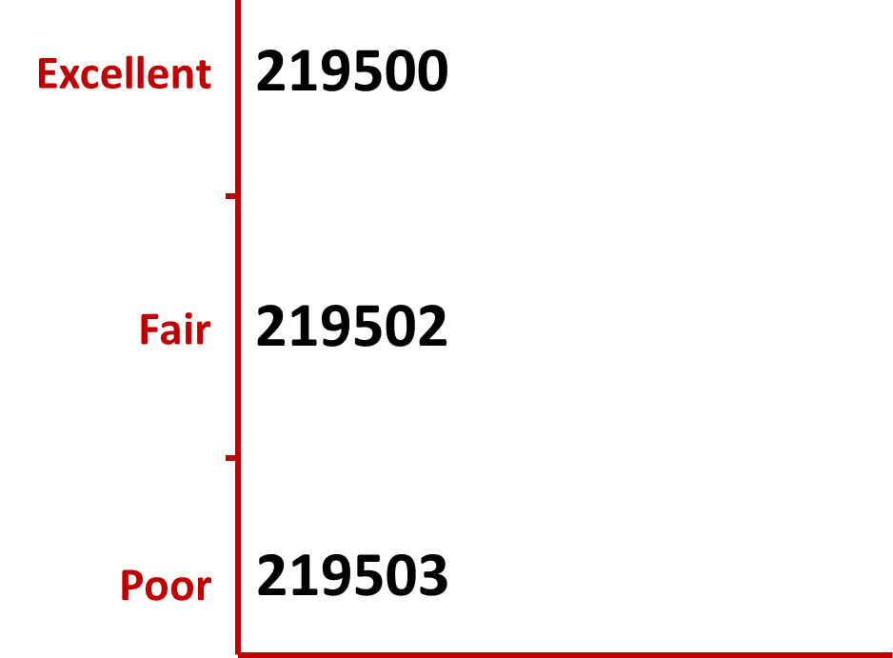
How do you rate this session?
Text one of the Codes below to 22333
Or go online to http://PollEv.com to submit one of the Codes above.
Notes:
Presenter Text Polling Notes- Explain what’s going on
Example (or use your own words) “Now I’m going to ask for your opinion. You’ll use your cell phones, iPads or laptops to respond just like on American Idol.”
Address any concerns
“This is a just standard rate text message, so it may be free for you, or up to twenty cents on some carriers if you do not have a text messaging plan.”- Standard texting rates only
“The service we are using is serious about privacy. We cannot see your phone numbers, and you’ll never receive follow-up text messages outside this presentation. There’s only one thing worse than email spam – and that’s text message spam because you have to pay to receive it!”

