Slide 1


How to Boost Your Business With Tech Products
Ryan West, West Music
John Mlynczak, PreSonus Audio
July 17, 2014

Slide 2
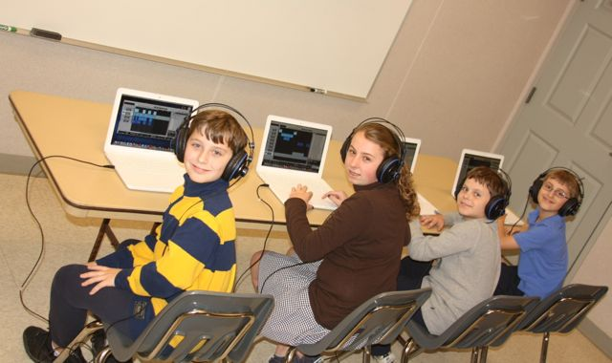
Background
John Mlynczak, M.M., M.Ed.
Music Education
Technology
Administration
Assessment and Standards
Music Industry
Ryan West, MFA
Senior Vice President
@ West Music

Slide 3

Technology in Schools
NCLB/ESEA
Race to the $
Common Core State Standards
Career Readiness
STEM to STEAM
More $$$
Notes:
ESEA 1965 Johnson
RTT: $ for new data systems, teacher evaluation, and training of teacher evaluation.
Paralysis by analysis

Slide 4
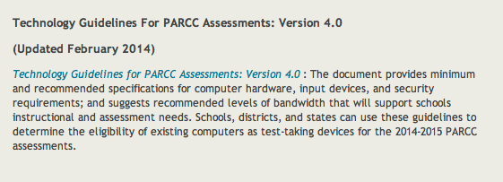
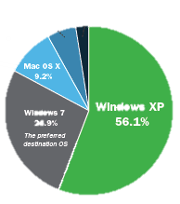

https://www.parcconline.org/technology
https://www.parcconline.org/parcc-states
http://www.smarterbalanced.org/wordpress/wp-content/uploads/2011/12/Tech_Framework_Device_Requirements_11-1-13.pdf
Notes:
Partnership of Assessment for Readiness of College and Careers

Slide 5
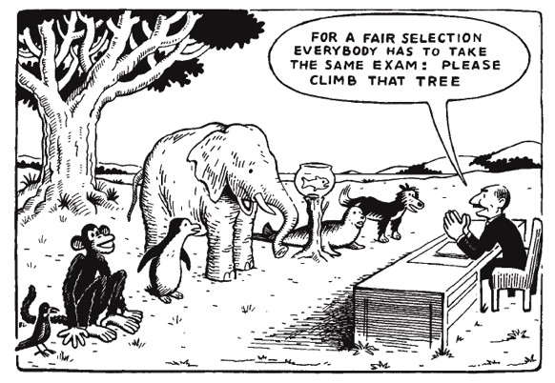

Slide 6

Notes:
Prof D Opportunities

Slide 7

Fears From Administration?
Administration worried about School Performance Scores (SPS), therefore assessment driven
Need more test prep time, so elective time cut down or refocused to “academic-focused” electives or students pulled out from PE or Arts for additional “core” subject work

Slide 8
Opportunity 1
Advocate for and sell technology solutions to schools at the administrative level.
Technology integration is heavily funded and promoted in schools
Classrooms now have computers available, so offering software and hardware solutions is key.
Also, many products can be purchased with school technology funds! Title I funds can also be used if SIP is linked to technology integration

Slide 9
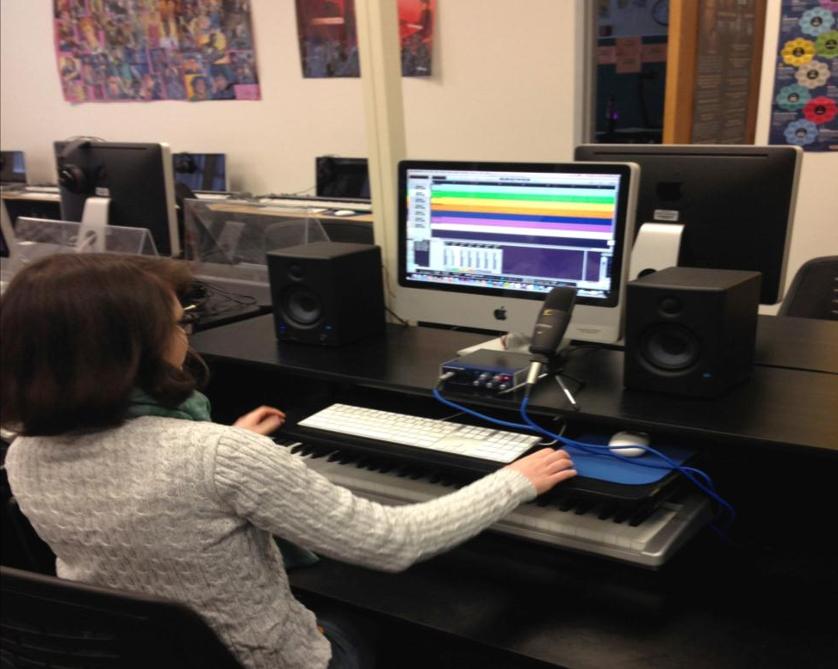

Slide 10
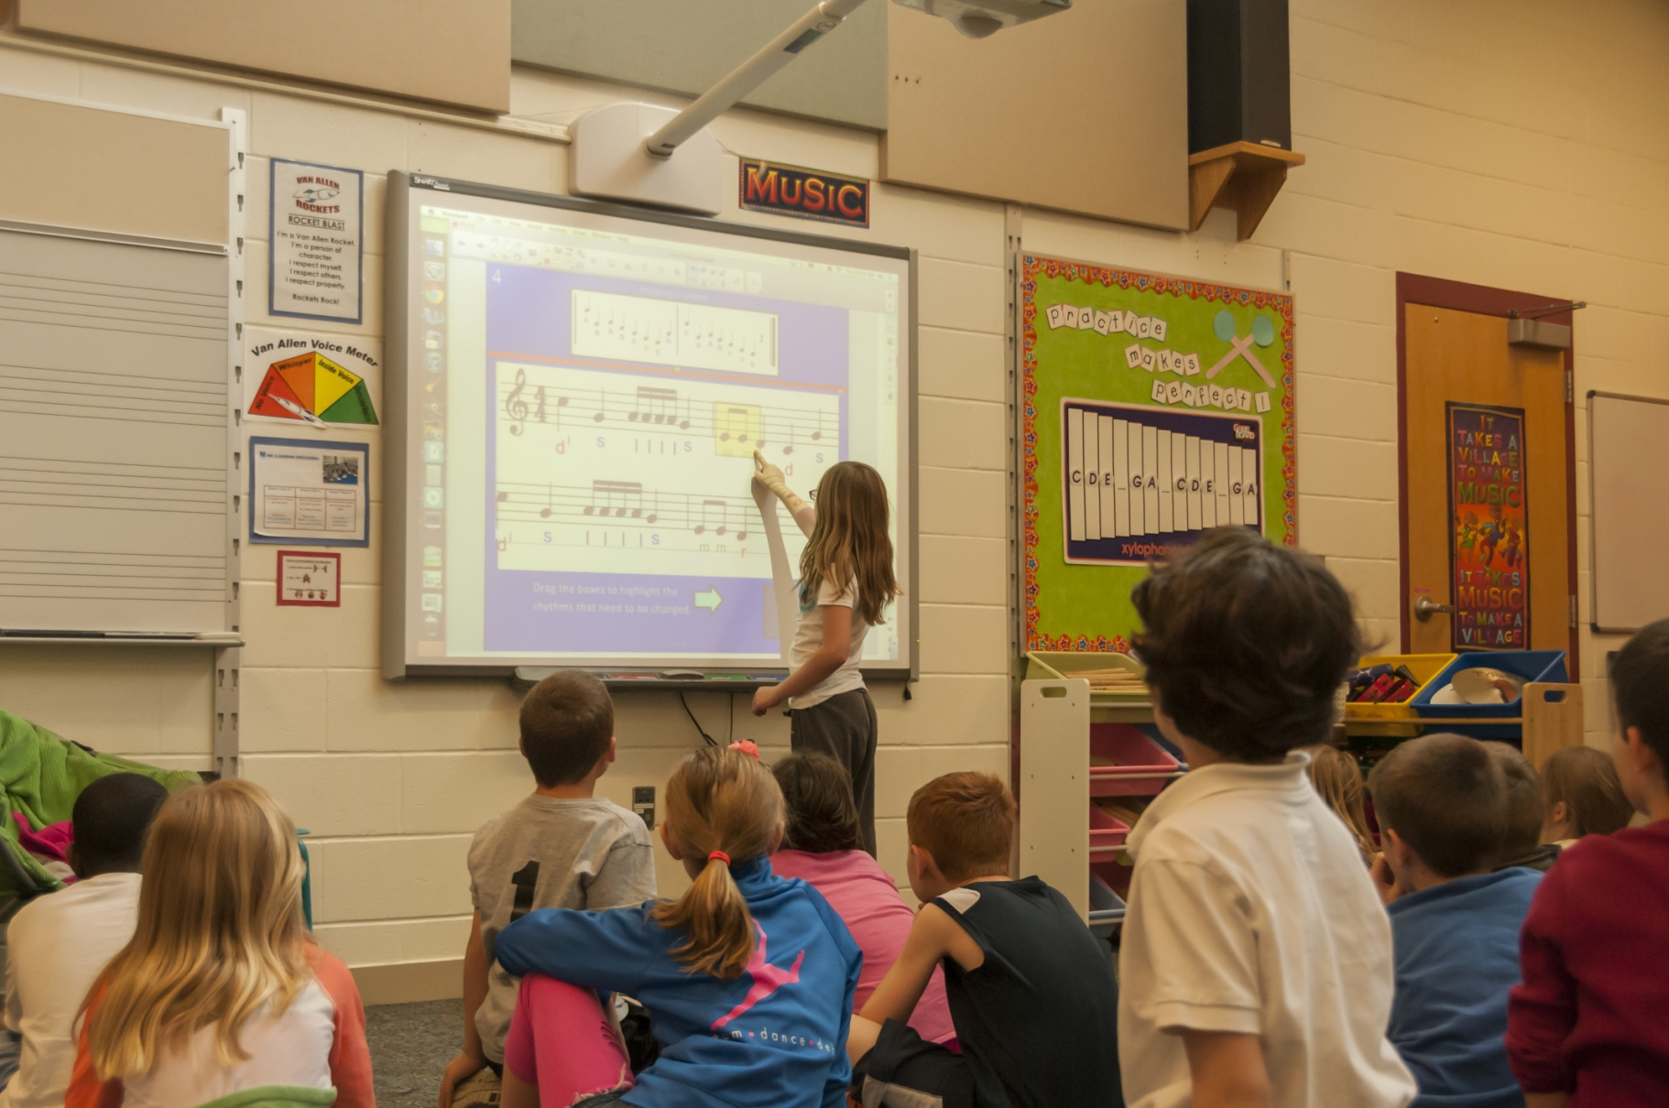
Advocate for and sell technology solutions to schools
Notes:
Advocate for and sell technology solutions to schools.
Technology integration is heavily funded and promoted in schools
Classrooms now have computers available, so offering software and hardware solutions is key.
Also, many products can be purchased with school technology funds! Title I funds can also be used if SIP is linked to technology integration

Slide 11
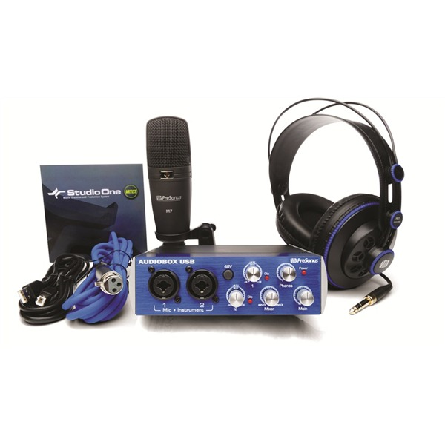
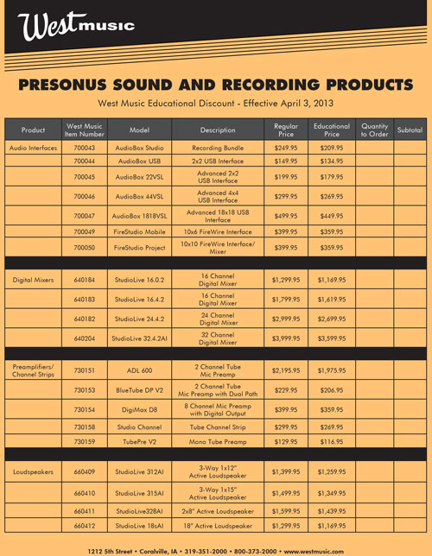
Solutions Mindset
Offer Software and Hardware Solutions
Notes:
Advocate for and sell technology solutions to schools.
Technology integration is heavily funded and promoted in schools
Classrooms now have computers available, so offering software and hardware solutions is key.
Also, many products can be purchased with school technology funds! Title I funds can also be used if SIP is linked to technology integration

Slide 12

Lets Talk About Teachers…

Slide 13

99% of teachers have computers in the classroom
95% of these computers have internet access
National Center for Educational Statistics:
Teachers’ Use of Educational Technology in
U.S. Public Schools: 2009
Notes:
8

Slide 14
Percent of teachers reporting the extent to which various kinds of education and training prepared them to make effective use of educational technology for instruction, by school and teacher characteristics:
-Undergrad 25% -Professional Development 61%
-Graduate 31% -Independent Learning 78%
National Center for Educational Statistics:
Teachers’ Use of Educational Technology in
U.S. Public Schools: 2009
Notes:
8

Slide 15


Slide 16
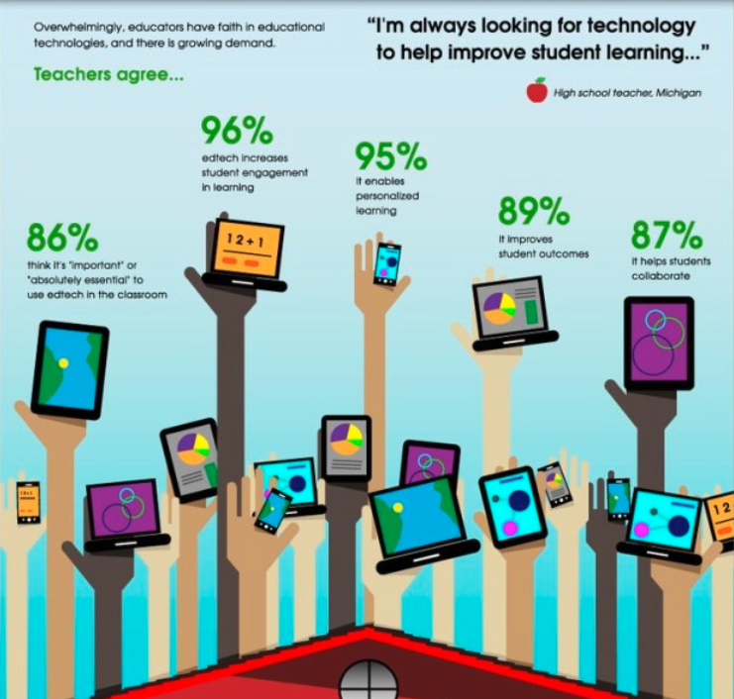
Notes:
Common Sense Media Survey in May 2013 of 850 educators
www.edudemic.com

Slide 17
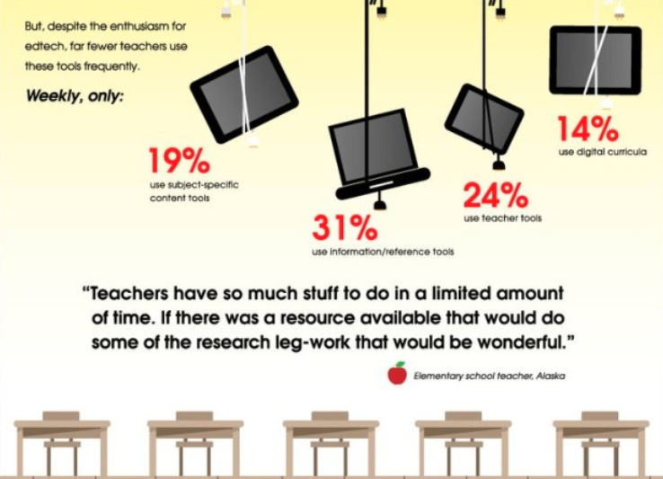
Notes:
8

Slide 18
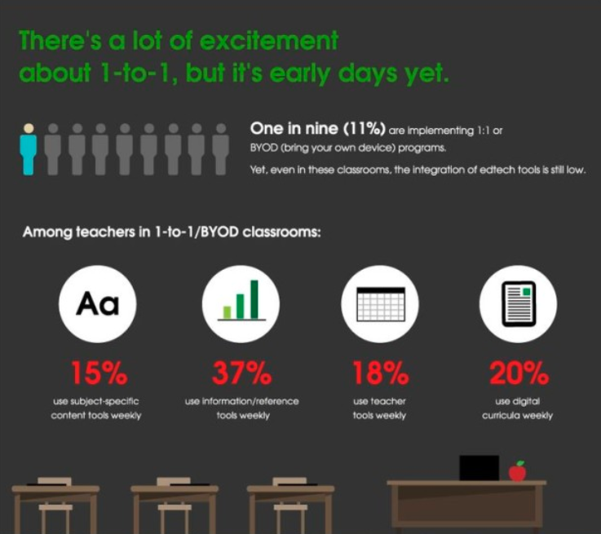
Notes:
8

Slide 19
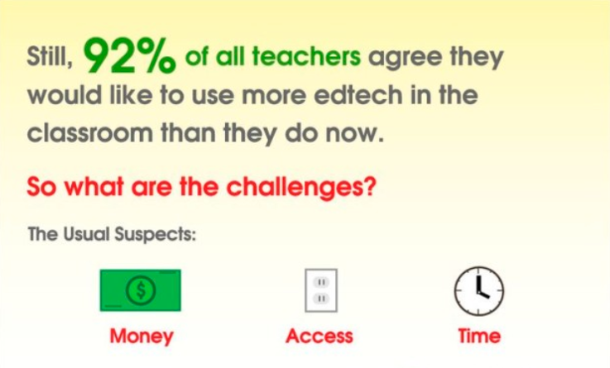

Slide 20
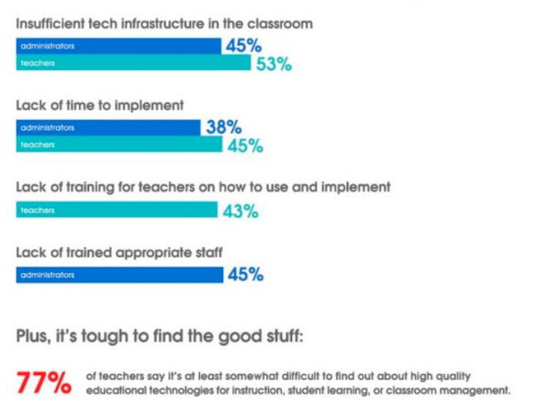

Slide 21

11 out of 13 of the 2014 NAMM “Best Tools for Schools” were technology products.

Slide 22

Fears From Educators?
Do not understand tech or know where to find information
Do not have time to learn it
Schools invest in tech but lack sufficient follow up with professional development

Slide 23
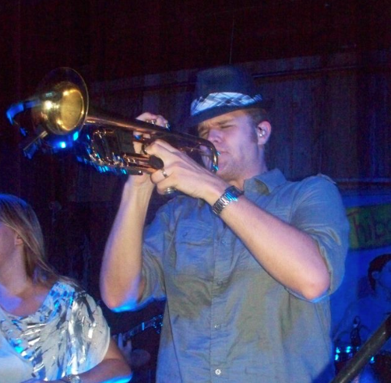
Fears From Mlynczak?
There is a lack of direction on who is driving tech sessions and knowledge, and there is a great divide between understanding tech and understanding education.
Some are pushing the easy sale, without regard to what is best for the future of education.
Most educators fear the investment in tech
so teacher-led tech sessions focus too
much on FREE, without regard to what
is best for the future of education.
Notes:
25 clinics in 7 states since Midwest in December

Slide 24

FREE
Is Limited
Free vs. Student Learning
How does this resource allow educators to teach music?
How does this resource prepare students for real world experiences?
Is it developmentally appropriate?
Hardware is not free, but many come with bundled software options.

Slide 25
What if the instrumental sessions looked like the technology sessions?

Slide 26
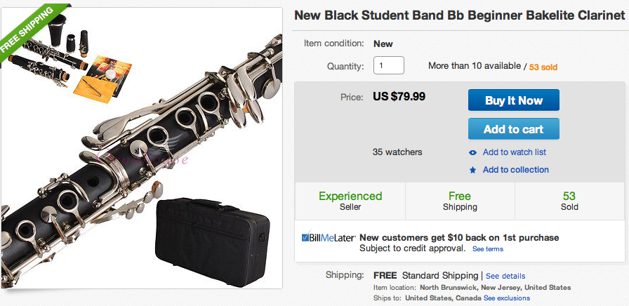
Superior Festival Ratings
for Less Than $100 Per Seat!

Slide 27
Making the Case for Resources
21st Century Skills/Common Core
Core Subjects and 21st Century Themes
English, reading or language arts, World languages, Arts, Mathematics, Economics, Science, Geography, History, Government and Civics
2. Learning and Innovation Skills
Creativity and Innovation
Critical Thinking and Problem Solving
Communication and Collaboration
3. Information, Media and Technology Skills
Information Literacy
Media Literacy
ICT Literacy
4. Life and Career Skills
Flexibility and Adaptability
Innovative and Self-Directed
Social and Cross-Cultural
Productivity and Accountability
Leadership and Responsibility
Notes:
John Kao discussed on Thursday the idea that music already teaches what education does, we just need to fill in the dialogue
Prof D Opportunities

Slide 28
Sample Conversation 1
“I would like to incorporate music technology this year, do we have any money for this? This class will really help grow our music program! I saw this incredibly handsome and charming presenter at my state conference, and he totally inspired me!”

Slide 29
Sample Conversation 2
“I would like to discuss technology integration in the music curriculum as my professional development goal this year, which would grow the entire program and allow us to differentiate instruction while integrating many cross-curricular and project-based learning activities in accordance with both the National Standards of Music Education and the National Education Technology Standards, requiring students to utilize both Higher Order Thinking Skills and 21st Century Skills which would support the Common Core Curriculum and in turn lead to improved standardized test scores.”

Slide 30
Opportunity 2
Be the specialist.
Do the research for teachers and present the products that fit their needs.
Appoint a road rep, employee, or both as the technology specialist.
Seek out local educators or professors who are effectively using technology and have them do in-store clinics and demonstrations.
Sponsor professional development days
Notes:
Be the specialist.
Do the research for teachers and present the products that fit their needs.
Appoint a road rep, employee, or both as the technology specialist.
Seek out local educators or professors who are effectively using technology and have them do in store clinics and demonstrations.
Sponsor professional development days

Slide 31
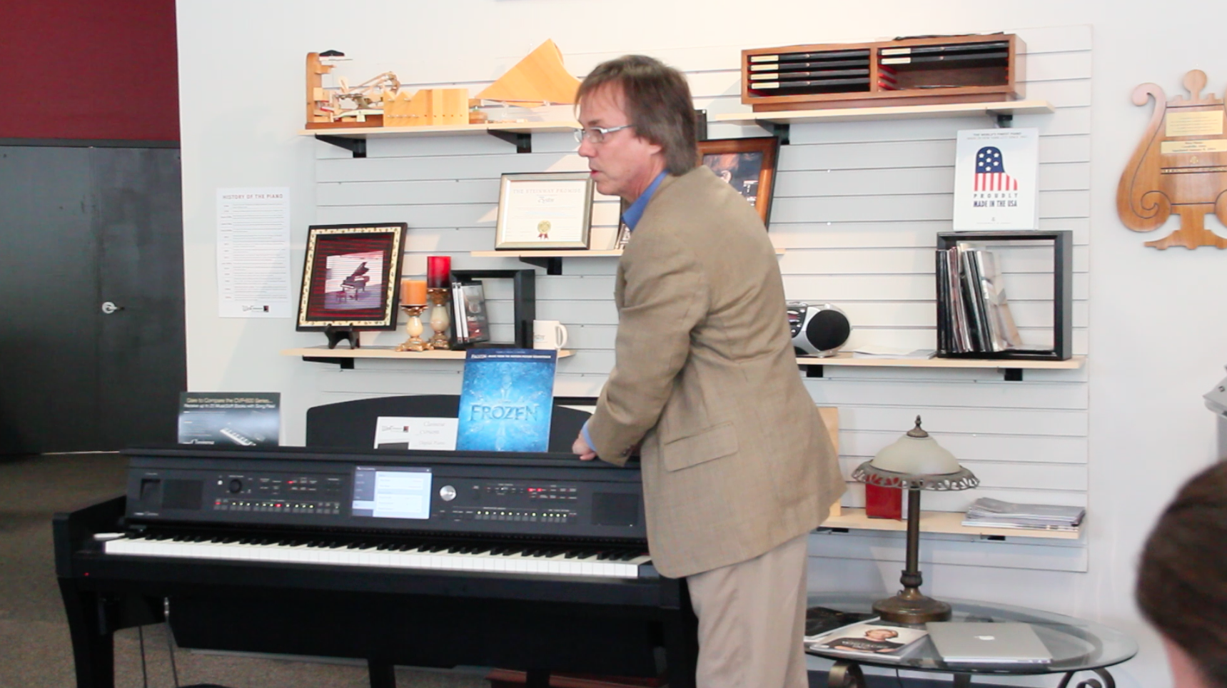
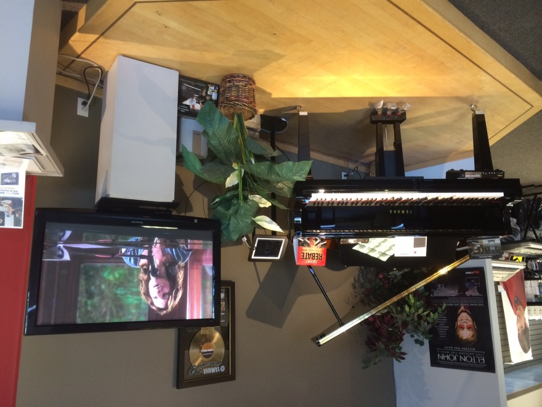
  BE THE SPECIALIST

Slide 32
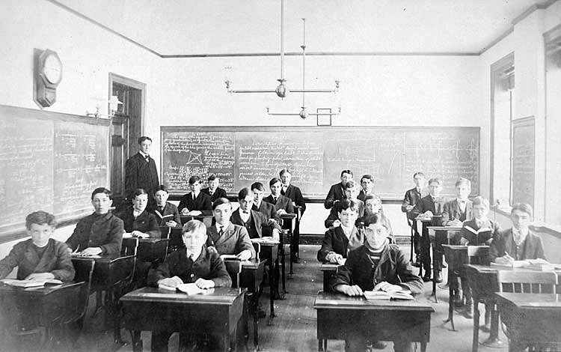
Let’s Talk About Students
Notes:
35

Slide 33
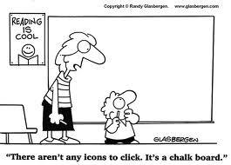

Slide 34
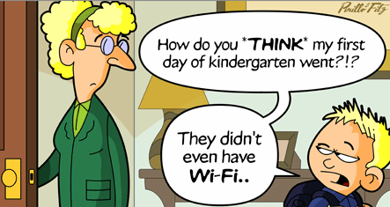

Slide 35
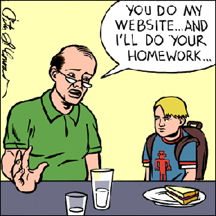

Slide 36

Music Technology
FACT: Students consume music with technology.
YouTube, Spotify, Pandora, Beats Music, iTunes, iPod
Reach all students
80/20
Popular music
“Looking back to 1890, it is estimated that
as many as 10,000 bands were active in the
United States, interest having been stimulated
by the popularity of the professional bands. In 1915 Albert Austin Harding reported that at one time the state of Illinois had more bands than towns”
http://www.lipscomb.edu/windbandhistory/rhodeswindband_09_americanschoolband.htm

Slide 37




Fears from Students?
Notes:
Reese Witherspoon?

Slide 38
Opportunity 3
Offer technology for students
Set up a demo station in the store
Offer music composition and production lessons
Offer bundled solutions and “starter packs”
Notes:
12

Slide 39
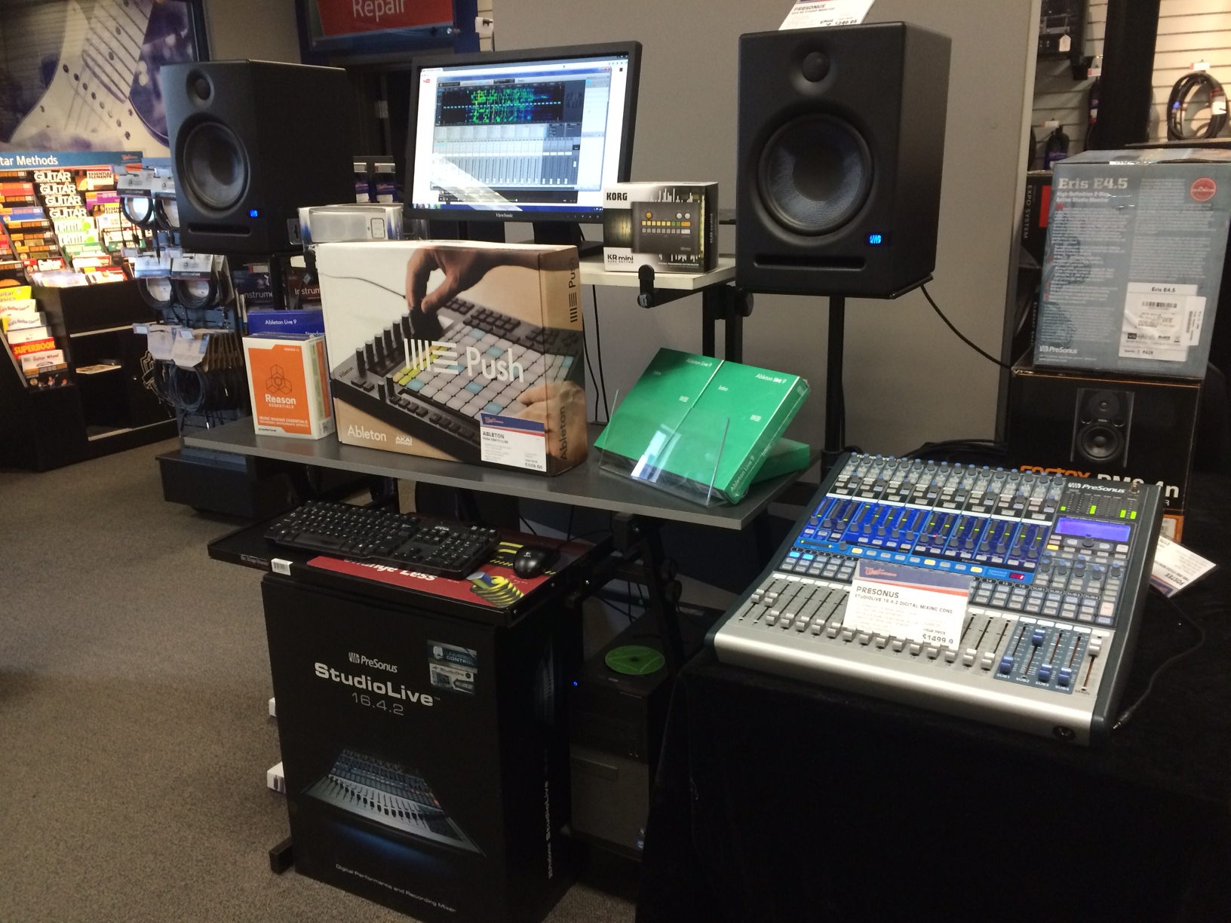
West Success
Offer technology for students
Set up a demo station in the store
Offer music composition and production lessons
Offer bundled solutions and “starter packs”
Notes:
Offer technology for students
Set up a demo station in the store
Offer music composition and production lessons
Offer bundled solutions and “starter packs”

Slide 40


Slide 41
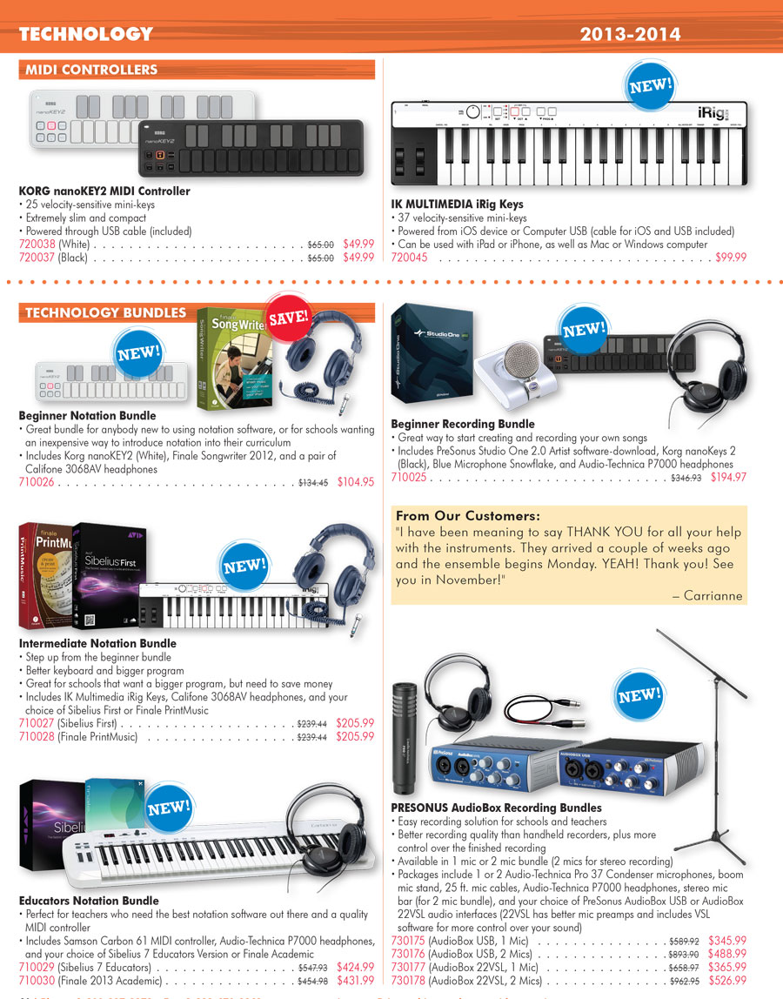
Offer
Bundled Solutions
& Starter Packs

Slide 42
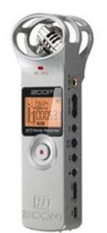
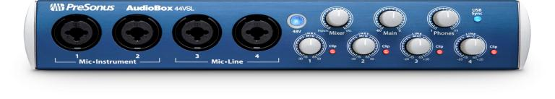
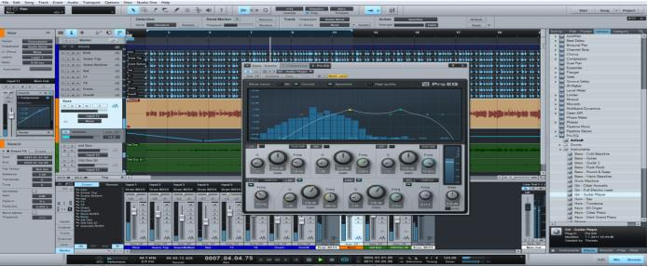
Music Technology
Recording
Notes:
48

Slide 43
Music Technology
Recording Bundles
Notes:
48

Slide 44


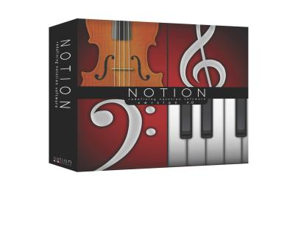
Music Technology
Notation
Notes:
48

Slide 45
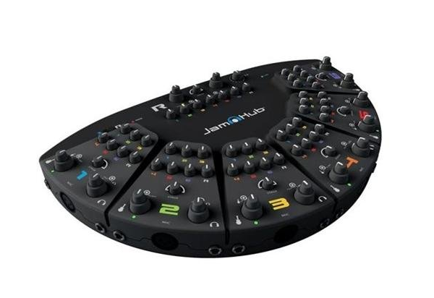
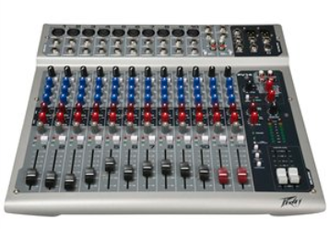
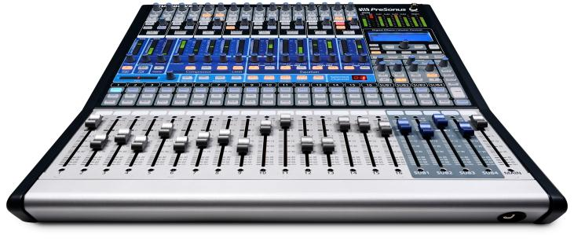
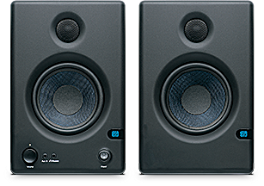
Music Technology
Pro Audio
Notes:
48

Slide 46
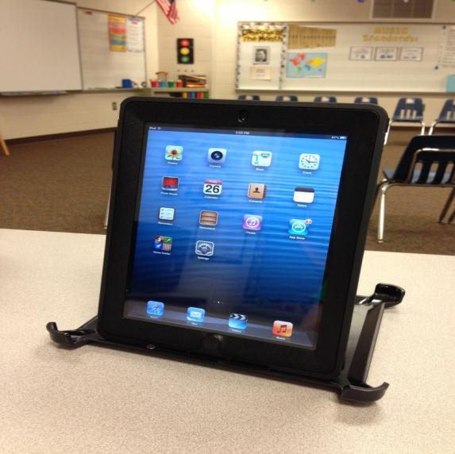
Music Technology
App Attack
Competing with iPad
Notes:
48

Slide 47
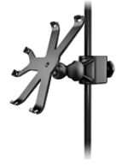
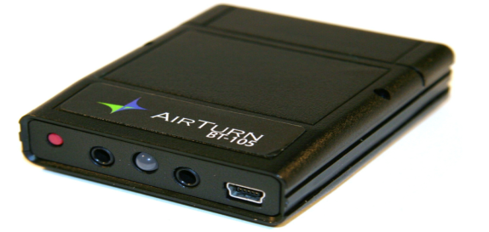
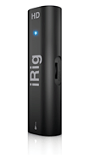
Opportunity 4
iOS Peripherals

Slide 48

Who drives the future of Music Education?
Who will drive the future of Music Education?

Slide 49
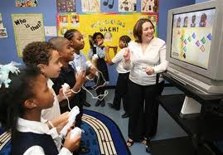
Who drives the future of Music Education?
Who will drive the future of Music Education?

Slide 50
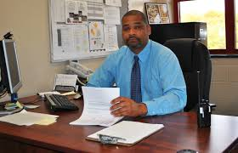
Who drives the future of Music Education?
Who will drive the future of Music Education?

Slide 51

Who drives the future of Music Education?

Slide 52

Opportunity 5
Advocate for new programs
Notes:
55

Slide 53
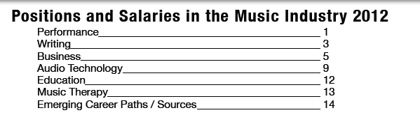
Advocacy
http://www.berklee.edu/pdf/pdf/studentlife/Music_Salary_Guide.pdf

Slide 54


Advocacy
Advocate for education at all levels
Notes:
55

Slide 55
Summary of Opportunities
Classrooms now have the computers available with technology funding, so offer software and hardware solutions.
Sponsor professional development days and engage teacher leaders.
Students consume music with technology, so offer technology and lessons for students.
1-1 iPads are growing rapidly, so there is opportunity in iOS Peripherals.
Advocate for new programs.

Slide 56

Contact
John Mlynczak, M.M., M.Ed.
Education Market Manager
jmlynczak@presonus.com
225-215-0686
John.Mlynczak Skype
@PreSonusMUED Twitter
musiced.presonus.com
Ryan West
Senior Vice President
rwest@westmusic.com

