Slide 1


Slide 2
Ideas to Boost Your School Business With Tech Products
John Mlynczak, President Elect of the Technology Institute of Music Educators
Jeff Mozingo, Mozingo Music

Slide 3

Today’s Student…

Slide 4

Today’s Student…

Slide 5


Today’s Student…

Slide 6
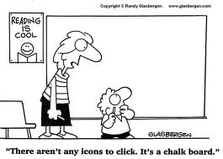
Today’s Student…

Slide 7

Today’s Student…

Slide 8

Technology Integration in Schools
Required integration
Assessment
Digital Literacy
Funding

Slide 9
Technology in the Music Classroom
Traditional Music Education
Record in class
Listen back and analyze
Share files for peer review or listening assignments
Recorded assessment data
Compose and arrange music

Slide 10
Technology in the Music Classroom
Traditional Music Education
Recording
Handheld recorders
iPad recording peripherals
Audio interfaces
Microphones
Recording bundles

Slide 11
Technology in the Music Classroom
Traditional Music Education
Listen back and analyze
Monitors
Sound systems

Slide 12
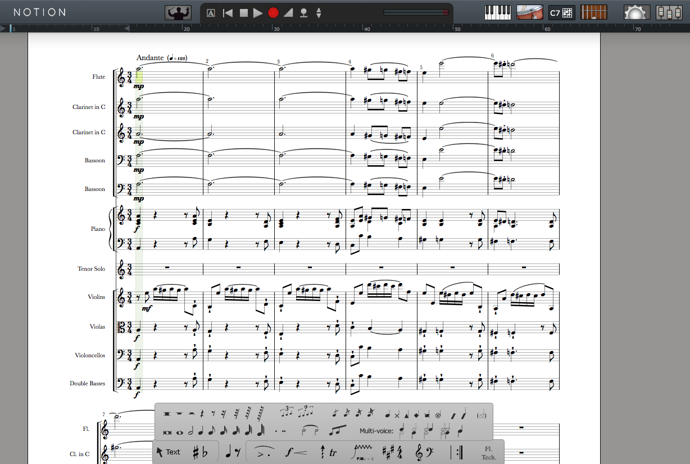
Technology in the Music Classroom
Traditional Music Education
Compose and arrange music
Notation software
Digital Audio Workstation

Slide 13

Technology in the Music Classroom
The Future of Music Education
Music technology courses
Music composition courses using technology
Recording and production courses
Multimedia courses

Slide 14
Technology in the Music Classroom
The Future of Music Education
Digital Audio Workstation software
Notation software
Audio interfaces
Microphones
Headphones
MIDI keyboards

Slide 15
Technology in the Music Classroom
Summary
Technology integration is required in schools
Teachers can incorporate technology into their current music classrooms
Music education with technology will allow more students to participate
Retail reps are the key to demonstrating and supporting technology solutions

Slide 16
Ideas to Boost Your School Business With Tech Products
John Mlynczak, President Elect of the Technology Institute of Music Educators
musiced@presonus.com
Jeff Mozingo, Mozingo Music
jmozingo@mozingomusic.com

