Slide 1
How to Start Selling
Your Products Online
A Checklist for Success!
Danny Rocks, The Company Rocks

Slide 2

Getting Started
Website design tools
Easy to add & edit product listings
Inventory management
Shopping cart
Online payment services
Order processing
Automated customer service
Reporting

Slide 3
Getting Found
Organic Search
  Key words
  Fresh, relevant content
  Links to other sites
  Links from other sites
Paid Search
  Per click
  Per impression

Slide 4
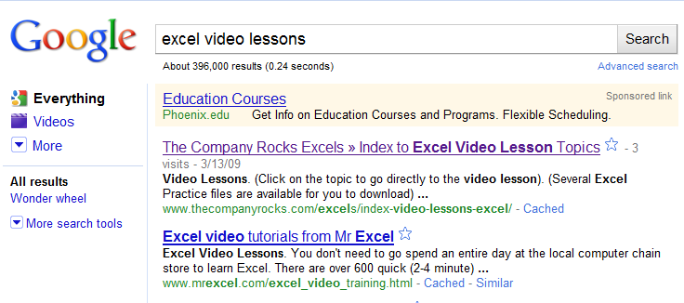
Organic Search

Slide 5
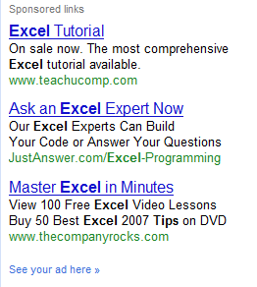
Paid Search

Slide 6
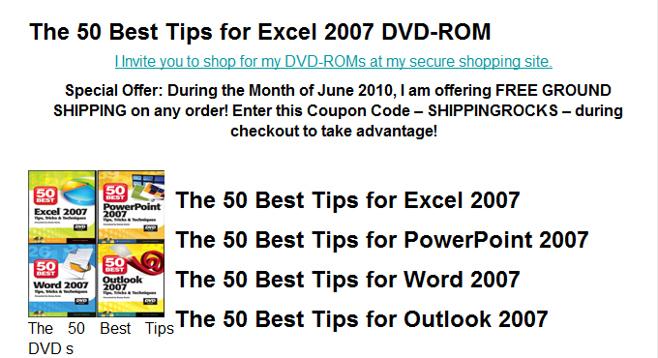
Creating Landing Page

Slide 7
Managing Online Sales
Managing your inventory
Managing your sales
Managing your customers
  Product questions
  Order verification
  Shipping notification
  Customer reviews & feedback

Slide 8
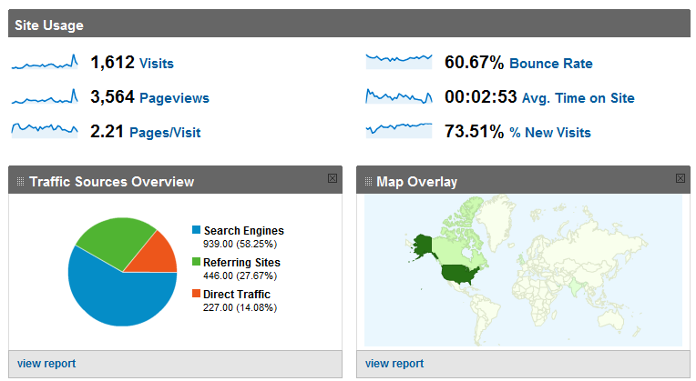
Fine-tuning Your Website

Slide 9
Danny’s Tips
Target your audience
Target your product offerings
Start slowly
Analyze results
Make Adjustments
Never stop testing!

Slide 10

  Thank You!
Danny Rocks

