Slide 1
A Creative Approach to Merchandising Without Spending a Fortune
With your host,
Jen Tabor
Souldier Guitar Straps, Booth 1706

Slide 2
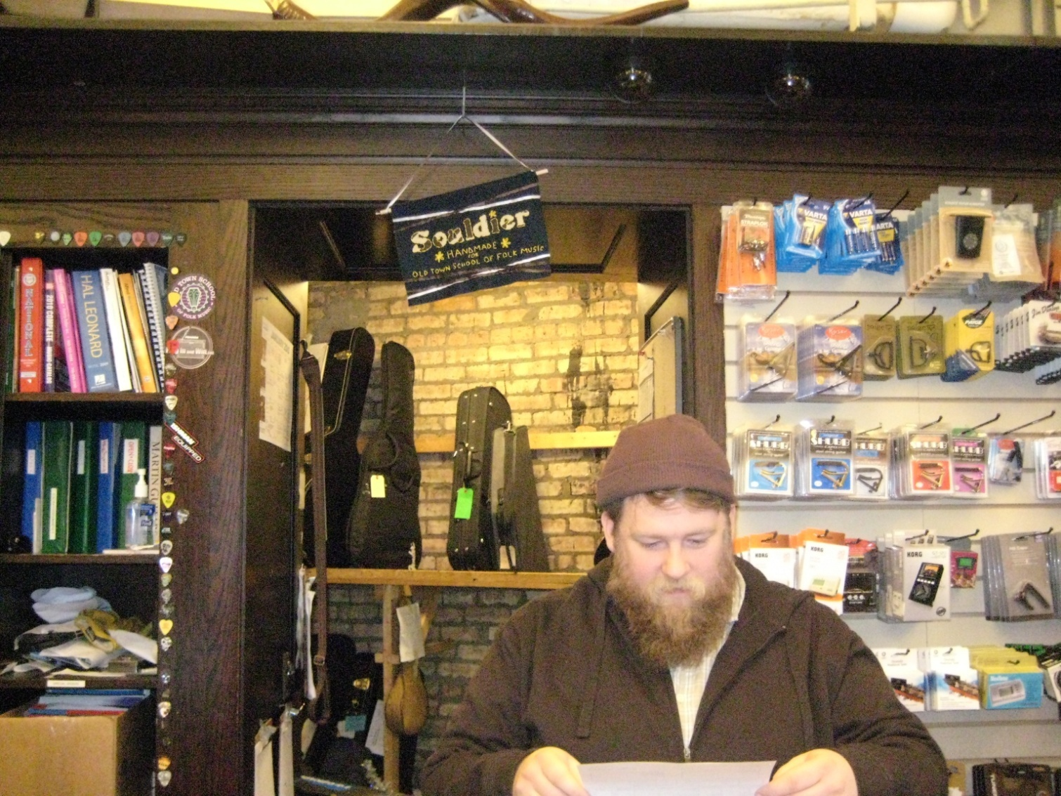
You’re a retail store first, then a music store.

Slide 3
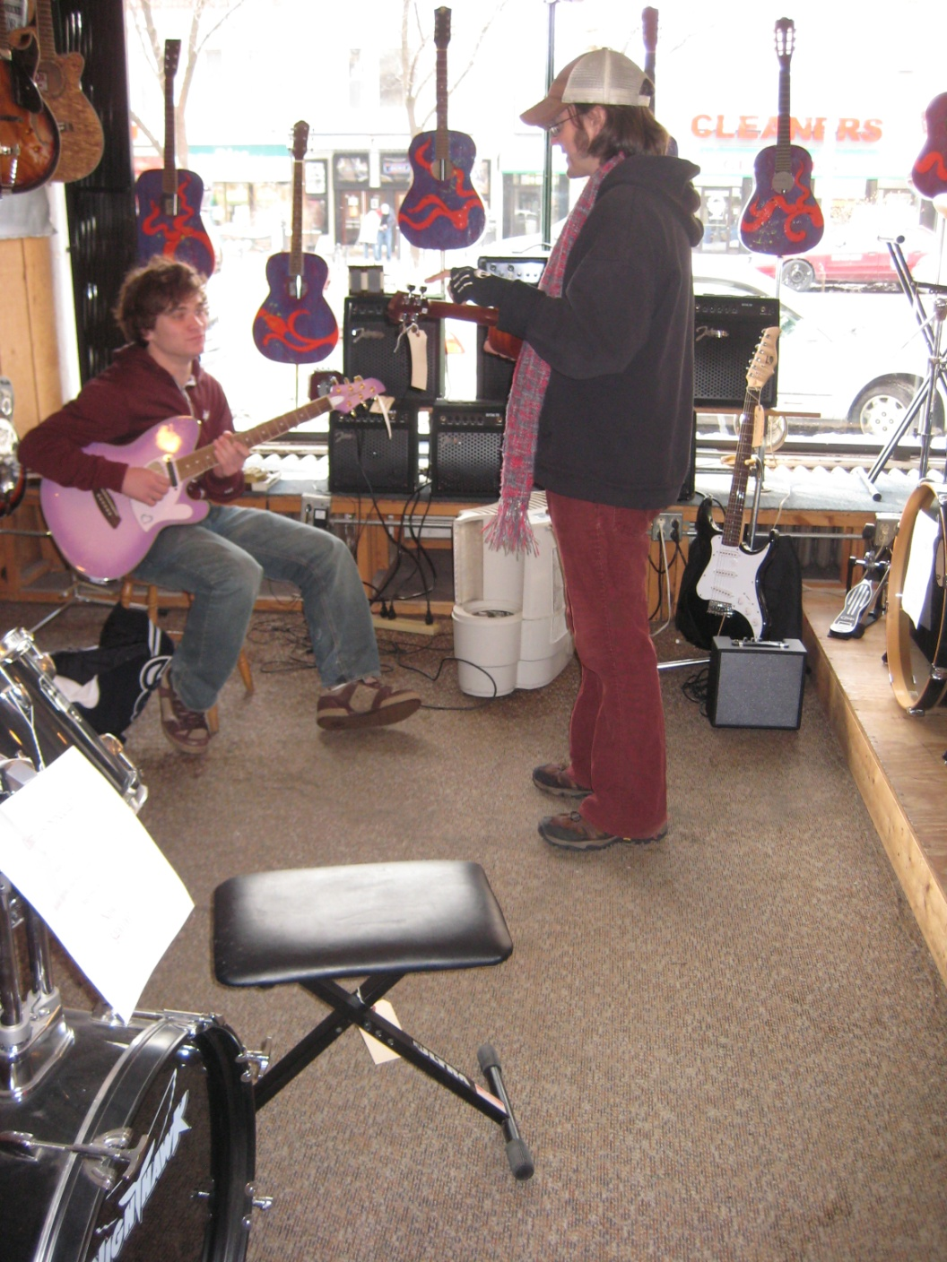
Why shop independent retail stores?
Scene
Trust/Knowledge
Advice
The people
Interaction
Charm

Slide 4
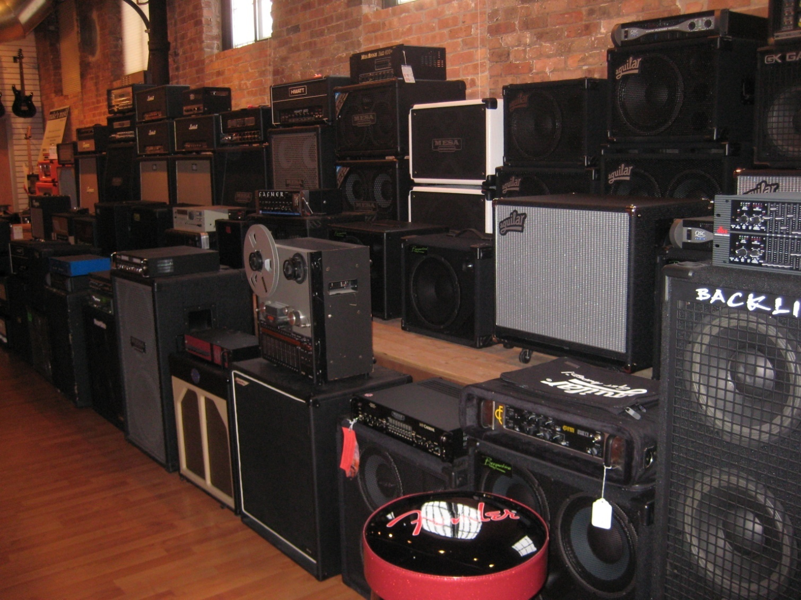
Think of an independent store like a boutique. Stock products and offer services that set you apart.

Slide 5
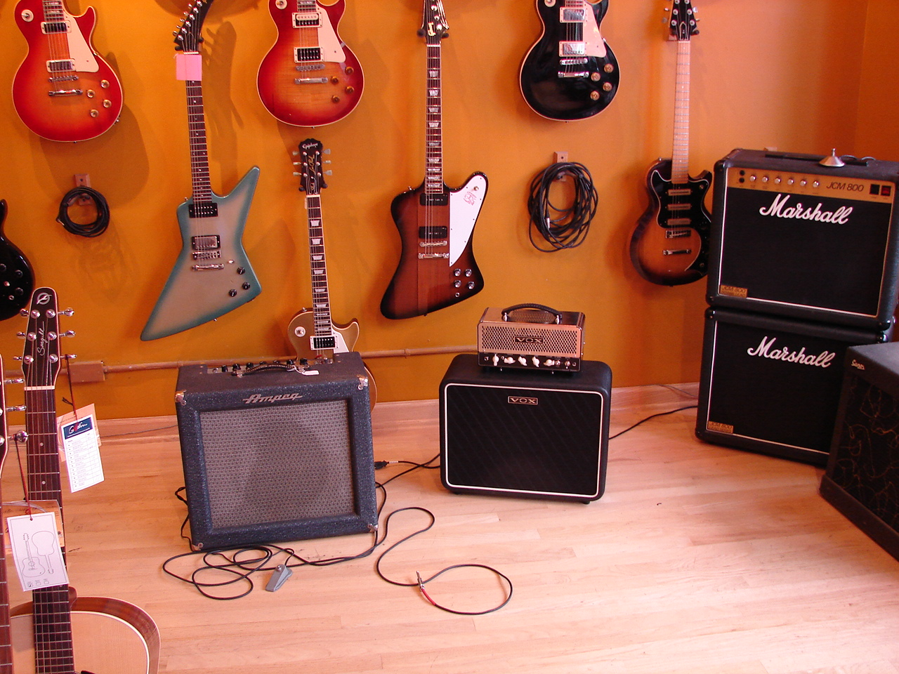
Location, Location, Location

Slide 6
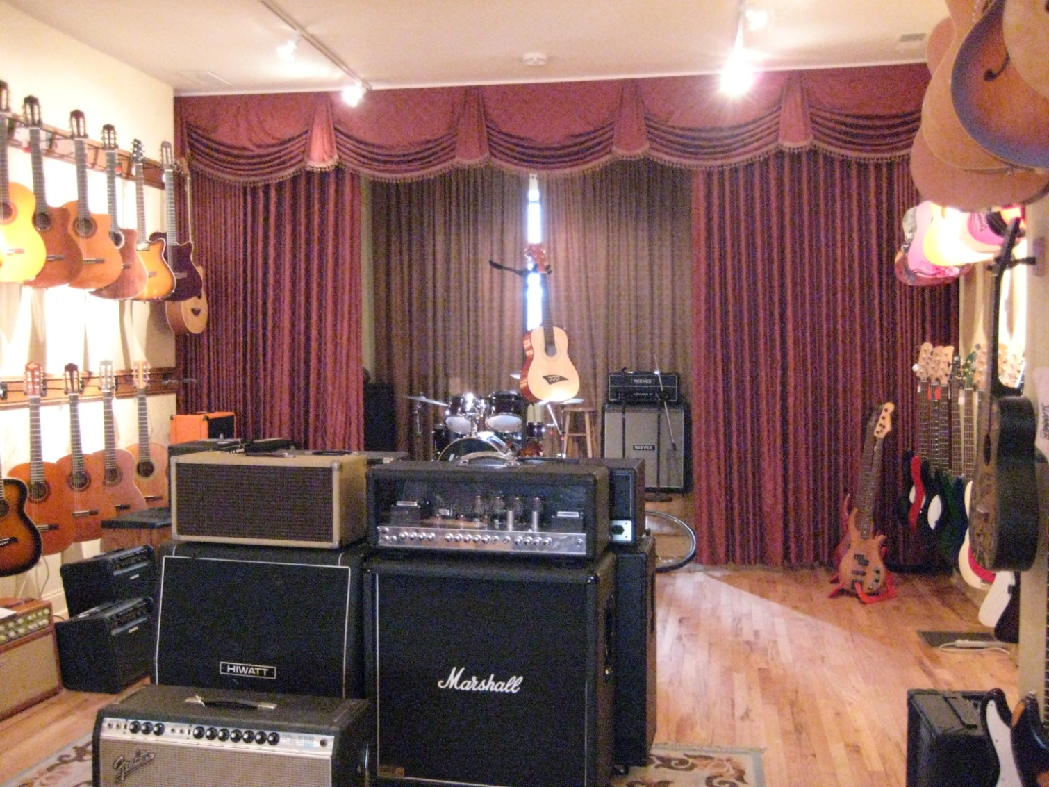
Create an obstacle course

Slide 7
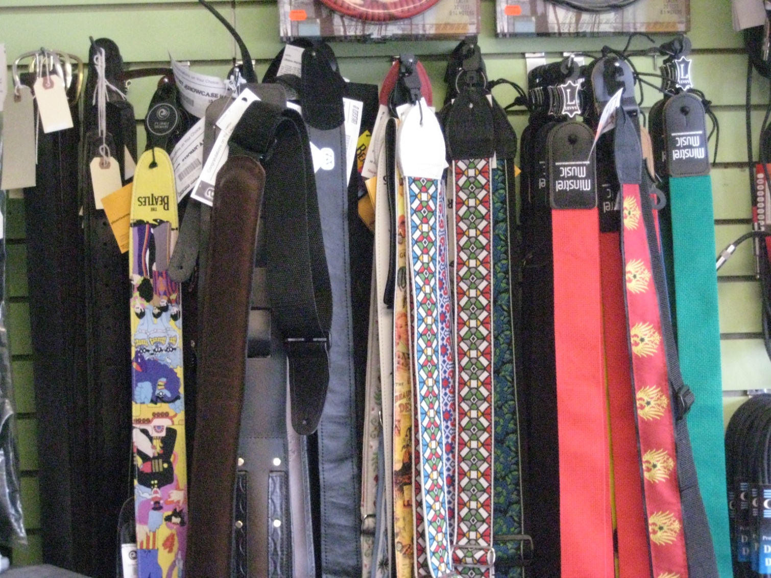
Organize racks and shelves or have someone else do it.

Slide 8
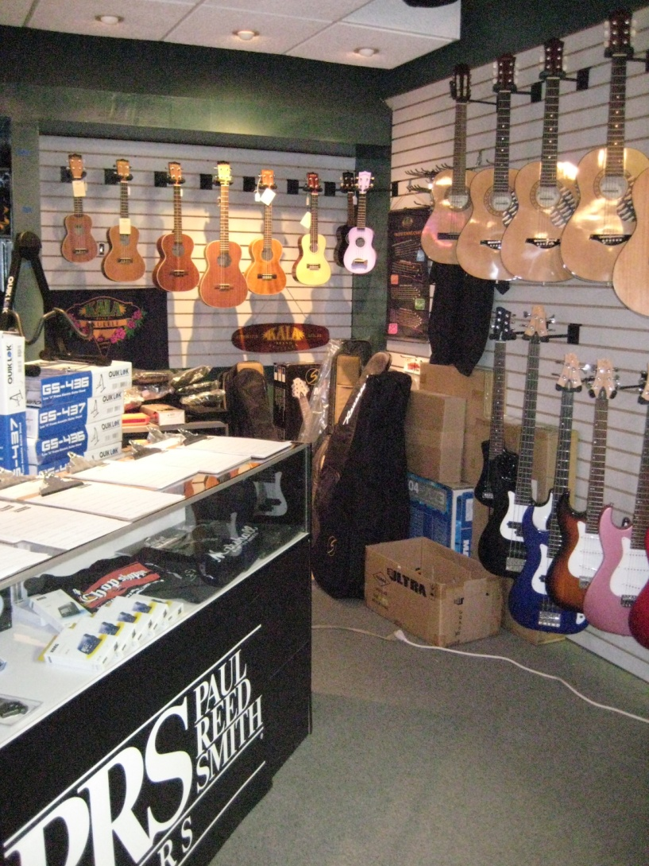
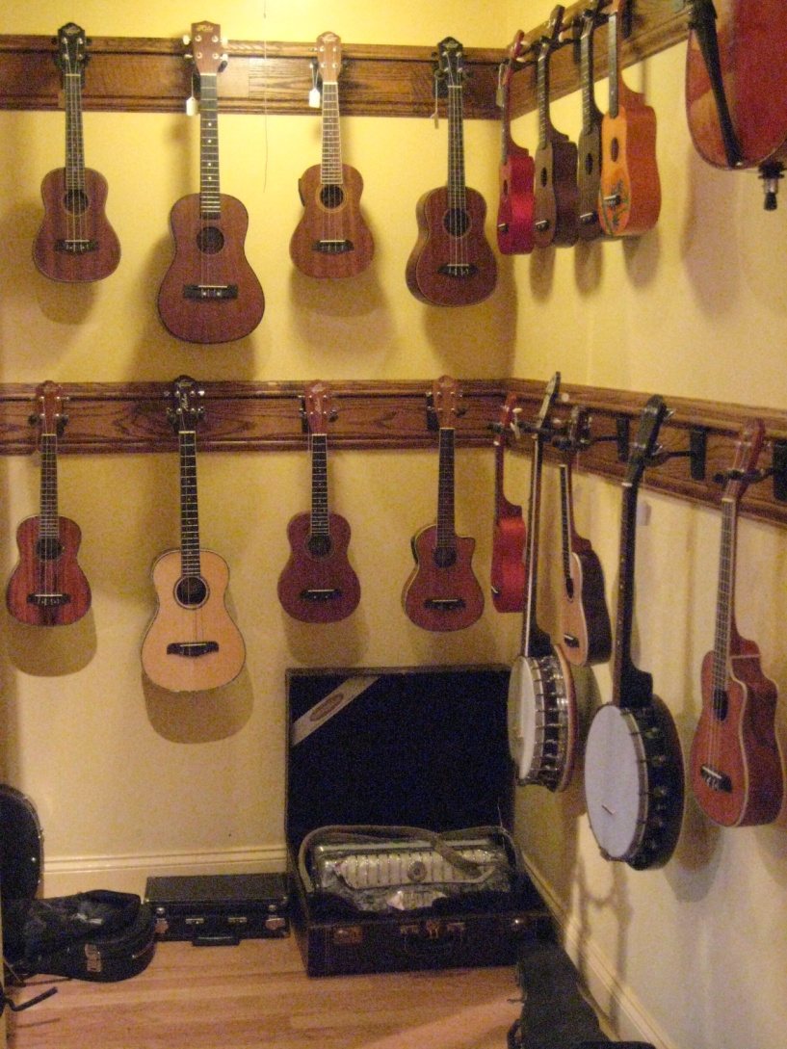
Spread things out.

Slide 9
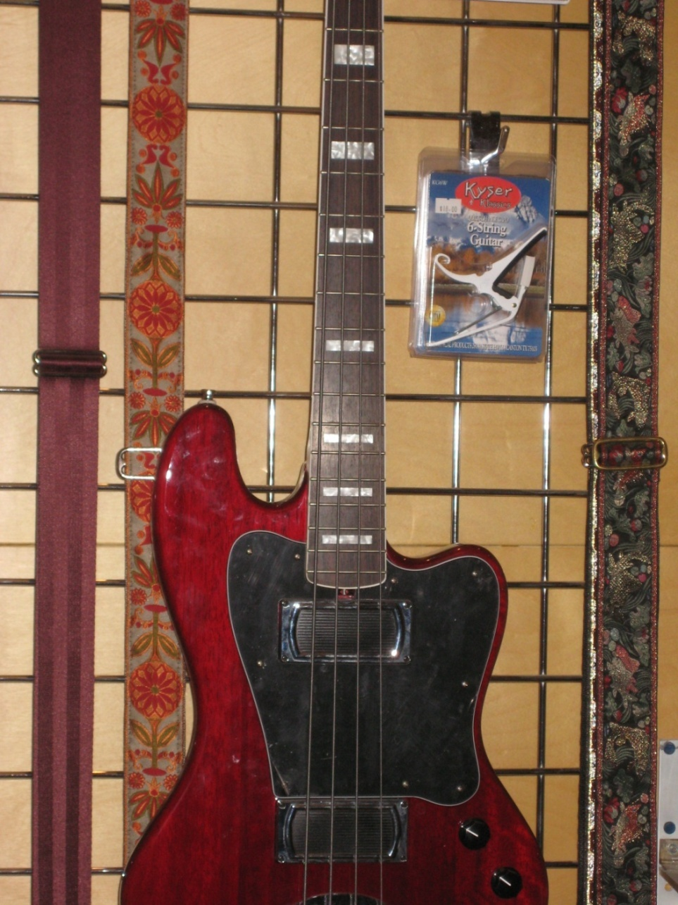
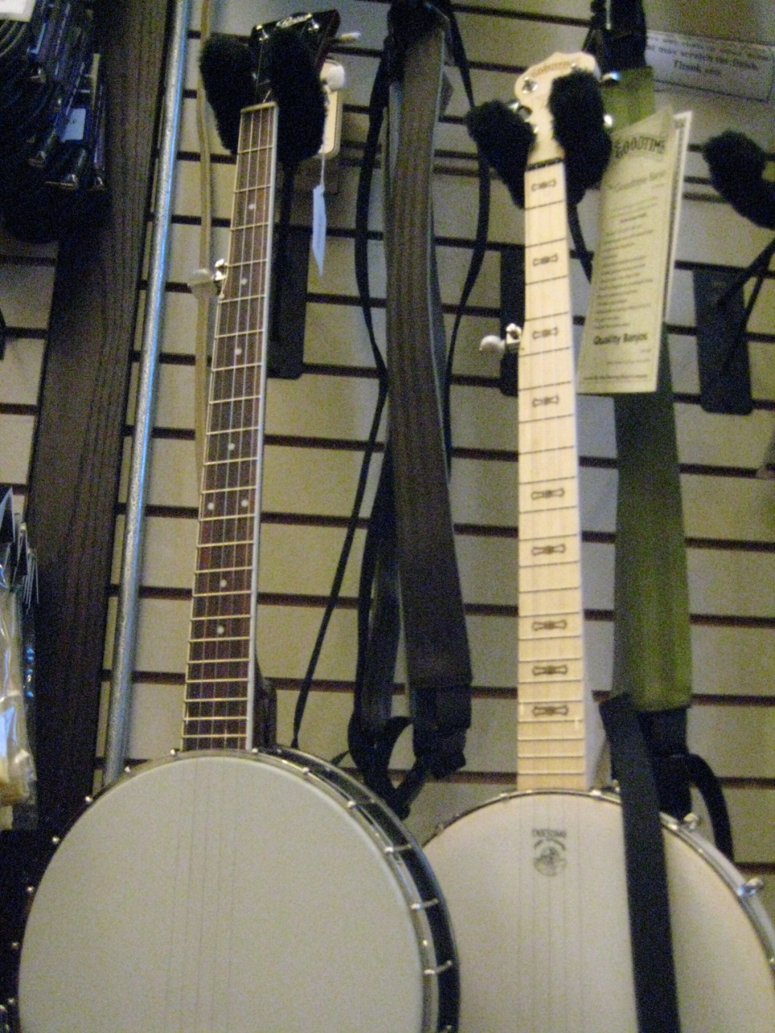
Integrate to create a natural habitat.

Slide 10
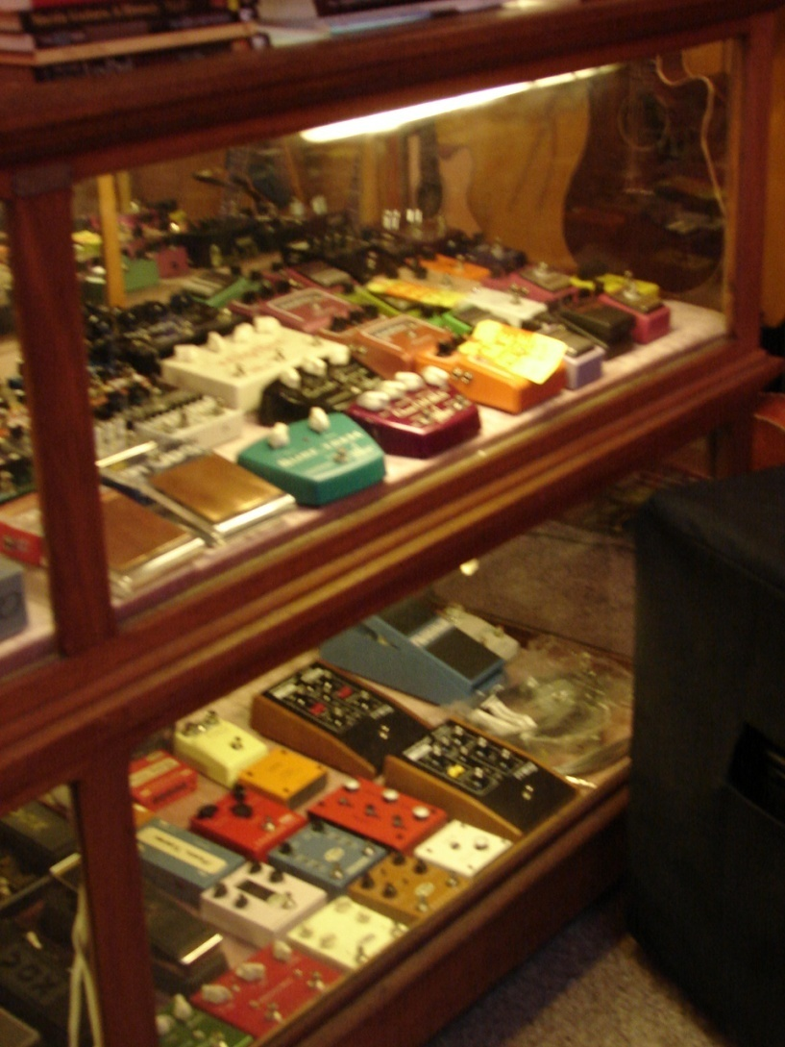
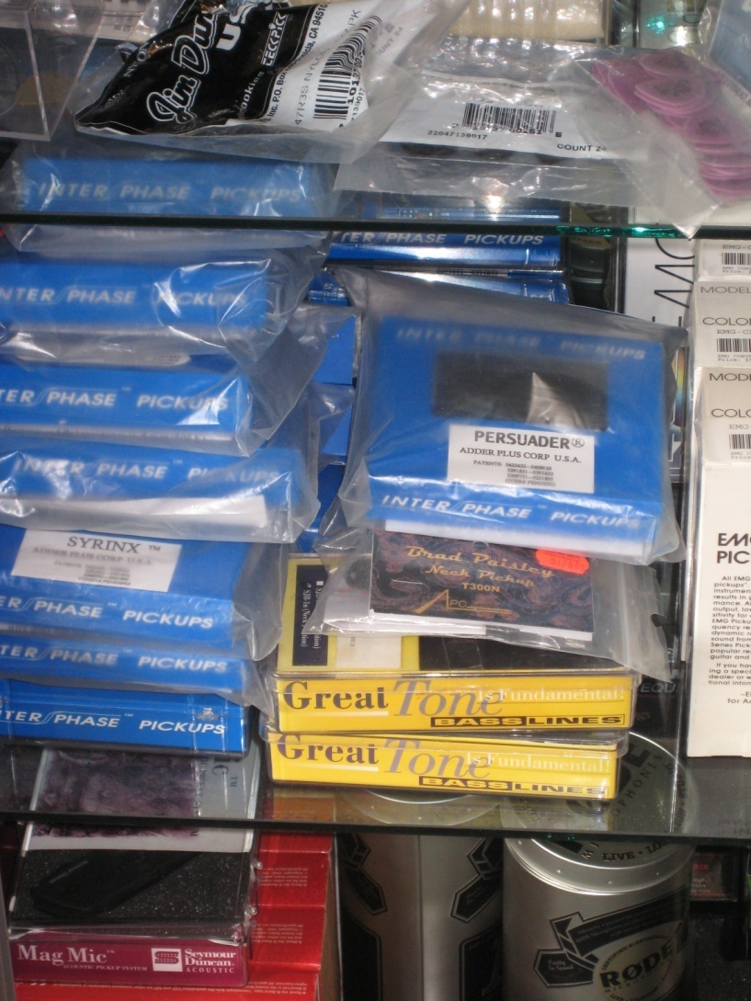
Alter perception.

Slide 11
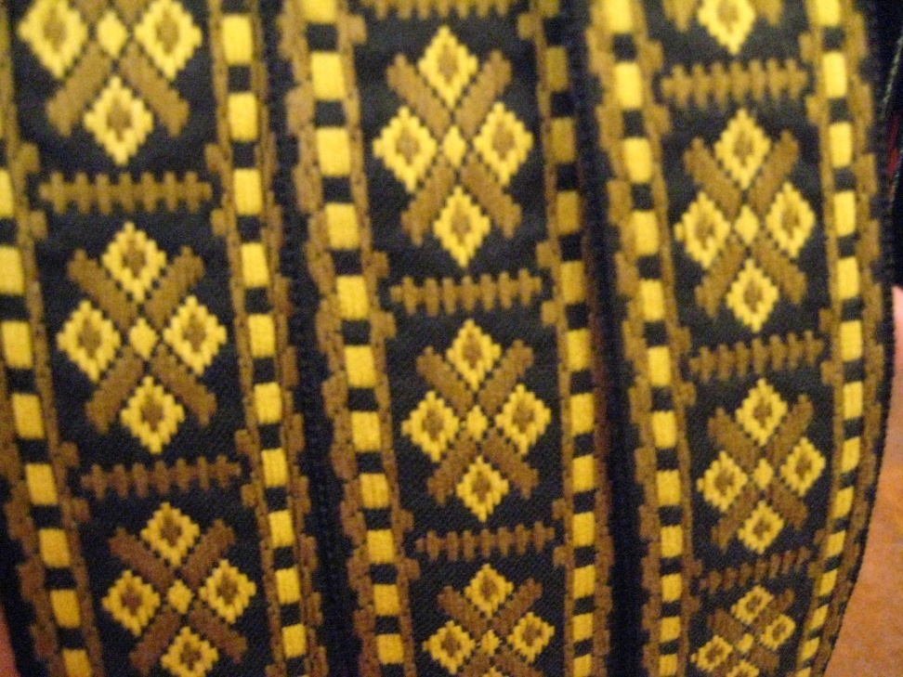

Increase the need to purchase.

Slide 12
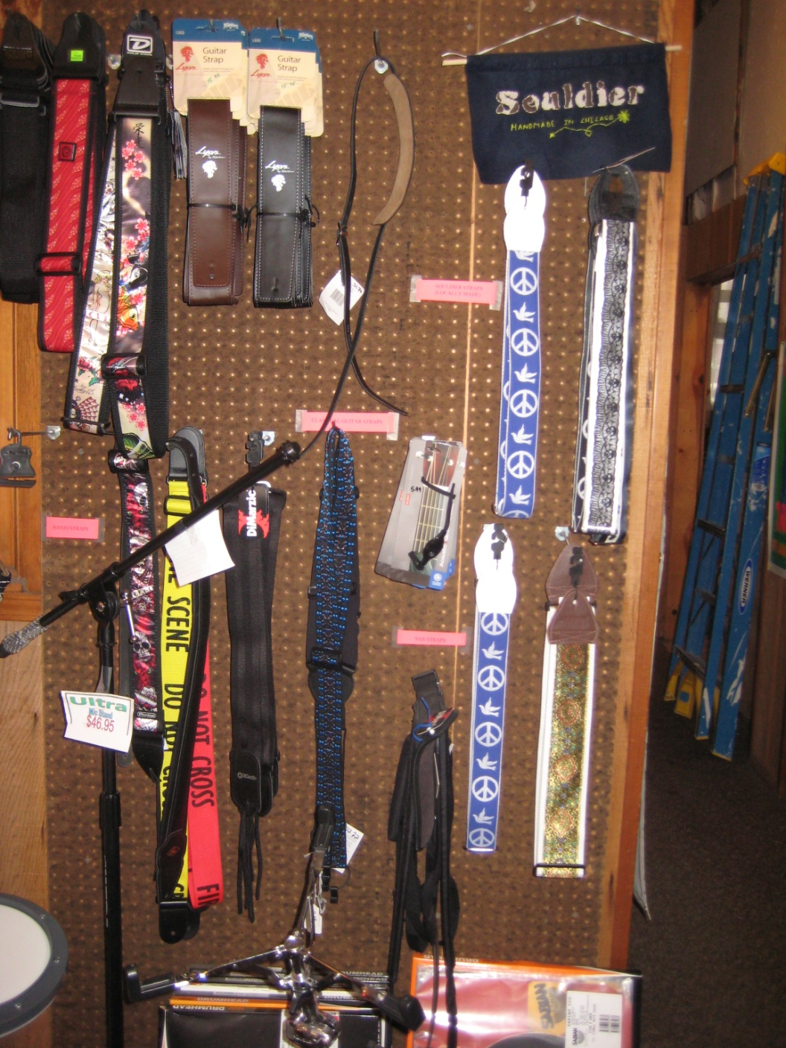
Be on top of your restock.
Don’t let your stock dwindle to the ‘leftovers’ on the rack. When you restock frequently, the leftovers appear less leftover.

Slide 13
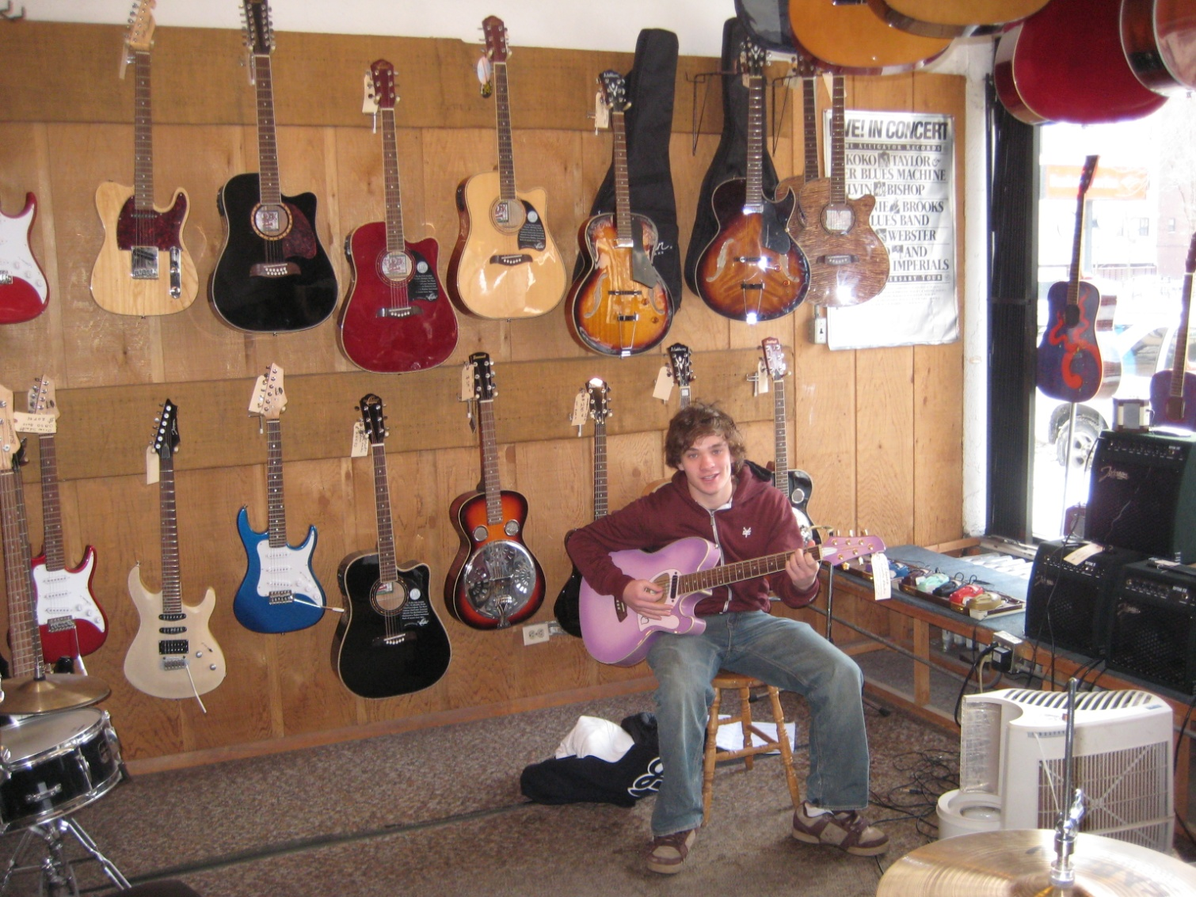
Create Specialists

Slide 14
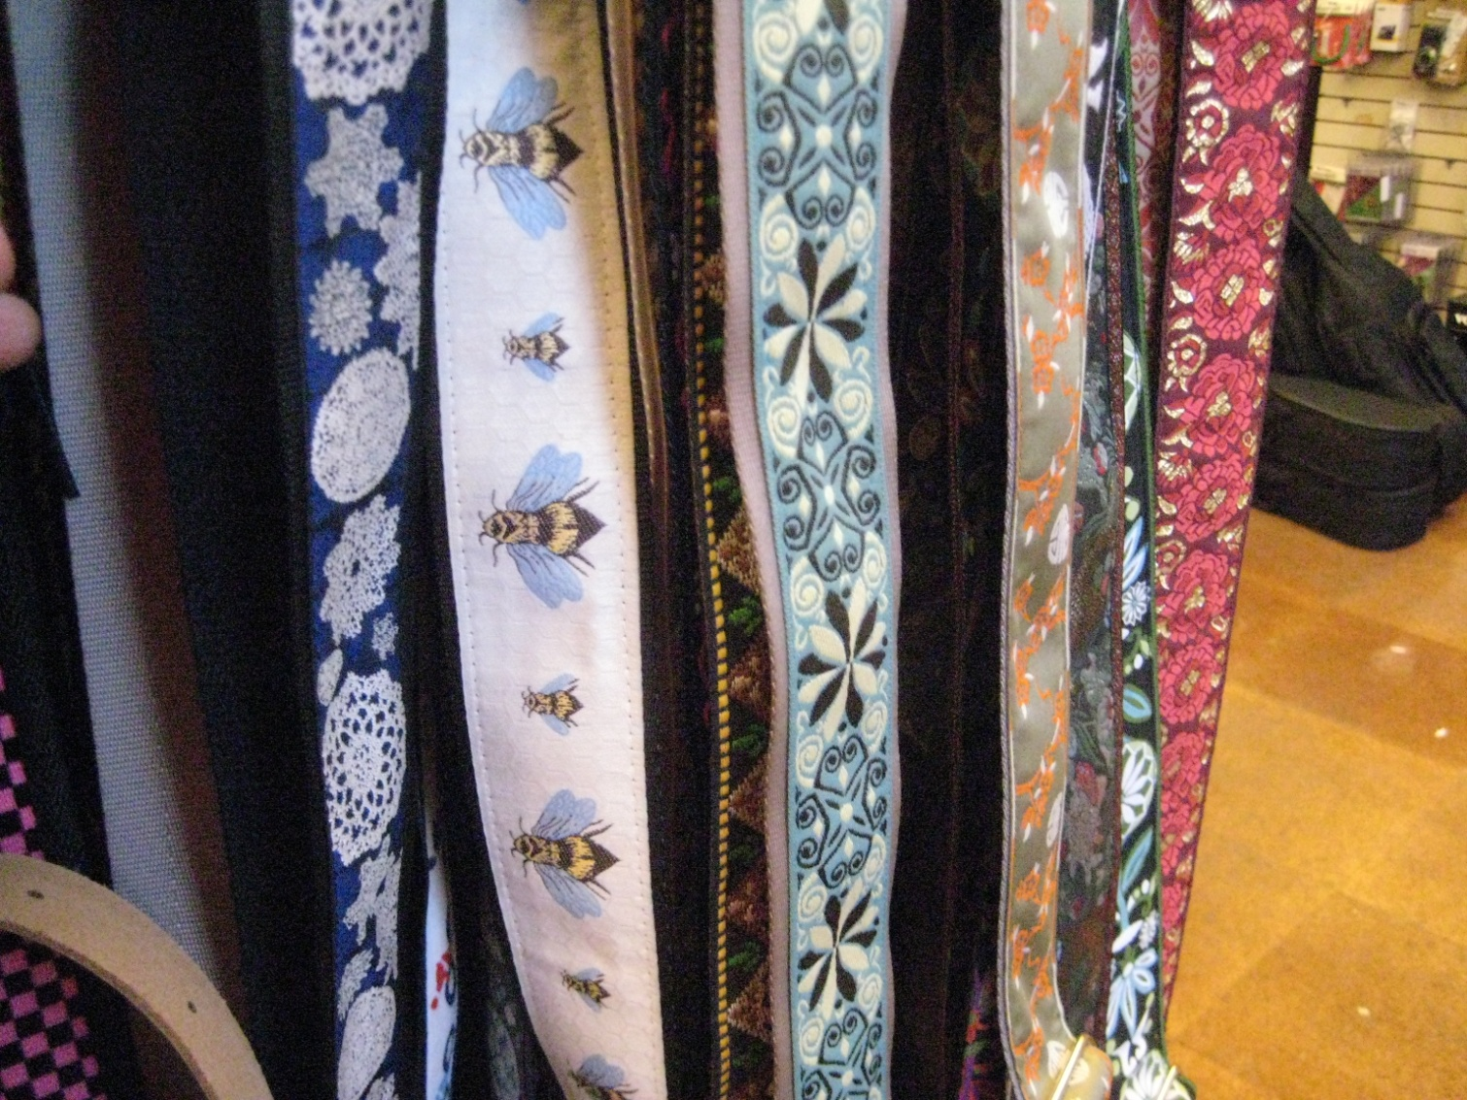
Include others on decisions when fashion is involved.

Slide 15
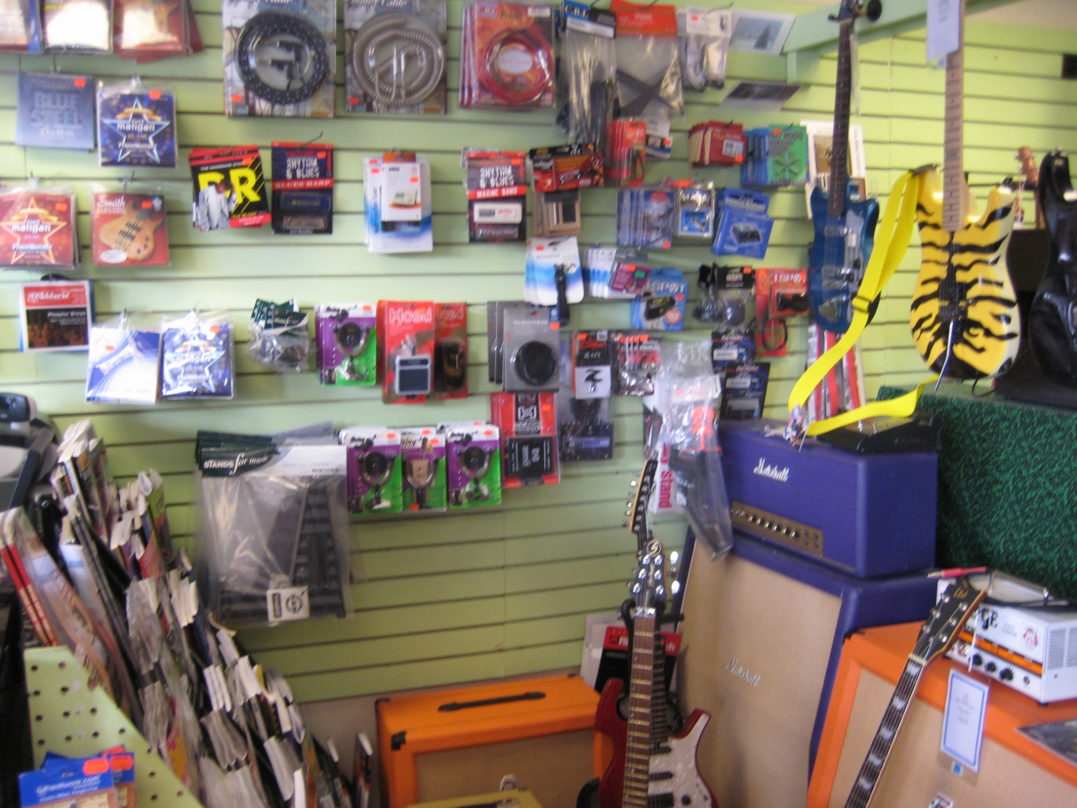
“You don’t have to go it alone,”
-Bono

Slide 16
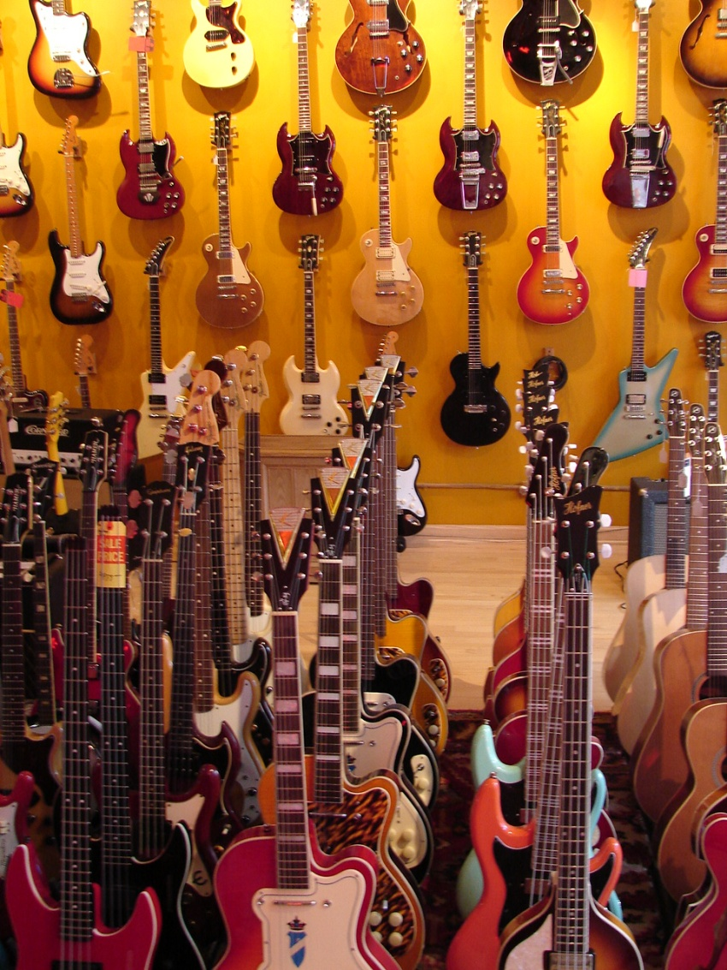
Be open to new lines.

Slide 17
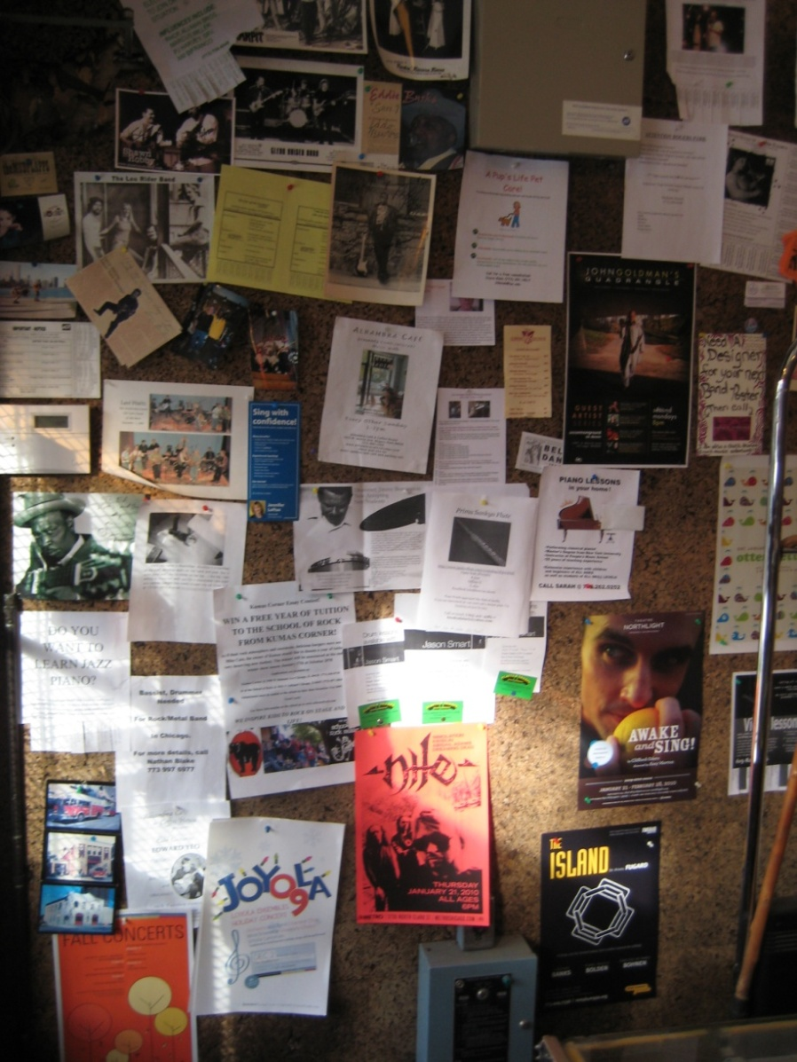
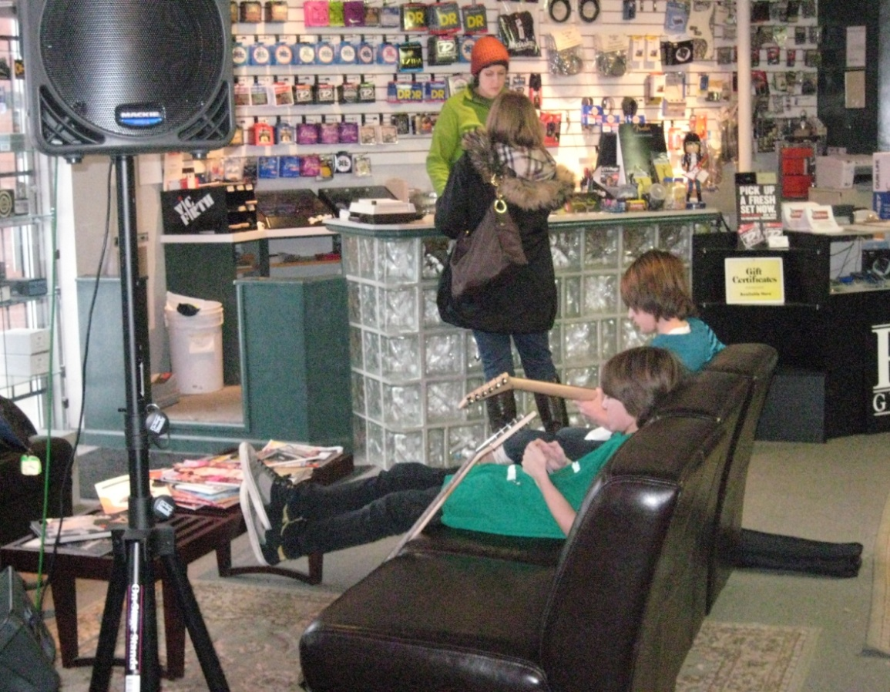
Is your store a ‘hang’?

Slide 18
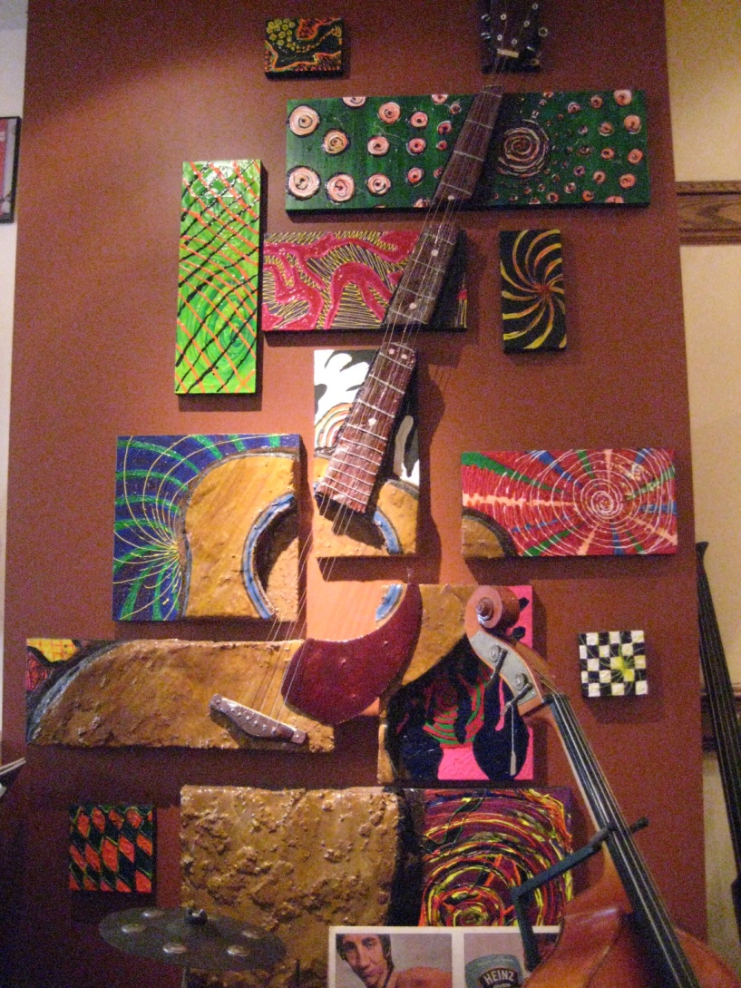
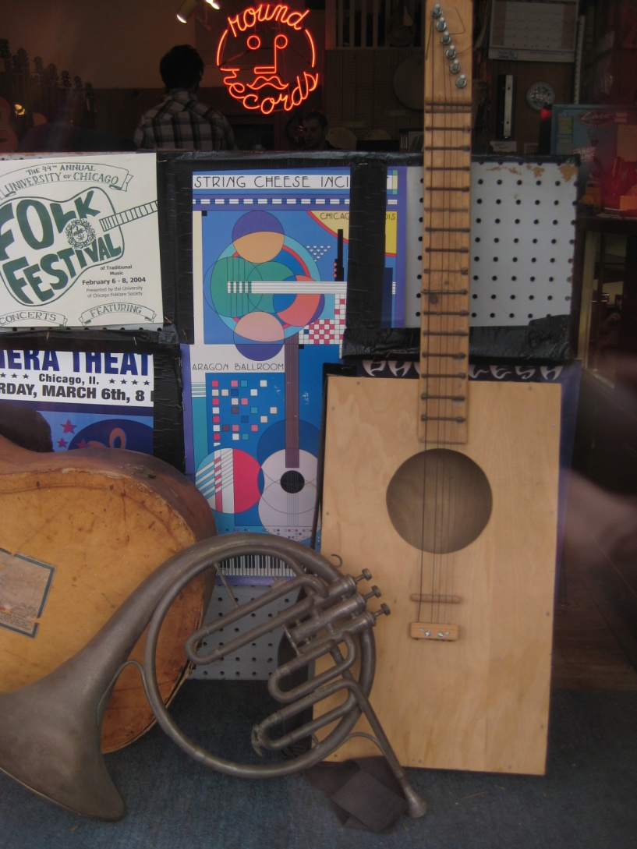
Go green with your junk.

Slide 19
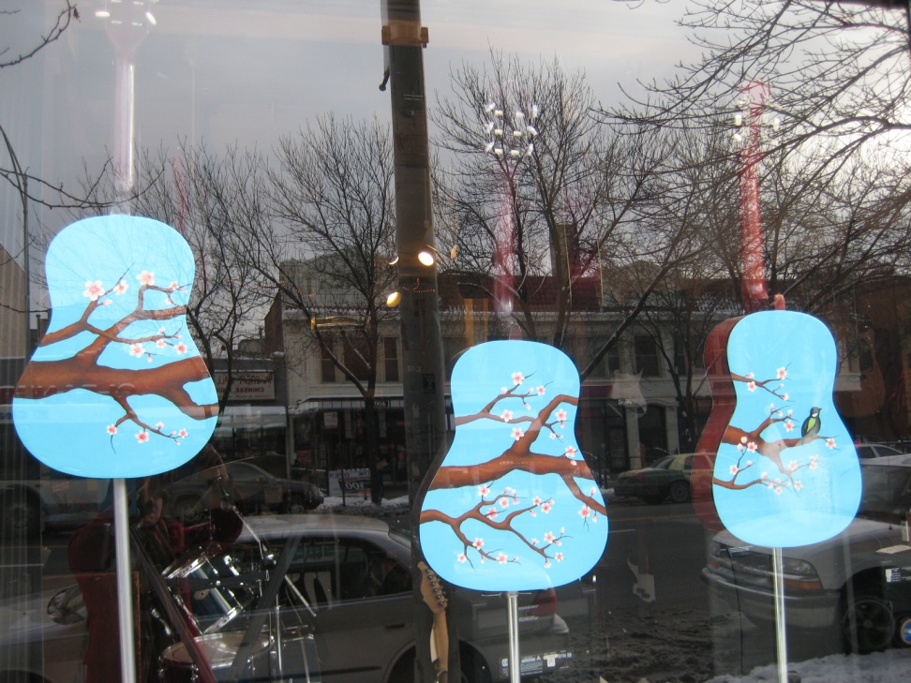
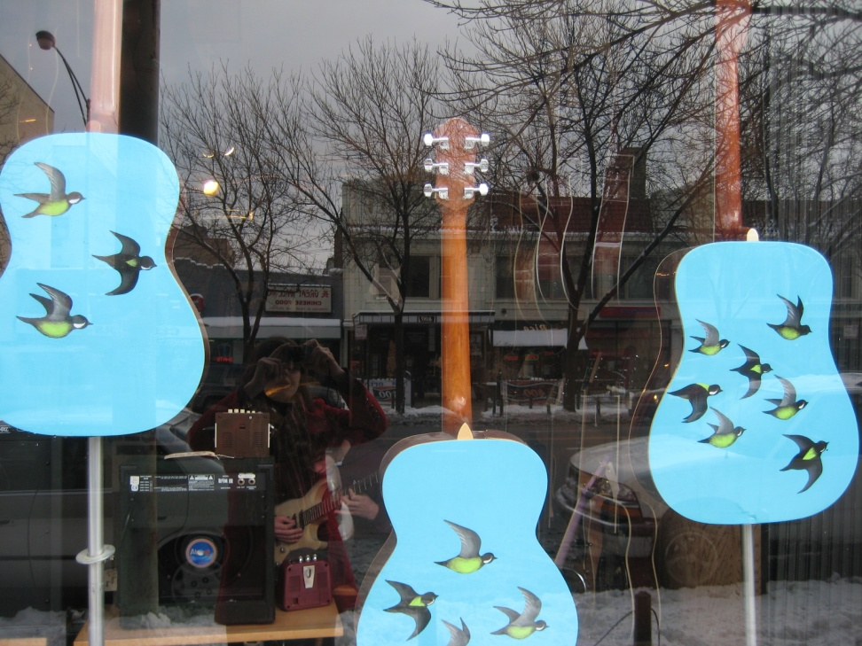
Trash to treasure.

Slide 20

* Upgrades *

Slide 21
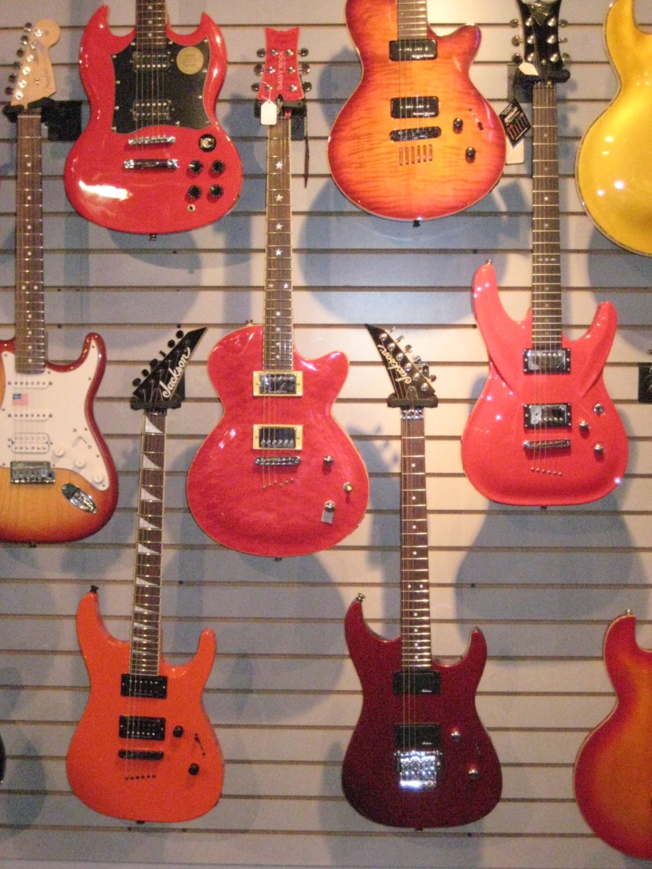
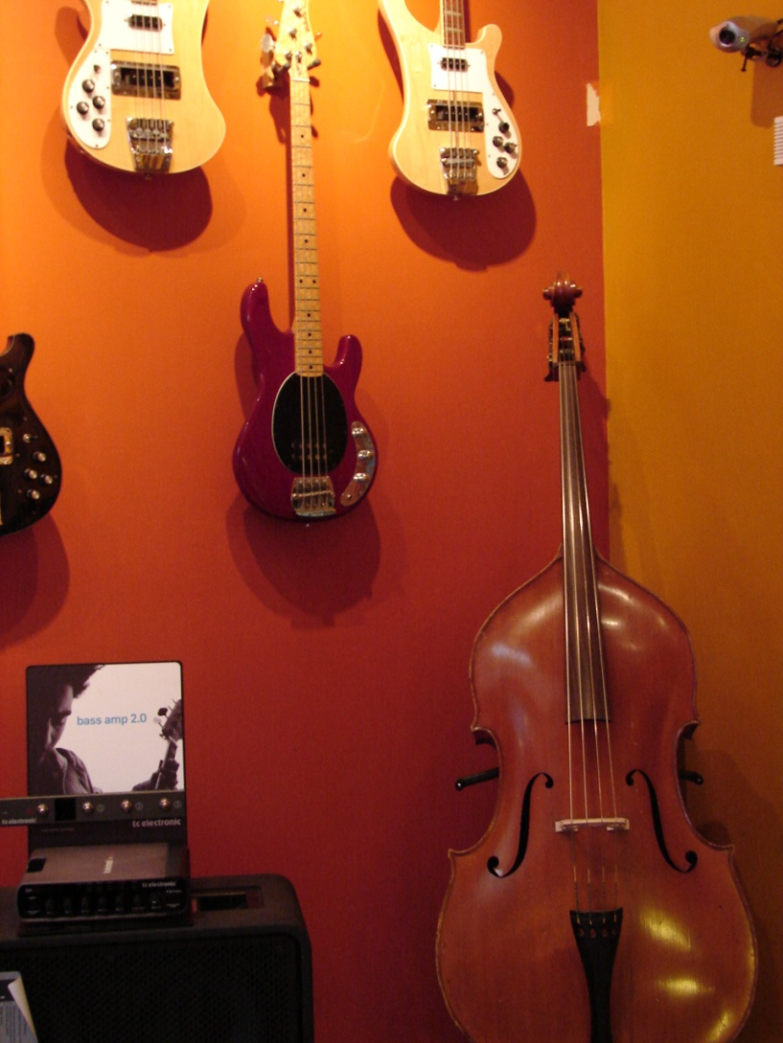
The power of paint.

Slide 22
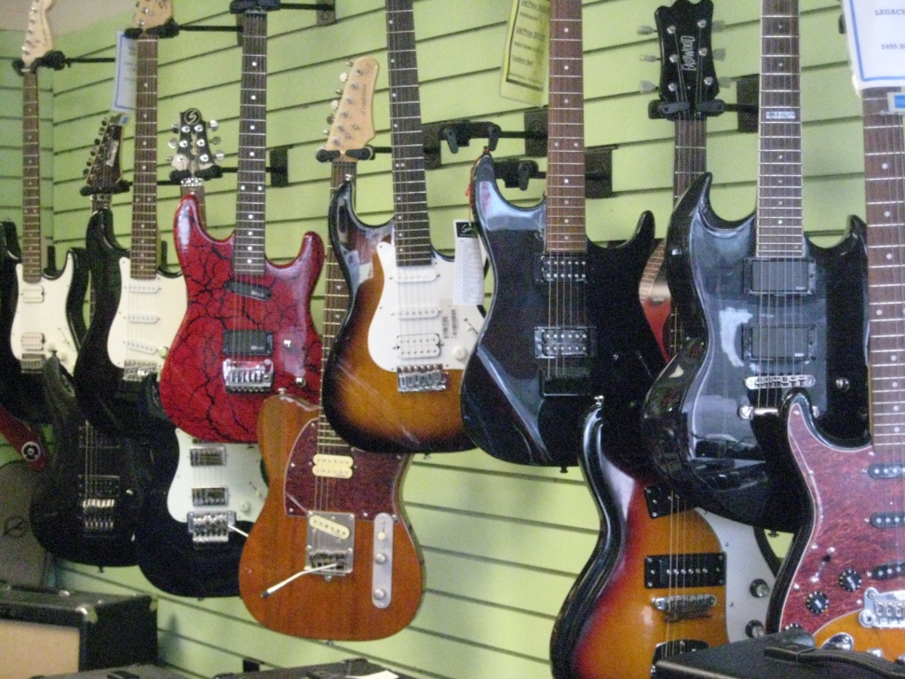
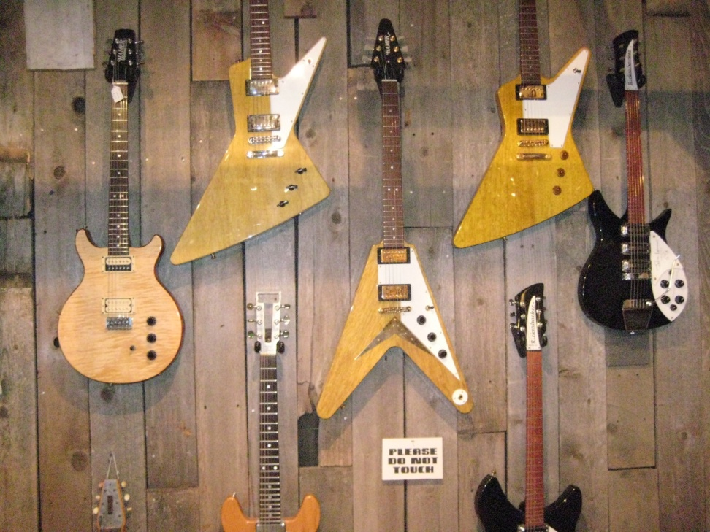
A little color goes the wrong way.

Slide 23
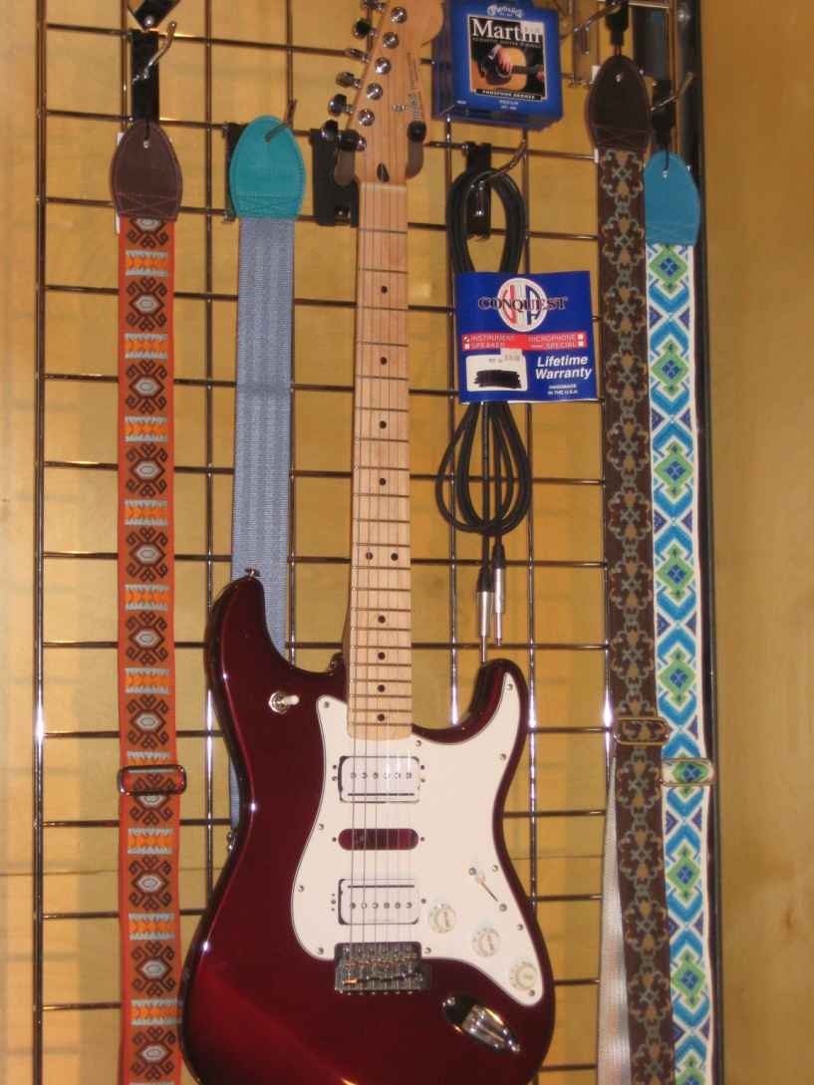
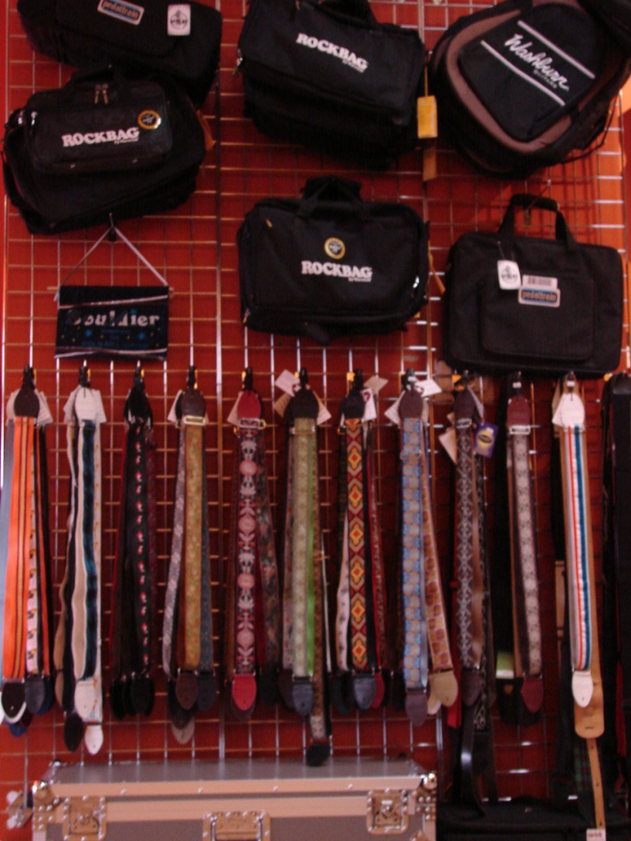
Opt for gridwall.

Slide 24
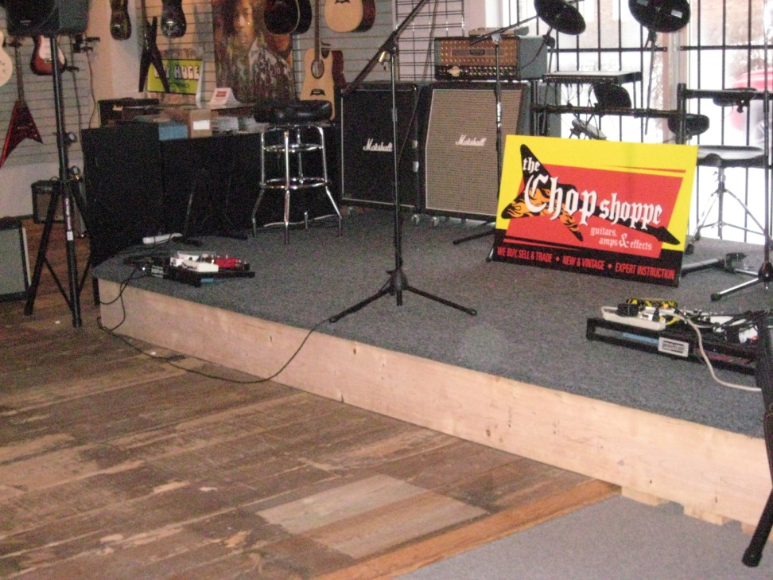
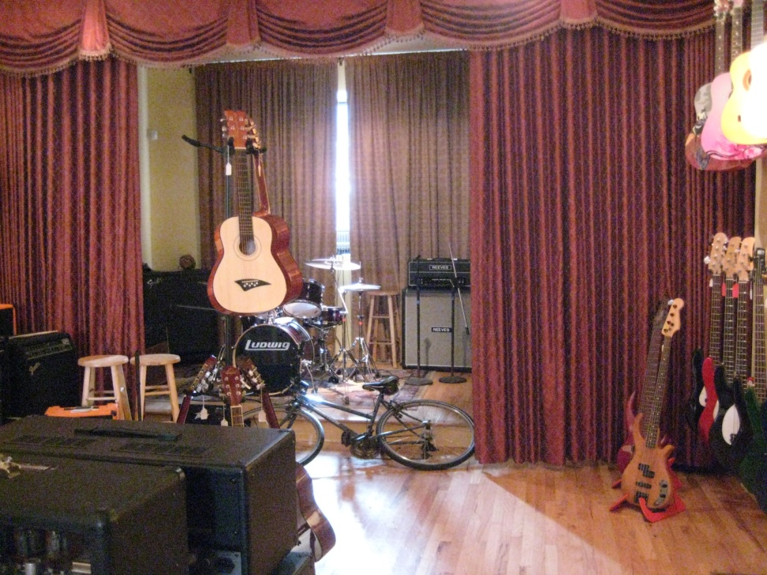
If you build it, they will come.

Slide 25
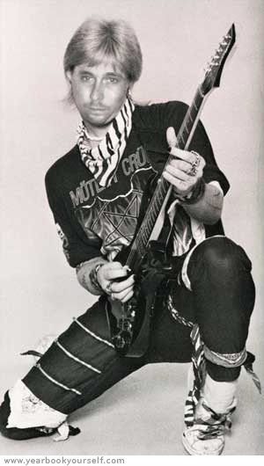
Live the dream!

Slide 26
* Contact *
If you would like to follow up or have specific questions, feel free to stop by the booth, pick up a business card, send an email.
Jen Tabor jen@souldier.us
Find us at Booth 1706
Thank you to all of my lovely stores owners who were willing to participate in this experiment with me.

