Slide 1

How to Establish a Successful Web Presence for Your Store
Danny Rocks
The Company Rocks

Slide 2
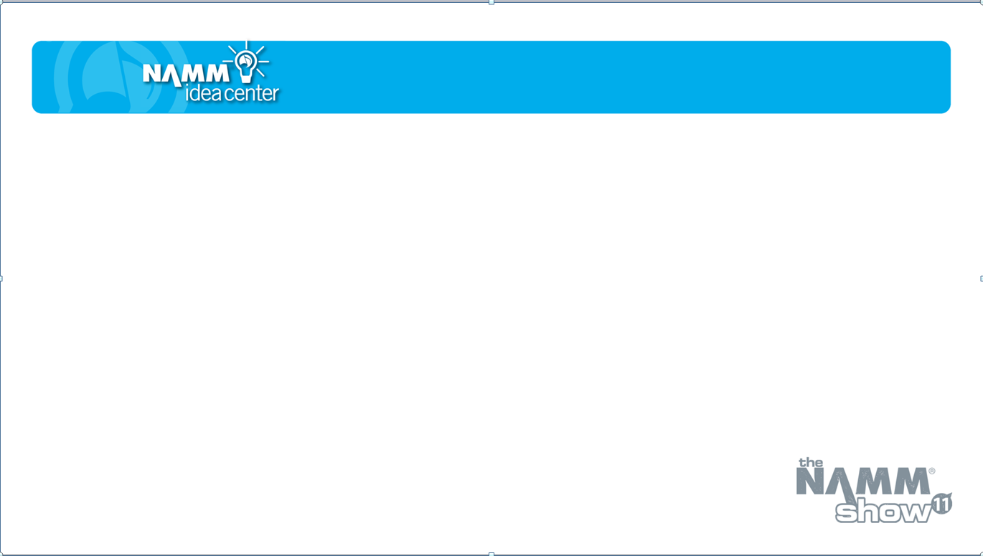
Target Your …
Audience
Message
Offer

Slide 3
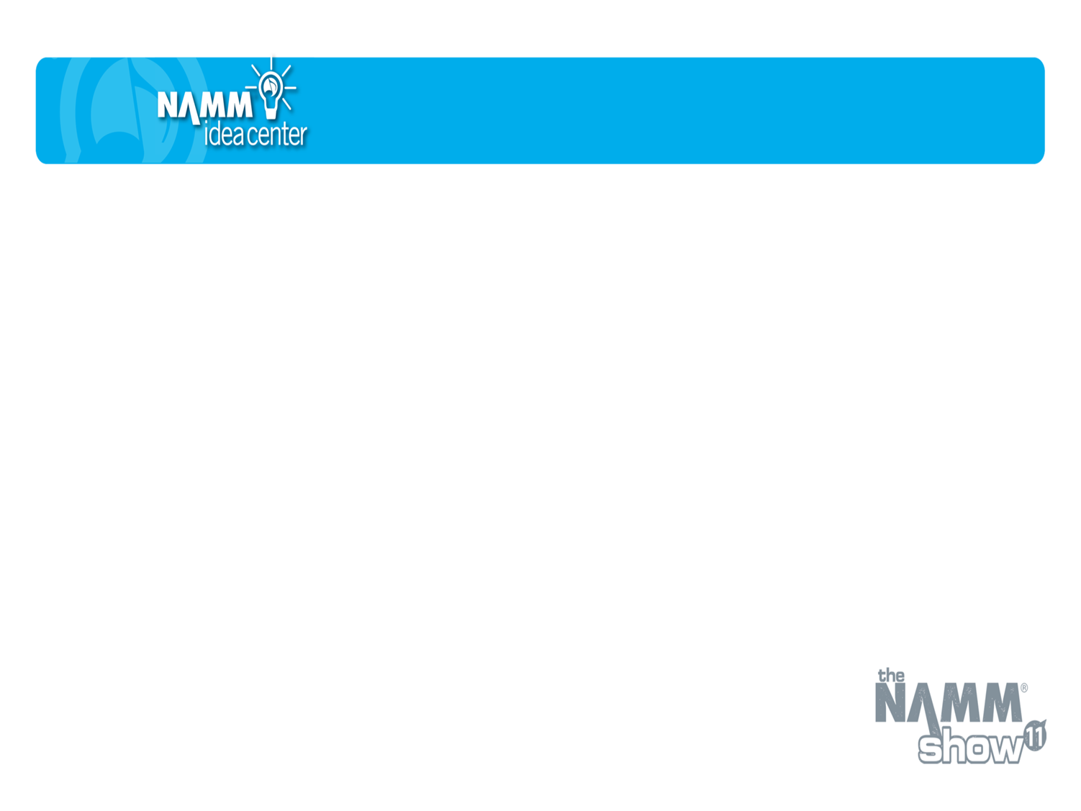
Follow a Process
Attention
Interest
Desire
Action

Slide 4
Attract Attention
Get Noticed
Organic
Pay Per Click (PPC)
Get Found
People are on a hunt
You only have 2 seconds!

Slide 5
Increase Interest
WII-FMR
What’s in it – for my readers?
Develop “Personas”
Talk about their problems
Use their language

Slide 6
Develop Desire
Focused Landing Page
Deliver on your promise
Focused - One point only!

Slide 7
Take Action
Define This!
Make it desirable
Make it easy
Make it repeatable

Slide 8
Profiting from
Social Media
How do I get started?
What are the key considerations?

Slide 9
Key Point
How to become more interesting
Be more interested in your targeted customers!

Slide 10

YouTube
Entertain
Educate
Inform

Slide 11

Facebook
Profiles
Pages
Personal
Business

Slide 12

Blogging
Personalize
Up-to date
Interact

Slide 13

Top Three Takeaways
Here are three takeaways from this session. Bring these ideas to back to your business and see what results you generate!
Takeaway 1: Target, target, target!
Takeaway 2: Follow a proven process
Takeaway 3: Create a Social Media Action Plan
Notes:
13

