Slide 1
HOW TO GET A GRAMMY NOD AS AN INDIE by Linda Chorney
Do you want to feed your ego, or your family?

Slide 2

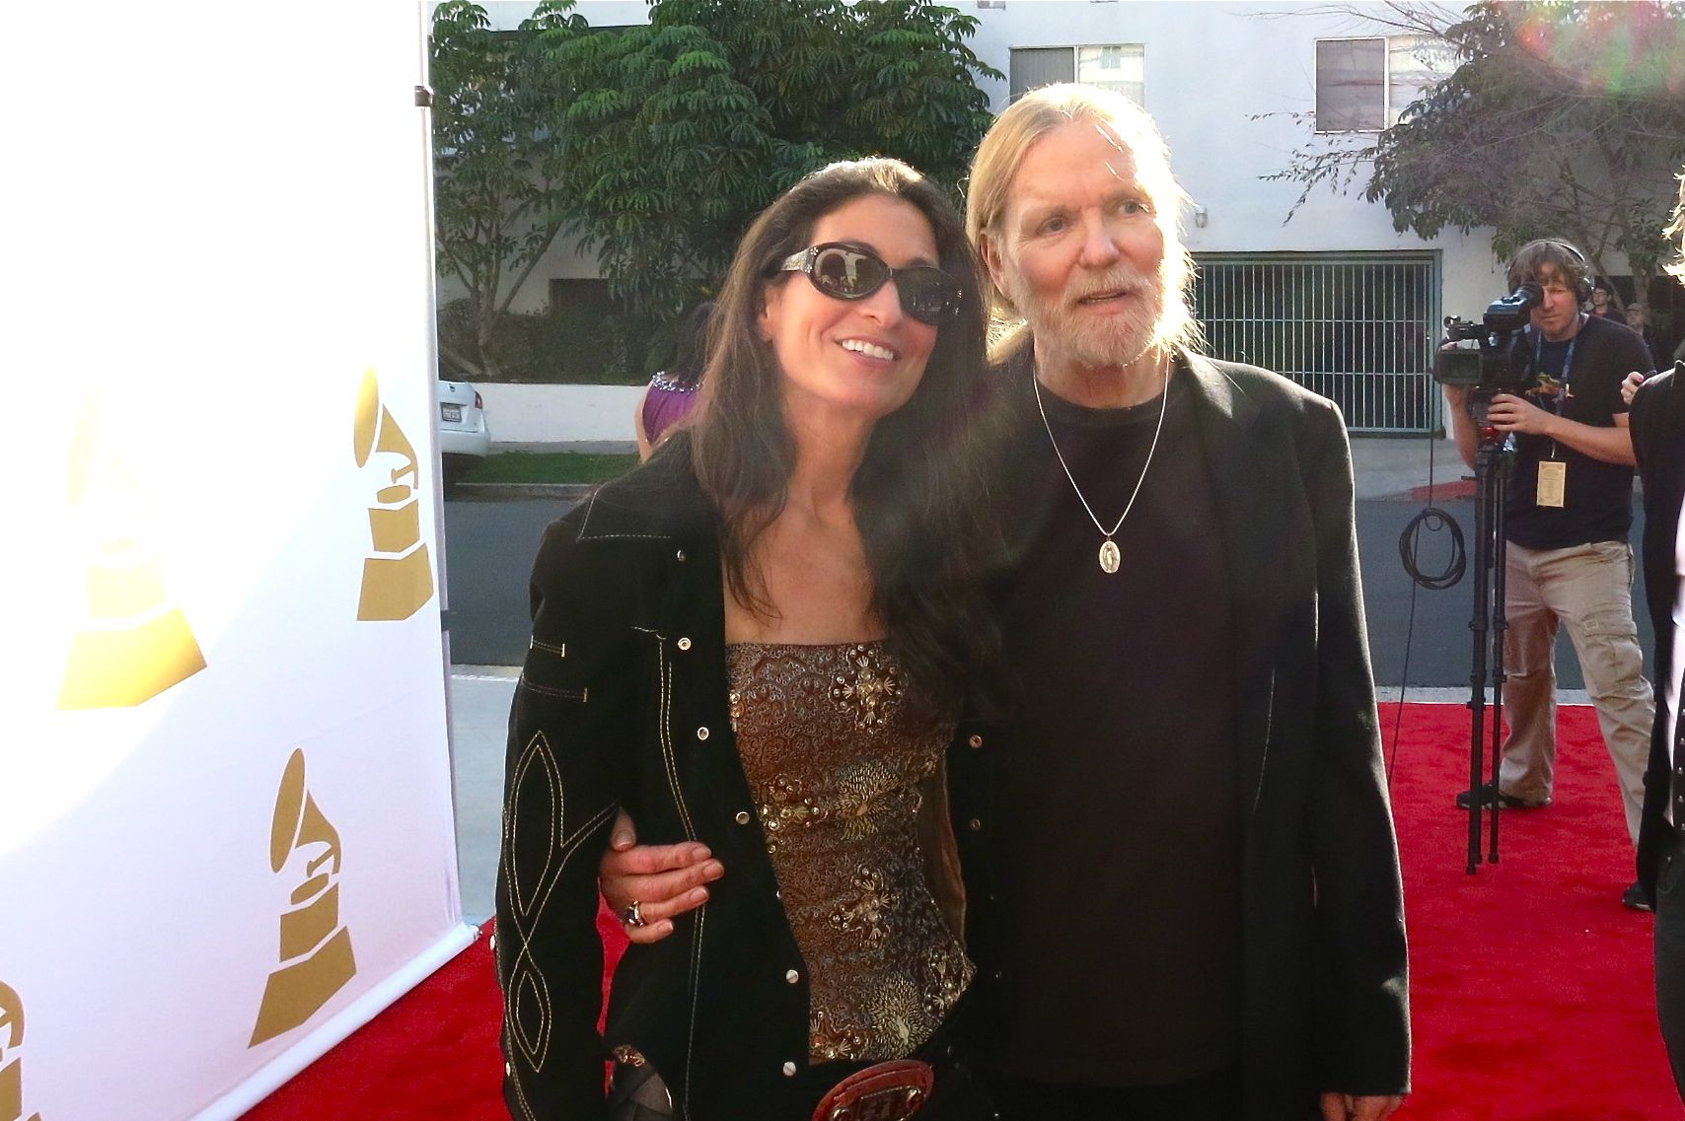
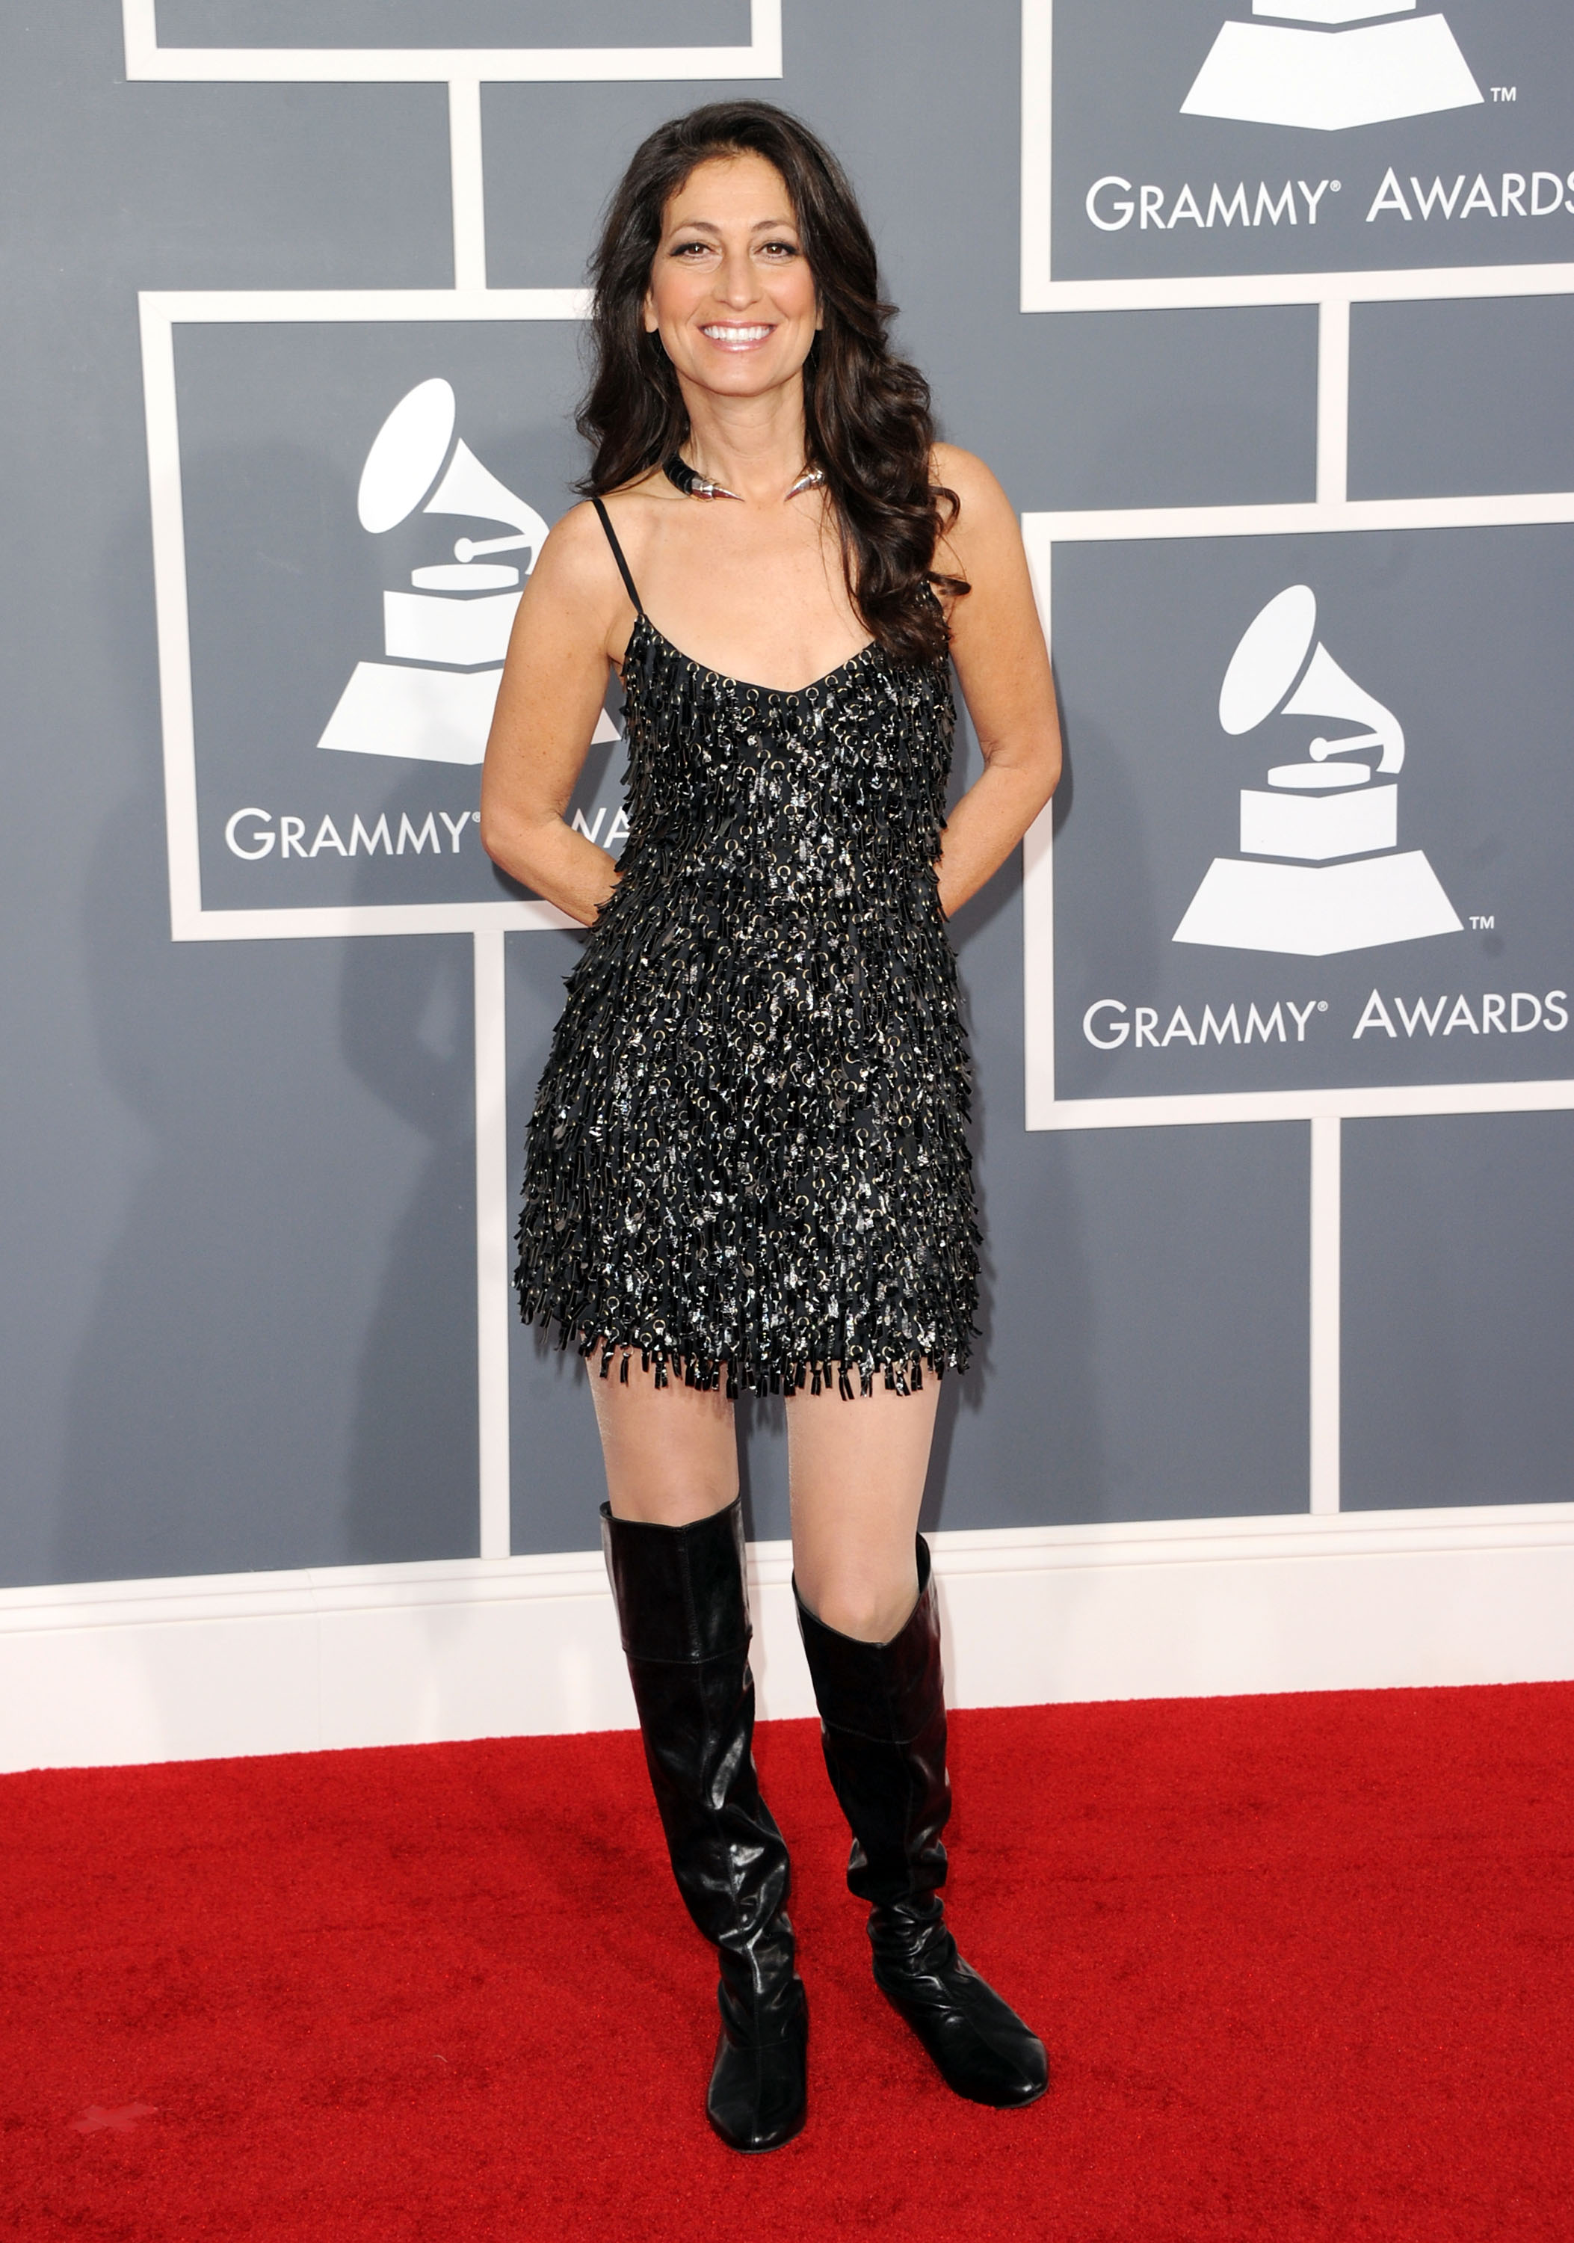
Do you want to feed your ego…
?

Slide 3
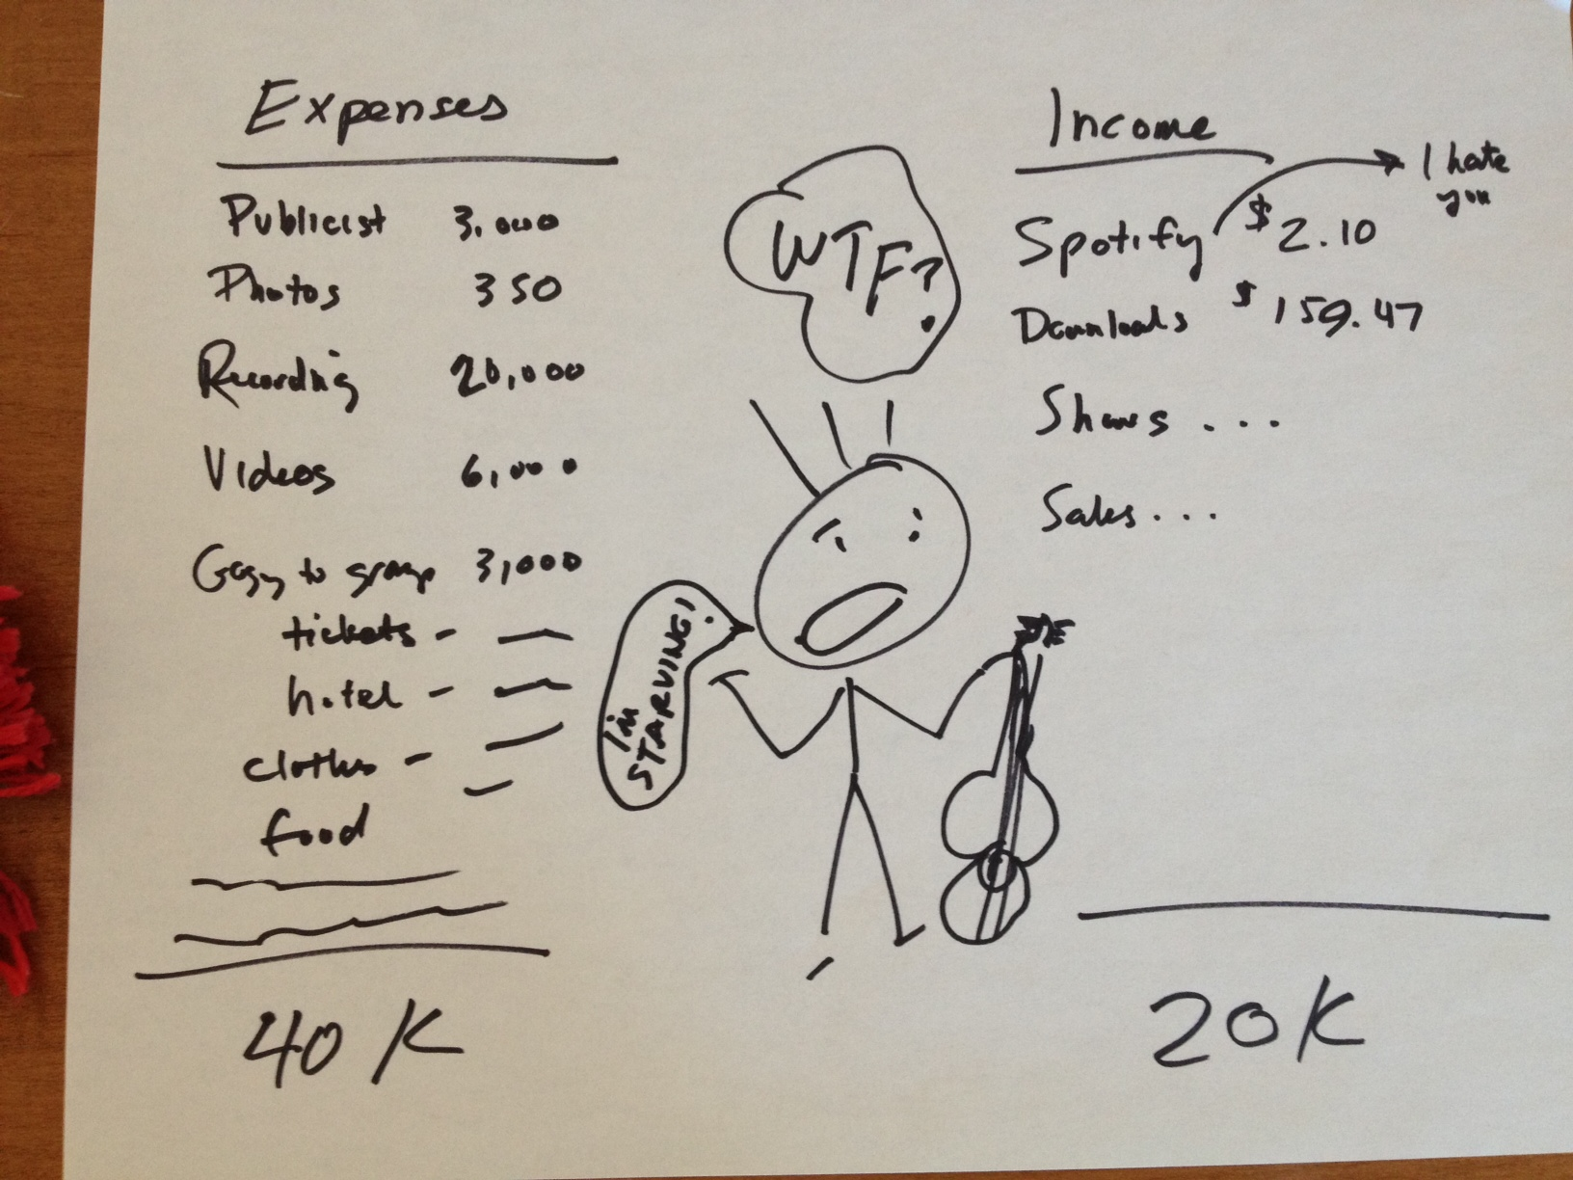
Or do you want to feed your family?

Slide 4
HOW TO GET A GRAMMY NOD AS AN INDIE
Do you want to feed your ego, or your family?

Slide 5
SELF-INDUNGENT BRIEF HISTORY
OF ME ALERT!
Yada, yada, yada…

Slide 6
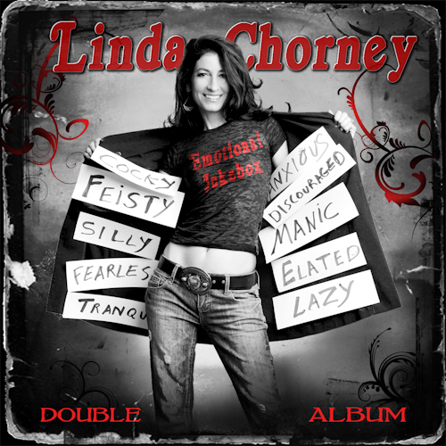
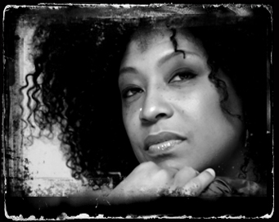
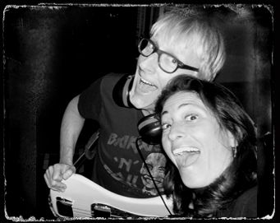
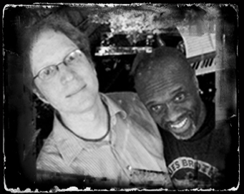
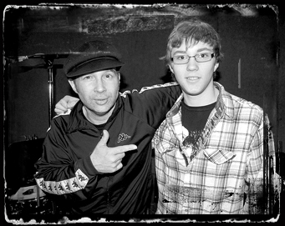
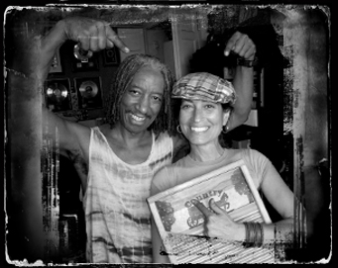
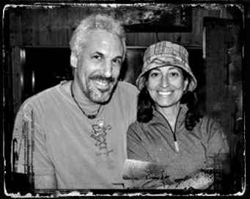
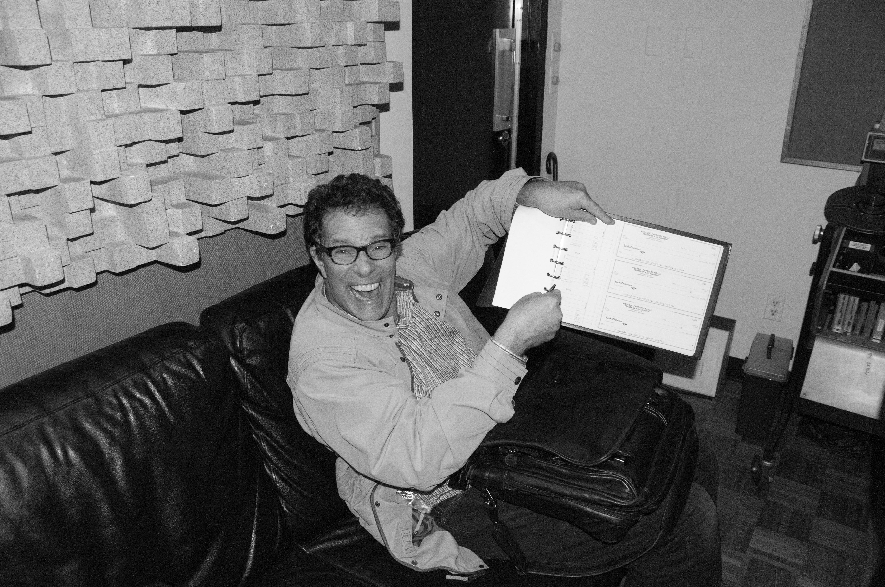
BEST AMERICANA ALBUM
EMOTIONAL JUKEBOX

Slide 7
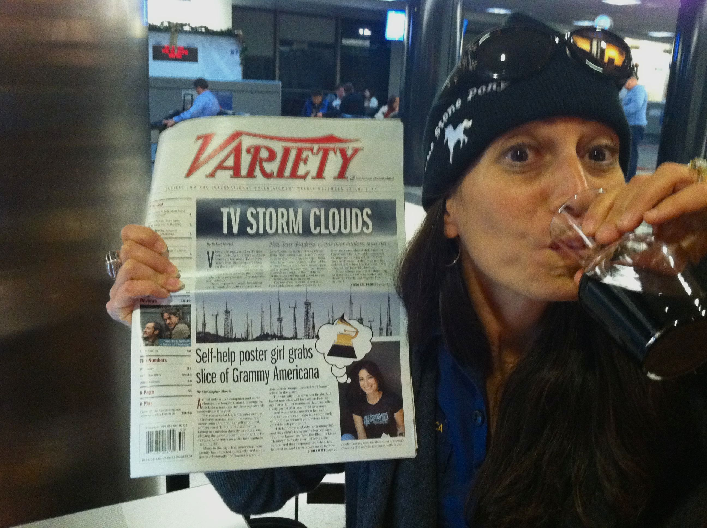
TADA! Self-help poster girl grabs slice of Grammy Americana

Slide 8

Step 1 – become a member
$100

Slide 9
Step 2 – Spend money to get nominated?
ON WHAT?
$$$$$$$$$$$$$$$$$$
?????????????????
$$$$$$$$$$$$$$$$$
S

Slide 10
STEP 0 - RECORD A GREAT ALBUM
Membership – essential
Build your contacts
Consideration, consideration, consideration
Mailing CD’s?
Hiring publicist?
Hiring “consultant”?
BUYER BEWARE

Slide 11
SPEND MONEY AFTER NOD to go for the WIN?
ON WHAT?
Publicist?
Shrink?
Mailing albums & shwag?
Get shwag from cool sponsors! (free)
Writing a blog so you don’t go insane? (Free!)
Throwing parties?
Hire a radio promoter? (Does airplay bring income?)
Making T-shirts?

Slide 12
Quotes from Variety Article
Al Moss, a prominent Atlanta-based radio promotion man and a member of the AMA board says, “I’d never heard of her before. Nobody I talked to about it had ever heard of her before…I don’t really know what’s going on.”
One veteran Texas Americana promoter, who declines to be identified, says, “Nobody in our field — managers, booking agents, radio promoters — knows who … this chick is.”

Slide 13
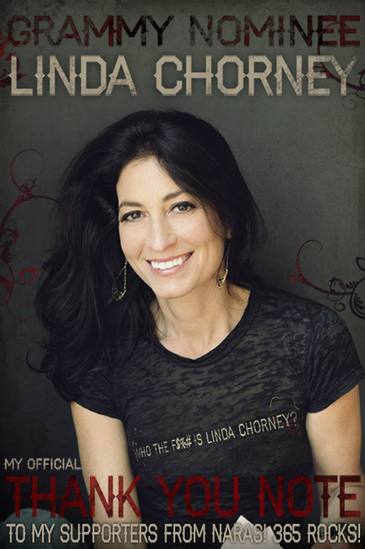
FIND THE HUMOR!

Slide 14
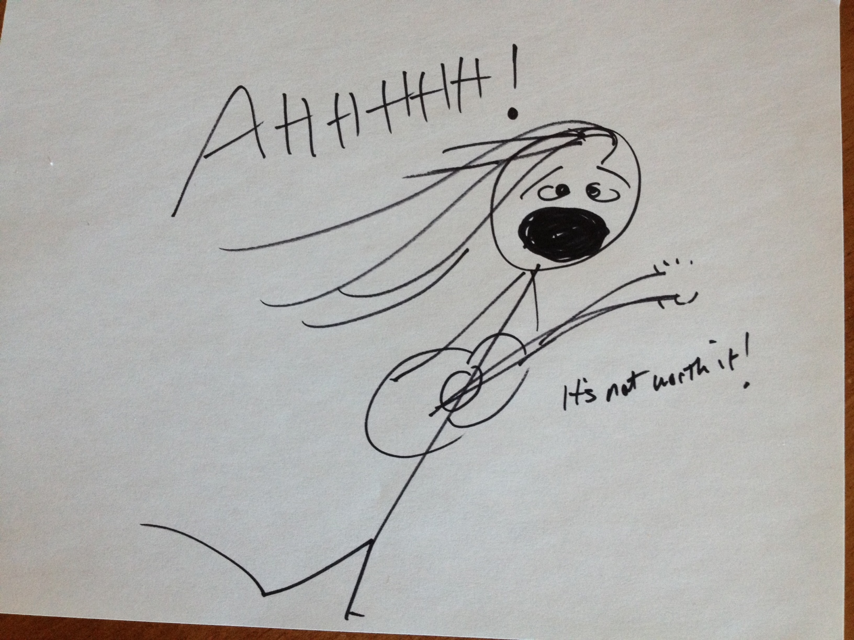
FIRST YELLOW FLAG…
RUN AWAYYYYYY!!!

Slide 15
Do you spend for and post Grammy Nod?
Going to Grammys? HELL YEAH!
Stylist? Make-up? Hair?
Limo?
Photos?
Lawyers?
A second shrink?

Slide 16
GRAMMY $365

Slide 17
TOTAL EXPENSES VS INCOME
OF GRAMMORAMAS
IN THE….(DRUMROLL)….

Slide 18
RED

Slide 19
Do you want to feed your ego…
?

Slide 20
Or do you want to feed your family?

Slide 21
WHAT CAN WE DO ABOUT IT AS MUSICIANS??!!!

Slide 22
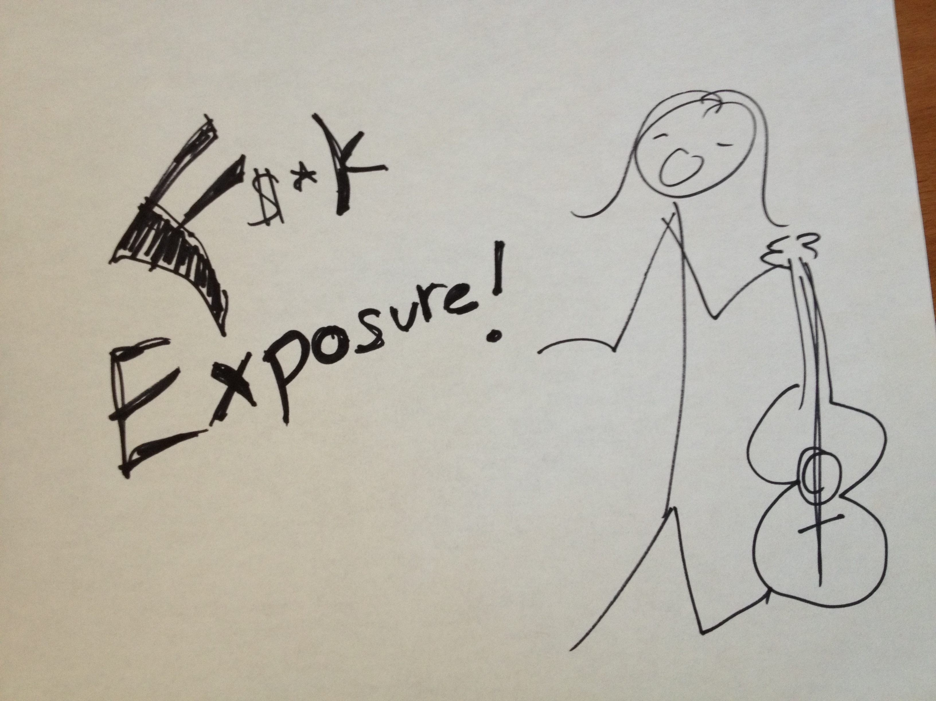
DO NOT PLAY FOR FREE
(Unless you have good friends that will record on your album for huge gratitude and some fooooood)

Slide 23
WHY BOTHER?!

Slide 24
CHEESE BALL ALERT
(yet poignant while simultaneously self-promoting)

Slide 25
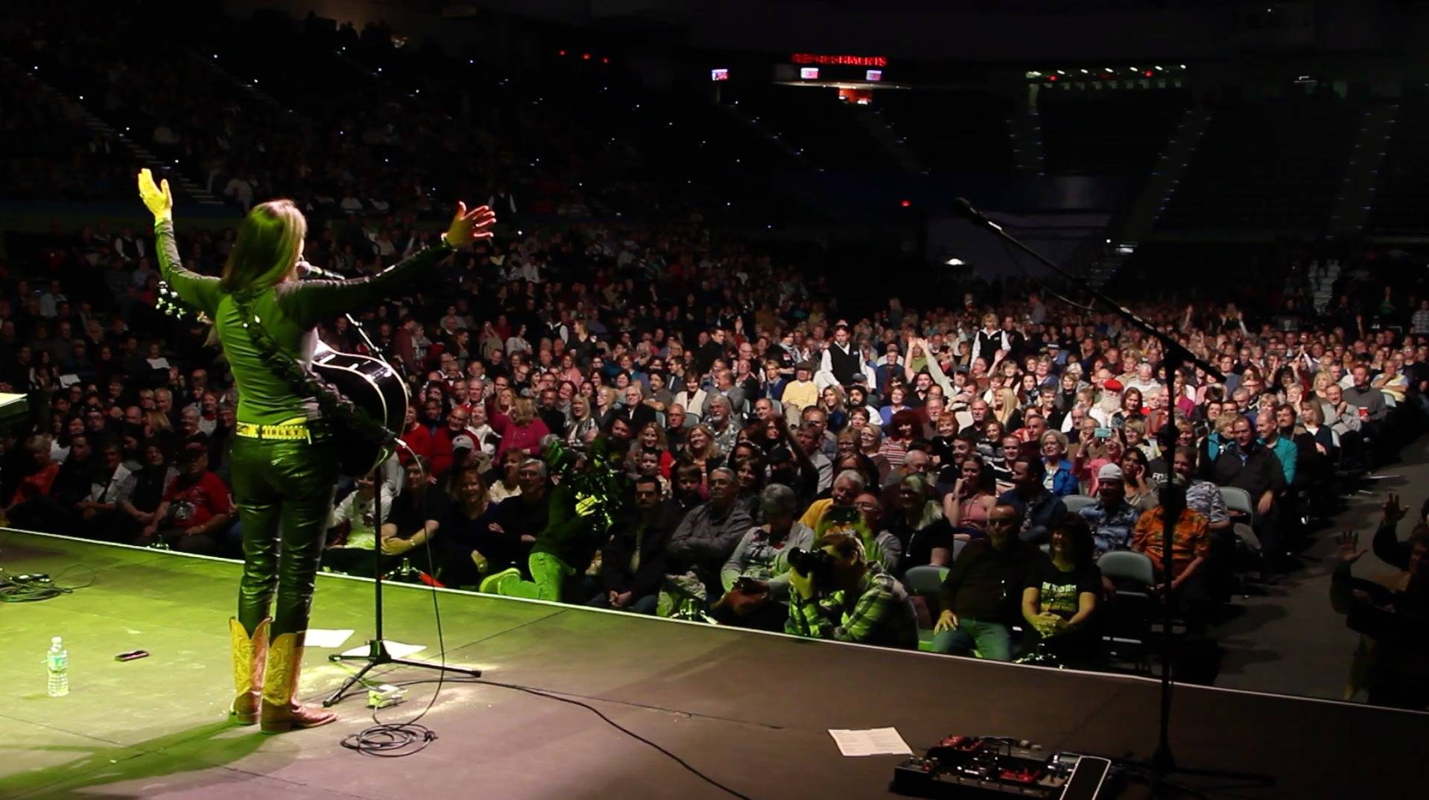
FEED THE SOUL, MAN!
Opening for The Beach Boys!
January 3, 2015

Slide 26
CONCLUSION:
1) SHOULD YOU INVEST THE HUNDY??

Slide 27
YES!
….but not with hope of a nomination
WHY?

Slide 28
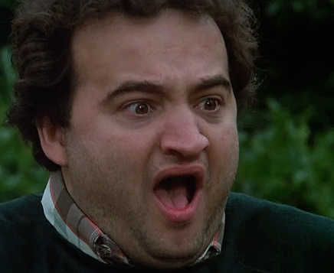
They Changed the F*$Kn rules!
(Recite like John Belushi in Animal House)

Slide 29
2. YELLOW FLAG??

Slide 30
RUN AWAYYYYYY!

Slide 31
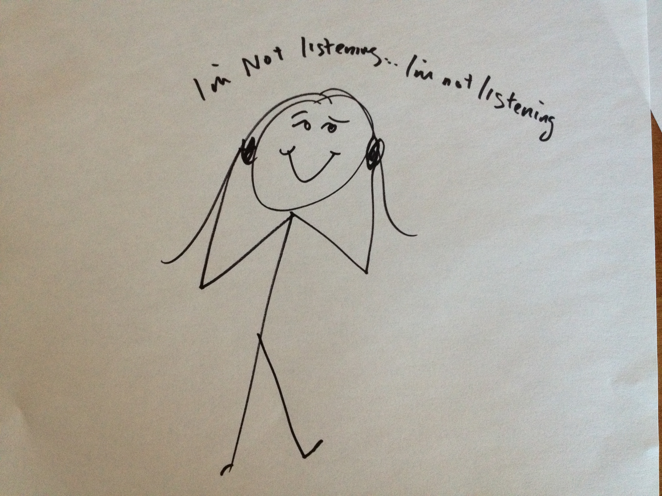
IGNORE THE NOISE

Slide 32

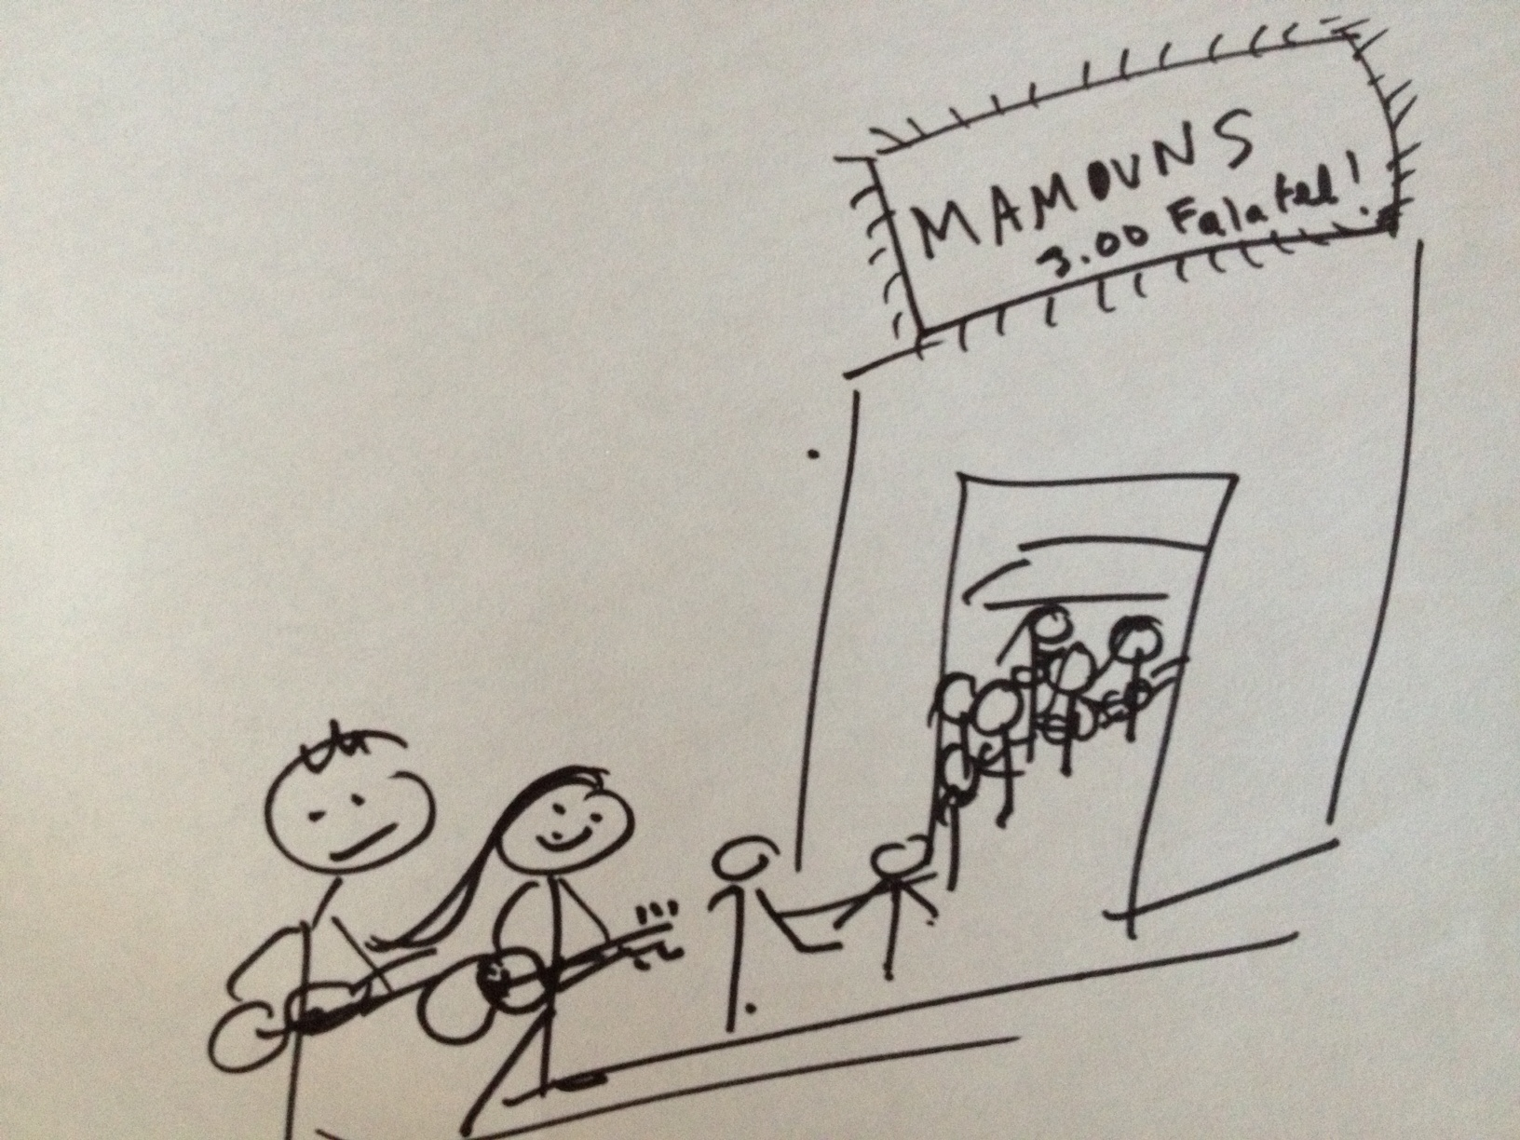
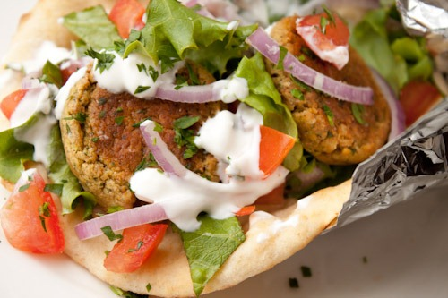
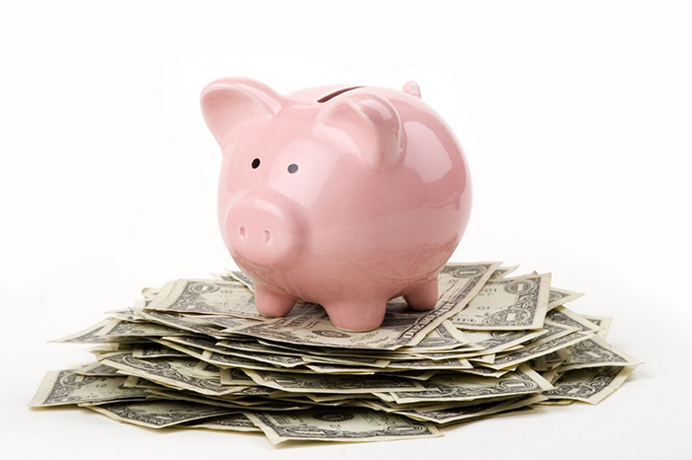
INVEST YOUR HARD EARNED MONEY WISELY SO YOU CAN… feed your ego, family, and soul

