Slide 1

National Association of Music Merchants
Nashville, Tennessee July 21 – 23 , 2011

Slide 2
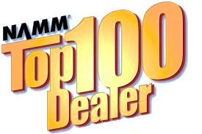
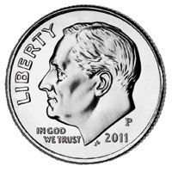
Successful Promos on a Dime
Creative and (Relatively) Inexpensive
Ways to Drive New Customers
into Your Store
Liz Reisman, Creative Music Center
Monroe, Connecticut
liz@TheCreativeMusicCenter.com

Slide 3
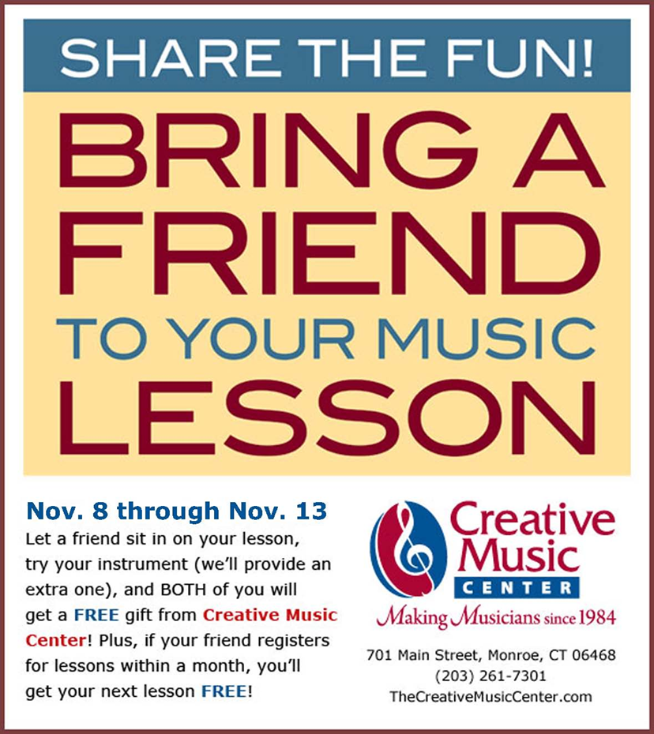
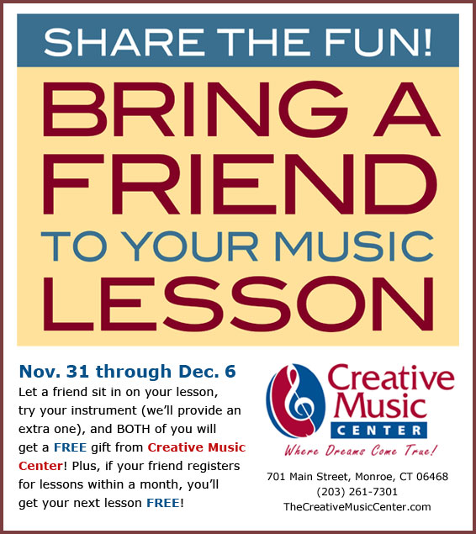
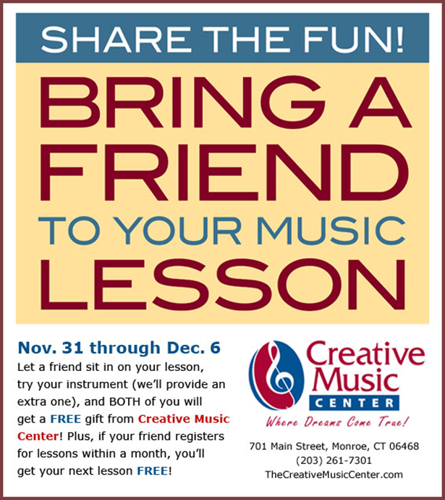
Strategy: Build on Your Base
Anytime!

Slide 4
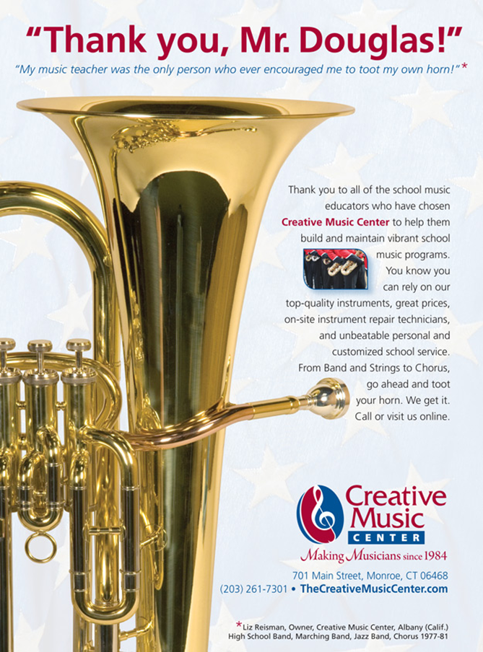
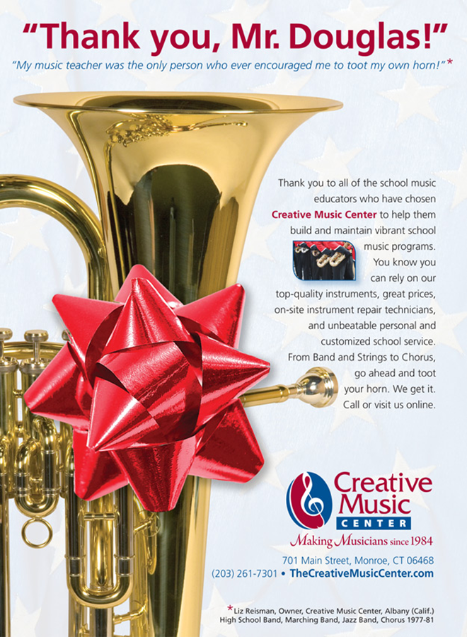
$$-Saving Tip

Slide 5


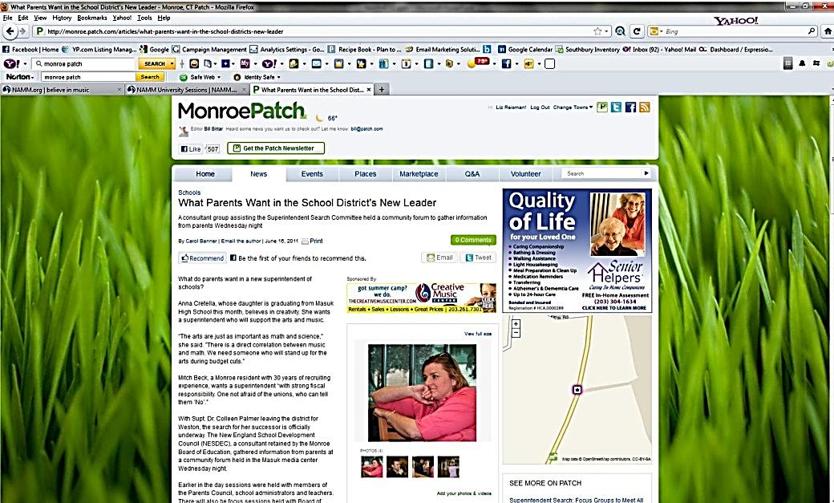
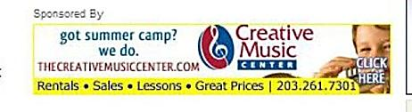
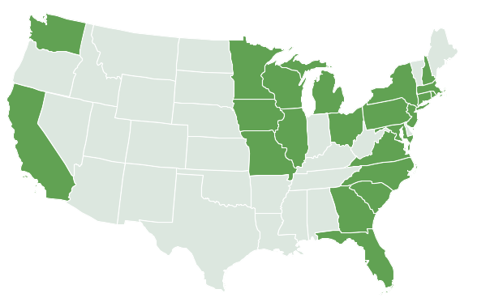
Strategy: Target, Target, Target

Slide 6
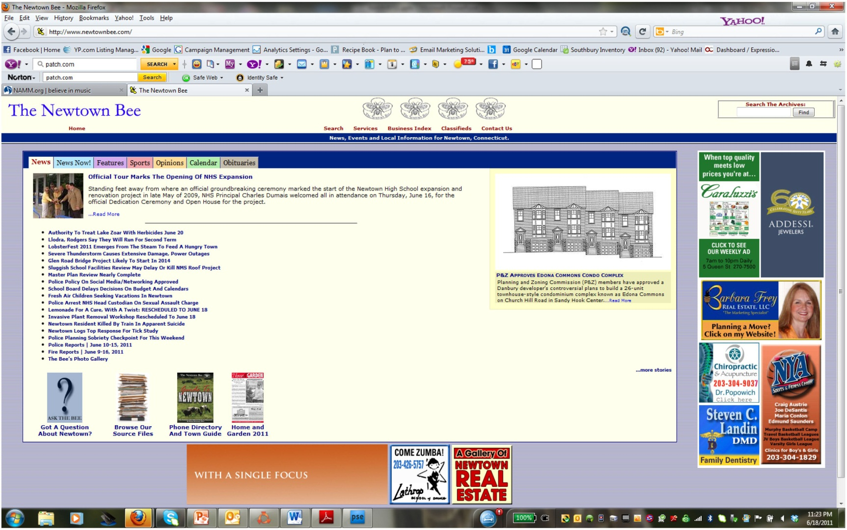
$$-Saving Tip
Banner ads = cost effective

Slide 7

$-Saving Tip

Slide 8
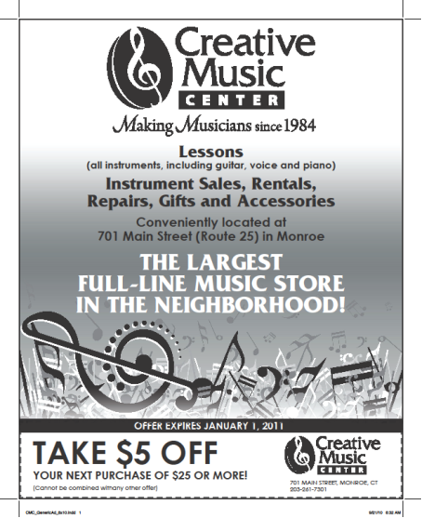
Strategy: Coupons
COUPONS!!

Slide 9
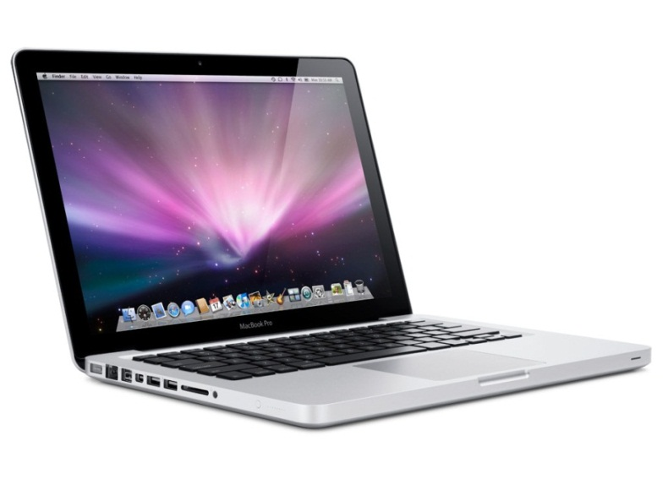
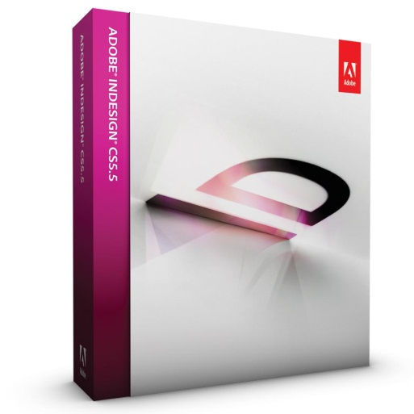
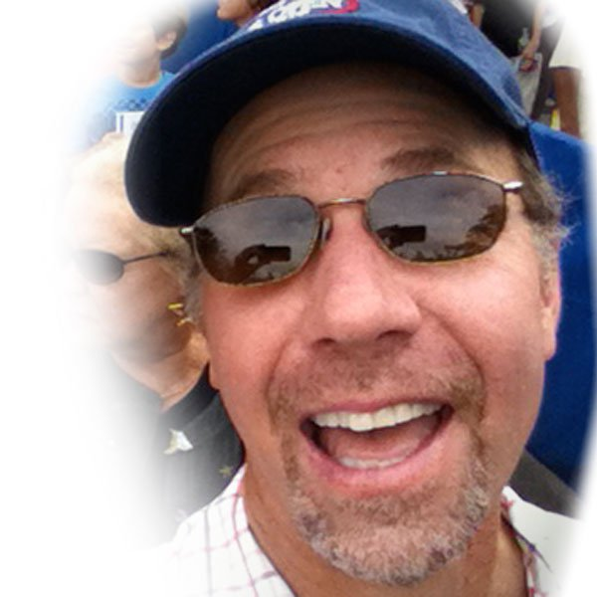
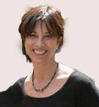

$-Saving Tools
$1,200
$549
$670
$50/hour
$350 +
Online Course $199 or less

Slide 10
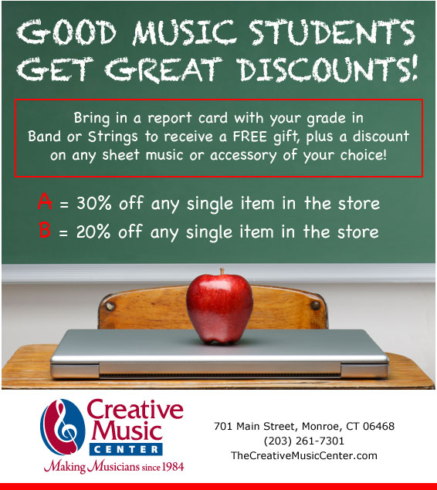
Strategy: Music Teachers

Slide 11
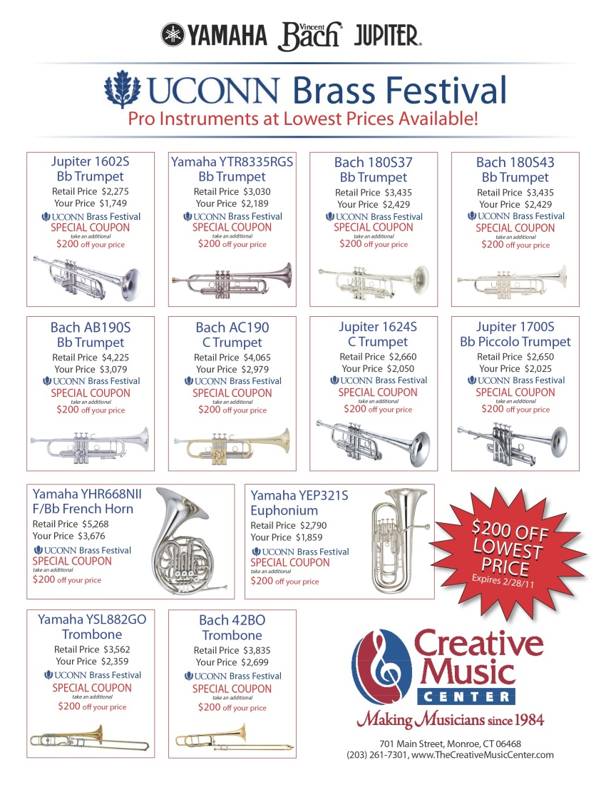
$$-Saving Tip

Slide 12
Thank you for coming!
Enjoy the show!

