Slide 1

Course Title
“How to Decide
Which Social Media Sites Work for Your Store””
Danny Rocks
The Company Rocks

Slide 2








Which Sites to Use?

Slide 3
The Three Rules
Be Active on Sites
Your Core Customers Use
Begin by Being Interested in Your Customers
Integrate Each Social Media Site Into Your Strategy

Slide 4
Begin by “Liking” Your Customers
Before Expecting Core Customers
to “Like” Your Site
Comment on their activities
Comment on & Share their YouTube Videos
“Retweet” their “Tweets”

Slide 5
Integrate Into Your Strategy
Event Strategy
Facebook to Announce / Invite
Twitter “Live” from Event
YouTube Before, During & After
Facebook Links / Share YouTube Videos

Slide 6
The “Pros and Cons”
For Major Social Media Sites

Slide 7
Facebook
Pro
Con
Almost everyone is on it!
Easy to stay connected with your customers
Take advantage of Event Invitations
Take advantage of “Links to” and “Share with” for YouTube Videos, Articles, Websites, etc.
Challenge to separate business & personal focus
Too easy to become “addicted”
None
None

Slide 8
YouTube
Pro
Con
Worldwide Reach
Valuable Demographic Insights (Owned by Google)
Write “key word – centric” descriptions & add hyperlinks
Encourage Comments to interact with viewers
Requires Plan to Film & Upload on a Regular Basis
Need to Know How to Interpret Insights
Takes Discipline & Skill to Write Effective Descriptions
Takes Time to Develop a Following

Slide 9
Twitter
Pro
Con
Rapidly Accepted for Business Use
Retweet Interesting Tweets
Easy to Share Links (Use URL Shortener)
Take advantage of # (Hash Tag) to Improve Search Results
Takes Time & Thought to Develop a Business Strategy
Schedule Time to Find Tweets
Collect Interesting Links in a File
None

Slide 10
Other Social Media Sites
LinkedIn
Google +
Pinterest
Yelp!
Foursquare

Slide 11
How Music Industry is Using Social Media
Examples of Social Media
From Music Industry Dealers
From Music Industry Suppliers
From a Case Study

Slide 12
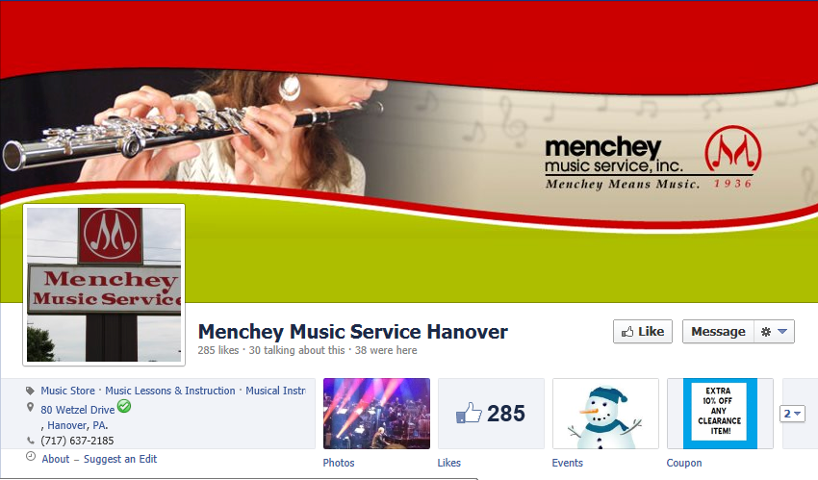
Menchey Music - Facebook

Slide 13
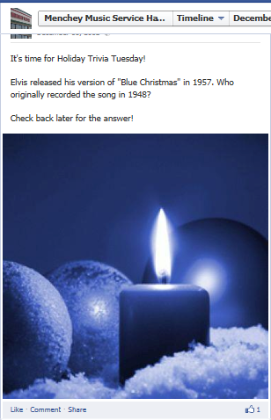
Menchey Music – Trivia Tuesday

Slide 14
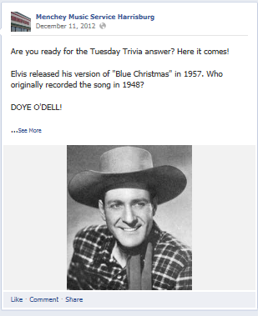
Menchey Music – Trivia Tuesday

Slide 15
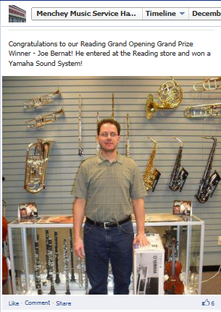
Menchey Music – Contests

Slide 16

Menchey Music – Quotations

Slide 17
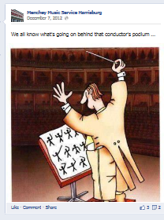
Menchey Music – Cartoons

Slide 18
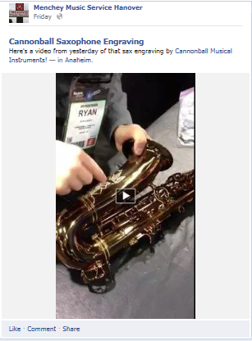
Menchey Music – Live from NAMM

Slide 19
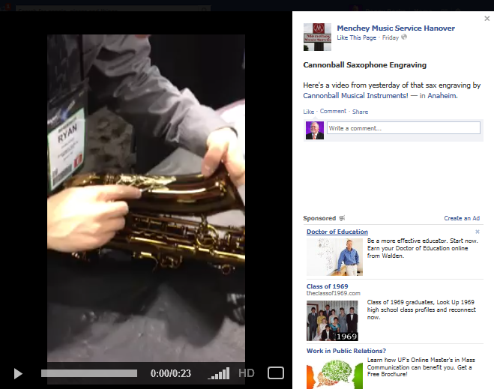
Menchey Music – Live from NAMM

Slide 20
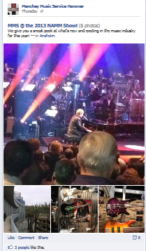
Menchey Music – Live from NAMM

Slide 21
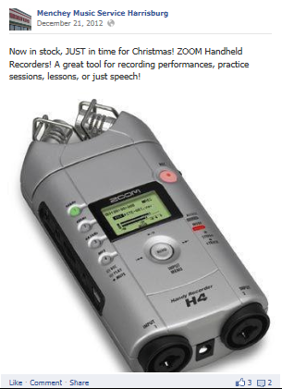
Menchey Music – Products

Slide 22
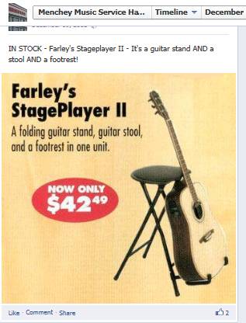
Menchey Music – Products

Slide 23
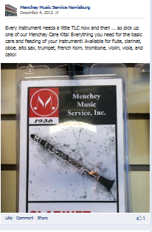
Menchey Music – Products

Slide 24
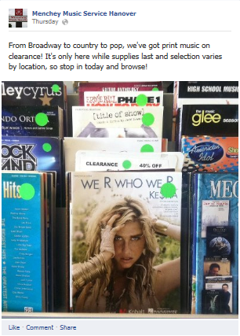
Menchey Music – Products

Slide 25
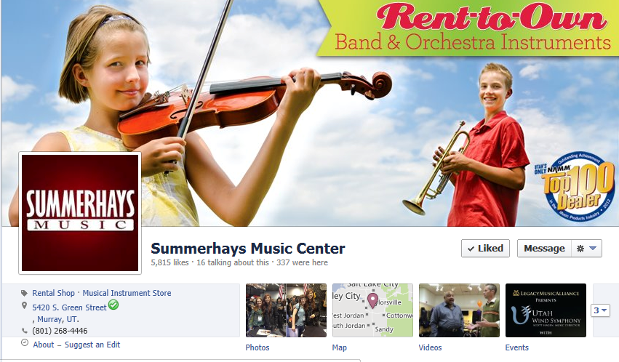
Summerhays Music - Facebook

Slide 26

Summerhays Music - Facebook

Slide 27
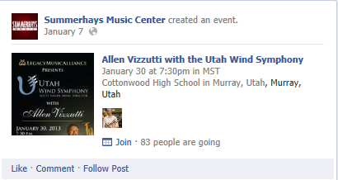
Summerhays Music - Events

Slide 28
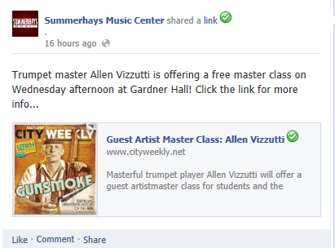
Summerhays Music - Events

Slide 29
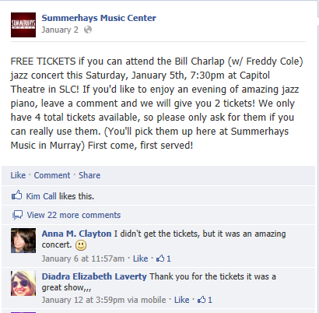
Summerhays Music – “Give Aways”

Slide 30
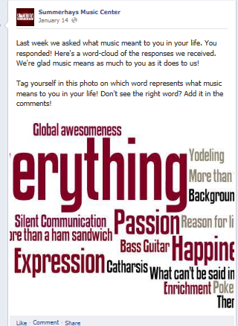
Summerhays Music – “Word Cloud”

Slide 31
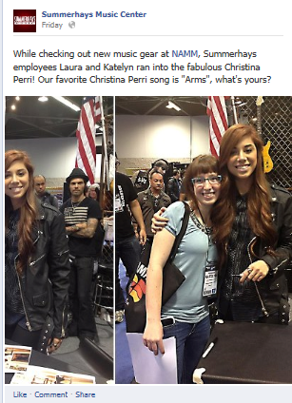
Summerhays Music – Live @ NAMM

Slide 32

Summerhays Music – Photos

Slide 33

Summerhays Music – Photos

Slide 34

Summerhays Music – Photos

Slide 35
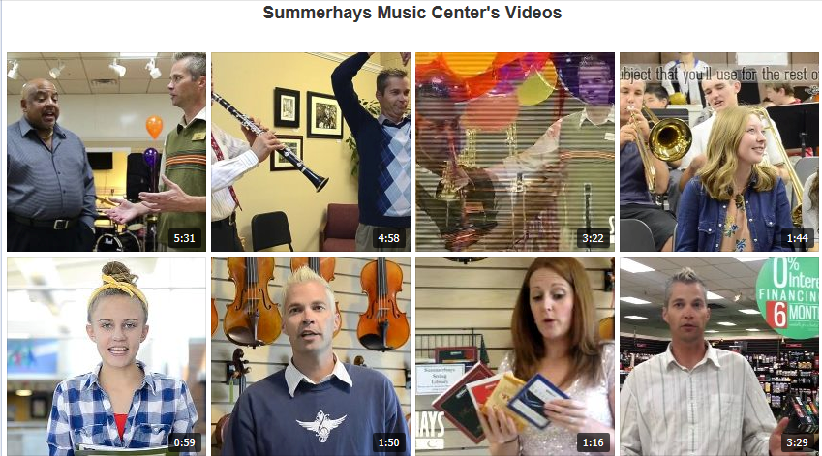
Summerhays Music – Videos

Slide 36
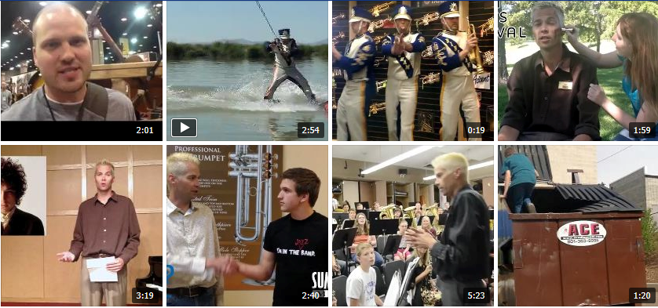
Summerhays “Facebook Friday”

Slide 37
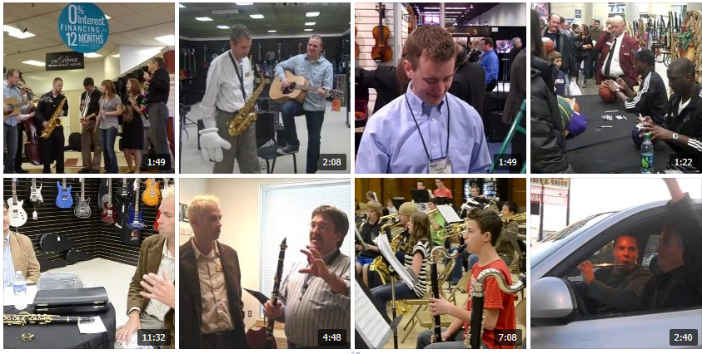
Summerhays “Facebook Friday”

Slide 38
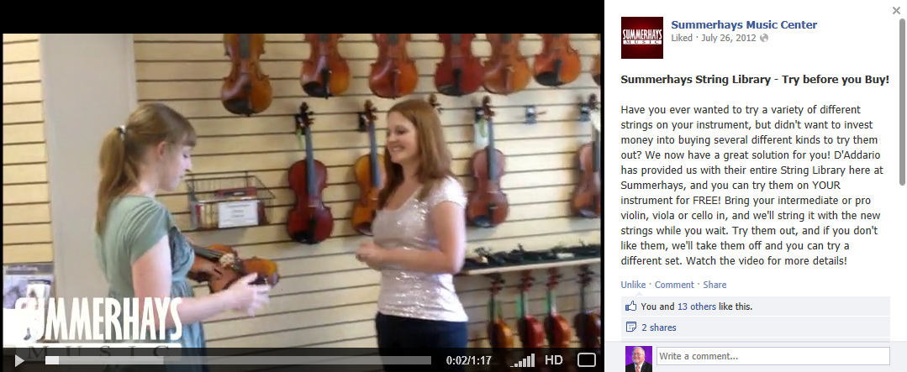
Summerhays “Facebook Friday”

Slide 39
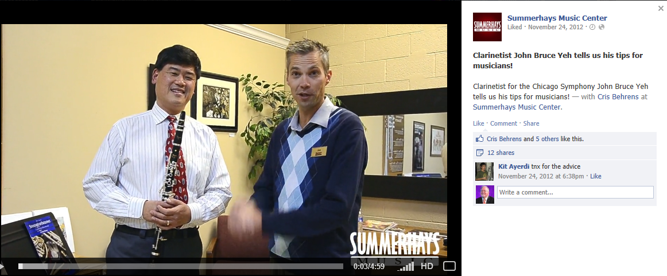
Summerhays “Facebook Friday”

Slide 40
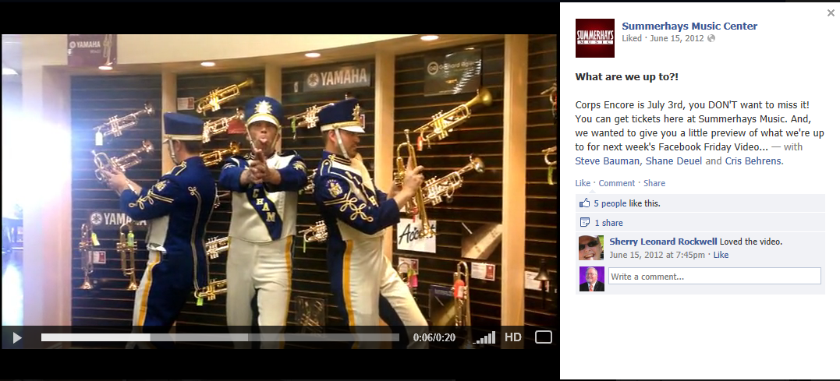
Summerhays “Facebook Friday”

Slide 41
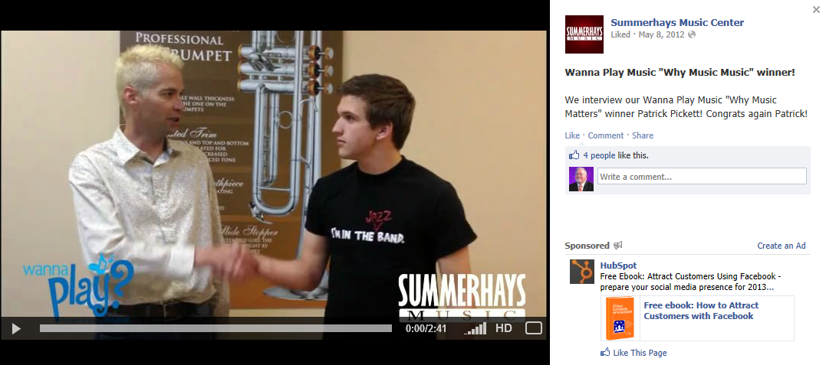
Summerhays “Facebook Friday”

Slide 42
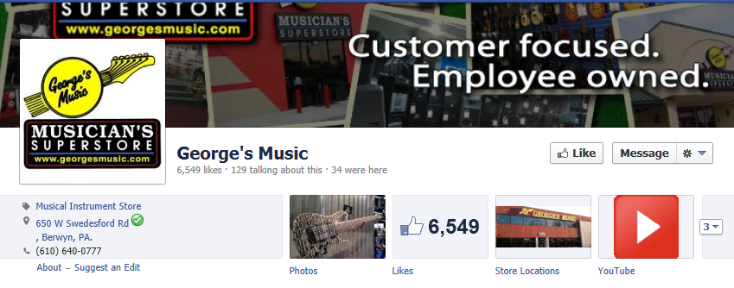
George’s Music - Facebook

Slide 43
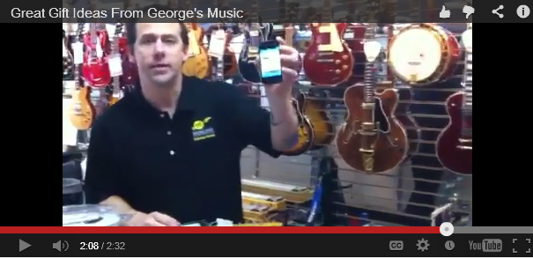
George’s Music – YouTube Videos

Slide 44
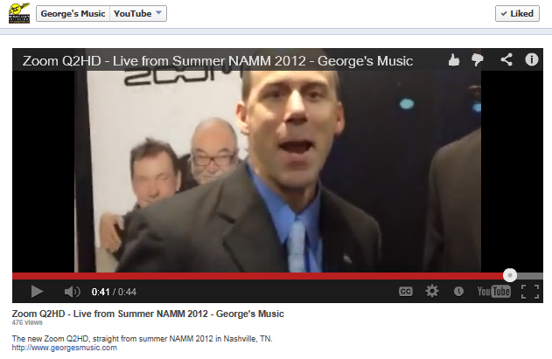
George’s Music – YouTube Videos

Slide 45
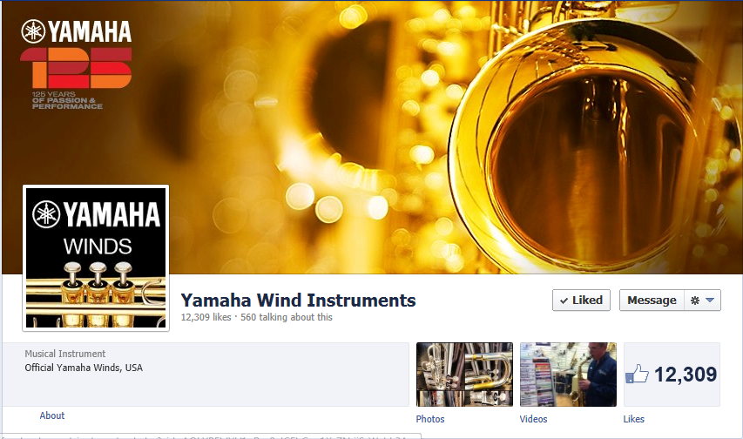
Yamaha Winds - Facebook

Slide 46

Yamaha Winds - Photos

Slide 47
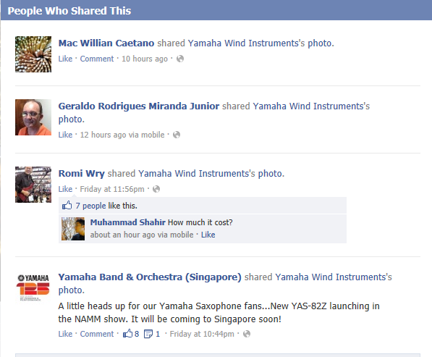
Yamaha Winds – Share Photos

Slide 48
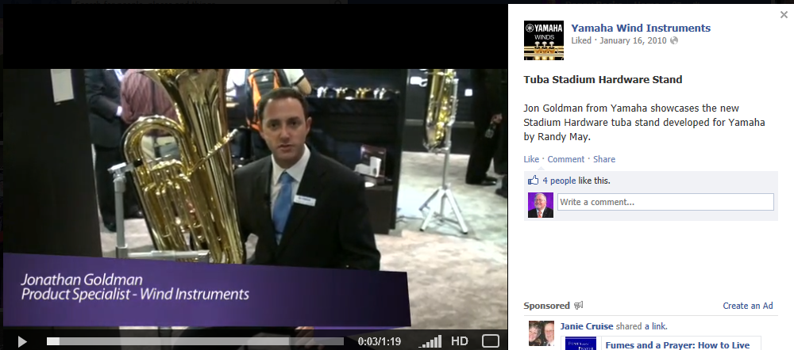
Yamaha Winds – Videos

Slide 49
Using Social Media to Promote Your Business
Integrating Social Media
A Case Study

Slide 50
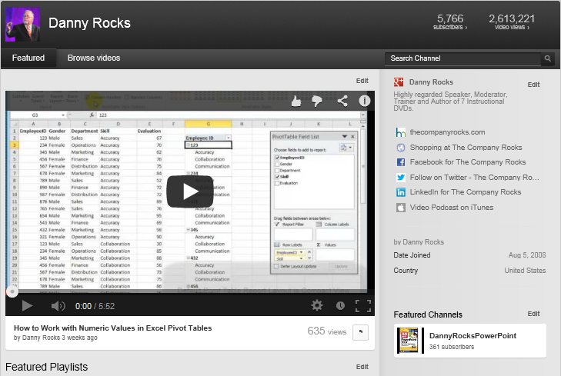
YouTube Channel

Slide 51
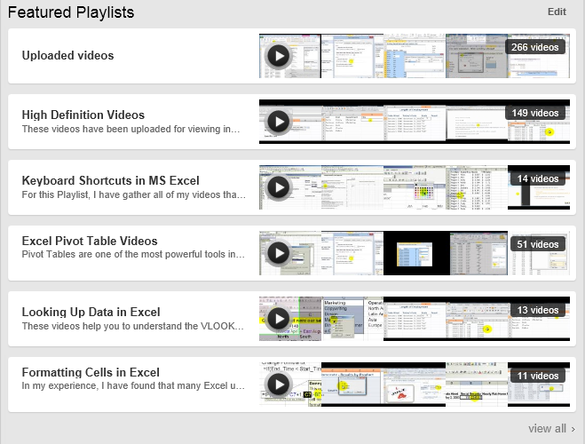
YouTube - Featured Playlists

Slide 52
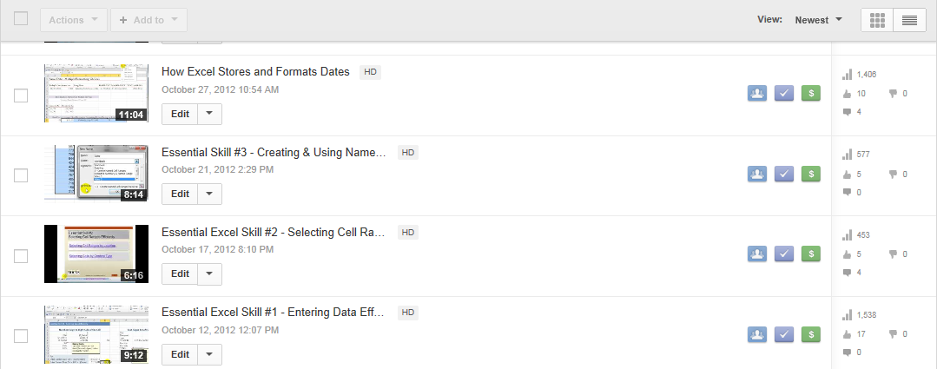
YouTube - Video Manager

Slide 53
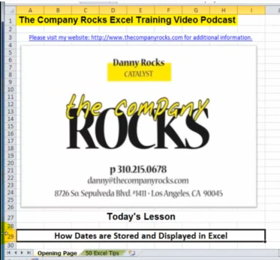
YouTube - Opening Screen

Slide 54
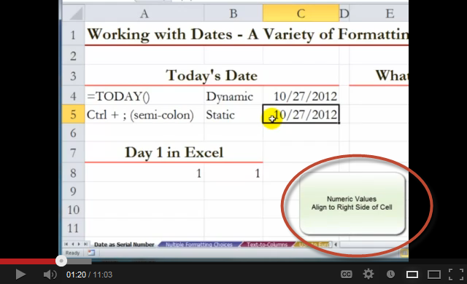
YouTube - Use Annotations

Slide 55
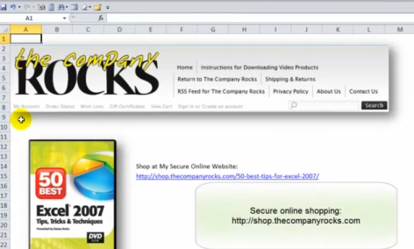
YouTube - Call to Action

Slide 56
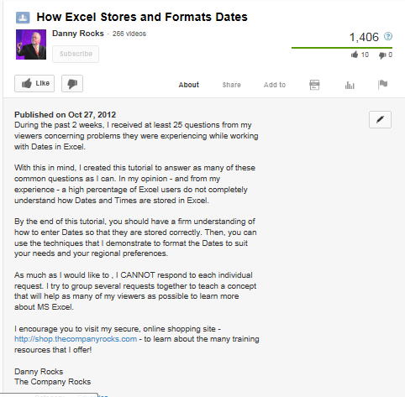
YouTube - Use Descriptions

Slide 57
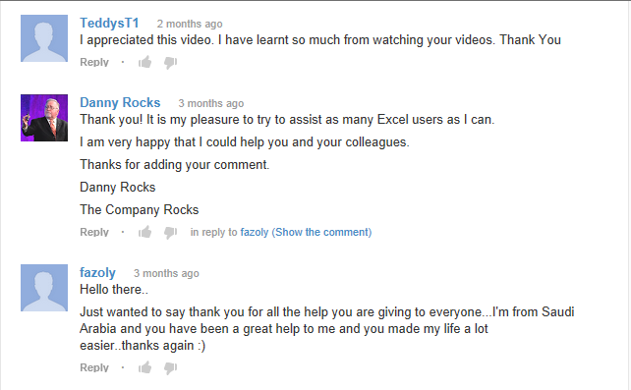
YouTube - Invite Comments

Slide 58
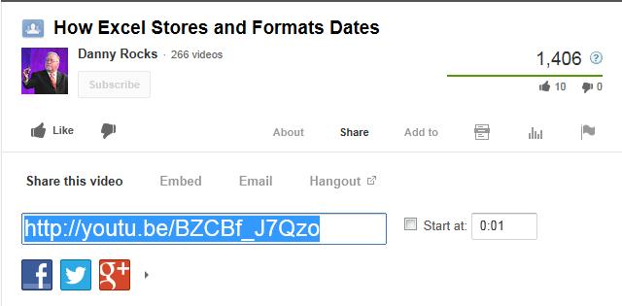
YouTube - Share Link to Video

Slide 59
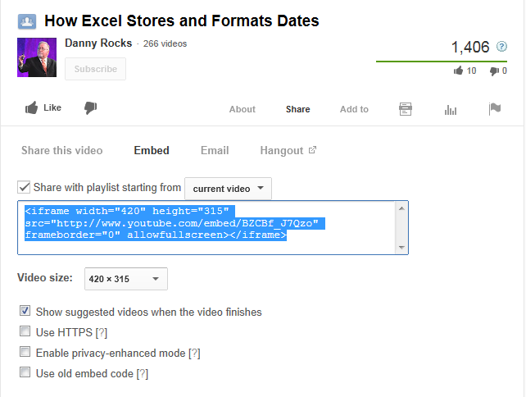
YouTube - Embed Code for Video

Slide 60
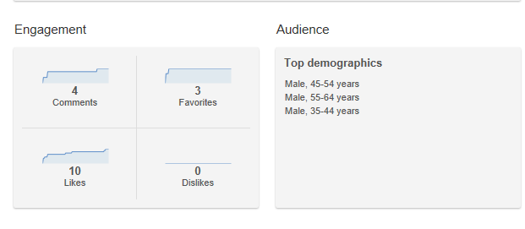
YouTube - Assess Engagement

Slide 61
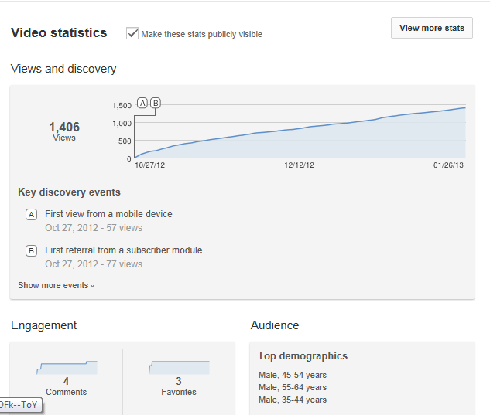
YouTube - Analyze Statistics

Slide 62
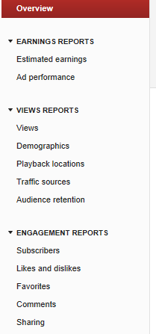
YouTube - Statistics for Channel

Slide 63
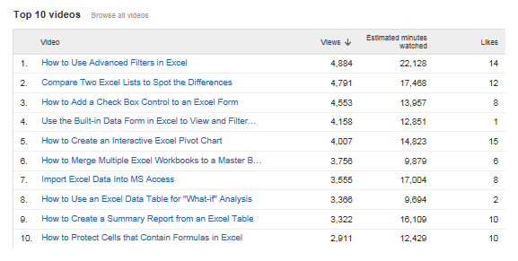
YouTube - Top 10 Videos

Slide 64
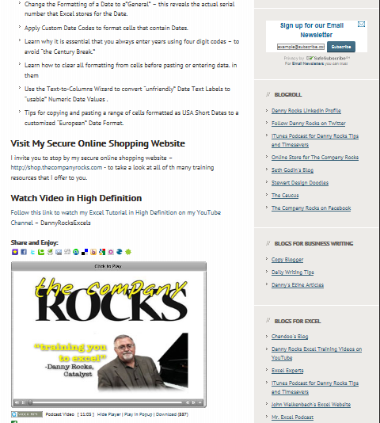
Post Videos on Your Website

Slide 65
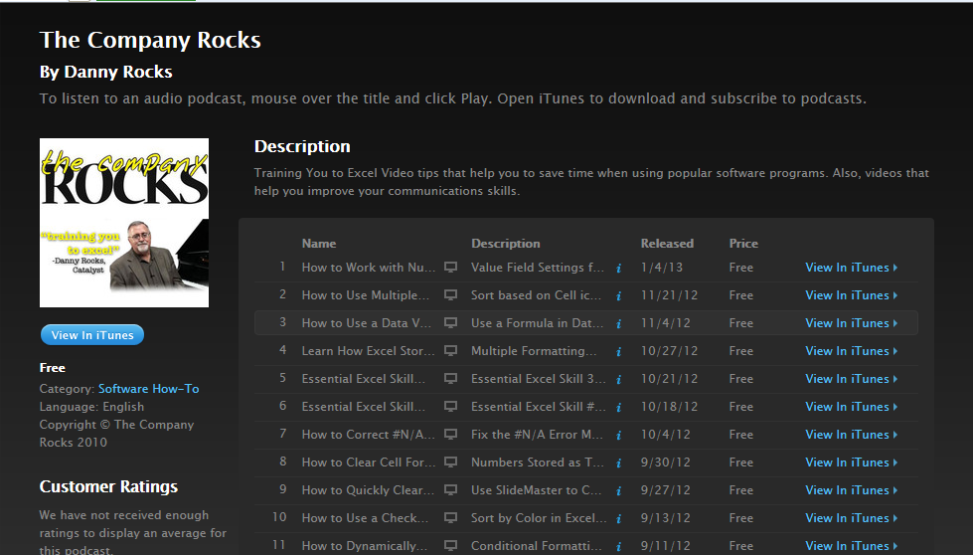
Create a Podcast on iTunes

Slide 66
Get the Most From Content
Create Video
Upload to YouTube
Add Description & Tags
Share Video on Other Sites
Copy YouTube Link
Copy Embed Code for Video
Assess Engagement
Use YouTube Statistics for Individual Videos
Analyze Statistics for YouTube Channel
Encourage Comments
Create a Call to Action

Slide 67
Questions?

Slide 68

Thank You!

