Slide 1

What is PMC?
  A non-profit, all-volunteer trade association, representing the entire percussion industry. Through creative marketing and advertising campaigns, educational programs and activities, the PMC brings increased public awareness of drums and the enjoyment of playing percussion musical instruments. All program initiatives support the organization's mission: creating NEW players for all kinds of percussion instruments and bringing new customers into all retail stores.

Slide 2
Where did the idea for Drums Across America come from?
  DAA builds upon the tremendous past three years in providing countless first free drum lessons within the PMC Lesson Lab Tents, located at the Vans Warped Tour locations throughout the U.S.
  Qualified drum instructors provided by local percussion retailers connected with 100s of drumming enthusiasts of all ages, giving FREE 5-minute lessons. By the end of the 5 minutes, most could play a basic rock beat.

Slide 3
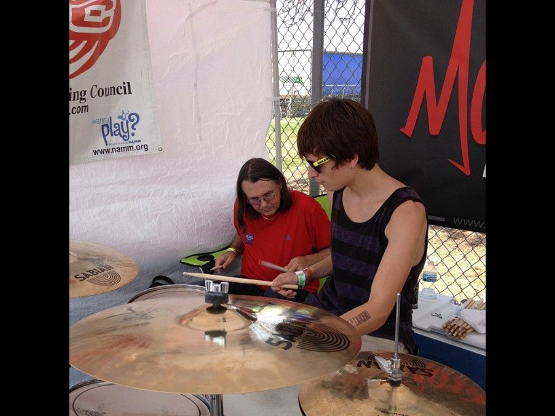
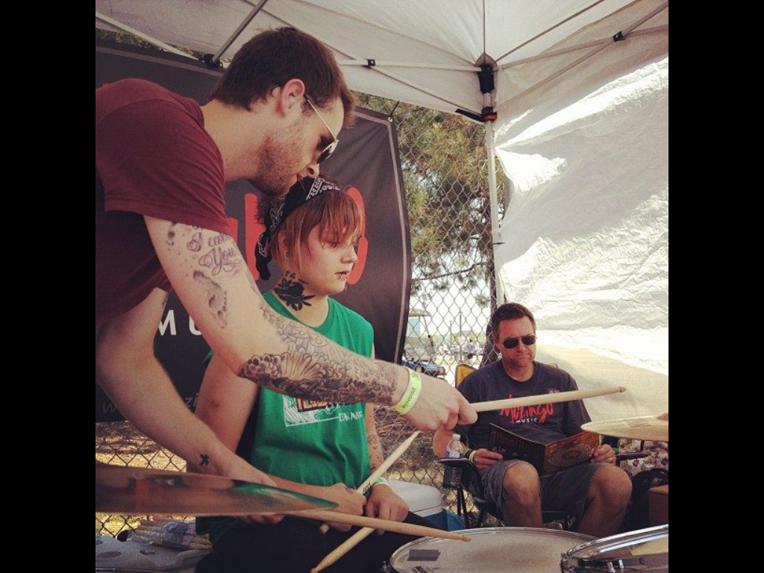
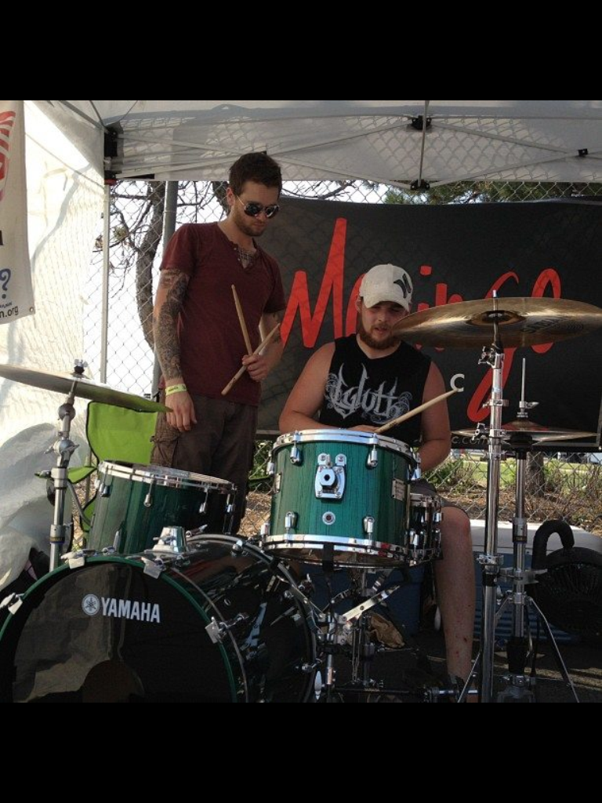
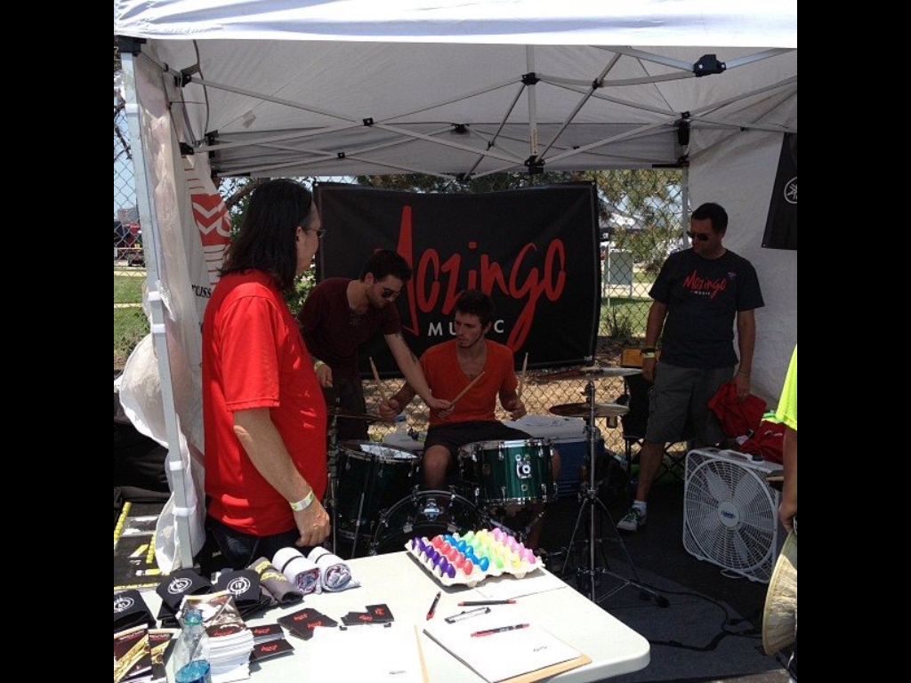

Slide 4
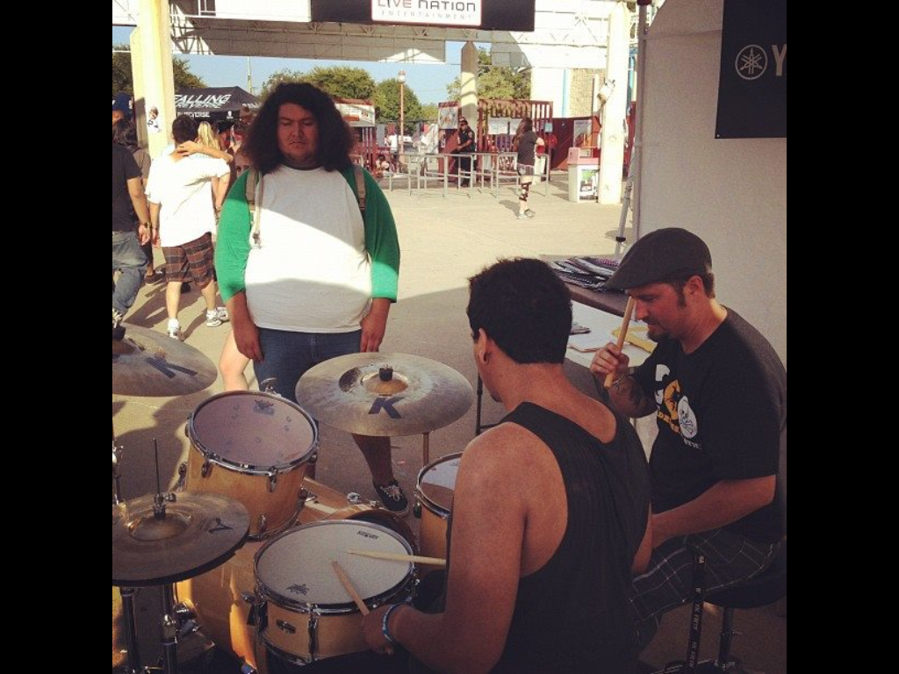
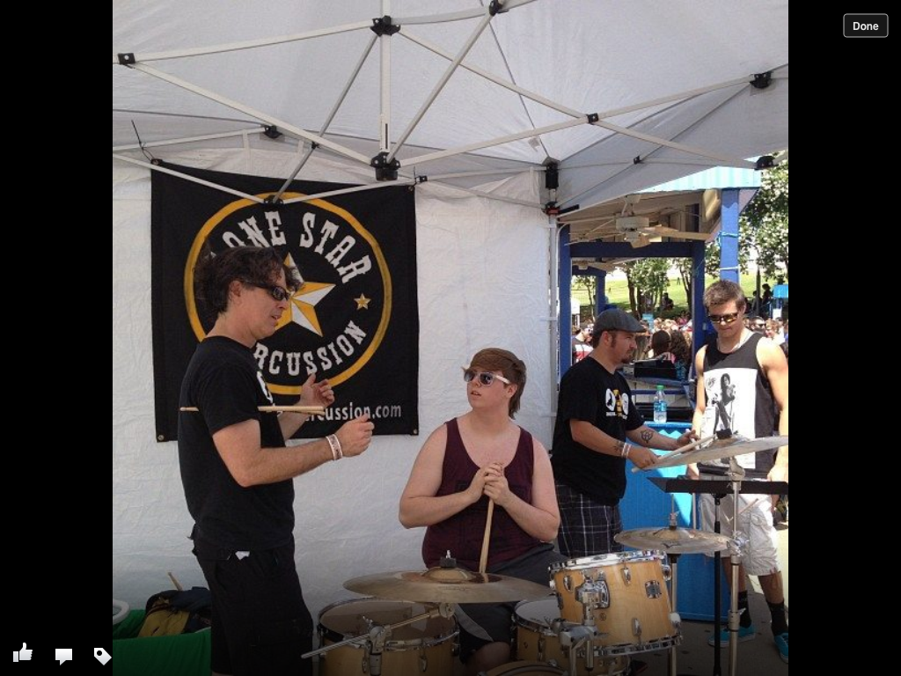
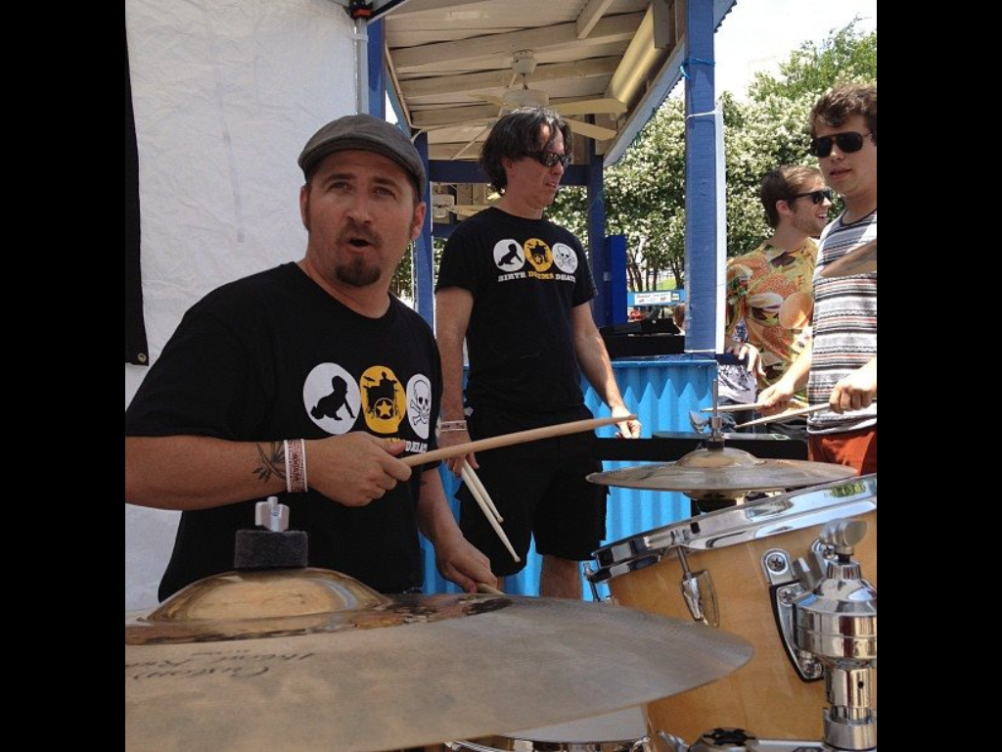
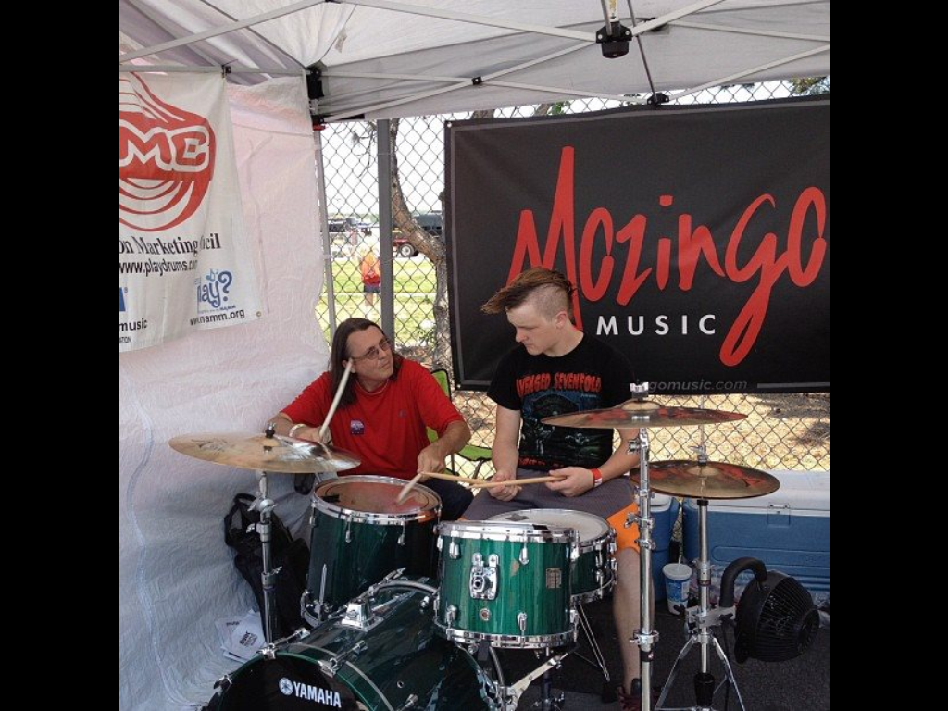

Slide 5
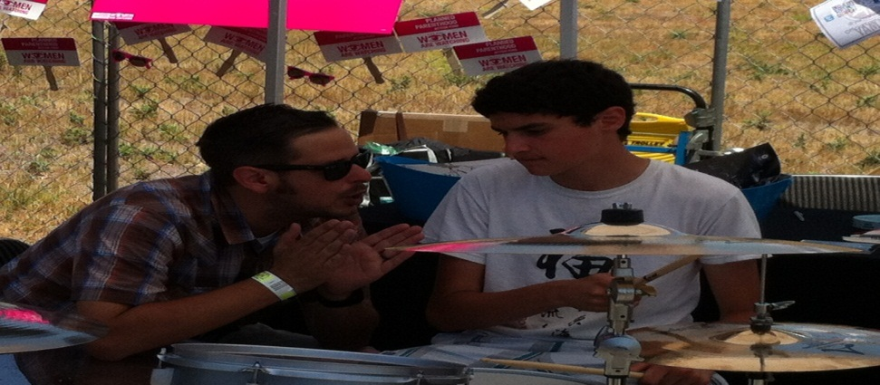
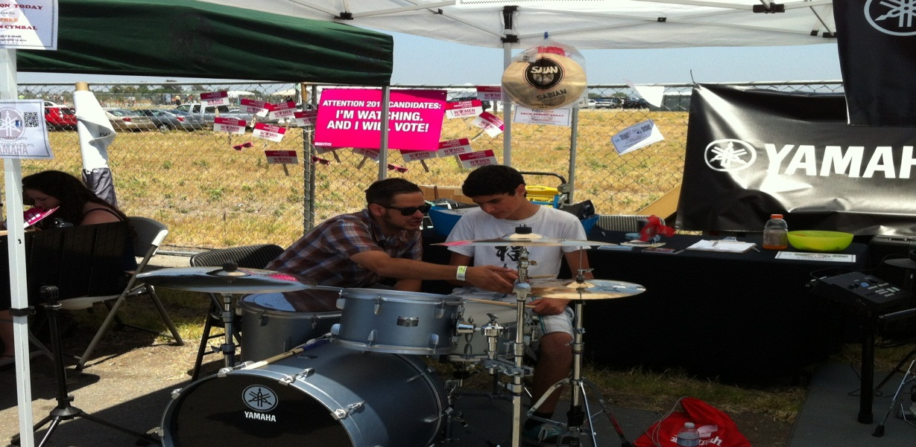
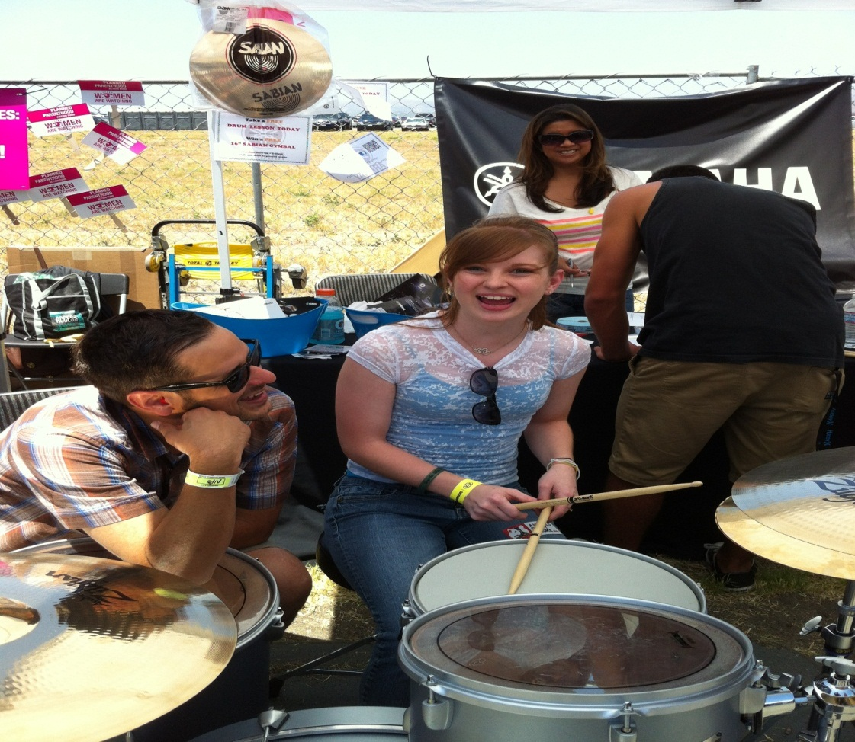
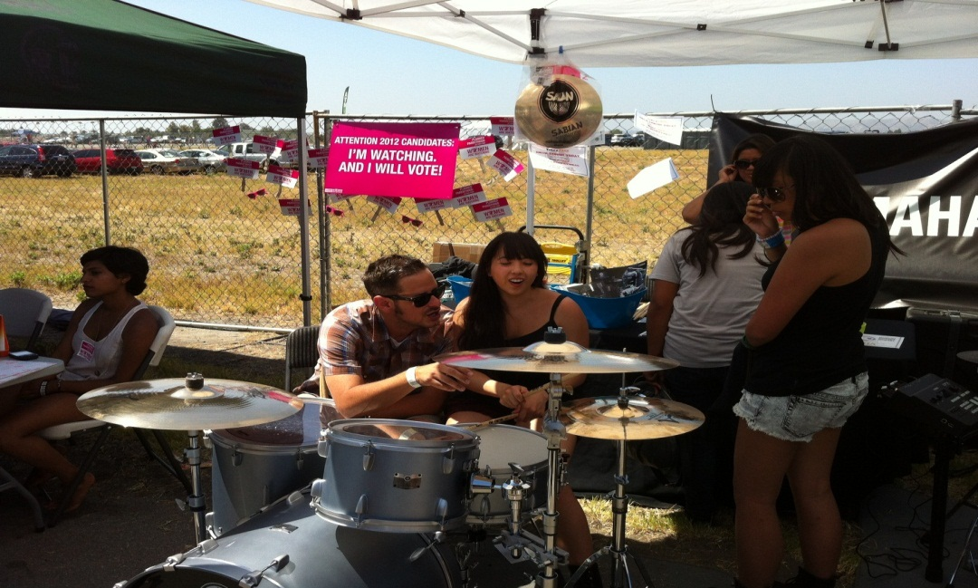

Slide 6
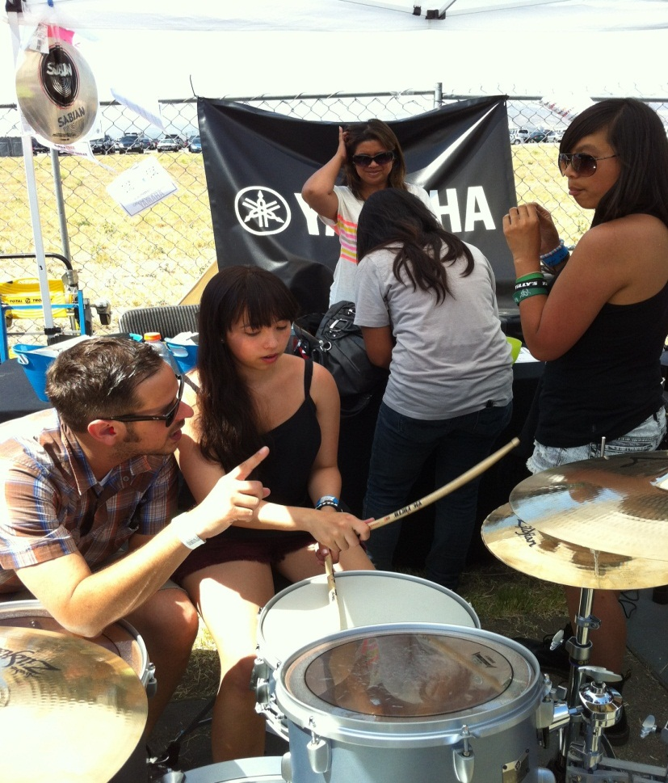

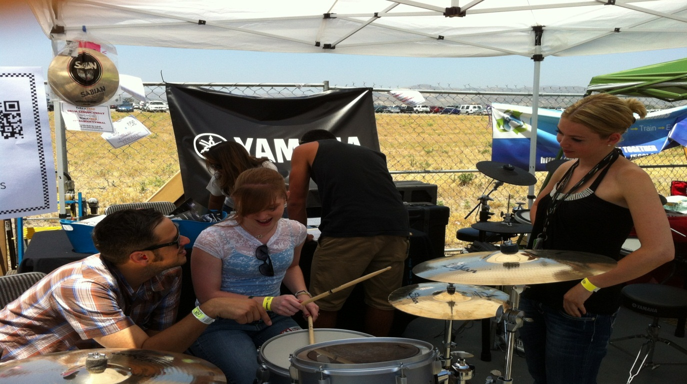


Slide 7
PMC realized that more NAMM member retailers wanted to get involved with the PMC’s Lesson Lab concept, and now we are able to increase the Lesson Lab Tent activities through the entire calendar year!

Slide 8
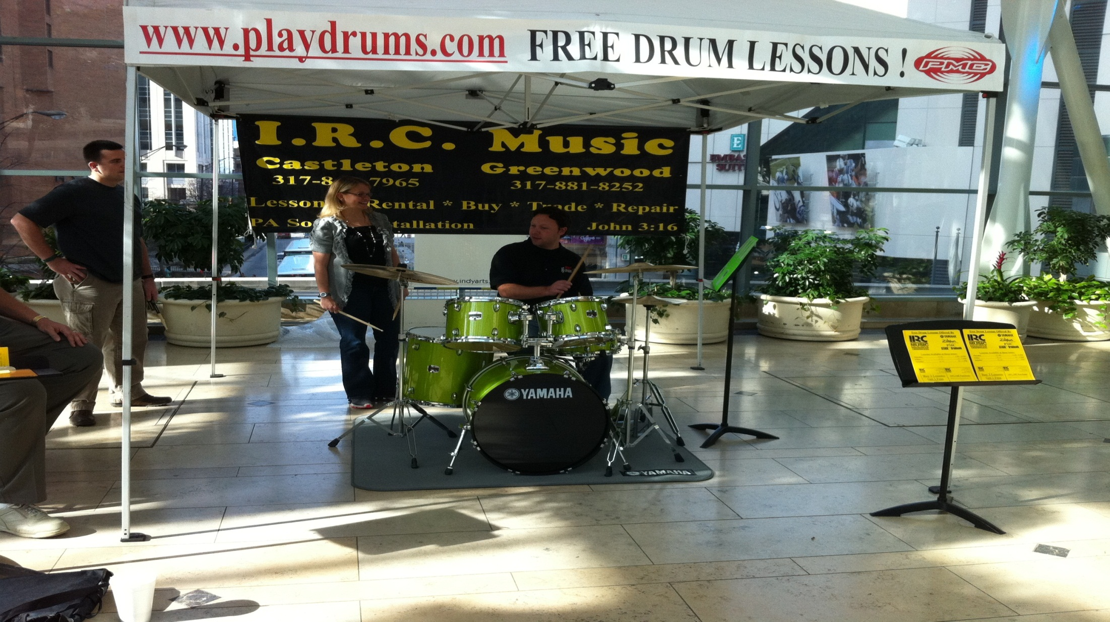

Slide 9
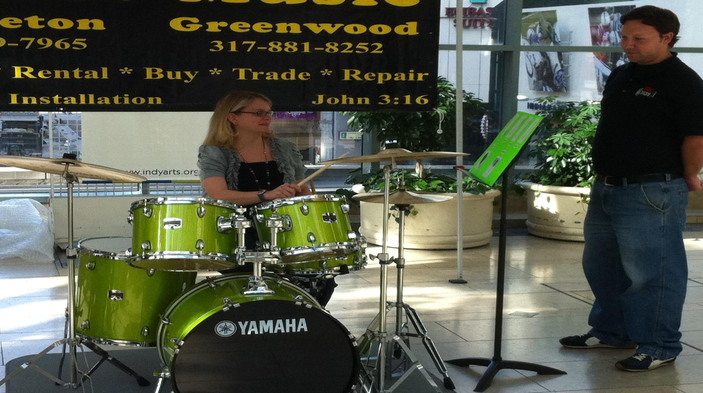

Slide 10
Get involved and take advantage of this great opportunity at these types of activities
  Anniversary or parking lot sale
  Saturday at the shopping mall
  Use the event to support a charity, and help them fundraise by giving FREE lessons.

Slide 11
Getting Started is simple:
  Become a "Friends of the PMC”...download membership .via www.playdrums.com.
  Complete DAA Lesson Lab Tent Request/Application, indicating your choice of dates, download via www.playdrums.com.
  Use only PMC member's branded products at all Drums Across America events, which are all listed in the Members Listing/Links of the playdrums.com website.
  E-Mail, fax or mail the Friends of the PMC and Drums Across America forms to the PMC Headquarters: E-Mail kbdustman@aol.com, Fax: 440-230-1346, U.S. Mail: P.O. Box 33252 Cleveland, Ohio 44133

Slide 12
The Percussion Marketing Council provides:
  Round trip prepaid shipment of the 10-by-10-foot pop-up tent with all banners and graphics, directly to your store in professional flight case...FREE OF CHARGE.
  PLAYDRUMS program materials are available as a download from www.playdrums.com at no cost.
  Inclusion and recognition of your event in all PMC Membership and NAMM reports.

Slide 13
The Percussion Marketing Council is a member of the Support Music Education Coalition and receives a grant from the NAMM Foundation for select educational programs that develop new markets and customers for all percussion products.

Slide 14

• Proud Members of the
Percussion Marketing Council
include:

Slide 15
THANK YOU FOR YOUR TIME. NOW ON TO SOME FREE LESSONS.
FEATURING NICK LAURITANO from Fork’s Drum Closet!
COPYRIGHT, 2013 Percussion Marketing Council Drums Across America is a trademark of the Percussion Marketing Council

