Slide 1


Slide 2

10 Tips for Effective Emails That Get Opened!
Just like music, email etiquette has evolved without having to use a detailed instruction manual.

Slide 3
Tip #1 - Subject line - most important feature!
First of all you have to have one ☺
Be concise & indicate the exact purpose of your email
Have your company name somewhere in the subject line or your email address

Slide 4
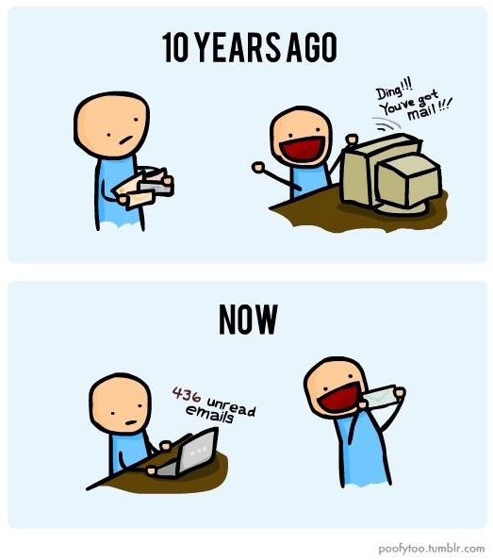

Slide 5
Tip #1 - Subject line (continued)
Refrain from using vague subject lines
Example: Bad - Orders
Better: Yamaha Band Orders
Fender PO# 39514

Slide 6
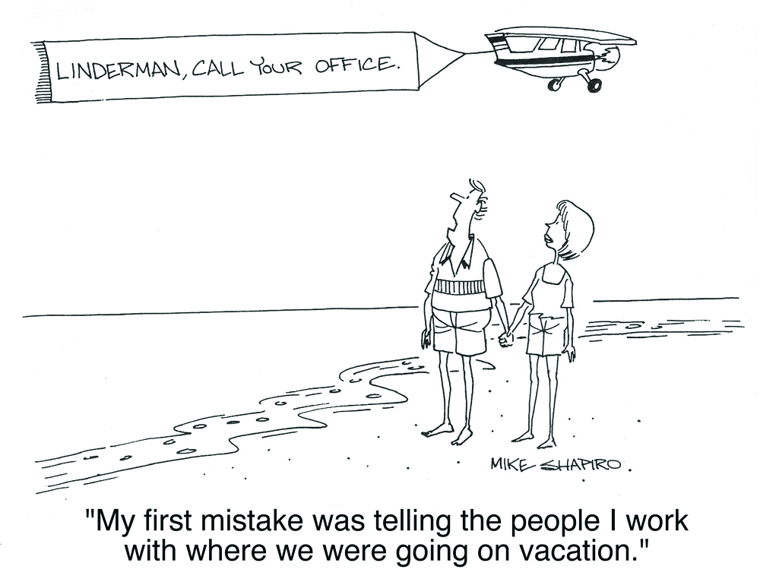

Slide 7
Tip #2 - Brevity is the key to results
Keep your emails “short and sweet”
Proofread to make sure persons on the receiving end will understand your message
Communication is a two-way street

Slide 8
Tip #3 – Effective email signature
Pertinent contact information
Name, company name, physical address, email address, website, phone number & extension, fax number, job title, cell phone number, & important company awards/ logos

Slide 9
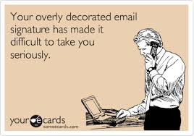

Slide 10
Tip #4 - Be 150% sure you want to send
Once you hit the send button, it is too late to change your mind. Recalling an email is very unprofessional
Take your time proofreading, and never, ever, allow emotions to get involved
Attachments - double check to make sure they are attached

Slide 11
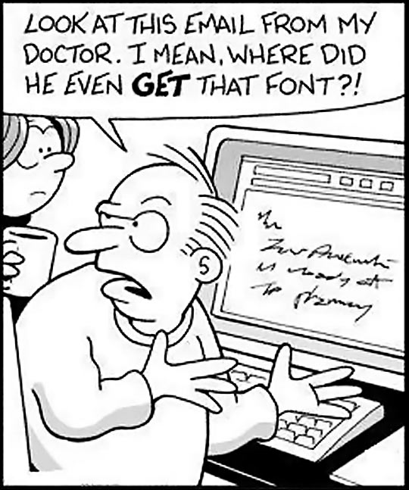

Slide 12
Tip #5 - Spelling, punctuation, grammar usage
Double check for accuracy, and remember that this is a permanent reflection on you once you click send

Slide 13
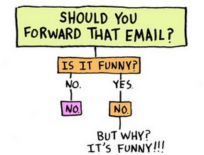

Slide 14
Tip #6 - Be professional & considerate
Since this is business related and we are all busy, don’t send needless emails, chain letters, etc.
Many of these may contain viruses
Receiver may not have interest in this

Slide 15
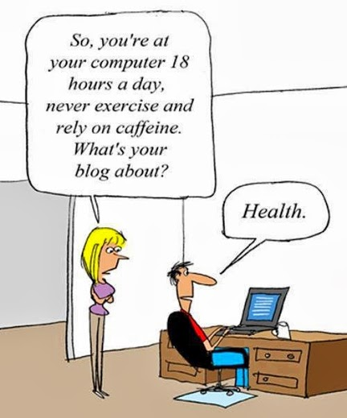

Slide 16
Tip #7 - Limit your emails to one subject
Better to send another email
Helps recipient to maintain focus and leads to positive action

Slide 17
Tip # 8 - Use upper- and lowercase letters
Use of all uppercase letters has been associated with “YOU ARE SHOUTING”.
Use of all lowercase letters can make you seem casual, and after all, this is business — we want to stay professional

Slide 18
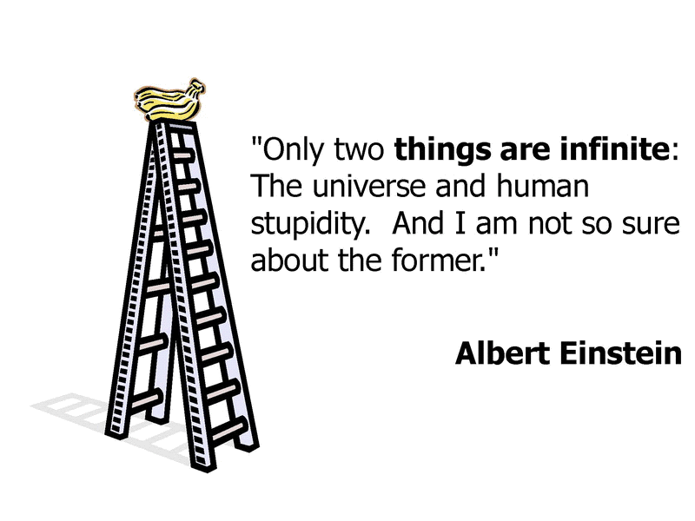

Slide 19
Tip #9 - Use the CC and BCC properly
Be considerate of the privacy of others
Recipients will not want to wade through a sea of email addresses to get to your message
Use “Reply all” only when you want ALL to see the reply

Slide 20
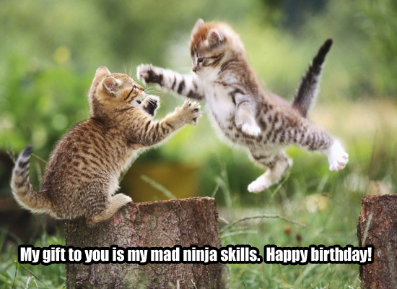

Slide 21
Tip #10 - A personal visit can be best
If you sense confusion, bruised feelings or lack of understanding, it may be better to call or personally visit the person
At this point, a “text” won’t help

Slide 22
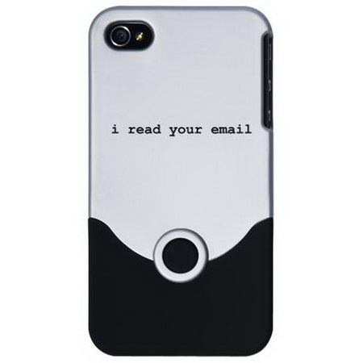

Slide 23
Mike Guillot
Purchasing Director
Mississippi Music Inc.
Email- purchasing@missmusic.com
Cell # - 601-906-8046

