Slide 1

Effective
Online Marketing Ideas
From Top 100 Dealers

Slide 2




Menzie Pittman
Christie Carter
The art of lifestyle Branding
Walter Carter
Paul Decker

Slide 3

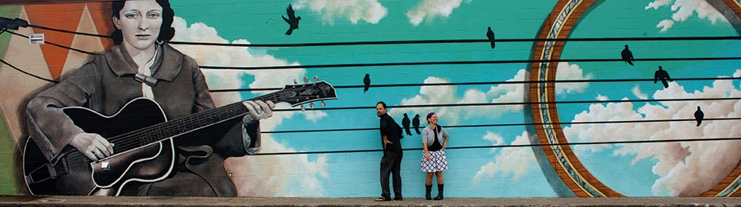
On Facebook….
The Carters
Tell the best story, and then…

Slide 4
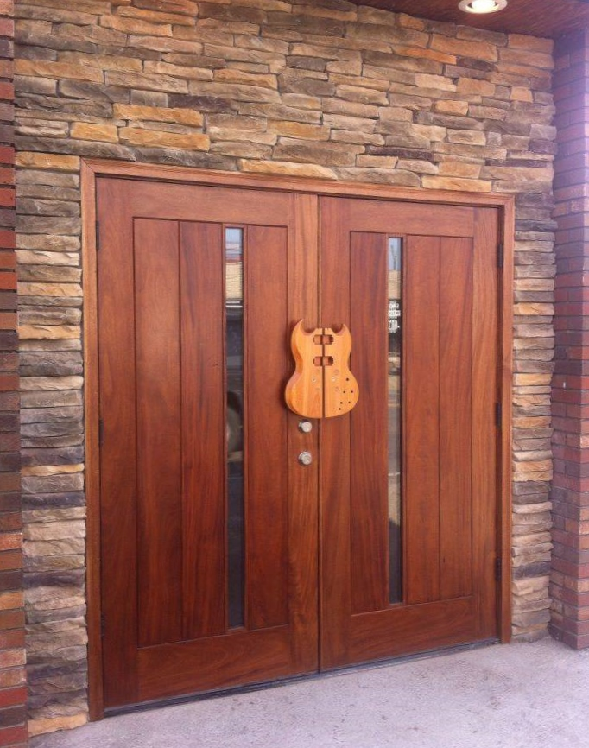
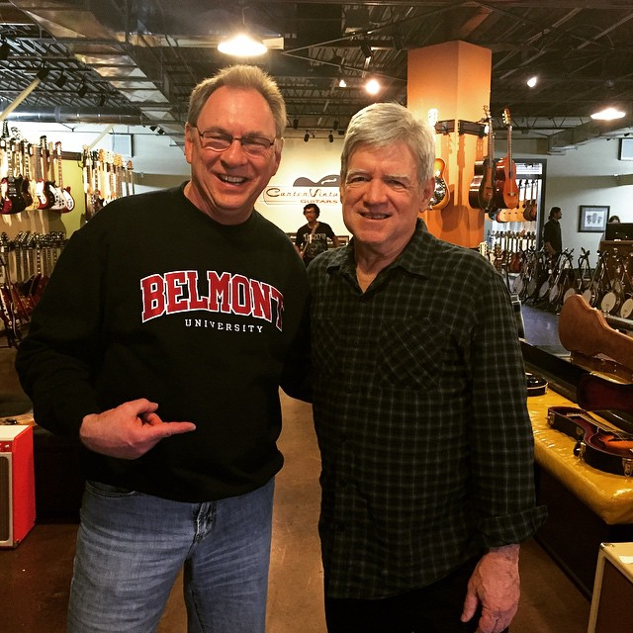
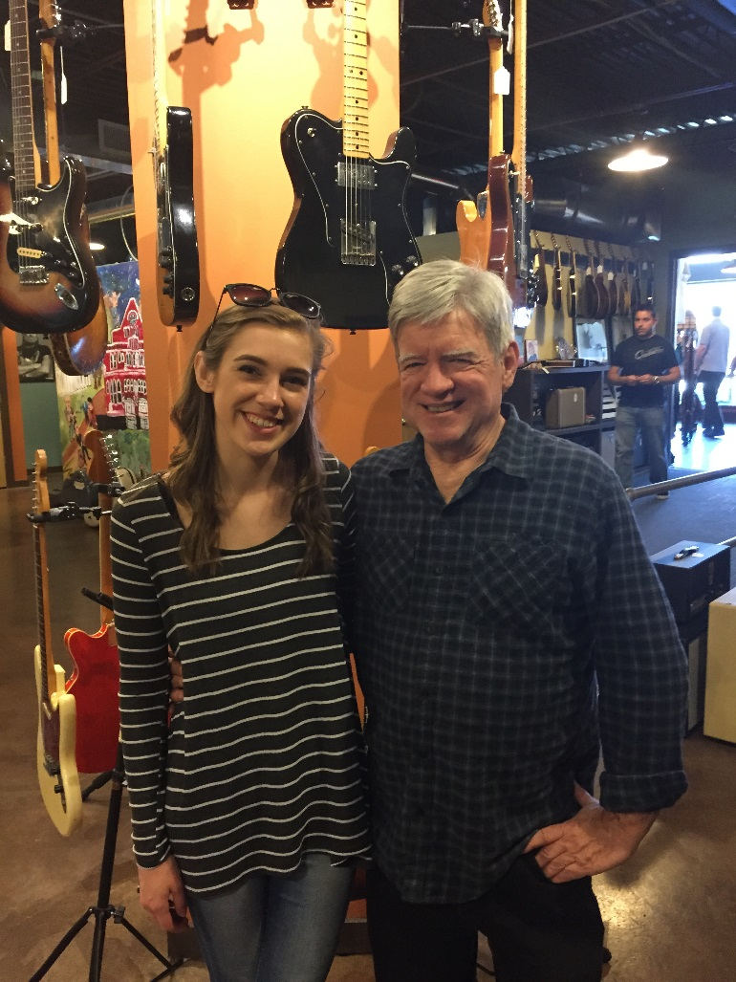
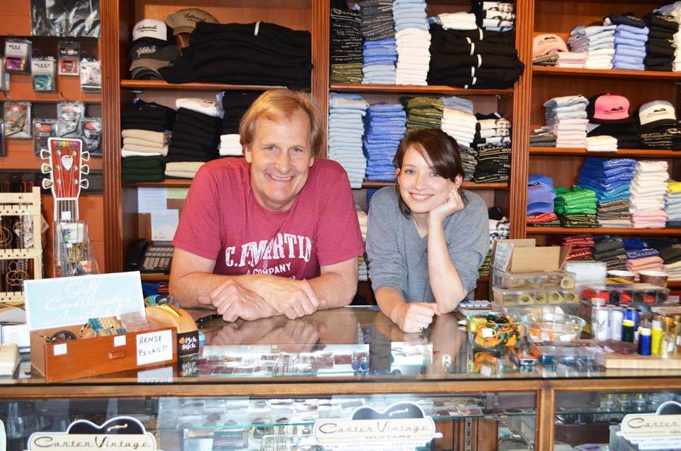
…Invite their customers to be part of the story.
Enabling everyone to cross sell on social media!

Slide 5
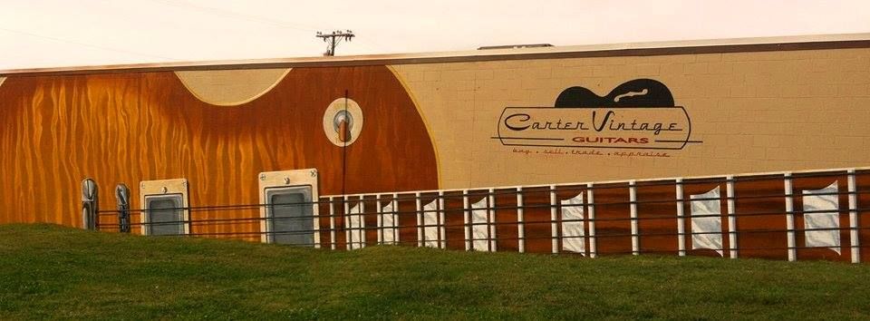
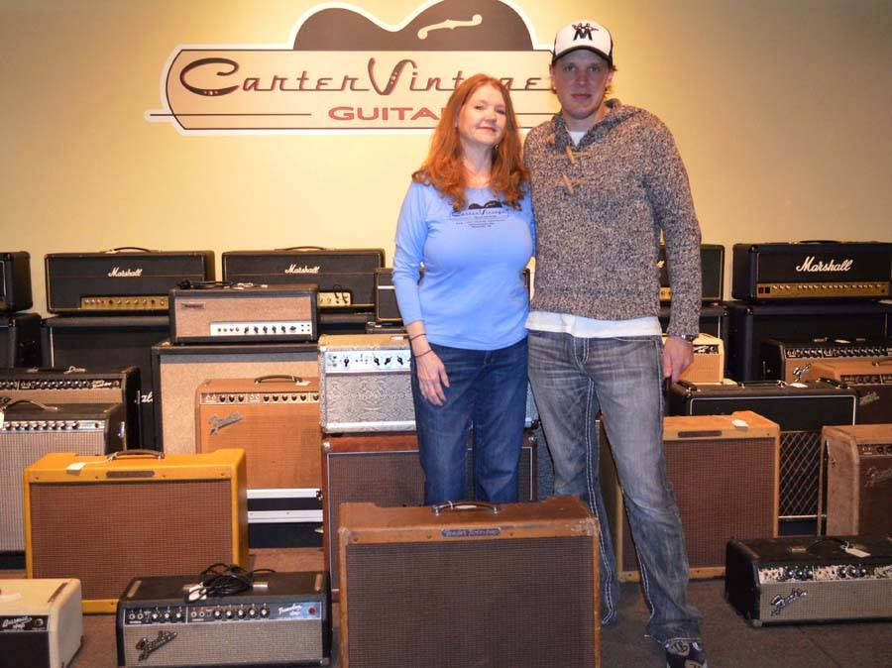
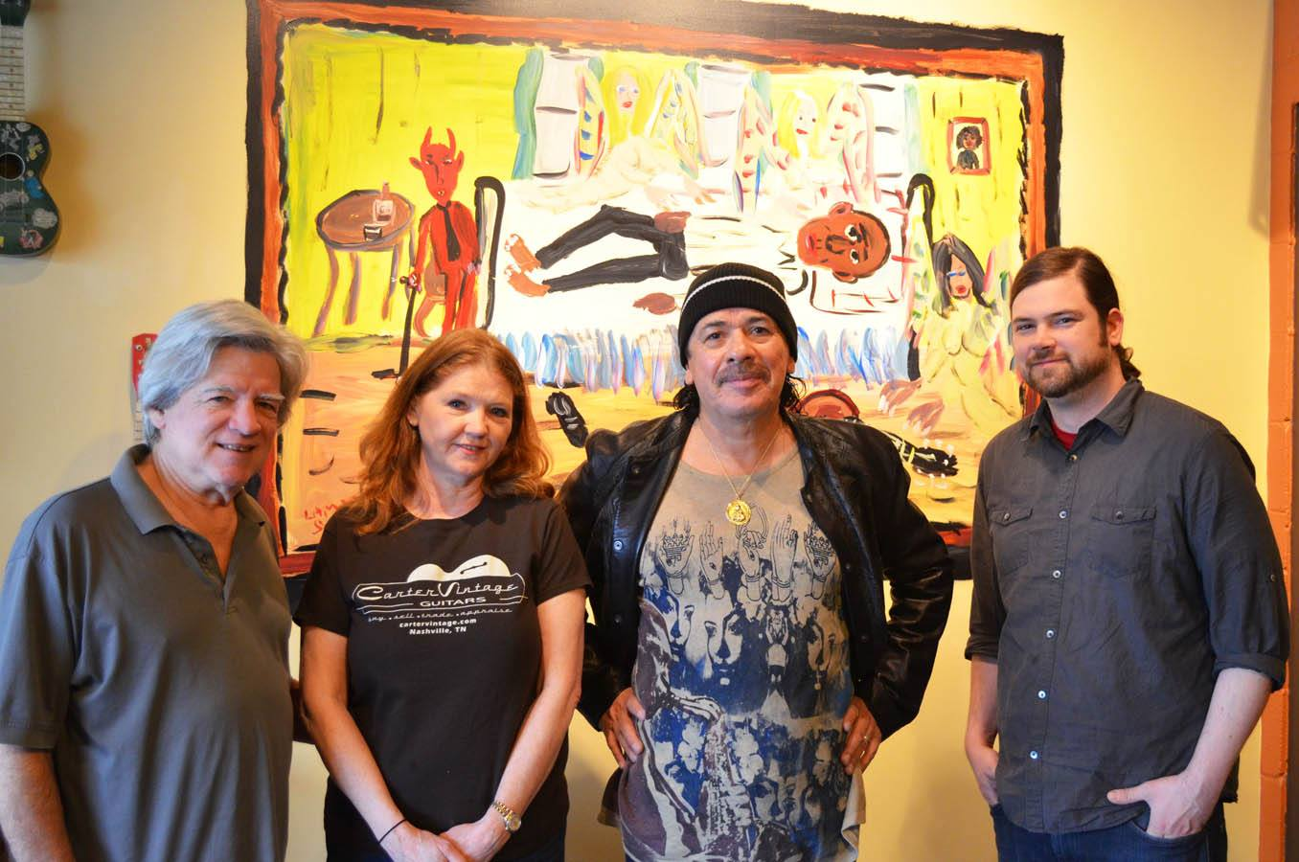
Carter sells a lifestyle brand no different than
Harley Davidson
…and no different than you and I

Slide 6
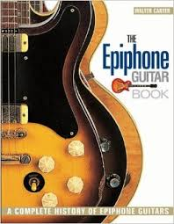
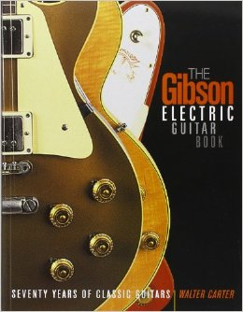

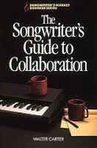
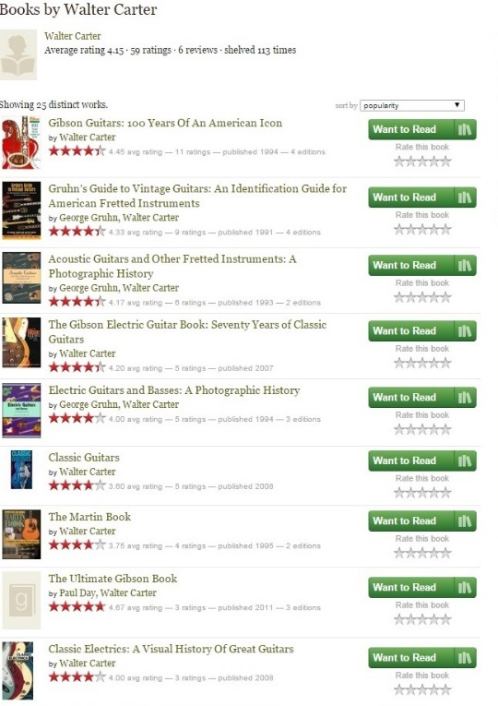
Walter Carter’s history
in the music business
makes Carter Vintage Guitars
“a trusted source”
Walter Carter
is the former historian for Gibson Guitar Corporation and the author of ten books on guitars, including Gibson Guitars: 100 Years of an American Icon.

Slide 7
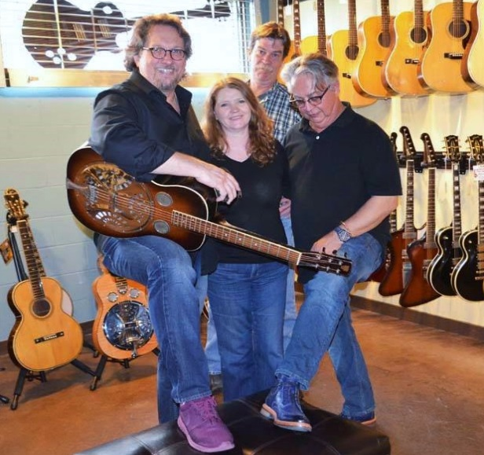
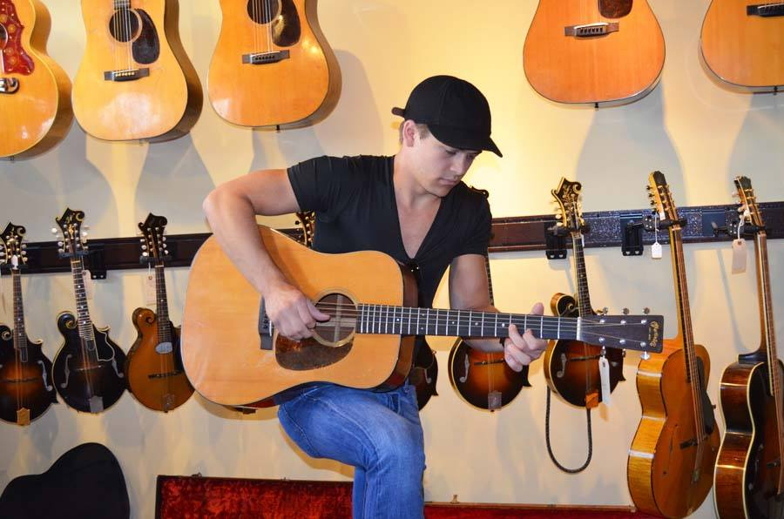
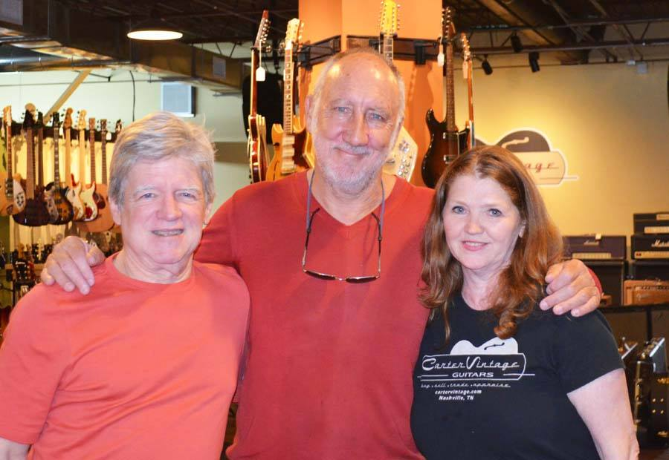
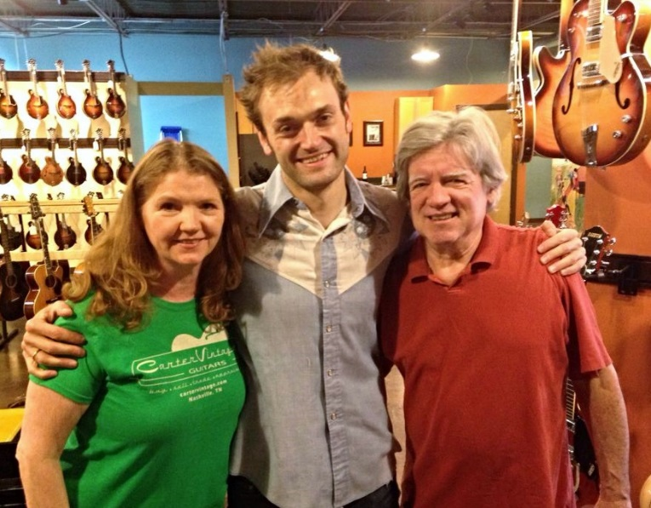
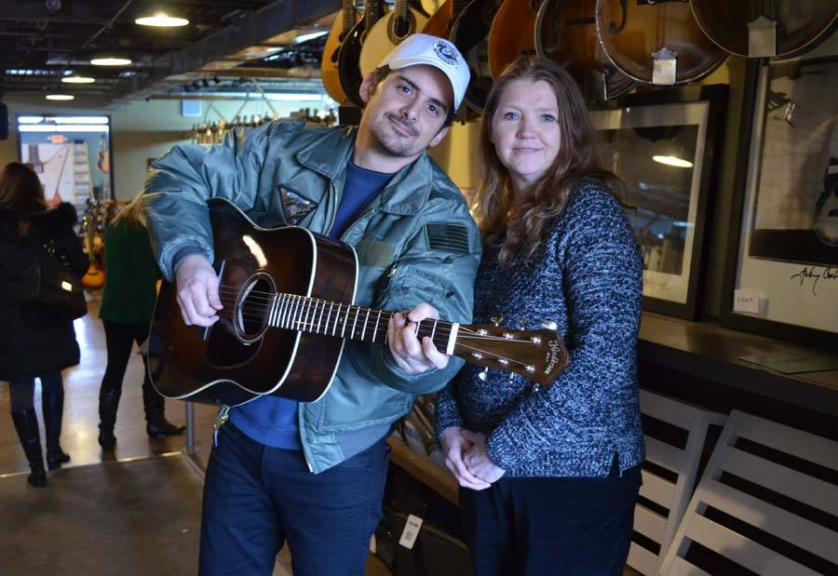
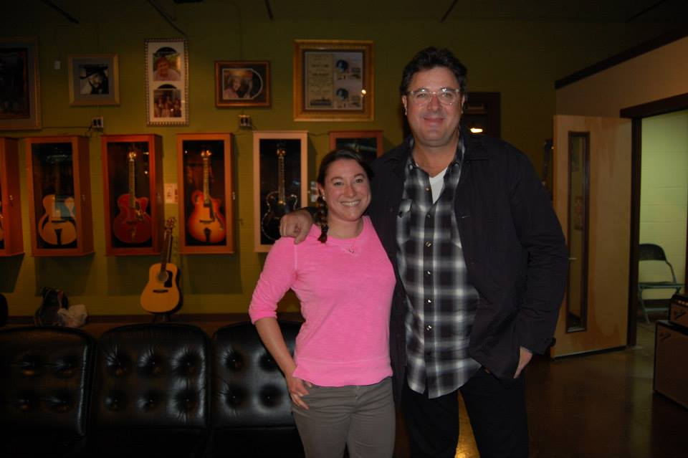
Carter displays that trust on social media and engages fans all over the world

Slide 8
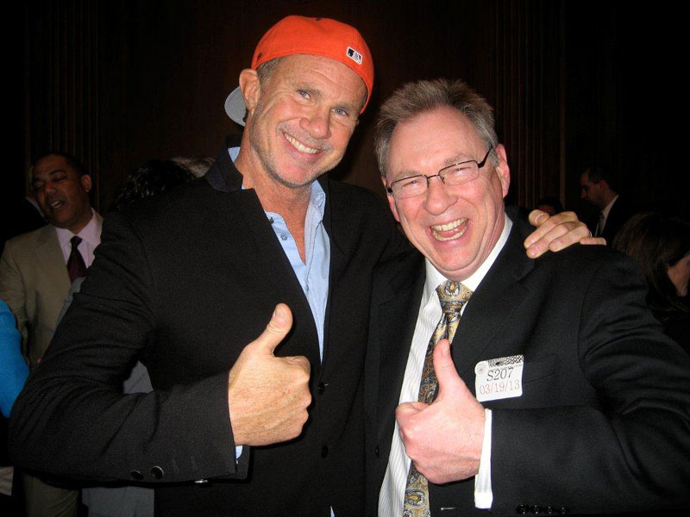
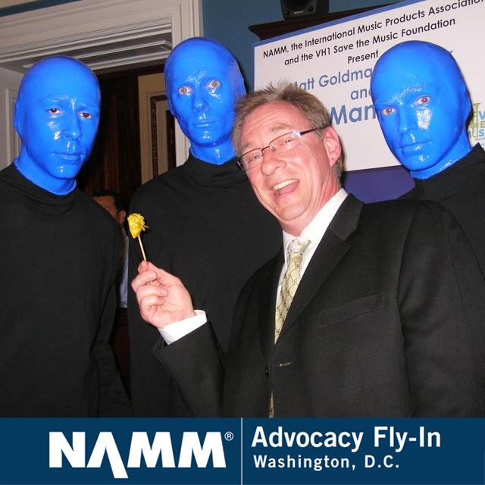
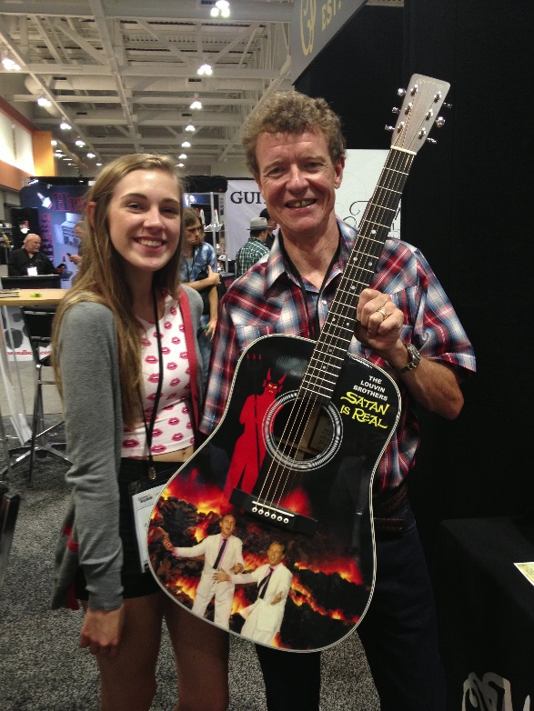
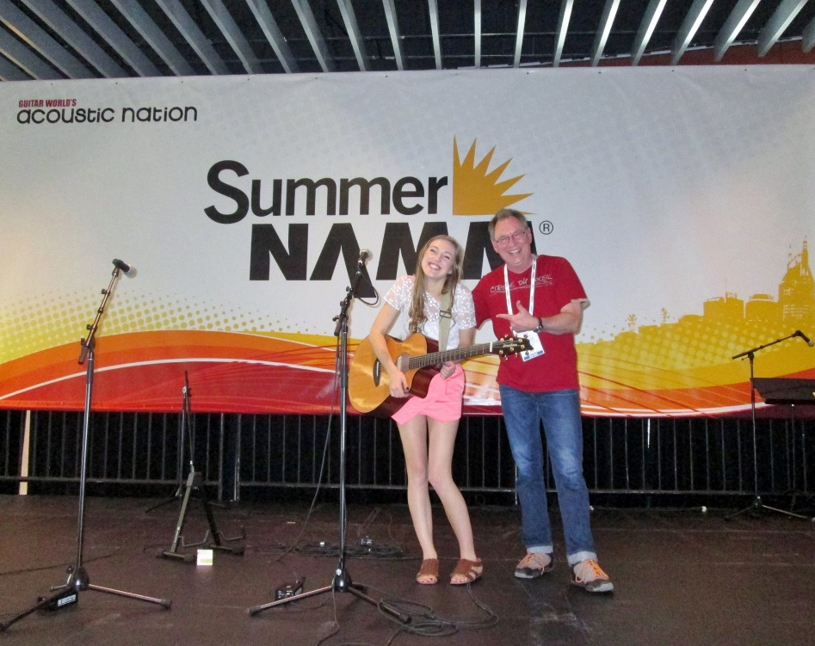
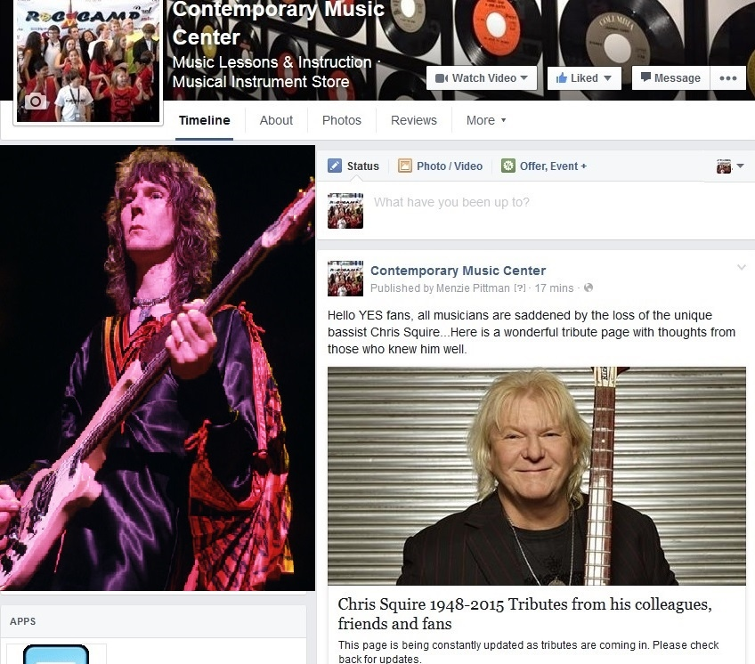
Facebook enables your customers to share in the
fun…And
The News

Slide 9
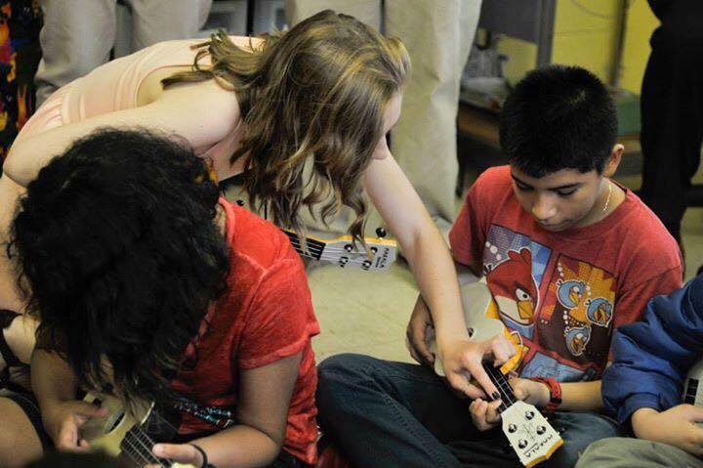
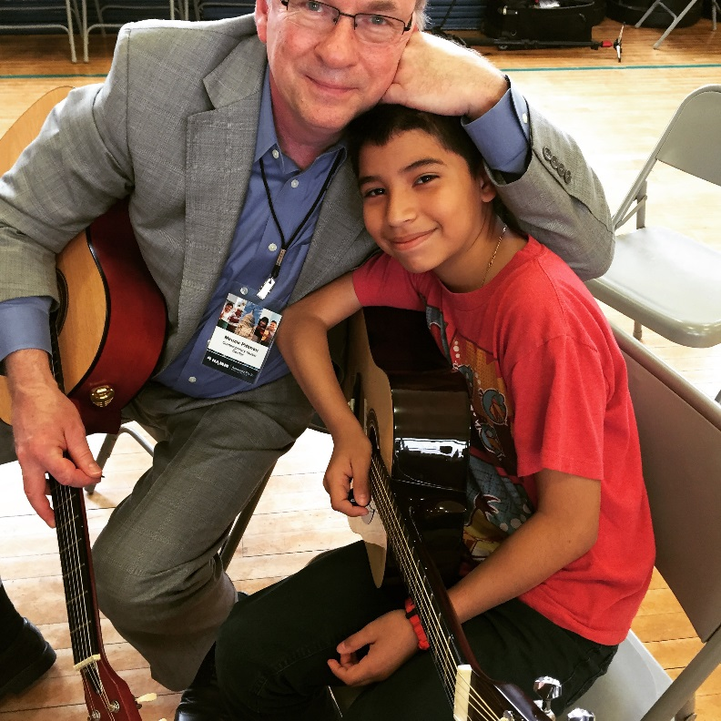
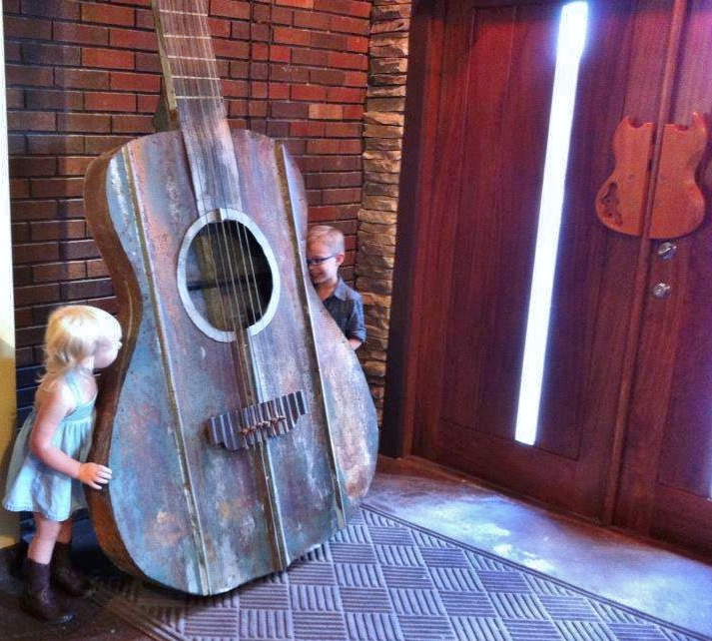
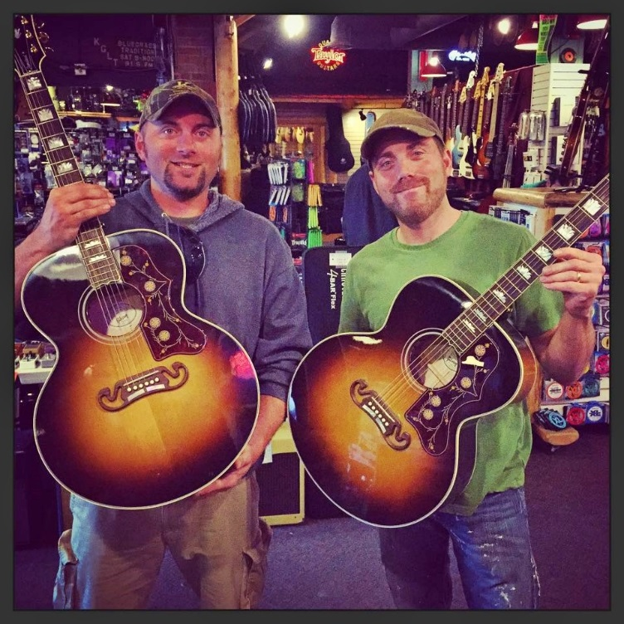
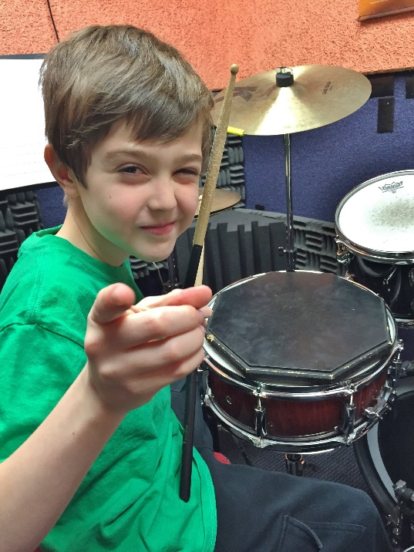
on Facebook post the heart in your story
Emotion connects community

Slide 10
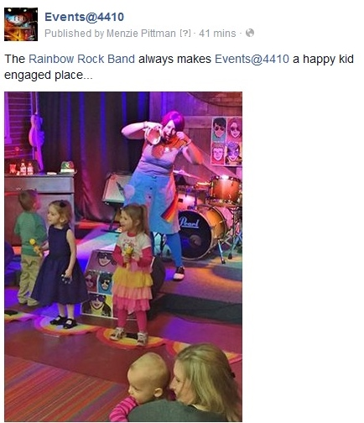
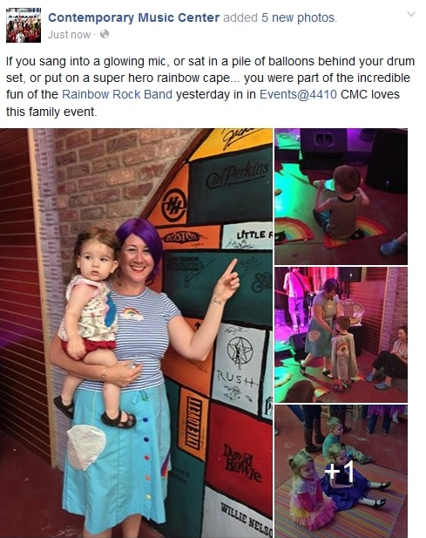
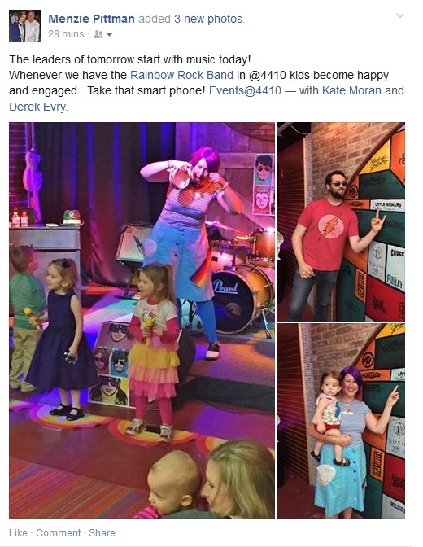
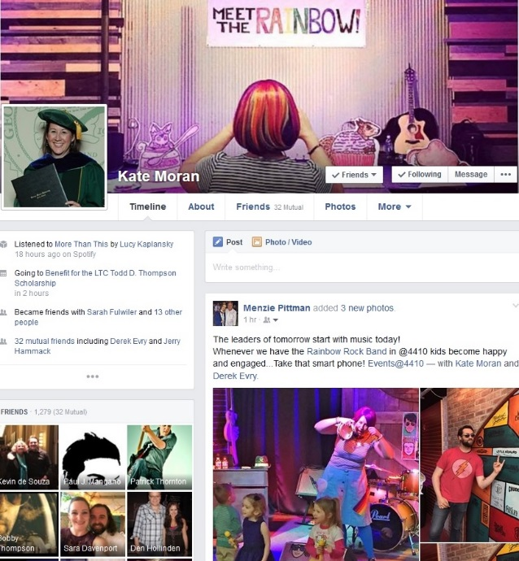
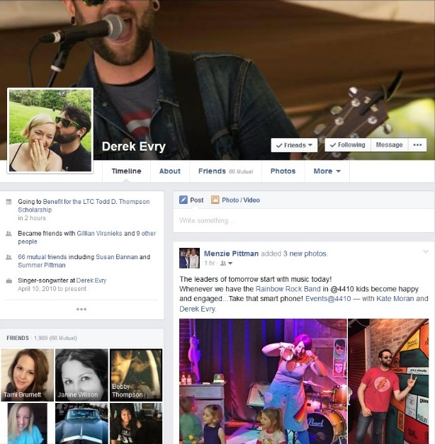
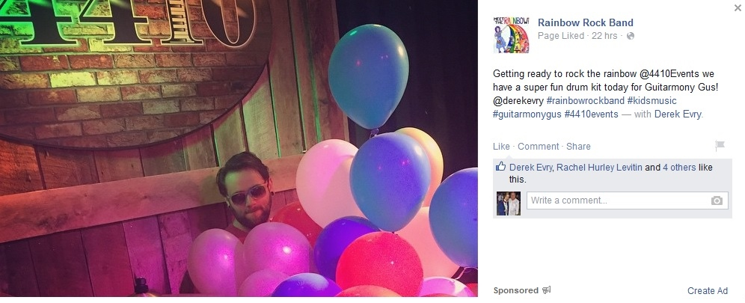
Then push your story into the music community…
So everyone
in the music community wins
Six high-profile pages
One story

Slide 11
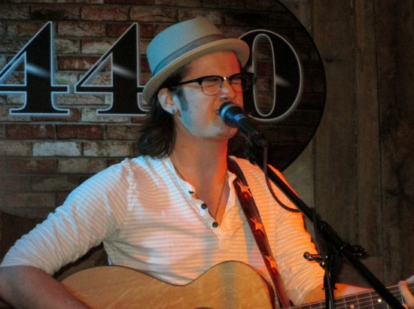
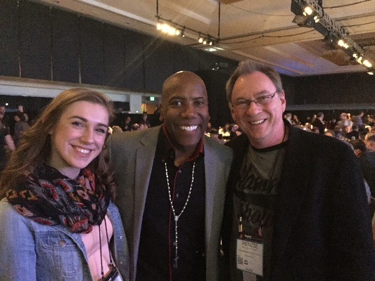
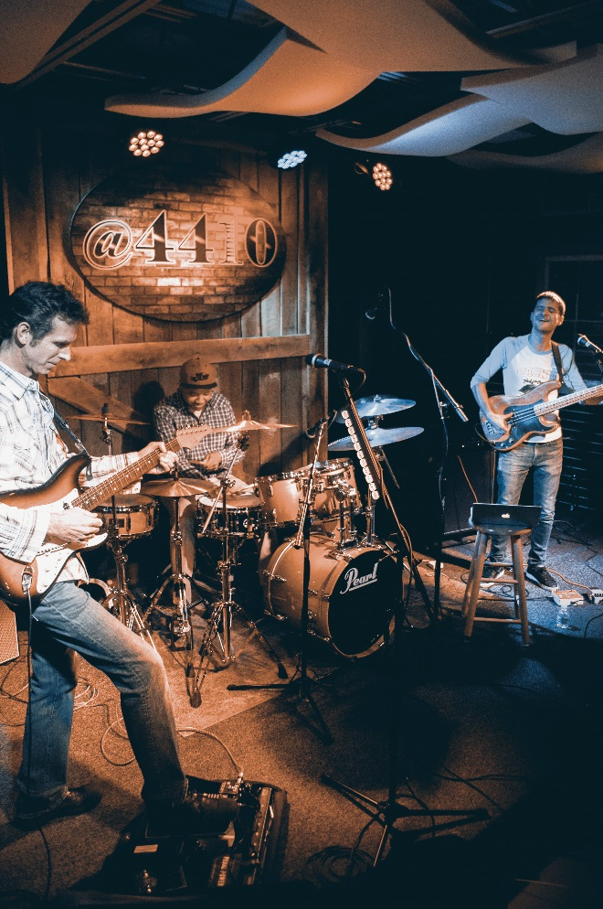
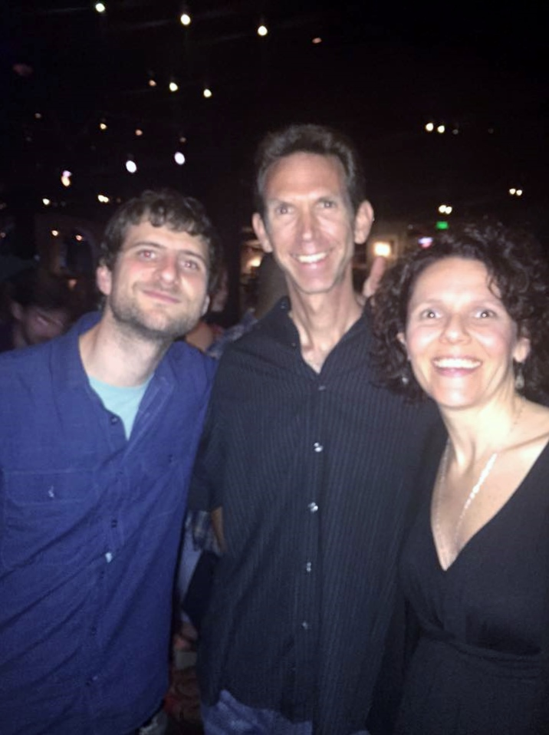
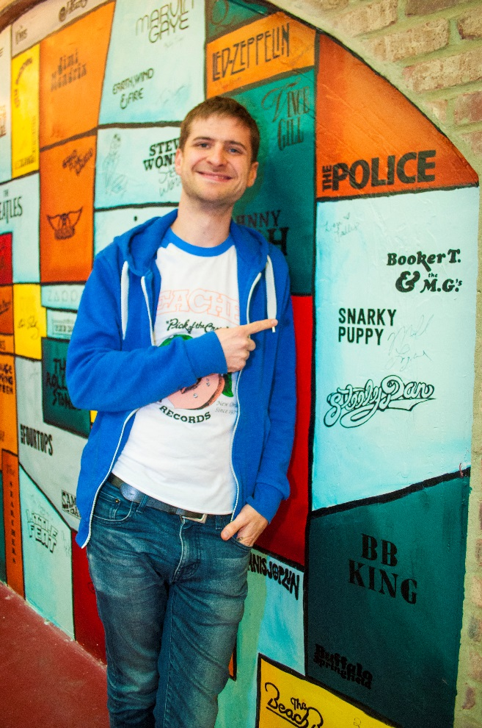
With social media
CMC Reinforces our relationships…
At every opportunity!
Dan Leonard, Greg Clark Jr, Michael league @4410
Michael league and CMC Teacher Dan Leonard
Michael League
Founder of Snarky Puppy

Slide 12
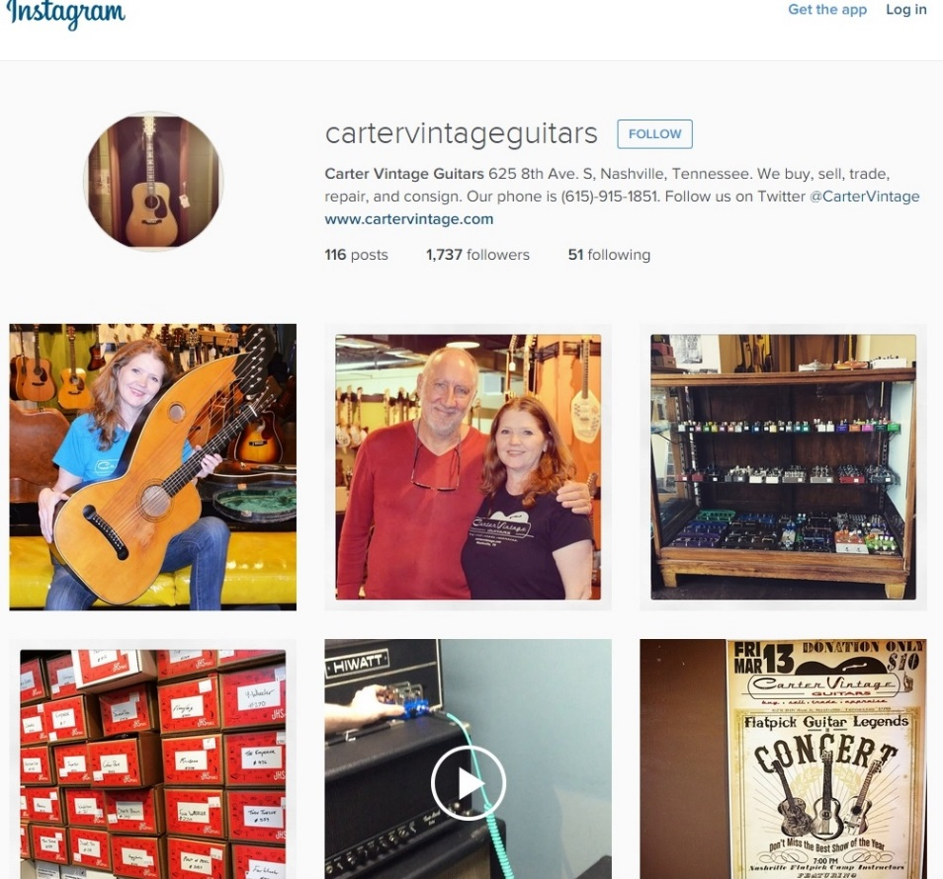
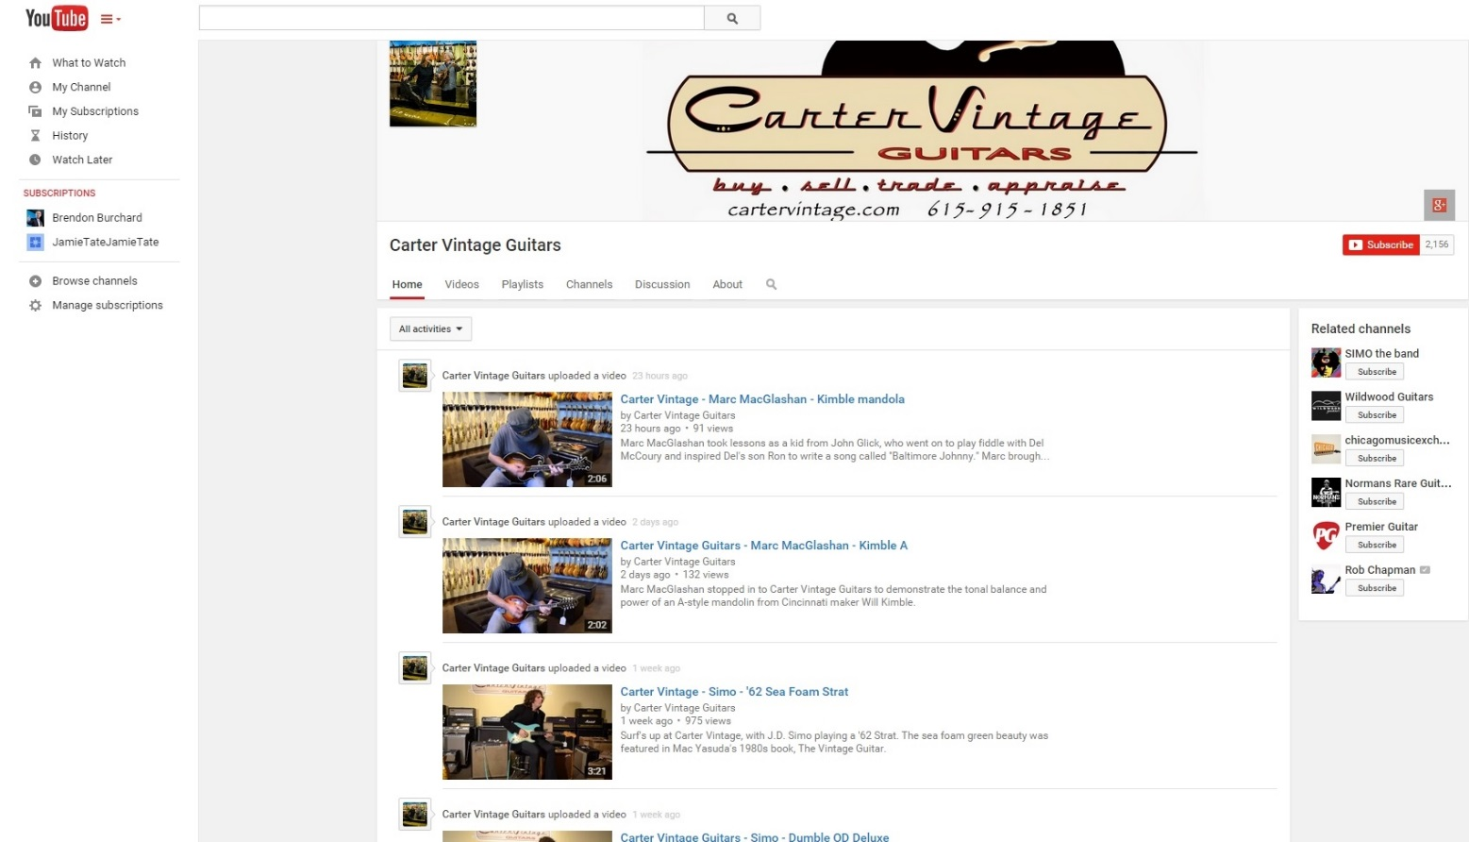
Carter Vintage Guitars uses multiple mediums to connect their message
Great videos on YouTube
Great photos on Instagram
Carter integrates great Nashville talent in their You Tube videos

Slide 13

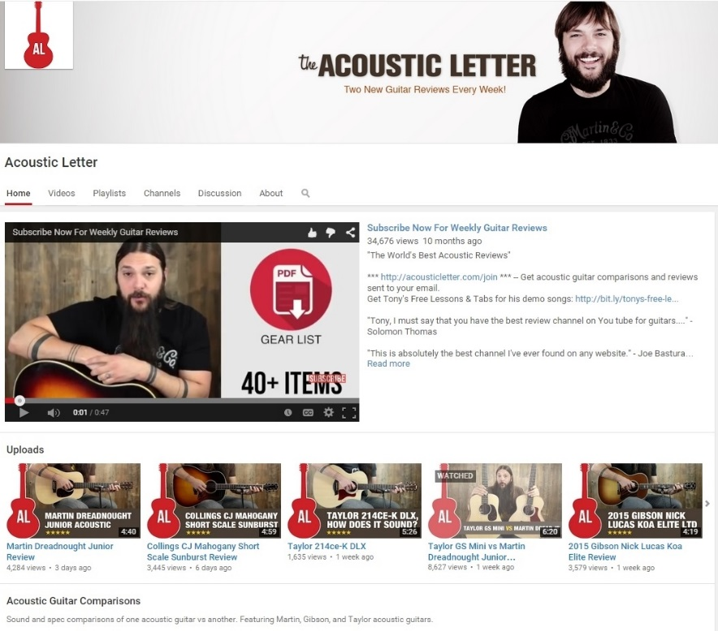
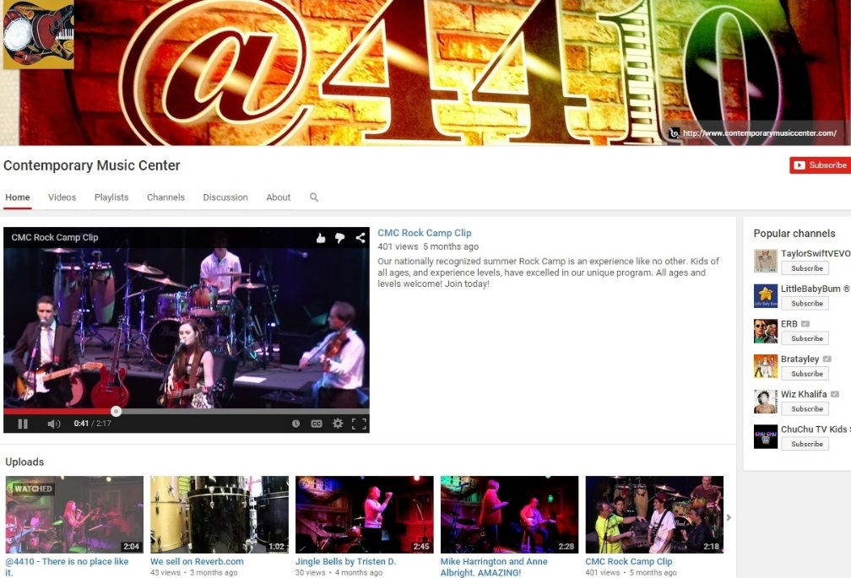
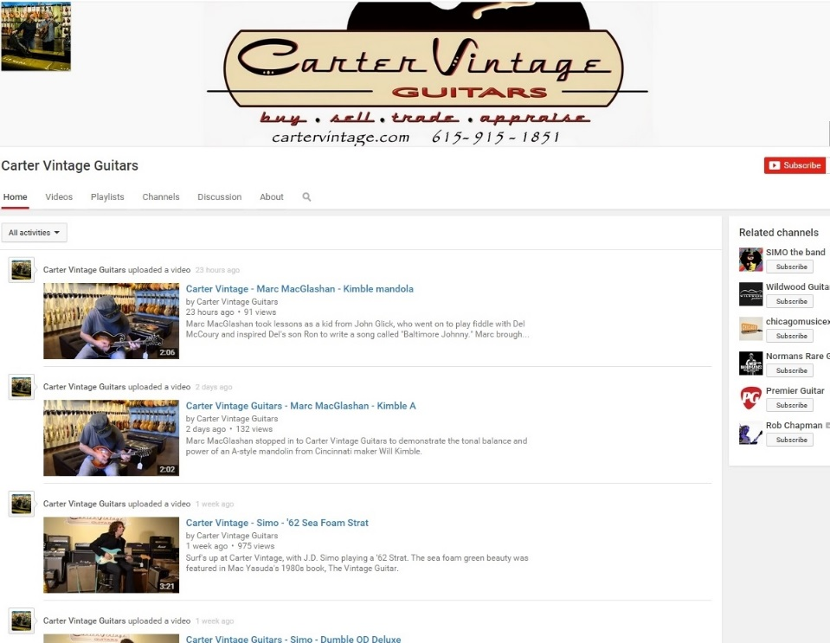
Engages, educates, legitimizes, cross sells!
You can use
YouTube to connect different aspects of your business

Slide 14
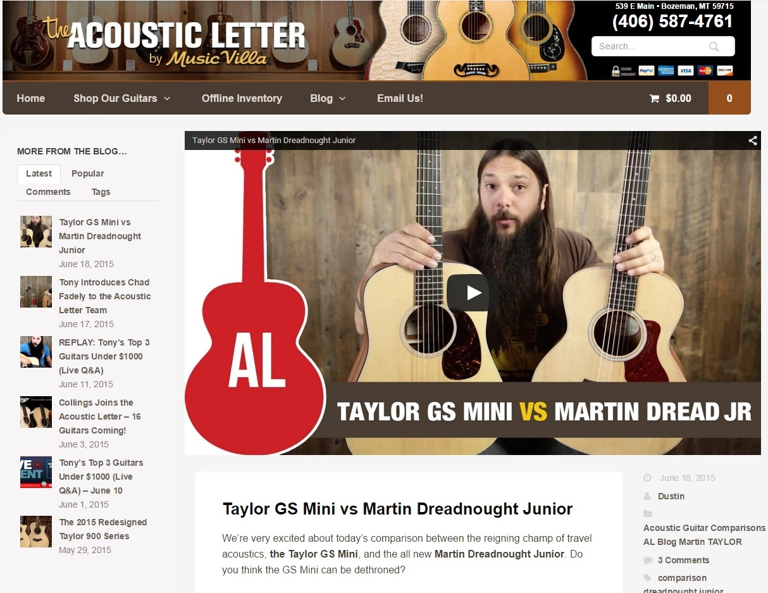

Through video reviews
Music Villa & Carter
provide
constant product knowledge
Engaging customers
in their Lifestyle Brands…
!
50,000 + subscribers

Slide 15
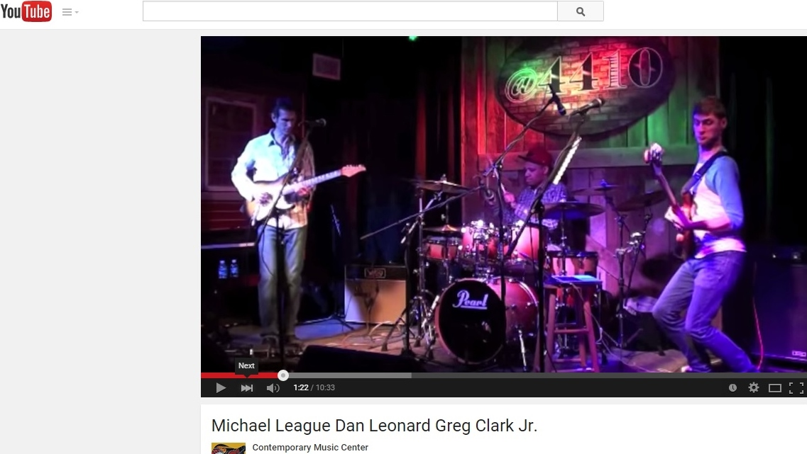
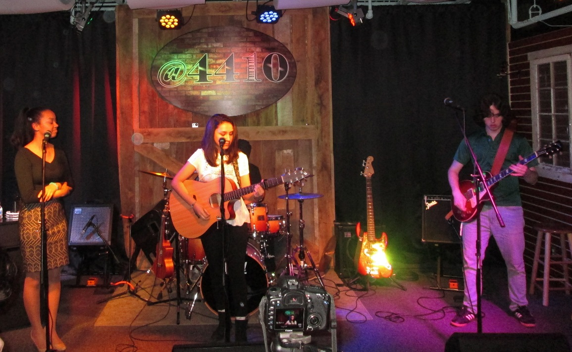
With YouTube, we engage customers in our lifestyle brand with videos of special performances, visual tours of our programs, and captures of events in our listening room @4410

Slide 16
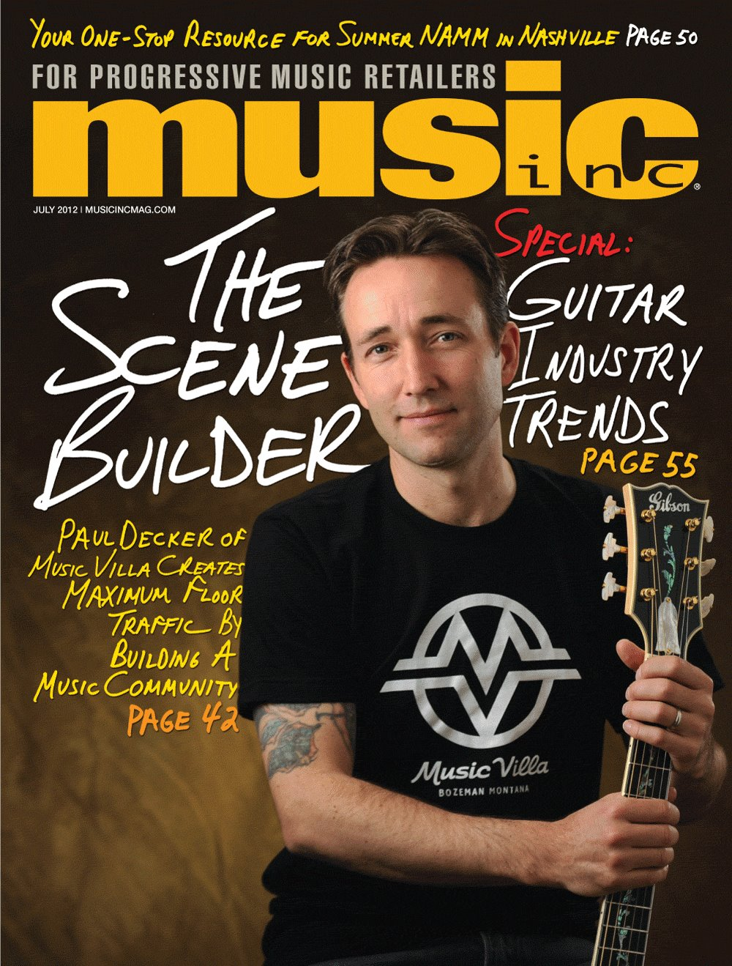
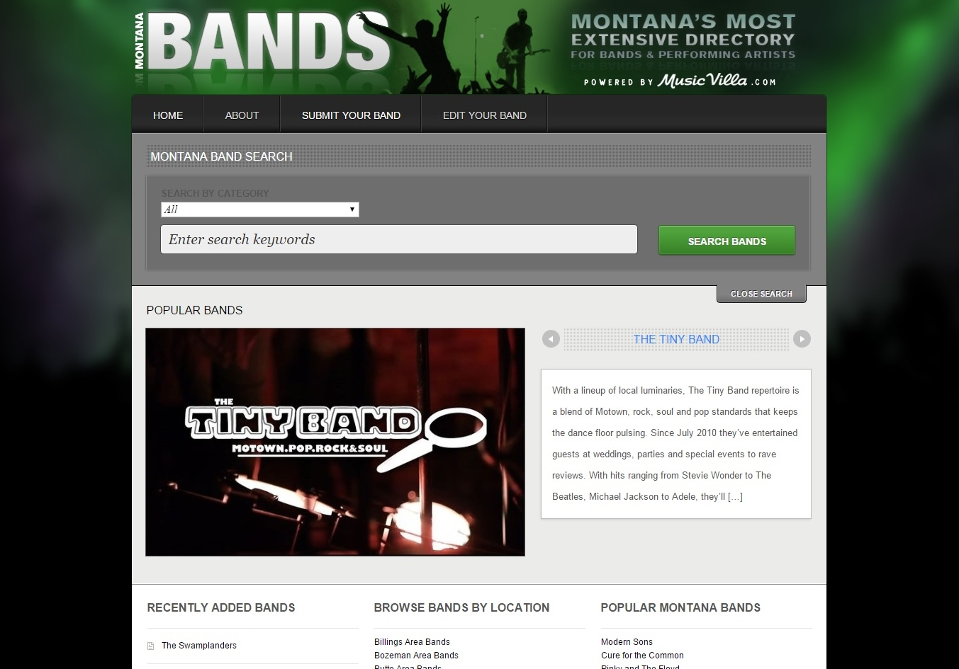

by providing them a platform…
Music Villa Invites their community to participate,
So they become
The “go to” Source
Music Villa’s Acoustic Letter

Slide 17
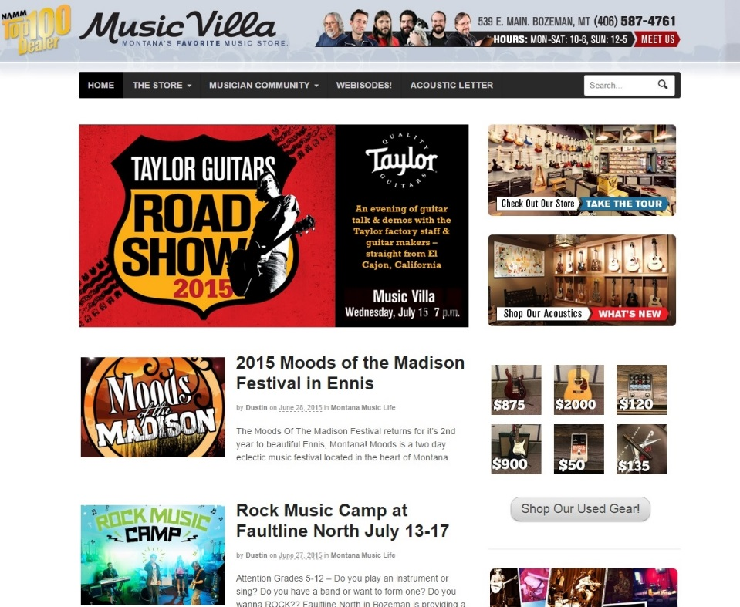

Music Villa gives their customers plenty of access with two web pages
Music villa.com
Acoustic letter.com

Slide 18


and multiple Twitter Pages
Music Villa
Acoustic Letter

Slide 19




Contemporary Music Center has made Education & Performance its lifestyle brand

Slide 20



Because what unites a community, is talked about by the community!
As seen in Haymarket Lifestyle Magazine October 2013

Slide 21




For CMC, this is where E-blast, Twitter & Instagram come into play!
We E-Blast every event
Because you want social pages to Re-Tweet
& Engage the Twittersphere

Slide 22



Instagram and Twitter are good platforms for CMC & @4410
and teens
Are our market
because they are the medium of teens
“Trailblazers are in the house and It’s a Full House @4410events Anniversary show”

Slide 23


Different mediums net different results
CMC’s Eventbrite page for tickets
@4410
Twitter
@4410events

Slide 24



All three of our businesses use Instagram & Twitter
Cater Vintage Guitars
Contemporary Music Center
Music Villa

Slide 25


Blogging
Here are 4 reasons you need to blog:
Drive traffic to your website
Increase your SEO/ SERP
Position your brand as an industry leader
Develop better customer relationships
“A search engine can’t see pictures,
THAT’S reason enough to BLOG” …Brian Jolliff
~WVU & CMC designer
Search engine spiders look for words, properly formatted.
So do the humans who buy your products…

Slide 26




CMC & @4410 stay connected
Web Site Content
E-Blast
Web Calendar for
Events @4410
Blogs
You Tube
Tweets
Instagram
Post to CMC FB Page
Post to @4410 FB page
Post to our Personal FB’s
Tag performers in @4410 photos on FB
Push & Share stories
Teen Network Tweets
Artist Network Tweets
Eventbrite Tickets

Slide 27

Remember: When it works for the community, it works for you!

Slide 28



Contemporary Music Center
Invites
YOU
to play!
As seen in
Music Inc. Magazine
October 2013

Slide 29
Takeaways
Use all social networks you possibly can
Sell a lifestyle brand
Invite your customers to be part of the story
Keep your customers engaged on social media
Push the story to other pages
Fun sells & emotion connects community
Updated product knowledge makes customers return
Playing music is why we are here.
Good blogging will position your brand as an industry leader
Stay connected
Be the source

Slide 30


Menzie Pittman
Walter Carter
Effective Online
Marketing
Christie Carter
& The art of lifestyle Branding
Paul Decker

