Slide 1

12 PR Tips for Musicians, Music Businesses and Everyone Else
Presented by Laura B. Whitmore and Pauline France
of Mad Sun Marketing
Download this presentation at http://www.slideshare.net/madsun/presentations

Slide 2

Effective Public Relations Equals:
Influencing the conversation and perceptions about your brand or product through relationships with media
Creating exposure opportunities to expand visibility, presence and top of mind
Establishing and maintaining mutually beneficial relationships between your brand and the public through controlled messaging
Two-way communication between your brand and the public
Transparency
Building and maintaining relationships
Planning, strategy and execution
Follow us on Twitter @laurabwhitmore @pauline_france

Slide 3
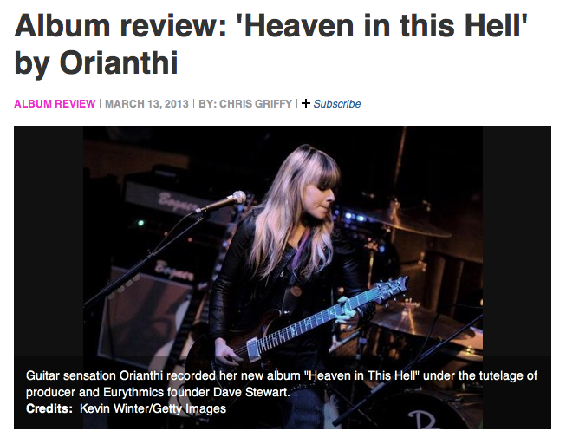
PR Elements
News releases
Media outreach (e.g., interviews)
Counseling
Media training
Speaking engagements
Brand stories and features
Guest writing
Product/song reviews
Events and show reviews
Charitable participation
Participation in unrelated
activities
Buzz!
Timing — Be on the lookout for timely, local and seasonal tie-ins (e.g., holiday gift guides, international guitar month, etc.)
Follow us on Twitter @laurabwhitmore @pauline_france

Slide 4

The Pitch
Your customized messaging tailored specifically to entice media contacts to cover your news
There’s no such thing as an effective blanket pitch; you must research and personalize each communication
The pitch is one of the most essential elements for PR success
Effective public relations takes time
A good pitch is concise, to the point, and news worthy with elements that are of direct interest to the recipient
Have an excellent subject line
Sometimes silence does not mean no. Pitching can take good follow up and perseverance
Quality over quantity
Follow us on Twitter @laurabwhitmore @pauline_france

Slide 5

The News Release
Written in the third person — always!
Concise, factual headline with short expanded subhead which lures editors into wanting to learn more
Have an excellent subject line
A date and city of origin gives editors context
Clearly state For Immediate Release or Embargoed Until Date so that editors know if they can post right away
Critical info of who, what, when, where, why should be in the first paragraph. This includes items, such as dates, times, location, company name, product name and category
Follow us on Twitter @laurabwhitmore @pauline_france

Slide 6

The News Release Part 2
Sentences should be concise, factual and readable
Quotes enhance and add substance
A URL or contact info to find out more is essential
Boilerplate at the bottom gives info about the company sending the release
Images are essential. Many sites cannot post without an image
Other elements, such as video links and embeds, can help tell your story
Make sure media contact information is clearly available but not part of the body of the news release
Follow us on Twitter @laurabwhitmore @pauline_france

Slide 7

What Editors Love
Clear, concise news releases that really are newsworthy
Pitches that take into account their publication and their beat
Properly formatted releases that don’t include double spacing and are easily editable (e.g., Word or Text documents)
Files sent to their email that are not large. But links to download high-res images should be included
Follow us on Twitter @laurabwhitmore @pauline_france

Slide 8
What Editors Love Part 2
Font sizes that are not tiny
Excellent grammar, punctuation and spelling (bad grammar severely affects credibility)
Captions for photos
URLs to find out more must be included
Quick response when they ask for items so they can make deadlines
Help them out with story ideas through HARO – Help a Reporter Out. http://go.helpareporterout.com
Follow us on Twitter @laurabwhitmore @pauline_france

Slide 9
PR Distribution
Fit your pitch to the recipient
Free wire services and paid wire services
Build your own list – reviewers, local press, national
reviewers, etc., and make sure you send to the right people
Sites that have news submission
forms – Blabbermouth, KVRaudio.com, Mi2N.com, more
Do not distribute on Fridays or weekends or late in the evening
Hire a publicist – make sure they are the right fit.
And be a squeaky wheel
“Some are born great, some achieve greatness, and some hire public relations officers.” – Bill Gates

Slide 10
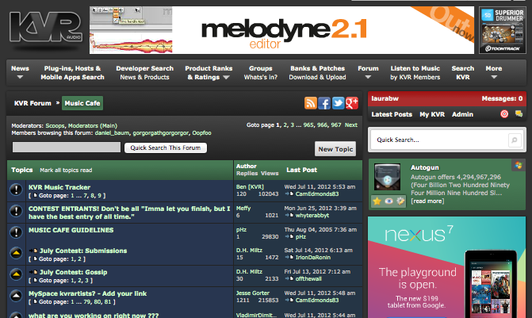
More Exposure
Forums: Share your music, comment, participate. Include your Web link.
Blogs: Comment on posts. Include your Web link.
Groups: Yahoo, Linked In, more. Comment on discussions. Include your Web link.
Media outlets: Share articles, comment,
vote. Include your Web link
Curate content, shine a light on others, engage with your audience and use visuals
Join and understand Twitter – make it your best friend
Follow us on Twitter @laurabwhitmore @pauline_france

Slide 11

Questions? Contact:
Laura B. Whitmore Pauline France
Mad Sun Marketing Mad Sun Marketing
@laurabwhitmore @pauline_france
info@mad-sun.com
www.mad-sun.com
Download this presentation at http://www.slideshare.net/madsun/presentations

