Slide 1


“The Basics to
Valuing Music Stores”
presented by
Alan M. Friedman, CPA
Friedman, Kannenberg & Company, P.C.

Slide 2
Objectives
Briefly discuss business valuation fundamentals & methodologies
Identify the difficulties & “quirky issues” in valuing music stores, and highlight the items that add value to your business
Teach you how to compute the value of your store (or a potential acquisition store)
Provide some succession & transition tips
Q&A along the way

Slide 3
This session is for you if:
You want to know how much your store is worth
You want to transition your store to someone you know (your kids, key employees, etc.)
You want to sell your store
You want to buy a store
You want to attract an investor

Slide 4

Some newsworthy “Mergers & Acquisitions” in the music industry

Slide 5
Newsworthy M&A’s
U.S. Music acquires Parker Guitars
Eastman Strings acquires Haynes Flute
DigiDesign acquires Bomb Factory Digital
D’Addario acquires Rico International
Conn-Selmer acquires G.LaBlanc Corp.
Avid Technology acquires M-Audio
Samick Music acquires Young Chang
Fender Musical Instruments acquires Tacoma Guitars
American Music Group acquires Karnes Music B&O
Guitar Center acquires Music & Arts & Musician’s Friend
Bain Capital acquires Guitar Center

Slide 6

Here’s “10” more…
…that’ll be announced at this show!!

Slide 7
Merger #1
Hickey’s Music Center (Ithaca, NY)
Mammoth Music (Anchorage, AK)
“Mammoth Hickey” Music

Slide 8
Merger #2
Noah’s Music Store (Yuma, AZ)
Jack’s Drum Shop (Boston, MA)
Swissvale Music (Pittsburgh, PA)
Beanstalk Music (McAlla, AL)
“Jack Beanstalk” Music and “Noah Vale” Music Store

Slide 9
Merger #3
Art’s Music Shop (Montgomery, AL)
Music & Arts Center (Frederick, MD)
Art’s “Music & Arts” Music

Slide 10
Merger #4
Past Perfect Piano (Valley Village, CA)
Mesa / Boogie Amps (Petaluma, CA)
Gasparick Music Svc. (Ironwood, MI)
Picker’s Delight (Smithville, TN)
“Past Gas Boogie Pickers” Music

Slide 11
Merger #5
Middle C Music (Washington, DC)
FingerWeight Music Corp. (Northbrook, IL)
“Middle Finger Music”

Slide 12
Merger #6
ABC Music (Scottsdale, AZ)
ABC Music (Benicia, CA)
ABC Music (Burbank, CA)
ABC Music (Honolulu, HI)
ABC Music (Tulsa, OK)
ABC Music (Salem, OR)
(Merger talk still in progress because no one’s creative enough to think of a cool store name)

Slide 13
Merger #7
Daddy’s Junky Music (Manchester, NH)
Hoosier Music (Bloomington, IN)
“Hoosier Daddy Music”

Slide 14
Merger #8
Mee Sheng Music Enterprise (Taiwan)
Russo Music Center (Trenton, NJ)
The Horn Shop (Fresono, CA)
Love Gun Guitars (Long Beach, CA)
Lou’s Music Center (Newton, NJ)
Long & McQuade Ltd (Ontario, Canada)
Music Time (Jacksonville, FL)
“Mee So Horn, Mee Love Lou Long Time” Music Center

Slide 15
Merger #9
Sam Ash Music (Hicksville, NY)
Peace Drums (Taiwan)
Nice Music, Inc. (Orange Park, FL)
“Nice Peace of Ash” Music

Slide 16
Merger #10
Mandolin Bros. Ltd (Staten Island, NY)
Freed Music International (Tampa, FL)
Alan’s Music Center, Inc. (La Mesa, CA)
Hot Licks Guitar Shop (Waldorf, MD)
Sweetwater Sound, Inc. (Fort Wayne, IN)
Divine Appointment Guitars (Paso Robles, CA)
The “Alan Friedman is Hot, Sweet and Divine” Guitar Shop

Slide 17
“FAILED” Merger
Friedman, Kannenberg & Co (Farmington, CT)
Banana’s At Large (San Rafael, CA)
“Friedman’s Large Banana”

Slide 18
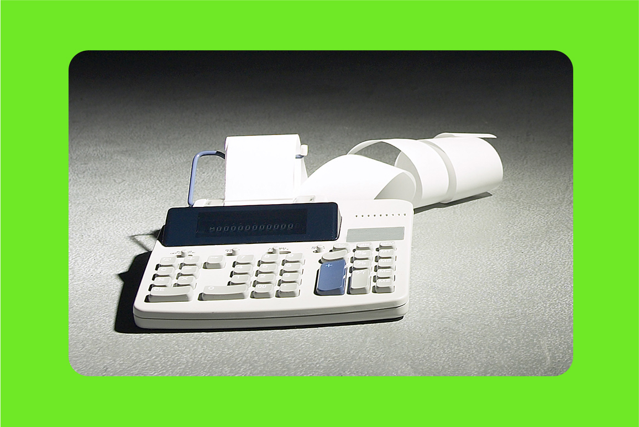
Part I
Business Valuation Fundamentals

Slide 19
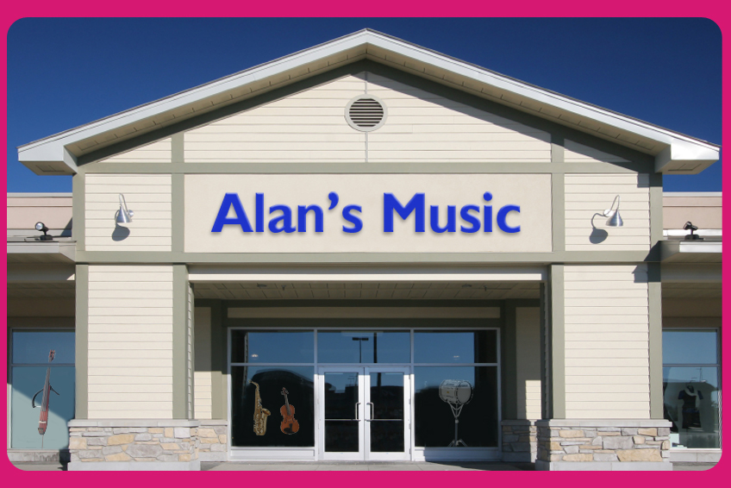
What is a Business Valuation?
Process of gathering financial, economic
and industry data to establish a dollar value of an interest in a business through quantitative and qualitative analysis

Slide 20
What is a Business Valuation?
The process of establishing the value of both tangible assets (building, store fixtures, office equipment, rental instrument pools) and intangible assets (customer lists, vendor product lines, trademarks, goodwill) assets.

Slide 21

What is a Business Valuation?
An estimation
of the dollar value of a given business ownership interest
at a specific point in time.

Slide 22

Why Perform a Valuation?
Tax Purposes, to accompany estate and gift tax returns
Succession planning to transfer wealth

Slide 23
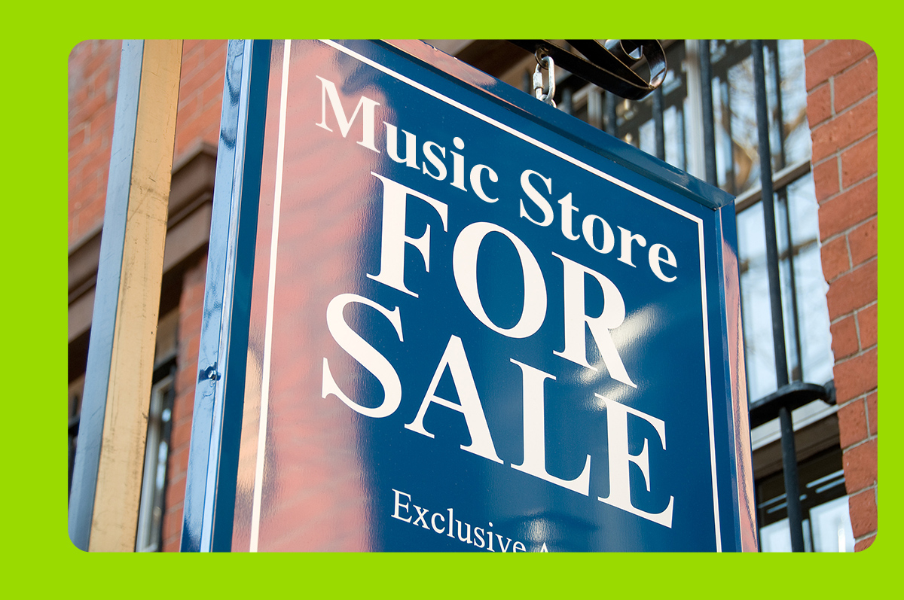
Why Perform a Valuation?
Purchase, sale or merger
Buy / sell agreements between business partners

Slide 24

Why Perform a Valuation?
Litigation support
  Divorce
  Disruption of business, due to theft, fire, flood, etc.
  Shareholder disputes

Slide 25

Why Perform a Valuation?
Management assistance
Bank financing
Seek investors
Employee benefit & Stock
Ownership Plans (ESOP)
Business plans
Bankruptcy & reorganization

Slide 26

What is “Value” ?

Slide 27

What’s the Value of My Business When…
I want to sell the business and retire?
My partner wants out?
My employees want in?
My bank wants assurance?
My spouse wants to divorce me?
I drop dead?

Slide 28
What is Value?
Fair Market Value
“The price at which the property would change hands between a willing buyer and a willing seller, when the buyer is not under any compulsion to buy, and the seller is not under any compulsion to sell, and both parties have reasonable knowledge of the relevant facts.” (Revenue Ruling 59-60)

Slide 29

What is Value?
Liquidation Value
Investment / Strategic Value
Book Value
Going Concern Value
Fair Value

Slide 30

What items affect value?

Slide 31
Value Drivers
An Investor’s Motivations, such as the desire to…
Buy a job, or be involved in something rewarding
Realize a desired rate of return on investment
Achieve a greater market position
Gain access to new product lines
Business Characteristics, such as the business’s…
Size and location
Customer base and loyalty; competitive position
Suppliers and vendor product lines
Years in business and quality of management
Financial condition and stability of earnings

Slide 32


CAUTION !!
Different value drivers dictate the use of different valuation approaches, making business valuation a “highly subjective” process

Slide 33
Valuation Approaches
Three Common Approaches to Valuation:
“Income” approach
“Market” approach
“Asset” approach

Slide 34

Valuation Approaches
The “Income” Approach
Value is based on the company’s future income producing capacity

Slide 35

Valuation Approaches
The “Market” Approach
Value is based on
the selling price of comparable companies
in the same market or industry

Slide 36

Valuation Approaches
The “Asset” Approach
Value is based on the assets (both tangible and intangible) of a business, less its liabilities

Slide 37
Valuation Approaches
Each approach contains generally accepted valuation methods unique to that approach; some of the common valuation methods are…

Slide 38
COMMONLY USED
VALUATION METHODS
Adjusted
Net
Assets
Discounted
Future
Earnings
Excess Earnings
Return on Assets
Commonly
Use
Methods
Capitalization
of
Earnings
Commonly
Used
Methods
Dividend
Paying
Capacity
Price
Earnings
Ratio
Industry
Formulas
Rule
Of Thumb

Slide 39

Part II
“7 Problems, Challenges & Quirks” in Valuing Music Stores

Slide 40
Challenge #1: Finding the Right Data
Financial data—financials, tax returns, forecasts and projections
Industry data—Cost of Doing Business Survey,
trade publications (Music Inc., MMR, Music Trades)
Economic Outlook data—information published by Dept. of Commerce, Dept. of Labor, state agencies, local Chamber of Commerce
Company data—organizational charts, management resumes, employee and sales data, market studies and competition data

Slide 41
Challenge #2: Interpreting the Data
Most financial statements present a picture that is very different from economic reality, making them not readily usable for valuation purposes
Most closely held business financial statements:
  are historical in nature
  are highly aggressive to avoid taxes, or
  are highly conservative to attract bank financing and vendor credit

Slide 42
Challenge #3: Properly Adjusting Data
Balance Sheet Adjustments
  A/R write-off’s for bad debts
  Realizable value of inventory
  Economic value of fixed & rental assets
  Value of intangibles assets
Income Statement Adjustments
  Excessive or low owner compensation & benefits
  Above or below-market rent
  Excessive T&E, travel, insurance
  Non-recurring revenue / expense

Slide 43
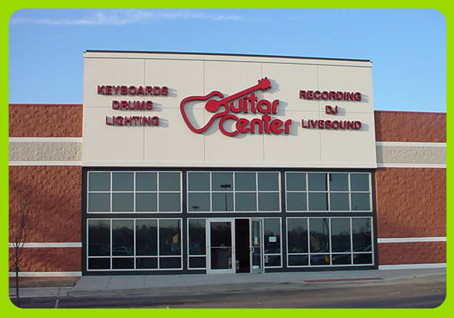
Challenge #4: No Comparable Market Data
Since only one retailer (Guitar Center) has been publicly held, it’s difficult to find comparable financial data to support a “market approach” in valuing small music retailers

Slide 44
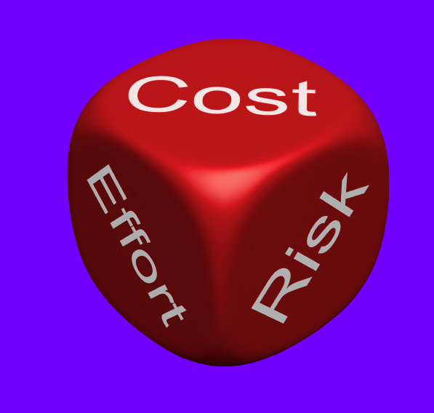
Challenge #5: Lots of Risk, Little Reward
Music retailers will find it difficult to attract investors looking for alternative investment opportunities

Slide 45

Challenge #6: Stiff Competition
With the increase in industry competition, many music retailers (especially “combo / pro audio” dealers) are throwing in the towel, resulting in a devaluation of music stores

Slide 46

Challenge #7: Lagging Technology
The lack of streamlined operations (evidenced by varied accounting software, non-barcode compliance, and little or no e-commerce presence) is affecting the typical retailer’s financial performance and lowering business values

Slide 47

Part III
How Do I Add Value To My Music Store —
And Get Paid For It?

Slide 48
Things That “DON’T” Add Value
Increasing sales at the expense of G.P. $$$
Increasing a profitable activity at the expense of cash flow (i.e. funding a rental program with cash or excessive debt)
A large build-up of inventory
Multiple talents of a single owner
Using a “unique” accounting system
Keeping things technologically the same
Carrying numerous product lines in an effort to be all things to all customers

Slide 49

Things That “DO” Add Value
A company that’s profitable by design
A company that has positive cash flow
A company that isn’t over-inventoried
A company that has a profitable rental program
A company that has a loyal, diverse customer base
A company that has a solid management team able
to operate without total reliance on the owner
A company using a supportable accounting system
A company that can document & prove their earnings

Slide 50

Music Store Buyers Typically Look For…
Great locations and demographics
  Potential for growth
  Expanding into a new market
  Elimination of a competitor
Proven history of earnings
Existing instrument rental programs
Access to new school markets
Strong management team
Reliable accounting records and systems

Slide 51
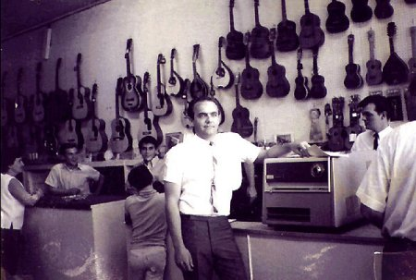
Part IV
“How Much Can I Get For My Store?”

Slide 52
“October. This is one of the dangerous months to speculate in stocks. The others are July, January, September, April, November, May, March, June, December, August & February.”
Mark Twain

Slide 53
How Much Buyers Will Pay…
They start with net income, convert it to net cash flow, and pay a multiple of that cash flow
They pay 3 – 6 times cash flow, with on average between 4 to 5 times
That multiple can vary greatly by buyer
A store that yields $200,000 of annual cash flow could yield a $1,000,000 selling price
But, that’s for the assets only…the owners then have to pay off all their debts and related taxes!!
Most buyers will NOT pay for any cash flow benefits they enjoy from the acquisition of your store

Slide 54
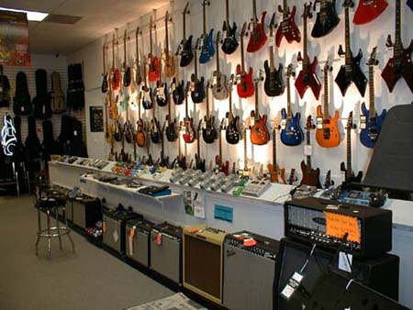
“Let’s calculate the value of a hypothetical music store…”

Slide 55
Part V
Some final Succession Planning
Tips & Strategies

Slide 56
What Are My Exit Options?
Be honest about why you want to get out…
  Tired?
  Illness, too much risk, or your heart’s not in it anymore?
Consider all options…
  Transfer (sell or gift) ownership to your kids
  Sell to key employee(s)
  Sell to a national or regional buyer
  Sell to a local music retailer
  Orderly liquidation
  Employee Stock Option Plan (ESOP)?

Slide 57
Succession Tips & Strategies
Plan early and don’t deny your own mortality
Avoid the “King Solomon” pitfall
Consider outside management for young heirs
Address technical issues, don’t over-promise & revisit as things change
When selling, consider timing
Document profitability and stability
Determine a value and find the right buyer

Slide 58

Need more help?
Contact Jen Lowe after this seminar
to set up a meeting time

Slide 59

Thanks RPMDA! Any questions?
Any Questions?

