Slide 1


Shoot for the $tar$,
You Might Hit the Moon!
Daniel Jobe
Friedman, Kannenberg & Co, P.C.

Slide 2

“When something is measured, it improves. When something is measured and reported, it improves exponentially.”
The Hawthorne Effect

Slide 3
History
Reinvention
Projection
Notes:
Game plan liken to football perhaps

Slide 4


What is the Missing Piece?

Slide 5


Each Employee Should Know…
The Objective

Slide 6
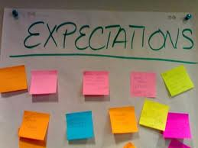
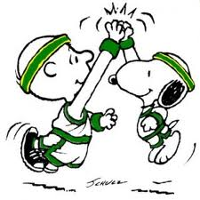
Each Employee Should be Informed…

Slide 7
Concept
Assign anticipated revenue to specific staff
Break figures down for accountability
Track progress individually
Provide tools to achieve goals

Slide 8
Ten-Year Industry Sales Trajectory
The Music Trades, April 2011

Slide 9
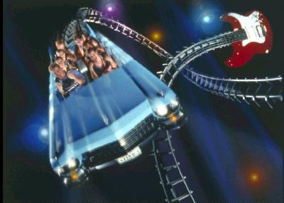
Sales – the roller coaster
Items to Breakdown per Sales Staff:
  Gross Profit Dollars vs. Salary (all annualized)
  Items per Sale
  Total Sales

Slide 10
Group Sales Performance
Notes:
Add web address

Slide 11

Repair – the consistent
Items to consider:
  Paying units by day
  Units repaired annually per person
  Average repair charge

Slide 12
Repair Performance Analysis

Slide 13

Inspect what you expect!

Slide 14
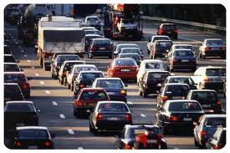
Lessons – traffic generator!
Items to consider:
  Individual Lessons
    Space utilization
    Incentives by Student Count
  Group Lessons
    Large profit generator
    Safe learning environment
    Promotes family activity

Slide 15

Rentals – the annuity!
Relationships are the key, so track them!
  Analyze per Route Day/Week
    Schools Visited
    Active Rentals
    Units Repaired
    Step-ups Generated

Slide 16
“The easiest thing is to react.
The second easiest is to respond. But the hardest thing is to initiate.”
-Seth Godin

Slide 17
Wrap-Up
Distribute the revenue load
Utilize more resources
Visit www.fkco.com for a more detailed spreadsheet on ways to track performance for various revenue sources.

Slide 18
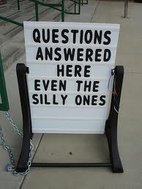
Any
Questions?

Slide 19

“Free” Consulting Meetings
At the Show
Contact Jen outside the Idea Center entrance
after this session to set up a meeting time

