Slide 1


Slide 2
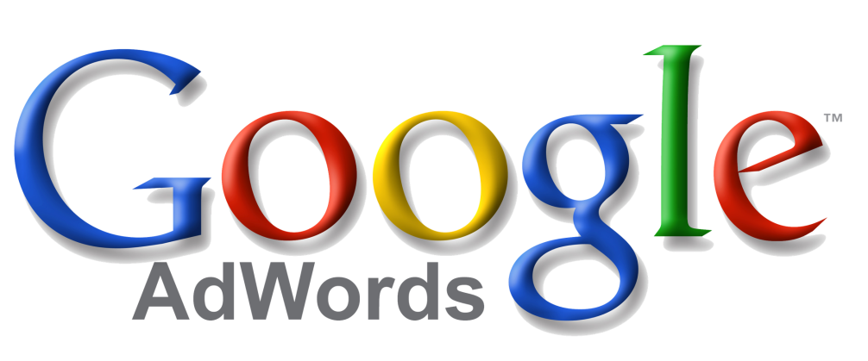
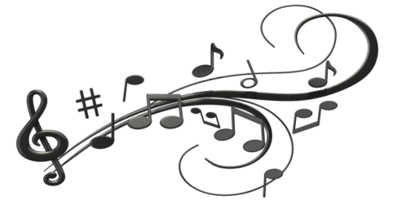
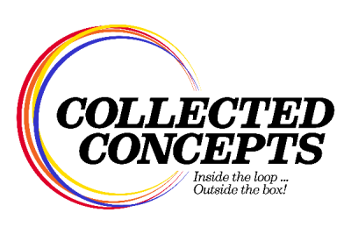
The Best Advertising for Your Buck!
Nick Failla

Slide 3
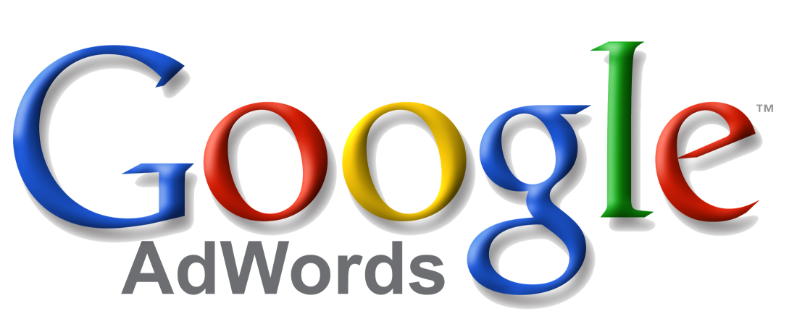
Google AdWords is an online advertising service that places advertising copy at the top or bottom of, or beside, the list of results Google displays for a particular search query.

Slide 4
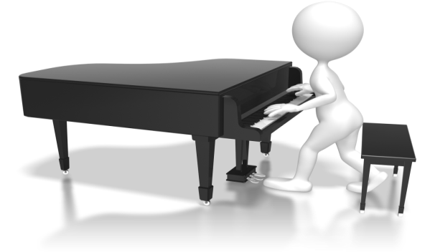
SHOPPING SEQUENCE
Product
Advertising
Google
Click & Review
Average Nine Times
Existing
Digital
Purchase
Traditional
Online
New
Organic
Paid
Visit Store
Touch
Traditional
Question
“If it isn’t on Google, it doesn’t exist.”
~Jimmy Wales

Slide 5
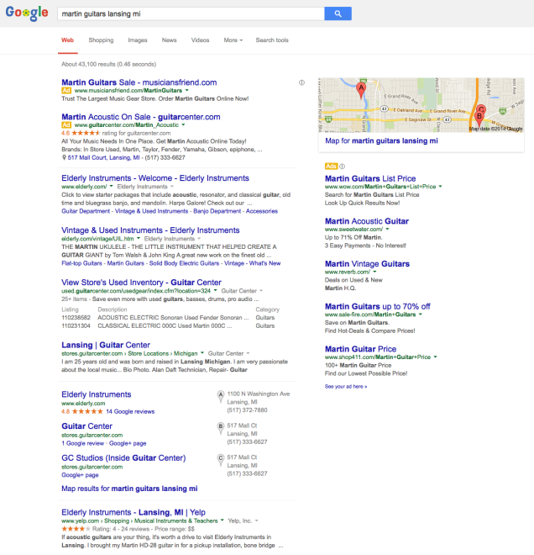
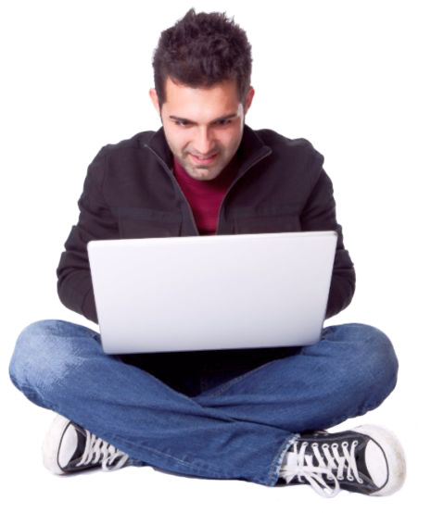
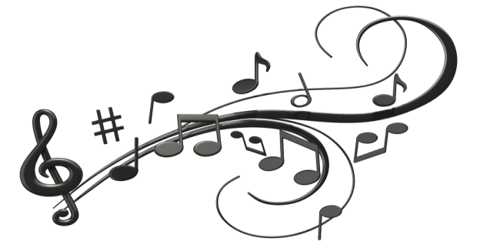
Google Search
Paid
Google Search
“Martin Guitars”
Organic
Search Results

Slide 6
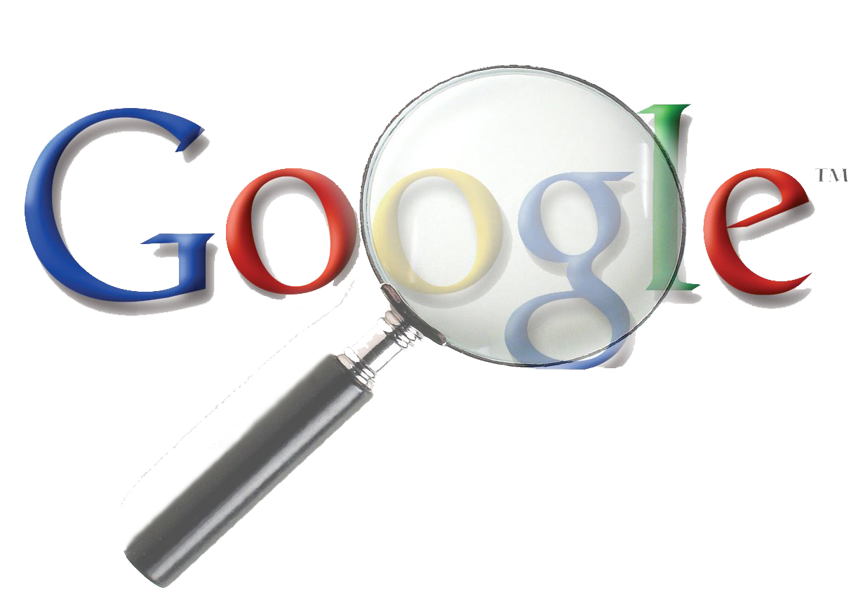
Google Search
NINE TIMES!
Google Search
“Martin Guitars”

Slide 7
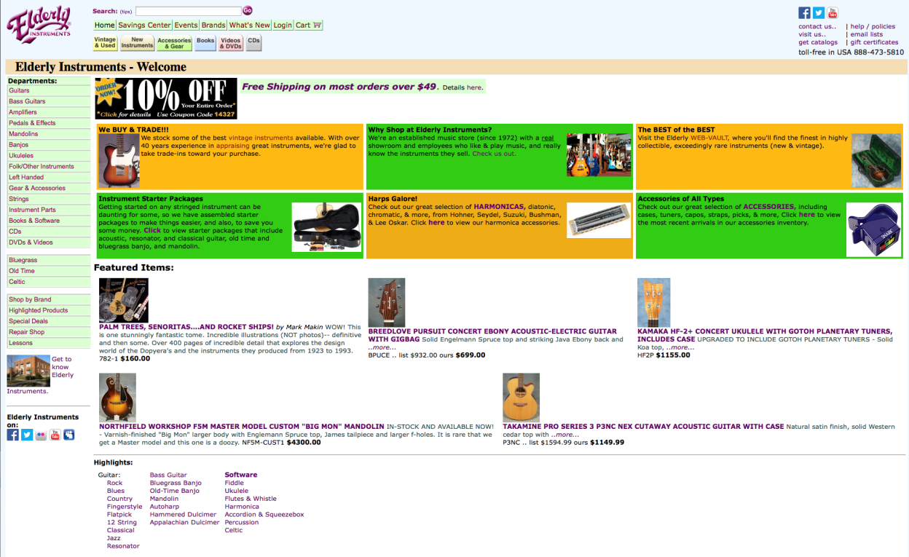
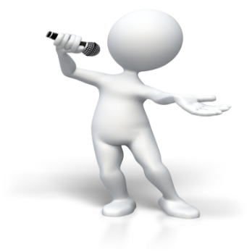
Organic
Landing Page
FREE
Minimal Targeting
Weak Call to Action

Slide 8
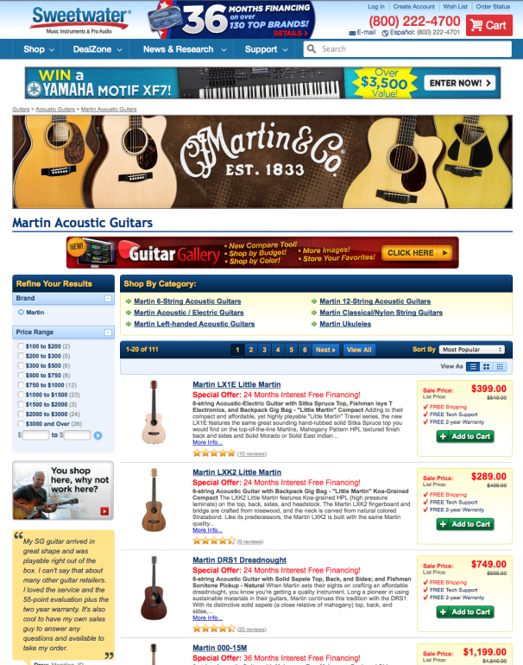
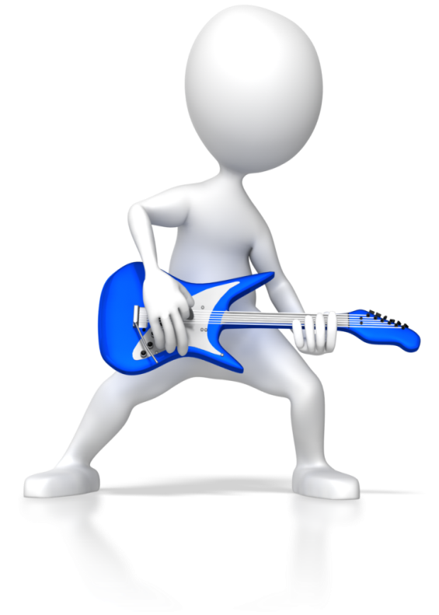
Paid Landing Page
Cost
Targeted
Clear Calls to Action

Slide 9
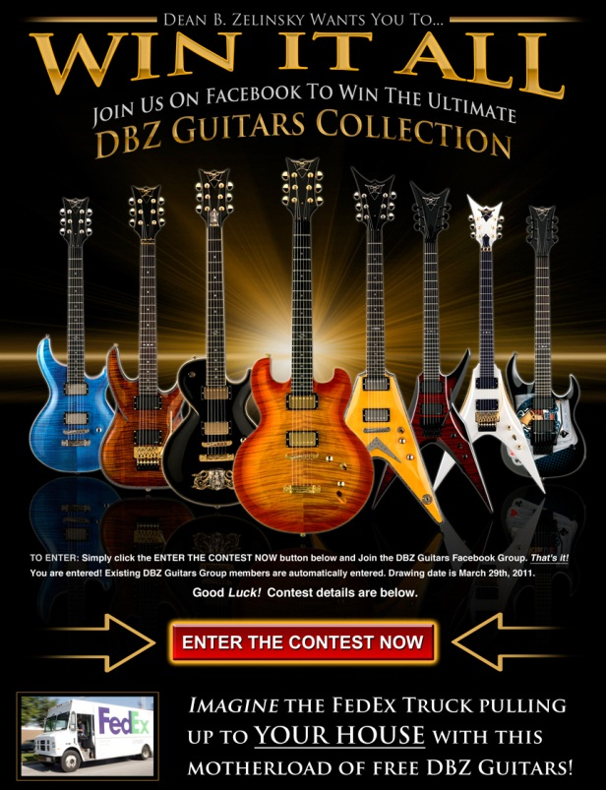
Where Did They Land?
Ad Promotes Brand
Builds Facebook Following
Call to Action

Slide 10
When to Use AdWords
Like all types of marketing tools, AdWords is best used for certain purposes, including when you have a:
1
Competitive or Unique Product
2
Special Event
3
Leverage Competitors Advertising

Slide 11
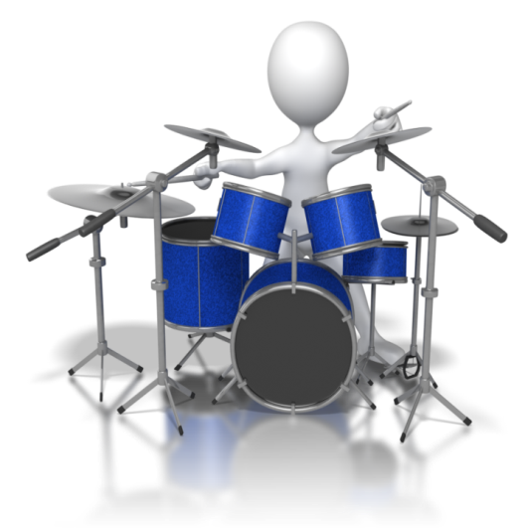
How to Use AdWords
Using AdWords is easy and offers many customizations as you become more adept.
1
Sign up for AdWords Account
adwords.google.com
2
Identify the product to promote
Unique – Hot – Heavily Advertised
3
Create campaign
4
Review and adjust daily

Slide 12
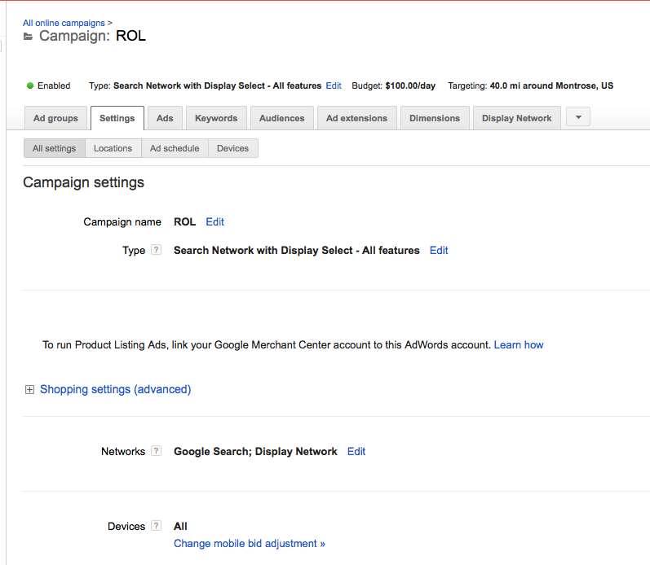
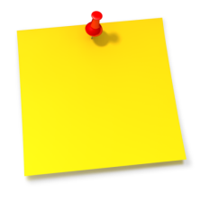
Campaign Settings
There are many ways to tweak and customize your campaign. However, keep it simple to start!
Choose “All Features”
“Search Display”
to start!

Slide 13
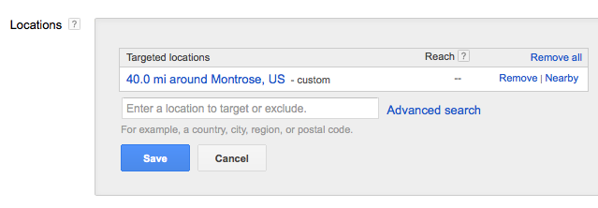
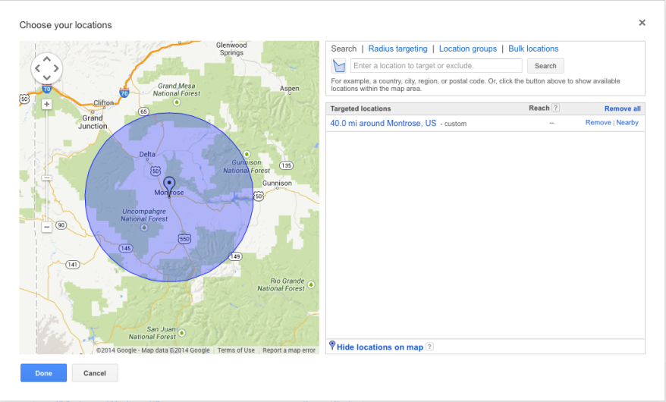
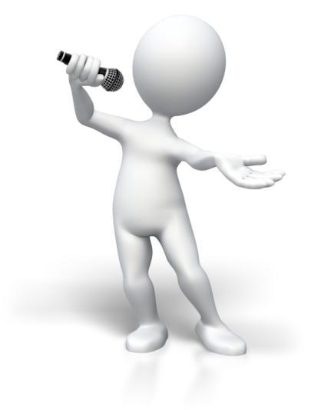
Campaign Settings
Target locations are very versatile. Choose by:
Zip code
Radius around location
State or Country
Location Groups

Slide 14
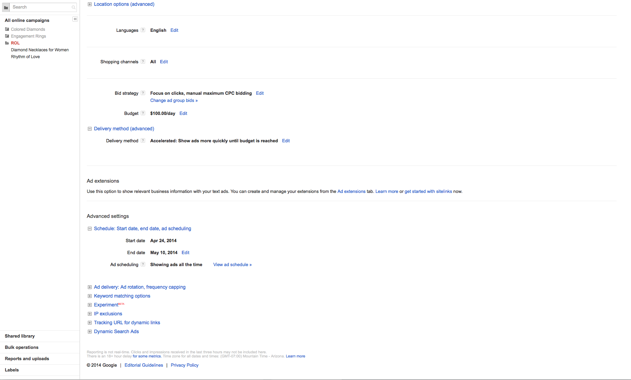
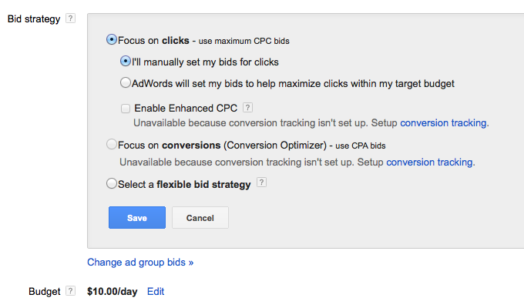
Campaign Settings
Bid strategy is something that needs attention and adjusted once campaign begins. Determine Daily Budget by dividing your overall budget by the number of days your campaign will run.

Slide 15
Campaign Settings
At this time, you cannot reset the start time. However, it is important to set the end date.
Your campaign will end at midnight the day you set it for.

Slide 16
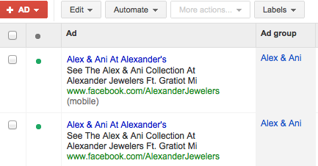
Campaign Settings
Tips:
Start all words with a capital letter
Have name and location in ad
Landing page should support ad
Have a “mobile” copy of each ad

Slide 17
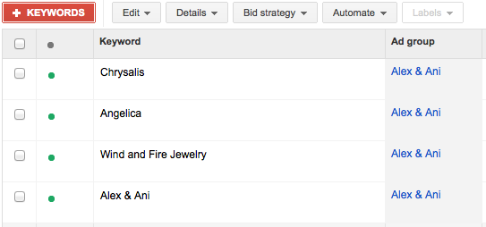
Campaign Settings
Tips:
List any brand name associated with the item you are promoting
List any common misspellings
List common language references to the item you are promoting

Slide 18
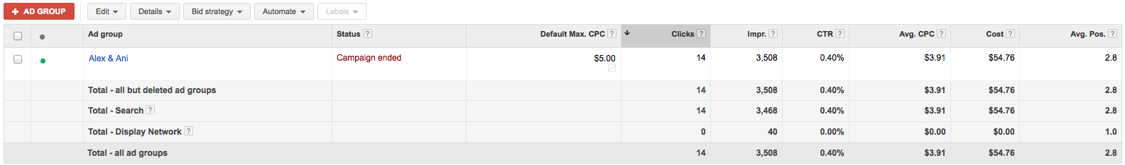
Campaign Settings
Clicks represent interested customers. However, you may also see benefits from your promotion without clicks because they are familiar with your store. A good CTR is sometimes considered 1–2%. However, there are so many factors that there is no hard and fast rule for this number.

Slide 19
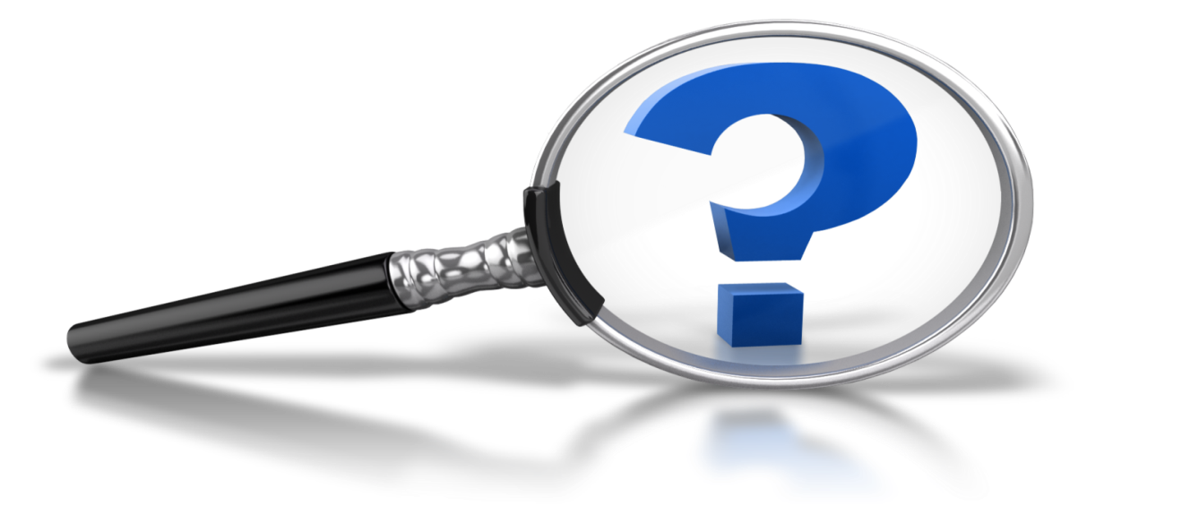
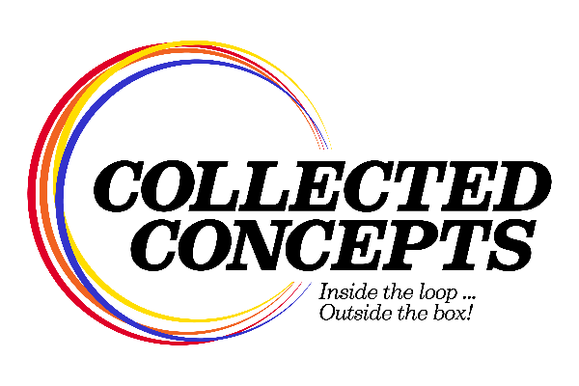
Questions? Comments?
We are happy to help you!
www.collectedconcepts.com
info@collectedconcepts.com
(586) 354-3600

