Slide 1


Take Your Lesson Program From Break-Even to Breakthrough
Donovan Bankhead & Misty Kristek
Notes:
Overview of Springfield Music – where, what, who…

Slide 2

Think of lessons as a
RETAIL service -
something that you sell at a profit
Notes:
We are no longer offering lessons solely as a traffic builder.
We are offering it to make money!
And if we do it well, we’ll get traffic, new musicians, increased retention, community involvement, and all of the other warm fuzzies too!

Slide 3
Create a program…
Worth paying for!
You are selling an experience!
Notes:
Firsts things first: Create a program that people will give you money for!
Pete Gamber is the expert on this, but here’s a quick overview.

Slide 4
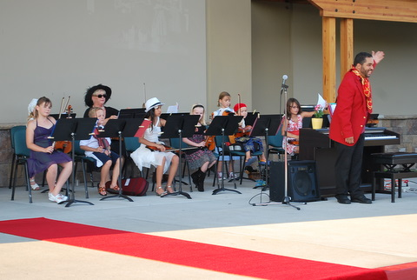
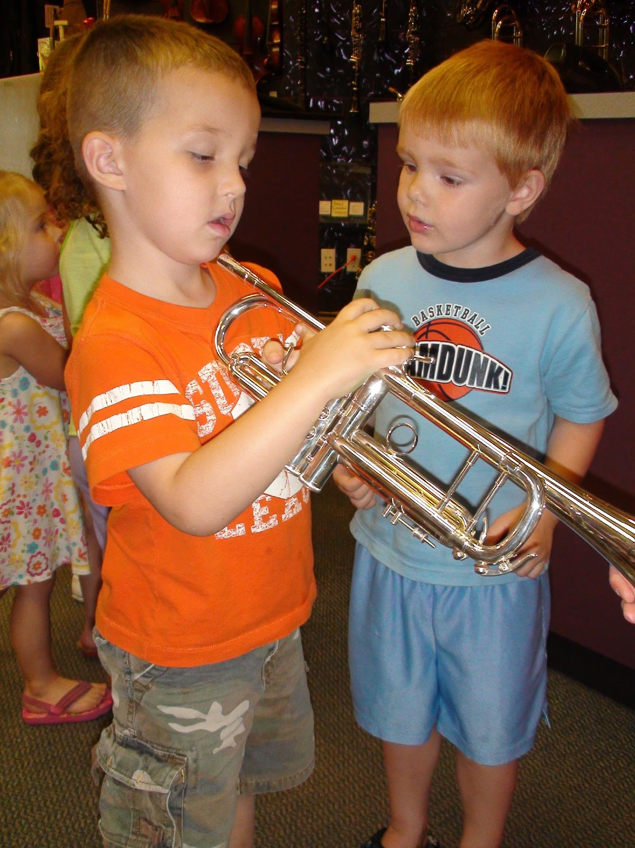
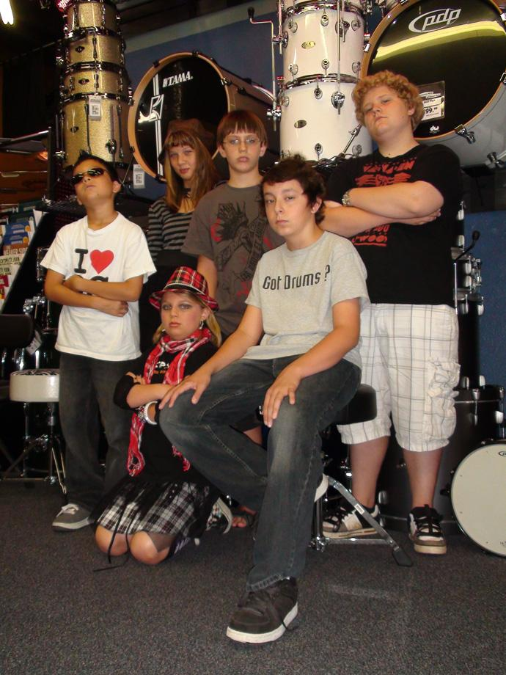



The Experience
Notes:
Too many stores think they are selling education, but that’s wrong. The vast majority of students are there because they want to have fun – not because they want to become a virtuoso.
You are selling a dream! You’re selling fun! Is your program fun?
Is it memorable?

Slide 5
The Environment
You are selling an experience!
Provide a clean, organized space
Notes:
No dirt or debris
Just like anything else you sell, you can’t get top dollar if it’s worn out or dirty.

Slide 6




The Environment
You are selling an experience!
Provide a clean, organized space
Notes:
If you can make room for a stage some where - you can offer ensembles and camps too. It can be simple, or more elaborate.
Good Lighting; Organized

Slide 7
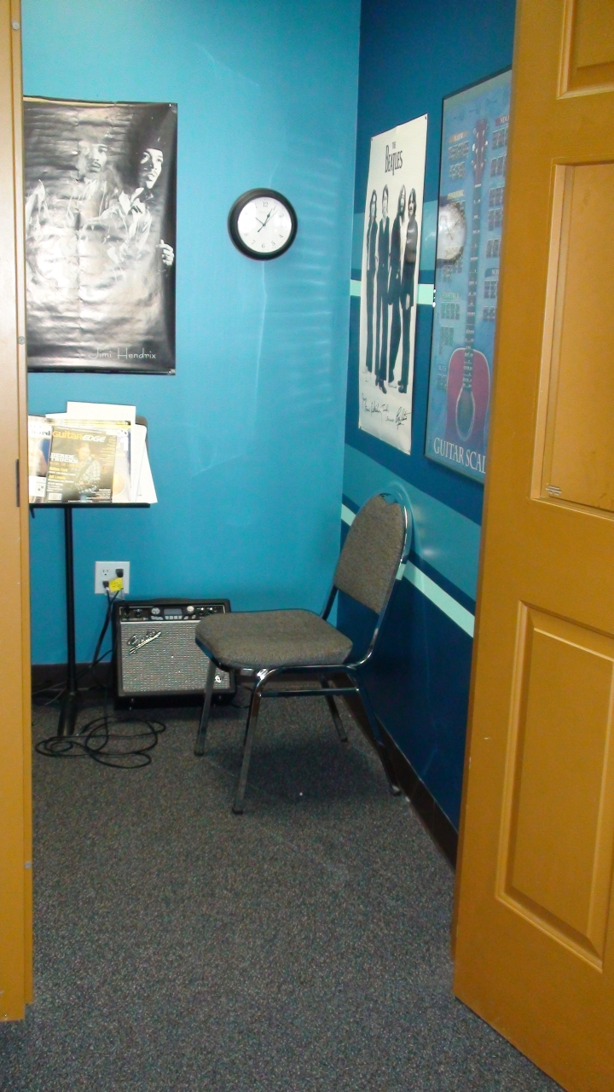
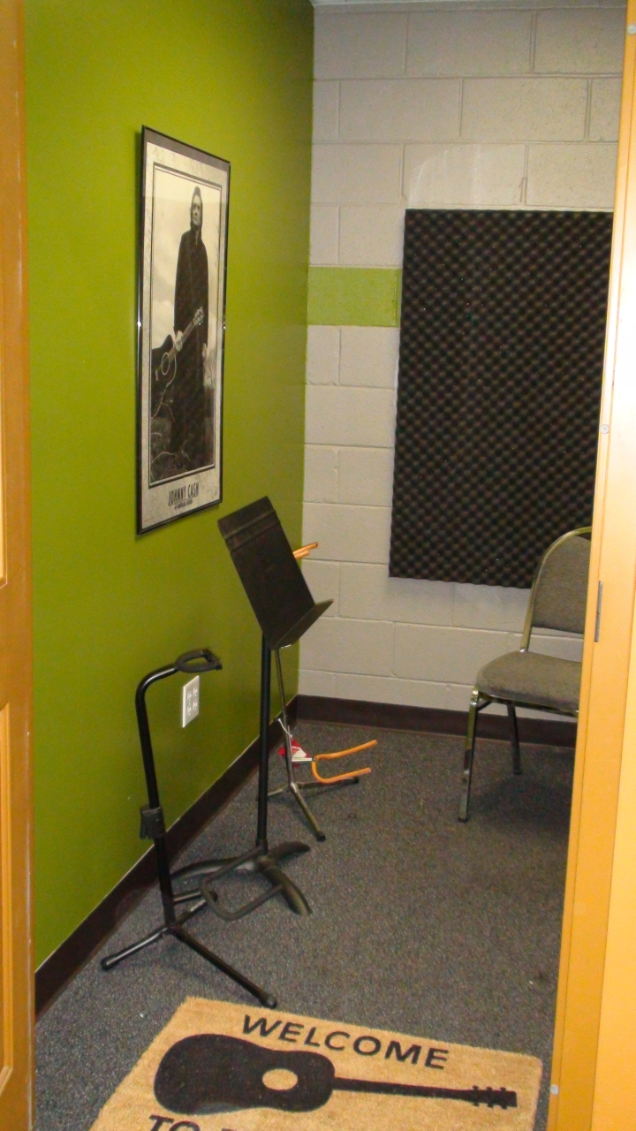
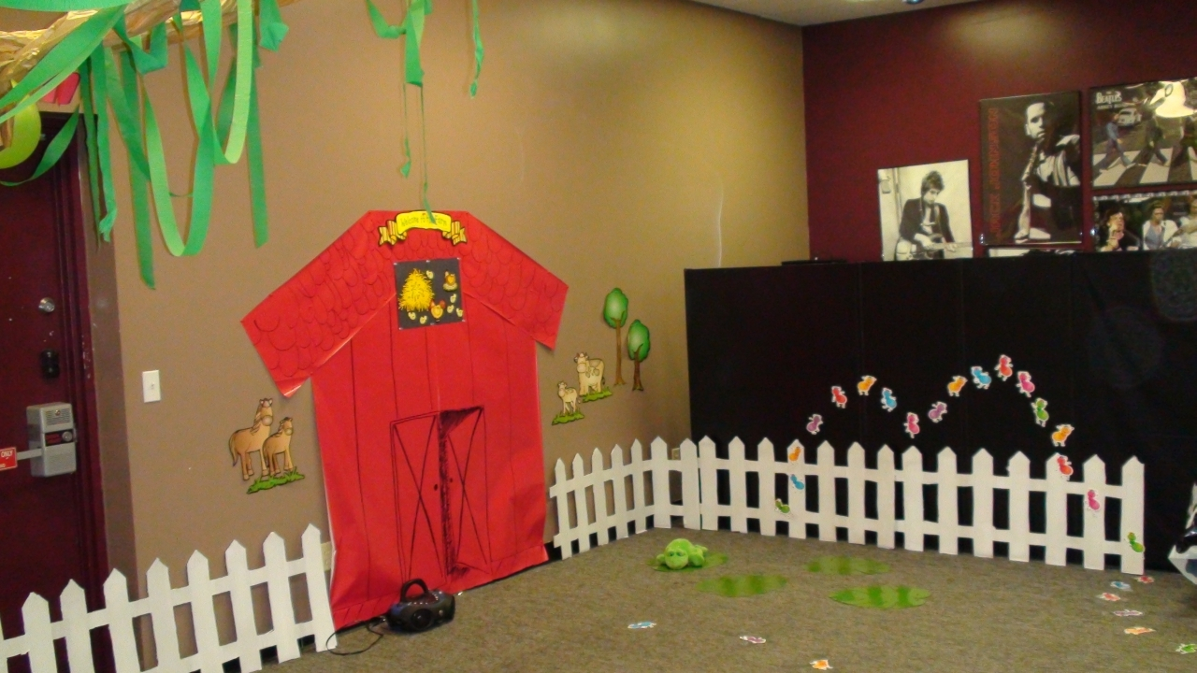
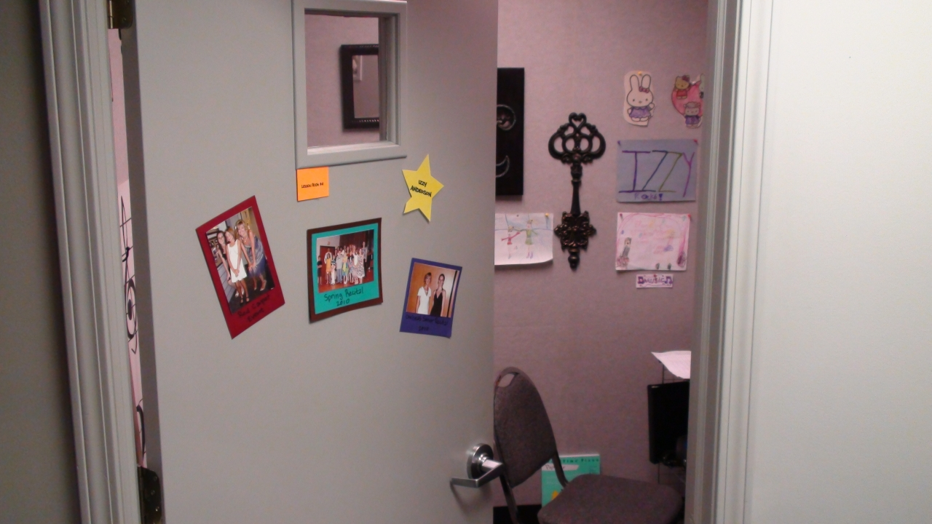
The Environment
You are selling an experience!
Provide a clean, organized space
Notes:
Fun paint colors

Slide 8
The Model
You are selling an experience!
Provide a clean, organized space
Provide cool, current gear in your lesson rooms

Slide 9
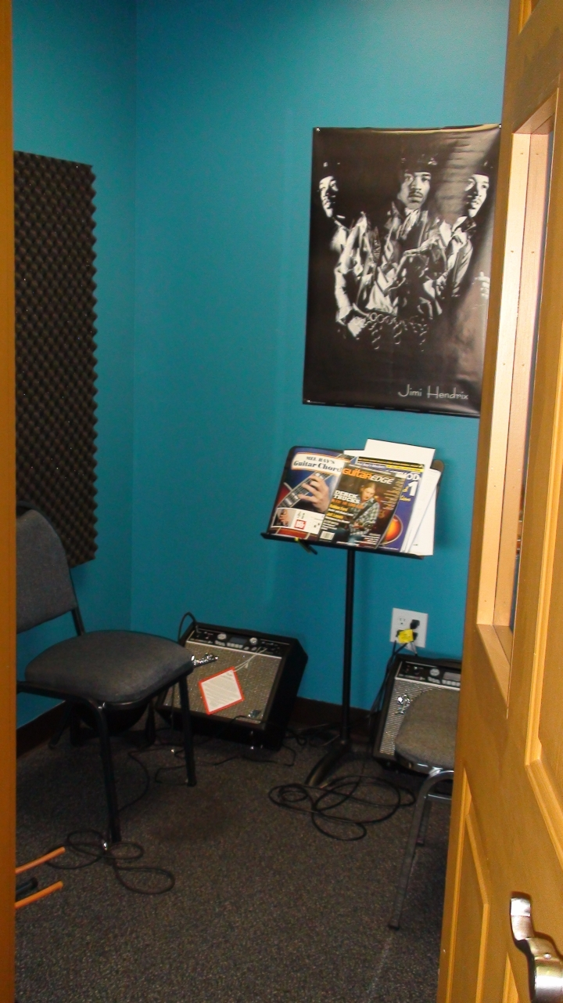

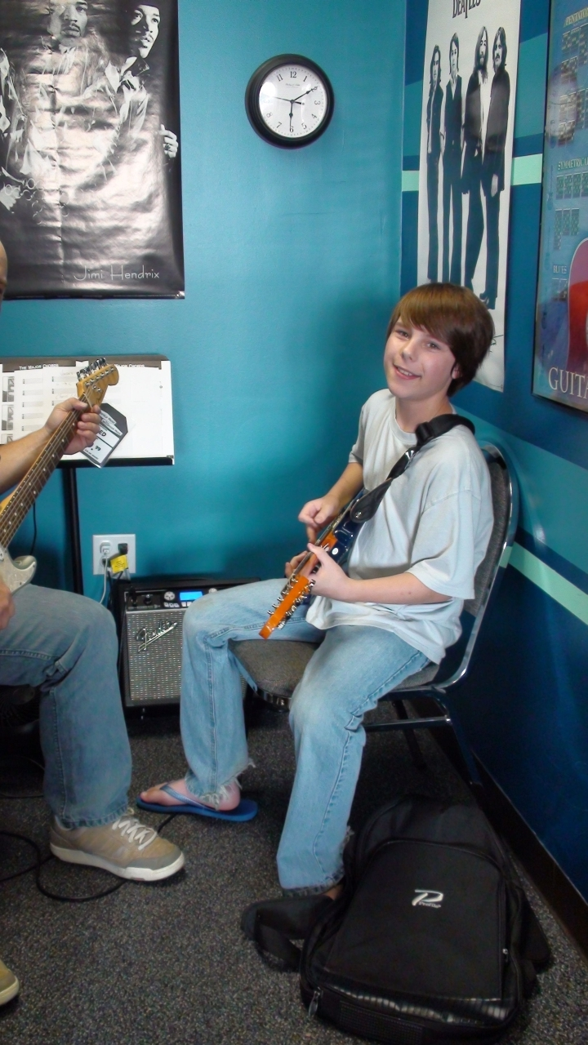
The Environment
Notes:
No outdated, used amps – put the latest cool stuff in there!
Use any cool, current amp THAT YOU SELL that your students might want to BUY
You will have dozens or even hundreds of people per week staring at this gear for 30 minutes per week – make ‘em want it!

Slide 10
With Lessons…
Teacher Payroll = “Cost of Good Sold”
Profit = The margin or spread between what the customer pays and what you are paying the teacher.
You get to keep this!!!
Notes:
Don’t feel guilty about making money – you took the risk in opening a store, you should be rewarded!

Slide 11
With Lessons…
The market rate that
employees (i.e., teachers) will work
and the price that customers will pay
for lessons
ARE NOT EQUAL.
Notes:
Just like what a customer will pay for a guitar is not equal to what you must pay your salespeople, so it is for teaching staff.
Too many stores are overpaying their teaching staff.

Slide 12
What margin
do you need to
survive in your store?
Notes:
This isn’t complicated, is it? How many of us are currently pricing our lessons at a margin that will allow us to survive, or even thrive? :D

Slide 13
The System
We are charging for tuition,
not per lesson
Payment is made regardless of whether the lessons are taught – the customer is paying
for the teacher’s time.

Slide 14
The System
We are charging for tuition, not for lessons
Tuition is pre-paid, before the lessons begin
Notes:
This insures that both you AND your teacher get PAID.
Investigate some form of auto-payment system for recurring payments.
All students must be on autopay, but can prepay to keep autopay from happening.

Slide 15
The System
Hire teachers as employees,
not independent contractors.
Notes:
This gives you much more control over pricing (both lessons {sale on lessons this week/month} and payroll), scheduling, conflicts, problem employees, etc
Different compensation systems – we pay a set dollar amount per student/month, per teacher. Different levels based on teacher’s ability and performance. 100% commission – they don’t get paid until I get paid.

Slide 16
The System: Staffing
Benefits to the Teaching Staff
  Don’t have to collect their own payments
  Aren’t responsible for booking/selling their lessons
  Don’t have to manage their schedule
  Don’t have to find/provide space for teaching
  Paid whether their student shows up or not
  Opportunity for Insurance/Benefits

Slide 17
The System: Staffing
Benefits to the Teaching Staff
  Almost NO responsibilities other than lesson preparation
  Still maintain autonomy over their make-up policies and general input regarding their schedule
  We deduct taxes, pay the employer portion, etc., thus saving them self-employment hassles.

Slide 18

The System: Staffing
Education & Event Admin

Slide 19
The System: Staffing
Education/Lessons Administrator: Main Responsibilities
Administer The Program
  Booking Students
  Create/Maintain Schedules
  Collect & Manage Tuition
Manage the Teaching Staff
  Aid or Oversee the hiring process
  Train New Teachers
  Oversee Payroll
  Prepare and Administer Teacher Meetings
Notes:
Coordinator is compensated for these items.
What gets measured, gets done. What gets measured and bonused, gets done well!

Slide 20
The System: Staffing
Education/Lessons Coordinator: Main Responsibilities
Create New Programs or Concepts
  Summer Camps
  Recitals
  Events
  Community Involvement

Slide 21
FAQ
“My store couldn’t get teachers to work for a salary that low.”
Notes:
Average public school teacher makes $17 per hour. You can certainly find guitar players that will teach guitar for $15-30 per hour.
You are in business to make a profit – not only to provide jobs to needy musicians. If you aren’t making money, you are making a mistake!

Slide 22
FAQ
“If I hire our teachers as store employees, I’ll have to pay taxes and liability insurance.”
Notes:
When else do you have to pay taxes? Anyone? WHEN YOU MAKE MONEY!!!
Taxes are less than 8%, and the add’l insurance is less than 1%. Your increase margin will be MORE THAN ENOUGH to accommodate this slight increase in expenses.

Slide 23
FAQ
“How am I going to manage a lessons program, plus run the store?”
Notes:
DELEGATE - Coordinator

Slide 24
FAQ
“There’s no way I could charge $XX for lessons. People wouldn’t pay it,” or, “The other stores in my area charge less.”
Notes:
The key is to create something that stands apart from the crowd
Create something people WILL pay for!

Slide 25
Review
Create a fun and exciting lesson program that people will pay real money for!
Create a sustainable profit margin for your lessons
Hire people who would love to teach for you at the price you are paying.
Delegate and PAY someone to coordinate, administer, and SELL your new program
And finally...

Slide 26
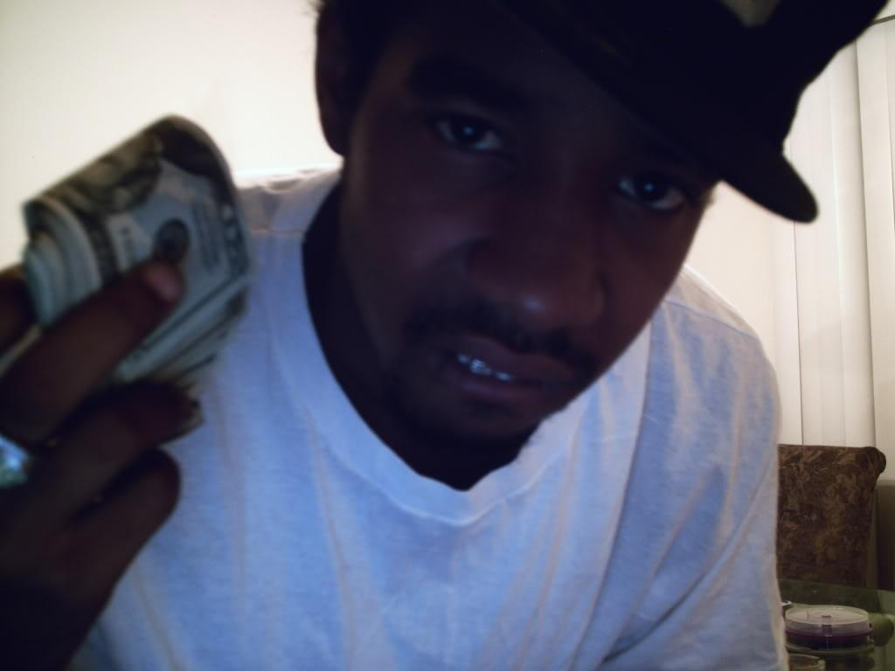




Review
Kick back on a beach somewhere and count yo benjamins!

Slide 27
Questions?
Donovan@springfield-music.com

