Slide 1

Essential Tips for
Selling on Amazon & eBay

Slide 2
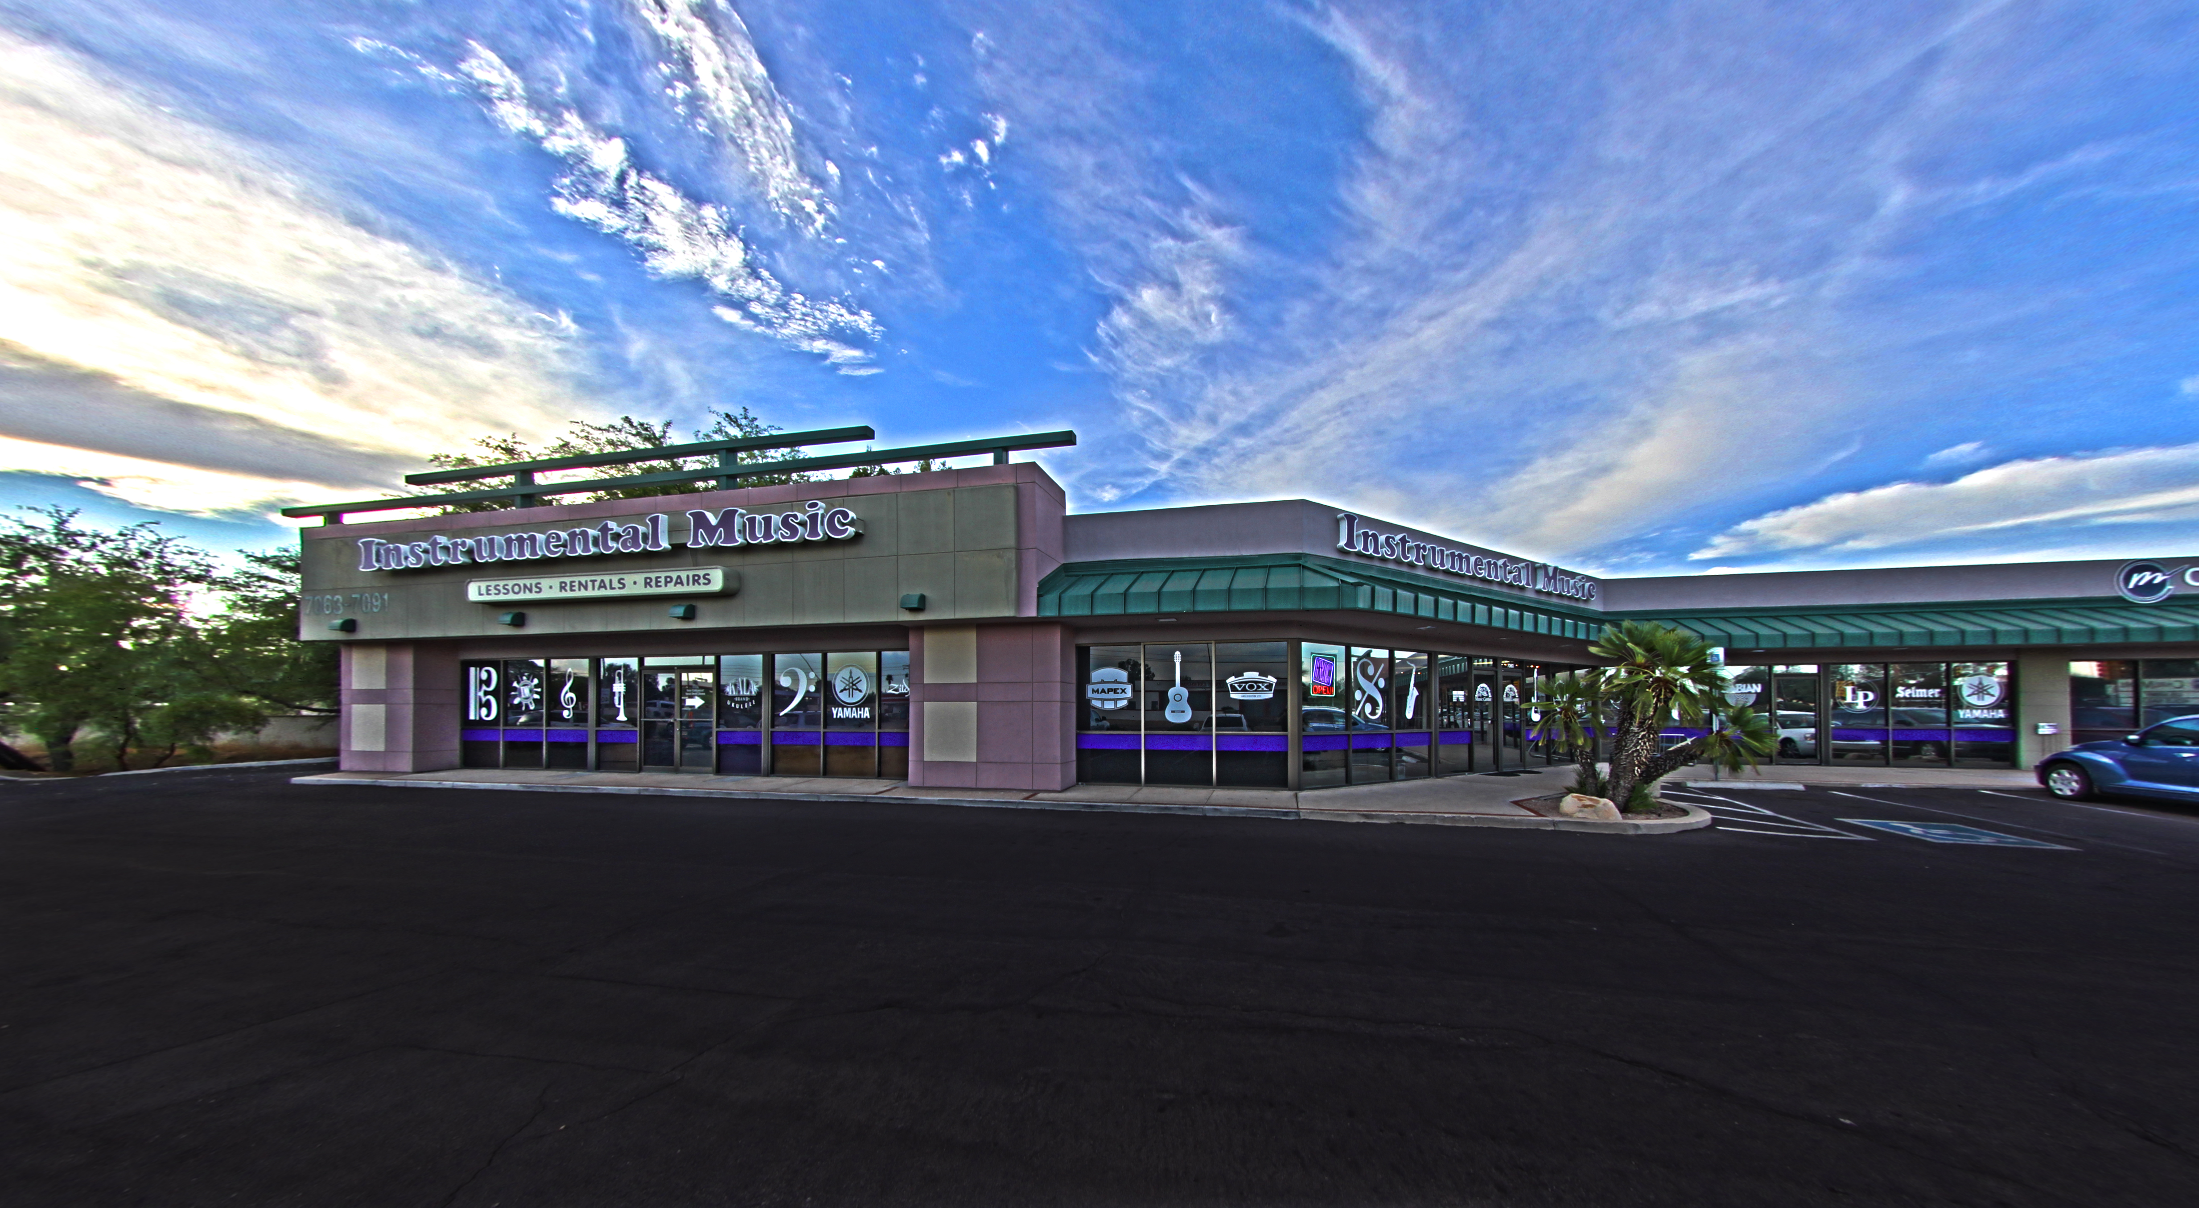
Instrumental Music Center, Tucson
Leslie Faltin co-owner

Slide 3
You can make money and turn product on Amazon and eBay.
You don’t have to like them or agree with their business practices to use the platform.
There will ALWAYS be an “Amazon” or **insert threatening retailer here**…

Slide 4


Slide 5
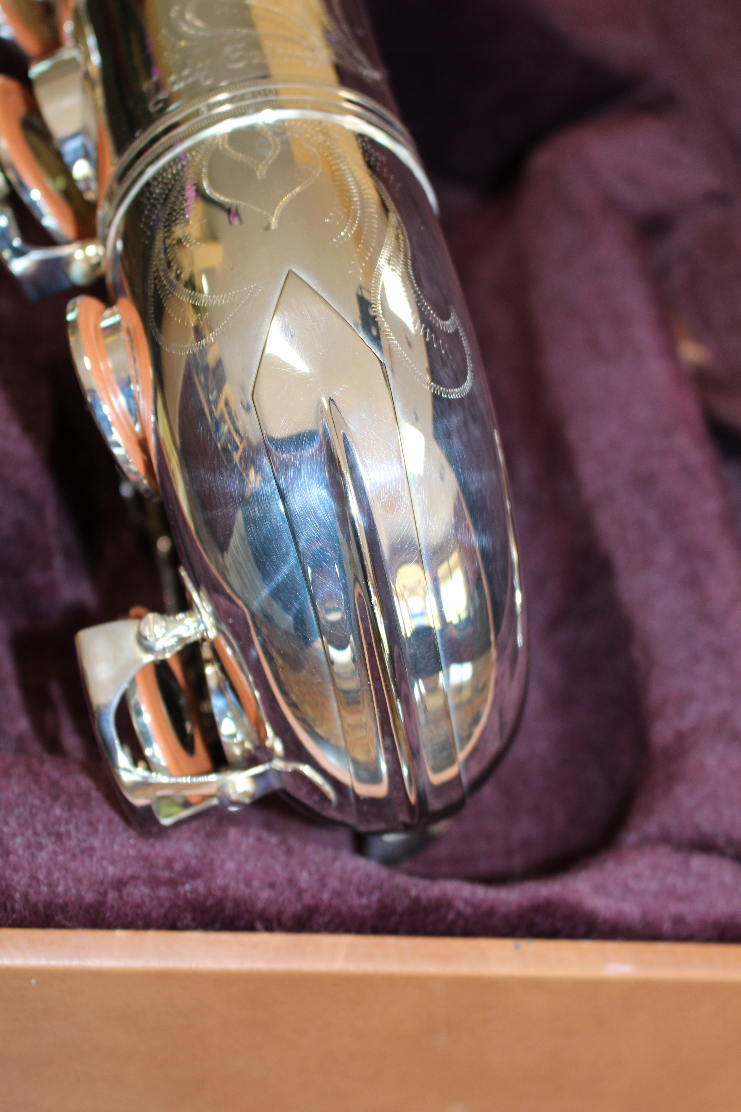

Get yourself a great camera

Slide 6
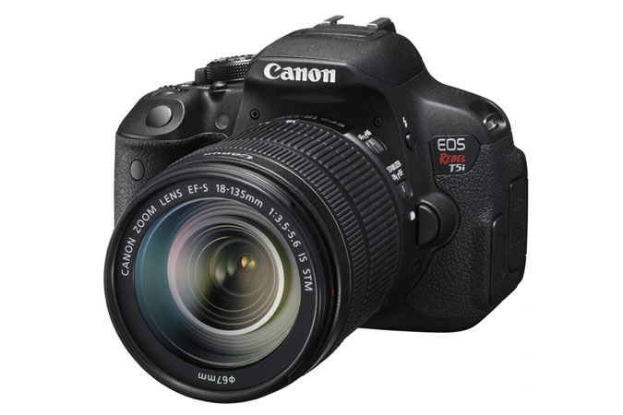
It’s not the mega pixel ratings … it’s the sensor size that really affects resolution
I chose the Canon Rebel T5i DSLR ~$700
  Bought it locally and got a free class!

Slide 7
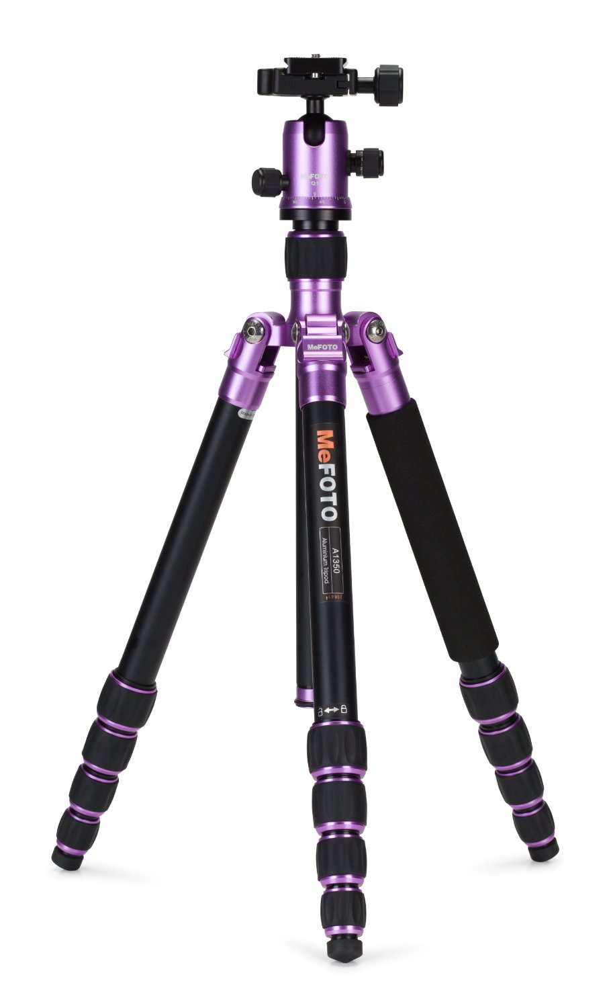
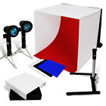
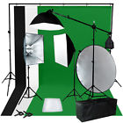
Get things to make your life easier!
  Tripod
  Better lighting
  Backdrops
  Photo editor
    Xara Photo & Graphic designer
    Corel Photopaint
$45
$148
$175

Slide 8
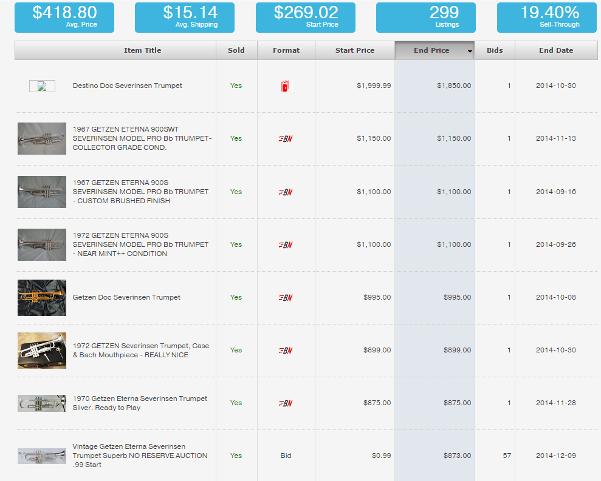
Know Your Market:
www.Terapeak.com
Search for: Severinsen Trumpet
This online site has fine-tuned our trade-in offers and honed pricing for eBay.

Slide 9
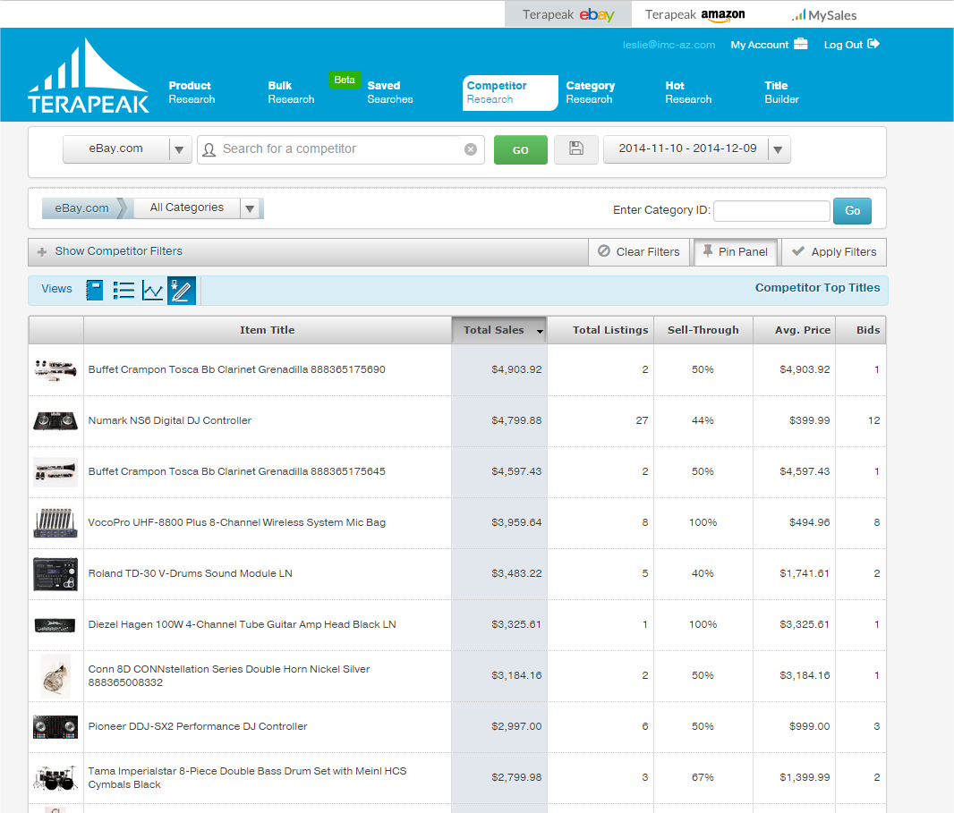
www.Terapeak.com
Research competitors
Find out what is actually selling
This tool is HUGE
A bargain at $7.49/mo

Slide 10
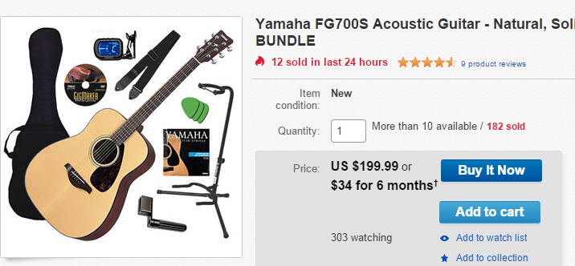
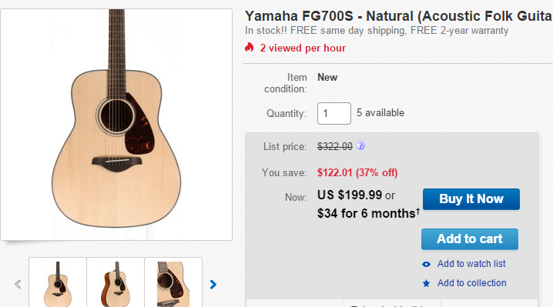
BUNDLE that stuff!
Create packages that provide solutions to people
Pricing concerns usually on product, not the free accessories.
  Which would you buy?

Slide 11
You’re gonna love eBay Global Shipping
+ You ship to a U.S. eBay shipping center
+ There is no fee to join the Global Shipping Program.
+ If the tracking shows acceptance at the U.S. shipping center of four days or less from the date of buyer payment, you'll get an automatic 5-star detailed seller rating for ship time.
(—CONTINUED—)

Slide 12
You’re gonna love eBay Global Shipping
+ Offer free domestic shipping to get an automatic 5-star detailed seller rating for shipping cost.
+ Removes the option to “Mark the value as $5”
+ Completely out of your hands once it gets to shipping center
- Prices appear higher to overseas customers since it includes all import fees

Slide 13
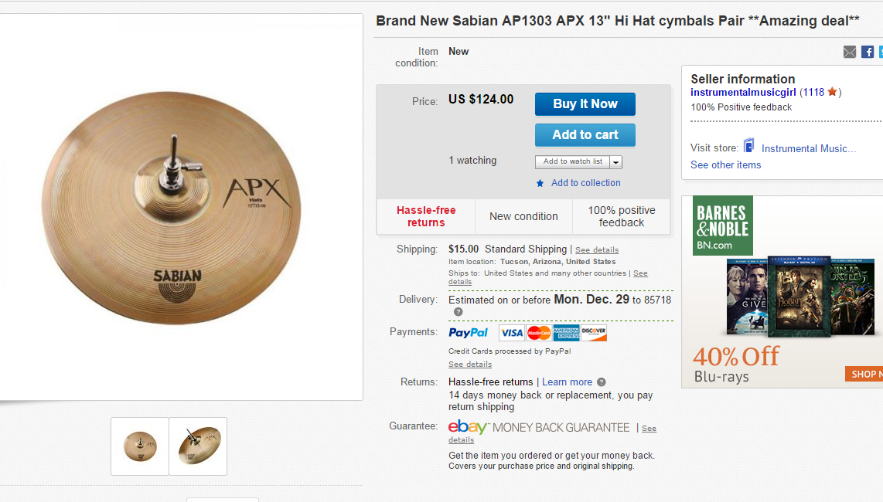
Pick a great selling strategy
Buy it Now
  Great for commodity items
  Great for turning “regular” stock
  Stays listed for 30 days and you can autorelist

Slide 14
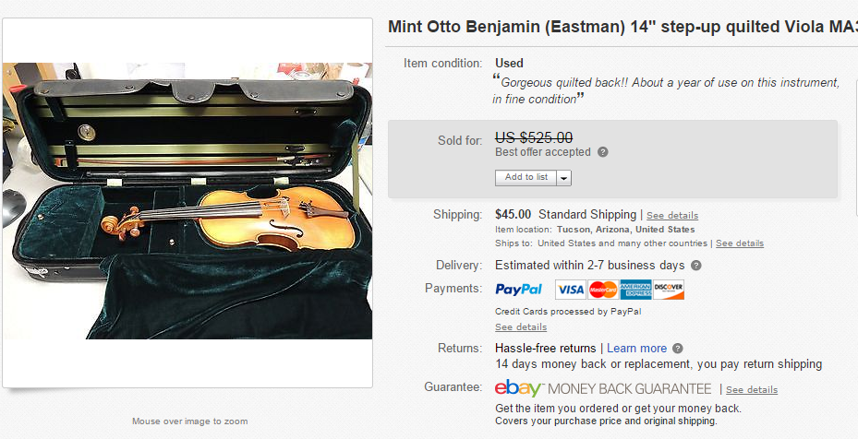
Buy-it-Now with Best Offer
  Customers will send in offers and you decide
  Watch the small print… they may sneak in “free shipping” as part of the deal
  Great if something has an unknown value or isn’t getting interest with just Buy-it-Now

Slide 15
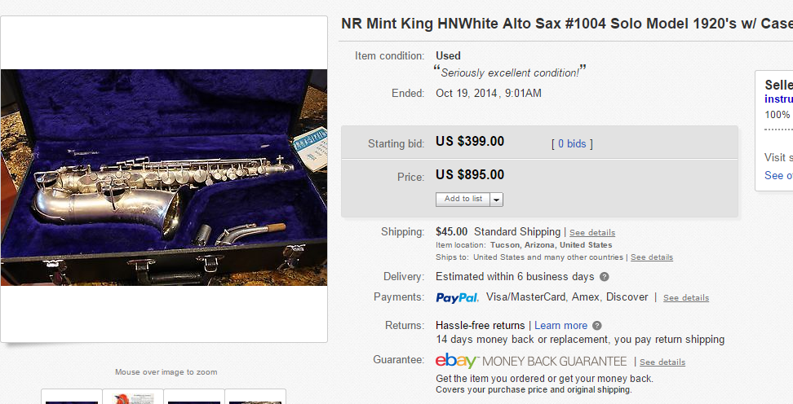
Auction with reserve
  Know what you want for an item? Start it there
  All auctions should end on a weekend

Slide 16
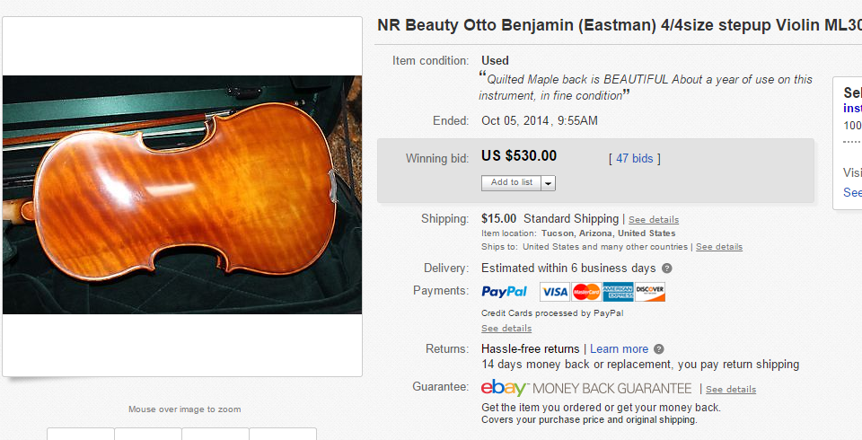
Straight Up Auction
  Market will dictate what it’s worth
    Pro … sometimes it goes for more than you expect
    Con … sometimes it goes for a song
  All auctions should end on a weekend

Slide 17
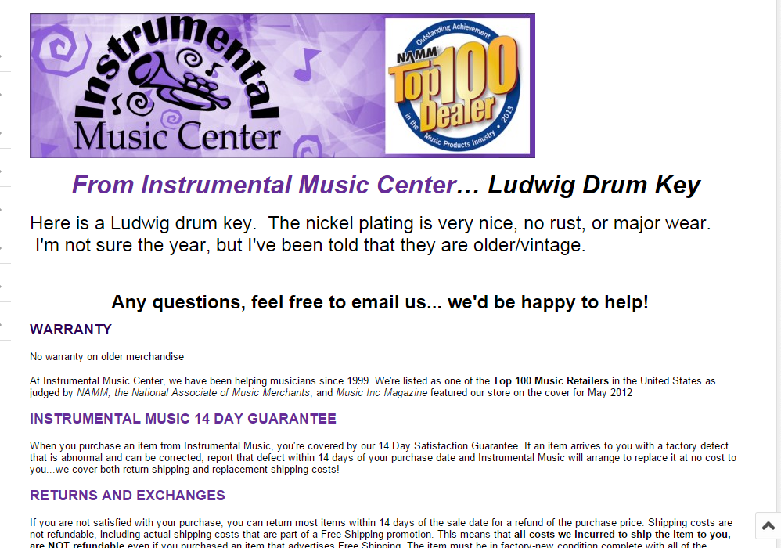
Create your identity
Customize your “look” by adding logos
  Host them on Imgur or Photobucket, then paste the graphics link into the HTML when creating your listing.
  Use this as a template, then edit as needed

Slide 18
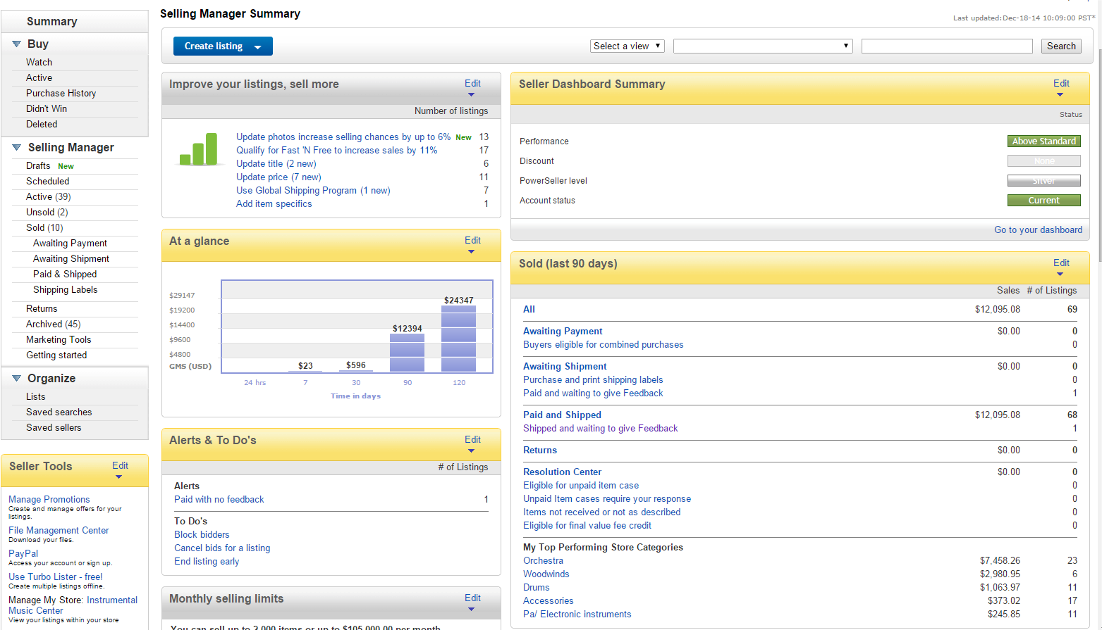
Shoot for Top Rated + Status
The Top Rated Plus seal displayed prominently
A 20% discount on final value fees
Improved search standing
USPS Commercial Plus pricing

Slide 19
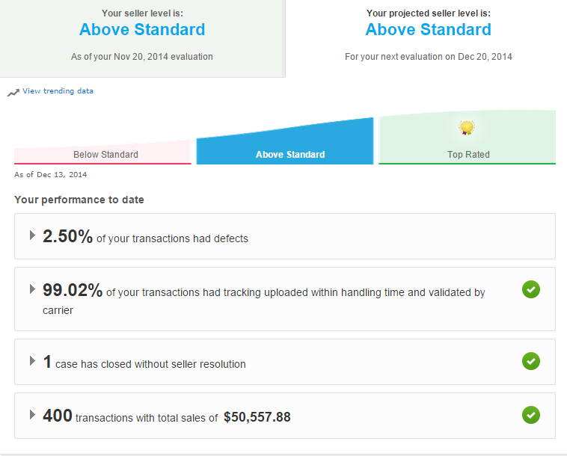

Active for 90 days
100 transactions and $1000 in last 12 mo
Defects <2%
14 day returns
1 day handling

Slide 20
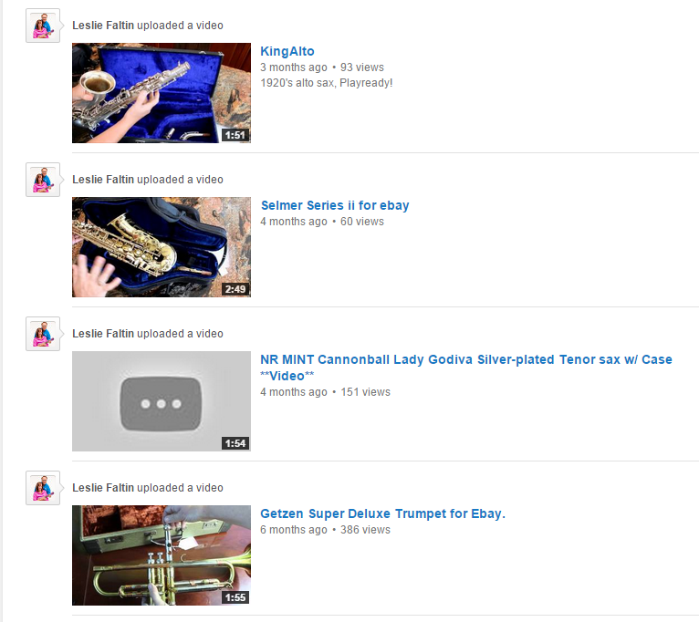
Include videos
Detailed videos give customers confidence
Go thru the whole horn… show the good and the bad
Then upload that video to YouTube.com
  Be sure to tag them!

Slide 21
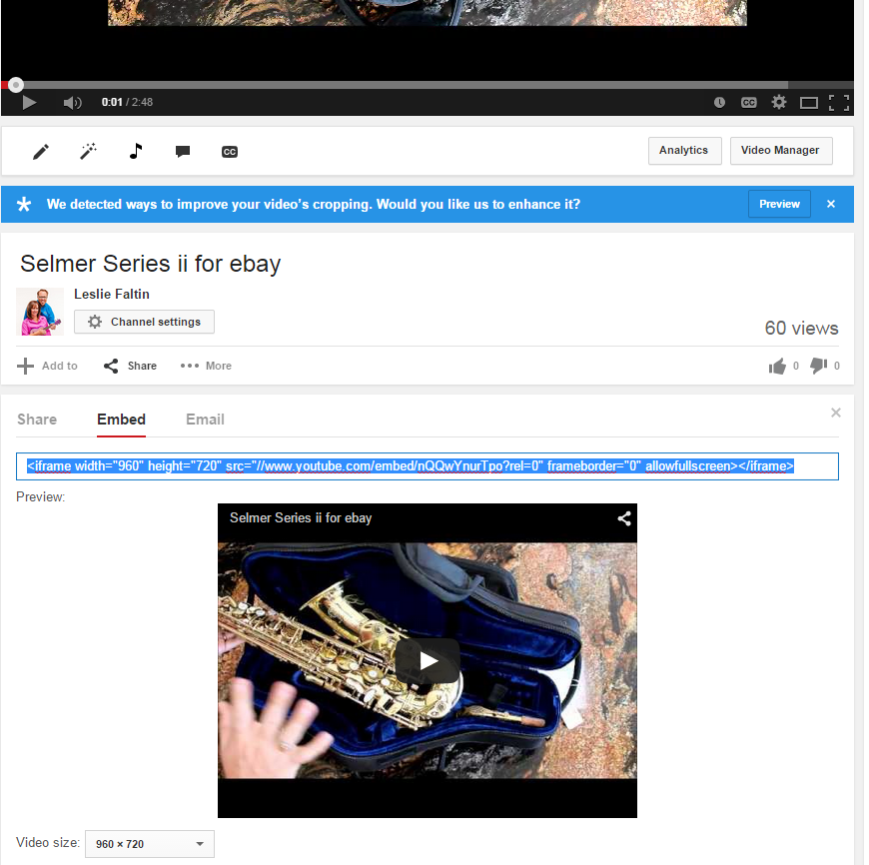
From the video’s page, click Share
Click Embed
Choose the video size (mid-sized is good) and copy that link

Slide 22
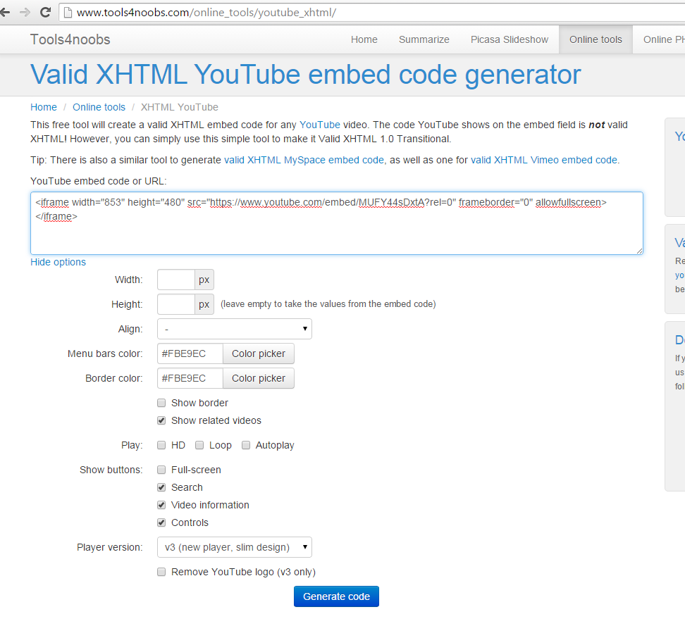
If your YouTube embed starts with <iframe, it needs to be changed to the “old embed code”
Google “old YouTube embed code”
  Or head to Tools4noobs.com
Paste in the code that starts with <iframe and the site will give you the code you need.
Copy that generated code… it will start with <object type=

Slide 23
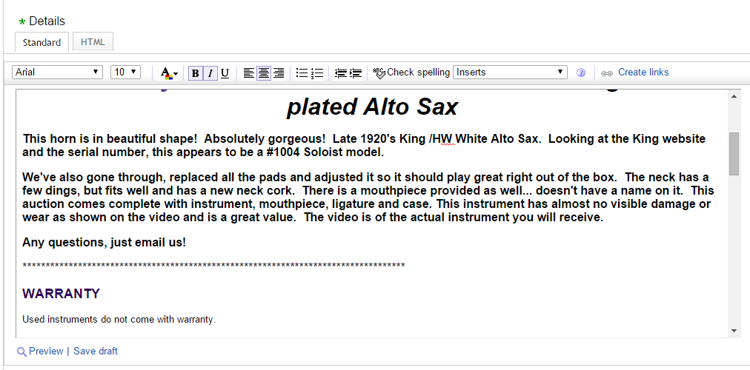
Head back to eBay…
In the Details section type in a line of *****
Then click the HTML tab

Slide 24
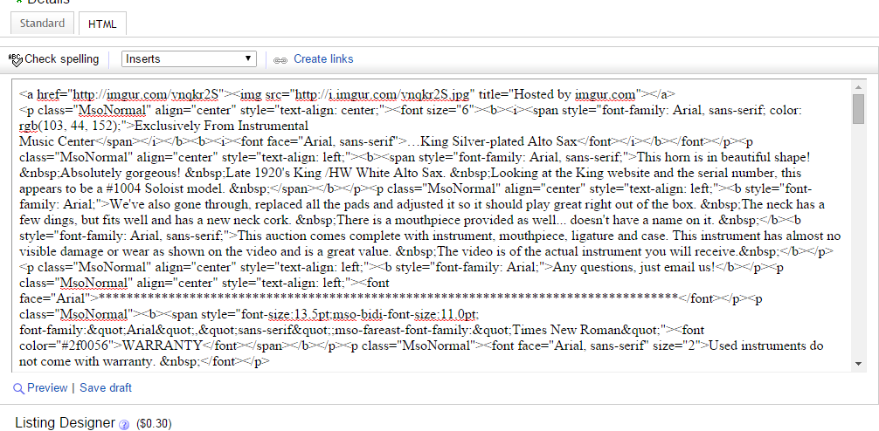
Paste your embedded link between >< right after your line of **

Slide 25
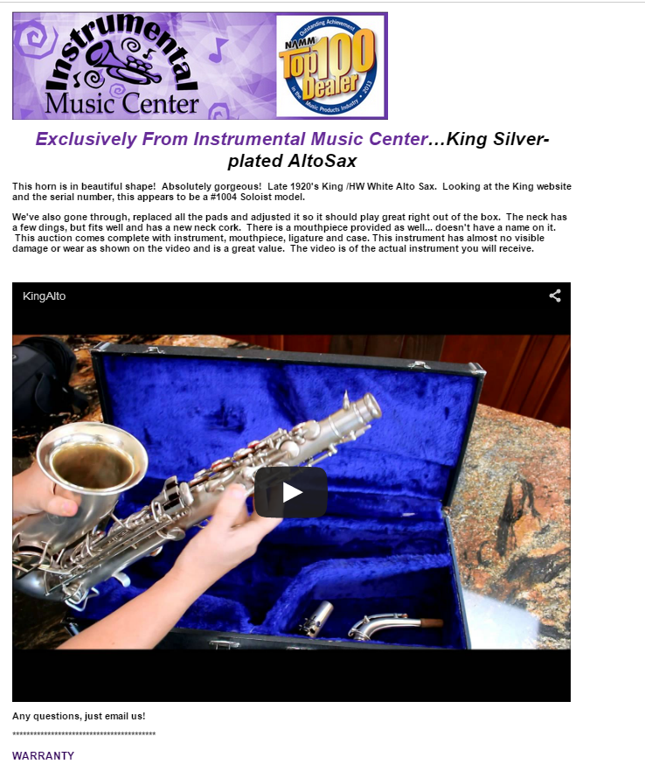

#1

Slide 26
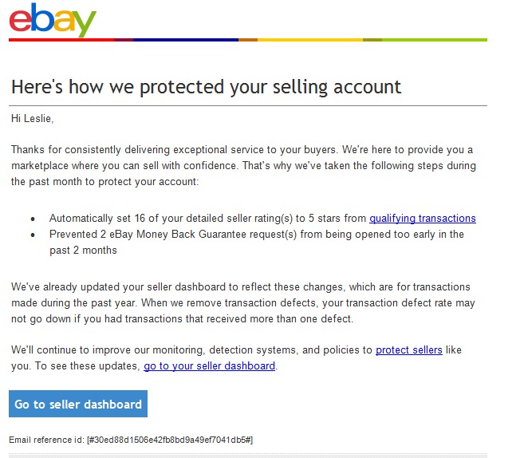
eBay is trying to help you
They don’t sell to your customers.
They are attempting to be more seller-friendly
Site is somewhat clunky … but is functional.

Slide 27


Slide 28

The house has the advantage
They will own the “buy box”
They encourage consumers to use your store as their showroom
They are your competitor, and you know they see our stores as such.

Slide 29
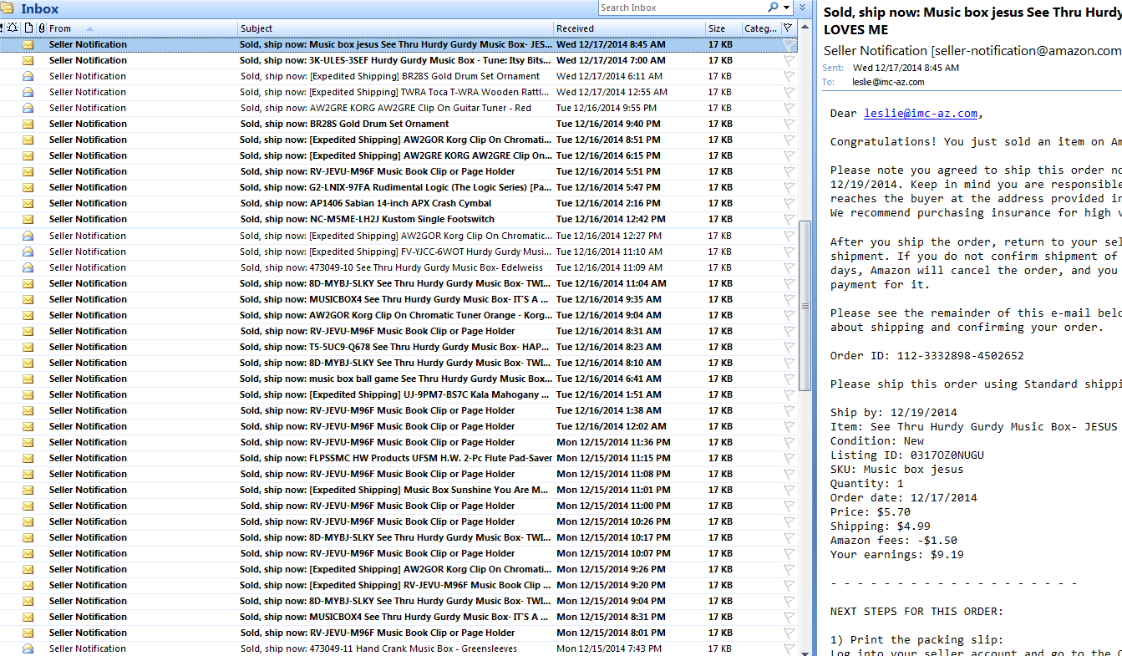
There are tons of customers there if you can find a money-making niche
Customers looking for ease, perceived bargains or lack of interaction
Can be operated by one staffer or a team … get as big as you want.
New products/commodity stuff is best on this platform.
  Great place for weird *New Issue* print music

Slide 30
Go ahead and market yourself
Insert marketing material, coupons, etc. to encourage customers to shop at your store directly.
Get a call/email with questions?
  We do what we can to book that sale directly

Slide 31
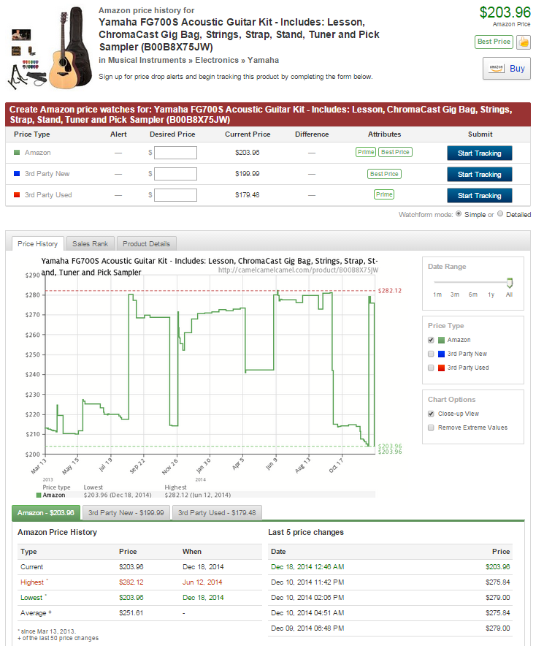
Use those market tools
Camel Camel Camel.com
Free Amazon price checker
Shows historical price data
Terapeak
Allows competitor research
  Great way to see what is working for other strong music retailers

Slide 32
Roll with the punches
The wrong thing will get sent to the wrong person
People will claim they never got it
Product will be returned damaged, and they said they got it that way
Customers will threaten lawsuits because you ran out of stock
Lack of empathy from customers. Be prepared to deal with the unexpected.
In our experience, there is generally a lot less fraud in Amazon payments than eBay

Slide 33

Sources for “help” are not helpful.
  3p-mi@amazon.com given out at Summer NAMM 2014 to help dealers set up selling accounts
    Their only responses to my questions were … that they couldn’t answer my questions.
  Difficult issues often go into black hole for 45 days
    FBA returns are a disaster
    Arbitrary deductions from account for “defects” without your knowledge or approval

Slide 34
The good and bad of fulfillment by Amazon
Good news…
Offers people “Prime” shipping
Often earns that buy box … even if yours is more expensive
Bad news…
Fees for storage, fees for administering
If you don’t choose correctly, your serial number could be sold under another seller’s name
Returns are whack

Slide 35
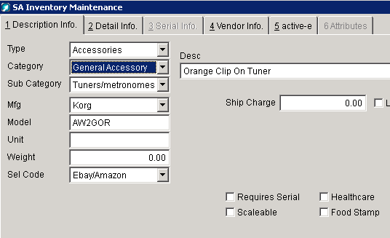
Watch your inventory
If your POS is not hooked to Amazon/eBay … you could run out of something in store and still have them listed online.
Aimsi
  Selection Code and consistently run reports of sold product for items listed online

Slide 36
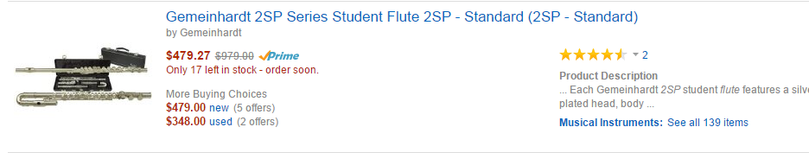
Beware of the crowd-sourced listing
Wrong images are often uploaded by customers or another seller
  Getting them changed / corrected is next to impossible
Many important details in existing listing are incorrect
  Can lead to returns … even if you did everything right

Slide 37
Move your stuff on an friendly, easily controlled, customizable platform.
TONS of volume when you find your niche. Just like selling at someone else’s music store.

Slide 38
Instrumental Music Center, Tucson
Leslie Faltin co-owner

