Slide 1


Slide 2

Structure Your Business for Success
Donovan Bankhead
Springfield Music

Slide 3


Notes:
Who all has read this book? {if lots of people raise their hands, tell them thanks for coming and walk off the stage}

Slide 4

Notes:
This is how most store owners/managers feel

Slide 5
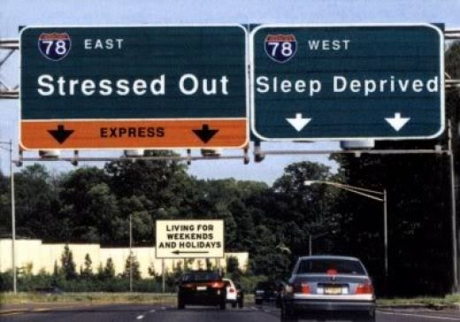

Slide 6

Notes:
Being stressed out can cause them to take it out on their coworkers

Slide 7

Notes:
or family

Slide 8
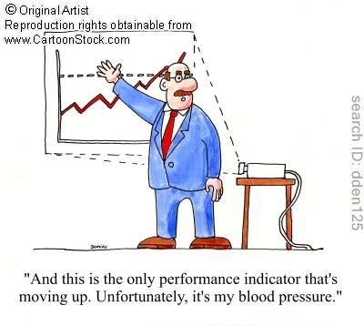
Notes:
Or themselves

Slide 9
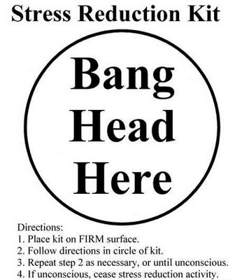
Notes:
And there are better solutions than this.

Slide 10
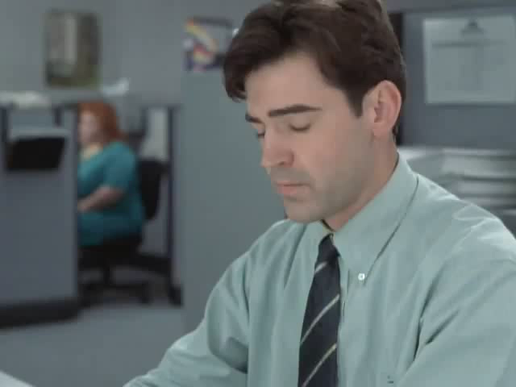
Notes:
Without turning into this guy…

Slide 11
Key Departments
Sales
Marketing
Operations
Accounts Payable
Management
Executive
Inventory Control
Notes:
Newer business – this will be very useful to you. Established business – challenge yourself to examine if you are REALLY doing these things well. First assume that you aren’t as good as you think, and then really examine it.
Sales – without this, you may not need any of these others. :D
Ops: restock, merchandising, cleaning, projects, receiving
Inventory Control: BUYING & controlling amount of inventory
AP: pay bills on time, advise of cash flow issues, etc
Marketing/PR/Promotions
Management – someone’s gotta make sure all these people are doing their job!
Executive – someone has to watch the managers! And watch financials, but most important, steer the ship!

Slide 12
Possible Departments
Accounts Receivable
Education (lessons)
IT
Repair
Notes:
A/R – if people owe you money, someone needs to be responsible to collect it. This would also include a collections person, and possibly repossession if you do rentals/in-house financing.
IT – this really should be a key department, as I can’t imagine being in business today without using computers, a POS, etc.
Repair
Ed. Coordinator

Slide 13
Typical Structure
Sales
Operations
Marketing
PR
Promotions
Accounts Payable
Accounts Receivable
IT
Repair
Lessons
Management
Executive
Inventory Control
Notes:
This would be typical for a full line retailer.
Notice that the mgmt/executive boxes aren’t bigger than the rest. We all have a role to play on this team. I don’t get into hierarchies, but rather responsibilities.

Slide 14
Most Overlooked Departments
Sales
Operations
Marketing
PR
Promotions
Accounts Payable
Accounts Receivable
IT
Repair
Lessons
Management
Executive
Inventory Control
Notes:
These 6 are the most overlooked

Slide 15
Most Overlooked Departments
Sales
Operations
Marketing
PR
Promotions
Accounts Payable
Accounts Receivable
IT
Repair
Lessons
Management
Executive
Inventory Control
Notes:
IMO, this is one of the worst run departments in any music store, so I’m starting with the most important.
Duties include: CLEANING – THE #1 FAIL FOR INDIE’S, Restocking, merchandising, Projects, Receiving Inventory
Assign people to this team, but someone MUST be the Ops Supervisor/Mgr/Whatever. This person’s KEY role is Ops. They can also serve other roles, but they exist in your organization for this purpose!
A well run ops team will keep your store from looking like this:

Slide 16
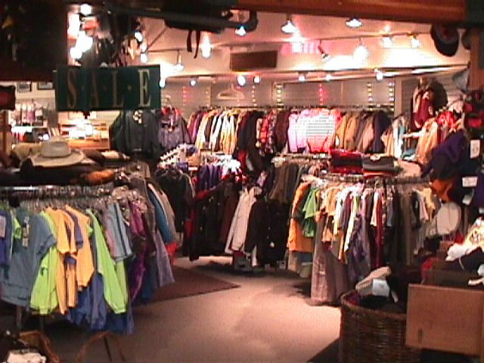

Slide 17
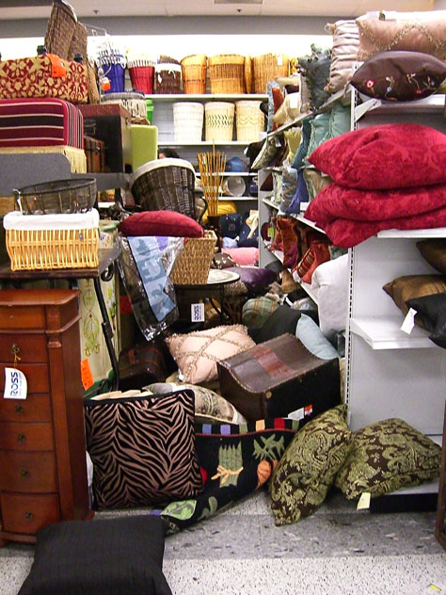

Slide 18
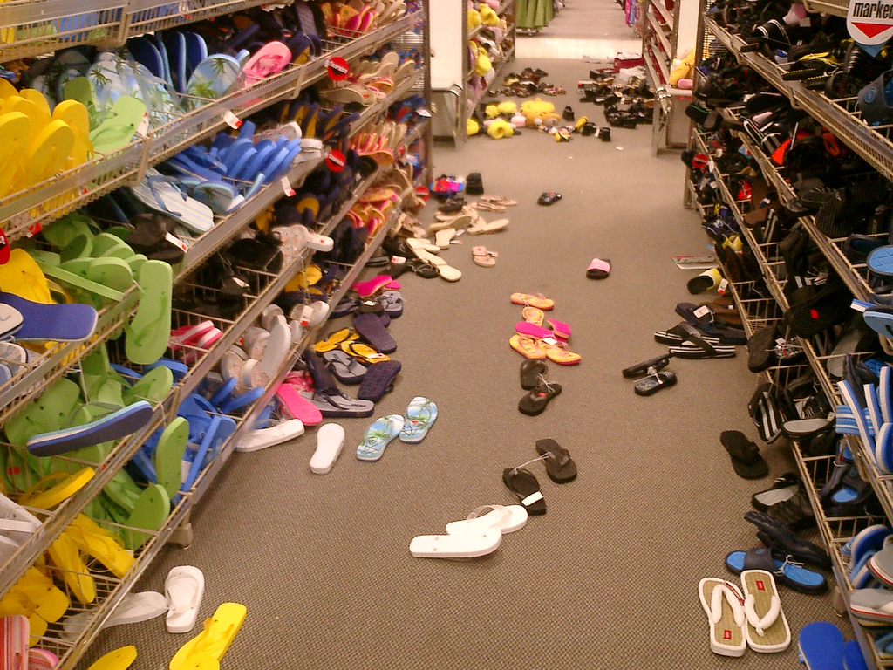

Slide 19
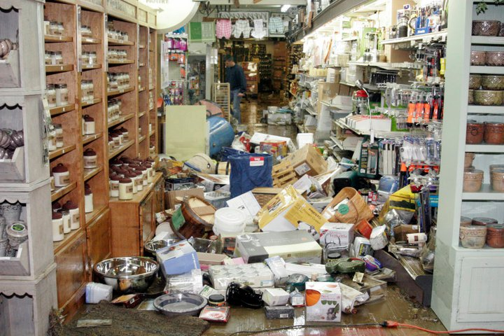
Notes:
And instead look more like this:

Slide 20
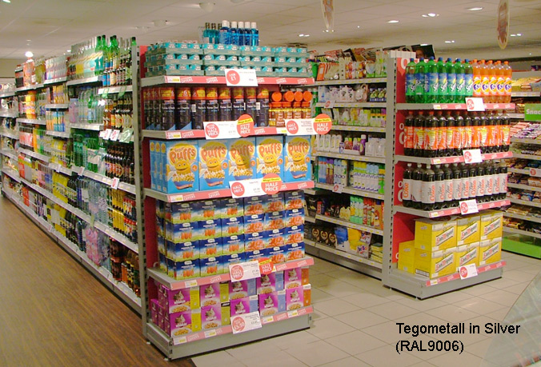

Slide 21

Notes:
If you don’t create a great looking, comfortable store environment, your customers will be woo’ed away by other business, and your store will starve to death.

Slide 22
Most Overlooked Departments
Sales
Operations
Marketing
PR
Promotions
Accounts Payable
Accounts Receivable
IT
Repair
Lessons
Management
Executive
Inventory Control
Notes:
Won’t spend much time on this – if I did, Alan Friedman might actually have to do some accounting or something!
But it’s the second biggest problem in most stores, IMO.
Just know that guitar stores problems isn’t that they don’t have enough inventory, but that they have TOO much!
Not always the problem with smaller, full line stores. They key is to merch in a way where you look full, but still maintain a good GMROI (over $1 store wide).
If not handled properly, you’ll spend your way out of business.

Slide 23
Most Overlooked Departments
Sales
Operations
Marketing
PR
Promotions
Accounts Payable
Accounts Receivable
IT
Repair
Lessons
Management
Executive
Inventory Control
Notes:
YOUR SERVICES MUST BE A PROFIT CENTER! Your retail is being taken away by big box stores and amazon and ebay, but it’s very hard to outsource service!
Lessons, when run correctly, have one of the most profitable ROI’s in your entire company. How to do this is outside the time restraints of todays session, but suffice it to say that if it’s a key financial contributor, then someone MUST be in charge of promotion, sales and management.
I have a session on this, ask NAMM to have me back to do it in January!
Quick tip: consider breaking this job up. Have a “Lessons Sales” person, and then have your A/R or office personnel handle the administration (schedules, payments, etc).

Slide 24
Most Overlooked Departments
Sales
Operations
Marketing
PR
Promotions
Accounts Payable
Accounts Receivable
IT
Repair
Lessons
Management
Executive
Inventory Control
Notes:
Marketing/PR/Promotions: when small, it’s often the owner that does this. However, if you don’t have a knack for it, hire someone who does! (Outsource, FT/PT, intern doesn’t matter). You must get out there and make the public aware of your presence. You must constantly find new customers JUST TO SURVIVE!
If you don’t position yourself, your competition and customers will.
A good marketing/pr person will position you in the community.

Slide 25
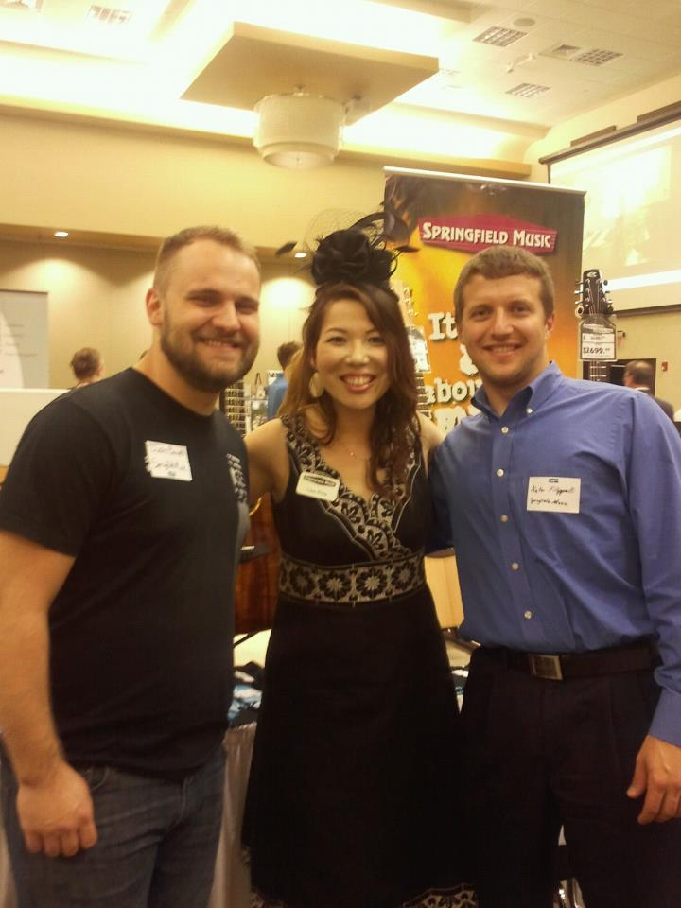

Slide 26
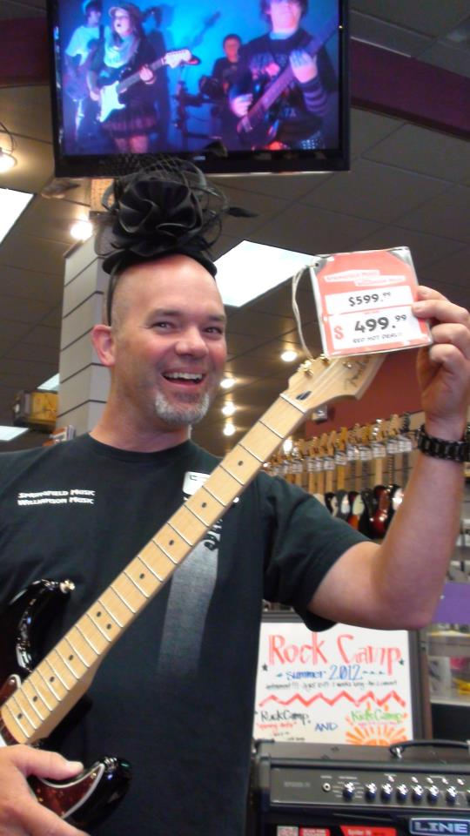
Notes:
Notice the kids on the tv in the background. We mentioned their parents names in this facebook posts, which made them aware of this posting, and they could like or share with the friends.

Slide 27
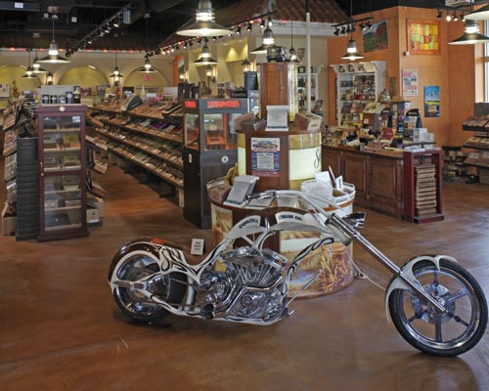
Notes:
A good marketing/PR person will come up with these ideas BECAUSE THIS IS WHY YOU ARE PAYING THEM!

Slide 28
Most Overlooked Departments
Sales
Operations
Marketing
PR
Promotions
Accounts Payable
Accounts Receivable
IT
Repair
Lessons
Management
Executive
Inventory Control
Notes:
Repair: Necessary evil or profit center? How many repairs have you bought off of ebay or Amazon?
Does your local auto mechanic fix cars because his customers expect it, because it’s “good service”, or because it’s how he makes his living???
Repair, when done right, is a solid profit center. But this isn’t right:

Slide 29
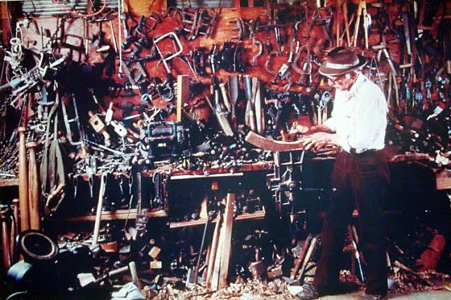

Slide 30
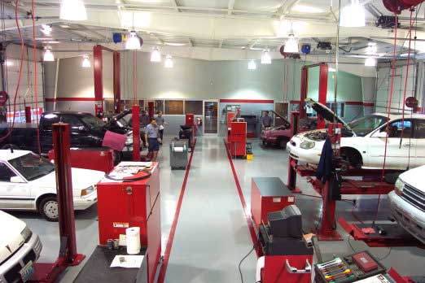
Notes:
This is how you do it, if you want to charge top dollar.
Notice the cars – it’s not bentley’s and lexus’es, etc. I see an old Ford Taurus, an old Nissan, an OLD Chrysler Minivan… So “regular” people use this mechanic because he has a reputation of being fair and knowledgeable.
Now, who’s job is it to keep the shop clean? If you say “repair” you are wrong! I would put this in charge of the Ops mgr, and have the tech’s assist him in keeping it this tidy.
As a side note – PROMOTE YOUR SERVICES! If possible, make them HIGHLY VISIBLE in your store – don’t just leave them hidden in the back!

Slide 31
Most Overlooked Departments
Sales
Operations
Marketing
PR
Promotions
Accounts Payable
Accounts Receivable
IT
Repair
Lessons
Management
Executive
Inventory Control
Notes:
This might be just me, but if I don’t have an IT guy on staff, I’m the defacto guy for that, and I freakin’ hate it!

Slide 32
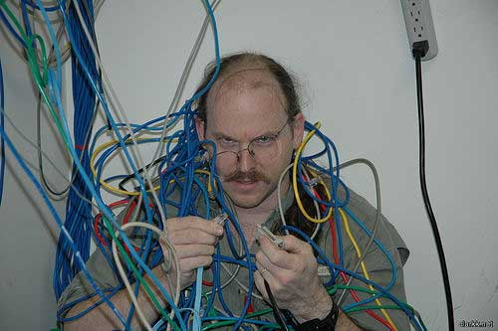
Notes:
Doing IT makes me feel like this.

Slide 33

Notes:
My suggestion – even if you like this stuff, it’s a distraction! Likely, you would be better off spending your time on business development issues then working on computers, website, etc.

Slide 34
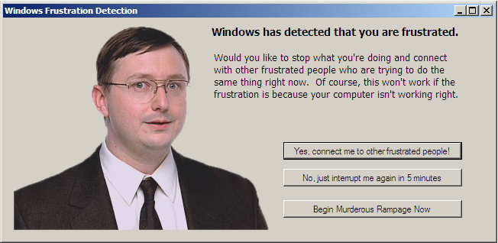
Notes:
And not feel like this.
Especially the murderous rampage part…

Slide 35
Structure for Success
Notes:
In conclusion, one of the best parts out of this type of delegation is that it develops your employees, show’s that you trust them and value their intellect and skills, and gives you more free time.
So no more of this:

Slide 36
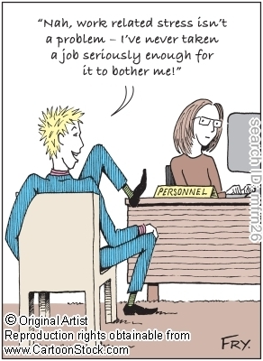
Notes:
And instead, more of this.

Slide 37
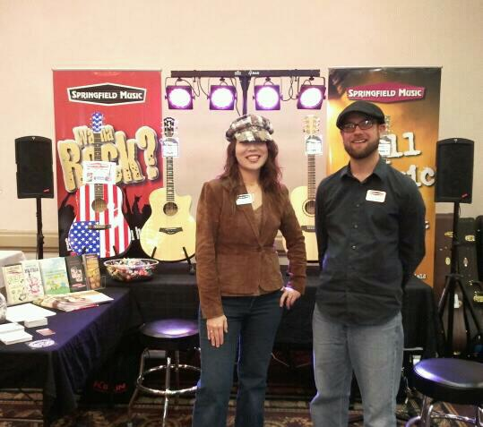
Notes:
So that you can enjoy this:

Slide 38
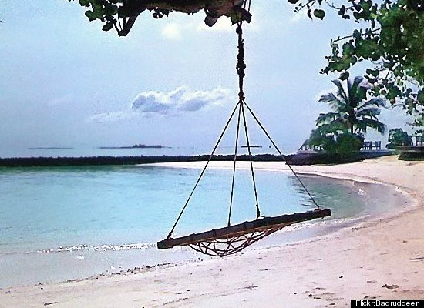
Notes:
And not have to concentrate as hard as this poor little guy:

Slide 39
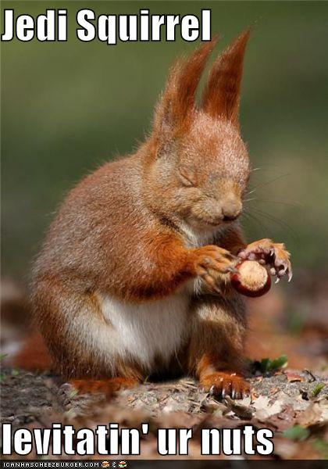
Notes:
Finally, A few reminders and sage words of advice:

Slide 40
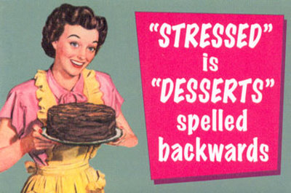

Slide 41
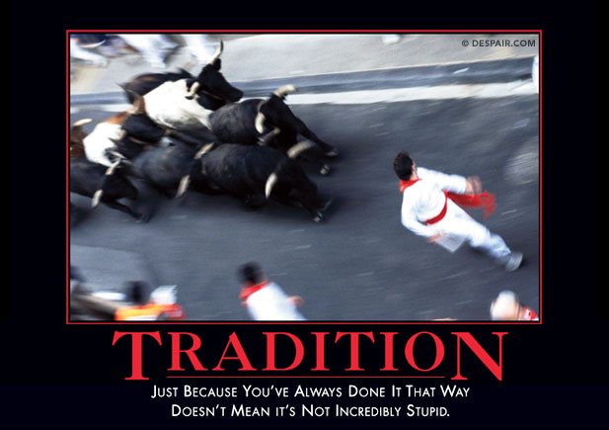

Slide 42


Slide 43


Slide 44


Slide 45
“There are no stupid questions, just stupid people”
-Scott Adams
Donovan Bankhead
Vice President – Springfield Music
donovan@springfield-music.com
417-827-9811
T: @spfldmusic
T: @ErnieWilliamson
Become a Facebook Fan!
http://www.facebook.com/SpfldMusic
http://www.facebook.com/ErnieWilliamsonMusic

Slide 46
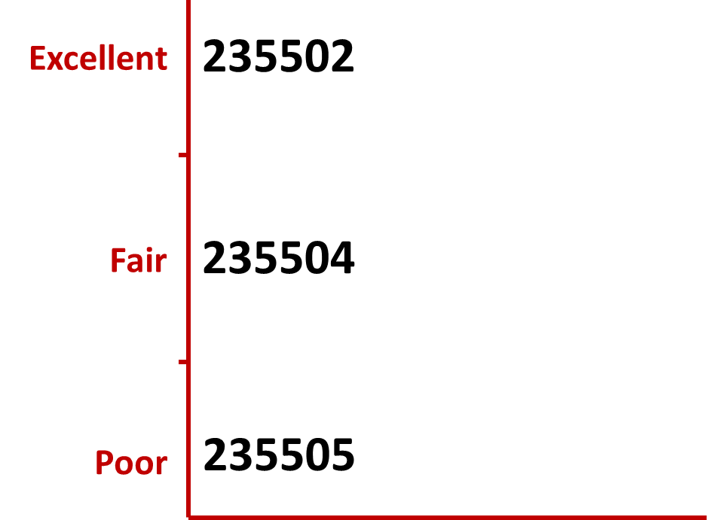
How do you rate this session?
Text one of the Codes below to 22333
Or go online to http://PollEv.com to submit one of the Codes above.
Notes:
Presenter Text Polling Notes- Explain what’s going on
Example (or use your own words) “Now I’m going to ask for your opinion. You’ll use your cell phones, iPads or laptops to respond just like on American Idol.”
Address any concerns
“This is a just standard rate text message, so it may be free for you, or up to twenty cents on some carriers if you do not have a text messaging plan.”- Standard texting rates only
“The service we are using is serious about privacy. We cannot see your phone numbers, and you’ll never receive follow-up text messages outside this presentation. There’s only one thing worse than email spam – and that’s text message spam because you have to pay to receive it!”

