Slide 1


Slide 2

Hook Them With Your
Home Page
Kate Blom
Associate Director of Marketing & Communications, NAMM

Slide 3
Know Who You Are!

Slide 4

This starts with a home page that will entice
consumers—and keep them returning.
The best content and design tell your story;
keep it simple and make it authentic.
So how exactly do you do that?

Slide 5

Make it effortless for your visitors to find the content you need them to find:
Look at your website through the eyes of a first-time visitor. Concentrate on the content that your visitors need to see—not what they don’t—on every page.
Arrange content for maximum effectiveness: Use the inverted pyramid—put the main content at the top of the page.
Be sure you include navigation that makes your site easy to use.
Use type styles and fonts to increase the readability of your
site so visitors can find the information that want.

Slide 6
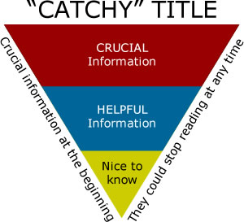
Most important information first
(front-loading) and above the fold
Start with the conclusion
Assists in scanning—user decides if this is the page they want

Slide 7
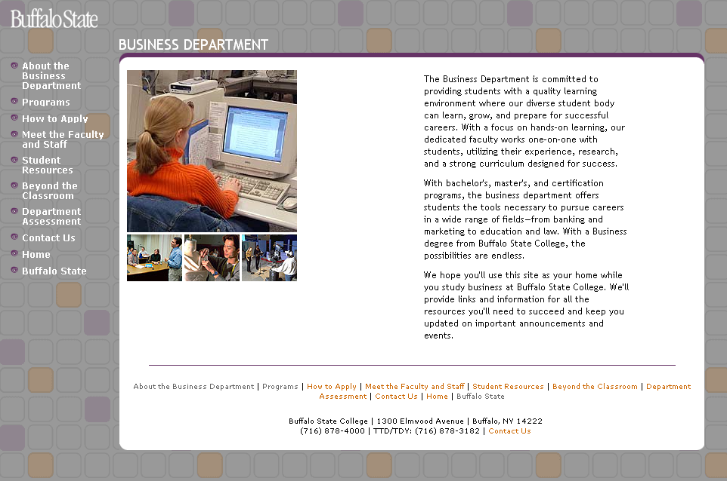

Slide 8
Do’s and Don’ts

Slide 9
Don't use meaningless jargon:
Since Bain was founded, we have worked with over 4,150 clients in virtually every industry and capability area. We work with top management to beat their competitors and generate substantial, lasting financial impact. We look at a business as an integrated, cohesive whole.

Slide 10
Straightforward and to the point:
R.DORSEY+COMPANY (RD+)
We specialize in a wide range of information technology solutions for your company, including network management, system assessment, project management, network design, integration and security, application development, risk assessment, contingency planning, compliance consulting, data warehousing, and many other information technology services and IT operations.

Slide 11
Don't use a stock photo of someone who isn't you…
In fact, the more photos of you and your team, the better.

Slide 12



Slide 13
Give options for people to contact you. Don't give a contact address or number that doesn't work.

Slide 14
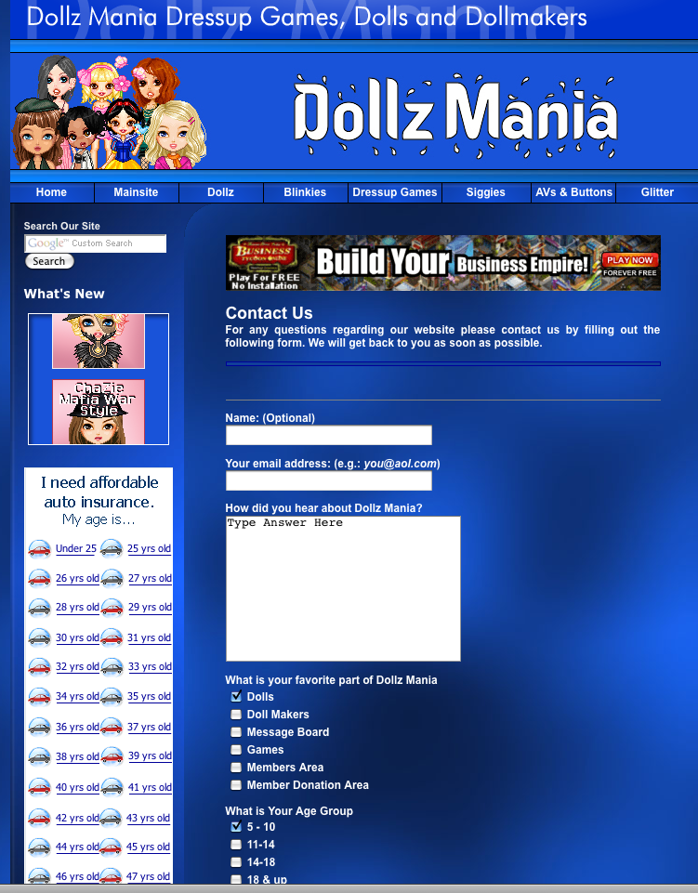
:
Make it easy to contact you.

Slide 15
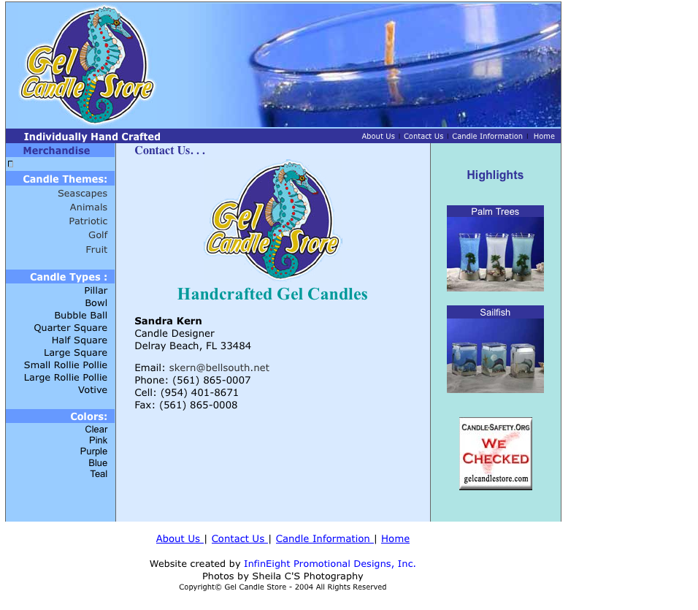
Make sure your contact information is easy to find and is correct.

Slide 16
Be human.
Write like you talk and put your name on it. Tell a story— a true one—that resonates.

Slide 17
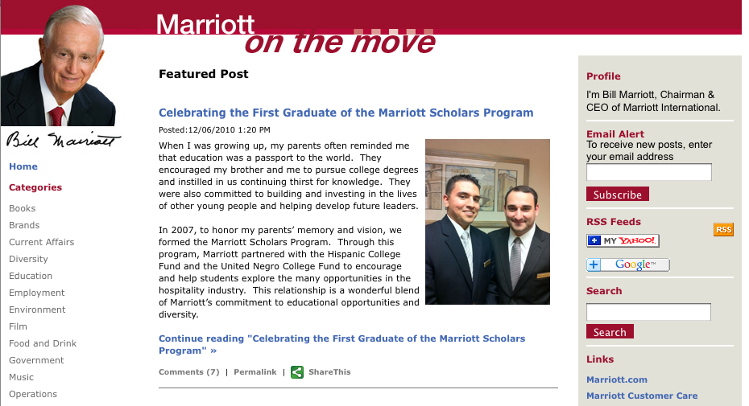

Slide 18
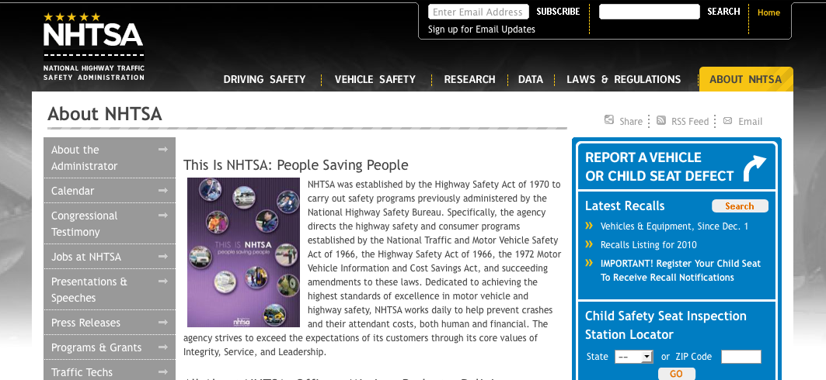

Slide 19
Use third-party comments and testimonials to establish credibility. Use a lot of them!
Make sure they're both interesting and true.

Slide 20
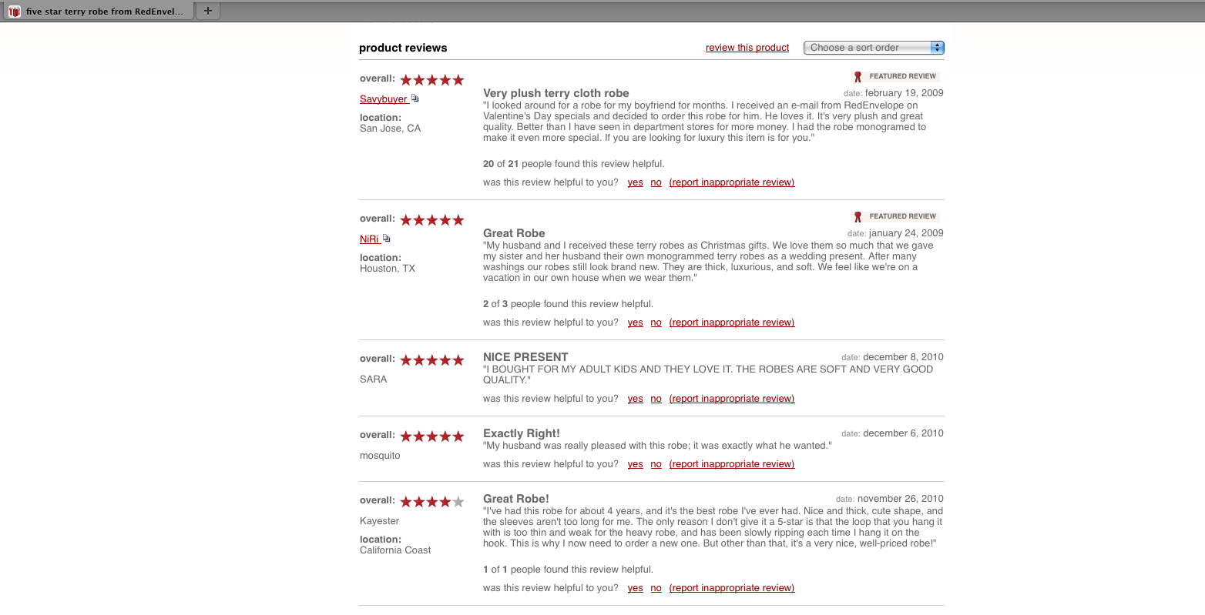

Slide 21
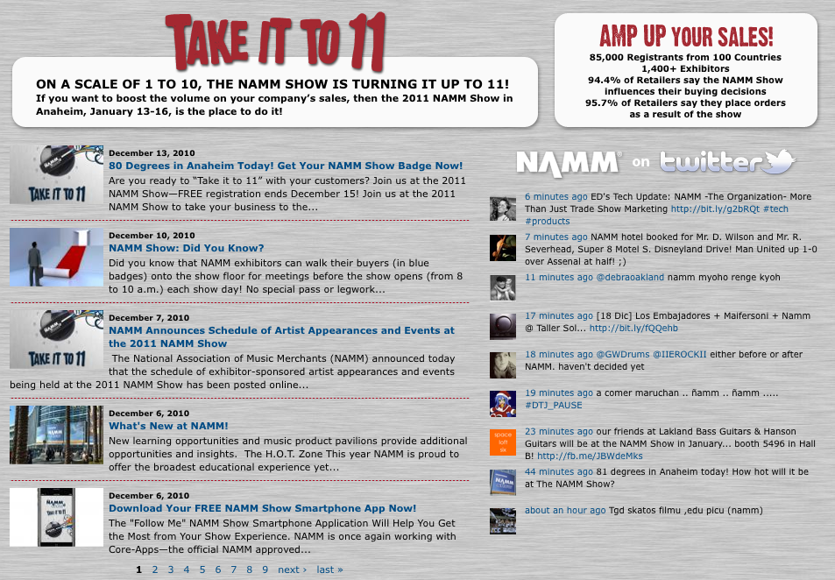

Slide 22
Be smart about your design—clean and simple, easy to navigate is better than over-designed. Think about the first impression and your personality, and reflect them in your design.

Slide 23
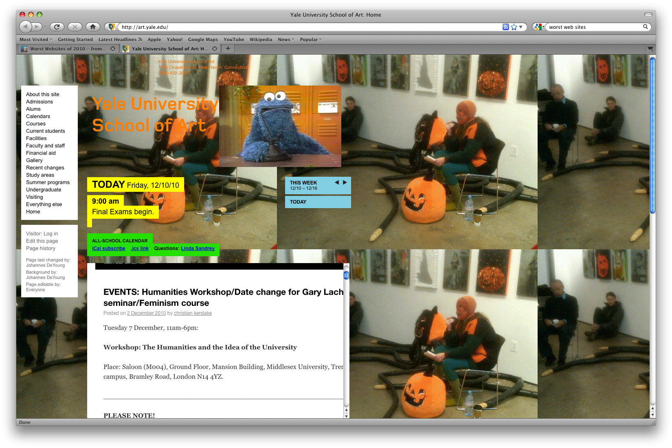

Slide 24
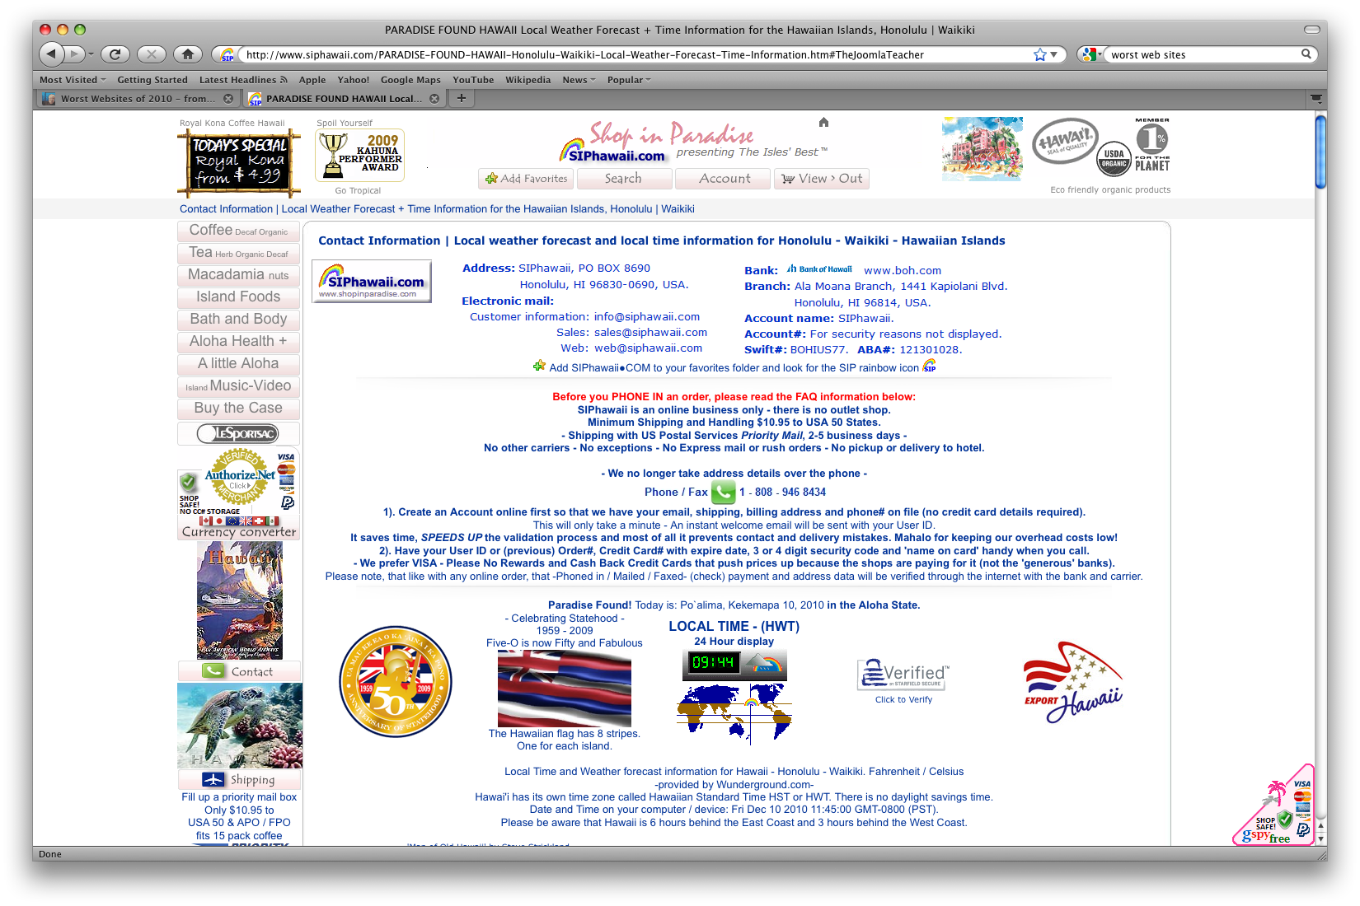

Slide 25
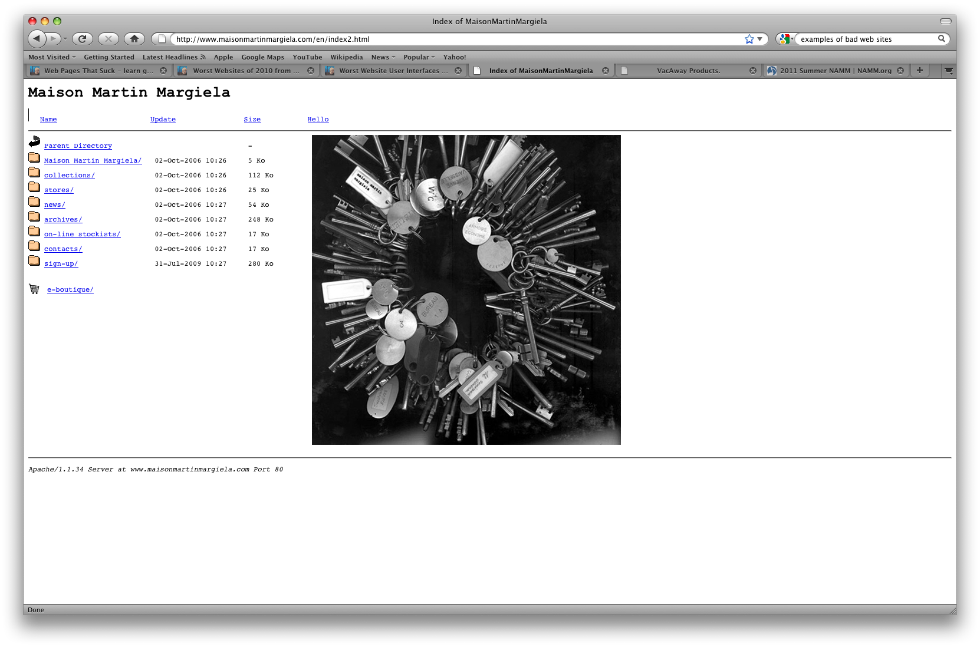

Slide 26
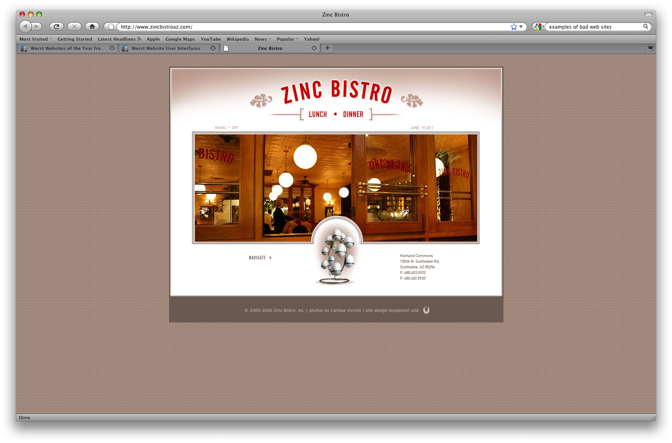

Slide 27
Once you have a great web page, be sure to drive customers to it!

Slide 28
Use your web site on your business cards, your marketing materials and in your advertisements.

Slide 29
Use a QR Code!
QR Code Defined...
A QR Code is a two-dimensional bar code, readable by a mobile phone with a camera or smartphones with a downloadable bar code scanner. The code takes customers directly to your company’s Web page.

Slide 30
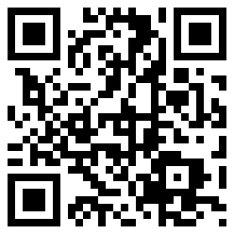
= www.namm.com/summer/2011

Slide 31
Top Four Takeaways
:
Takeaway 1: Be sure your most important content is featured:
who you are, what you do, how to contact you.
Takeaway 2: Be honest and genuine.
Use real content, real photos and real customer comments and feedback.
Takeaway 3: Don’t go crazy with your design
Reflect who you are, make a good first impression and be simple and neat.
Takeaway 4: Drive people to your site!

