Slide 1
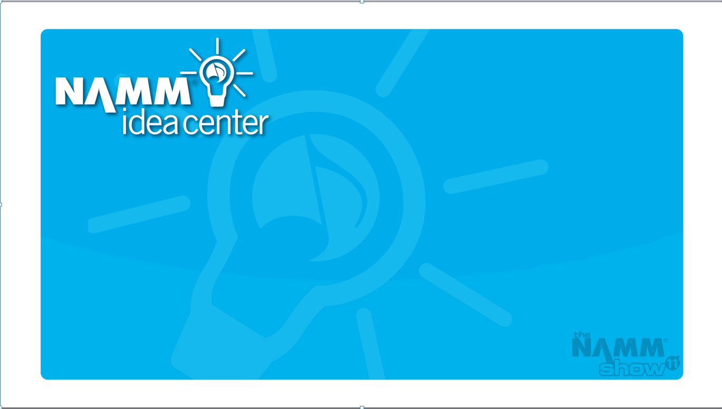
Technology & Music Retailer:
What Do You Need to Implement Social Media
Danny Rocks and Panel

Slide 2
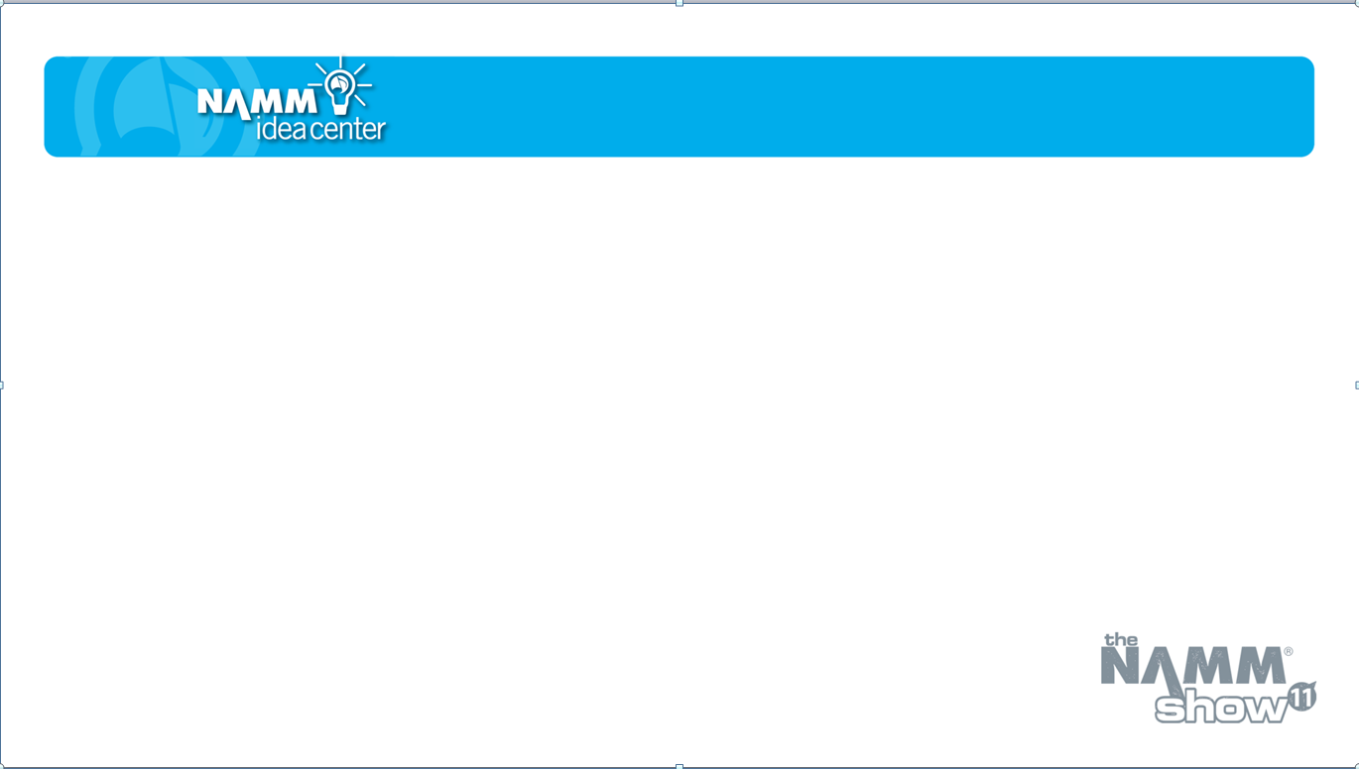
Jen Lowe – BoomBoom Percussion
Greg Grunberg – Actor, Musician
Mike Nessen– Rinforza Social Media
Scott Robertson – NAMM
Notes:
2

Slide 3
Retailers who use Social Media
to save time:
  Who are they?
  How do they do it?
Notes:
3

Slide 4
Retailers who use Social Media
to reduce costs:
  Who are they?
  How do they do it?
Notes:
4

Slide 5

Retailers who use Social Media
to make money:
  Who are they?
  How do they do it?
Notes:
5

Slide 6
Open Discussion
Questions?
Final Thoughts
Notes:
6

Slide 7
Top Four Takeaways
Here are four takeaways from this session. Bring these ideas to back to your business and see what results you generate!
Takeaway 1:
Takeaway 2:
Takeaway 3:
Takeaway 4:
Notes:
7

