Slide 1


Make More Money with Rentals
Presented By
Alan M. Friedman, CPA and Daniel Jobe
Friedman, Kannenberg & Company, P.C.

Slide 2
Session Objectives
Review the core components of a healthy rental program
Learn how to evaluate your rental program profitability
Discover new ways to make your rental program more profitable
Q&A Along the Way

Slide 3

The Basics of Rentals

Slide 4
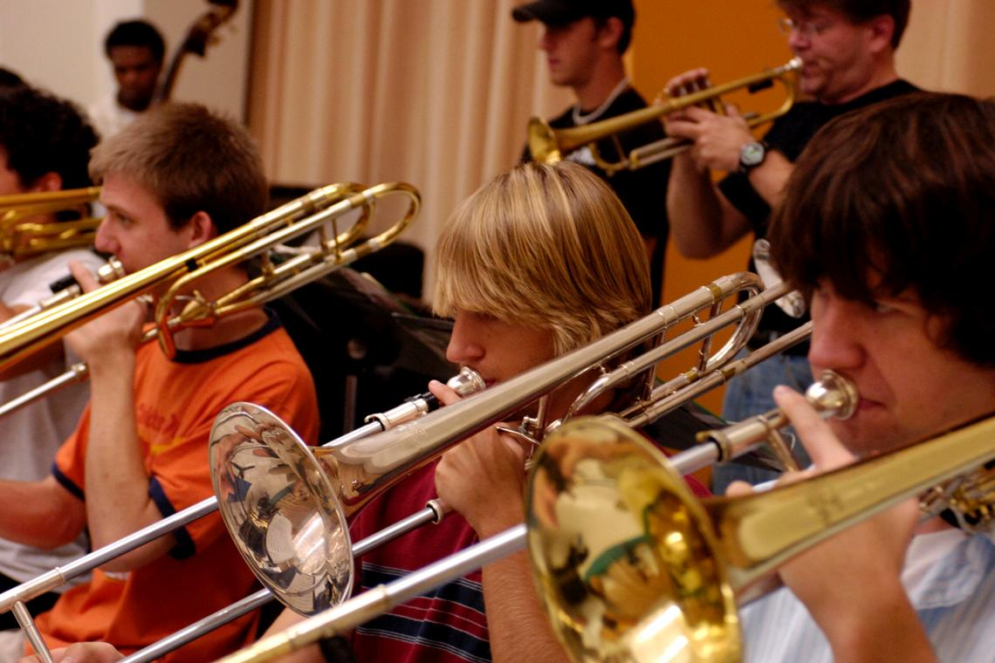
Relationships are Key!
                School Districts
                Music Instructors
                Repair Facilities

Slide 5

Keeping Track of the Rentals
  Monthly Payments
  Collections

Slide 6

The Legal Side of Rentals
            Are your contracts legal?
            Do you know how to account for the rentals?

Slide 7
A Quick Test….which one is correct?
OPTION #1
OPTION #2

Slide 8

Rentals are an Investment
Bank financing may be needed!

Slide 9
Can you “afford” to rent?
Year
Year
Year
**This scenario assumes all units are rented and payments are made. Additional overhead costs are not reflected.

Slide 10

Measuring the Profitability of your Rentals

Slide 11
Net Rental Income
Are you making money?

Slide 12

Rate of Return on Rental Investment
How long does it take you to recoup your cost?

Slide 13
Annual Rental Income $235,000
Rental Instrument Pool Cost $275,000
In this example, this rental pool recoups 85% of its cost annually. That means it takes a little over 14 months for this pool to “break-even” from a cost perspective.

Slide 14

Instrument Return Rate Do you have any instruments on the shelves at the end of the rental season?
Delinquent Accounts
The only thing worse than “slow payers” is “no payers”!

Slide 15

Making Rentals More Profitable

Slide 16

Are you priced competitively and
to make a profit?

Slide 17
Foster Existing Relationships
Intermediate and Pro Instrument Upgrades
Private or Group Lessons
Performance Opportunities
Relationships with Music Instructors
Encourage and give them tools to start more beginners
Ask them how you can help them grow their program

Slide 18

Track Everything for Improvement
Monthly
  Profitability
  Collections
Annually
  Rental Returns
  Rate of Return on Rental Investment

Slide 19


Slide 20

Consulting Meetings
Contact Jen outside the Idea Center entrance
after this session to set up a meeting time

