Slide 1





Course Title
Social Media Simplified: Stories Build Brands
Jen Lowe Social Media Consultant

Slide 2
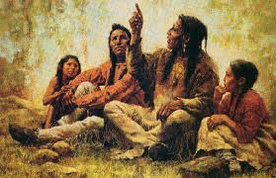
Story telling
Notes:
…the conveying of events in words, images and sounds, often by improvisation or embellishment. Stories or narratives have been shared in every culture as a means of entertainment, education, cultural preservation and to instill moral values.

Slide 3
Digital Marketing Story Line
IM
Email
Fax
Direct Mail
Telephone
On Line Ads
Paid Search
Landing Pages
Mobile Email
SMS
RSS
Podcasts
TV
2000’s
Radio
Print
Display
Website
Search
Microsites
Online Video
Affiliate Mrkt
Webinars
Blogs
Wikis
Virtual Worlds
SMS + MMS
IM
Email
Fax
Direct Mail
Telephone
On Line Ads
Paid Search
Landing Pages
Mobile Email
SMS
RSS
Podcasts
TV
Location Based
2012
QR Codes
Social Ads
Radio
Print
Display
Website
Search
Microsites
Online Video
Affiliate Mrkt
Webinars
Blogs
Wikis
IM
Email
Fax
Direct Mail
Telephone
On Line Ads
Paid Search
Landing Pages
1999
TV
Radio
Print
Display
Website
Search
Microsites
Online Video
Affiliate Mrkt
IM
Email
Fax
Direct Mail
Telephone
On Line Ads
1990s
TV
Print
Radio
Display
Website
Search
Fax
Direct Mail
Telephone
1990
TV
Print
Radio
Notes:
We are evolving quickly – it is easier than ever to tell your story

Slide 4
AD
Mailer
Catalog
1-800
Visit
A
store
Sales
Rep
Cust.
Service
Reward
Card
Notes:
Former consumer purchasing story line
Predictable and controlled

Slide 5
Notes:
Cyber story telling today
There is a revolution on how we communicate not how we do business
----- Meeting Notes (12/2/12 08:22) -----
We went from a linear one way conversation to a multi channel multi-level conversation with millions of voices having the ability to chime in. If your story is catchy and hip, people will re-tell it.

Slide 6
“ The savviest brands will begin to build small highly engaged communities
where they can learn about what their audiences want, need, and desire”
We are social – April 2012
Notes:
Homework assignment – ask yourself the entire weekend “what is the story here”

Slide 7
Increase communication between customers
51% of fans will answer questions before the brand even has a chance to
answer the question.

Slide 8
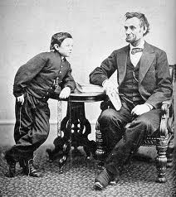
Notes:
Abraham Lincoln – one of the most told stories of all time and one of the best story tellers of all time. Tell your story, then tell it over and over again

Slide 9
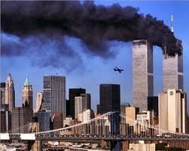
What if….
It would have given many the ability to say goodbye one last time, giving some families closure if their loved ones were never found. For others a chance to say they had made it out.
A Facebook update or a tweet could have said, "I'm fine, worry about everyone else who needs help."
Notes:
Who remembers this day? How many times have you told the story of where you were and what you were doing on this day. What if social media had been as progressed on this day as it is now, what would our story have looked like then?

Slide 10
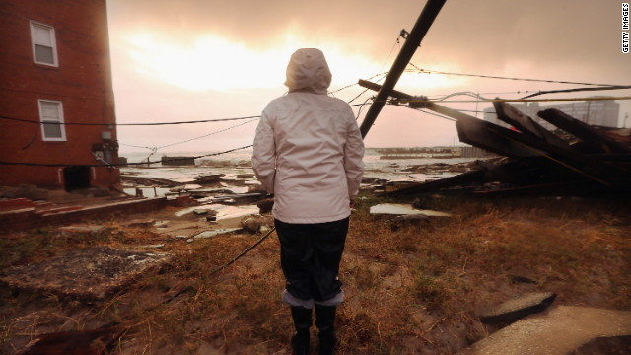
Connection now
At least four Facebook pages were created to reunite people with photographs, kayaks, wedding invitations and other cherished mementos they thought were lost
during Super Storm Sandy.
The sites underscore the pivotal role social media has been playing after the storm, disseminating news, connecting people and organizations, soliciting information and organizing volunteer efforts.
Notes:
----- Meeting Notes (12/1/12 06:54) -----
The difference between 911 and Super storm sandy in terms of social media connection and stories

Slide 11

Use your resources
Notes:
Create a catch phrase about the product. Dig in and get emotional – this entire industry is built on emotion and the emotional sale

Slide 12
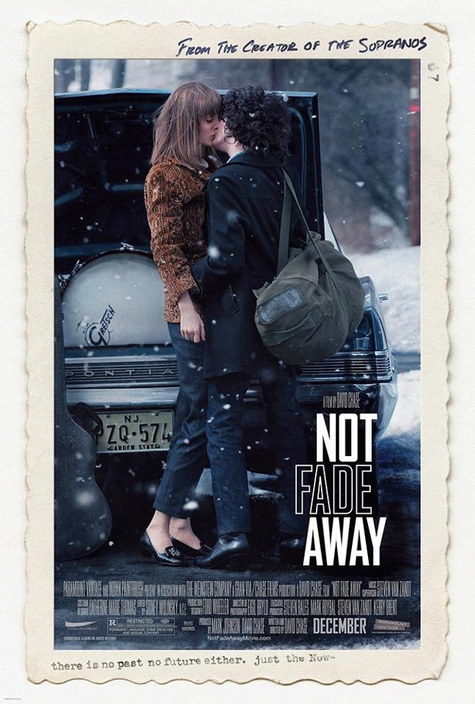
Notes:
Product placement is happening more and more – find and share these stories – create some product placement of your own with local bands, band programs, retirement communities, music venues, etc.

Slide 13

Notes:
Ads created for print are also being shared on line – create ads that tell a story

Slide 14

Notes:
Manufacturers are stepping up and creating wonderful content to be shared and talked about

Slide 15

Notes:
Learn from the best – Jason has been blogging since the very beginning of his touring days Jason built his career by telling great stories both on and off the stage

Slide 16
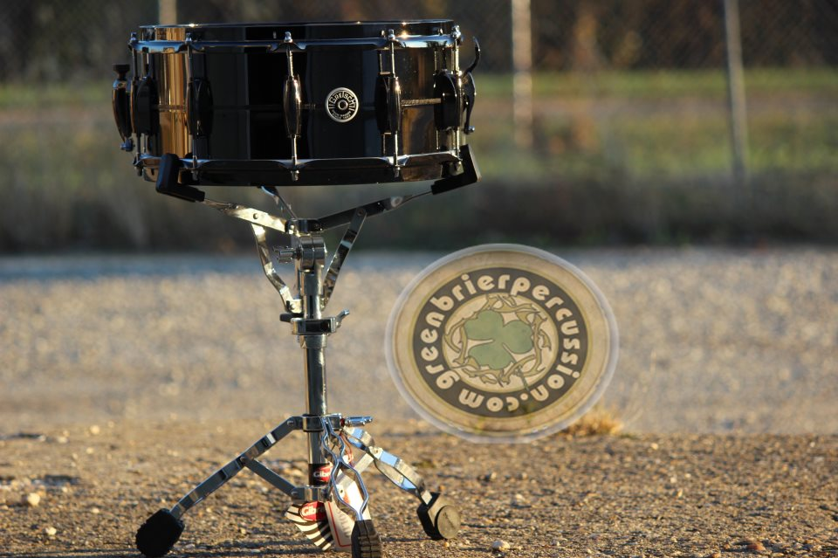
Notes:
Retailers who are going the distance to tell their story on line – Greenbrier Percussion

Slide 17
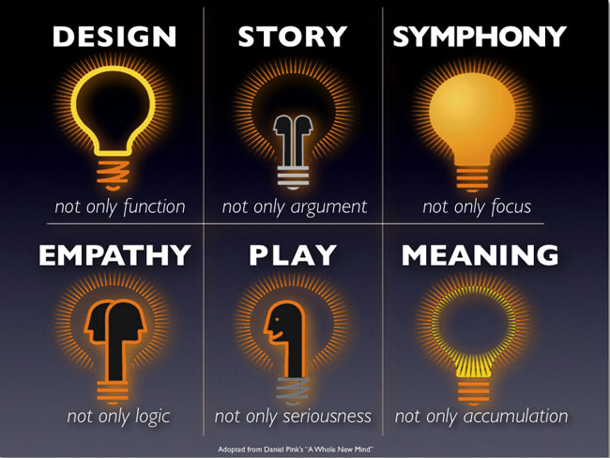

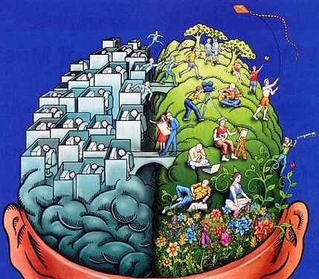
Notes:
Read this book – understand why story telling is so very important

Slide 18
What is the story here?

Slide 19
My Story: Friday night
Hilton Stage
10 PM
Jen Lowe and the Sensitive Dudes
Featuring Johnny Rabb and Alan Friedman

